Slide 1

What Will A Clean Energy Future Look Like in 2050?
And How Do We Get There?
Pat and Steve Miller patmiller@comcast.net stevemiller@comcast.net http://climate.smiller.org http://electric.smiller.org
This talk: http://climate.smiller.org/talks
Your Town FOR
CLEAN ENERGY
Notes:
These slides and all resources are linked at the above URL

Slide 2

Dog Sledding On The Greenland Ice Sheet

Slide 3
1 minute video of Swedish Greta Thunberg
Google for any of a number of talks (on YouTube)

Slide 4



Sierra Club
100% Committed

Slide 5
HOW DO I KNOW WE WILL HAVE A CLEAN ENERGY FUTURE BY 2050?
Because We Must!
We must save the world for our children and grandchildren. Starting Now!
And We Will.

Slide 6
WHAT CRISIS?
IPCC (UN): “The Impacts of Global Warming of 1.5°C”, Oct 2018
National Climate Assessment, Nov 2018
2018 Arctic Report Card, NOAA, Dec 2018
Global Assessment Report on Biodiversity and Ecosystem Services, May 2019
The Bad News Is Non-Stop

Slide 7
HOW DO I KNOW WE WILL HAVE A CLEAN ENERGY FUTURE BY 2050?
And because the people demand it.

Slide 8
YALE CLIMATE OPINION MAPS 2018
Show how Americans’ climate change beliefs, risk perceptions, and policy support vary at the state, congressional district, metro area, and county levels
https://climatecommunication.yale.edu/visualizations-data/ycom-us-2018/?est=happening&type=value&geo=county
70% of people favor enacting policies to address climate change
  In US
  In NJ
  In Monmouth County

Slide 9
HOW DO I KNOW WE WILL HAVE A CLEAN ENERGY FUTURE BY 2050?
And the market will drive it.

Slide 10

In the 2015 Paris Agreement,
every nation in the world agreed
to work together to achieve net zero greenhouse gas emissions by mid-century.
The U.S. cannot legally withdraw until the day after the 2020 Presidential election.
© SevArt/Pond5
Notes:
ID #3782.B - Can be used in noncommercial online and TV broadcasts of your presentation, but not modified.
The final question is: will we change? Of course the Paris Agreement was a start, a breakthrough, every country in the world, 195 of them, have agreed. And yes, President Trump said he wanted to withdraw, but a lot of people don't realize that under the law, the first day the US could legally withdraw from the Paris Agreement happens to be the day after the 2020 Presidential election. That means that the decision is not up to Donald J. Trump. It's up to us! It's in our hands! If we do what is necessary.
Another provision that's not as widely known. If there is a new president, they just have to give 30 days' notice and we're right back in the Paris Agreement. And this is an agreement that is steadily being strengthened because next year is the so-called "review and ratchet" year, when every nation upgrades its commitment.
DESCRIPTION: Video of canal boats in the Seine River in Paris and text about the Paris Agreement’s net zero greenhouse gas emissions goal
ADDITIONAL TALKING POINTS: All 196 of the United Nations Framework Convention on Climate Change’s (UNFCCC) participating member states plus the European Union, totaling 197 parties, adopted the Paris Agreement at the conclusion of the United Nations 21st Conference of the Parties (COP 21) in December 2015.[1*]
The Paris Agreement sets a long-term goal to keep global average temperature rise to well below 2 degrees Celsius, while pursuing efforts to hold it under 1.5 degrees Celsius. It operationalizes this with a mitigation goal of peaking global emissions as soon as possible, then aiming for net-zero greenhouse gas emissions in the second half of this century. To achieve these goals, the agreement requires countries to submit an action plan (known as a “nationally-determined contribution,” or NDC) every five years, progressively strengthening the plan over time. Along with new frameworks for measuring, reporting, and verifying emissions reductions, and providing capacity building for less-developed countries, the Paris Agreement effectively establishes a framework for continued action.[2*]
Although President Trump announced, on June 1, 2017, his intent to withdraw the United States from the Paris Agreement, the earliest date at which any country can leave the agreement is November 4, 2020, the day after the 2020 US Presidential election.[3*]
REFERENCES:
[1*] United Nations Framework Convention on Climate Change, “COP 21,” United Nations, last accessed April, 2018. https://unfccc.int/resource/docs/2015/cop21/eng/10.pdf
[2*] United Nations Framework Convention on Climate Change, Paris Agreement (December 2015). https://unfccc.int/files/meetings/paris_nov_2015/application/pdf/paris_agreement_english_.pdf
[3*] Brad Plumer, “The U.S. Won’t Actually Leave the Paris Climate Deal Anytime Soon,” The New York Times, June 7, 2017. https://www.nytimes.com/2017/06/07/climate/trump-paris-climate-timeline.html

Slide 11
200+ Cities 9 States
183 Colleges And Universities
1,700 Businesses And Investors
IN 2019, 3750 ENTITIES HAD committed to the Paris Climate Agreement
Notes:
ID #4918.C - Can be used in noncommercial online and TV broadcasts of your presentation, but not modified.
Bottom of https://www.wearestillin.com/about (as of 5/27/2019):
“We Are Still In is as a joint declaration of support for climate action, signed by more than 3,750 CEOs, mayors, governors, college presidents, and others. The organizations they represent comprise the largest and most diverse coalition of actors ever established in pursuit of climate action”.
Two-hundred plus cities, nine states, all these colleges and universities, 1,700 businesses, have all committed to the Paris Agreement. The hashtag is #WeAreStillIn.
DESCRIPTION: Text that exclaims the open letter declaring commitment to the Paris Agreement has amassed over two thousand signatories
ADDITIONAL TALKING POINTS: At least 2,300 governors, mayors, businesses, investors, and colleges and universities from across the US have signed an open letter to the international community and parties to the Paris Agreement to voice their support for, and dedication to, the US’ commitments as outlined under the Agreement. Together, these leaders are sending a strong signal to the rest of the world about the continued commitment of the US to ambitious action on climate change, absent leadership at the federal level.*
As of November 2017, participating cities and states represented over 127 million Americans and contributed $6.2 trillion to the US economy. The businesses and investors that have signed on account for a total annual revenue of $1.4 trillion and include over 20 Fortune 500 companies.**
REFERENCES:
* We Are Still In, “Leaders in U.S. Economy Say ‘We Are Still In’ on Paris Climate Agreement,” June 5, 2017. http://wearestillin.com/#press-release
** We Are Still In, “About,” last accessed October, 2017. http://wearestillin.com/about

Slide 12
Cost of Clean Energy Technologies in the U.S.
Residential PV
Utility-scale PV
Wind
EV Batteries
LED Lightbulbs
- 55%
- 75%
- 71%
- 79%
- 94%
Data: Natural Resources Defense Council
Notes:
ID #5574 - Can be used in noncommercial online and TV broadcasts of your presentation, but not modified.
DESCRIPTION: A graph displaying the cost decreases of clean energy technology in the U.S. from 2008-2017
ADDITIONAL TALKING POINTS: Between 2008 and 2016, utility-scale solar photovoltaic (PV) project installation costs dropped by 71 percent, while costs for community and rooftop solar decreased by 55 percent. The installation of these small-scale solar projects increased by more than 2,000 percent from 2008 to 2016. Wind capacity in the US reached 89 gigawatts in 2017, an increase of 64 gigawatts since 2008. The 2017 total wind capacity in the US could power upwards of 25 million households. After 2017, there are now more than 750,000 electric vehicles on US roads, with 195,000 being bought in 2017 alone. Lithium-ion battery costs have fallen by 79 percent since 2008, assisting significantly in the expansion of the EV market.*
REFERENCES:
* Natural Resources Defense Fund, "Revolution Now: The Future Is Here For Clean Energy Technology," (2018). https://www.nrdc.org/revolution-now

Slide 13
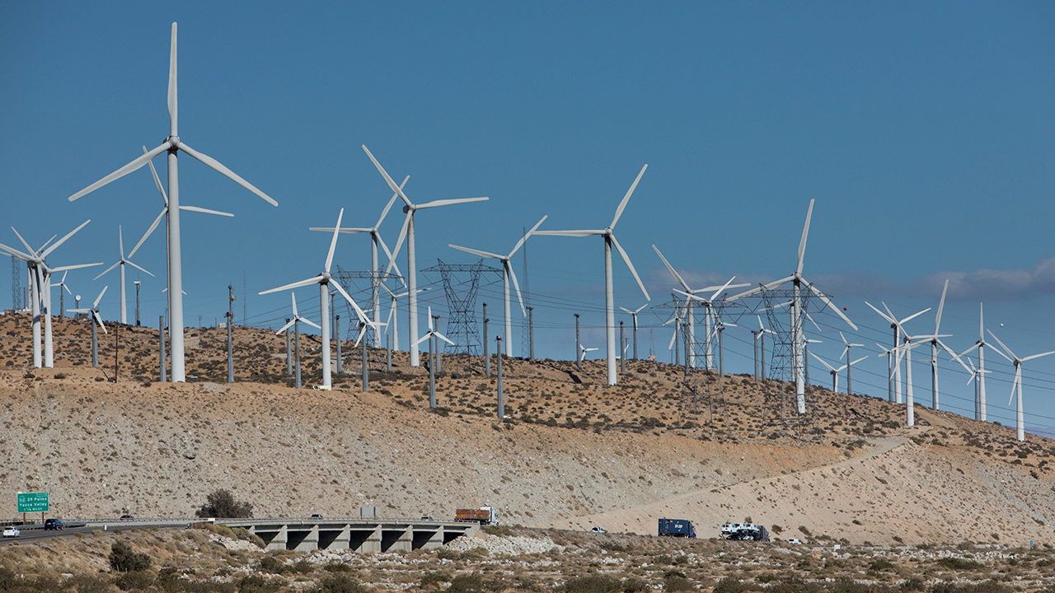
San Gorgonio Pass, California
September 2017
Wind power has the potential to supply worldwide electricity consumption 40 times over.
© 2017 Frank Duenzl/picture-alliance/dpa/AP Images
Notes:
ID #5563 - May not be modified or used in presentations that are recorded, streamed, or broadcast.
DESCRIPTION: Photo of wind turbines in San Gorgonio Pass, California, September 2017, and text about wind energy potential in the state
ADDITIONAL TALKING POINTS: Wind power makes up more than 6 percent of California's electricity generation, totaling over 5.6 GW in renewable energy capacity [1*] and providing enough electricity to power more than about 1.3 million California households.[2*] The state has an estimated 303 GW of wind power potential, enough to power the state nearly twice over.[3*] California's wind power potential is widespread, especially along the state's many mountain crests and offshore in the northern part of the state.[4*] Wind energy accounted for 31 percent of the state's renewable energy production for the renewable portfolio standard as of 2017.[5*]
REFERENCES:
[1*] California Energy Commission, "Electric Generation Capacity & Energy," last updated May 8, 2018. http://www.energy.ca.gov/almanac/electricity_data/electric_generation_capacity.html
[2*] Amiercan Wind Energy Association, "Wind Energy in California," last accessed August 6, 2018. http://awea.files.cms-plus.com/FileDownloads/pdfs/California.pdf
[3*] US Department of Energy, "WINDExchange- U.S. Installed and Potential Wind Power Capacity and Generation," last accessed June 2018. http://apps2.eere.energy.gov/wind/windexchange/wind_installed_capacity.asp; US Department of Energy, "U.S. Installed and Potential Wind Power Capacity and Generation," last accessed June 2018. http://apps2.eere.energy.gov/wind/windexchange/wind_installed_capacity.asp; US Energy Information Administration, "Electricity-State Electricity Profiles," January 25, 2018. http://www.eia.gov/electricity/state/
("Nearly twice over" is derived by dividing California's technical wind energy generation potential of 498 TWh by the state's total retail electricity sales in 2016 of 256.85 TWh.)
[4*] California Energy Commission, "Wind Energy in California," last accessed June 2018. http://www.energy.ca.gov/wind/; US Energy Information Administration, "California-Profile Analysis," last updated October 19, 2017. https://www.eia.gov/state/analysis.php?sid=CA
[5*] California Wind Energy Association, "Fast Facts about California Wind Energy," last accessed August 6, 2018. https://www.calwea.org/fast-facts

Slide 14
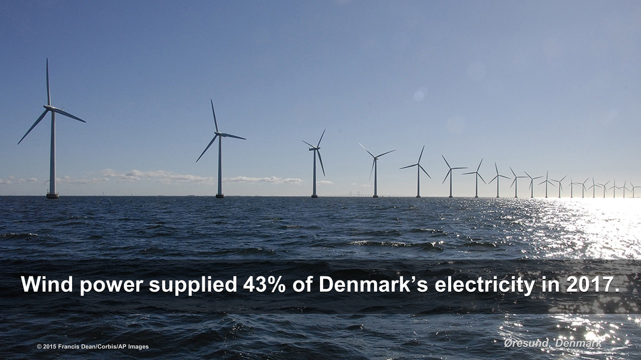
NJ has goal of 3,500 MW from offshore wind by 2030

Slide 15
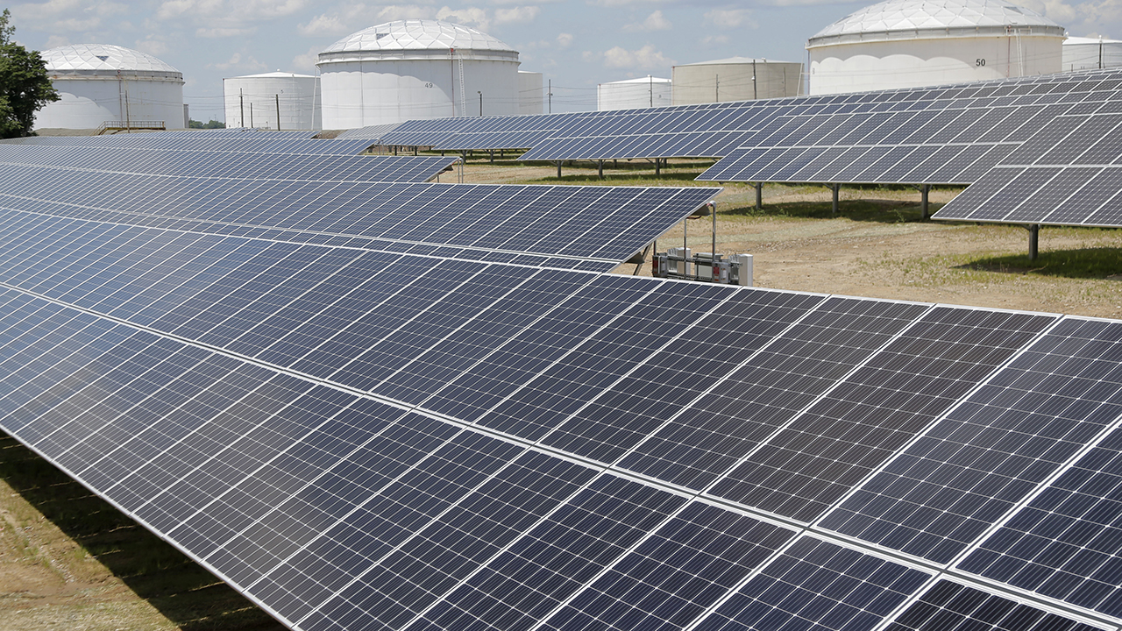
The U.S. has 55.9 GW of solar energy capacity, enough to power 10.7 million homes
Staten Island, New York
© 2018 AP Photo/Seth Wenig
Notes:
ID #5572 - May not be modified or used in presentations that are recorded, streamed, or broadcast.
DESCRIPTION: Text stating that the US has 55.9 gigawatts (GW) of solar energy capacity and enough to power 10.7 million homes, along with a photo of a solar installation in Staten Island, New York, July 18, 2018
ADDITIONAL TALKING POINTS: Solar capacity continues to grow at a rapid clip in the US. At the end of the second quarter of 2017, total US solar PV capacity reached 47.1 GW.* By the end of the first quarter of 2018, that number rose to 55.9 GW, enough to power 10.7 million homes..**
Looking forward, US solar PV capacity is expected to more than double over the next five years. By 2023, over 14 GW of solar PV is projected to be installed annually.**
REFERENCES:
* Environment America, "Another record-setting quarter for solar, explained in 3 stats," September 27, 2017 (blog). https://environmentamerica.org/blogs/environment-america-blog/ame/another-record-setting-quarter-solar-explained-3-stats
**Solar Energy Industries Association, "U.S. Solar Market Insight," last updated June 12, 2018. https://www.seia.org/us-solar-market-insight

Slide 16
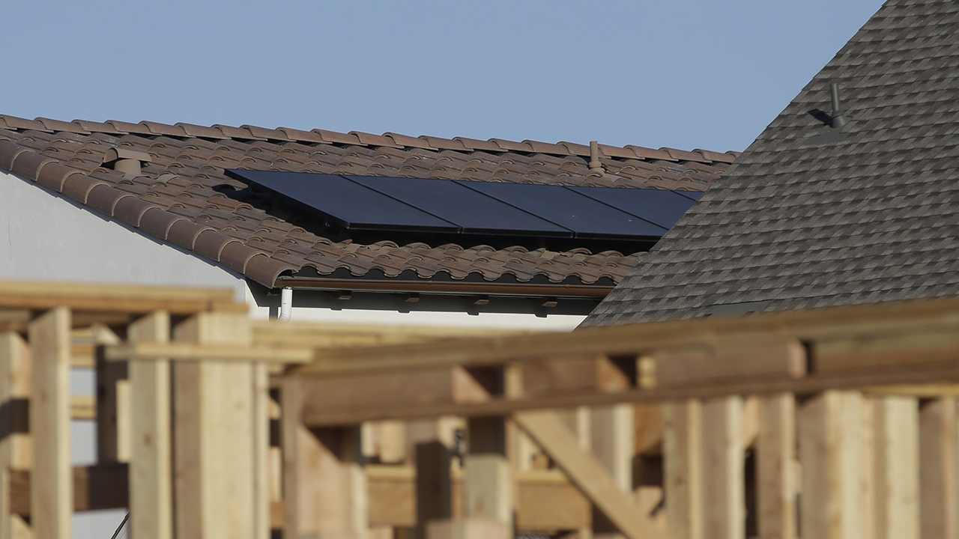
Sacramento, California
May 9, 2018
Starting in 2020, nearly all new homes in California will be required to integrate solar energy and energy efficiency solutions.
© 2018 AP Photo/Rich Pedroncelli
Notes:
ID #5569 - May not be modified or used in presentations that are recorded, streamed, or broadcast.
DESCRIPTION: Text stating that nearly all new homes in California will be required to integrate solar energy and energy efficiency solutions starting in 2020, along with a photo of solar panels on a rooftop in Sacramento, California, May 7, 2018
ADDITIONAL TALKING POINTS: In May 2018, California announced that it will require all homes built after January 1, 2020 to have solar panels, becoming the first state to establish such an order. The requirement, which was part of the state's 2019 Energy Efficiency Standards, will apply to single-family homes as well as apartment and condominium complexes of three stories or less.*
Although there are concerns that the new requirement will drive up housing costs, proponents argue that homeowners will save in the long term. The California Energy Commission estimated that its 2019 Energy Efficiency Standards (which include the solar mandate as well as other building efficiency rules related to issues like insulation and ventilation) will add $9,500 to the cost of a new home, but will save $19,000 on electricity over 30 years. In addition, some analysts have noted that the commission probably overestimated costs because the price of solar panels is already falling and panels for new developments will likely be bought in bulk, meaning savings for solar customers will likely be even higher.**
REFERENCES:
* James Rainey, "California becomes first state to require solar panels on new homes," NBC News, May 9, 2018. https://www.nbcnews.com/news/us-news/california-becomes-first-state-require-solar-panels-new-homes-n872531
** Mia Nakaji Monnier, "7 Things to Know about California's New Solar Panel Policy," California Magazine (Cal Alumni Association of UC Berkeley), May 31, 2018. https://alumni.berkeley.edu/california-magazine/just-in/2018-05-31/7-things-know-about-californias-new-solar-panel-policy

Slide 17
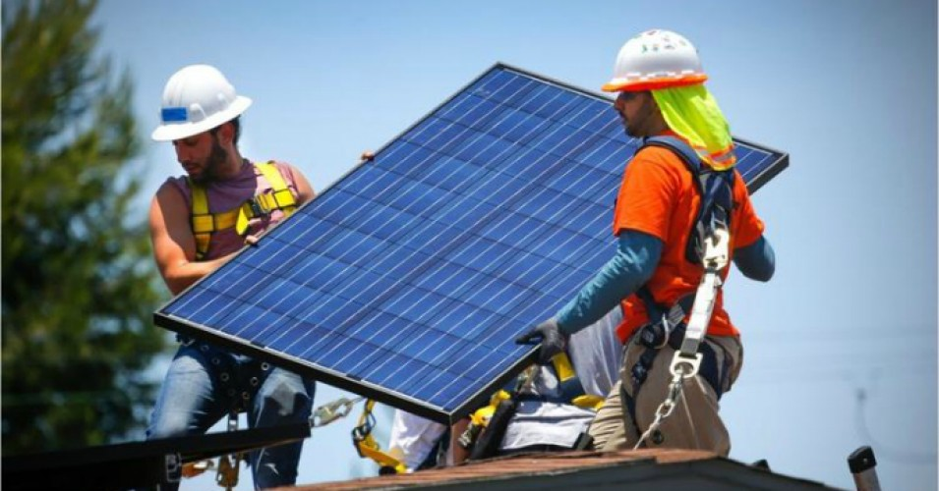
NJ Top 6 Solar States: Solar Panels on 2 Million Homes

Slide 18
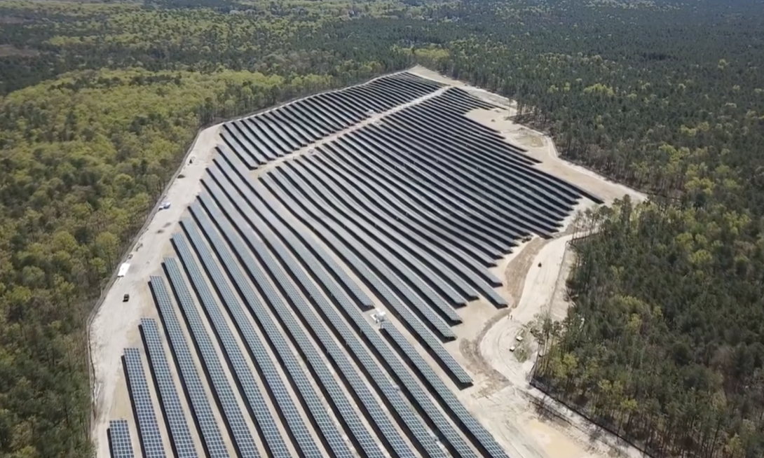
Solar at Six Flags Great Adventure

Slide 19
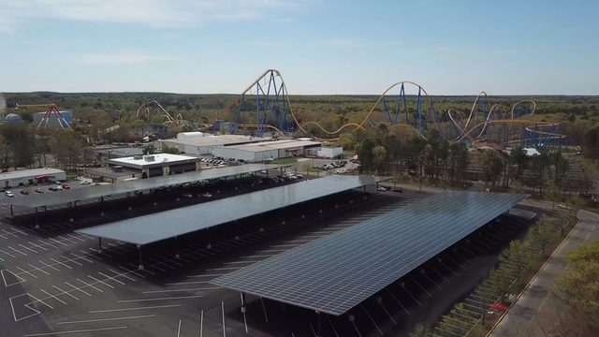
Six Flags Solar Canopy over Parking

Slide 20
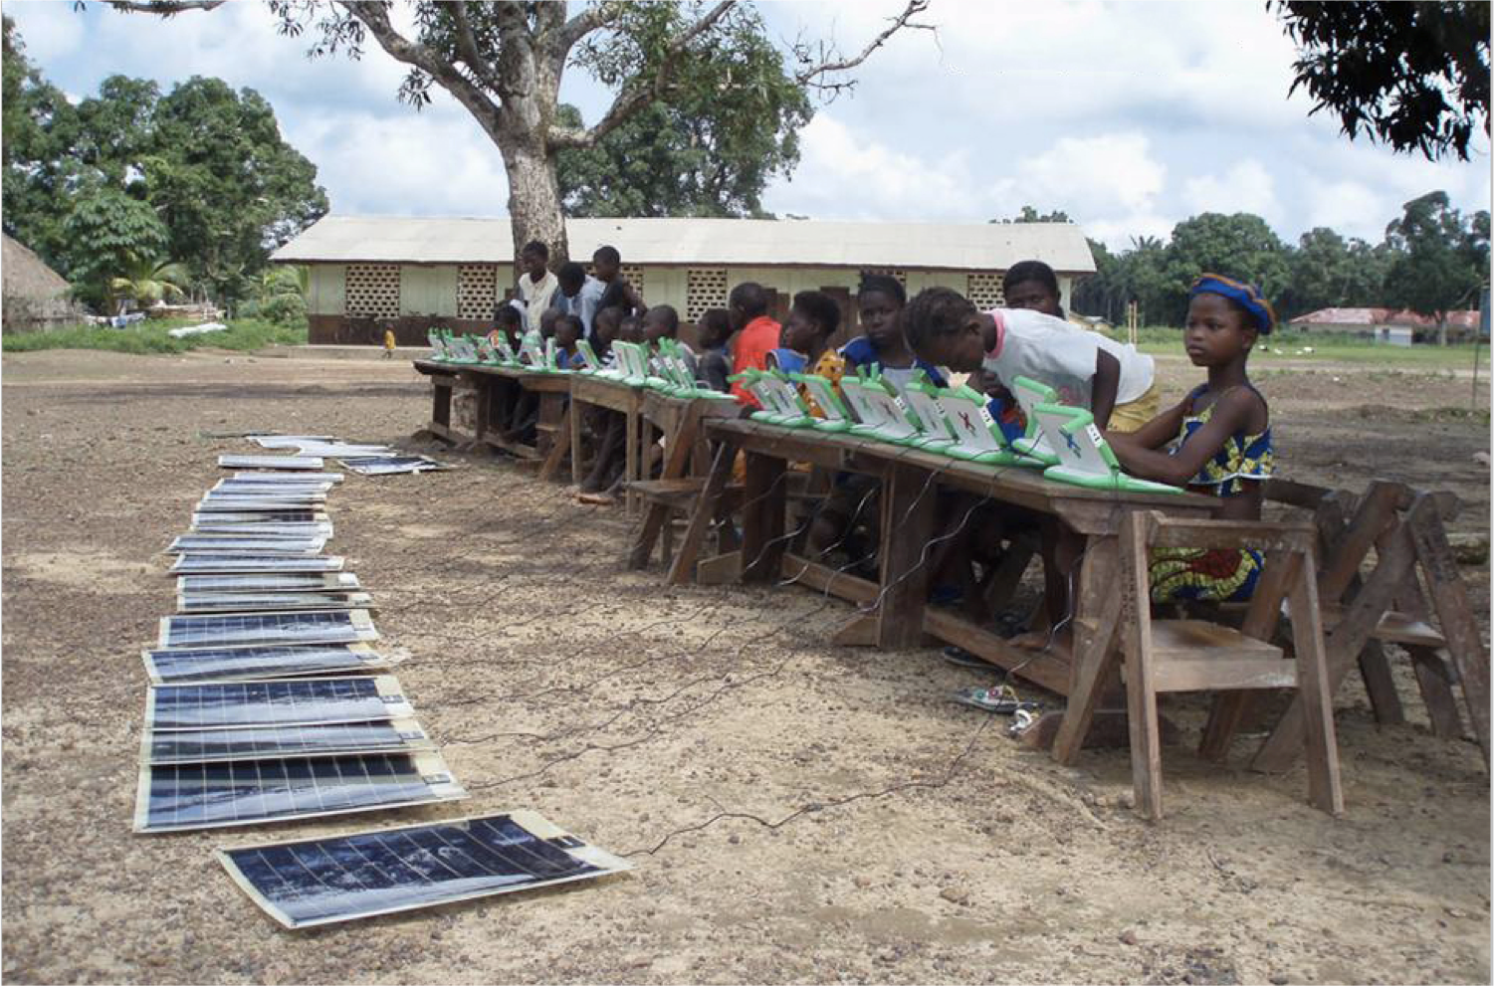
Solar-Powered Laptops
Sierra Leone, Africa
© One Laptop Per Child
Notes:
ID #1034 - May not be modified or used in presentations that are recorded, streamed, or broadcast.
DESCRIPTION: Photo of children working on solar-powered laptops, Sahn Malen Town, Sierra Leone
ADDITIONAL TALKING POINTS: The non-profit, One Laptop Per Child (OLPC), is working with local communities and citizen leaders around the world to distribute solar-powered laptops across Africa.*
REFERENCES:
* One Laptop Per Child, “About: Mission,” last accessed June 2018. http://one.laptop.org/about/mission

Slide 21
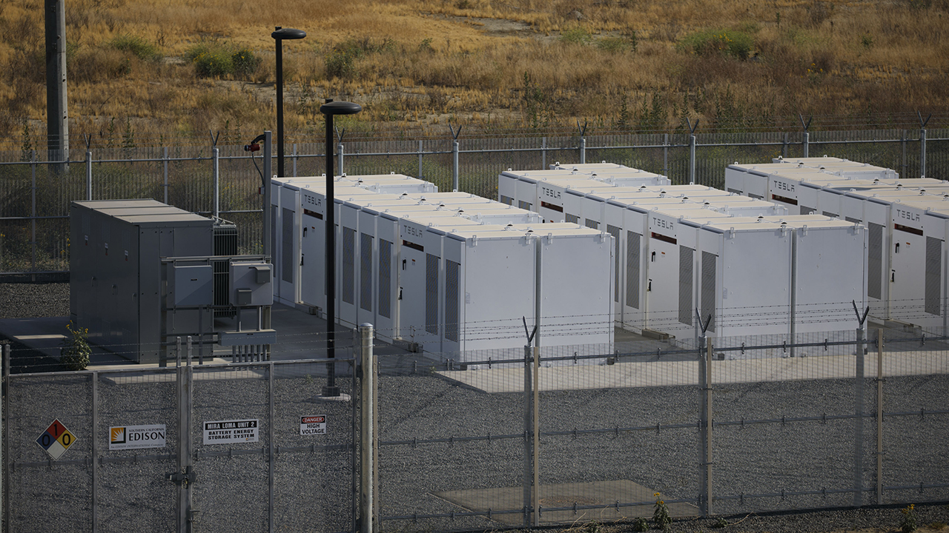
Ontario, California
June 1, 2017
California is the
largest energy storage market in the U.S.
© 2017 Patrick T. Fallon/Bloomberg via Getty Images
Notes:
ID #5576 - May not be modified or used in presentations that are recorded, streamed, or broadcast.
DESCRIPTION: Photo of Tesla battery packs in Ontario, California on June 1, 2017
ADDITIONAL TALKING POINTS: California has the largest energy storage market in the US. In recent years, California has led the nation in energy storage installations within nearly every market segment.In 2013, California adopted the world's first energy storage mandate, requiring its utilities to adopt 1,325 megawatts of energy storage by 2020.*
California has also shown the value of energy storage in the real world, installing in 2017 what was then the world's largest lithium-ion battery project to stave off an energy supply emergency caused by a massive natural gas leak at the Aliso Canyon Natural Gas Storage Facility near Los Angeles.**
In July 2018, PG&E, one of the state's utilities, requested permission to build four lithium-ion battery story projects. One of the projects could become the world's first grid-scale lithium-ion battery operation to store more than a gigawatt-hour of energy (1.2 GWh).Tesla has also reportedly been involved in the construction of one the projects, which is slated to be able to deliver 730 MWh, but could increase to 1.1 GWh.***
REFERENCES:
* The Climate Group, "How California is driving the energy storage market through state legislation," April 2017. https://www.theclimategroup.org/sites/default/files/devel-generate/rop/etp_californiacasestudy_apr2017.pdf
** Danielle Ola, "Blackouts & batteries: How California pulled off the world's fastest grid-scale battery procurement" April 26, 2017. https://www.energy-storage.news/blogs/blackouts-batteries-how-california-pulled-off-the-worlds-fastest-grid-scale
***Megan Geuss, "Tesla strikes another mammoth energy storage deal in California" June 2, 2018. https://arstechnica.com/information-technology/2018/07/california-utility-looks-to-add-gigawatt-hours-of-battery-storage-before-2020/

Slide 22
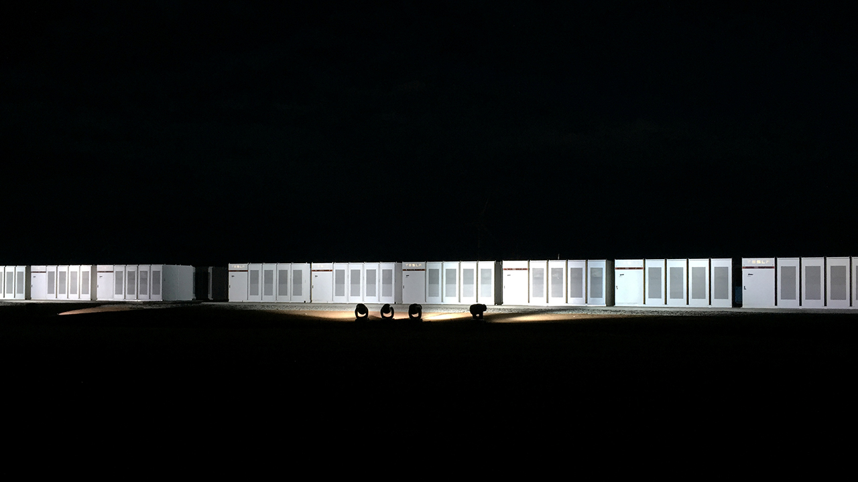
Hornsdale, South Australia
September 29, 2017
Tesla has built the
world’s largest lithium ion battery
at a wind farm in South Australia
© 2017 Reuters/Sonali Paul
Notes:
ID #5151 - May not be modified or used in presentations that are recorded, streamed, or broadcast.
DESCRIPTION: Photo of Tesla’s lithium ion battery in Hornsdale, South Australia with text saying Tesla built the world’s largest lithium ion battery at a wind farm in South Australia
ADDITIONAL TALKING POINTS: In November 2017, Tesla announced that it had fully installed the world’s largest lithium ion battery in South Australia. The company worked with a French renewable energy firm and the local Australian government to install the battery. The battery is intended to help ease power cuts and energy shortages which are frequent in South Australia.*
This battery installation has demonstrated the financial feasibility of the system, making $1 million AUD in just a couple days. The system was also able to show its stabilizing mechanisms, responding to a coal power plant crash in milliseconds.** After 6 months, the energy storage service reduced costs in the ancillary services market by 90 percent.***
REFERENCES:
* Sherisse Pham, "Tesla has built the world's biggest battery in Australia," CNN, November 23, 2017. http://money.cnn.com/2017/11/23/technology/tesla-south-australia-battery-wind-farm/index.html
** Fred Lambert, "Tesla's giant battery in Australia made $1 million in just a few days," January 23, 2018. https://electrek.co/2018/01/23/tesla-giant-battery-australia-1-million/
*** Fred Lambert, "Tesla's giant battery in Australia reduced grid service costs by 90%" May 11, 2018. https://electrek.co/2018/05/11/tesla-giant-battery-australia-reduced-grid-service-cost/

Slide 23
Auto Manufacturers Are Moving to Electric Vehicles
Companies with Electric Models in Production
Aixam
Aston Martin
Audi
BAIC
BMW
Bolloré
Buddy Electric
BYD
ChangAn
Chery
Chevy
Citroën
Citydom GmbH
CODA
Daimler
Exagon
Fiat
Fisker
Ford
Geely
GM
Goupil
Honda
Hyundai
JAC
Kandi
Kantanka
Kia
Kyburz
Mahindra
Mercedes-Benz
Mitsubishi
Mullen
NIO
Nissan
Opel
Peugeot
Qiantu
Rayttle
Renault
$mart
Subaru
Tata
Tesla
Toyota
Trumpchi
Venturi
Volkswagen
Zotye
Data: Bloomberg New Energy Finance, EVObsession
Notes:
ID #4842.B - Can be used in noncommercial online and TV broadcasts of your presentation, but not modified.
DESCRIPTION: Text list of auto manufacturers with an electric model in production
ADDITIONAL TALKING POINTS: According to recent research by McKinsey & Company, about 30 percent of vehicle buyers in the US would consider an electric vehicle (EV) purchase today. In Germany, this number is closer to 45 percent. One of the factors behind this low percentage is that around half of the consumers in the US and Germany comprehend how electrified vehicles and the associated technology work, compared to almost 100 percent of consumers for an internal combustion engine (ICE). But less than 5 percent of potential buyers ultimately purchase an EV over an ICE (~3 percent in the US, ~4 percent in Germany, and ~22 percent in Norway).*
Although understanding and purchases of EVs may be low, the stage is set for a change as the average battery pack price has fallen almost 80 percent between 2010 and 2016. Additionally, significant range increases since 2013 of about 20 to 40 percent helped offset consumer concerns about mileage, one of the major deterrents to an EV purchase. Finally, projections indicate that global charging station deployments – both public and private – could grow from around two million in 2016 to over 12 million in 2020.**
In 2016, there were over two million electric vehicles on the road globally. Although they represented only a small portion — about 0.2 percent — of total passenger light-duty vehicles in circulation that year, carmakers estimate between 9 and 20 million electric vehicles could be deployed by 2020, and between 40 and 70 million by 2025.***
Perhaps as a sign of where investors believe the future of automobile sales lies, in April 2017, electric car manufacturer Tesla surpassed General Motors in market value.****
REFERENCES:
* McKinsey & Company, “Electrifying insights: How automakers can drive electrified vehicle sales and profitability,” Advanced Industries, January 2017. http://www.mckinsey.com/industries/automotive-and-assembly/our-insights/electrifying-insights-how-automakers-can-drive-electrified-vehicle-sales-and-profitability
** Katie Fehrenbacher, “5 Ways Automakers Can Make Electric Cars Profitable,” Greentech Media, February 7, 2017. https://www.greentechmedia.com/articles/read/5-ways-automakers-can-make-electric-cars-profitable
*** International Energy Agency, “Electric Vehicles Have Another Record Year, Reaching 2 Million Cars in 2016,” June 7, 2017. https://www.iea.org/newsroom/news/2017/june/electric-vehicles-have-another-record-year-reaching-2-million-cars-in-2016.html
**** The New York Times, “Tesla Hits a New Milestone, Passes G.M. in Market Valuation,” April 10, 2017. https://www.nytimes.com/2017/04/10/business/tesla-general-motors-stock-market.html

Slide 24
“General Motors believes the future is all electric.”
Mark Reuss, General Motors
EVP of Global Product Development
  October 2, 2017
Notes:
ID #5116.B - Can be used in noncommercial online and TV broadcasts of your presentation, but not modified.
DESCRIPTION: Text with a quote from a General Motors official stating that the company believes the future is all electric from October 2, 2017
ADDITIONAL TALKING POINTS: In October 2017, General Motors announced its plan to become an all-electric automaker. GM intends to introduce at least 20 all-electric vehicles by 2023, and two new models by 2018. GM’s strategy will rely on two prongs – battery electric vehicles and hydrogen fuel-cell electric vehicles – and is part of a broader initiative to promote zero-emissions and autonomous-driving.*
Other automobile manufacturers are moving towards electric vehicles, too. On the same day as GM’s announcement, Ford announced that it will increase investments in battery all-electric vehicles through a new initiative called “Team Eddison.”** BMW has announced that it will produce a total of 25 electrified vehicle models by 2025, with 12 of those being full-electric cars.***
REFERENCES:
* Matthew DeBord, “GM promises 20 all-electric cars by 2023,” Business Insider, October 2, 2017. http://www.businessinsider.com/gm-to-launch-20-all-electric-cars-by-2023-2017-10
** Dale Buss, “Ford Creates ‘Team Eddison’ To Accelerate Its Efforts in Battery-Electric Vehicles,” Forbes, October 2, 2017. https://www.forbes.com/sites/dalebuss/2017/10/02/ford-creates-team-edison-to-accelerate-its-efforts-in-battery-electric-vehicles/#19f7b9134a8d
*** Darrell Etherington, “BMW to offer 12 fully electric car models by 2025,” TechCrunch, September 7, 2017. https://techcrunch.com/2017/09/07/bmw-to-offer-12-fully-electric-car-models-by-2025/

Slide 25
Half of the World’s Buses Will be Electric by 2025
Electric Buses, in Thousands
Data: Bloomberg New Energy Finance
Notes:
ID #5358 - Can be used in noncommercial online and TV broadcasts of your presentation, but not modified.
DESCRIPTION: Graph depicting the real and expected number, in thousands, of electric buses in the world from 2017 to 2025
ADDITIONAL TALKING POINTS: The total number of electric buses in service is forecast to more than triple, from 386,000 last year to about 1.2 million in 2025, equal to about 47 percent of the worldwide city bus fleet, according to a Bloomberg New Energy Finance report released in early 2018. According to this report, China will account for 99 percent of the world’s battery-powered buses.*
REFERENCES:
* Mark Chediak, “Electric Buses Will Take Over Half the World Fleet by 2025,” Bloomberg, February 1, 2018. https://www.bloomberg.com/news/articles/2018-02-01/electric-buses-will-take-over-half-the-world-by-2025

Slide 26
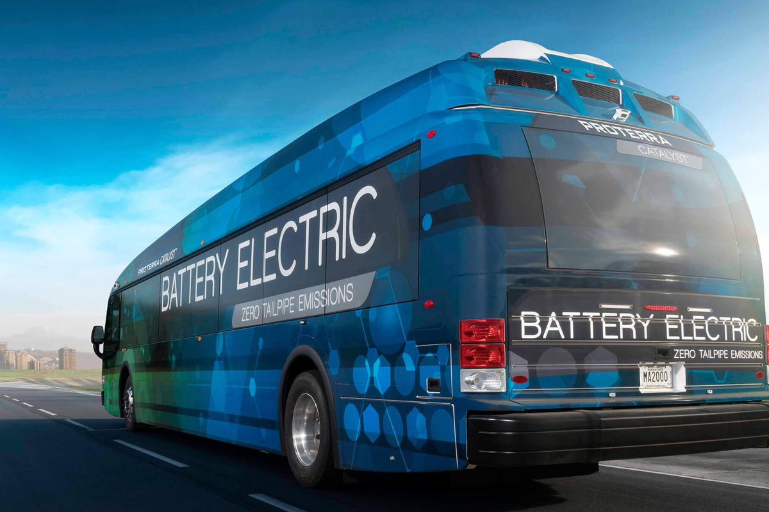
ELECTRIC BUS
Notes:
TODAY we tabled at Middletown HS North HANDOUTS and poster display. Our handouts and poster display are available for YOU to use.
Switch to 100% electricity today AND the back shows the available vendors and price.
A list of 25 ways to reduce emissions, each for less than $25. the right column shows pounds of CO2 that has been avoided – showing between 20 and 200 pounds avoided each year. But the 1st item is an ORDER OF MAGNITUDE GREATER CO2 reduction. The average NJ home can save 4000 POUNDS of GHG emissions by switching to 100% renewable. It is definitely less than $25 cost, since it SAVES MONEY on the total electric bill.

Slide 27
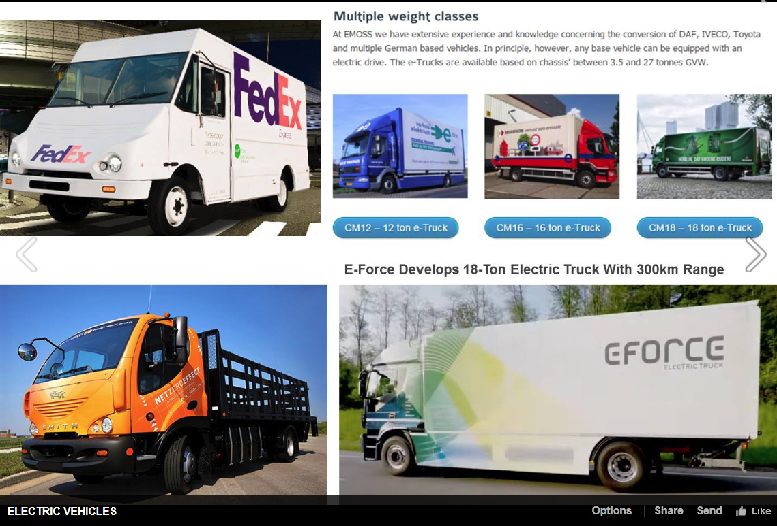
ELECTRIC TRUCKS
USE ARIAL BOLD FONT.
Tesla
Semi truck (9/2017)
Pickup truck (2018)
Volvo
Delivery &
Garbage trucks (5/16/2018)
Self-Driving Semi (9/14/2018)
Notes:
Anton Kole, 4/8/2017 Presenters Forum

Slide 28

AND ELECTRIC AIRPLANES

Slide 29
AND ALL THIS REQUIRES LABOR
= CLEAN ENERGY JOBS

Slide 30
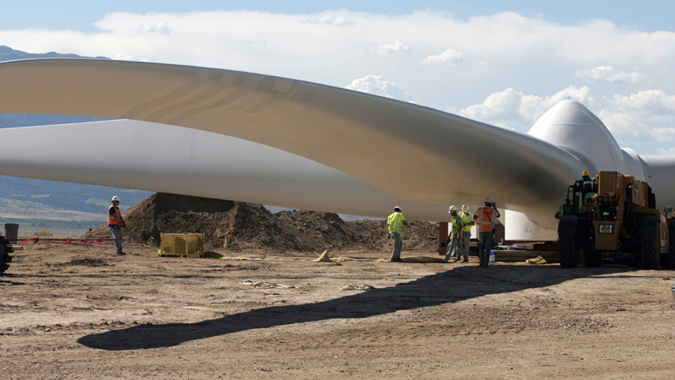
There are over 2.6 million jobs in the U.S. in the solar, wind and energy efficiency sectors.
Near Pueblo, Colorado
© 2013 Steven Clevenger/Corbis / AP Images
Notes:
ID #3209.B - May not be modified or used in presentations that are recorded, streamed, or broadcast.
There are more than 2.5 million jobs in renewable and efficiency in the US now.
DESCRIPTION: Text stating that there are over 2.6 million Americans employed in the solar, wind, and energy efficiency sectors and photo of workers examining the rotor before it is installed on a wind generator tower near Pueblo, Colorado, United States, July 2013
ADDITIONAL TALKING POINTS: According to the national nonpartisan business group, Environmental Entrepreneurs, there were actually over 3 million Americans working in clean energy sectors at the end of 2016. It found that there are 2.2 million Americans employed in energy efficiency, 475,000 employed in solar and wind power, 259,000 employed in “clean vehicles," and 120,000 employed in “other clean sectors”.*
REFERENCES:
* Environmental Entrepreneurs, “3 Million Clean Energy Jobs in America,” February 2017. https://www.e2.org/wp-content/uploads/2017/02/E2_CleanEnergyJobs_National.pdf

Slide 31
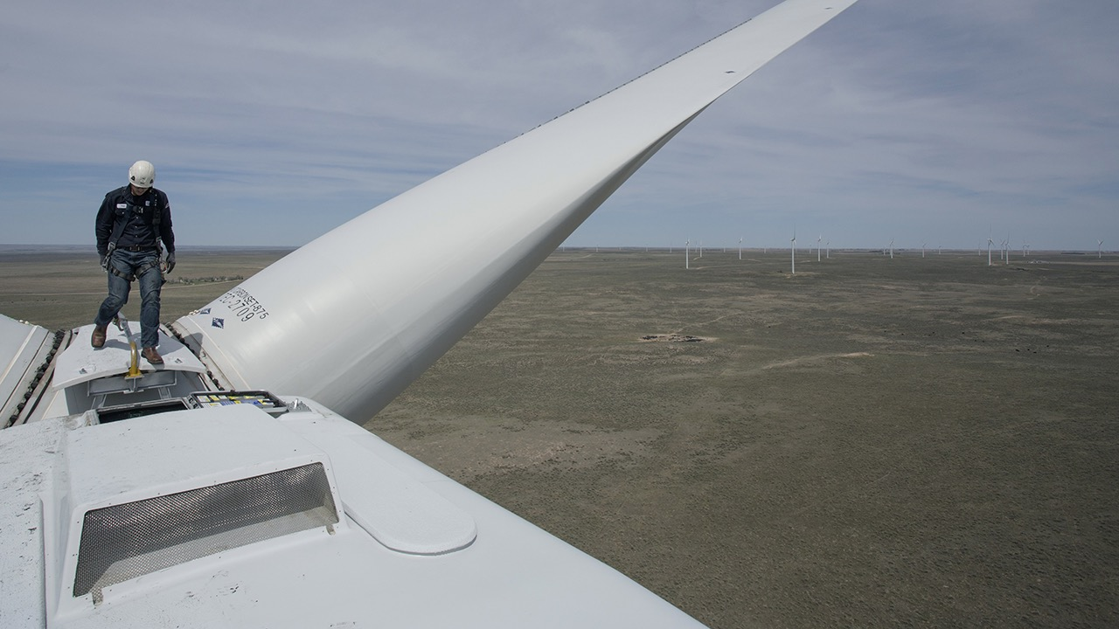
“Solar installer” is forecast to be the fastest-growing job category in the U.S. through 2026, and “wind turbine service technician” is second.
Colorado Highlands Wind Farm,
Fleming, Colorado
Photo: © 2016 Matthew Staver/Bloomberg via Getty Images
Data: U.S. Bureau of Labor Statistics via Bloomberg
Notes:
ID #4680.B - May not be modified or used in presentations that are recorded, streamed, or broadcast.
The Bureau of Labor Statistics just announced that for the next 10 years, the single fastest-growing job category is going to be wind turbine service technician. This is a job opportunity.
DESCRIPTION: Text about the future growth of US solar installer and wind turbine service technician jobs and photo of a wind technician walking on a turbine at the Colorado Highlands Wind Farm in Fleming, Colorado, United States
ADDITIONAL TALKING POINTS: “Solar photovoltaic installer” and “Wind turbine service technician” are forecast to be the United States’ fastest-growing occupations through 2026, outpacing health care and technology fields, according to the US Bureau of Labor Statistics.*
REFERENCES:
* US Bureau of Labor Statistics, “Fastest Growing Occupations,” last modified April 14, 2017. https://www.bls.gov/emp/ep_table_103.htm

Slide 32
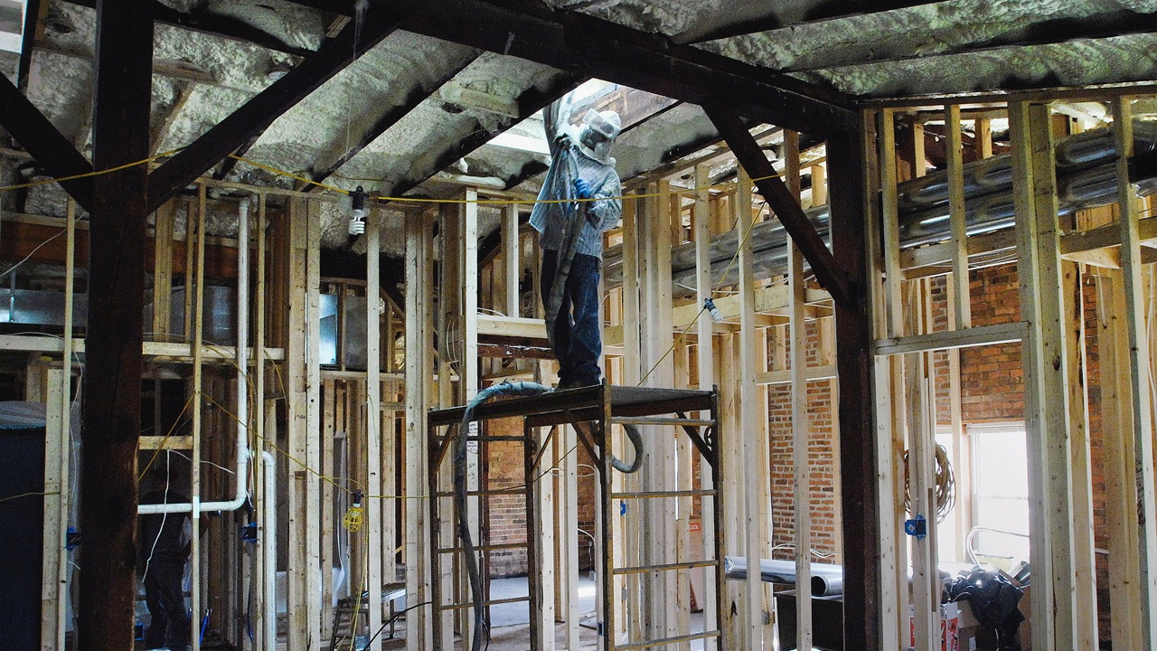
Cumulative global investment in commercial building energy efficiency retrofits will total $959 billion from 2014 through 2023.
© 2014 AP Photo/The Pantagraph, David Proeber
Notes:
ID #4079 - May not be modified or used in presentations that are recorded, streamed, or broadcast.
DESCRIPTION: Photo of a worker spraying insulation into a building with text stating that cumulative global investment in commercial building energy efficiency retrofits will total $959 billion from 2014 through 2023
ADDITIONAL TALKING POINTS: According to a 2014 report by the research firm, Navigant Research, the global market for energy efficiency commercial building retrofits is projected to grow at more than 7 percent per year through 2023. Regulations and policy measures, technological advances, and cost reductions are all driving increased investment in energy efficiency retrofits. Because the existing building stock dwarfs the amount of building space that is added on an annual basis, retrofits are a critical pathway to greening the world’s commercial buildings.*
Navigant Research expects annual global revenue for energy efficiency commercial building retrofits to grow to $100.8 billion by 2025.**
REFERENCES:
* Navigant Research, “Commercial Building Owners and Managers Will Invest Nearly $960 Billion in Energy Efficiency Retrofits from 2014-2023,” July 24, 2014. http://www.navigantresearch.com/newsroom/commercial-building-owners-and-managers-will-invest-nearly-960-billion-in-energy-efficiency-retrofits-from-2014-2023
** Navigant Research, “Energy Efficiency Retrofits for Commercial and Public Buildings,” last accessed April 2018. https://www.navigantresearch.com/research/energy-efficiency-retrofits-for-commercial-and-public-buildings

Slide 33

Los Angeles has more Energy Star certified buildings than any other U.S. city.
© ESB Professional via Shutterstock
Notes:
ID #5584 - May not be modified or used in presentations that are recorded, streamed, or broadcast.
DESCRIPTION: Photo of Los Angeles with text stating Los Angeles has more Energy Star certified buildings than any other US city
ADDITIONAL TALKING POINTS: In 2017, the ACEEE ranked Los Angeles fourth among the nation's municipalities for its energy efficiency policies and programs. The City of Los Angeles released its Sustainable City pLAn in 2015, which set goals to reduce municipal energy usage 5 percent every year, with a long-term goal of 18 percent by 2025 and 25 percent by 2035 (compared to 2013 levels).*
REFERENCES:
* American Council for an Energy-Efficient Economy, "State and Local Policy Database," last updated January 2017. https://database.aceee.org/city/los-angeles-ca

Slide 34
OTHER CHANGES WE WILL SEE IN 2050
Standards to require Zero Carbon Energy, Zero Carbon Buildings, Zero Carbon Transport, and Zero Waste
Heating and appliances all electric; no gas furnaces, hot water heaters, stoves, or dryers
Electric grid upgraded for reliability, capacity and smart metering
EV charging stations replace gas stations; or exchangeable batteries
Plastic and Styrofoam packaging, bags, straws – all gone
US breadbasket will grow only food, not ethanol, and far more plants than animals
Notes:
Zero carbon buildings: a lot of these will have rooftop or parking lot canopy solar

Slide 35
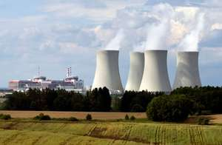
NO MORE NUCLEAR, COAL, OIL, OR GAS

Slide 36
SO HOW DO WE GET TO THIS
CLEAN ENERGY FUTURE?

Slide 37
REMEMBER ALL THESE?
200+ Cities 9 States
183 Colleges And Universities
1,700 Businesses And Investors
Notes:
ID #4918.C - Can be used in noncommercial online and TV broadcasts of your presentation, but not modified.
Bottom of https://www.wearestillin.com/about (as of 5/27/2019):
“We Are Still In is as a joint declaration of support for climate action, signed by more than 3,750 CEOs, mayors, governors, college presidents, and others. The organizations they represent comprise the largest and most diverse coalition of actors ever established in pursuit of climate action”.
Two-hundred plus cities, nine states, all these colleges and universities, 1,700 businesses, have all committed to the Paris Agreement. The hashtag is #WeAreStillIn.
DESCRIPTION: Text that exclaims the open letter declaring commitment to the Paris Agreement has amassed over two thousand signatories
ADDITIONAL TALKING POINTS: At least 2,300 governors, mayors, businesses, investors, and colleges and universities from across the US have signed an open letter to the international community and parties to the Paris Agreement to voice their support for, and dedication to, the US’ commitments as outlined under the Agreement. Together, these leaders are sending a strong signal to the rest of the world about the continued commitment of the US to ambitious action on climate change, absent leadership at the federal level.*
As of November 2017, participating cities and states represented over 127 million Americans and contributed $6.2 trillion to the US economy. The businesses and investors that have signed on account for a total annual revenue of $1.4 trillion and include over 20 Fortune 500 companies.**
REFERENCES:
* We Are Still In, “Leaders in U.S. Economy Say ‘We Are Still In’ on Paris Climate Agreement,” June 5, 2017. http://wearestillin.com/#press-release
** We Are Still In, “About,” last accessed October, 2017. http://wearestillin.com/about

Slide 38
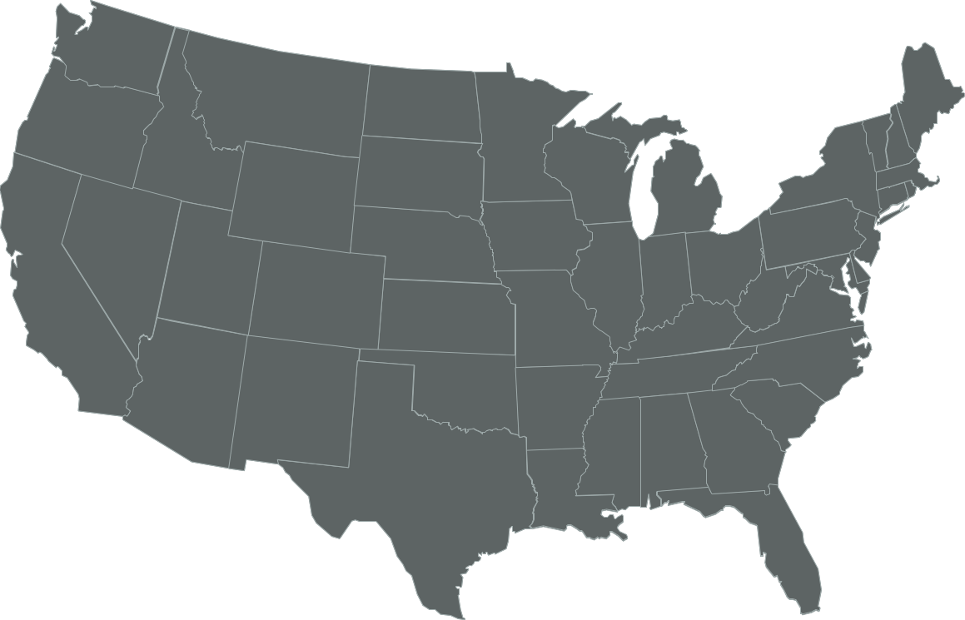
U.S. Commitments to 100% Renewable Electricity
Whatcom County
Edmonds
Spokane
Portland
Multnomah County
Burlington, VT
Milwaukie
Hanover
Plainfield
Cornish
St. Louis Park
Concord
Minneapolis
Eau Claire
Amherst
Cambridge
Eureka
St. Paul
Windsor
Lowell
Northampton
Middleton
Southampton
East Hampton
Nevada City
Truckee
Salt Lake City
Summit County
Madison
E. Bradford
New Brunswick
Breckenridge
Evanston
Cleveland
Downingtown
Haverford
San Fran.
S. Lake Tahoe
Park City
Nederland
Ft. Collins
Kennett Township
Phoenixville
Menlo Park
Berkeley
Aspen, CO
Longmont
Rock Port, MO
Washington, DC
West Chester
Palo Alto
Lafayette
Columbia, MD
Portola Valley
San Jose
Moab
Boulder
Denver
Kansas City
Cincinatti
Monterey
Summit County
Pueblo
St. Louis
San Luis Obispo
Pueblo County
Greensburg, KS
Blacksburg
Floyd County
Goleta
Santa Barbara
Questa
Hillsborough
Orange County
Ventura
Oxnard
Taos Ski Valley
Red River
Ojai
Culver City
Eagle Nest
Wake County
Santa Monica
Rolling Hills
Taos
Angel Fire
Norman
Fayetteville
Buncombe County
Encinitas
La Mesa
Taos County
Solana Beach
San Diego
Clarkston
Columbia
Committed
Del Mar
Chula Vista
Atlanta
Denton
Augusta
Already There
Georgetown, TX
Abita Springs
Gainesville
Dunedin
Orlando
Kodiak Island, AK
St. Petersburg
Sarasota
Largo
Data: The Sierra Club
Notes:
ID #4910.G - Can be used in noncommercial online and TV broadcasts of your presentation, but not modified.
Here are the cities that have pledged to go 100 percent renewable. Here are the ones that have already achieved 100 percent renewable.
DESCRIPTION: Map of the US showing the cities that have committed to 100% renewable energy or are already there
ADDITIONAL TALKING POINTS: Sierra Club’s ‘Ready For 100’ campaign has challenged cities in the US to commit to 100 percent clean energy. When this slide was updated in January 2019, over 100 cities had adopted policies committing them to a goal of 100 percent clean energy, while seven cities had already fulfilled their commitments: Aspen, CO; Burlington, VT; Greensburg, KS; Kodiak Island, AK; Georgetown, TX; Columbia, MD; and Rock Port, MO.[1*]
REFERENCES:
[1*] Sierra Club, “100% Commitments in Cities, Counties, & States,” last accessed June, 2018. https://www.sierraclub.org/ready-for-100/commitments

Slide 39
New Jersey’s Clean Energy Initiatives
100% Clean Energy by 2050
Rejoined Regional Greenhouse Gas Initiative (RGGI)
Joined US Climate Alliance
Joined Regional Transportation and Climate Initiative
Renewable Energy Law
  Renewable Energy Standard (graduated to 50% by 2030)
  Solar, Offshore Wind, Energy Efficiency, Energy Storage
  Community Solar, Energy Aggregation
2019 NJ Energy Master Plan released in draft
Notes:
Gov Murphy Executive Order #28: 100% Clean Energy by 2050 –
rollout is being defined in the 2019 Energy Master Plan
5/23/2018 signed new LAW: 50% renewable electrical power is legislated by 2030; 3500 MW of Offshore Wind; reforms solar program; Community Solar, Energy Storage (VIP)…
RGGI provides carbon trading across east cost states. NJ is officially back in RGGI as of Jun 2019 and stands to benefit financially from credits that could be used for additional renewable projects.
BAN OFFSHORE DRILLING : we cant actually control drilling in Federal Waters (beyond 3 miles or so). BUT WE CAN and ARE PROHIBITING any use of land-based facilities – no ships, pipelines, etc.
12/18/2018 NJ joined with 9 other regional and mid-atlantic states in the “Transportation and Climate Initiative” (TCI) to within 1 year, define a low-carbon transportation policy

Slide 40
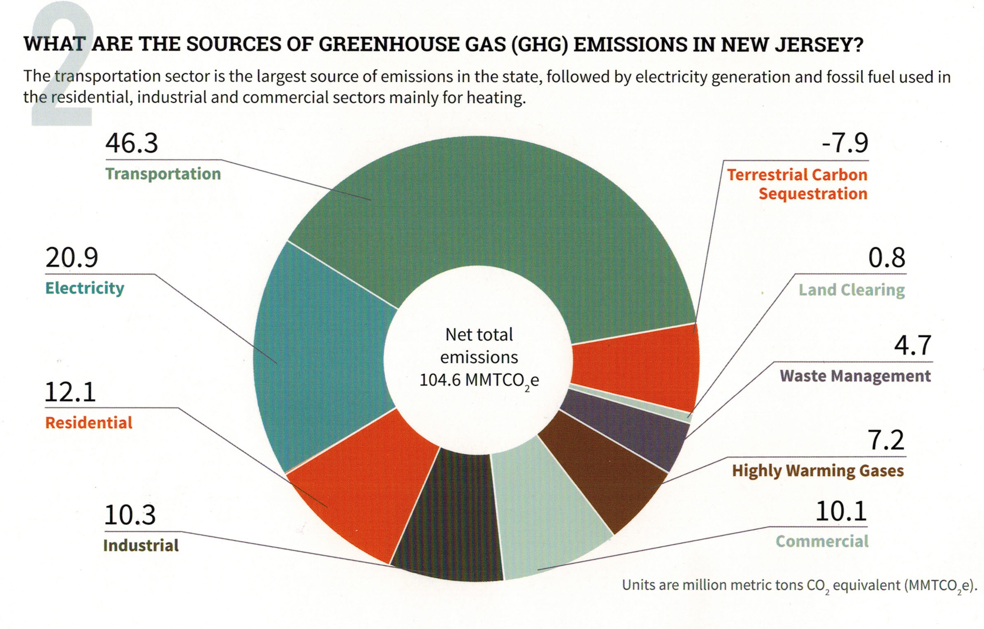
Your (Typical NJ) GHG Emissions EEEmissions
“Reducing NJ Greenhouse Gas Emissions”, Rutgers, Jan 2018
Notes:
Sustainable Jersey states: “the primary goal [of “Gold Star in Energy” is reducing Green House Gases. Responding to this overarching imperative will help achieve all the other [sustainability] goals.”
The green team needs to decide: what to TACKLE FIRST?
A short cut is to use this NJ average carbon footprint.
TRANSPORTATION + ELECTRICAL ARE GREATEST EMISSION SOURCES.
EXAMPLE: As an individual, switching your electrical supplier to 100% clean electricity (OR INSTALLING ROOFTOP SOLAR) will reduce your emissions 21%
Then take the next step- buy a plug-in EV, you reduce emissions another 46% - a total of 67% reduction – you have eliminated 2/3 of your total emissions!!
This can be expanded to your entire city!!

Slide 41
What Am I To Do?
Switch To Clean Electricity
http://electric.smiller.org
Install rooftop solar
Invest in or subscribe to community solar
Switch to a 100% clean supplier
Ask your town to supply clean electrical aggregation

Slide 42
Your Town For Clean Energy
Examples of Electrical Aggregation
Your Town FOR
CLEAN ENERGY
New Brunswick is a best example: 50% renewable
Essex Hub (Maplewood, Montclair, South Orange, Verona, Glen Ridge)
Glen Rock and Livingston
Fair Haven Municipal (only) 5% renewable (added to RPS)
Red Bank (renewable percentage TBD)
Woodbridge, Toms River,…
Notes:
Electrical Aggregation can eventually convert a whole city to 100% renewable electricity.
The contract typically specifies the total renewable tracks annual RPS increases (but at a higher total renewable content) EXAMPLES:
1. New Brunswick is a great example. They contracted for renewable energy provider to replace PSE&G with 50% renewable electrical content for every household (& business if they requested).
2. Essex Hub (Maplewood, Montclair, South Orange, Verona, Glen Ridge)
3. independent renewable energy in Glen Rock and Livingston
4. Fair Haven has Municipal (only) renewable energy contract thru 2020 (5% above JCP&L RPS)
5. Woodbridge, Toms River,…

Slide 43
Switch To Plug-in Electric Car
Plug Into Your Clean Electricity
Save On Fuel Costs (~30-70% more efficient)
Save On Car Maintenance
Notes:
Save 30 to 70% by switching your fuel from gas to electricity!
In less than 5 years, the cost of an EV propulsion system will drop below cost of an internal combustion system - at that point, the financial cost benefit is very clear in all aspects, and EV sales should take off.

Slide 44
More Personal Steps to Cleaner Energy
  Cut energy use: make home more efficient
    Insulation and air sealing; Smart thermostat
    LED lighting
  Make your next water heater an electric heat pump
  Replace gas appliances (stove/dryer) with electric
  Make your next AC/furnace an electric heat pump
  Adopt a more plant-rich diet
  Avoid single-use plastic (water bottles, straws, bags, take-out containers)
Notes:
1st: get a free energy audit- and follow-thru with recommendations
Insulated, seal, changout to LED bulbs
Switch your house electricity to 100% renewable. Then recharge your battery-powered car with that renewable household electric
Switch ALL appliance, HVAC, hot water to electric!
Plan a plant-rich diet – if, by 2050, HALF the worlds population switched to plant-rich, less than 2500 calories/day, the energy savings is MORE THAN all the solar investment combined!!! SOURCE: “Drawdown” bible, by Hawken.

Slide 45

Influence Your Town To Adopt Clean Energy
FLORIDA
Notes:
Join marches and rallies - Pat and I organized the “Monmouth County for Clean Energy” march and rally-
200 attendees; ~40 volunteers; 11 guest speaker (incl Middletown Mayor), but Gov Murphy and Tammy couldn’t make it, and sent a letter which we read; 10 tables of displays; 11 plug-in electric cars on display.

Slide 46
Middletown for Clean Energy
Letter Campaign
Vision/Mission: 100% Clean Energy by 2050; (Electric by 2030)
Near-Term Benefits
  Clean Energy Businesses and Jobs
  Prestige as Leader in NJ; Enhanced Quality of Life
  Improved Air Quality and Health
  Gold Star in Energy
Strategy: Sustainable Jersey Gold Star in Energy
Actions: Efficiency, EV, Solar, Green Building in Master Plan

Slide 47
Middletown for Clean Energy
Outcome of Letter Campaign
Middletown will revise its Master Plan starting in fall, and our Stakeholder Team will be a subcommittee to work on the Energy Plan.
Now we want to expand to towns throughout Monmouth County.

Slide 48
Your Town For Clean Energy
Foundations for Your Energy Plan
Your Town FOR
CLEAN ENERGY
Aug, 2010 Rutgers “Energy Plan” (prepared for Middletown; Howell; Parsippany-Troy Hills; Fort Lee; Perth Amboy; East Orange; West Orange; Plainfield; Edison; Montclair; and Willingboro) http://www.middletownnj.org/DocumentCenter/View/2695
NJ 2019 Master Energy Plan 7 strategies;(to be finalized Fall 2019) https://nj.gov/bpu/pdf/publicnotice/EMP%20Press%20Release%20610_Revised.pdf
Sustainable Jersey ACTIONS (already established/well documented; http://www.sustainablejersey.com/fileadmin/media/Actions_and_Certification/Gold_Star_Standard/Overview_of_Gold_Star_Standard_In_Energy_FINAL_12-4-17_.pdf
Notes:
“Your Town” HAS 3 FOUNDATIONS for drafting the energy plan
In 2010, Rutgers used common methodology for 11 towns
(see “resources” for link to the Middletown Energy Plan)
Leverage the NJ Master Energy Plan (when signed, Fall, 2019).
3. Sustainable Jersey ACTIONS

Slide 49

Sustainable Jersey: A Framework for Getting To 100% Clean Energy
Sustainable Jersey Certification: a prestigious designation for municipal governments in New Jersey
450 NJ towns participating
203 towns currently certified
Actions to score points toward certification are documented. Review comparable cities’ documentation as models.
Certification is free and completely voluntary.
http://sustainablejersey.com has all actions, resources, numerous presentations, and complete documentation from all certified communities.
Notes:
Add schools?

Slide 50
Sustainable Jersey Certifications
A Framework for Getting To 100% Clean Energy
Bronze certification: commitment to sustainability, implemented first significant steps, 150 points
Silver certification: significant progress toward sustainability, 350 points, state-wide and national leader
Gold Star Standard is a NEW level of recognition for silver certified communities.
  Gold Star in Energy
  Gold Star in Waste
1 Town has Achieved Gold Star in Energy: Woodbridge
Notes:
Thank you, Pat. Middletown for Clean Energy campaigned hard for a city-wide energy plan.
We succeeded! We were told: YES, but you need to create the energy plan!
The Middletown Mayor has been pushing hard for Silver Certification.
THIS HIGH LEVEL ATTENTION IS IMPORTANT!!
This week, the Middletown Green Team leader is preparing an application for 420 points, and we expect to achieve Silver in November.
When silver certified, Middletown is eligible for Gold Star recognition--
A step in our energy plan goals: 100% clean electricity by 2030 and netzero by 2050.
WE CAN LEARN FROM WOODBRIDGE- THE ONLY GOLD STAR ACHIEVER IN NJ – to be discussed later
*****************
FOR NEXT STEPS we will benchmark other cities

Slide 51
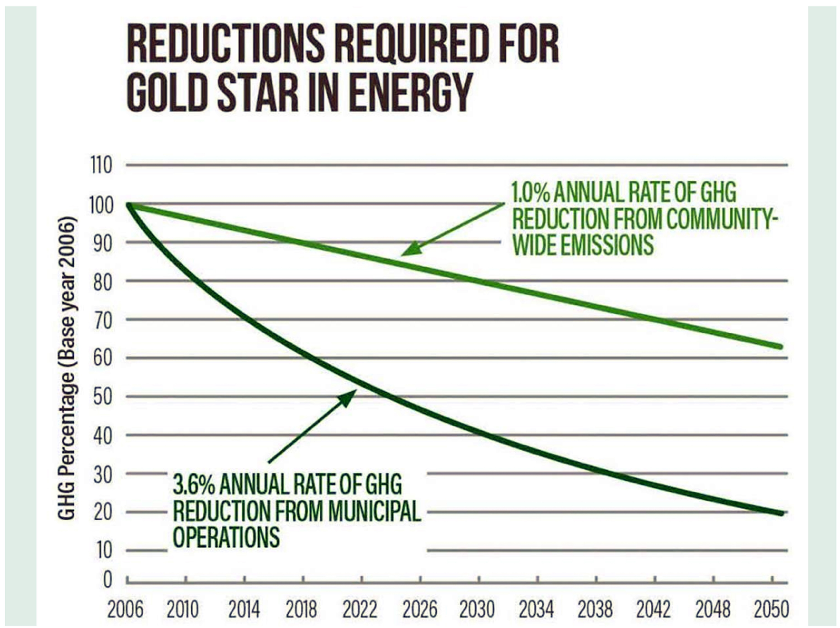
Notes:
Use Soloman’s slide Green Teams, must reduce GHG gas emissions of BOTH municipal and the residents/businesses in town.
This curve shows the MUNICIPAL emission reduction must be at least 3.6% reduction per year.
This compounded 3.6%/year will meet the 80% mandated emission reductions under New Jersey’s Global Warming Response Act, which requires 80% reduction in GHG, below 2006 levels, by 2050.

Slide 52
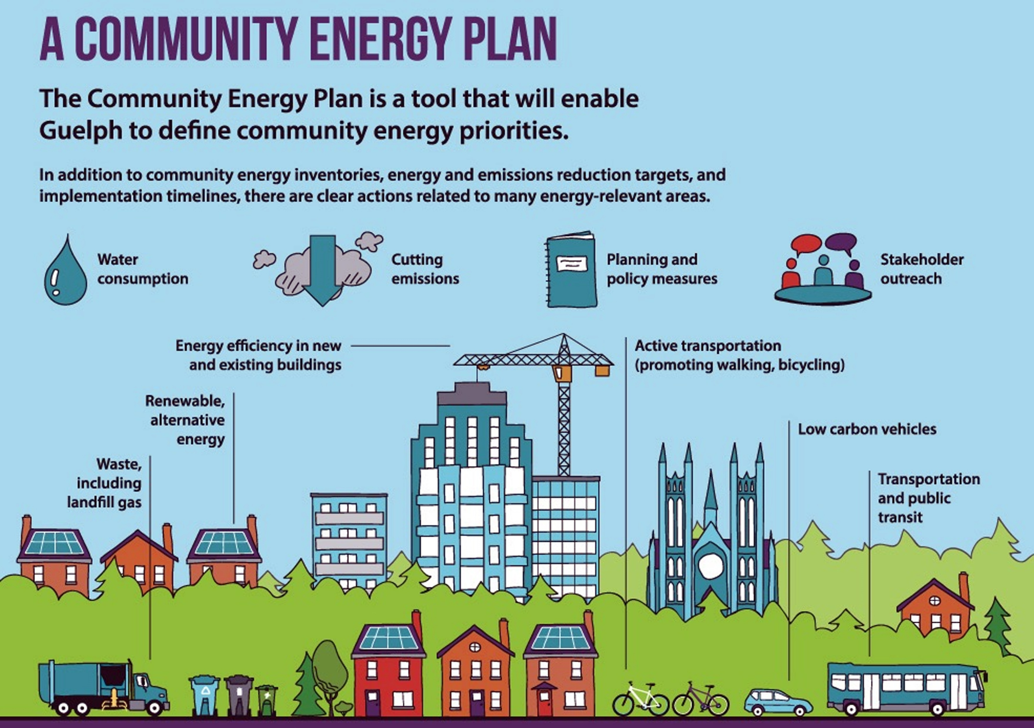
Notes:
From 6/14/2019 Sustainable Summit at Bell Works

Slide 53
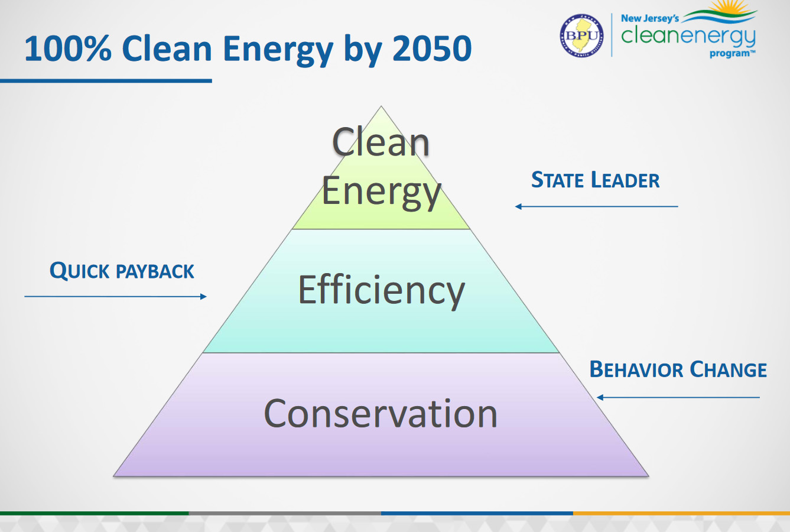
Notes:
From 6/14/2019 Sustainable Summit at Bell Works

Slide 54
Mayors Climate Summit
Inspirational Video (3 minute) from 2018 Mayors Climate Summit
search www.sustainablejersey.com

Slide 55

RECOMMENDED EVENT THIS WEEK
Community Movie
and Discussion
Thurs, June 27 7PM
Old First Church
69 Kings Highway
Middletown, NJ
Sponsors:
Sierra Club RF100
Middletown for Clean Energy
Monmouth Community Climate Coalition
Old First Church

Slide 56

2050: THE FUTURE IS BRIGHT AND GREEN
Notes:
Allow the future looks blue in this slide!

Slide 57
What Will A Clean Energy Future Look Like in 2050?
And How Do We Get There?
Pat and Steve Miller patmiller@comcast.net stevemiller@comcast.net http://climate.smiller.org http://electric.smiller.org
This talk: http://climate.smiller.org/talks
Your Town FOR
CLEAN ENERGY
Notes:
These slides and all resources are linked at the above URL

