Slide 1

MIDDLETOWN FOR CLEAN ENERGY
100% CAMPAIGN
May 28 HUB slides & references at http://climate.smiller.org/talks/hub
Pat and Steve Miller patmiller@comcast.net stevemiller@comcast.net http://climate.smiller.org http://electric.smiller.org
Notes:
These slides and all resources are linked at the above URL

Slide 2
WHAT CRISIS?
IPCC (UN): “The Impacts of Global Warming of 1.5°C”, Oct 2018
National Climate Assessment, Nov 2018
Yale Climate Opinion Maps, Aug 2018
2018 Arctic Report Card, NOAA, Dec 2018
Global Assessment Report on Biodiversity and Ecosystem Services, May 2019

Slide 3
IPCC REPORT
Issued by UN Intergovernmental Panel on Climate Change, October 2018; 2-year study by 100 scientist authors
Conclusion: Paris Agreement limit of 2°C global warming NOT sufficient to avert human catastrophe
Warming above 1.5°C would produce consequences:
  Extreme storms and flooding; sea level rise
  Heat waves [kill people]
  Drought [crop failure, food shortages]
  Fires
  Marine system collapse; species loss [food shortages, disease]

Slide 4
NATIONAL CLIMATE ASSESSMENT 2018
Produced by 13 US government agencies led by NOAA, 300 experts
Conclusions consistent with IPCC Report; broken down by US region, eg
  More rain and flooding in Northeast
  More drought and fires in the West
Quantified the economics of non-action:
  Annual losses in US $200 billion by 2050
  Contracting of US GDP by 10% by 2100

Slide 5
YALE CLIMATE OPINION MAPS 2018
Show how Americans’ climate change beliefs, risk perceptions, and policy support vary at the state, congressional district, metro area, and county levels
https://climatecommunication.yale.edu/visualizations-data/ycom-us-2018/?est=happening&type=value&geo=county
70% of people favor enacting policies to address climate change
  In US
  In NJ
  In Monmouth County

Slide 6
2018 ARCTIC REPORT CARD
Issued annually; peer reviewed; written by more than 80 scientists from 12 countries
Sea Ice Coverage during 2015 thru 2018 are lowest in satellite record
Surface Temperatures are breaking records; increasing more than 2X faster than rest of globe
Atmospheric Warming is more rapidly melting Greenland ice sheet
Increased Air Temperatures result in sluggish/wavy jet-stream. Deep jet stream waves coincided with:
  North Pole heat wave, late 2017
  Severe winter storms in Eastern US in 2018
  Extreme cold in Europe in March, 2018

Slide 7
SIXTH MASS EXTINCTION
Global Assessment Report on Biodiversity and Ecosystem Services, 6 May 2019, on the global state of biodiversity
Produced by UN Intergovernmental Science-Policy Platform on Biodiversity and Ecosystem Services
Due to human impact on the environment, Earth's biodiversity has suffered a catastrophic decline unprecedented in human history. Faced with extinction:
  40 percent of amphibians
  Almost a third of reef-building corals
  More than a third of marine mammals
  10 percent of all insects
Catastrophic consequences on human food supply

Slide 8

In the 2015 Paris Agreement,
every nation in the world agreed
to work together to achieve net zero greenhouse gas emissions by mid-century.
The U.S. cannot legally withdraw until the day after the 2020 Presidential election.
© SevArt/Pond5
Notes:
ID #3782.B - Can be used in noncommercial online and TV broadcasts of your presentation, but not modified.
The final question is: will we change? Of course the Paris Agreement was a start, a breakthrough, every country in the world, 195 of them, have agreed. And yes, President Trump said he wanted to withdraw, but a lot of people don't realize that under the law, the first day the US could legally withdraw from the Paris Agreement happens to be the day after the 2020 Presidential election. That means that the decision is not up to Donald J. Trump. It's up to us! It's in our hands! If we do what is necessary.
Another provision that's not as widely known. If there is a new president, they just have to give 30 days' notice and we're right back in the Paris Agreement. And this is an agreement that is steadily being strengthened because next year is the so-called "review and ratchet" year, when every nation upgrades its commitment.
DESCRIPTION: Video of canal boats in the Seine River in Paris and text about the Paris Agreement’s net zero greenhouse gas emissions goal
ADDITIONAL TALKING POINTS: All 196 of the United Nations Framework Convention on Climate Change’s (UNFCCC) participating member states plus the European Union, totaling 197 parties, adopted the Paris Agreement at the conclusion of the United Nations 21st Conference of the Parties (COP 21) in December 2015.[1*]
The Paris Agreement sets a long-term goal to keep global average temperature rise to well below 2 degrees Celsius, while pursuing efforts to hold it under 1.5 degrees Celsius. It operationalizes this with a mitigation goal of peaking global emissions as soon as possible, then aiming for net-zero greenhouse gas emissions in the second half of this century. To achieve these goals, the agreement requires countries to submit an action plan (known as a “nationally-determined contribution,” or NDC) every five years, progressively strengthening the plan over time. Along with new frameworks for measuring, reporting, and verifying emissions reductions, and providing capacity building for less-developed countries, the Paris Agreement effectively establishes a framework for continued action.[2*]
Although President Trump announced, on June 1, 2017, his intent to withdraw the United States from the Paris Agreement, the earliest date at which any country can leave the agreement is November 4, 2020, the day after the 2020 US Presidential election.[3*]
REFERENCES:
[1*] United Nations Framework Convention on Climate Change, “COP 21,” United Nations, last accessed April, 2018. https://unfccc.int/resource/docs/2015/cop21/eng/10.pdf
[2*] United Nations Framework Convention on Climate Change, Paris Agreement (December 2015). https://unfccc.int/files/meetings/paris_nov_2015/application/pdf/paris_agreement_english_.pdf
[3*] Brad Plumer, “The U.S. Won’t Actually Leave the Paris Climate Deal Anytime Soon,” The New York Times, June 7, 2017. https://www.nytimes.com/2017/06/07/climate/trump-paris-climate-timeline.html

Slide 9
200+ Cities 9 States
183 Colleges And Universities
1,700 Businesses And Investors
All committed to the Paris Climate Agreement
Notes:
ID #4918.C - Can be used in noncommercial online and TV broadcasts of your presentation, but not modified.
Bottom of https://www.wearestillin.com/about (as of 5/27/2019):
“We Are Still In is as a joint declaration of support for climate action, signed by more than 3,750 CEOs, mayors, governors, college presidents, and others. The organizations they represent comprise the largest and most diverse coalition of actors ever established in pursuit of climate action”.
Two-hundred plus cities, nine states, all these colleges and universities, 1,700 businesses, have all committed to the Paris Agreement. The hashtag is #WeAreStillIn.
DESCRIPTION: Text that exclaims the open letter declaring commitment to the Paris Agreement has amassed over two thousand signatories
ADDITIONAL TALKING POINTS: At least 2,300 governors, mayors, businesses, investors, and colleges and universities from across the US have signed an open letter to the international community and parties to the Paris Agreement to voice their support for, and dedication to, the US’ commitments as outlined under the Agreement. Together, these leaders are sending a strong signal to the rest of the world about the continued commitment of the US to ambitious action on climate change, absent leadership at the federal level.*
As of November 2017, participating cities and states represented over 127 million Americans and contributed $6.2 trillion to the US economy. The businesses and investors that have signed on account for a total annual revenue of $1.4 trillion and include over 20 Fortune 500 companies.**
REFERENCES:
* We Are Still In, “Leaders in U.S. Economy Say ‘We Are Still In’ on Paris Climate Agreement,” June 5, 2017. http://wearestillin.com/#press-release
** We Are Still In, “About,” last accessed October, 2017. http://wearestillin.com/about

Slide 10

U.S. Commitments to 100% Renewable Electricity
Whatcom County
Edmonds
Spokane
Portland
Multnomah County
Burlington, VT
Milwaukie
Hanover
Plainfield
Cornish
St. Louis Park
Concord
Minneapolis
Eau Claire
Amherst
Cambridge
Eureka
St. Paul
Windsor
Lowell
Northampton
Middleton
Southampton
East Hampton
Nevada City
Truckee
Salt Lake City
Summit County
Madison
E. Bradford
New Brunswick
Breckenridge
Evanston
Cleveland
Downingtown
Haverford
San Fran.
S. Lake Tahoe
Park City
Nederland
Ft. Collins
Kennett Township
Phoenixville
Menlo Park
Berkeley
Aspen, CO
Longmont
Rock Port, MO
Washington, DC
West Chester
Palo Alto
Lafayette
Columbia, MD
Portola Valley
San Jose
Moab
Boulder
Denver
Kansas City
Cincinatti
Monterey
Summit County
Pueblo
St. Louis
San Luis Obispo
Pueblo County
Greensburg, KS
Blacksburg
Floyd County
Goleta
Santa Barbara
Questa
Hillsborough
Orange County
Ventura
Oxnard
Taos Ski Valley
Red River
Ojai
Culver City
Eagle Nest
Wake County
Santa Monica
Rolling Hills
Taos
Angel Fire
Norman
Fayetteville
Buncombe County
Encinitas
La Mesa
Taos County
Solana Beach
San Diego
Clarkston
Columbia
Committed
Del Mar
Chula Vista
Atlanta
Denton
Augusta
Already There
Georgetown, TX
Abita Springs
Gainesville
Dunedin
Orlando
Kodiak Island, AK
St. Petersburg
Sarasota
Largo
Data: The Sierra Club
Notes:
ID #4910.G - Can be used in noncommercial online and TV broadcasts of your presentation, but not modified.
Here are the cities that have pledged to go 100 percent renewable. Here are the ones that have already achieved 100 percent renewable.
DESCRIPTION: Map of the US showing the cities that have committed to 100% renewable energy or are already there
ADDITIONAL TALKING POINTS: Sierra Club’s ‘Ready For 100’ campaign has challenged cities in the US to commit to 100 percent clean energy. When this slide was updated in January 2019, over 100 cities had adopted policies committing them to a goal of 100 percent clean energy, while seven cities had already fulfilled their commitments: Aspen, CO; Burlington, VT; Greensburg, KS; Kodiak Island, AK; Georgetown, TX; Columbia, MD; and Rock Port, MO.[1*]
REFERENCES:
[1*] Sierra Club, “100% Commitments in Cities, Counties, & States,” last accessed June, 2018. https://www.sierraclub.org/ready-for-100/commitments

Slide 11
New Jersey’s Clean Energy Initiatives
100% Clean Energy by 2050
Rejoin Regional Greenhouse Gas Initiative (RGGI)
Join US Climate Alliance
Renewable Energy Law
  Renewable Energy Standard (graduated to 50% by 2030)
  Solar, Offshore Wind, Energy Efficiency, Energy Storage
  Community Solar
NJ Energy Master Plan forthcoming
Notes:
Gov Murphy Executive Order #28: 100% Clean Energy by 2050 –
rollout is being defined in the June 1, 2019 Energy Master Plan
5/23/2018 signed new LAW: 50% renewable electrical power is legislated by 2030; 3500 MW of Offshore Wind; reforms solar program; Community Solar, Energy Storage (VIP)…
RGGI provides carbon trading trading across east cost states. Once in RGGI, NJ stands to benefit financially with credits that could be used for additional renewable projects.
BAN OFFSHORE DRILLING : we cant actually control drilling in Federal Waters (beyond 3 miles or so). BUT WE CAN and ARE PROHIBITING any use of land-based facilities – no ships, pipelines, etc.
12/18/2018 NJ joined with 9 other regional and mid-atlantic states in the “Transportation and Climate Initiative” (TCI) to within 1 year, define a low-carbon transportation policy

Slide 12


Sierra Club
100% Committed

Slide 13

EVERY TOWN FOR
CLEAN ENERGY
As concerned citizens, we recognize the ongoing environmental threats posed to our community, our loved ones, and our own health and property. We aspire to the following VISION for our town and are working toward achieving it:
Our legacy of a town (and world) where our children and grandchildren can flourish: leave it better than we found it

Slide 14
Middletown for Clean Energy
Letter Campaign: The Letter
Vision/Mission: 100% Clean Energy by 2050
Near-Term Benefits
  Clean Energy Businesses and Jobs
  Prestige as Leader in NJ; Enhanced Quality of Life
  Improved Air Quality and Health
  Gold Star in Energy
Strategy: Sustainable Jersey Gold Star in Energy
Actions: Efficiency, EV, Solar, Green Building in Master Plan

Slide 15
Middletown for Clean Energy
Letter Campaign: Getting Signers
Goal of 200 signers (Middletown popn: 67,000)
MCE organization has email list of 150 members, monthly meetings
Asked all members to sign letter and solicit family and friends
Good response from tabling at Green Fairs or environmental orgs, speaking at orgs (homeowners, etc), door-to-door neighbors, personal friends, orgs we belong to
Less successful: letters, email, phone
Gathered 290 signed letters from Middletown; also many other Monmouth Co towns at tabling events

Slide 16
Middletown for Clean Energy
Presentation to Township Committee
Private meetings with 4 of 5 Committee members and Township administrator; this feedback refined our letter before introduction.
At April 15 Committee meeting, presented binder and CD of all letters.
3 people spoke during general comments time (5 minutes ea); meeting was video recorded.
Cover letter asked for a resolution to charter a Green Energy Stakeholder Team to create a 10-year plan toward 100% clean.
We relayed that Sustainable Jersey was there to help with Gold Star in Energy.
April 15 – May 8, MCE members sent emails, texts to Committee members, submitted letters to editor endorsing clean energy.

Slide 17
Middletown for Clean Energy
Outcome
On May 8, 6 MCE members met with Mayor.
  The Mayor described his vision - a grand, long-term plan much broader than just energy.
On May 16, 12 members of MCE wrote letter to Mayor describing comparable cities, and accepting his challenge to work on Energy portion of his Plan.
On May 18, we again met with Mayor and learned:
  Middletown will revise Master Plan starting in fall, and will have our Stakeholder Team as a subcommittee to work on Energy Plan.

Slide 18
Middletown for Clean Energy
Further Status
We will solicit people with skills we need for the Green Energy Stakeholder Team (project management, risk management, energy, accounting, technical writing)
Will begin data collection by attending May 31 Sustainable Jersey Going for Energy Gold Workshop in Ewing.
Now want to expand to towns throughout Monmouth County.

Slide 19

Sustainable Jersey Certifications
A Framework for Getting To 100% Clean Energy
Bronze certification: commitment to sustainability, implemented first significant steps, 150 points
Silver certification: significant progress toward sustainability, 350 points, state-wide and national leader
Gold Star Standard is a NEW level of recognition for silver certified communities.
  Gold Star in Energy
  Gold Star in Waste
1 Town has Achieved Gold Star in Energy: Woodbridge
Notes:
Thank you, Pat. Middletown for Clean Energy campaigned hard for a city-wide energy plan.
We succeeded! We were told: YES, but you need to create the energy plan!
The Middletown Mayor has been pushing hard for Silver Certification.
THIS HIGH LEVEL ATTENTION IS IMPORTANT!!
This week, the Middletown Green Team leader is preparing an application for 420 points, and we expect to achieve Silver in November.
When silver certified, Middletown is eligible for Gold Star recognition--
A step in our energy plan goals: 100% clean electricity by 2030 and netzero by 2050.
WE CAN LEARN FROM WOODBRIDGE- THE ONLY GOLD STAR ACHIEVER IN NJ – to be discussed later
*****************
FOR NEXT STEPS we will benchmark other cities

Slide 20
Your Town For Clean Energy
Foundations for Your Energy Plan
Your Town FOR
CLEAN ENERGY
Aug, 2010 Rutgers “Energy Plan” (prepared for Middletown Twp.; Howell Twp.; Parsippany-Troy Hills Twp.; Fort Lee; Perth Amboy; East Orange; West Orange; Plainfield; Edison Township; Montclair Township; and Willingboro Township)
Leverage the NJ 2019 Master Energy Plan (when signed, Fall, 2019)
Sustainable Jersey ACTIONS (already established/well documented)
Notes:
MIDDLETOWN HAS 3 FOUNDATIONS for drafting the energy plan
In 2010, Rutgers used common methodology for 11 towns
(see “resources” for link to the Middletown Energy Plan)
Leverage the NJ Master Energy Plan (when signed, Fall, 2019).
3. Sustainable Jersey ACTIONS

Slide 21
Your Town For Clean Energy
Sustainable Jersey Actions
Your Town FOR
CLEAN ENERGY
CHOOSE 3 OF THESE PRIORITY ACTIONS for SILVER
Climate Adaptation: Flooding Risk | *Municipal Carbon Footprint
Diversity on Boards & Commissions | Natural Resource Inventory
*Energy Tracking & Management | Prescription Drug Safety and Disposal
*Energy Efficiency for Municipal Facilities | Recycling and Waste Reduction Education and Compliance
*Fleet Inventory | Sustainable Land Use Pledge
*Green Business Recognition Program | Water Conservation Ordinance
*get started toward “gold energy star” If choose these *ENERGY-RELATED actions
Notes:
Middletown has ALREADY started working toward the Gold Star in Energy
There are 12 “Priority Actions” for Bronze or Silver certification.
Silver requires you to choose 3 of these 12 priority actions.
HERE IS A SHORT CUT: choose the ENERGY-related ACTIONS while pursuing Bronze or Silver Certification.
THE RESULT: you will be automatically earning ACTIONS for Gold Star in Energy!
Middletown has ALREADY achieved:
“Energy Tracking & Management”
“Energy Efficiency for Municipal Facilities”
“Fleet Inventory”

Slide 22
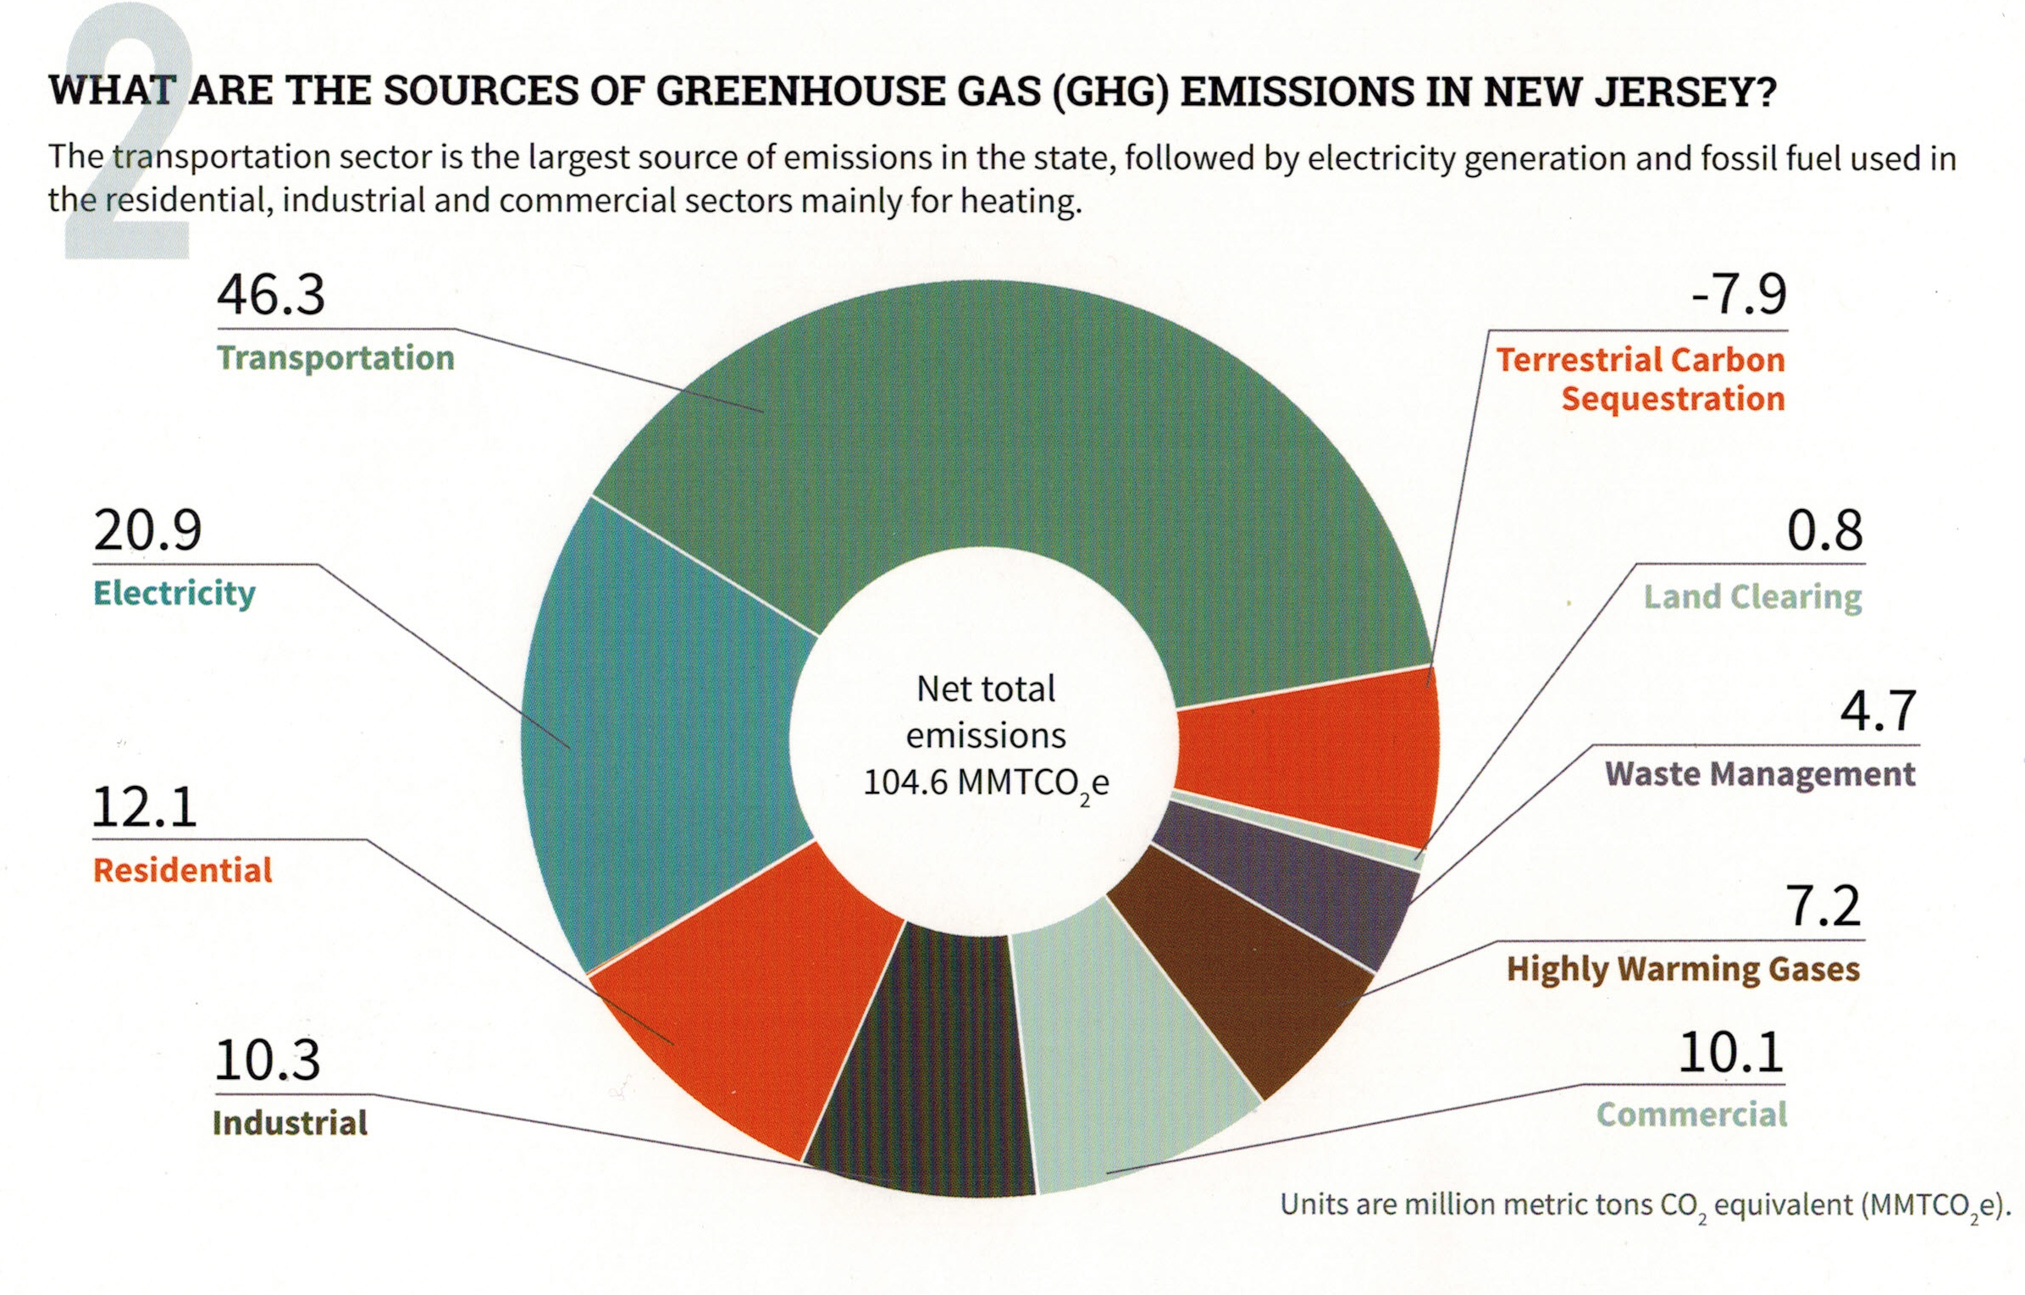
Your (Typical NJ) GHG Emissions EEEmissions
“Reducing NJ Greenhouse Gas Emissions”, Rutgers, Jan 2018
Notes:
Sustainable Jersey states: “the primary goal [of “Gold Star in Energy” is reducing Green House Gases. Responding to this overarching imperative will help achieve all the other [sustainability] goals.”
The green team needs to decide: what to TACKLE FIRST?
A short cut is to use this NJ average carbon footprint.
TRANSPORTATION + ELECTRICAL ARE GREATEST EMISSION SOURCES.
EXAMPLE: As an individual, switching your electrical supplier to 100% clean electricity (OR INSTALLING ROOFTOP SOLAR) will reduce your emissions 21%
Then take the next step- buy a plug-in EV, you reduce emissions another 46% - a total of 67% reduction – you have eliminated 2/3 of your total emissions!!
This can be expanded to your entire city!!

Slide 23
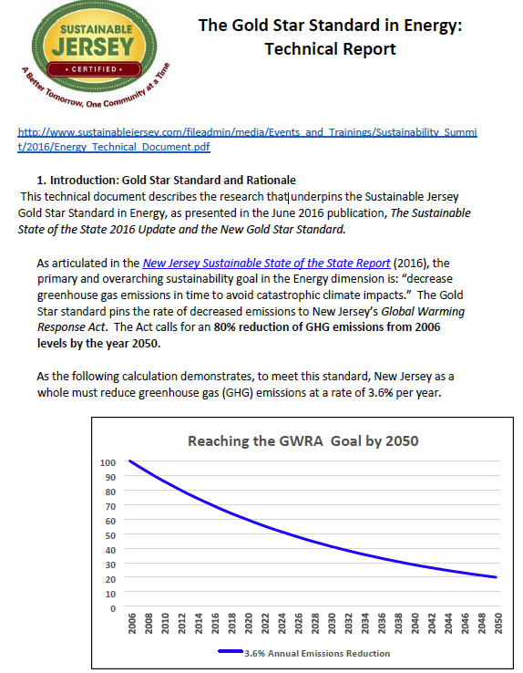
GOLD STAR STANDARD IN ENERGY
3.6% / per year
Enables reaching 80% emission reduction by 2050
Notes:
Green Teams, must reduce GHG gas emissions of BOTH municipal and the residents/businesses in town.
This curve shows the MUNICIPAL emission reduction must be at least 3.6% reduction per year.
This compounded 3.6%/year will meet the 80% mandated emission reductions under New Jersey’s Global Warming Response Act, which requires 80% reduction in GHG, below 2006 levels, by 2050.

Slide 24
Apply for EDF GRANT (early spring, 2020)
Environmental Defense Fund (EDF) Climate Corps interns funded by NJ Natural Gas
2019 edf interns awarded to Monmouth County:
Keyport, Red Bank, Manalapan, Neptune, and W Long Branch School District
  focus on jump starting energy efficiency programs
Municipal (buildings)
Residential Outreach
Commercial Outreach
Notes:
HERE IS A FUNDAMENTALLY IMPORTANT SHORTCUT taken by Middletown - AN OFFER your city can not refuse- a free expert working several months to jump-start your Gold Star energy ACTIONS.
These EDF masters-level experts will get you started to save money and to save GHG emissions
EDF interns start NEXT WEEK! Those here from Keyport, Red Bank, Manalapan or Neptune applied early this spring!
Energy efficiency is the bottom rung. The energy not spent is the cheapest energy of all

Slide 25
START ENERGY ACTIONS WITH ENERGY EFFICIENCY IMPROVEMENT
funded by BPU societal benefit fund
MUNICIPAL:
Free energy audit
Recommended energy efficiency improvements funded by:
70% paid by direct install (arrange through NJ Nat Gas)
  30% paid via loans (payments guaranteed to be less than energy savings)
  BUSINESS:
free energy audit
recommended energy efficiency improvements funded by:
70% paid by direct install (arrange through NJ Nat Gas)
  30% paid through gas bill
  RESIDENTS:
  free audit for income-qualified residents; $49 for higher incomes (limited time)
  Recommended energy efficiency improvements partly funded by SaveGreen
Notes:
The HUB has heard this directly from NJ Natural Gas – I wont repeat. GO TO NEXT SLIDE
********************
Municipal and Business energy efficiency programs are similar: free energy audit, then 70% off energy improvements!
Residents are different: low income households receive a free audit.
All households benefit from attractive BPU-sponsored Clean Energy programs and Energy Star discounts
I signed up for the $49 energy audit for my house. An auditor installed a door fan to create a vacuum in my house, and spent a couple of hours using an IR camera taking numerous photos of cold air leaks into house.
I thought my house was well insulated, but found air leaks everywhere.
I followed the auditor around the house, and tagged the air leaks. I elected NOT to sign the automatic requests from 3 contractors, to bid on fixing the leaks.
Instead, I spent ~$100 on supplies to do it myself. I now offer a “CLUB” of similar people to share practices/advice to MIDDLETOWN homeowners to patch up our houses after the audit reveals the problems!

Slide 26
AFTER COMPLETING ENERGY EFFICIENCY ACTIONS
Begin Municipal And City-wide Energy Actions
MUNICIPAL OPERATIONS: GHG REDUCTIONS (10 ACTIONS)
Renewable Energy Generation: Solar, Wind, Geothermal
Green The Municipal Fleet
Buildings & Street Lighting Efficiency
COMMUNITY-WIDE GHG REDUCTION OPERATIONS (9 ACTIONS)
Renewable Energy Generation: Solar, Electric Aggregation
Mobile Sources
Trees – Canopy Shading Effect
Notes:
AFTER you complete the Energy Efficiency ACTIONS:
There are 19 possible Actions by the Green Team in your town. - About half MUNICIPAL, and half Community-wide
**********************
10 Actions reduce MUNICIPAL emissions
add solar to buildings and parking areas; green the municipal fleet;
9 Actions reduce COMMUNITY-wide emissions: 100 times more impact than Municipal:
Become a solar-friendly town: make permitting easy & standardized
Become an EV –friendly town: install public charging stations
Conserve your trees: they absorb carbon, and provide shading to reduce city temps.

Slide 27
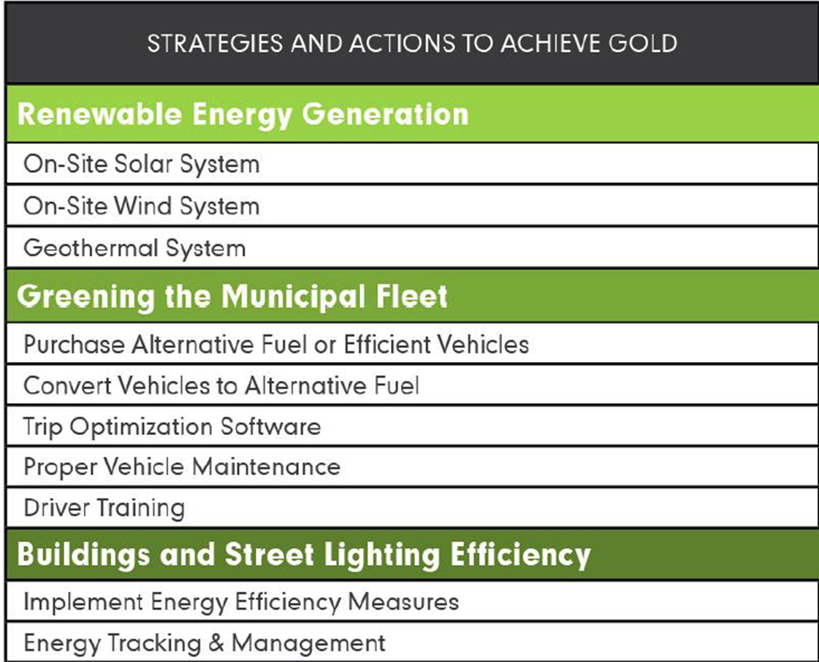
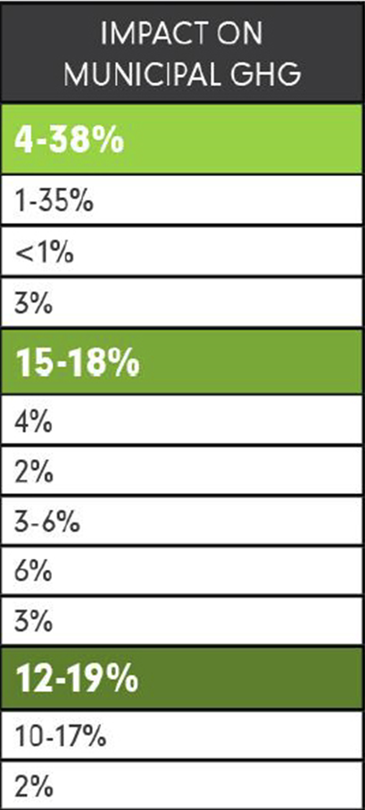
GOLD STAR STANDARD IN ENERGY
Notes:
Here are the MUNICIPAL actions. FOCUS ON THE RIGHT COLUMN: showing the percent emissions impact
RESULTS ARE TOTALLY under your control.
When ALL the ACTIONS are added, the total likely emission reduction is between 31% and 75% - good for many years at 3.6% reduction per year
***********************
Most of these “MUNICIPAL” Actions are ELECTIVE.
All you have to do is show before and after carbon footprints, to prove that you have met the 3.6% reduction, averaged over 3 years of more.
“Community Led Solar initiatives”:“Solar by Right and as Accessory”, AND a uniform permit process, fixed permit fee & 3 day processing.
ENERGY SAGE–“no annoying phone calls” automated sign up for solar
MAKE YOUR TOWN EV FRIENDLY: Amend the zoning ordinances: add charging stations as a permitted accessory use.
TRAINING FOR local first responders
CHARGING STATIONS FUNDED BY THRID PARTIES! (20% charge premium over in-home charging is gold standard)

Slide 28
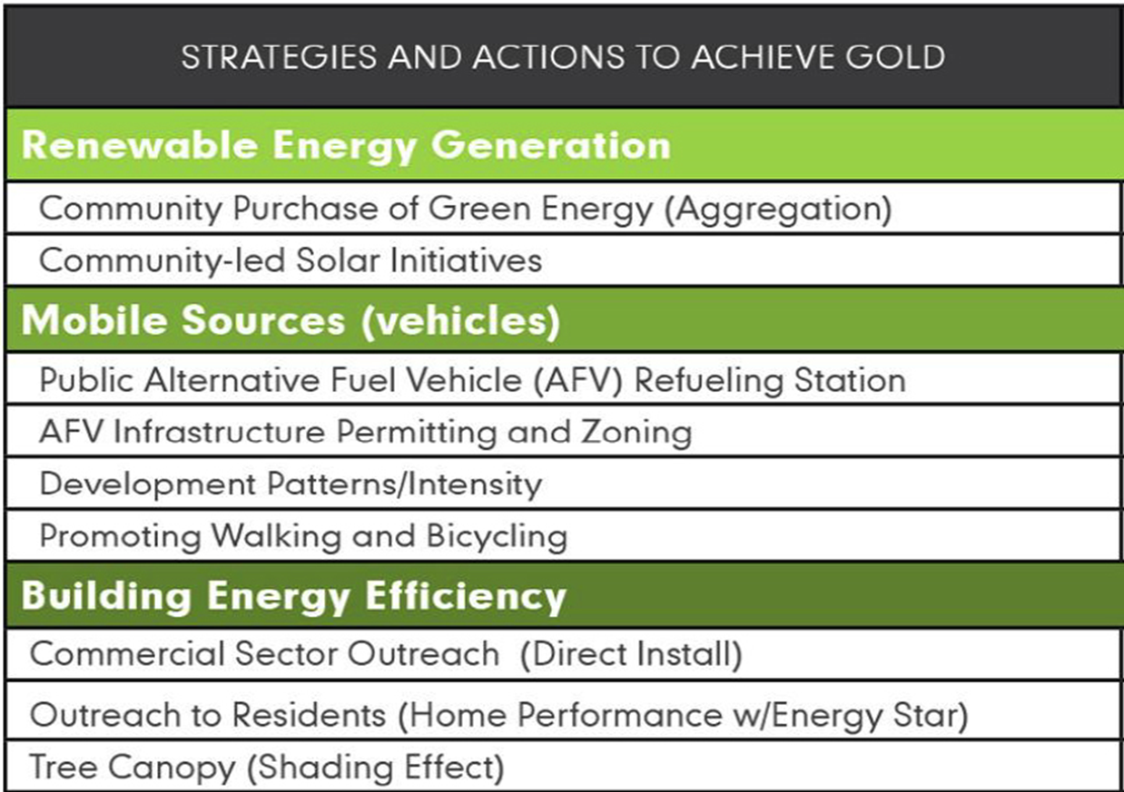
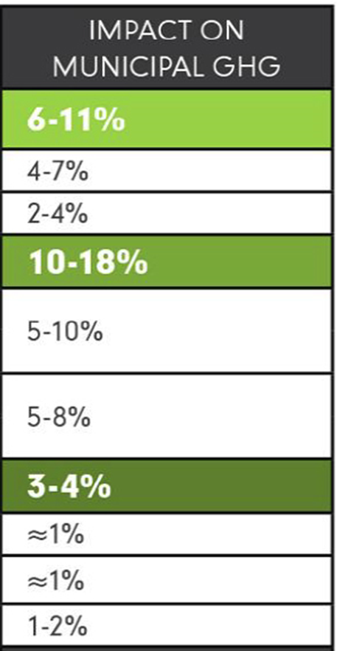
GOLD STAR STANDARD IN ENERGY
Notes:
Here are COMMUNITY-WIDE ACTIONS. (I added stars on the left, for MANDATORY ACTIONS). Look at right column
The requirement is at least 1% emission reduction per year. If all of ACTIONS are implemented, the reduction is 19% to 33% - good for MANY years at 1% per year
FIRST ITEM- AND MAYBE THE EASIEST: Electrical Aggregation to convert a whole city to 100% renewable electricity. EXAMPLES: next slide
************
“Community Led Solar initiatives: provides “Solar by Right and as Accessory”, AND a uniform permit process, fixed permit fee ($300) & 3 day processing.
ENERGY SAGE is on-line signup . EXAMPLE: 288 customers signed for site inspection; 50 new contracts signed;
PUBLIC EV CHARGING INFRASTRUCTURE “Public Alternative Fuel Vehicle (AFV) Refueling Station”
MAKE YOUR TOWN EV FRIENDLY “AFV Infrastructure Permitting and Zoning”
Amend the zoning ordinances: add charging stations as a permitted accessory use. to include regulations and design standards for charging and parking spaces,.
TRAINING FOR local first responders
CHARGING STATIONS FUNDED BY THRID PARTIES! (20% charge premium over in-home charging is gold standard)

Slide 29
Your Town For Clean Energy
Examples of Electrical Aggregation
Your Town FOR
CLEAN ENERGY
New Brunswick is a best example: 50% renewable
Essex Hub (Maplewood, Montclair, South Orange, Verona, Glen Ridge)
Glen Rock and Livingston
Fair Haven Municipal (only) 5% renewable (added to RPS)
Woodbridge, Toms River,…
Notes:
Electrical Aggregation can eventually convert a whole city to 100% renewable electricity. EXAMPLES:
1. New Brunswick is a great example. They contracted for renewable energy provider to replace PSE&G with 50% renewable electrical content for every household (& business if they requested).
2. Essex Hub (Maplewood, Montclair, South Orange, Verona, Glen Ridge)
3. independent renewable energy in Glen Rock and Livingston
4. Fair Haven has Municipal (only) renewable energy contract thru 2020 (5% above JCP&L RPS)
5. Woodbridge, Toms River,…

Slide 30
Your Town For Clean Energy
Other Opportunities for Emission Reductions
Your Town FOR
CLEAN ENERGY
44 energy-related Actions in current Woodbridge certification
                Community Energy Initiatives
                Municipal Energy Initiatives
                Transportation Initiatives
                Green Design
                Green Design Commercial and Residential Buildings
                Innovation & Demonstration Projects
                Land Use & Transportation
                Local Economies
                Grounds & Maintenance
                Sustainability & Climate Planning
http://www.sustainablejersey.com/?type=1336777441&tx_sjcert_certification[certification][__identity]=700
Notes:
BUT YOU ARE NOT LIMITED TO ONLY GOLD STAR “ACTIONS”
WOODBRIDGE, the ONLY Gold Energy Star recipient in NJ has close to 1200 points.
Every time I scan the Woodbridge certification, I think of new ideas for Middletown!
Scattered throughout, are 44 ADDITIONAL great ideas for energy & emission reduction – for use in YOUR town!

Slide 31
Improve Your Town’s Master Plan
Add a “Green Building and Environmental Sustainability” Element to the Master Plan. This provides:
Efficient use of natural resources
Renewable Energy Systems in new and retrofitted buildings
Impact of buildings on environment
Allow Ecosystems to function naturally
Conserve and reuse water
Treat storm water on-site
Optimize site orientation and design for the Climate
http://www.sustainablejersey.com/actions-certification/actions/#open/action/484
Notes:
This is the final Middletown ACTION I want to discuss tonight. We have been advocating for 2 years for the “Green Building and Environmental Sustainability Element” to be added to Middletown’s Master Plan.
AND IT IS SCHEDULED TO HAPPEN!
All other documents flow down from the master plan.
For instance, site plans could require new and rebuilt structures to have rooftops amenable to rooftop solar!
You should consider adding this Master Plan “Element” in all future construction in YOUR TOWN!.
BEFORE MOVING ON, LET ME SUMMARIZE:
Gold Star is only a start. Middletown’s energy plan is a work in progress. This summer and fall, our Middletown Green Energy Stakeholders Team will be planning how to reduce emissions through 2050.

Slide 32
County Climate Coalition
Notes:
Climate Reality Project advocates
that cities come together in a county climate coalition

Slide 33



Overview
Counties in the County Climate Coalition commit to efforts to fight the climate crisis
Resolution urging the federal government adhere to its GHG emissions reduction commitments made under the Paris Agreement - and take actions of their own!
Join a growing national group of counties that have passed a similar resolution to uphold the Paris Agreement with or without federal action.
Notes:
Counties are asked to pass a resolution asking the federal government to adhere to GHG reductions committed under the Paris Agreement
ALSO, counties can take actions on their own- just as cities can and ARE taking action to ensure a cleaner, safer, and more sustainable future for our families and our planet

Slide 34
Member Counties
Santa Clara County, CA
Santa Barbara County, CA
San Miguel County, CO
Charles County, MD
Gilpin County, CO
San Mateo County, CA
Summit County, UT
Contra Costa County, CA
Essex County, NJ
Marin County, CA
Alameda County, CA
Humboldt County, CA
Pima County, AZ
Union County, NJ
Washtenaw County, MI
Taos County, NM
…And the list is growing
Notes:
So far, two NJ counties are members of a County Coalition

Slide 35
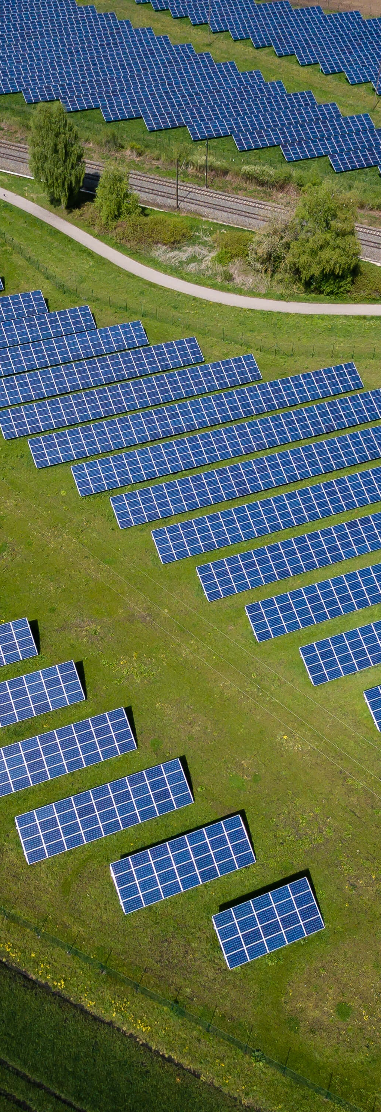
Benefits of Joining CCC
A network of counties nationwide committed to taking climate action
Share resources and best practices for reducing greenhouse gas emissions
Collective Action
Joining a global movement
Encourage and Enable Towns’ 100% Campaigns
Notes:
The biggest benefit to the town: the County is encouraging and enabling their towns to move to 100% Clean Energy

Slide 36
ALTERNATIVE: 100% COMMITTED
If Paris Agreement language won’t fly –
County can commit to 100% Clean Electricity by 2030 via resolution.
This could be done via NJ Government Energy Aggregation contract for entire county or sub-regions.
Make contract require 100% clean by 2030, or some reasonable date.
Saves money for all consumers.
Encourage and Enable Towns’ 100% Campaigns.
Notes:
One alternative: If Paris Agreement resolution can not be achieved, then the COUNTY could create a100% clean energy electrical aggregation, with a goal of reaching 100% clean electricity by 2030.
Cities could elect to join that aggregation, to
TAKE ADVANTAGE of the rapid drop in prices of renewable electricity to save on their electric bill,
AND to create enormous drops in GHG emissions across the county.

Slide 37
SUSTAINABLE JERSEY MAYORS SUMMIT
PLAY THE 3 MINUTE INSPIRING VIDEO!!
https://youtu.be/gXZMRYAwq6A
(this video is stored & plays locally within the next slide)

Slide 38
Notes:
TODAY we tabled at Middletown HS North HANDOUTS and poster display. Our handouts and poster display are available for YOU to use.
Switch to 100% electricity today AND the back shows the available vendors and price.
A list of 25 ways to reduce emissions, each for less than $25. the right column shows pounds of CO2 that has been avoided – showing between 20 and 200 pounds avoided each year. But the 1st item is an ORDER OF MAGNITUDE GREATER CO2 reduction. The average NJ home can save 4000 POUNDS of GHG emissions by switching to 100% renewable. It is definitely less than $25 cost, since it SAVES MONEY on the total electric bill.

Slide 39
MIDDLETOWN FOR CLEAN ENERGY
100% CAMPAIGN
May 28 HUB slides & references at http://climate.smiller.org/talks/hub
Pat and Steve Miller patmiller@comcast.net stevemiller@comcast.net http://climate.smiller.org http://electric.smiller.org
Notes:
All slides and resources are linked to the above URL

