Slide 1

RUMSON FOR CLEAN ENERGY Pat and Steve Miller patmiller@comcast.net stevemiller@comcast.net http://climate.smiller.org http://electric.smiller.org

Slide 2
WHAT CRISIS?
IPCC (UN): “The Impacts of Global Warming of 1.5°C”, Oct 2018
National Climate Assessment, Nov 2018
Yale Climate Opinion Maps, Aug 2018
2018 Arctic Report Card, NOAA, Dec 2018
Global Assessment Report on Biodiversity and Ecosystem Services, May 2019

Slide 3
IPCC REPORT
Issued by UN Intergovernmental Panel on Climate Change, October 2018; 2-year study by 100 scientist authors
Conclusion: Paris Agreement limit of 2°C global warming NOT sufficient to avert human catastrophe
Warming above 1.5°C would produce consequences:
Extreme storms and flooding; sea level rise
Heat waves [kill people]
Drought [crop failure, food shortages]
Fires
Marine system collapse; species loss [food shortages, disease]

Slide 4
NATIONAL CLIMATE ASSESSMENT 2018
Produced by 13 US government agencies led by NOAA, 300 experts
Conclusions consistent with IPCC Report; broken down by US region, eg
More rain and flooding in Northeast
More drought and fires in the West
Quantified the economics of non-action:
Annual losses in US $200 billion by 2050
Contracting of US GDP by 10% by 2100

Slide 5
YALE CLIMATE OPINION MAPS 2018
Show how Americans’ climate change beliefs, risk perceptions, and policy support vary at the state, congressional district, metro area, and county levels
https://climatecommunication.yale.edu/visualizations-data/ycom-us-2018/?est=happening&type=value&geo=county
70% of people favor enacting policies to address climate change
In US
In NJ
In Monmouth County

Slide 6
2018 ARCTIC REPORT CARD
Issued annually; peer reviewed; written by more than 80 scientists from 12 countries
Sea Ice Coverage during 2015 thru 2018 are lowest in satellite record
Surface Temperatures are breaking records; increasing more than 2X faster than rest of globe
Atmospheric Warming is more rapidly melting Greenland ice sheet
Increased Air Temperatures result in sluggish/wavy jet-stream. Deep jet stream waves coincided with:
North Pole heat wave, late 2017 (50 degrees above normal, Feb 25, 2018)
Severe winter storms in Eastern US in 2018
Extreme cold in Europe in March, 2018
Notes:
North Pole temperatures reached 50degrees F (28 degrees Celsius) higher than normal on February 25, 2018

Slide 7
SIXTH MASS EXTINCTION
Global Assessment Report on Biodiversity and Ecosystem Services, 6 May 2019, on the global state of biodiversity
Produced by UN Intergovernmental Science-Policy Platform on Biodiversity and Ecosystem Services
Due to human impact on the environment, Earth's biodiversity has suffered a catastrophic decline unprecedented in human history. Faced with extinction:
40 percent of amphibians
Almost a third of reef-building corals
More than a third of marine mammals
10 percent of all insects
Catastrophic consequences on human food supply

Slide 8

In the 2015 Paris Agreement,
every nation in the world agreed to work together to achieve net zero greenhouse gas emissions by mid-century.
The U.S. cannot legally withdraw until the day after the 2020 Presidential election.
© SevArt/Pond5
Notes:
ID #3782.B - Can be used in noncommercial online and TV broadcasts of your presentation, but not modified.
The final question is: will we change? Of course the Paris Agreement was a start, a breakthrough, every country in the world, 195 of them, have agreed. And yes, President Trump said he wanted to withdraw, but a lot of people don't realize that under the law, the first day the US could legally withdraw from the Paris Agreement happens to be the day after the 2020 Presidential election. That means that the decision is not up to Donald J. Trump. It's up to us! It's in our hands! If we do what is necessary.
Another provision that's not as widely known. If there is a new president, they just have to give 30 days' notice and we're right back in the Paris Agreement. And this is an agreement that is steadily being strengthened because next year is the so-called "review and ratchet" year, when every nation upgrades its commitment.
DESCRIPTION: Video of canal boats in the Seine River in Paris and text about the Paris Agreement’s net zero greenhouse gas emissions goal
ADDITIONAL TALKING POINTS: All 196 of the United Nations Framework Convention on Climate Change’s (UNFCCC) participating member states plus the European Union, totaling 197 parties, adopted the Paris Agreement at the conclusion of the United Nations 21st Conference of the Parties (COP 21) in December 2015.[1*]
The Paris Agreement sets a long-term goal to keep global average temperature rise to well below 2 degrees Celsius, while pursuing efforts to hold it under 1.5 degrees Celsius. It operationalizes this with a mitigation goal of peaking global emissions as soon as possible, then aiming for net-zero greenhouse gas emissions in the second half of this century. To achieve these goals, the agreement requires countries to submit an action plan (known as a “nationally-determined contribution,” or NDC) every five years, progressively strengthening the plan over time. Along with new frameworks for measuring, reporting, and verifying emissions reductions, and providing capacity building for less-developed countries, the Paris Agreement effectively establishes a framework for continued action.[2*]
Although President Trump announced, on June 1, 2017, his intent to withdraw the United States from the Paris Agreement, the earliest date at which any country can leave the agreement is November 4, 2020, the day after the 2020 US Presidential election.[3*]
REFERENCES:
[1*] United Nations Framework Convention on Climate Change, “COP 21,” United Nations, last accessed April, 2018. https://unfccc.int/resource/docs/2015/cop21/eng/10.pdf
[2*] United Nations Framework Convention on Climate Change, Paris Agreement (December 2015). https://unfccc.int/files/meetings/paris_nov_2015/application/pdf/paris_agreement_english_.pdf
[3*] Brad Plumer, “The U.S. Won’t Actually Leave the Paris Climate Deal Anytime Soon,” The New York Times, June 7, 2017. https://www.nytimes.com/2017/06/07/climate/trump-paris-climate-timeline.html

Slide 9
200+ Cities 9 States
183 Colleges And Universities
1,700 Businesses And Investors
All committed to the Paris Climate Agreement
Notes:
ID #4918.C - Can be used in noncommercial online and TV broadcasts of your presentation, but not modified.
Two-hundred plus cities, nine states, all these colleges and universities, 1,700 businesses, have all committed to the Paris Agreement. The hashtag is #WeAreStillIn.
DESCRIPTION: Text that exclaims the open letter declaring commitment to the Paris Agreement has amassed over two thousand signatories
ADDITIONAL TALKING POINTS: At least 2,300 governors, mayors, businesses, investors, and colleges and universities from across the US have signed an open letter to the international community and parties to the Paris Agreement to voice their support for, and dedication to, the US’ commitments as outlined under the Agreement. Together, these leaders are sending a strong signal to the rest of the world about the continued commitment of the US to ambitious action on climate change, absent leadership at the federal level.*
As of November 2017, participating cities and states represented over 127 million Americans and contributed $6.2 trillion to the US economy. The businesses and investors that have signed on account for a total annual revenue of $1.4 trillion and include over 20 Fortune 500 companies.**
REFERENCES:
* We Are Still In, “Leaders in U.S. Economy Say ‘We Are Still In’ on Paris Climate Agreement,” June 5, 2017. http://wearestillin.com/#press-release
** We Are Still In, “About,” last accessed October, 2017. http://wearestillin.com/about

Slide 10
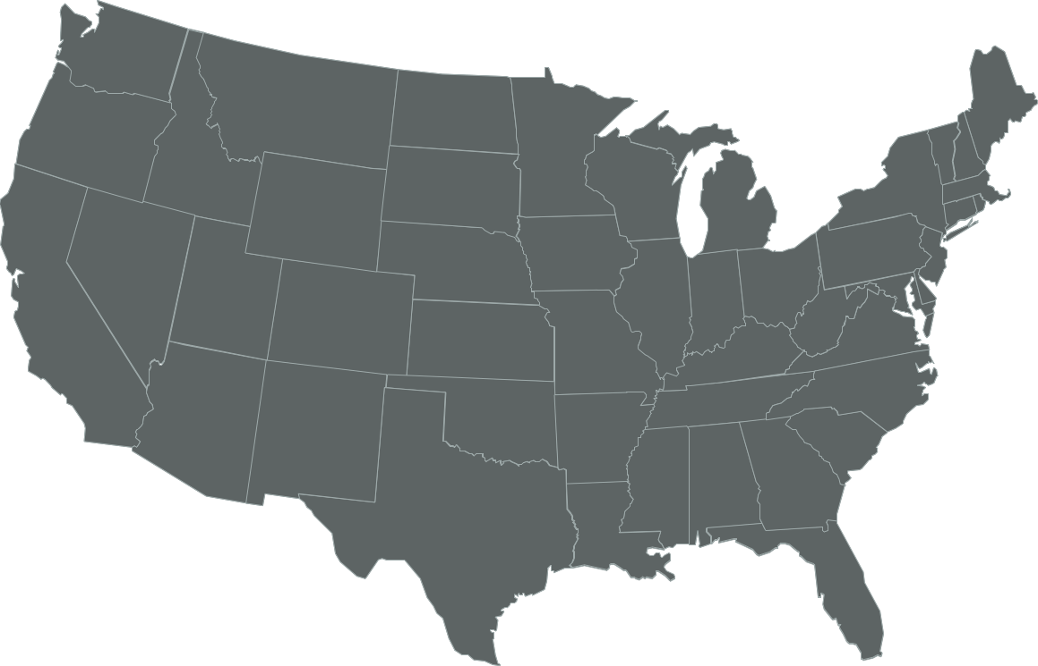
U.S. Commitments to 100% Renewable Electricity
Whatcom County
Edmonds
Spokane
Portland
Multnomah County
Burlington, VT
Milwaukie
Hanover
Plainfield
Cornish
St. Louis Park
Concord
Minneapolis
Eau Claire
Amherst
Cambridge
Eureka
St. Paul
Windsor
Lowell
Northampton
Middleton
Southampton
East Hampton
Nevada City
Truckee
Salt Lake City
Summit County
Madison
E. Bradford
New Brunswick
Breckenridge
Evanston
Cleveland
Downingtown
Haverford
San Fran.
S. Lake Tahoe
Park City
Nederland
Ft. Collins
Kennett Township
Phoenixville
Menlo Park
Berkeley
Aspen, CO
Longmont
Rock Port, MO
Washington, DC
West Chester
Palo Alto
Lafayette
Columbia, MD
Portola Valley
San Jose
Moab
Boulder
Denver
Kansas City
Cincinatti
Monterey
Summit County
Pueblo
St. Louis
San Luis Obispo
Pueblo County
Greensburg, KS
Blacksburg
Floyd County
Goleta
Santa Barbara
Questa
Hillsborough
Orange County
Ventura
Oxnard
Taos Ski Valley
Red River
Ojai
Culver City
Eagle Nest
Wake County
Santa Monica
Rolling Hills
Taos
Angel Fire
Norman
Fayetteville
Buncombe County
Encinitas
La Mesa
Taos County
Solana Beach
San Diego
Clarkston
Columbia
Committed
Del Mar
Chula Vista
Atlanta
Denton
Augusta
Already There
Georgetown, TX
Abita Springs
Gainesville
Dunedin
Orlando
Kodiak Island, AK
St. Petersburg
Sarasota
Largo
Data: The Sierra Club
Notes:
ID #4910.G - Can be used in noncommercial online and TV broadcasts of your presentation, but not modified.
Here are the cities that have pledged to go 100 percent renewable. Here are the ones that have already achieved 100 percent renewable.
DESCRIPTION: Map of the US showing the cities that have committed to 100% renewable energy or are already there
ADDITIONAL TALKING POINTS: Sierra Club’s ‘Ready For 100’ campaign has challenged cities in the US to commit to 100 percent clean energy. When this slide was updated in January 2019, over 100 cities had adopted policies committing them to a goal of 100 percent clean energy, while seven cities had already fulfilled their commitments: Aspen, CO; Burlington, VT; Greensburg, KS; Kodiak Island, AK; Georgetown, TX; Columbia, MD; and Rock Port, MO.[1*]
REFERENCES:
[1*] Sierra Club, “100% Commitments in Cities, Counties, & States,” last accessed June, 2018. https://www.sierraclub.org/ready-for-100/commitments

Slide 11
New Jersey’s Clean Energy Initiatives
100% Clean Energy by 2050
Rejoin Regional Greenhouse Gas Initiative (RGGI)
Join US Climate Alliance
Renewable Energy Law
Renewable Energy Standard (graduated to 50% by 2030)
Solar, Offshore Wind, Energy Efficiency, Energy Storage
Community Solar
NJ Energy Master Plan forthcoming
Notes:
Gov Murphy Executive Order #28: 100% Clean Energy by 2050 –
rollout is being defined in the 2019 Energy Master Plan
5/23/2018 signed new LAW: 50% renewable electrical power is legislated by 2030; 3500 MW of Offshore Wind; reforms solar program; Community Solar, Energy Storage (VIP)…
RGGI provides carbon trading trading across east cost states. Once in RGGI, NJ stands to benefit financially with credits that could be used for additional renewable projects.
BAN OFFSHORE DRILLING : we cant actually control drilling in Federal Waters (beyond 3 miles or so). BUT WE CAN and ARE PROHIBITING any use of land-based facilities – no ships, pipelines, etc.

Slide 12


Sierra Club
100% Committed
Notes:
Our campaign for clean energy is using the best of Climate Reality Project, and Sierra Club RF100 campaign

Slide 13

EVERY TOWN FOR
CLEAN ENERGY
As concerned citizens, we recognize the ongoing environmental threats posed to our community, our loved ones, and our own health and property. We aspire to the following VISION for our town and are working toward achieving it:
Our legacy of a town (and world) where our children and grandchildren can flourish: leave it better than we found it

Slide 14
Middletown for Clean Energy Letter Campaign: The Letter
Vision/Mission: 100% Clean Energy by 2050
Near-Term Benefits
Clean Energy Businesses and Jobs
Prestige as Leader in NJ; Enhanced Quality of Life
Improved Air Quality and Health
Gold Star in Energy
Strategy: Sustainable Jersey Gold Star in Energy
Actions: Efficiency, EV, Solar, Green Building in Master Plan

Slide 15
Middletown for Clean Energy Letter Campaign: Getting Signers
Goal of 200 signers (Middletown popn: 67,000)
MCE organization has email list of 150 members, monthly meetings
Asked all members to sign letter and solicit family and friends
Good response from tabling at Green Fairs or environmental orgs, speaking at orgs (homeowners, etc), door-to-door neighbors, personal friends, orgs we belong to
Less successful: letters, email, phone
Gathered 290 signed letters from Middletown; also many other Monmouth Co towns at tabling events

Slide 16
Middletown for Clean Energy Presentation to Township Committee
Private meetings with 4 of 5 Committee members and Township administrator; this feedback refined our letter before introduction.
At April 15 Committee meeting, presented binder and CD of all letters.
3 people spoke during general comments time (5 minutes ea); meeting was video recorded.
Cover letter asked for a resolution to charter a Green Energy Stakeholder Team to create a 10-year plan toward 100% clean.
We relayed that Sustainable Jersey was there to help with Gold Star in Energy.
April 15 – May 8, MCE members sent emails, texts to Committee members, submitted letters to editor endorsing clean energy.

Slide 17
Middletown for Clean Energy Outcome
On May 8, 6 MCE members met with Mayor.
The Mayor described his vision - a grand, long-term plan much broader than just energy.
On May 16, 12 members of MCE wrote letter to Mayor describing comparable cities, and accepting his challenge to work on Energy portion of his Plan.
On May 18, we again met with Mayor and learned:
Middletown will revise Master Plan starting in fall, and will have our Stakeholder Team as a subcommittee to work on Energy Plan.

Slide 18
Middletown for Clean Energy Further Status
We will solicit people with skills we need for the Green Energy Stakeholder Team (project management, risk management, energy, accounting, technical writing)
We will begin data collection by attending May 31 Sustainable Jersey Going for Energy Gold Workshop in Ewing.
Now want to expand to towns throughout Monmouth County.

Slide 19

Sustainable Jersey Actions: A Framework for Getting To 100% Clean Energy
Sustainable Jersey Certification: A Prestigious Designation For Municipal Governments In New Jersey
450 NJ Towns Participating
203 Towns Currently Certified
Actions To Score Points Toward Certification Are Documented And Reviewed.
Certification Is Free And Completely Voluntary.
http://sustainablejersey.com Has All Actions, Resources, Numerous Presentations, And Complete Documentation From All Certified Communities.
See Certification For Fair Haven And Haddonfield Boro (A Peer City?)

Slide 20
Sustainable Jersey Certifications
Bronze certification: commitment to sustainability, implemented first significant steps, 150 points
2 of 12 priority actions
Completed actions in 6 of 18 categories
Silver certification: significant progress toward sustainability, 350 points, state-wide and national leader
3 of 12 priority actions
Completed actions in 8 of 18 categories
Gold Star Standard is a NEW level of recognition for silver certified communities.
1 Town has Achieved Gold Energy Star: Woodbridge

Slide 21
Your Town For Clean Energy Sustainable Jersey Actions
Your Town FOR
CLEAN ENERGY
PRIORITY ACTIONS
Climate Adaptation: Flooding Risk | *Municipal Carbon Footprint
Diversity on Boards & Commissions | Natural Resource Inventory
*Energy Tracking & Management | Prescription Drug Safety and Disposal
*Energy Efficiency for Municipal Facilities | Recycling and Waste Reduction Education and Compliance
*Fleet Inventory | Sustainable Land Use Pledge
*Green Business Recognition Program | Water Conservation Ordinance
*ENERGY-RELATED

Slide 22
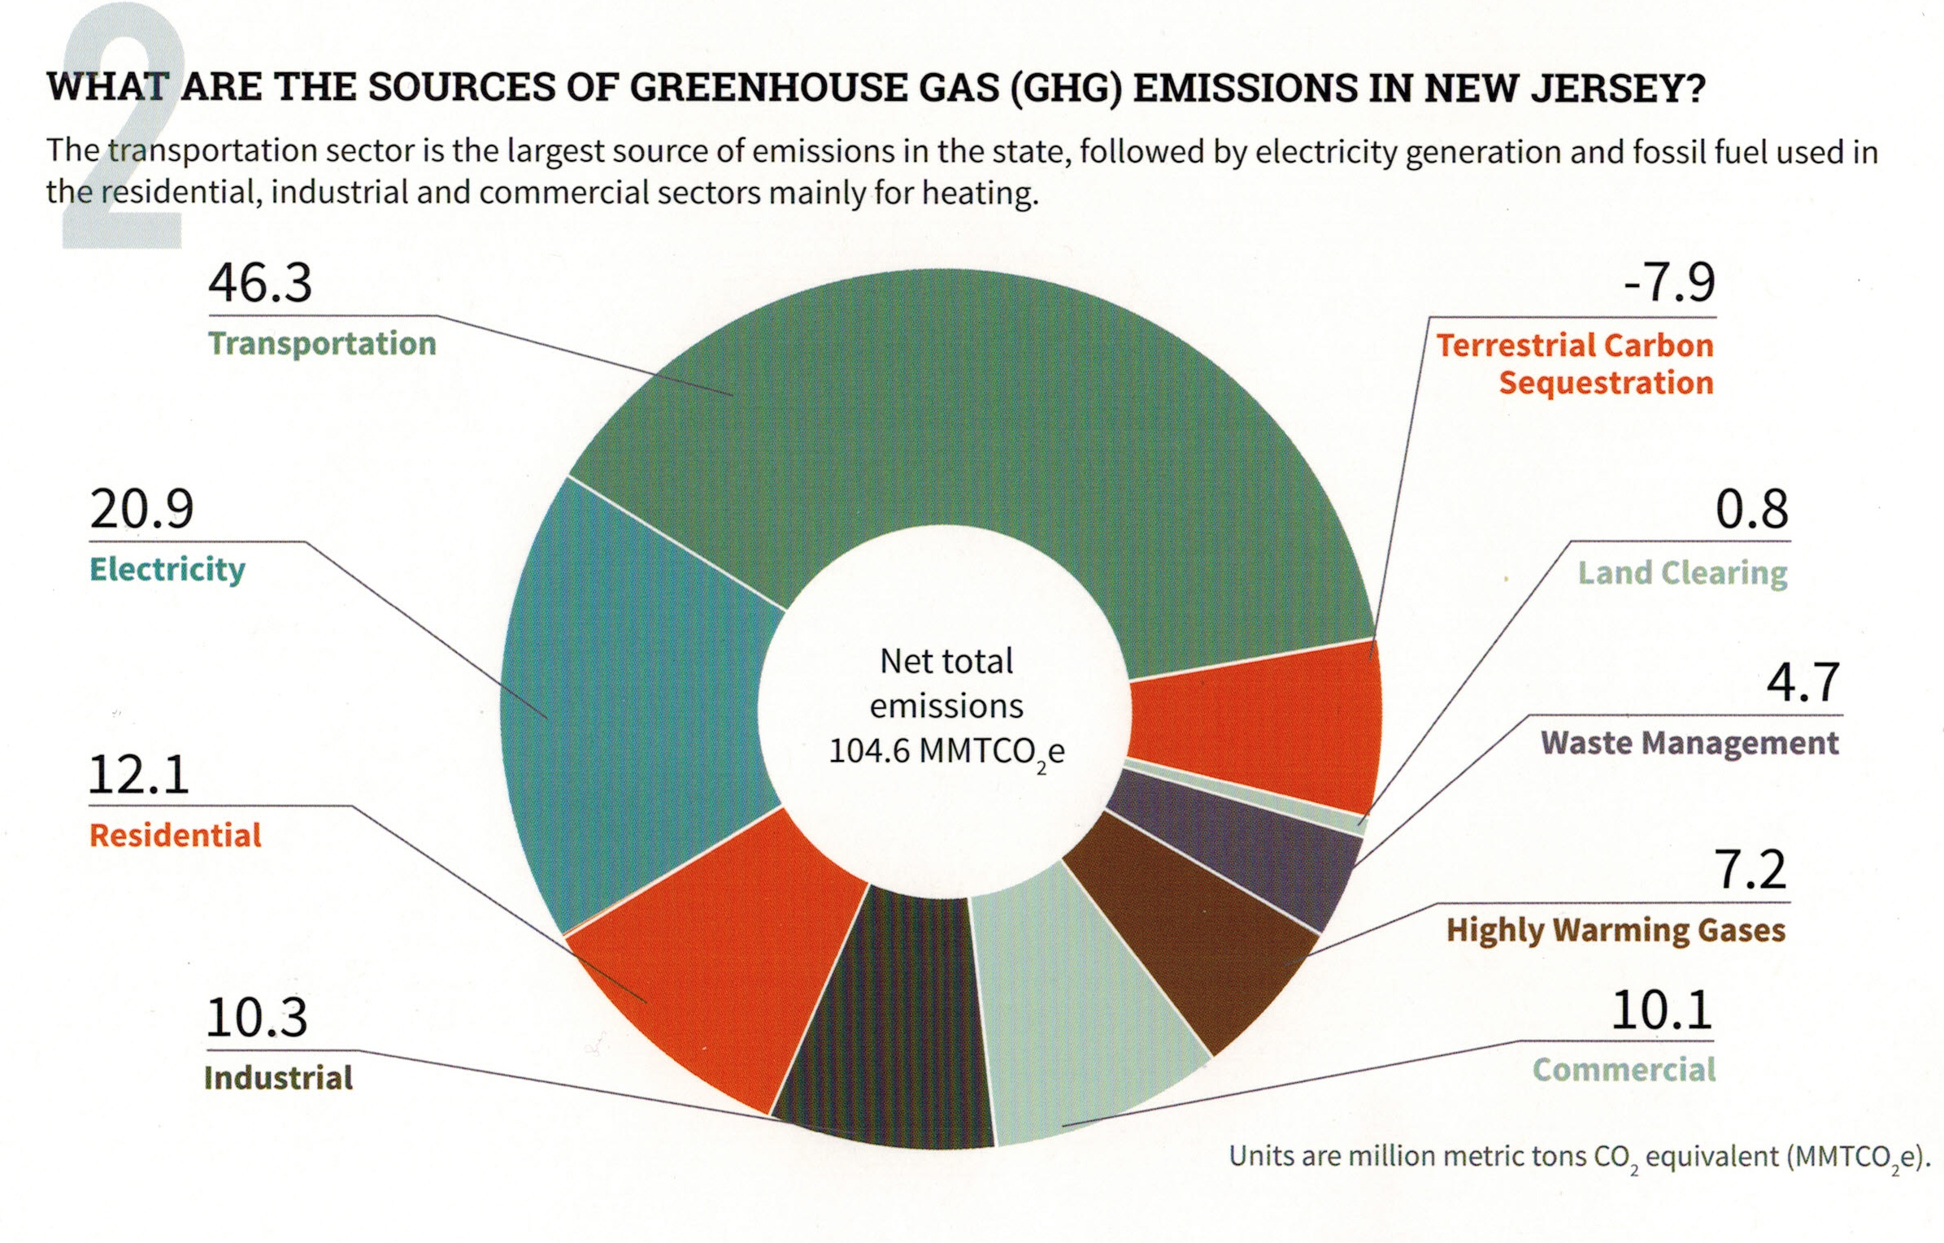
Your (Typical NJ) GHG Emissions EEEmissions
“Reducing NJ Greenhouse Gas Emissions”, Rutgers, Jan 2018
Notes:
WHAT DO YOU TACKLE FIRST? TRANSPORTATION + ELECTRICAL ARE GREATEST EMISSION SOURCES.
If your town has NOT determined its own GHG footprint, then use this pie chart of current NJ emissions.

Slide 23
START ENERGY ACTIONS WITH ENERGY EFFICIENCY IMPROVEMENT to get started, apply for a grant for EDF Fellow
Municipality, Businesses, Residences (most funded by BPU societal benefit fund)
MUNICIPAL:
Free energy audit
Recommended energy efficiency improvements funded by: 70% paid by direct install (arrange through NJ Nat Gas)
30% paid via loans (payments guaranteed to be less than energy savings)
BUSINESS:
free energy audit
recommended energy efficiency improvements funded by: 70% paid by direct install (arrange through NJ Nat Gas)
30% paid through gas bill
RESIDENTS: free audit for income-qualified residents; small fee for higher incomes
Notes:
The bottom rung is to increase energy efficiency. The energy not spent is the cheapest energy of all
Municipal and Business efficiency programs are similar: free energy audit, then 70% off energy improvements!
Residents are different: low income households receive a free audit. All households benefit from attractive Clean Energy programs and Energy Star discounts

Slide 24
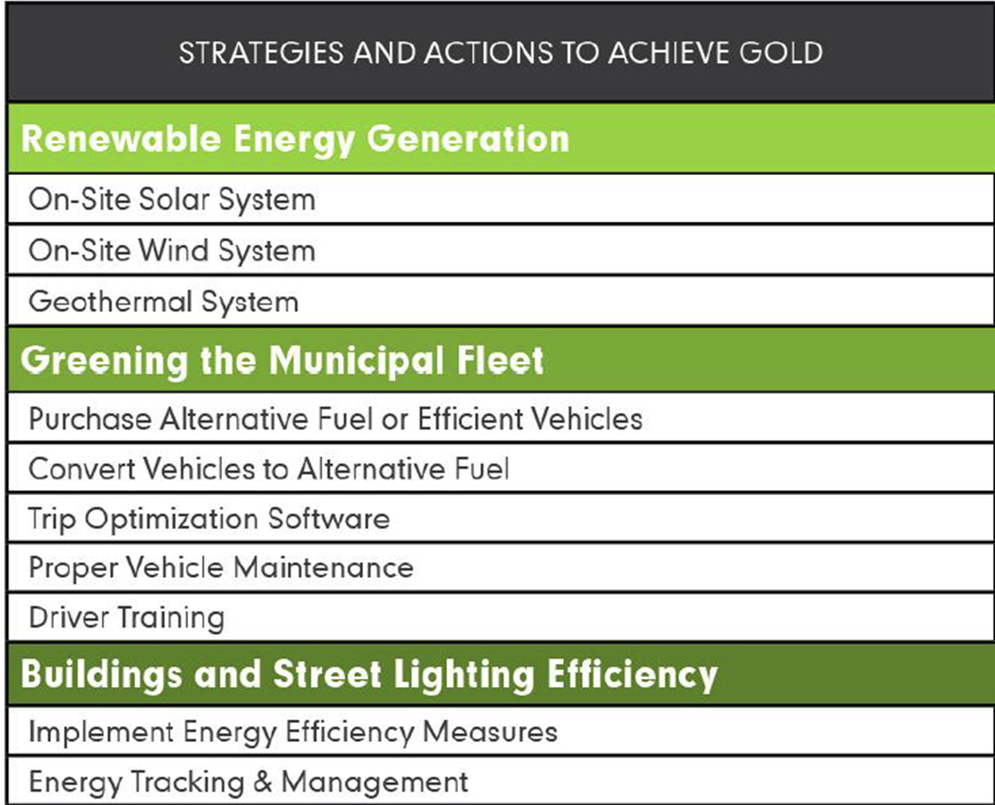
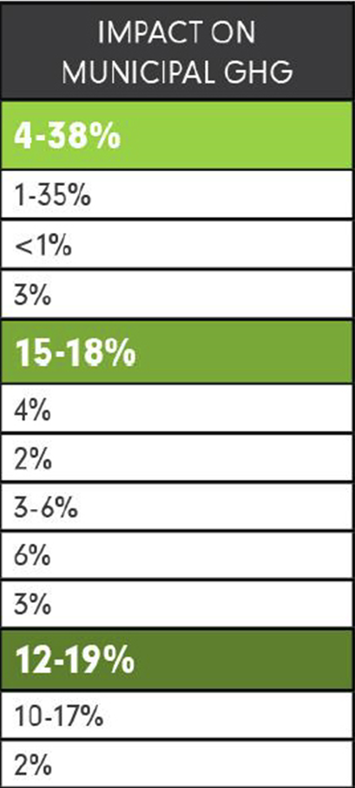
GOLD STAR STANDARD IN ENERGY

Slide 25
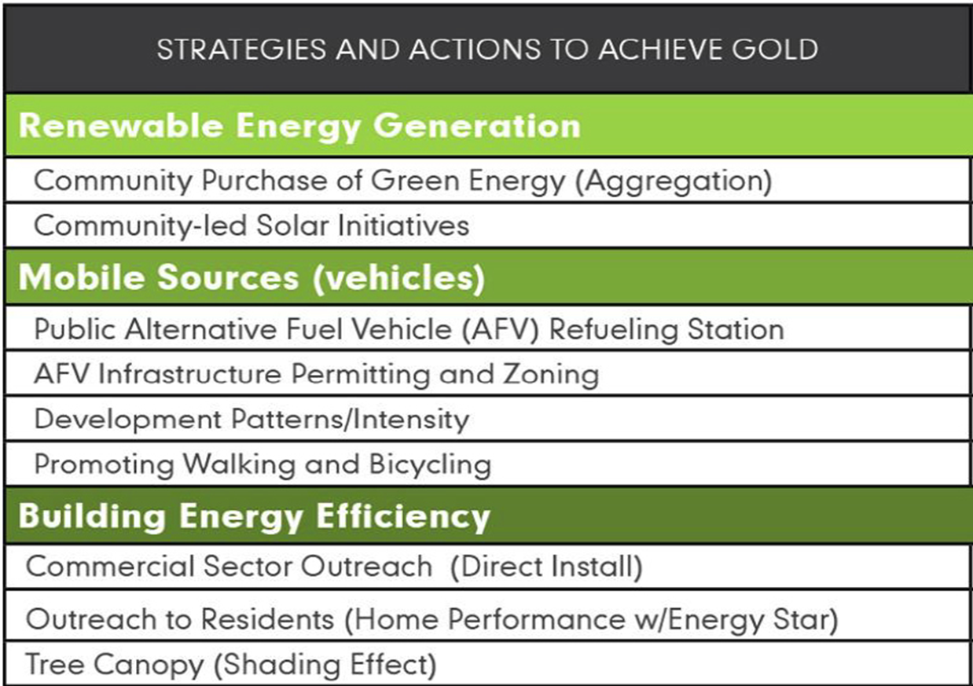
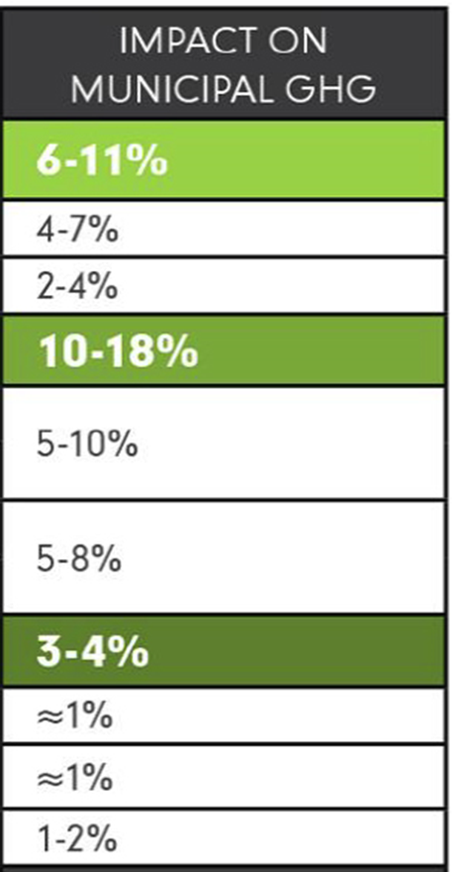
GOLD STAR STANDARD IN ENERGY
Notes:
*starred are mandatory “ACTIONS” (“Make your town Solar Friendly” is one more mandatory – not shown above)
“Community Led Solar initiatives”
Community allows “Solar by Right and as Accessory”, AND a uniform permit process, fixed permit fee & 3 day processing.
ENERGY SAGE is USDE SunShot initiative –“no annoying phone calls” automated sign up to evaluate your house, and generate bid at a discount. EXAMPLE: 288 customers signed for site inspection; 50 new contracts signed;
PUBLIC EV CHARGING INFRASTRUCTURE “Public Alternative Fuel Vehicle (AFV) Refueling Station”
MAKE YOUR TOWN EV FRIENDLY “AFV Infrastructure Permitting and Zoning”
Amend the zoning ordinances: add charging stations as a permitted accessory use. to include regulations and design standards for charging and parking spaces,.
TRAINING FOR local first responders
CHARGING STATIONS FUNDED BY THRID PARTIES! (20% charge premium over in-home charging is gold standard)

Slide 26
Improve Your Town’s Master Plan
Add a “Green Building and Environmental Sustainability” Element to the Master Plan. This Green Team “Action” provides:
Efficient use of natural resources
Renewable Energy Systems in new and retrofitted buildings
Impact of buildings on environment
Allow Ecosystems to function naturally
Conserve and reuse water
Treat storm water on-site
Optimize site orientation and design for the Climate
http://www.sustainablejersey.com/actions-certification/actions/#open/action/484
Notes:
After Mayor’s proclamation, and ruling body Resolution, ask Your Town to improve its Master Plan, (all other documents flow down from the master plan).
This will guide sustainability in all future construction in your town.

Slide 27
Path To 100% Clean Energy In
Your (Every) Town In New Jersey
Certification Highlights of towns details of how “solutions” were implemented
Woodbridge township (a role model for nj)
Haddonfield boro (many characteristics of rumson)
Fair haven boro (next door neighbor!)
Review solutions of rumson schools
http://climate.smiller.org
http://electric.smiller.org
Notes:
COMPARISONS
Rumson: Population 7.1K; 7sq miles; med household income $134K
Fair Haven Population 6K; 2 sq miles; med household income $112K
Haddonfield Boro (Camden County);population 12K; 3 Sq miles; med household income $112K
We are VERY fortunate to be living in NJ at this point in time. The state environment is supportive of our energy transformation.
TOWNS ACROSS THE COUNTRY ARE ESTABLISHING BOLD COMMITMENTS: move away from dirty fuels and repower their communities with 100% clean, renewable energy to address the threat of climate change.
More than 200 mayors have pledged, typically 100% clean electrical energy by 2035, and 100% clean energy for transportation and heating by 2050.
Within NJ, ~60 NJ mayors have pledged to 100% renewable energy
We want YOU, to take personal energy efficiency improvements, and request the Green Team in your town to take your town to 100% clean, renewable energy!!

