Slide 1

SAVING THE WORLD FROM CLIMATE CHANGE
Pat and Steve Miller

Slide 2
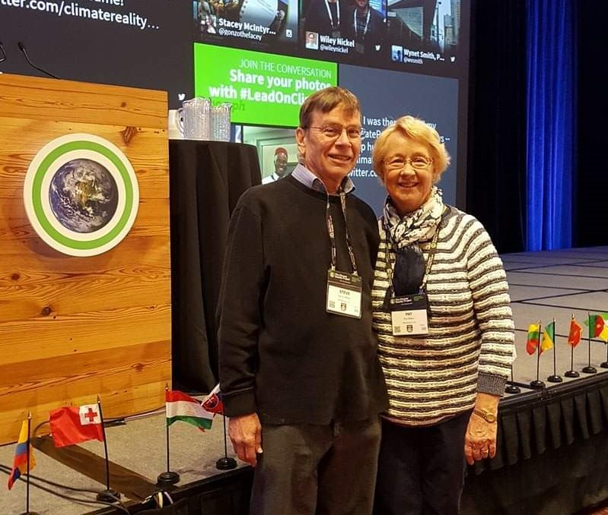
Our Journey Begins:
New Climate Reality Leaders
Notes:
AND/OR – JOIN WITH OTHERS and push for your town to switch ALL residents to 100% renewable Community Choice Electric aggregation. This saves 5 or 10% on electric bill, and has the BIGGEST GHG reduction!

Slide 3
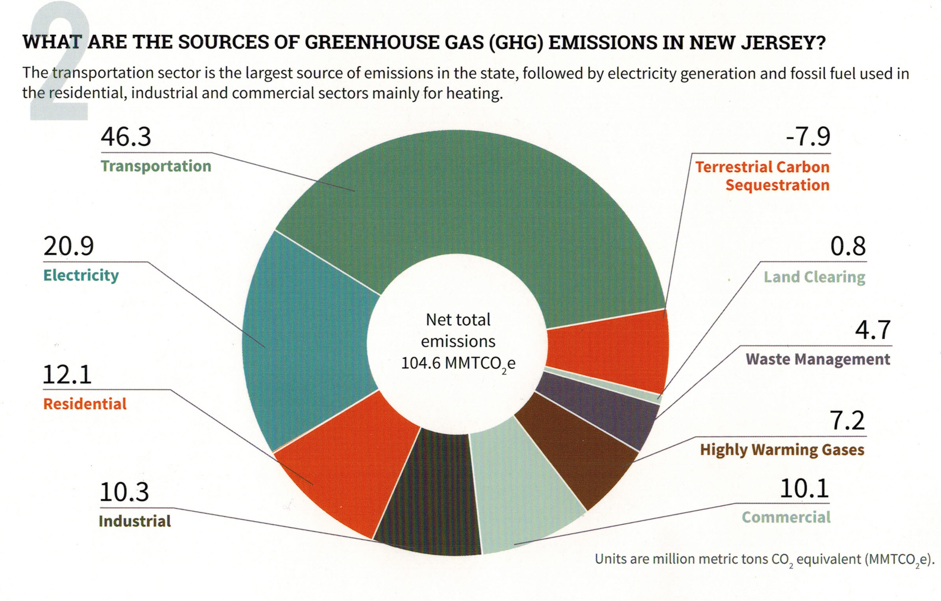
Your (Typical NJ) GHG Emissions EEEmissions
“Reducing NJ Greenhouse Gas Emissions”, Rutgers, Jan 2018
Notes:
This is the NJ “Footprint” of sources of world-heating Greenhouse gases, to show what to tackle first.
Sustainable Jersey states: “the primary goal [of “Gold Star in Energy” is reducing Green House Gases. Responding to this overarching imperative will help achieve all the other [sustainability] goals.”
20% of the GHG is from electricity generation; nearly 50% is from transportation.
Switching electricity to 100% wind/solar, then switching all vehicles to batteries charged by renewable electricity will ELIMINATE almost 70% of our GHG.
VERY IMPORTANT: -8% carbon sequestration by marshes, mudflats, trees, landscaping

Slide 4
3 STEPS TO CLEAN ENERGY
Electrify Vehicles
100% Clean Electricity (wind, solar …)
Electrify Space Heating and Appliances and Increase Efficiency

Slide 5
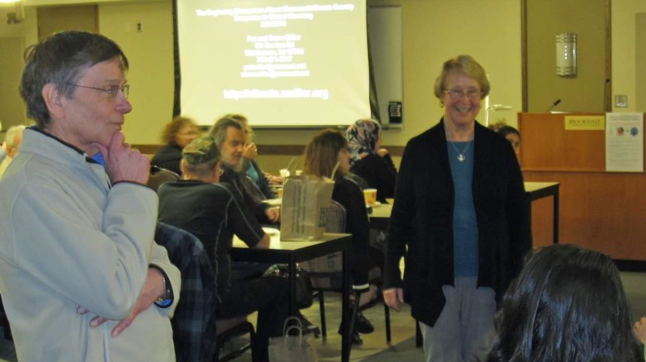
Our First Sierra Club Talk
Notes:
AND/OR – JOIN WITH OTHERS and push for your town to switch ALL residents to 100% renewable Community Choice Electric aggregation. This saves 5 or 10% on electric bill, and has the BIGGEST GHG reduction!

Slide 6



Sierra Club
100% Committed
Our mission is to leave a legacy of a livable world for our children and grandchildren.

Slide 7

WHY WE WANT TO SAVE THE WORLD

Slide 8
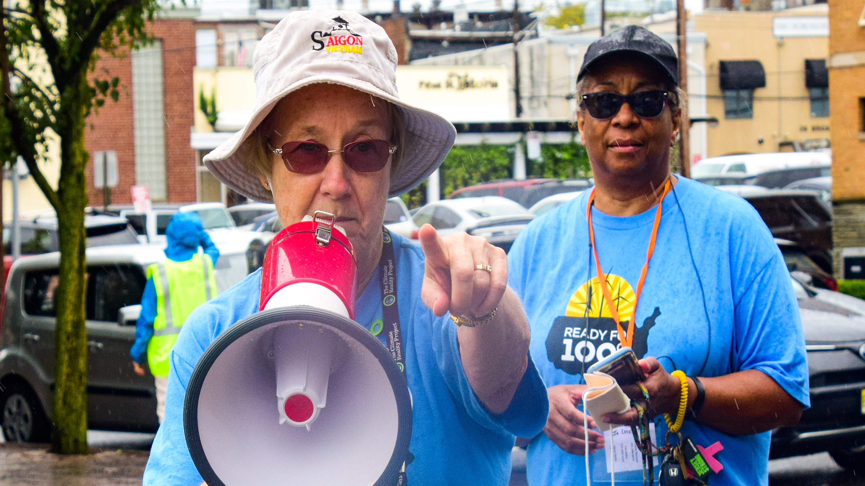
People’s Climate March 2018

Slide 9
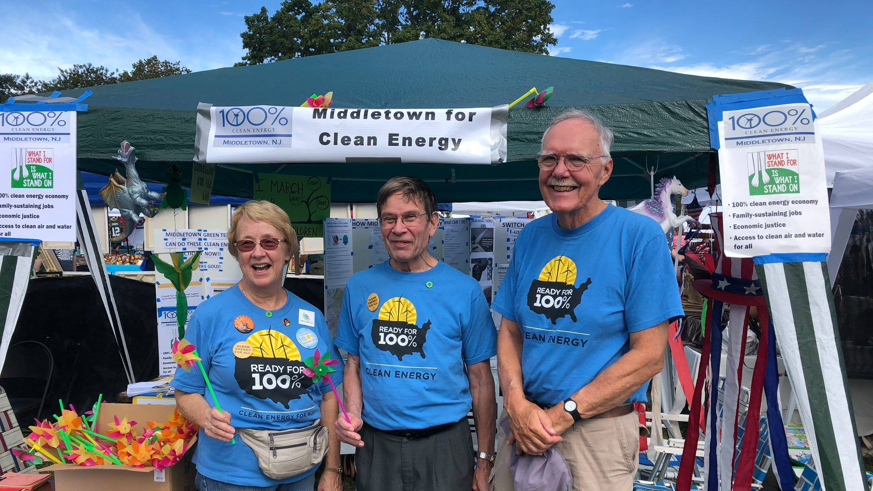
Citizen Action: Lobbying Middletown
Notes:
AND/OR – JOIN WITH OTHERS and push for your town to switch ALL residents to 100% renewable Community Choice Electric aggregation. This saves 5 or 10% on electric bill, and has the BIGGEST GHG reduction!

Slide 10
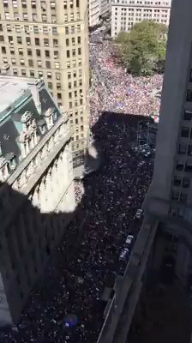
GLOBAL
YOUTH
CLIMATE
STRIKE
NYC
September 20, 2019
Notes:
And the Youth of the world demanded Climate Action during this Strike, Sept, 2019, by 250K people in NYC (8 million people, in thousands of events during the week before and during the 2019 UN Climate summit in this was the current UN Climate summit in NYC.
Pat and I were down there carrying Climate Crisis signs as we marched and chanted to Battery Park to hear Greta Thunberg, the climate hero of the world’s youth.

Slide 11
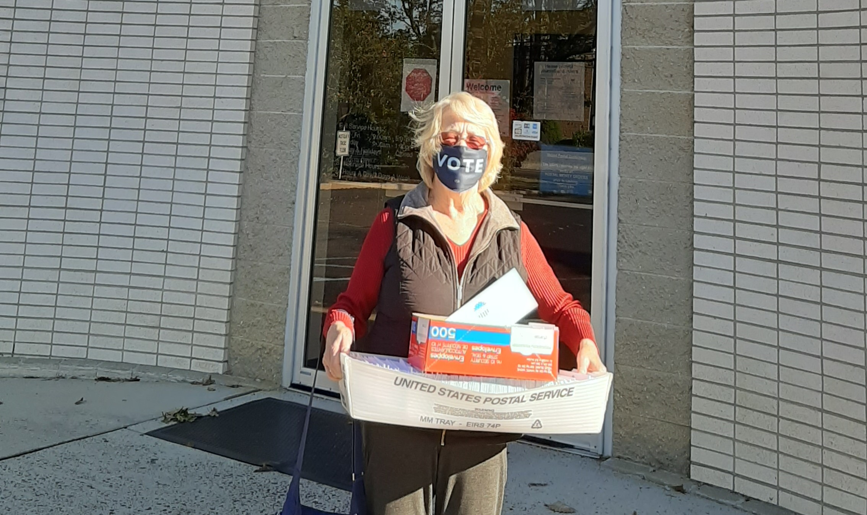
Sierra Club Get Out The Vote 2020

