Slide 1
PATH TO 100% CLEAN ENERGY IN YOUR TOWN
http://climate.smiller.org
Notes:
TOWNS ACROSS THE COUNTRY ARE ESTABLISHING BOLD COMMITMENTS: move away from dirty fuels and repower their communities with 100% clean, renewable energy to address the threat of climate change.
More that 50 towns have committed, and are taking steps to 100% renewable energy
More than 200 mayors have pledged, typically 100% clean electrical energy by 2035, and
100% clean energy for transportation and heating by 2050.
We want YOU, in this room, to JOIN a team in your town to MAKE YOUR TOWN using 100% clean, renewable energy!!

Slide 2
YOUR TOWN in a Warming World
How to Respond
CONTACT YOUR MUNICIPAL GOVERNMENT OFFICIALS
WRITE A LETTER
SET UP AN APPOINTMENT
ASK YOUR TOWN TO COMMIT TO RENEWABLE ENERGY
57 NJ TOWNS HAVE PLEDGED
SIGN A SIERRA CLUB MAYOR ENDORSEMENT
SUGGEST A RESOLUTION
Notes:
TAKE ACTION: let your town leaders know what you want! – write to them; meet with them!
Show them that in 57 NJ towns, the mayor ALREADY has pledged 100% clean
ASK the committee/council to issue a binding resolution for clean energy!

Slide 3
NJ CITIES (57) ENDORSING 100% RENEWABLE PLEDGE
These cities pledged one or more of seven 100% NJ campaigns
Source: http://climate.smiller.org/clean-energy-city.xls, 2/23/2018
Atlantic | Franklin Township | Marlboro | Secaucus
Bloomingdale Borough | Freehold Borough | Millstone Borough | Shrewsbury Borough
Bordentown Township | Glen Rock | Morristown | South Orange Village
Buena Vista Township | Gloucester Township | Newark | Swedesboro
Cape May Point | Highland Park | New Brunswick | Teaneck
Chatham Borough * | Hoboken | Oradell Borough | Tenafly, NJ
Cherry Hill | Hope | Perth Amboy | Trenton
East Brunswick | Jersey City | Piscataway | Union City
East Orange | Kearny | Plainfield | Verona
Elizabeth | Lambertville | Plainsboro | Wallington Borough
Englewood | Lawrence Township* | Pleasantville | West New York
Ewing Township, NJ | Long Branch | Princeton | Westwood
Fanwood | North Brunswick | Phillipsburg Red Bank Borough | Woodbridge Township*
Franklin Lakes, NJ | Maplewood | Runnemede Borough | West Windsor Tnsp
Key:
Red Cities in Monmouth County
*Mayors who signed only the Sustainable Jersey pledge
Notes:
Let your town know the mayors in these NJ towns have ALREADY pledged 100% renewable
Towns in Red are in Monmouth County

Slide 4
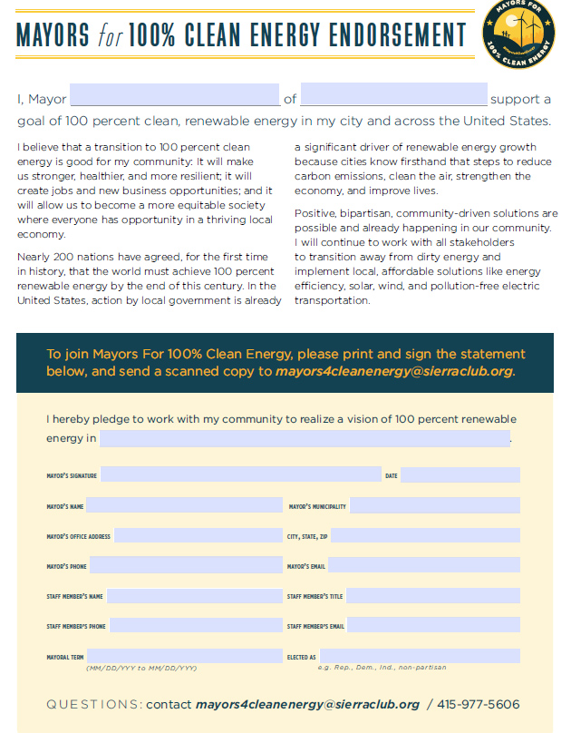
An ASK: Sign “MAYORS FOR 100% CLEAN ENERGY ENDORSEMENT” “I believe that a transition to 100 percent clean energy is good for my community” Sierra Club version of the 100% endorsement: https://www.sierraclub.org/ready-for-100/mayors-for-clean-energy
Notes:
ASK your mayor to sign a 100% clean energy pledge: “I believe that a transition to 100 percent clean energy is good for my community. It will make us stronger, healthier and more resilient…”

Slide 5
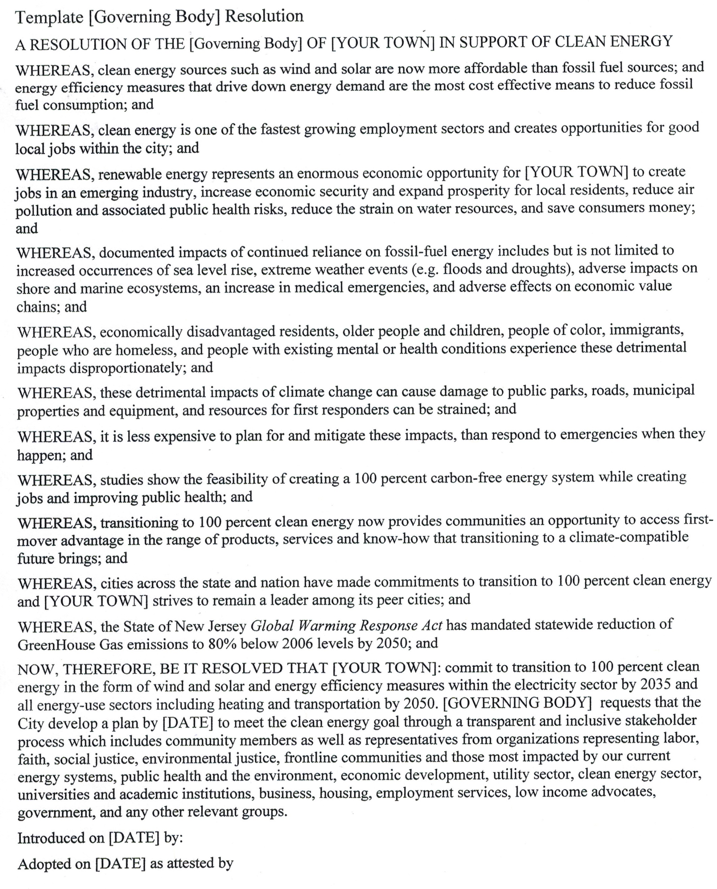
“RESOLUTION IN SUPPORT OF CLEAN ENERGY” multiple short and long examples are available on Sierra Club Readyfor100 Resource Hub contact Steve Miller
Notes:
THEREFORE, be it resolved that YOUR TOWN .[will have 100% Clean Electricity by 2035 and 100% including transportation & heating by 2050.]

Slide 6
SUGGEST: “RESOLUTION IN SUPPORT OF 100% RENEWABLE ELECTRICAL ENERGY BY 2035” multiple short and long examples are available on Sierra Club Readyfor100 Resource Hub contact Steve Miller
TEMPLATE- COMMITTEE RESOLUTION - 100% Clean Electrical Energy by 2035
WHEREAS, [Related policies, commitments, plans and/or actions city has taken on climate and energy to-date]
WHEREAS, clean energy sources such as wind are now more affordable than fossil fuel sources; and energy efficiency measures that drive down energy demand are the most cost effective means to reduce fossil fuel consumption; and
WHEREAS, renewable energy represents an enormous economic opportunity for [CITY] to create jobs in an emerging industry, increase economic security and expand prosperity for local residents, reduce air pollution and associated public health risks, reduce the strain on water resources, and save consumers money
WHEREAS, people of color, immigrants, refugees, economically disadvantaged residents, older people and children, people who are homeless, and people with existing mental or health conditions experience the impacts of climate change disproportionately; and
WHEREAS, clean energy is one of the fastest growing employment sectors and creates opportunities for good local jobs within the city; and
WHEREAS, cities across the nation have made commitments to transition to 100 percent clean energy and [CITY] strives to remain a leader among its peer cities.
NOW THEREFORE IT BE RESOLVED by the [GOVERNING BODY] of [CITY] calls for the City to commit to transition to 100 percent clean energy in the form of wind and solar and energy efficiency measures within the electricity sector by 2035 and all energy-use sectors including heating and transportation by 2050. [GOVERNING BODY] requests that the City develops a plan by [DATE] to meet the clean energy goal through a transparent and inclusive stakeholder process which includes community members as well as representatives from organizations representing labor, faith, social justice, environmental justice, frontline communities and those most impacted by our current energy systems, public health and the environment, economic development, utility sector, clean energy sector, universities and academic institutions, business, housing, employment services, low income advocates, government, and any other relevant groups.
Introduced on [DATE] by:
Adopted on [DATE] as attested by
Notes:
ASK your town Council or Committee to issue a binding resolution
THEREFORE, be it resolved that YOUR TOWN will have 100% Clean Electricity by 2035, AND 100% in all energy sectors, including transportation & heating by 2050.

Slide 7
YOUR TOWN in a Warming World
How to Respond
FOLLOW THROUGH ON THE COMMITMENT
Notes:
Later slides will discuss your own, and your town’s expected next steps. You should continue to follow these steps, even if, like Pat and me, our initial requests did NOT get a YES from the mayor!

Slide 8
NJ POLICY CHANGES TO DATE (a few of many)
GOV MURPHY IS FOLLOWING HIS ENERGY TRANSITION PLAN 1st PRIORITY: 100% CE BY 2050
REJOINING RGGI (CT, DE, ME, MD, MA, NJ, NY, RI, VT)
SETS POWER SECTOR CO2 CAPS (declines 3%/year after 2020)
SELL EMISSION ALLOWANCES & INVEST PROCEEDS
JOINED “US CLIMATE ALLIANCE” (with 15 other states on E & W coasts)
RESTORE HIGHER SOCIETAL COST OF CARBON (EPA reduced)
REQUIRE NEAR-TERM GHG REDUCTIONS (at least 26-28% below 2005 by 2025)
Transition plan: http://nj.gov/governor/news/reports/docs/Environment%20and%20Energy%20Transition%20Report.pdf
Notes:
WE HAVE A NEW ENVIRONMENT IN NJ . At the RGGI (Regional Greenhouse Gas Initiative) last Thurs, the NJ state moderator, stated it was a sea-change to AGAIN be able to use the word “CLIMATE”!!
Gov Murphy continues to implement his energy transition plan: 1st priority is 100% CE by 2050
REJOINING RGGI: CO2 caps on EMISSIONS FROM ELECTRICAL GENERATION will decline 3% per year
OPPORTUNITY: sell emission allowances and invest in energy efficiency and renewable energy
2, NJ JOINED 16 state “US Climate Alliance” of east & west coast states, to reduce all GHGas emissions per Paris Agreement
- The Climate Alliance is using accurate social cost of carbon, as was used a few years ago to create the EPA Clean Power Plan. That Clean Power Plan was to be one of the chief ways the US would use to meet the Paris Agreement.
Then last year, the EPA negated the cost of carbon, to justify ELIMINATING the Clean Power Plan
With the US Climate Alliance, actual social cost of carbon has been restored.

Slide 9

US CLIMATE ALLIANCE
SOURCE: https://www.usclimatealliance.org/

Slide 10

US CLIMATE ALLIANCE
SOURCE: https://www.usclimatealliance.org/

Slide 11

US CLIMATE ALLIANCE
SOURCE: https://www.usclimatealliance.org/

Slide 12
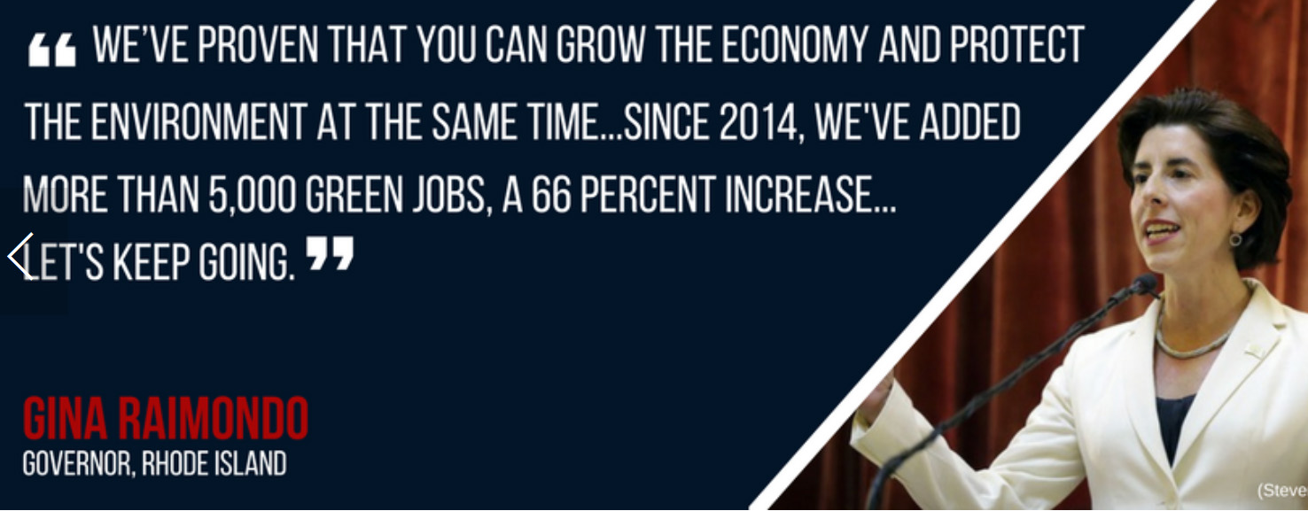
US CLIMATE ALLIANCE
SOURCE: https://www.usclimatealliance.org/
SOURCE: https://www.usclimatealliance.org/

Slide 13

US CLIMATE ALLIANCE
SOURCE: https://www.usclimatealliance.org/

Slide 14
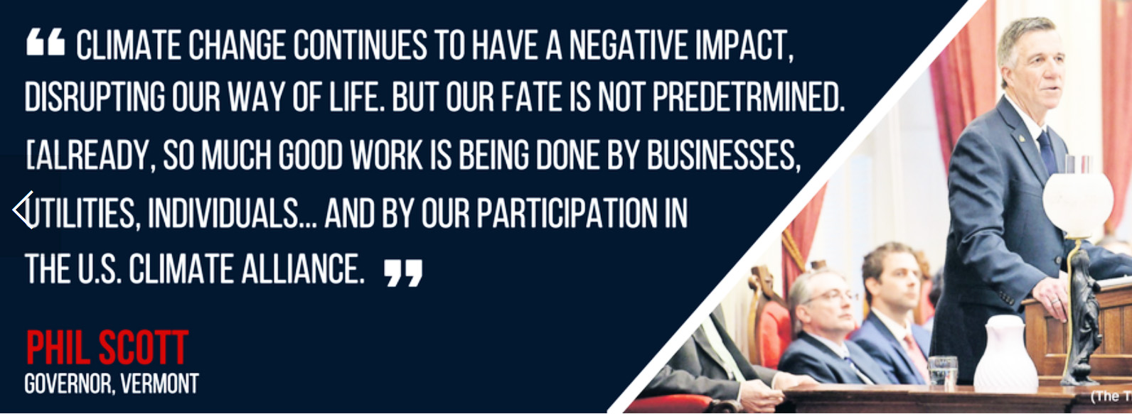
US CLIMATE ALLIANCE
SOURCE: https://www.usclimatealliance.org/

Slide 15

US CLIMATE ALLIANCE
SOURCE: https://www.usclimatealliance.org/

Slide 16

MAYORS CLIMATE CONFERENCE
Notes:
This 3 minute video has NJ mayors describing their towns’ efforts.

Slide 17
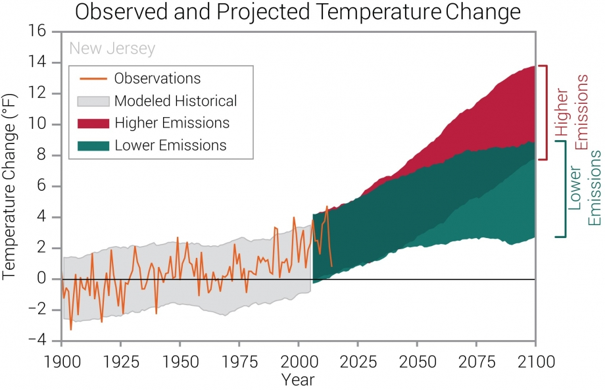
NOAA State Climate Summary - NJ
Key Message 1 (updated 1/2017)
Avg annual temperatures have increased by 3°F in NJ over the past century. Under a higher emissions pathway, historically unprecedented warming is projected by the end of the 21st century. Heat waves are projected to be more intense while cold waves are projected to be less intense
7.0 degrees
2.5 degrees
Source: New Jersey _ statesummaries.ncics.org.html#
Notes:
NOAA National Oceanic and Atmospheric Administration. Observed and projected changes (compared to the 1901–1960 average) in near-surface air temperature for New Jersey, averaged over 5-year periods. Observed data are for 1900–2014. Projected changes for 2006–2100 are from global climate models for two possible futures: one in which greenhouse gas emissions continue to increase (higher emissions) and another in which greenhouse gas emissions increase at a slower rate (lower emissions). Temperatures in New Jersey (orange line) increased from 1900 to the 1950s, then declined into the 1960s and 1970s, and have risen since then by about 2°F to the warmest levels on record. Shading indicates the range of annual temperatures from the set of models. Observed temperatures are generally within the envelope of model simulations of the historical period (gray shading). Historically unprecedented warming is projected during the 21st century. Less warming is expected under a lower emissions future (the coldest years being about as warm as the warmest years in the historical record; green shading) and more warming under a higher emissions future (the hottest years being about 10°F warmer than the hottest year in the historical record; red shading).
Source: CICS-NC and NOAA NCEI.

Slide 18
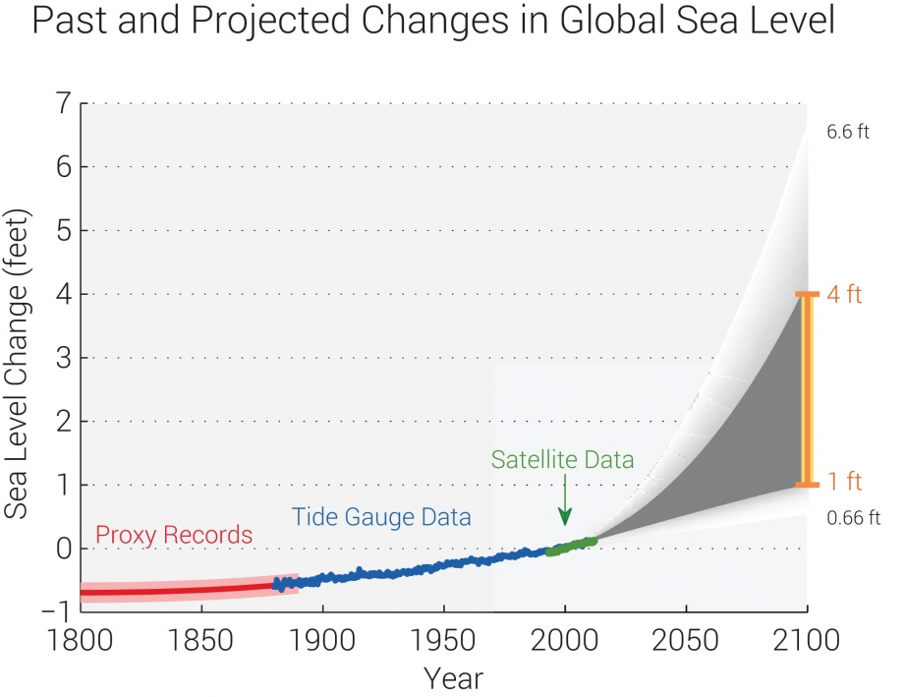
NOAA State Climate Summary - NJ
Sea level along the New Jersey coast has risen by more than 16 inches since 1911, double the global average. Global sea level is projected to rise another one to four feet by 2100. Sea level rise poses substantial risks, including greater vulnerability to severe coastal flooding.
1.2 ft
0.5 ft
Source: New Jersey _ statesummaries.ncics.org.html# . 1.6 inches/decade in Atlantic City due to subsidence among other factors
Notes:
Estimated, observed, and possible future amounts of global sea level rise from 1800 to 2100, relative to the year 2000. The orange line at right shows the most likely range of 1 to 4 feet by 2100 based on an assessment of scientific studies, which falls within a larger possible range of 0.66 feet to 6.6 feet
Source: Melillo et al. 2014 and Parris et al. 2012.

Slide 19

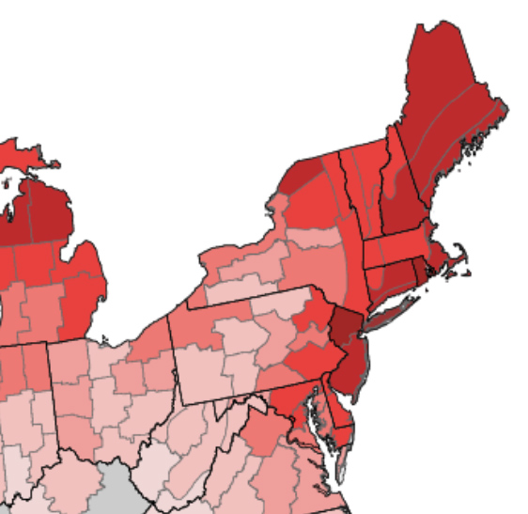
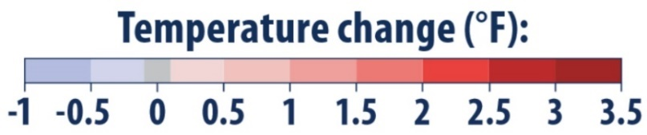
Increasing # of extremely heavy rain storms
Rising seas & stronger seacoast storms
Infectious diseases spreading northward
Increasing # of hot, unhealthy days (ozone)
increasing temps & rain: increased pollen – worsening allergies & asthma
In last century, NJ has warmed more than twice as much as US avg
Notes:
Sources: https://www.epa.gov/sites/production/files/2016-09/documents/climate-change-nj.pdf, which relies on:
US Global Change Research Program; US Climate Change Science Program; Intergovernmental Panel on Climate Change; EPA Climate Change Indicators in the US
Infectious diseases are spreading northward (Zika & West Nile ) & increase opportunities for Lyme disease
Extremely heavy rain storms increasing – erosion of brooks & flooding of low areas
Rising seas & stronger storms to increase flooding of Bayshore & Navesink River & tributaries
Hot days increase ozone & unhealthy days;
increasing temps & rain increase pollen – worsening allergies & asthma

Slide 20
IMPROVE YOUR TOWN’S MASTER PLAN
ADD A “GREEN BUILDING” ELEMENT
“Green Building and Environmental Sustainability” Element of the Master Plan
is a Green Team “Action” which Provides:
Efficient Use of Natural Resources
Renewable Energy Systems in new and retrofitted buildings
Impact of Buildings on environment
Allow Ecosystems to function naturally
Conserve and Reuse Water
Treat Storm Water On-site
Optimize site orientation and design for the Climate
http://www.sustainablejersey.com/actions-certification/actions/#open/action/484
Notes:
Up at the top of your list, after Mayor’s proclamation, and Committee/Council Resolution, is that Your Town implement the “Green Building and Environmental Sustainability Element”. This is a permitted Master Plan Element, per the “Municipal land Use Law”. It provides vision and goals for towns to implement sustainability concepts including Green House Gas emissions, use of renewable energy, implement Green Building and Design, land-use decisions, smart growth strategies, and water conservation and protection.
Many NJ towns have implemented this Master Plan Element, and can be used as examples. See the Sustainable Jersey link (at bottom of the slide)

Slide 21
YOUR TOWN in a Warming World
How to Respond
COMMIT TO MEETING NJ LEGAL REQUIREMENT
NJ “Global Warming Response Act” – 80% GHG Reduction below 2006, by 2050
REDUCE YOUR CITY’S HIGHEST EMISSIONS
Notes:
BACK TO BASICS:
NJ MUST MEET the NJ 2007 “GLOBAL WARMING RESPONSE ACT”
To do this, you need to know your biggest emissions!

Slide 22
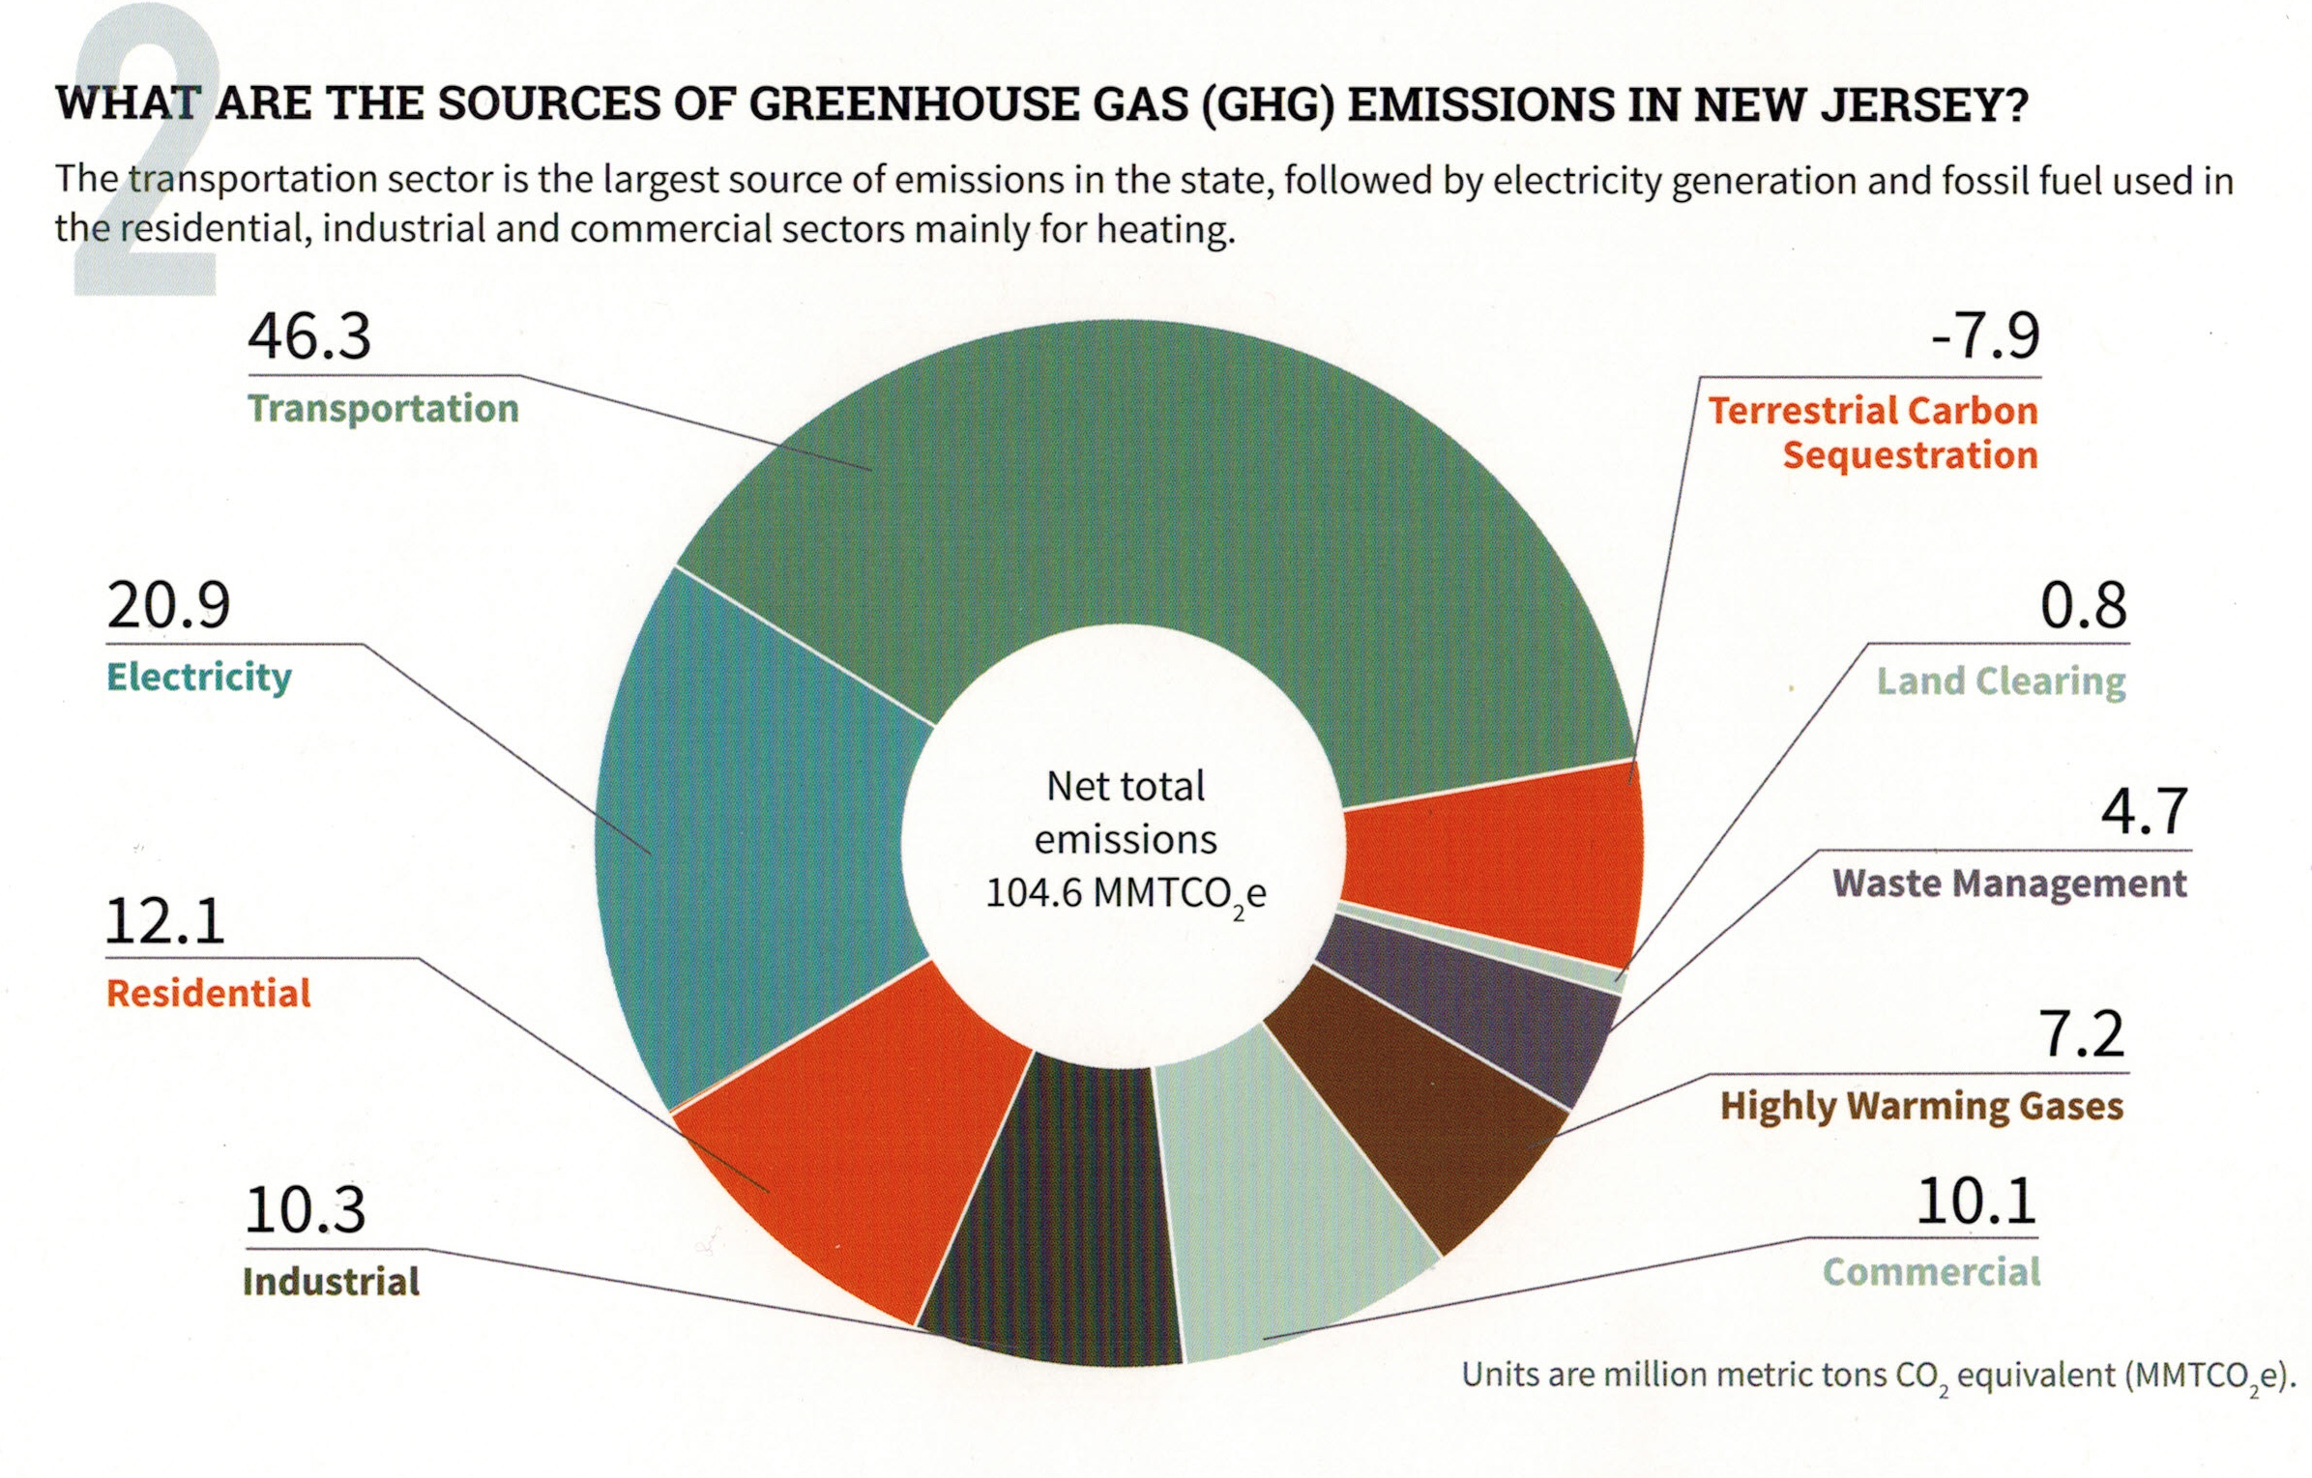
YOUR TOWN GHG (representative)
“Reducing NJ Greenhouse Gas Emissions”, Rutgers, Jan, 2018
Notes:
If your town has NOT determined its own GHG footprint, then use this pie chart of current NJ emissions.

Slide 23
YOUR TOWN in a Warming World
How to Respond
SUPPORT YOUR GREEN TEAM TO UNDERTAKE SUSTAINABLE JERSEY ENERGY ACTIONS TOWARD BRONZE, SILVER, AND GOLD CERTIFICATION
STEP 1: ENERGY EFFICIENCY
Notes:
The Town’s “Green Team” can carry the ball, supported by Sustainable Jersey (seen in the earlier film)
The Green Team earns points for their “Actions”, and the town is proud of the resulting bronze, silver and gold certifications

Slide 24
START WITH ENERGY EFFICIENCY IMPROVEMENTS
Municipality, Businesses, Residences (most funded by BPU societal benefit fund)
MUNICIPAL:
1. “Local Government Energy Audit” (Free). Recommended Energy Efficiency Improvements Funded By: 70% paid by Direct Install (arrange through NJNatGas)
30% paid through ESIP (Energy Savings Improvement Program –Loans paid with energy savings)
2. “Energy Efficiency for Municipal Facilities” (receive points for simply following-up the LGEA- above)
BUSINESS: “Commercial Energy Efficiency Outreach “ (free energy audit for businesses, 70% “Direct Install” grant for improvements)
RESIDENTS: “Residential Energy Efficiency Outreach” (free audit for income-qualified residents; $250 audit for higher income residents- who then receive a free installed $250 thermostat)

Slide 25
START WITH ENERGY EFFICIENCY IMPROVEMENTS
Municipality, Businesses, Residences (most funded by BPU societal benefit fund)
MUNICIPAL:
Free Energy Audit
Recommended Energy Efficiency Improvements Funded By: 70% paid by Direct Install (arrange through NJNatGas)
30% paid via loans (payments guaranteed to be less than energy savings)
BUSINESS:
Free Energy Audit
Recommended Energy Efficiency Improvements Funded By: 70% paid by Direct Install (arrange through NJNatGas)
30% paid through gas bill
RESIDENTS: free audit for income-qualified residents; small fee for higher incomes
Notes:
The bottom rung is to increase energy efficiency. The energy not spent is the cheapest energy of all
Municipal and Business efficiency programs are similar: free energy audit, then 70% off energy improvements!
Residents are different: low income households receive a free audit. All households benefit from attractive Clean Energy programs and Energy Star discounts

Slide 26
YOUR TOWN in a Warming World
How to Respond
SUSTAINABLE JERSEY ENERGY ACTIONS
STEP 2: SWITCH TO CLEAN ENERGY
Notes:
Once well insulated and highly efficient, the buildings require LESS clean energy as the town migrates to 100% renewable.

Slide 27
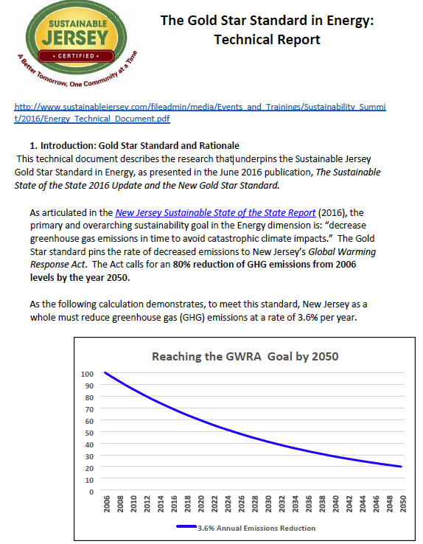
GOLD STAR STANDARD IN ENERGY 3.6% / per year Enables reaching 80% emission reduction by 2050
Notes:
Green Teams, under the Sustainable Jersey program must show their Actions result in a 3.6% minimum compounded emission reduction This meets the 80% mandated emission reductions under the Global Warming Response Act.

Slide 28
AFTER COMPLETING ENERGY EFFICIENCY ACTIONS
BEGIN MUNICIPAL AND CITY-WIDE ENERGY ACTIONS
MUNICIPAL OPERATIONS: GHG REDUCTIONS (10 ACTIONS)
RENEWABLE ENERGY GENERATION: SOLAR, WIND, GEOTHERMAL
GREEN THE MUNICIPAL FLEET
BUILDINGS & STREET LIGHTING EFFICIENCY
COMMUNITY-WIDE GHG REDUCTION OPERATIONS (9 ACTIONS)
RENEWABLE ENERGY GENERATION: SOLAR, GREEN ELECTRIC AGGREGATION
MOBILE SOURCES
TREES – CANOPY SHADING EFFECT
Notes:
This describes 19 possible Actions by the Green Team in your town.
10 Actions reduce MUNICIPAL emissions
add solar to buildings and parking areas; green the municipal fleet;
9 Actions reduce COMMUNITY-wide emissions: 100 times more impact than Municiipal:
Become a solar-friendly town: make permitting easy & standardized
Become an EV –friendly town: install public charging stations
Conserve your trees: they absorb carbon, and provide shading to reduce city temps.

Slide 29
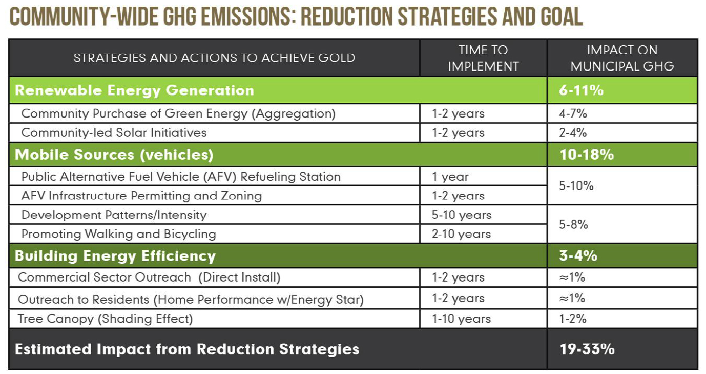

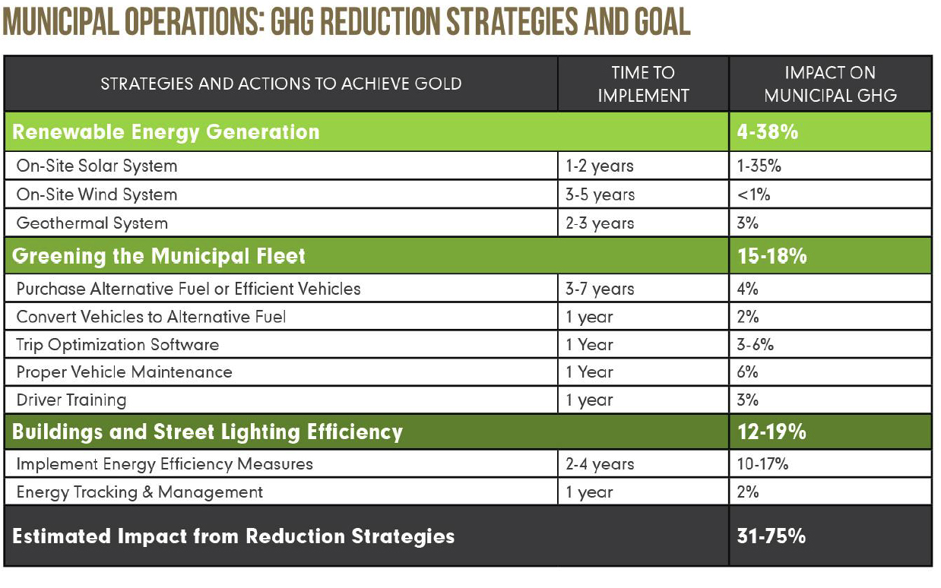
GOLD STAR STANDARD IN ENERGY
Source: “Overview of Gold Star Standard in Energy”
Another resource: 43 Climate Actions to reduce emissions to "net zero“
Compiled from “Drawdown”, Sustainable Jersey, and innovative Actions from NJ Green Team reports: http://climate.smiller.org/table-of-climate-actions-sorted-public-v3-4.xls
Notes:
“Community Led Solar initiatives”
Community allows “Solar by Right and as Accessory”, AND a uniform permit process, fixed permit fee & 3 day processing.
ENERGY SAGE is USDE SunShot initiative –“no annoying phone calls” automated sign up to evaluate your house, and generate bid at a discount. EXAMPLE: 288 customers signed for site inspection; 50 new contracts signed;
MAKE YOUR TOWN EV FRIENDLY
Amend the zoning ordinances: add charging stations as a permitted accessory use. to include regulations and design standards for charging and parking spaces,.
TRAINING FOR local first responders
CHARGING STATIONS FUNDED BY THRID PARTIES! (20% charge premium over in-home charging is gold standard)
The TOP initiative –AGGREGATION - is next!

Slide 30
YOUR TOWN in a Warming World
How to Respond
THE MOST SIGNIFICANT SUSTAINABLE JERSEY ACTION
RENEWABLE GOVERNMENT ENERGY AGGREGATION
Notes:
The single highest emission reduction: tongue – twister words: “Renewable Government Energy Aggregation”

Slide 31
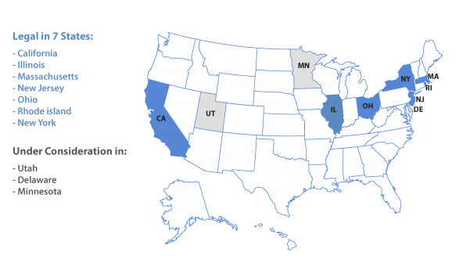
STATES WITH COMMUNITY CHOICE AGGREGATION (CCA)
In New Jersey, called:
GOVERNMENT ENERGY AGGREGATION (GEA)
GEA programs launched in 2012
New aggregation programs are approved by municipality’s elected body and must be approved by the Board of Public Utilities.
New Jersey allows residential customers to opt out, and allows commercial and municipal accounts to opt in during a specified period.

Slide 32
NJ GOVERNMENT ENERGY AGGREGATION (GEA)
GEA programs launched in 2012
New aggregation programs are approved by municipality’s elected body and must be approved by the Board of Public Utilities.
New Jersey allows residential customers to opt out, and allows commercial and municipal accounts to opt in during a specified period.
Notes:
The program launched thru a 2012 law which allows the town region to bulk-buying of electricity
Approval thru BPU appears to be automatic
BIG ADVANTAGE:
ALL residential customers are INCLUDED from the get-go (take advantage of cheap, renewable electricity)
- but they can opt-out after a month or so , if they wish
BUSINESSES can opt-in to be included in the electrical aggregation, after a month or so delay

Slide 33
ELECTRICAL AGGREGATIONS HAVE EXISTED FOR YEARS
57 municipalities (as of 1/2018) have contracted with 3rd party electrical suppliers to save money on municipal, business and residential electrical bill
~200 NJ Cities & Utilities are members of NJSEM (Sustainable Energy Joint Meeting) through which they can buy Aggregated Electricity and Gas.
Likely ONLY Fossil Fuel (no renewable mixes are known)
Energy supplier/consultant does most of the work
Notes:
The NJ BPU shows 57 towns have had an electrical aggregation – many through a collective organization called NJSEM
The town hires an Energy consultant who does the work: takes his fee as a small percentage of electric billing
Likely all use these only buy electric from fossil fuel sources – because historically fossil was cheaper than renewables
But renewables are now becoming cheaper than fossil fuels!!

Slide 34
MUNICIPAL AGGREGATIONS IN JCP&L TERRITORY
New in 2017 Florham Park Borough Frelinghuysen Township Green Township Manchester Township Mendham Borough Monroe Township Mount Arlington Borough Oxford Township Plumsted Township Rockaway Township Sayreville Borough Union Beach Borough | Before 2017 (no termination records are kept) Andover Borough Bay Head Borough Colts Neck Township Eatontown Borough Farmingdale Flemington Borough Fredon Township Hardwick Township Harmony Township Hope Township Keyport Borough Knowlton Township Lacey Township | Lambertville Lincoln Park Boro Long Hill Township Old Bridge Township Point Pleasant Beach Raritan Borough Riverdale Borough Southampton Township Stanhope Borough Toms River Township Wayne Township West Amwell Township Wharton Borough Woodland Township Wrightstown Borough
RED = Monmouth & Nearby Ocean County
SOURCE: www.bgs-auction.com/documents/EDC_Municipal_aggregation_Programs_January_2018.pdf
Notes:
A number of local towns (in RED) have aggregations – These might be good references for YOUR TOWN.

Slide 35
WESTCHESTER, NY GREEN AGGREGATION SUCCESS STORY (2016-2017)
20 communities elected to enroll in the county-wide electrical Community Choice Aggregation (40% of county population)
TWO electrical mixes offered:
100 % renewable saved 5.7% compared to utility price
CCA basic (the same mix as utility) saved 9.1% compared to utility price
70% of all enrolled participants chose 100% renewable
Achieved 15% reduction in GHG emissions!
Source: 6/28/2017 Sustainable Jersey Webinar “Commit Your Town to Climate Progress”
NJ TRIAL IS UNDERWAY in 2018 IN NJ “ESSEX HUB” - RESULTS & BEST PRACTICES WILL BE STANDARDIZED BY SUSTAINABLE JERSEY
Notes:
A SUCCESS STORY in Westchester, NY: 20 towns (40% of population) created an aggregation.
(Go thru the data)….
NJ has our own trial- in Essex County: The focus is to have low priced Electricity sourced LOCALLY (PJM, within the state, or local). This provides stimulus for local investors in renewable electric sources.

Slide 36
YOUR CITY in a Warming World
How to Respond
MOVE FORWARD ON NJ FRAMES
Notes:
Most of these topics are emission MITIGATION
NJ Frames is ADAPTATION: - the regions response to protect from future storms.
.

Slide 37
NJ FRAMES
(FOSTERING REGIONAL ADAPTATION THROUGH MUNICIPAL ECONOMIC SCENARIOS) – a grant from NOAA
15 Cities: ”Two Rivers – One Future” (TWO RIVER COUNCIL OF MAYORS)
Eatontown, Fair Haven, Highlands, Little Silver, Long Branch, Middletown, Monmouth Beach, Ocean Township, Oceanport, Red Bank, Rumson, Sea Bright, Shrewsbury Borough, Tinton Falls and West Long Branch
GOAL: Reduce risks/impacts thru a longterm Resilience and Adaptation Plan
LEADER: NJ DEP Coastal Management Program
TIMELINE:
6/20/2017 email asked cities to survey residents and visitors to identify important community & regional assets
1/1/2020 final plan (as of 2/23/2017 Resiliency Planning Open House) DETAILS:
Learn areas most vulnerable to flooding now and in the future.
Use 3 feet, 7 feet, and 12 feet above high tide (sea level rise + Storm tide records)
Plan ways to reduce risk of flood damage
Create regional RESILIENCE (ability to quickly recover) and ADAPTATION PLANS
Notes:
A concern: status is not being published (at least not public).
MCCC (Monmouth Community Climate Coalition) volunteered to contact Tony Mercantante and provide help if needed
SOURCES: 1. paper handouts on 2/23/2017 “Resiliency Planning Open House”;
2. 6/20/2017 email;
3. “Assessing New Jersey’s Exposure To Sea-Level Rise and Coastal Storms: A Companion Report to te New Jersey Climate Adaptation Alliance Science and Technical Advisory Panel Report”, Oct, 2016

Slide 38
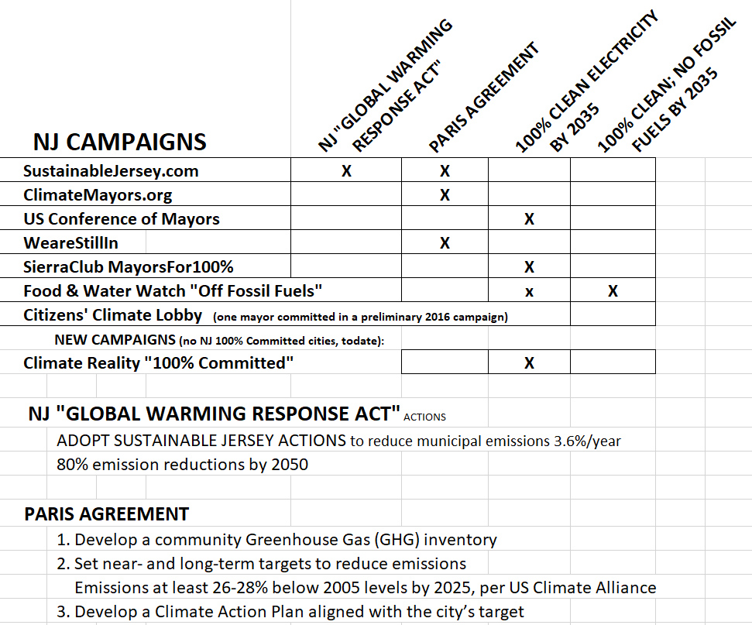
Source:
http://climate.smiller.org/clean-energy-city.xls
Source:
http://climate.smiller.org/clean-energy-city.xls
SOURCE: http://climate.smiller.org/clean-energy-city.xls
Source:
http://climate.smiller.org/clean-energy-city.xls
Notes:
7 campaigns in left column – all differ a little in detail shown across the top.
BACKGROUND: (not in talk)
Food & Water Watch “Off Fossil Fuels” has the most stringent pledge no fossil fuels by 2035. However, an ADDITIONAL pledge, the “New Jersey Needs a Real Clean Energy Plan” is a pledge letter for 100% clean electricity by 2035
This pledge letter has internal links to fwwatch.org – (Food and water Watch) https://docs.google.com/forms/d/1Zki_xURmtJsgyKByRryDEptm0Uuc9U6kFKWasHz3_kY/viewform?edit_requested=true
Details of the 2016 campaign of Citizens’ Climate Lobby remain unclear, but has at least 1 mayor who pledged and is listed in this compilation.
350.Org is advocating “fossil Free”, without a clear definition https://act.350.org/letter/fossil-free-en/ is an invitation to Join Fossil Free, advocating “100% renewable energy for all”. It does not appear to be focused on city leaders, and has no list of city signers, and is not included in the above list of 7..

Slide 39
WHAT CAN YOU PERSONALLY DO
TO REDUCE YOUR GREENHOUSE GAS EMISSIONS
BECOME MORE ENERGY EFFICIENT:
INSULATE; STOP AIR INFILTRATION
REDUCE HEATING EMISSIONS: SMART THERMOSTAT
REDUCE LIGHTING EMISSIONS: SWITCH BULBS TO LED
REDUCE CAR USAGE: WALK/BIKE/PUBLIC TRANSIT
ELECTRICITY: SWITCH TO RENEWABLE
Notes:
You can personally do things- you have heard about for decades!!
TODAY- you can easily switch to 100% renewable electricity

Slide 40
SWITCH YOUR ELECTRIC SUPPLY TO GREEN RENEWABLE ENERGY
RESIDENCES, BUSINESSES, ORGANIZATIONS, COMMUNITIES
can save money, help the environment, and fight climate change
BEST INVESTMENT: INSTALL SOLAR ON YOUR ROOF - OR
1. ASK YOUR CITY/REGION TO PROVIDE A 100% RENEWABLE ENERGY AGGREGATION
2. ASK A LOW COST GREEN SUPPLIER TO PROVIDE 100% RENEWABLE ENERGY AGGREGATION TO YOUR ORGANIZATION & ALL MEMBERS 3. SWITCH TO A LOW COST GREEN SUPPLIER FOR HOME AND BUSINESS
HTTP://ELECTRIC.SMILLER.ORG
Notes:
Best investment is rooftop solar ( return your investment in as little as 4 years) - tax credits and benefits including accelerated depreciation
- SRECs (Solar Renewable Certificates paid by the power companies which pay an annual premium for 15 years

Slide 41
SWITCH YOUR ELECTRIC SUPPLY TO GREEN RENEWABLE ENERGY
1. ASK YOUR CITY/REGION TO PROVIDE A 100% RENEWABLE ENERGY AGGREGATION
Notes:
Next best: Ask your city to provide a renewable electric aggregation (discussed earlier)

Slide 42
SWITCH YOUR ELECTRIC SUPPLY TO GREEN RENEWABLE ENERGY
2. ASK A LOW COST GREEN SUPPLIER TO PROVIDE 100% RENEWABLE AGGREGATION TO YOUR ORGANIZATION & ALL MEMBERS 3. SWITCH TO A LOW COST GREEN SUPPLIER FOR YOUR HOME AND BUSINESS
Notes:
2. AAUW can aggregate its bulk buying over all members to get a low bulk electricity pricess
3. each household and business can select a 3rd party supplier for themselves!

Slide 43
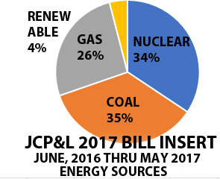


SWITCH YOUR ELECTRIC SUPPLY TO GREEN RENEWABLE ENERGY
N J Renewable Portfolio Standard (RPS) requires 24% renewable in 2020
(Purchased through SRECs and RECs).
HTTP://ELECTRIC.SMILLER.ORG
Notes:
JCP&L electricity is generated about half by fossil-fuel, and 4% renewable
JCP&L is NOT investing directly in renewables, but buys renewables to satisfy Renewable Portfolio Standard: It buys about 20% added renewables on the open market (it buys SRECs which subsidizes rooftop solar )

Slide 44
NJ RPS (RENEWABLE PORTFOLIO STANDARD)
% RENEWABLE ENERGY
CLASS I: SOLAR, WIND, WAVE/TIDAL, GEO, LANDFILL GAS, HYDRO (< 3MW)…
CLASS II: HYDRO 3MW TO 30 MW + MUNICIPAL LANDFILL RECOVERY
SOLAR: “CARVE OUT” FOR SRECs
Notes:
https://www.pjm-eis.com/~/media/pjm-eis/documents/rps-comparison.ashx
https://www.energy.gov/savings/renewables-portfolio-standard-0

Slide 45
NJ RENEWABLE ELECTRIC PRICES
3/18/2018 JCP&L Territory; “Basic Generation Service” (formerly “Price to Compare”):
9.692cents/kwh (residence in 07748); 9.04 cents/kwh (business in 07733)
COMPANY | PLAN NAME | RESOURCE MIX | RESIDENCE | BUSINESS
 |  |  | Cents/kwh | Cents/kwh
Liberty Power *(e-certified) | Liberty Green | Super Green 21 | 9.215 (21mo)
https://www.libertypowercorp.com/ |  |  | promo code 25x2 gets $50 discount
Great Eastern Energy | Renewable Electricity | 100% Renewables | 9.698 (12mo ) | 8.549 (12mo)
 |  |  | 9.029 (24mo) | 8.025 (24mo)
http://greateasternenergy.com |  |  | (promo price after enter “green”) | (promo price after enter "green")
ELECTRIC.SMILLER.ORG
http://electric.smiller.org
Notes:
See electric.smiller.org for a table of ~ten 3rd party renewable electrical suppliers (EPA had a web site early 2017, but regretfully took it down). Switching to renewables saves a few percent of the electric supply cost,
Use this site with utility bill in hand: about 60% of the total is the “Basic Generation Service” charge- called “price to compare” in 2017. 40% of the bill is the delivery/maintenance- The utility fixes the lines when they are down – and you pay this regardless of electric generation supplier.

Slide 46
WHAT CAN YOU PERSONALLY DO
TO REDUCE YOUR GREENHOUSE GAS EMISSIONS
TRANSPORTATION: UPGRADE TO HYBRID/PLUG-IN HYBRID, OR FULL EV
HOT WATER: CONSIDER A HEAT PUMP
HVAC: CONSIDER HEAT PUMP
Notes:
Big ticket emission reductions: Transportation emits half of NJs Green house Gases. Upgrade your car. Consider Heat pumps when replacing furnace and hot water tank

Slide 47
WHAT YOU CAN PERSONALLY DO
TO REDUCE GREENHOUSE GAS EMISSIONS
CUSTOMIZE THIS TALK, AND GIVE TO YOUR TOWN LEADERS, “GREEN TEAM” OR ENVIRONMENTAL COMMISSION
JOIN OR VOLUNTEER WITH YOUR TOWN’S “GREEN TEAM”
DOWNLOAD , REHEARSE, AND PRESENT THE CLIMATE REALITY “TRUTH IN 10” https://www.climaterealityproject.org/truth; then watch Al Gore present “truth in 10”: https://www.youtube.com/watch?v=GX9plA52Efs
ATTEND (free) CLIMATE REALITY TRAINING (life changing!) Watch for 3 day training near you. At the “TRUTH IN 10” download site, check the box “Yes, I would like to receive periodic updates…”
all information at http://climate.smiller.org
Notes:
Download and give this talk to your city leaders and other volunteers (esp town’s Green Team).
Download and give the “TRUTH IN 10” (condensed version of the Climate Reality talk
Best of all, attend the next Climate Reality training (3 days with Al Gore). It is free.
Google “Climate Reality Training”, and sign up for notifications.
Hen you can have fun like the following groups of people at town Rallies and Celebrations.

Slide 48

JOIN RALLIES AND PROCLAMATIONS
FLORIDA
https://www.sierraclub.org/ready-for-100

Slide 49
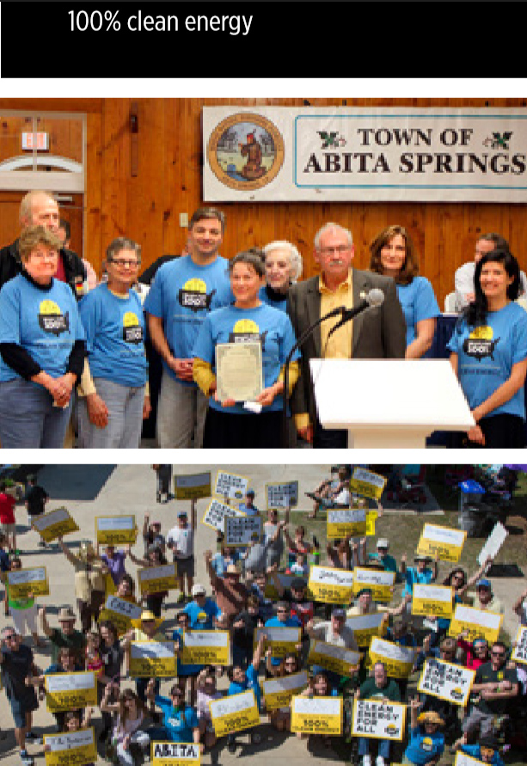
JOIN RALLIES AND PROCLAMATIONS
https://www.sierraclub.org/ready-for-100
LOUISIANA

Slide 50
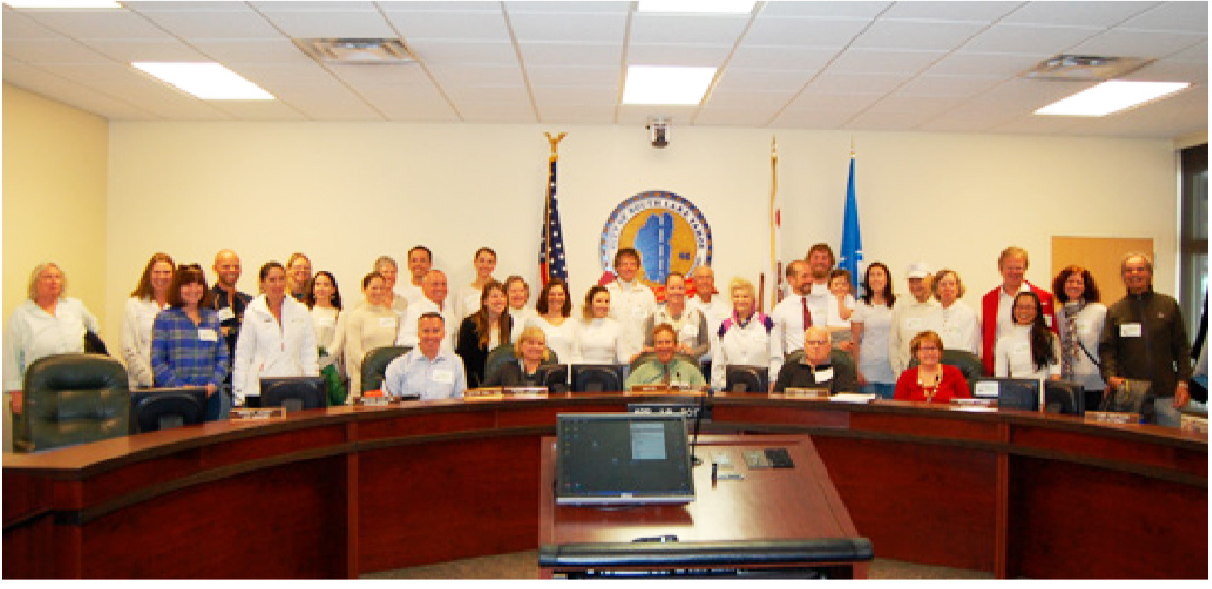
JOIN RALLIES AND PROCLAMATIONS
CALIFORNIA
https://www.sierraclub.org/ready-for-100
Notes:
https://www.sierraclub.org/ready-for-100

Slide 51
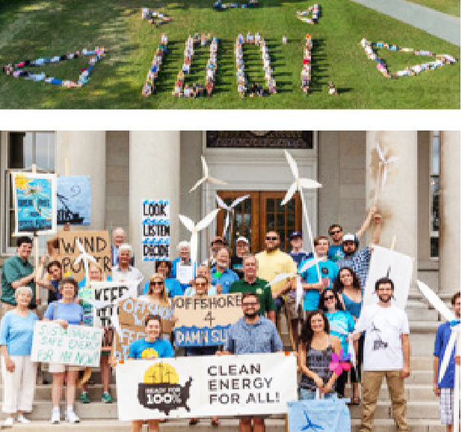
JOIN RALLIES AND PROCLAMATIONS
NEW HAMPSHIRE
https://www.sierraclub.org/ready-for-100

Slide 52
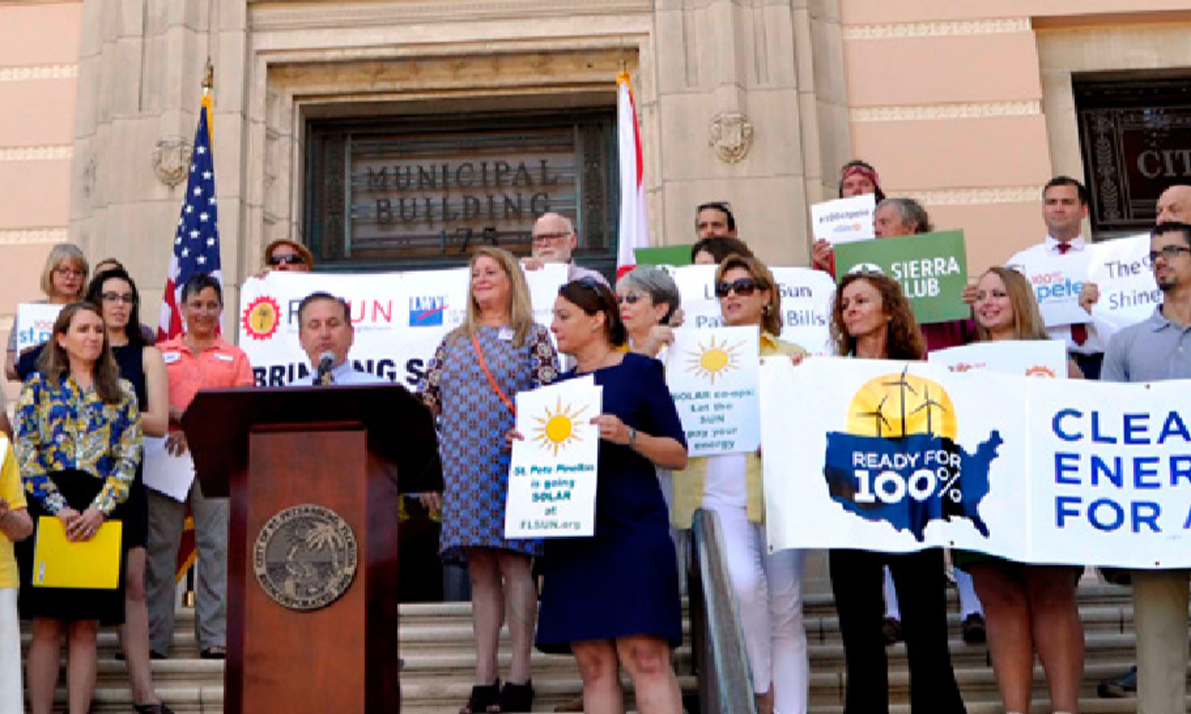
JOIN RALLYS AND PROCLAMATIONS
https://www.sierraclub.org/ready-for-100
Notes:
https://www.sierraclub.org/ready-for-100

Slide 53
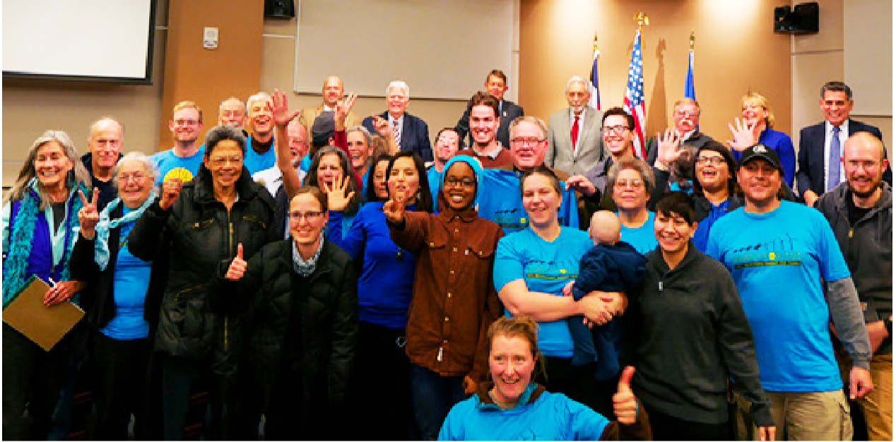
JOIN RALLIES AND PROCLAMATIONS
COLORADO
https://www.sierraclub.org/ready-for-100

Slide 54
WHAT YOU CAN DO IN A GROUP TO BUILD MOMENTUM IN YOUR TOWN FOR 100% CLEAN ENERGY
SUPPORTED BY SIERRA CLUB READY FOR 100% CAMPAIGN:
“HOW TO DO IT” STEP BY STEP DOCUMENTATION
ACCESS TO SIERRA CLUB CLIMATE ACTIVISTS IN YOUR TOWN
SIGN UP TONIGHT- ADD YOUR NAME, AND CONTACT INFORMATION INCLUDING YOUR TOWN.
WE WILL CONTACT YOU AND HELP FORM A CORE GROUP IN YOUR TOWN, AND HELP WITH SLIDES/TALKS AS REQUIRED
Notes:
JOIN A GROUP IN YOUR TOWN!
Sierra Club has the best organization structure, documentation, support
SIGN UP TONIGHT!!
WE WILL HELP YOU FORM A CORE GROUP!
FOLLOWING is a one minute video- Climate Change from a mountain Biker’s Perspective!!

Slide 55
WE BRAKE 4 CLIMATE

Slide 56
WhatWeKnow.aaas.org “We Brake 4 Climate” https://vimeo.com/88817119 (1 minute movie)
American Association for the Advancement of Science

Slide 57
PATH TO 100% CLEAN ENERGY IN YOUR TOWN
YOUR NAME & CONTACT INFO
RESOURCES:
http://climate.smiller.org
Notes:
SIGNUP UP NOW!
Join a team. Take action with your city leaders
GET YOUR TOWN MOVING TO 100% CLEAN ENERGY!

