Slide 1

Making Holmdel’s Future Bright: A Plan for Action
Steve Miller
Climate Reality Leader
Aug 14, 2017
Notes:
ID #1 - Can be used in noncommercial online and TV broadcasts of your presentation.

Slide 2
Global Carbon Emissions from Fossil Fuels
Billion Metric Tons of Carbon
2015
Data: U.S. Department of Energy/CDIAC
Notes:
ID #3430.C - Can be used in noncommercial online and TV broadcasts of your presentation, but not modified.
DESCRIPTION: Graph showing the growth of global carbon emissions from fossil fuels in million metric tons of carbon, 1850-2015
ADDITIONAL TALKING POINTS: Emissions of carbon dioxide from the burning of fossil fuels continue to rise. As the graph shows, this rise has been quite steep since the middle of last century.*
REFERENCES:
* Global Carbon Project version 2014 Budget v1.1. (US Department of Energy, Office of Science, November 2016). http://cdiac.ornl.gov/GCP/

Slide 3
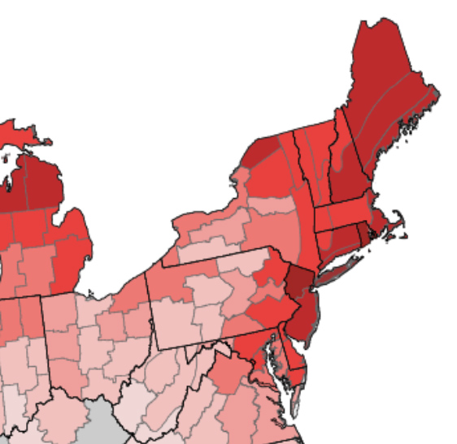
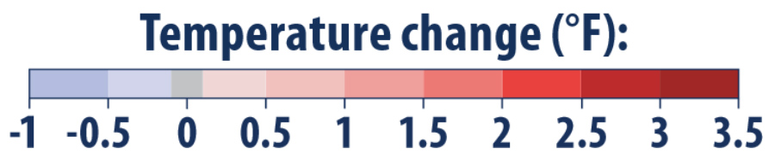
New York Times, Aug 8, 2017
“9 Takeaways From the National Climate Report”
1.2 F Avg US Temp increase; Warming fastest in North Great Plains, Alaska, SWest, NWest, NEast
Rising sea levels (esp in NE and Gulf of Mexico) heavier rain; flooding;
wetter hurricanes – potentially more destructive
California: water supply chronic shortages by 2100
Humans: “Extremely likely …the dominant cause”
Expect surprises in this “unprecedented experiment”

Slide 4
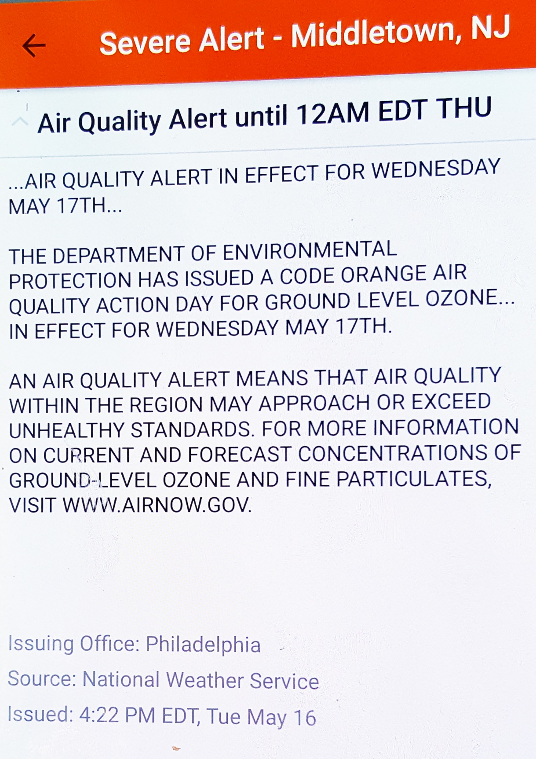
OZONE “SEVERE ALERT” IN MIDDLETOWN May17 + May19, 2017
EPA: “Sensitive groups: Reduce prolonged or heavy outdoor exertion.. Watch for symptoms such as coughing or shortness of breath. Schedule outdoor activities in the morning when ozone is lower.”
People with asthma should follow their asthma action plans and keep quick relief medicine handy.
EPA: “Federal rules, including the Cross-State Air Pollution Rule, the Tier 3 Vehicle Emissions and Fuels Standard, and the Clean Power Plan will significantly reduce ozone-forming pollution in the years ahead”
Notes:
Source 5/16/2017 + 5/19/2017 ”The Weather Channel” Android App.
(Snapshot of Steve Miller’s Android Smartphone)
Source: National Weather Service
EPA website as of 5/16/17

Slide 5
HOLMDEL CARBON FOOTPRINTS
  MUNICIPAL CARBON FOOTPRINT
  COMMUNITY CARBON FOOTPRINT
Source/credit information goes here
Notes:
GET CREDIT TOWARD Carbon footprints, PLUS beginning of CLEAN ENERGY PLAN

Slide 6
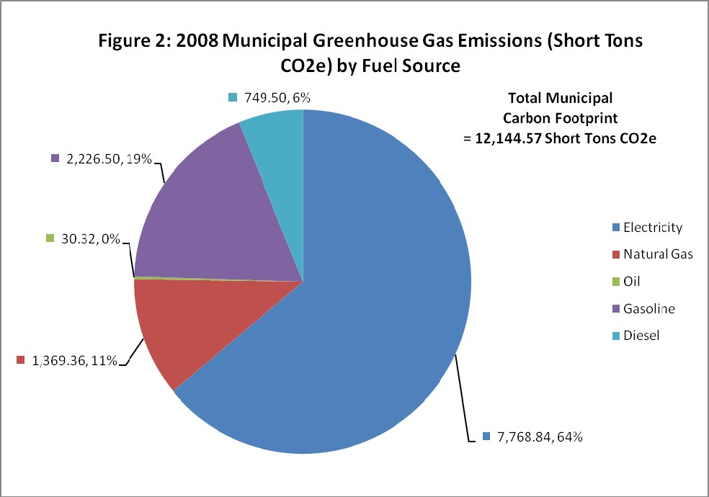
EXAMPLE MUNICIPAL (gov) CARBON FOOTPRINT
(by fuel source)
64%% of total is Electrical
25% of total is Transportation (gas/diesel)
11% of total is Natural Gas (heating)
Source: 2010 Middletown Energy Plan (draft)
Notes:
Middletown Municipal carbon footprint (from 2010 Middletown Energy Plan - draft). 2008 data

Slide 7
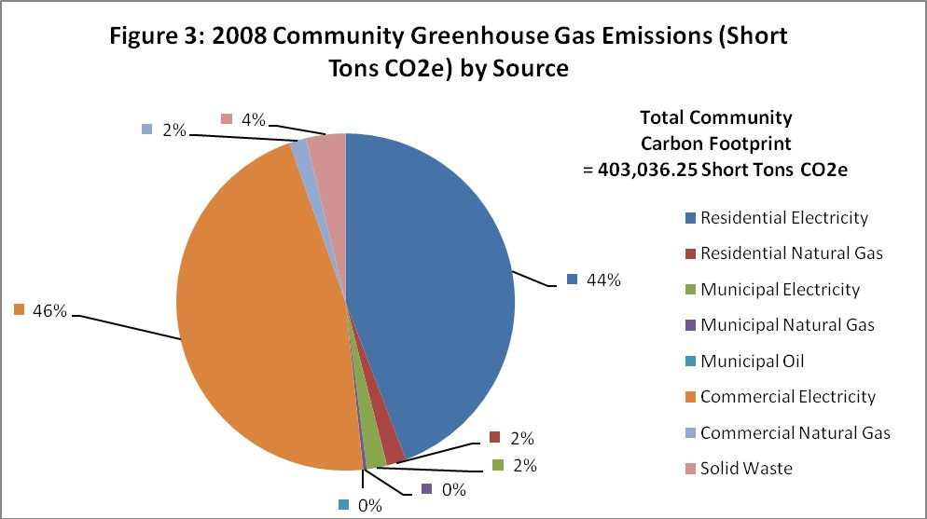
EXAMPLE COMMUNITY CARBON FOOTPRINT
(by source)
92% of total is Electrical (commercial + residential + 2% municipal)
Transportation (gas/diesel) is not shown
4%Nat Gas is low (heating- commercial+res)
Source: 2010 Middletown Energy Plan (draft)
Notes:
Middletown Community Carbon Footprint (2010 Middletown Energy Plan - draft). Data is suspect! – see notes on left of slide 2008 data

Slide 8
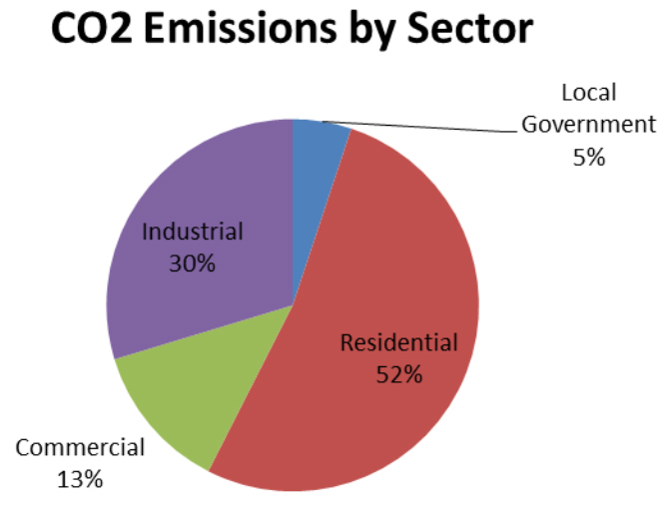
EXAMPLE COMMUNITY CARBON FOOTPRINT
“Local Government” (Municipal) is ONLY 5%
(“Industrial” is high in Woodbridge)
Source: Woodbridge Climate Action Plan
Notes:
Woodbridge carbon footprint

Slide 9
Levelized Cost of Energy in the U.S.
High
Mean
Low
Levelized Cost ($/MWh)
Renewable
Conventional
Wind – Onshore
Solar –
Utility Scale
Gas Combined Cycle
Coal
Nuclear
Data: 2016 Lazard Lazard's Levelized Cost of Energy Analysis v.10.0; Energy Innovation Policy & Technology, LLC
Notes:
ID #4697 - Can be used in noncommercial online and TV broadcasts of your presentation, but not modified.
DESCRIPTION: Graph comparing the levelized cost of renewables and conventional energy sources in the US in dollars per megawatt-hour
ADDITIONAL TALKING POINTS: Renewable energy generation technologies are fast becoming cost-competitive with conventional generation technologies. Since the turn of the decade, wind and solar PV in particular have become increasingly economically competitive with conventional power sources, partly due to declines in the cost of equipment and installations.*
According to the financial advisory and asset management firm Lazard, wind costs have dropped 66 percent between 2009-2016. The cost of solar showed an even more substantial decline, dropping 85 percent during the same time period.**
REFERENCES:
* Lazard, “”Lazard’s Levelized Cost of Energy Analysis- Version 10.0,” December 2016. https://www.lazard.com/media/438038/levelized-cost-of-energy-v100.pdf
** Mike O’Boyle, “Wind and Solar are Our Cheapest Electricity Sources- Now What Do We Do?” Medium, America’s Power Plan, December 21, 2016. https://medium.com/americas-power-plan/wind-and-solar-are-our-cheapest-electricity-sources-now-what-do-we-do-b323082239de#.9emz48c96

Slide 10
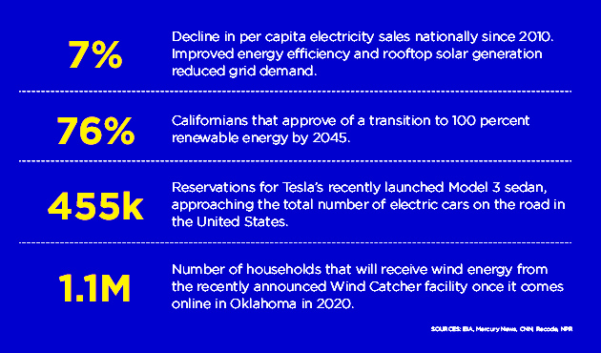
AUGUST 14, 2017 CLEAN ENERGY SCORECARD
Sierra Club “Ready for 100” Campaign
Notes:
Sierra Club broadcast email, 8/14/2017

Slide 11
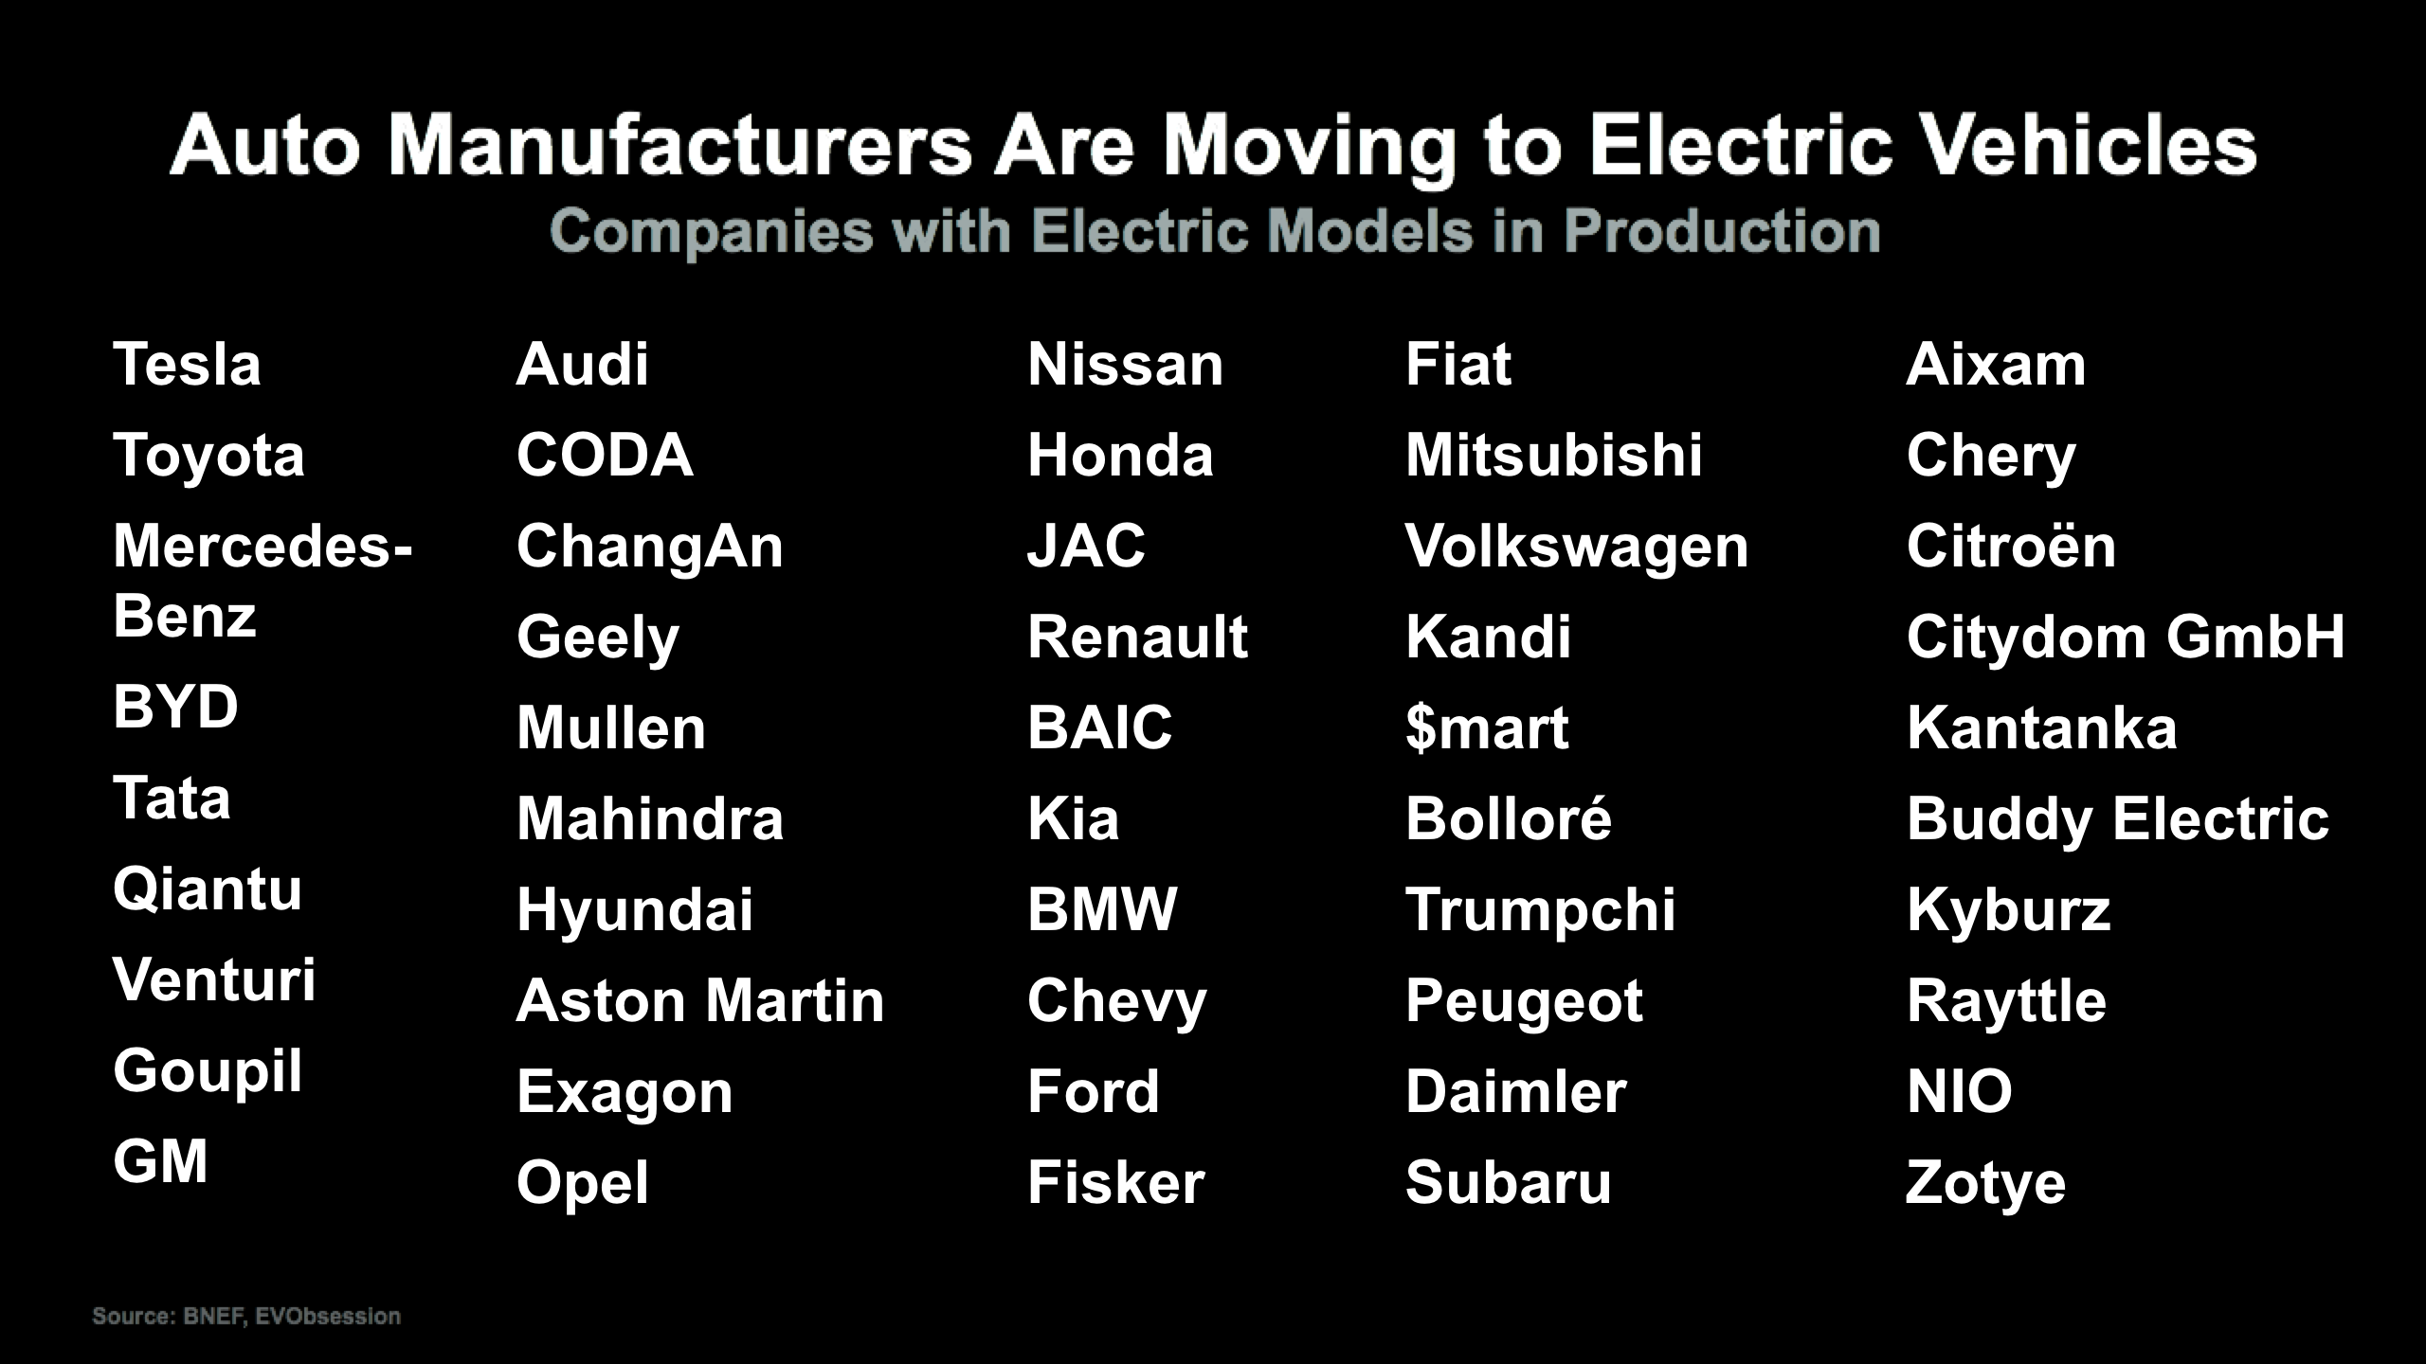
Auto Manufacturers Are Moving to Electric Vehicles
Companies with Electric Models in Production
Data: Bloomberg New Energy Finance, EVObsession
Notes:
ID #4842 - Can be used in noncommercial online and TV broadcasts of your presentation, but not modified.
DESCRIPTION: Text list of auto manufacturers with an electric model in production
ADDITIONAL TALKING POINTS: According to recent research by McKinsey & Company, about 30 percent of vehicle buyers in the US consider an electric vehicle (EV) purchase today. In Germany, this number is closer to 45 percent. One of the factors behind this low percentage is that around half of the consumers in the US and Germany comprehend how electrified vehicles and the associated technology work, compared to almost 100 percent of consumers for an internal combustion engine (ICE). But less than 5 percent of potential buyers ultimately purchase an EV over an ICE (~3 percent in the US, ~4 percent in Germany, and ~22 percent in Norway).*
Although understanding and purchases of EVs may be low, the stage is set for a change as the average battery pack price has fallen almost 80 percent between 2010 and 2016. Additionally, significant range increases since 2013 of about 20 to 40 percent helped offset consumer concerns about mileage, one of the major deterrents to an EV purchase. Finally, projections indicate that global charging station deployments – both public and private – could grow from around two million in 2016 to over 12 million in 2020.*
In 2016, there were over two million electric vehicles on the road globally. Although they represented only a small portion — about 0.2 percent — of total passenger light-duty vehicles in circulation that year, carmakers estimate between 9 and 20 million electric vehicles could be deployed by 2020, and between 40 and 70 million by 2025.**
Perhaps as a sign of where investors believe the future of automobile sales lies, in April 2017, electric car manufacturer Tesla surpassed General Motors in market value.***
REFERENCES:
* McKinsey & Company, “Electrifying insights: How automakers can drive electrified vehicle sales and profitability,” Advanced Industries, January, 2017. http://www.mckinsey.com/industries/automotive-and-assembly/our-insights/electrifying-insights-how-automakers-can-drive-electrified-vehicle-sales-and-profitability
** Katie Fehrenbacher, “5 Ways Automakers Can Make Electric Cars Profitable,” Greentech Media, February 7, 2017. https://www.greentechmedia.com/articles/read/5-ways-automakers-can-make-electric-cars-profitable
*** International Energy Agency, “Electric Vehicles Have Another Record Year, Reaching 2 Million Cars in 2016,” June 7, 2017. https://www.iea.org/newsroom/news/2017/june/electric-vehicles-have-another-record-year-reaching-2-million-cars-in-2016.html
**** The New York Times, “Tesla Hits a New Milestone, Passes G.M. in Market Valuation,” April 10, 2017. https://www.nytimes.com/2017/04/10/business/tesla-general-motors-stock-market.html

Slide 12
Auto Manufacturers Are Moving to Autonomous Vehicles
(as soon as 2021; there may be a marketing connection to EVs)
Tesla
Toyota
PSA
Delphi
VW Group
Volvo/Autoliv/Zenuity
Renault-Nissan
Baidu
Uber
GM
Ford
Daimler
BMW
Waymo
Hyundai Motor Group
ZF
Honda
NuTonomy
Link to Aug 13, 2017 source:
SOURCE:
https://www.designnews.com/automotive-0/15-most-important-autonomous-car-programs?cid=nl.x.dn14.edt.aud.dn.20170801.tst004c
Data: Bloomberg New Energy Finance, EVObsession

Slide 13
OTHER MAJOR CANDIDATES FOR EMISSION REDUCTION
WASTE
D28 Waste to Energy
D26 Methane Digesters
D42 Reduced Food Waste
D100 Landfill Methane
D158 Household Recycling
D160 Industrial Recycling
D160 Recycled Paper
D168 BioPlastic
D170 Water Saving- Home
SJ-GOLD STAR IN WASTE (8 Actions): http://www.sustainablejersey.com/actions-certification/gold-star-standards/
FOOD
D38 Plant-Rich Diet
D54 Regenerative Agriculture
D56 Nutrient Management
D60 Conservation Agriculture
D62 Composting
WOMEN & GIRLS
D78 Family Planning
D80 Educating Girls
Dpage# = “Drawdown”, edited by Paul Hawken ( possible “innovative” Actions)
Notes:
Sources: “Drawdown” (edited by Hawken), and Sustainable Jersey

Slide 14
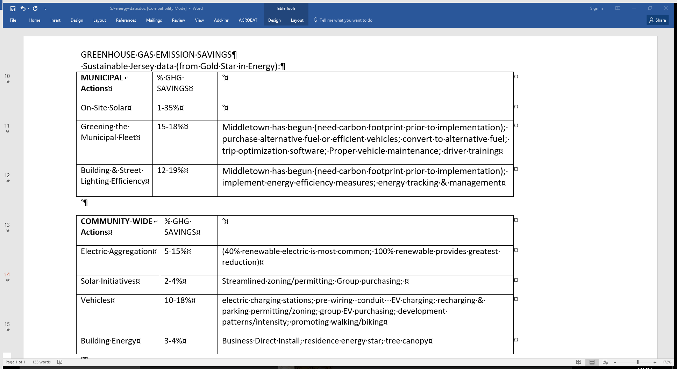
Notes:
Source: Sustainable Jersey

Slide 15
OPPORTUNITIES FOR MAYOR GREGORY BUONTEMPO TO COMMIT HOLMDEL
TO CLEAN ENERGY
  SIERRA MAYORS FOR CLEAN ENERGY
  sierraclub.org/ready-for-100/mayors-for-clean-energy
  Climatemayors.org
  WeAreStillIn.com
  Oct, 2017 Mayors Climate Conference (sponsored by League of Conservation Voters). Sustainable Jersey will ask mayors to sign a pledge for Gold Star in Energy collection of Actions

