Slide 1
Cost and Job Benefits From Transitioning New Jersey to 100% Clean, Renewable Energy and Storage for Everything
Mark Z. Jacobson New Jersey Senate Env. Committee
Stanford University
June 13, 2022
Notes:
Image credit: Envision Energy

Slide 2
What are the Problems? Why act Quickly?
Fossil-fuel and biofuel air pollution cause ~7 million air pollution deaths/yr worldwide (1,100/yr in NJ), costing world ~$30 trillion/year
Global warming will cost world ~$30 trillion/year by 2050.
Fossil fuels cause economic, social, and political instability for several reasons
Drastic problems require immediate solutions

Slide 3
Wind, Water, Solar (WWS) Solution
Electrify or Provide Direct Heat For All Sectors and Provide the Electricity and Heat with 100% WWS
ELECTRICITY TRANSPORTATION HEATING/COOLING INDUSTRY
Wind Battery-electric Electric heat pumps Electric arc furnaces
Solar PV/CSP H₂ fuel cell District heat/cold Induction furnaces
Geothermal Geothermal heat Resistance furnaces
Hydro Solar heat Dielectric heaters
Tidal/Wave Electron beam heaters

Slide 4
Types of Storage for a 100% WWS System
ELECTRICITY HEATING/COOLING OTHER
CSP with storage Water tank Hydrogen
Pumped hydro storage Ice
Existing hydroelectric Underground
Batteries Borehole
Flywheels Water Pit
Compressed air Aquifer
Gravitational Storage Building materials

Slide 5
Transitioning an Individual Home to Run on WWS Electricity/Storage and No Gas

Slide 6
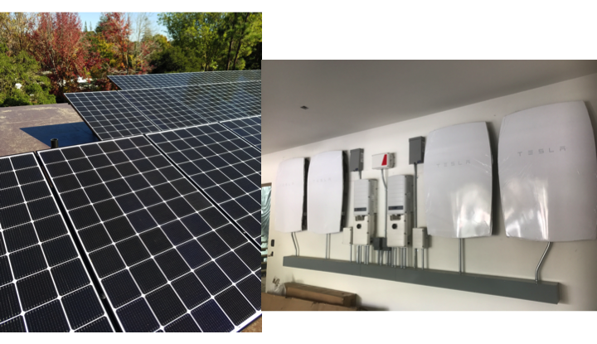
Rooftop Solar Plus Battery Storage
Photo by M.Z. Jacobson

Slide 7
Ductless Mini-Split Electric Heat Pump Air Heater /
Air Conditioner
M.Z. Jacobson
Notes:
Indoor unit blows warm air from the room over cold evaporator coils. Refrigerant running through the coils absorbs the heat and takes it through thin pipes to the outside unit, where the heat is released to the outside air.

Slide 8
Electric Heat Pump Water Heater
Photo by M.Z. Jacobson
Notes:
https://www.atlantic-comfort.com/How-to-choose/Choosing-your-water-heater/Water-heating-technologies/Heat-pump-water-heaters-working-principle

Slide 9
Electric Induction Cooktop
Photo by M.Z. Jacobson
Notes:
Left: Stand-alone electric induction cooker. © Della Liner/AdobeStock. Right: Five electric induction cookers on a cooktop. © Mark Z. Jacobson.
Iron or stainless steel pots.

Slide 10

Five Years of Energy Use
Generated 120% of all home and vehicle energy
→ No electric bill, natural gas bill, or gasoline bill
Received average $860/yr from CCA for excess electricity to grid
Avoided costs of all-electric home Gas hookup fee: 3-8 K
Gas pipes: 2-15 K
Electric bill 1-3 K per year
Natural gas bill 1-3 K per year
Vehicle fuel bill 1-4 K per year
Total: 5-23 K plus 3-10 K per year
5y payback with subsidy; 10y w/o
M.Z. Jacobson
Notes:
http://home.costhelper.com/install-gas-line.html
https://www.pge.com/en/myhome/customerservice/other/newconstruction/projectcosts/results.page?serviceType=gas&gasType=gas_new&electricOverType=&electricUnderType=&pevType=&proj=gas_new

Slide 11
No Blackout on Hottest Day of Year
Sept. 6, 2020
Outside temperature: 106 F
Inside temperature: 77 F
Blue=consumption by solar during day or batteries after sunset (2-3.3 kW/6.4 kWh)
Red=grid electricity
M.Z. Jacobson

Slide 12
Can the World and New Jersey Transition to 100%, Clean, Renewable Energy for all Purposes?
Roadmaps for 145 Countries and 50 States

Slide 13

All-Purpose End-Use Power Demand
Year and Fuel Type | 145-Countries
2018 End-use demand | 13.1 TW
2050 Demand with current fuels (BAU) | 20.4 TW
2050 Demand with WWS | 8.9 TW
2050 Demand reduction with WWS 20.5% efficiency of BE, HFC v. ICE 4.3% efficiency of electric industry 13.6% efficiency of heat pumps 11.3% eliminating fuel mining 6.6% efficiency beyond BAU | 56.4%
Notes:
145-Country Paper

Slide 14
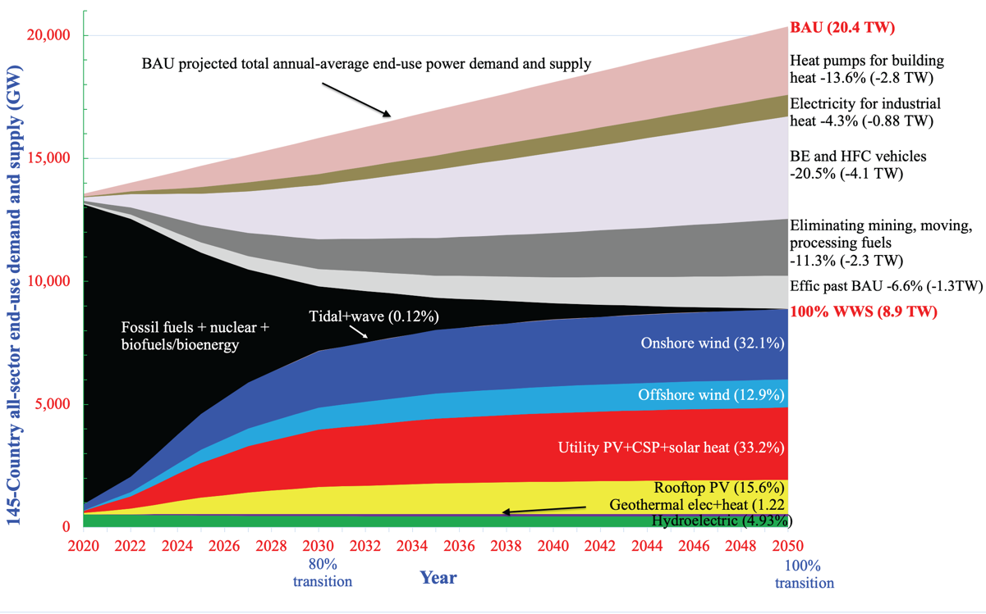
Timeline for a 145-Country Transition

Slide 15
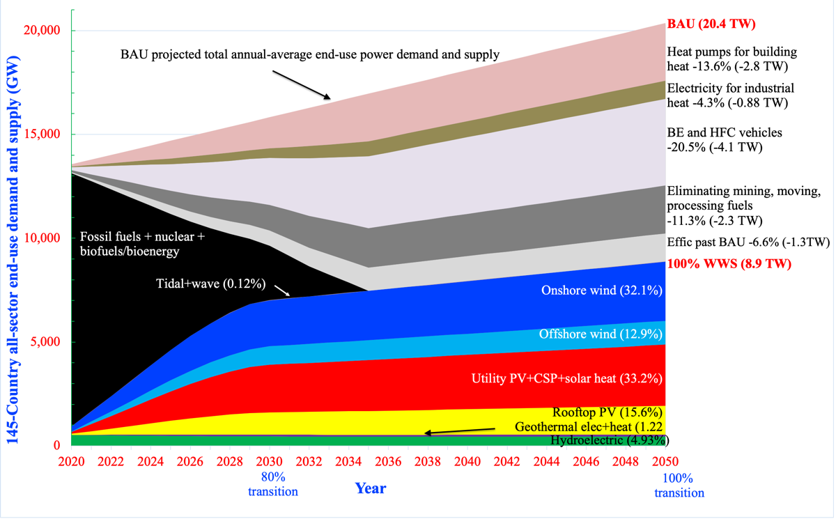
Faster Timeline for a 145-Country Transition

Slide 16
Percent of 2050 145-Country, U.S., and RFC End-Use Demand Supplied by WWS
TECHNOLOGY World U.S. RFC grid
Onshore wind 32.1% 28.3% 20.8%
Offshore wind 12.9 16.4 14.2
Rooftop Solar PV 15.6 20.5 15.2
Utility PV 30.0 30.8 49.1
CSP 2.73 0.44 0
Geothermal electricity 0.73 0.46 0
Hydroelectric 4.93 2.97 0.48
Tidal 0.04 0.022 0.009
Wave 0.08 0.19 0.17
Geothermal heat 0.49 0* 0*
Solar heat 0.42 0* 0*
100% 100% 100%
*Simulations assumed electricity produced 100% of heat.
Notes:
Reliability First Corporation (RFC) grid (DC, DE, IN, MD, MI, NJ, OH, PA, WV)

Slide 17
Percent of Land Beyond 2018 Installations to Power 145 Countries, U.S., RFC for all Purposes With 100% WWS in 2050
Onshore wind: 0.36%
Utility PV+CSP: 0.17%
Total 145 Countries 0.53%
Onshore wind: 0.55%
Utility PV+CSP: 0.29%
Total U.S. 0.84%
Onshore wind: 1.59%
Utility PV+CSP: 1.89%
Total RFC 3.48%

Slide 18
Matching RFC All-Sector Demand Every 30 Seconds With 100% WWS+Storage for all of 2050 and for 100 Days
Red = Energy supply
Blue = Energy demand + change in storage + losses + shedding

Slide 19
Energy Cost Resulting in a Stable Grid Upon Electrification of all Energy With 100% WWS+Storage
World: 8.5 cents/kWh
Capital Cost: $61.5 trillion
U.S.: 9.0 cents/kWh
Capital cost: $8.9 trillion
New Jersey: 10.2 cents/kWh
Capital cost: $206 billion

Slide 20
2050 World BAU vs WWS Cost
BAU fuel energy cost $17.8 trillion/yr
BAU fuel health cost $33.6 trillion/yr
BAU fuel climate cost $31.8 trillion/yr
BAU total social cost $83.2 trillion/yr
WWS total social cost $6.6 trillion/yr
WWS reduces energy cost 63% and economic (social) cost 92%
Jacobson et al. (2022)

Slide 21
2050 U.S. BAU vs WWS Cost
BAU fuel energy cost $2.51 trillion/yr
BAU fuel health cost $0.70 trillion/yr
BAU fuel climate cost $3.58 trillion/yr
BAU total social cost $6.79 trillion/yr
WWS total social cost $0.93 trillion/yr
WWS reduces energy cost 62.9% and economic (social) cost 86.3%
Jacobson et al. (2022)

Slide 22
2050 New Jersey BAU vs WWS Cost
BAU fuel energy cost $53.5 billion/yr
BAU fuel health cost $14.8 billion/yr
BAU fuel climate cost $70.4 billion/yr
BAU total social cost $138.7 billion/yr
WWS total social cost $18.7 billion/yr
WWS reduces energy cost 65% and economic (social) cost 86.5%
Jacobson et al. (2022)

Slide 23

2009
100% worldwide wind, water, solar (WWS) all-sector energy plan introduced
Basis for Green New Deal
Conclusion
While technically and economically possible to transition by 2030, social and political barriers make complete transition more practical by 2050 with most (~80%) by 2030
Notes:
https://www.congress.gov/bill/114th-congress/house-resolution/540/cosponsors?q=%7B%22search%22%3A%5B%22%5C%22hres540%5C%22%22%5D%7D&resultIndex=1
https://www.demconvention.com/wp-content/uploads/2016/07/Democratic-Party-Platform-7.21.16-no-lines.pdf

Slide 24
61 Countries Committed to 100% Renewable Electricity
Afghanistan Denmark Kirbati Papua N.G. Tanzania
Aruba Djibouti Lebanon Philippines Timor-Les
Bangladesh Dominica Madagas Portugal Tokelau
Barbados Dom Rep. Malawi Rwanda Tunisia
Bhutan Ethiopia Maldives Samoa Tuvalu
Burkina Faso Fiji Marsh Is. Senegal Scotland
Cabo Verde Gambia Mongolia Solom Is. Vanuatu
Cambodia Ghana Morocco S. Sudan Vietnam
Colombia Grenada Nepal Spain Yemen
Comoros Guatemala Niger Sri Lanka
Congo, DR Haiti Niue St. Lucia
Cook Islands Honduras Palau Sudan
Costa Rica Kenya Palestine Sweden

Slide 25
13 Countries Near or Above 100% of their Electricity Generated by WWS in Annual Average and Their Top Two Electricity Sources
Iceland* (H,G) Kenya (G,H) H = hydro
Norway* (H,W) Bhutan* (H) G = geothermal
Costa Rica* (H,W) Nepal* (H,S) W = wind
Paraguay* (H) Ethiopia* (H,W)
Albania* (H, S) Congo, DR* (H,S)
Tajikistan (H)
Namibia* (H,S)
Scotland (W,H) *97.5-100% WWS; others > 91%

Slide 26
18 100% Renewable Electricity State/Territory Laws/Exec Orders Resulting From WWS Roadmaps
100% by 2030
Rhode Island
By 2032
Washington D.C.
By 2040
Connecticut, Oregon
By 2045
Hawaii, Calif., New Mexico, Wash. State, New York, Illinois
By 2050
Puerto Rico, NV, ME, WI, VA, NJ, NC, NE
Notes:
https://www.congress.gov/bill/114th-congress/house-resolution/540/cosponsors?q=%7B%22search%22%3A%5B%22%5C%22hres540%5C%22%22%5D%7D&resultIndex=1
https://www.demconvention.com/wp-content/uploads/2016/07/Democratic-Party-Platform-7.21.16-no-lines.pdf
https://malegislature.gov/Bills/190/SD1932

Slide 27
Some of 180 US Cities/Counties Committed to 100% Renewables
Atlanta (GA) Salt Lake City (UT) Sylva (NC)
Chicago (IL) San Diego (CA) Moab (UT)
Cincinatti (OH) San Francisco (CA) Boulder (CO)
Cleveland (OH) San Jose (CA) Burlington (VT)
Denver (CO) Spokane (WA) Rochester (MN)
Kansas City (MO) St. Louis (MO) Fayetteville (AR)
Los Angeles (CA) St. Paul (MN) Palo Alto (CA)
Madison (WI) St. Petersburg (FL) Middleton (WI)
Minneapolis (MN) Tallahassee (FL) Missoula (MT)
N. Brunswick (NJ) Abita Springs (LA) Questa (NM)
Philadelphia (PA) Sarasota (FL) Fayetteville (AR)
Portland (OR) Hanover (NH) Clarkston (GA)

Slide 28
Some of the 360+ Companies Committed to 100% Renewables
IKEA Adobe JPMor/Chas Coca Cola
Google H&M HP Goldman-Sachs
Microsoft Nestle Nike Johnson & Johnson
Apple S&P Starbucks Walmart
Workday T-Mobile AB InBev Bank of America
Bloomberg BMW Group Burberry Citi
P&G Ebay Facebook Estee Lauder
GM Goldman-Sachs HSBC Infosys
Kellogg’s Lego Mars Morgan Stanley
Salesforce Organic Valley Amazon Wells Fargo
Notes:
http://there100.org/companies
https://weather.com/science/environment/news/clean-energy-cities

Slide 29
Summary–Transitioning New Jersey to 100% WWS
Creates 144,000 more jobs than lost in New Jersey
Avoids ~1,120 air pollution deaths per year in New Jersey
Reduces annual energy costs by 64% in New Jersey
Upfront capital cost of ~$200 bil. pays itself off through energy sales
Reduces annual energy+health+climate costs by 87%
Keeps electric grids stable

Slide 30
Paper about U.S. State Plans
web.stanford.edu/group/efmh/jacobson/Articles/I/WWS-50-USState-plans.html
Infographic Map With U.S. State Plans
https://sites.google.com/stanford.edu/wws-roadmaps/home
Book on 100% WWS
https://web.stanford.edu/group/efmh/jacobson/WWSBook/WWSBook.html
Online short course on 100% WWS
https://online.stanford.edu/courses/xeiet200-planning-sustainable-future-wind-water-and-sun
Twitter: @mzjacobson

