Slide 1
Building Electrification (BE) Legislative Recommendations
Sorted according to ACEEE Key Recommendations for State Legislators
American Council for an Energy-Efficient Economy
“Building Electrification: Programs and Best Practices,” Feb 2022 (page ix)
From NJ 50 x 30 Building Electrification Team
June 6, 2022

Slide 2
ACEEE Key Recommendations for State Legislators
American Council for an Energy-Efficient Economy
Include explicit building electrification targets within larger climate plans, and prioritize access to resources and support for marginalized communities when setting goals
Provide consistent funding streams for building electrification programs, particularly whole-building retrofits for underserved communities
Capture electrification opportunities in new buildings through building codes and standards, such as requiring new buildings to be all-electric or “ready to electrify”
Utilize carbon market revenues to create sustainable funding streams for building electrification programs

Slide 3
1. Specify Building Electrification Targets
(“Building Electrification Act and goals”)
1.1 Set goals to achieve net zero energy in residential units:
100K new and existing/retrofit residential units electrified by 2025; 800K new and existing/retrofit residential units electrified by 2030.
(800K represents about 2.3 MMT of carbon emissions reduced, about 16% of residential building sector emissions.)
Direct BPU to allocate these goals to each utility. (Amend A1440/S1170)

Slide 4
2. Funding Streams For Building Electrification, esp. in Underserved Communities (“Building Electrification Act and goals”)
2.1 Authorize funding for increased incentives for Zero Energy Buildings, building efficiency measures, or efficient electric appliances such as heat pump space or water heaters. Authorize enhanced incentives for low/moderate income, prioritizing whole-building (multi-family) retrofits.
2.2 Create funding for training HVAC contractors in heat pumps and to expand the trained workforce.
2.3 Authorize municipalities to approve and provide incentive funding for projects for community/district ground source for heat pump systems for developers, neighborhood community groups, campuses, and especially affordable housing communities or complexes.

Slide 5
3. Codes and Standards Require All-Electric
Zero Energy Buildings (ZEB)
3.1 Require NJBPU, in conjunction with NJDCA and NJDEP, to produce a BE Roadmap for new and retrofit/rehab construction, including codes, proper design of incentives, outreach and education, and a technical resource center, by the end of 2022.
3.2 “Zero Energy Readiness” and “Zero Energy Buildings” for new and rehab construction:
    Require Zero Energy Readiness in new construction by 2025. “Zero Energy Readiness” requires an electrical system capable of supporting electric cold climate heat pump for space and water heating, all-electric appliances, EV charging, and solar; also requires building siting and energy efficient construction to support Zero Energy. (Amend A1440/S1170)
    Require Zero Energy Buildings (ZEB) in new construction by 2028. ZEB requires the above features be in place, including appliances and enough solar or other clean energy for the building to consume only as much energy as can be produced onsite through renewable resources. (Amend A1440/S1170)
    Update rehab code with above requirements no more than one year later than the 2025 and 2028 dates for new construction. (Amend A1440/S1170)
    Require new state-subsidized affordable housing construction or retrofits to be ZEB immediately.
3.3 Revise the Energy Law relating to the State Energy Code to change from 7-year cost effectiveness criterion to require a payback period over a longer time horizon (10 years) with consideration for equipment lifecycle or societal effects. (“Building Electrification Act and goals”)
3.4 Amend the Uniform Construction Code to allow for adoption of a statewide voluntary stretch energy code to require additional energy efficiency and charge the NJDCA with developing and promulgating it. (Amend A1440/S1170)

Slide 6
4. Create Sustainable Funding Streams For
Building Electrification Programs
  4.1 Potential revenue streams for electrification incentives (in addition to existing RGGI, Clean Energy Program Fund, and other funds):
    To Finance the transition to Cold Climate Heat Pumps, adopt a Clean Thermal Energy Certificate (CTEC) as part of the Renewable Energy Portfolio Standard. (“Building Electrification Act and goals”)
    Divert fossil fuel subsidies to increased incentives for cold climate heat pumps and building weatherization/efficiency measures. (“Building Electrification Act and goals”)

Slide 7
Building Electrification Meetings with Key NJ Policy Makers
Meetings held to date
Rutgers Center for Green Building – Jennifer Senick, Executive Director
NJBPU Division of Clean Energy – Stacy Richardson, Deputy Director
Assemblyman James J. Kennedy (A1440)
NJDCA – Robert Long, Deputy Commissioner, Edward Smith, Director, Div Codes & Standards
Meetings Planned
Governor’s Office of Climate Action – Jane Cohen, Executive Director
Senator Andrew Zwicker
Senator Bob Smith
NJBPU Chief Counsel Abe Silverman, Chief Economist Ben Witherell
NEEP (Northeast Energy Efficiency Partnerships) – Andrea Krim, Building Policy Manager

Slide 8
Following two slides show end user price of various fuels for space heating/cooling.
Prices are based upon one specific bill of one JCPL and one PSEG customer.
JCPL electric and NJNG gas
PSEG electric and PSEG gas
Following two slides are for background

Slide 9
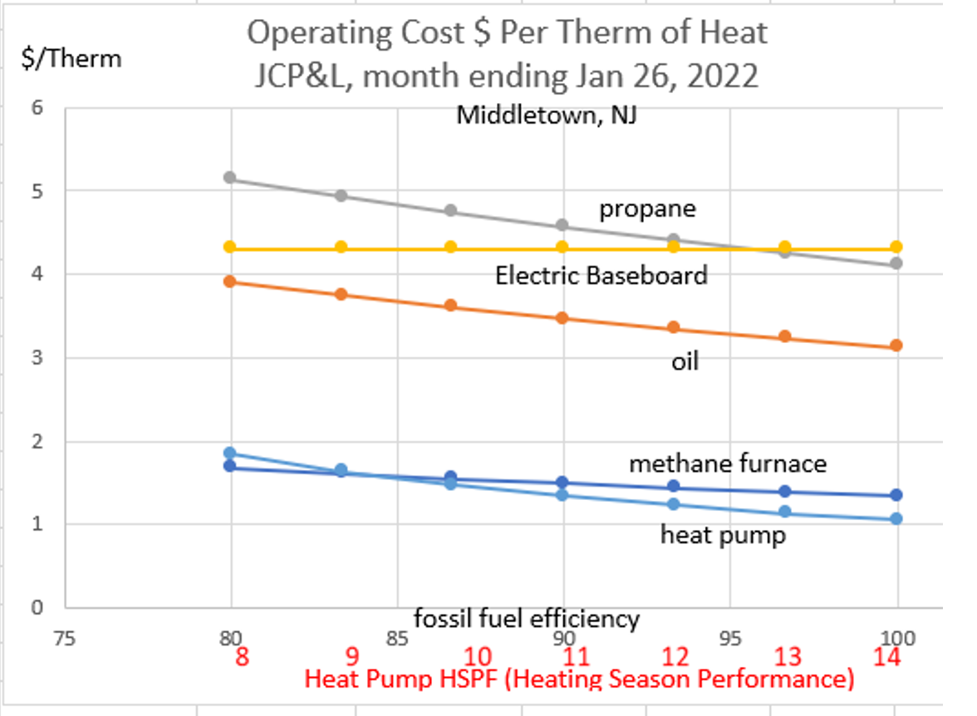

Slide 10
