Slide 1
Building Electrification (BE) Recommendations
Meeting with NJ DCA
Lt. Governor Sheila Y. Oliver, Commissioner
May 19, 2022
May 2 and May 11, 2022, Letters to Governor Murphy
From NJ 50 x 30 Building Electrification Team

Slide 2
NJ 50x30 Building Electrification Team
MISSION
The NJ 50 x 30 Building Electrification (BE) Team will work with all willing partners to establish and implement firm goals and timeframes for BE as part of the statewide strategies to meet the state’s 50% reduction in 2006 GHG emissions by 2030.

Slide 3
6 Recommendations for BE
Governor announce goal of 100K residential units electrified by 2025, 800K by 2030.
New and Retrofit/Rehab BE Roadmap, including codes, proper design of incentives, outreach and education, and a technical resource center, by 2022.
Much stronger incentives for BE: esp. electric heat pumps for heating/cooling; building energy efficiency. More aggressive marketing of BE programs.
Adopt building energy codes from International Code Council (ICC) for 2021, 2024, 2027 with No weakening amendments.
Electrify government buildings (state, local, county) and provide funding.
3300 affordable housing units in Murphy budget ($305M) electrified and high-efficiency with heat pump heating/cooling, with rooftop solar where feasible.

Slide 4
Rec 1. Announce Goal of 100K New & Retrofit Residential Building Units Electrified by 2025; 800K by 2030
2025 goal conservative, since recommendations not yet in place
2030 goal consistent with NJ EMP’s Least Cost Scenario
Other states, EU have announced goals:
  Maine: 100K heat pumps by 2025
  Mass: 1M homes with heat pumps by 2030
  NY: 1M homes electrified + 1M homes electric-ready by 2030
  EU: 30M by 2030
Least cost scenario includes electric space and water heating, induction cooktop

Slide 5
Rec 2. Aggressive BE Roadmap by EO 2022
Path to net zero energy codes for new & existing buildings by 2027
Provide mechanisms for tracking and enforcement
Include relevant goals for:
    Design of Incentives
    Outreach, Education, and Technical Resource Center
    Clean Energy (i.e., 100% clean electricity by 2035)
    Grid Sufficiency (30-year Integrated Distribution Plan to ensure smart, sufficient, reliable grid distribution through 2050)
    Electric Vehicle (e.g., sufficient charging capability)

Slide 6
Rec 3. Stronger Incentives for BE Heat Pumps, Energy Efficiency
Increase incentives for electric cold-climate heat pump space and water heating and building energy efficiency (weatherization).
More aggressive marketing of BE programs. User-friendly website. Counter dis- and misinformation about BE costs/benefits.
Streamline clean energy financing through vendors to ensure equitable access to all areas of state and all income levels.
Include in incentives costs for electrical upgrades, energy efficiency, higher electricity costs in some areas, and for what might be longer Return on Investment than currently allowed
NO incentives for fossil fuel equipment.

Slide 7
Rec 4. Adopt Strong BE Codes for 2021, 2024, 2027 with No Weakening Amendments
EMP Goal 3.3.1: “Advocate for net zero carbon buildings in new construction in the 2024 ICC code change hearings.”
Acadia Report: “By 2027, adopt a zero-energy building code for new and existing buildings.”
Implement statewide stretch codes for better energy efficiency, electrification, and renewable energy interconnection.
UCC should require net zero energy ready in the 2024 code and net zero energy in the 2027 code for all new construction, retrofits and significant remodeling.

Slide 8
Rec 5. State & Local Government Buildings Electrified
State and local government entities need to lead.
Need state funding to electrify government buildings.
Opportunity for Ground Source District Heating.

Slide 9
Rec 6. Electrify 3300 Affordable Housing Units with $305M in Rescue Funding
Governor included in 2022 budget proposal.
EMP 3.3.4: “Build state-funded projects and buildings to a high-performance standard.”
EMP 4.1.2: “Partner with private industry to establish electrified building demonstration projects.”
Build units all-electric with high efficiency, heat pump heating/cooling, and rooftop solar, where feasible.
Showcase NJ’s commitment to climate mitigation goals, and be a proof-of-concept.

Slide 10
Following two slides show end user price of various fuels.
Prices are based upon one specific bill of one JCPL and one PSEG customer.
JCPL electric and NJNG gas
PSEG electric and PSEG gas
Following two slides are for background

Slide 11
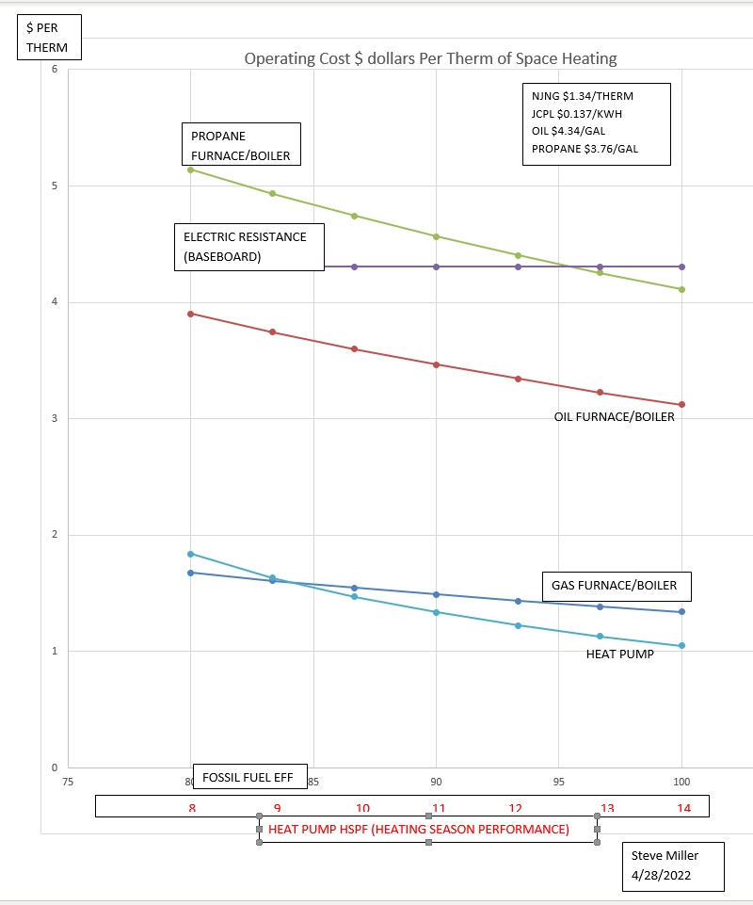

Slide 12
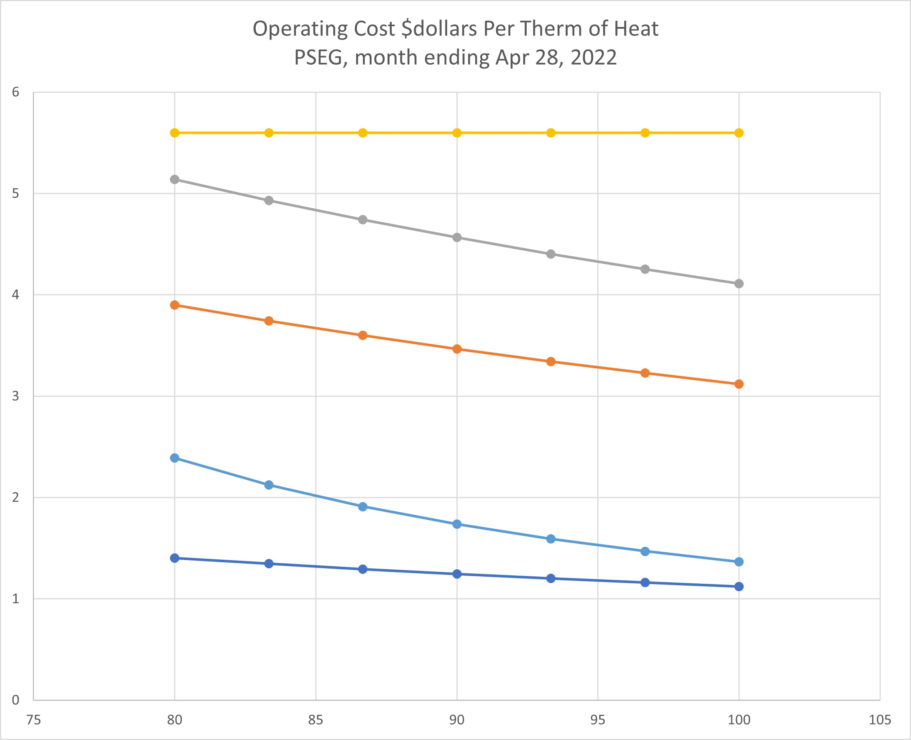
ELECTRIC RESISTANCE HEAT
PROPANE
OIL
Heat Pump
Methane furnace/boiler
EFFICIENCY
8 9 10 11 12 13 14
HSPF

