Slide 1
NJ 50 x 30 Building Electrification (BE) Team Recommendations
Meeting with NJ Any Dept
Any Name, Any Title
Any Date, 2022

Slide 2
NJ 50x30 Building Electrification Team
MISSION
The NJ 50 x 30 Building Electrification (BE) Team will work with all willing partners to establish and implement firm goals and timeframes for BE as part of the statewide strategies to meet the state’s 50% reduction in 2006 GHG emissions by 2030.

Slide 3
NJDEP GWRA Report 80 x 50 https://www.nj.gov/dep/climatechange/docs/nj-gwra-80x50-report-2020.pdf

Slide 4
Clean Electrification to Reduce GHG
In NJ plans are underway to reduce transportation emissions by electrification of vehicles.
Plans are underway to increase clean electricity via wind, solar programs.
We cannot reach 50% reduction by 2030 without building electrification.

Slide 5
Building Electrification (BE) Administrative Recommendations
May 2 and May 11, 2022, Letters to Governor Murphy
From NJ 50 x 30 Building Electrification Team
Any Date, 2022

Slide 6
6 Recommendations for BE
Governor announce goal of 100K residential units electrified by 2025, 800K by 2030.
New and Retrofit/Rehab BE Roadmap, including codes, proper design of incentives, outreach and education, and a technical resource center, by 2022.
Much stronger incentives for BE: esp. electric heat pumps for heating/cooling; building energy efficiency. More aggressive marketing of BE programs.
Adopt building energy codes from International Code Council (ICC) for 2021, 2024, 2027 with No weakening amendments.
Electrify government buildings (state, local, county) and provide funding.
3300 affordable housing units in Murphy budget ($305M) electrified and high-efficiency with heat pump heating/cooling, with rooftop solar where feasible.

Slide 7
Rec 1. Announce Goal of 100K New & Retrofit Residential Building Units Electrified by 2025; 800K by 2030
2025 goal conservative, since recommendations not yet in place
2030 goal consistent with NJ EMP’s Least Cost Scenario; reduces about 2.3 MMT of carbon emissions, 16% of residential building sector emissions
Other states, EU have announced goals:
  Maine: 100K heat pumps by 2025
  Mass: 1M homes with heat pumps by 2030
  NY: 1M homes electrified + 1M homes electric-ready by 2030
  EU: 30M by 2030
Least cost scenario includes electric space and water heating, induction cooktop

Slide 8
Rec 2. Aggressive BE Roadmap by EO 2022
Path to net zero energy codes for new & existing buildings by 2027
Provide mechanisms for tracking and enforcement
Include relevant goals for:
    Design of Incentives
    Outreach, Education, and Technical Resource Center
    Clean Energy (i.e., 100% clean electricity by 2035)
    Grid Sufficiency (30-year Integrated Distribution Plan to ensure smart, sufficient, reliable grid distribution through 2050)
    Electric Vehicle (e.g., sufficient charging capability)

Slide 9
Rec 3. Stronger Incentives for BE Heat Pumps, Energy Efficiency
Increase incentives for electric cold-climate heat pump space and water heating and building energy efficiency (weatherization).
More aggressive marketing of BE programs. User-friendly website. Counter dis- and misinformation about BE costs/benefits.
Streamline clean energy financing through vendors to ensure equitable access to all areas of state and all income levels.
Include in incentives costs for electrical upgrades, energy efficiency, higher electricity costs in some areas, and for what might be longer Return on Investment than currently allowed
NO incentives for fossil fuel equipment.

Slide 10
Rec 4. Adopt Strong BE Codes for 2021, 2024, 2027 with No Weakening Amendments
EMP Goal 3.3.1: “Advocate for net zero carbon buildings in new construction in the 2024 ICC code change hearings.”
Acadia Report: “By 2027, adopt a zero-energy building code for new and existing buildings.”
Implement statewide stretch codes for better energy efficiency, electrification, and renewable energy interconnection.
UCC should require net zero energy ready in the 2024 code and net zero energy in the 2027 code for all new construction, retrofits and significant remodeling.

Slide 11
Rec 5. State & Local Government Buildings Electrified
State and local government entities need to lead.
Need state funding to electrify government buildings.
Opportunity for Ground Source District Heating.

Slide 12
Rec 6. Electrify 3300 Affordable Housing Units with $305M in Rescue Funding
Governor included in 2022 budget proposal.
EMP 3.3.4: “Build state-funded projects and buildings to a high-performance standard.”
EMP 4.1.2: “Partner with private industry to establish electrified building demonstration projects.”
Build units all-electric with high efficiency, heat pump heating/cooling, and rooftop solar, where feasible.
Showcase NJ’s commitment to climate mitigation goals, and be a proof-of-concept.

Slide 13
Building Electrification (BE) Legislative Recommendations
Sorted according to ACEEE Key Recommendations for State Legislators
American Council for an Energy-Efficient Economy
“Building Electrification: Programs and Best Practices,” Feb 2022 (page ix)
From NJ 50 x 30 Building Electrification Team
Any Date, 2022

Slide 14
ACEEE Key Recommendations for State Legislators
American Council for an Energy-Efficient Economy
Include explicit building electrification targets within larger climate plans, and prioritize access to resources and support for marginalized communities when setting goals
Provide consistent funding streams for building electrification programs, particularly whole-building retrofits for underserved communities
Capture electrification opportunities in new buildings through building codes and standards, such as requiring new buildings to be all-electric or “ready to electrify”
Utilize carbon market revenues to create sustainable funding streams for building electrification programs

Slide 15
1. Specify Building Electrification Targets
1.1 Set goals to achieve net zero energy in residential units:
100K new and existing/retrofit residential units electrified by 2025; 800K new and existing/retrofit residential units electrified by 2030.
(800K represents about 2.3 MMT of carbon emissions reduced, about 16% of residential building sector emissions.)
Direct BPU to allocate these goals to each utility. (Amend A1440/S1170)

Slide 16
2. Funding Streams For Building Electrification, esp. in Underserved Communities
2.1 Authorize funding for increased incentives for Zero Energy Buildings, building efficiency measures, or efficient electric appliances such as heat pump space or water heaters. Authorize enhanced incentives for low/moderate income, prioritizing whole-building (multi-family) retrofits.
2.2 Create funding for training HVAC contractors in heat pumps and to expand the trained workforce.
2.3 Authorize municipalities to approve and provide incentive funding for projects for community/district ground source for heat pump systems for developers, neighborhood community groups, campuses, and especially affordable housing communities or complexes.

Slide 17
3. Codes and Standards Require All-Electric
Zero Energy Buildings (ZEB)
3.1 Require NJBPU, in conjunction with NJDCA and NJDEP, to produce a BE Roadmap for new and retrofit/rehab construction, including codes, proper design of incentives, outreach and education, and a technical resource center, by the end of 2022.
3.2 “Zero Energy Readiness” and “Zero Energy Buildings” for new and rehab construction:
    Require Zero Energy Readiness in new construction by 2025. “Zero Energy Readiness” requires an electrical system capable of supporting electric cold climate heat pump for space and water heating, all-electric appliances, EV charging, and solar; also requires building siting and energy efficient construction to support Zero Energy. (Amend A1440/S1170)
    Require Zero Energy Buildings (ZEB) in new construction by 2028. ZEB requires the above features be in place, including appliances and enough solar or other clean energy for the building to consume only as much energy as can be produced onsite through renewable resources. (Amend A1440/S1170)
    Update rehab code with above requirements no more than one year later than the 2025 and 2028 dates for new construction.
    Require new state-subsidized affordable housing construction or retrofits to be ZEB immediately.
3.3 Revise the Energy Law relating to the State Energy Code to change from 7-year cost effectiveness criterion to require a payback period over a longer time horizon (10 years) with consideration for equipment lifecycle or societal effects.
3.4 Amend the Uniform Construction Code to allow for adoption of a statewide voluntary stretch energy code to require additional energy efficiency and charge the NJDCA with developing and promulgating it.

Slide 18
4. Create Sustainable Funding Streams For
Building Electrification Programs
  4.1 Potential revenue streams for electrification incentives (in addition to existing RGGI, Clean Energy Program Fund, and other funds):
    To Finance the transition to Cold Climate Heat Pumps, adopt a Clean Thermal Energy Certificate (CTEC) as part of the Renewable Energy Portfolio Standard.
    Divert fossil fuel subsidies to increased incentives for cold climate heat pumps and building weatherization/efficiency measures.

Slide 19
Building Electrification Meetings with Key NJ Policy Makers
Meetings held to date
Rutgers Center for Green Building – Jennifer Senick, Executive Director
NJBPU Division of Clean Energy – Stacy Richardson, Deputy Director
Assemblyman James J. Kennedy (A1440)
NJDCA – Robert Long, Deputy Commissioner, Edward Smith, Director, Div Codes & Standards
Meetings Planned
Governor’s Office of Climate Action – Jane Cohen, Executive Director
Senator Andrew Zwicker
Senator Bob Smith
NJBPU Chief Counsel Abe Silverman, Chief Economist Ben Witherell
NEEP (Northeast Energy Efficiency Partnerships) – Andrea Krim, Building Policy Manager

Slide 20
Following two slides show end user price of various fuels for space heating/cooling.
Prices are based upon one specific bill of one JCPL and one PSEG customer.
JCPL electric and NJNG gas
PSEG electric and PSEG gas
Following two slides are for background

Slide 21
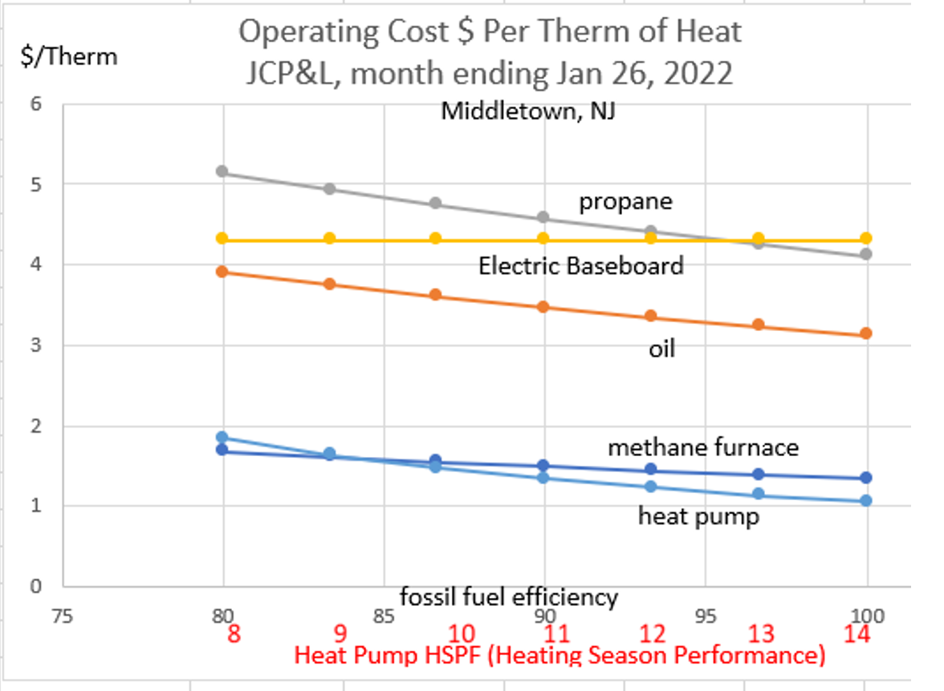

Slide 22
