Slide 1
BUILDING ELECTRIFICATION
ADVENTURES IN DESIGN & USE
OF AN ELECTRIFIED RV
Professor Ben Wymore
July 17, 2025
host: Steve Miller

Slide 2

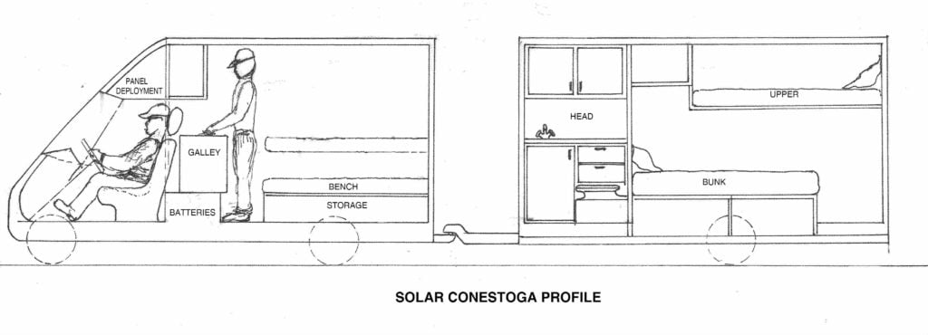
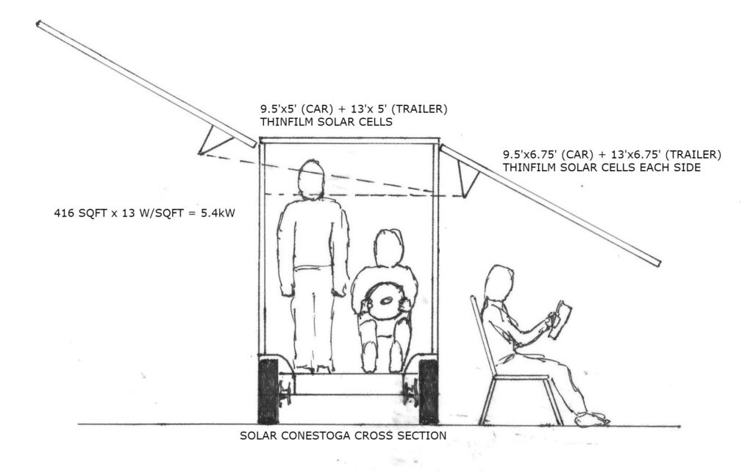
SOLAR CONESTOGA
(Rik van Hemmen concept) https://martinottaway.com/rhemmen/solar-conestogas/ rhemmen@martinottaway.com
NISSAN LEAF DRIVE TRAIN
80KW motor
24KWh BATTERY
100 MILE RANGE
(5 hour charge time)

Slide 3
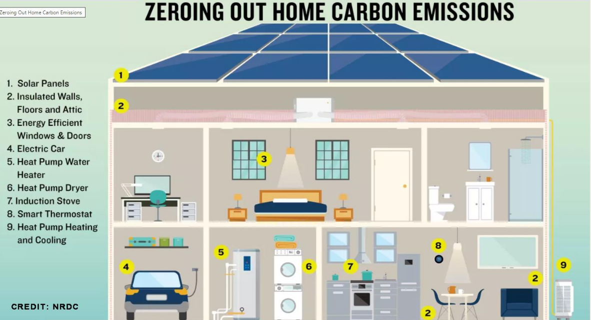

Slide 4


Slide 5
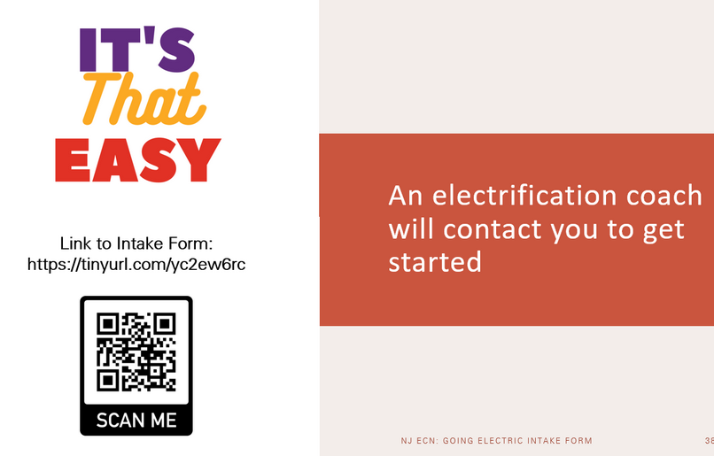
REQUEST A FREE ELECTRIFICATION COACH
Provide your name, city, county, state, and email.
Answer a few simple questions:
Why do you want to electrify your home/apartment?
Do you have an anticipated time frame to start on your electrification journey?
Do you have an estimated cost in mind for your electrification improvements?
We recommend that you fill out Rewiring America’s Personal Electrification Planner.

