Slide 1


Why NJ Electric Rates Are Increasing So Dramatically in June and What You Can Do About It
The NJ Electrification Coaching Network Explains:
It’s NOT due to the push for clean energy
NJECN.substack.com:
Notes:
You may have heard that NJ customers will get an Increase in electric rates of about 20% in June. Why is that? What can you do?
NJECN is group of volunteers and clean energy advocates who can help advise you for free on various electrification projects for your home.
We felt obliged to make a statement about why this increase is happening, because we don’t want it to be unfairly blamed on clean energy.
Last month, we gave the short version. This month, we’re looking in more detail at how electricity rates are set, so that you can judge the conflicting reports yourself. We also provide recommendations about what you can do individually, or what all of us can do together.

Slide 2
Energy Prices Are Rising
Electric rates will rise ~20% in June
Gov. Murphy has asked for an investigation
We’ll describe why
Gas prices are expected to rise also:
US EIA:
$2.10/MMBTU in 2024 => $4.60/MMBTU in 2025/6
Notes:
Just to add some context, it’s not only electricity prices that will rise. Gas prices are expected to rise also.

Slide 3
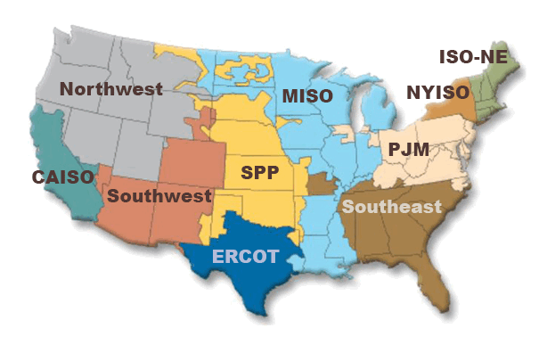
PJM Manages Your Power
Who are they?
Notes:
Many people have never heard of PJM, although PJM is the one who manages your electric power. PJM is one of the RTOs – Regional Transmission Organizations. The RTOs were established when energy was deregulated in the 1990s. You may have heard news stories about other RTOS such as ERCOT in Texas, CAISO in California, or the NY and NE RTOs.

Slide 4
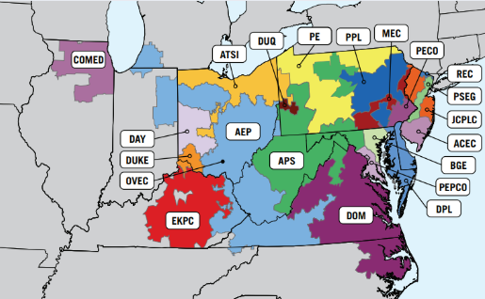
Electric Utilities within PJM
Notes:
Here’s a closer look at PJM and the utilities that comprise it. Note NJ’s electric utilities – REC, PSEG, JCPLC, ACEC. PJM is comprised of 13 states, which include not only Pennsylvania, New Jersey, Maryland (hence the name) but also states as far west as Illinois and as far south as NC. The states are very different and may have conflicting interests. There is coal-powerhouse WV. PA is a large natural gas producer, and VA could become the home of a number of large power-hungry data centers.

Slide 5
Who Are the Players?
Regulatory
FERC – Federal Energy Regulatory Commission
Sets rules for all Regional Transmission Organizations
Regulates transmission lines
NJBPU – State of NJ, Board of Public Utilities
Sets policies and programs
Regulates utility costs to maintain distribution lines and substations
Does NOT determine energy pricing
Rate Counsel – State of NJ agency – 20% of voting membership of PJM
Represents the interest of ratepayers in all proceedings
Operating units
PJM – Regional Transmission Organization, for 13 states
Determines energy pricing via auctions
Approves interconnections of new energy suppliers
80% of voting membership are holding companies, generation & transmission owners, utilities ,etc
20% of voting membership is Rate Counsel
Electric Utilities, or Electric Distribution Companies (EDC)
Customer administration and local maintenance
E.g. PSE&G, JCP&L, ACE, Orange & Rockland
Electric holding companies
Owners of generation & transmission facilities, utilities, other electric services
Notes:
Various companies and agencies are involved in energy production, regulation, and distribution. (Read the slide)

Slide 6

Your Bill
(40%) Delivery cost
Distribution lines, meters, etc managed by local utility
Regulated by NJ BPU. NOT the cause of the increase.
(60%) Supply cost
Energy cost, managed by PJM, NOT the State of NJ
Price is determined by auctions
Energy purchase: Daily auctions
Capacity purchase: Yearly auctions: THIS IS THE CAUSE
Power generators are paid simply to be available in case they are needed
Notes:
Your bill is divided into 2 parts, although it might be a little difficult to read! About 40% is the cost to DELIVER energy to you. That part is regulated by the NJ BPU. That is NOT the part that is going up.
About 60% of the bill is the actual cost of energy, which is managed by PJM. That IS the part that is going up. And energy costs come in 2 parts – the actual energy that is purchased on a daily basis and payments to the energy suppliers who are paid to stand by, in case they are needed. More on that soon.

Slide 7
How Power Is Managed Every Day
“Firm capacity” vs Variable Renewable Energy
Firm: Turn it on/off when needed
Could be slow or fast to respond
Natural gas, nuclear, oil, coal, hydropower
Variable Renewable: Use it when its available
Solar (20%), Off Shore Wind (65%)
Mixed: Available for short periods of time
Battery storage (must be charged, lasts a few hours)
Notes:
Before we can explain how prices are set, you have to know a little bit about how the grid operates every day. Energy is generally classified into 2 or 3 different categories (Read slide)

Slide 8
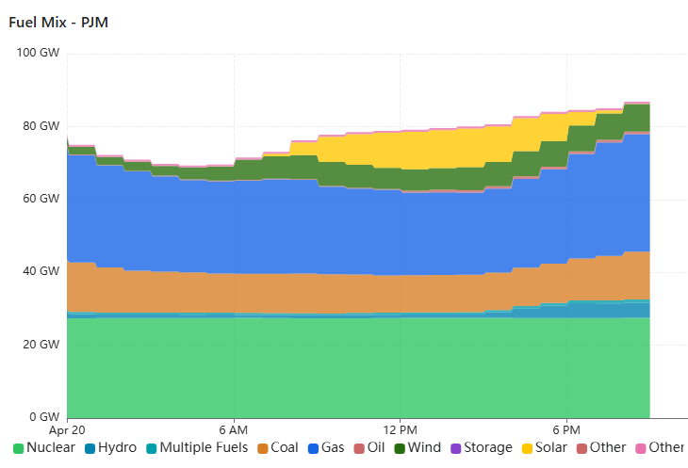
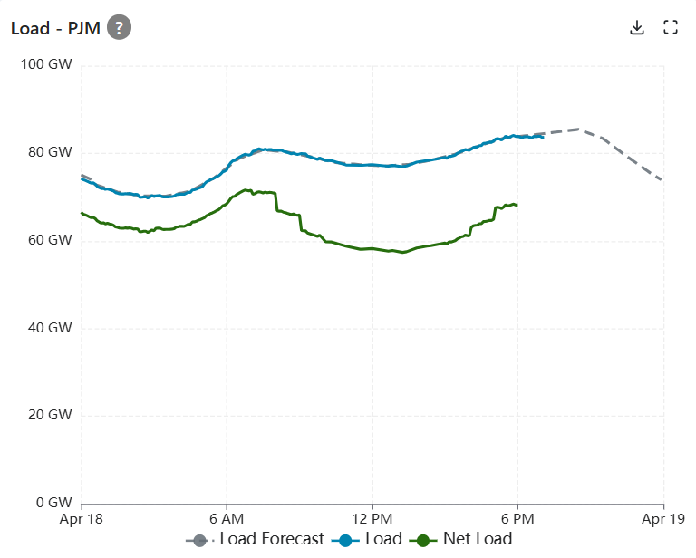
PJM Actual Grid Use Different Kinds of Energy
The Duck Curve
Credit: https://www.gridstatus.io/live/pjm
Notes:
Let’s take a short detour to explain how your power is managed on a minute-by-minute basis. Now let’s look at the energy demand, which is typically not constant. There’s a low demand overnight, then it spikes up in the morning, levels a bit in the afternoon, and has it’s biggest spike in the late afternoon and early evening. I took a snapshot on Friday, April 18. This graph also shows the “net load”, or the energy that the rest of the system has to supply, after wind and solar have contributed what they can. Sometimes this curve is called the “duck curve”, if you use your imagination a little. You’ll see a little more later.
The dotted line is the forecast, given at 3pm each day, and the solid blue line is what is actually needed and supplied.
Where does that power actually come from? Here is an example on April 20, a Sunday. About 1/3 of the power is nuclear (green) and it stays quite constant. Solar power (yellow) increases during the day and goes to zero over night. Wind (dark green) was apparently increasing during the day. Coal (orange) and natural gas (darker blue) decreased as the renewable energy came online, and then they increased as solar went offline.

Slide 9
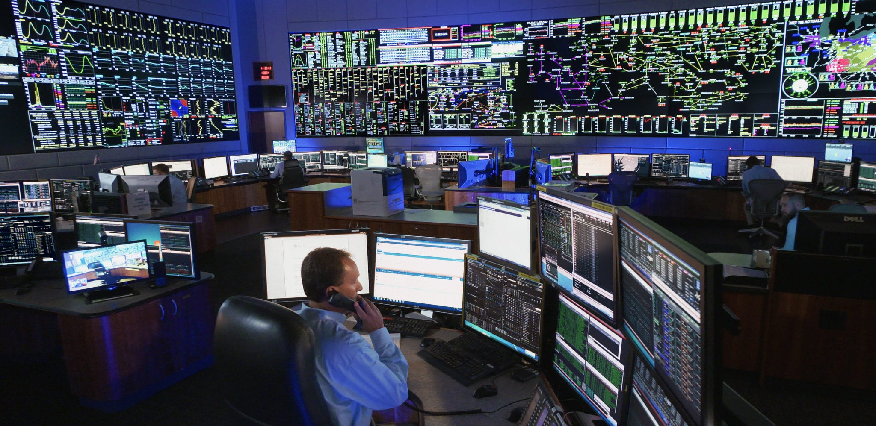
PJM Control Room
Credit: https://www.rtoinsider.com/70686-five-pjm-states-bills-requiring-utilities-file-stakeholder-votes/
Notes:
Who makes sure that the actual power matches what is needed? The PJM control room. They bring up/shut down power as needed, according to the prices determined in the auction, described next. <Joke: In case you were wondering what your kid who loves video games is going to do when he grows up, maybe tell him about this! An unscheduled outage! A storm! Unplanned surge in usage!> Sorry, couldn’t resist…

Slide 10
SUPPLY COST:
Long Term & Short Term Planning
Buying Capacity
Buying Energy
15% typically, not this time!
75%
Notes:
Now that you know how the grid operates, let’s look at how energy is purchased to supply the forecasted need. We said that 60% of your bill is the Supply Cost. Where does that come from? Basically, there are 2 parts - Capacity and Energy, so let’s look at each of these. Remember that “Capacity” is the cost to pay suppliers to “stand by” in case they are needed.
15% of the supply cost is for Capacity, 75% for the actual energy, 10% for other services.

Slide 11
Buying Capacity (Long Term Planning)
Auction simulates free market –
Lower price suppliers push out higher price suppliers
Base Rate Auction - every year covering 3 years into the future
(DEMAND to satisfy) Determined by energy forecast
Flat demand for a long time in the past
THIS TIME: Large increase: data centers, AI, mfg
(SUPPLY to bid) Suppliers bid with fixed costs (not operating cost) of supplying a specific amount of energy
Bids from Firm Capacity suppliers only – can be called on at any time
PJM selects enough suppliers by price to meet the peak forecast demand
Winning suppliers are paid to stand by, every day
Base Rate Auction WAS THE PROBLEM!!! Stay tuned…
Notes:
To explain capacity, let’s make an analogy to paying firefighters. We pay them to be available in case we need them. If there’s an actual fire, we could also pay them overtime, or we could place an emergency call to neighboring towns to ask for help from their firefighters.
So, we pay energy suppliers to stand by. We pay their fixed costs and if they actually supply energy, then we pay them for the energy also. But, they have to be guaranteed to be available, so only firm capacity suppliers, like natural gas/nuclear/coal are eligible (not strictly true, but that’s another whole level of detail).
How do we choose which suppliers to pay and how much? By auctions. (Read slide)

Slide 12
Buying Energy (Short Term Planning)
Day-ahead auctions to meet daily forecast of energy
Max peak is 145 GW in summer, less in winter
Variable renewable energy can be used
Covers operating costs, not fixed costs
Operators bring energy suppliers online/offline as needed
Most expensive selected price is the “clearing price”.
EVERY SUPPLIER gets the clearing price
So, peak energy needs have a huge effect on the price
In addition, a very short term market:
Real-time energy market for emergency outages & unforecast demand
Notes:
Now let’s shift to talking about buying the actual energy on a daily basis. (Read slide)

Slide 13
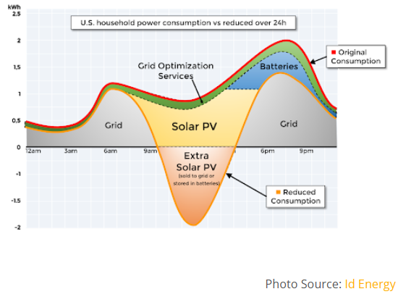
The Peak Determines the Price Bringing Down the Short-Term Peak
Battery storage
Demand Response
Heat pumps more efficient than AC, so they reduce the peak
Additional load in winter is still not an issue since winter peak is smaller
BPU mandates 2% efficiency improvements every year
Notes:
As we saw on the last slide, the PEAK determines the price, since enough suppliers are selected to meet the peak, and they ALL are paid the same price as the last one in. So, the name of the game in holding down energy prices is to bring down the peak. Here is an example of how the peak can be reduced.
We see the “duck curve” we talked about earlier, and this one looks more like a duck! You can see the demand rise in the morning, decline a little, then peak in the afternoon. You can also see that solar renewables supply a LOT of energy in the middle of the day and then decline as evening approaches, and while it is active, it is reducing the power that is required from all other sources, and in fact it can even supply more energy than the grid requires. That extra energy COULD be used to charge batteries. Then the batteries can be used to supply power during the peak, just as solar is declining and thereby holding down the energy that is required from other sources.
There are also effects from Grid Optimization, e.g. Demand Response, where customers agree to cut their usage on cue from their utilities, to bring down the peak. So for example, Evs might be stopped from charging then, or thermostat settings might be changed by a small amount. And of course, general efficiency improvements help out also, by reducing the peak EVERY day. Weatherizing your home, or using Energy Star appliances, reduce the peak. And Heat pumps are much more efficient than AC in the summer, also bringing down the peak in the summer (which BTW is higher than the winter peak here in NJ). All of these help to reduce the price you pay.

Slide 14
The Peak Determines the Price Bringing Down the Long-Term Peak
(DEMAND FORECAST) Utilities provide individual forecasts
Is the forecast real? Transparency needed.
Are large energy users counted more than once?
Are they serious?
Ask large new energy users to put down deposit
Should large users bring their own energy? Or pay the full cost instead of ratepayers?
(SUPPLY QUEUE) Can the project be built in a timely fashion?
PJM queue of unreviewed energy suppliers is HUGE (145 GW)
Approved but unbuilt energy supply is also large (50 GW)
Notes:
We talked about bringing down the short term peak, but what can we do over the long term, to hold prices down? We have to examine both supply and demand. Prices are determined in an auction, to meet a forecast of demand, but is the forecast accurate? If the DEMAND forecast is too large, we’ll be paying for capacity we don’t need and/or falsely encouraging new supplies to be built. (Read slide)
Now look at the SUPPLY side. PJM has to approve the interconnection of all new suppliers to the grid. If the queue for approving new SUPPLY interconnections doesn’t move fast enough, we’ll be artificially inflating the price. (Read slide)

Slide 15
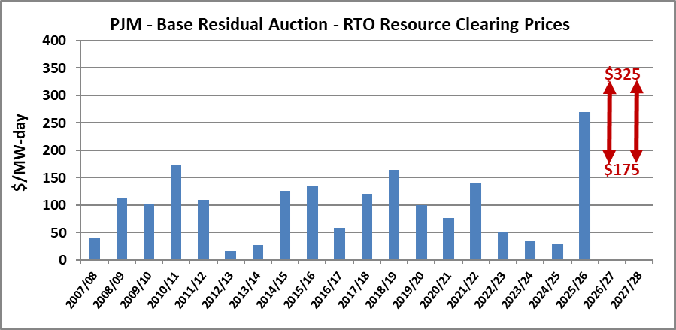
What Happened in the Last Capacity Auction?
Prices ⬄ Supply & Demand
Notes:
This is what happened in the Capacity Auction. There was a 10 fold increase in cost. (The red arrows represent a later lawsuit, setting a floor and ceiling price on the auction.) The question is why?

Slide 16
What Happened in the Last Capacity Auction?
Prices ⬄ Supply & Demand
Demand
PJM forecast a large demand increase: data centers, AI, onshoring of mfg
Not due to amount of clean energy: EVs < 1%, heat pumps even less
Heat pumps and solar energy help by decreasing the summer peak
Supply
PJM has a HUGE backlog of energy suppliers waiting for permission to connect
PJM auction rule changes understated the supply
Later changed via lawsuit & FERC, new auction in July
Notes:
Some very different things happened this time on both the supply and demand side.
On the Demand side:
PJM forecast some large new users – data centers, AI, and new mfg.
Some say that new electrification is causing the new demand increase. No – EV’s < 1%, heat pumps even less. In fact, heat pumps and solar energy help decrease the summer peak energy usage.
There are also big problems on the supply side:
As we saw, new suppliers haven’t been approved by PJM, and approved ones haven’t been connected.
And some complex PJM rule changes understated the supply.
So PJM had issues in managing both the supply and forecasting the demand.
You may have heard that Gov Murphy suggested that this auction should be investigated by FERC, the Federal Energy Regulatory Commission. And there has been a lawsuit. There will be a new auction in July.

Slide 17
Recommendations
For You Now
For Everyone Later
Notes:
You made it through the explanations! So what can you do about this? We have 2 sets of recommendations – ones that you can do yourself now to decrease your bill, and others that involve rule and policy changes.

Slide 18
What can YOU do NOW to decrease your bill?
Cut down on wasted energy by getting an energy audit and weatherizing your home
Subscribe to the new Demand Response programs from your utility to qualify for reduced prices. Ask your utility how you can sign up.
Buy lower cost clean energy
Subscribe to Community Solar
Install rooftop solar
Buy from an independent supplier instead of your utility, but be careful to read the fine print since a long term variable rate can also result in a higher bill.
Notes:
What can YOU do?
NJECN can help you with these.
Stop throwing away energy. Get an energy audit and weatherize your home. There are rebates to help with that.
Sign up for your utility’s Demand/Response program and qualify for lower energy prices from your utility. Demand/Response allows the utility, WITH YOUR PERMISSION, to turn your thermostat up or down when peak energy usage is threatening to create problems or high prices on the electric grid.
You can also buy LOWER COST and CLEAN energy.
Easiest: Sign up for Community Solar. Community Solar is a program whereby large buildings construct solar installations on THEIR roofs, and you sign up for the energy produced by specific panels assigned to you. With a little fancy bookkeeping, you get the reduced cost energy from your assigned panels, instead of the energy that your utility sells you. You also get credits if they produce more energy than you consume, and in the case where they don’t produce ENOUGH power, you get the remaining energy you need at the regular utility price.
Harder: Rooftop solar panels also help – there’s usually about a 7 year ROI. I installed some and haven’t paid for electricity in 3 years except for January of 2024 which was very cloudy.
You can also buy from an independent supplier of clean energy, but this can be trickier – it could be more expensive, so read the contract carefully.
Now let me introduce Mike Winka, our expert on policy and regulations, to talk about how regulations and policies can be changed to obtain more reasonable outcomes. Mike?

Slide 19
How can future price increases
be prevented?
(NJ BPU):
Make Offshore Wind (OSW) a reality
11GB of power substantially affects supply & reliability
(PJM):
Speed up the energy review process
145 GW of supply in queue
Shovel-ready projects jump the queue
(Legislators):
Clear the pathway for more clean energy projects in NJ
(NJ BPU & Utilities):
Encourage Demand Response Programs, Plan transmission lines that limit suppliers
(PJM):
Get rid of rules that allowed artificially high prices
(Legislators): Pass bills S4143 and A5564
They require new large users of power, like data centers, to bring their own new clean energy.
Notes:
PJM chose 51 projects: https://www.pjm.com/-/media/DotCom/about-pjm/newsroom/2025-releases/20250502-pjm-chooses-51-generation-resource-projects-to-address-near-term-electricity-demand-growth.pdf
The projects are 2275 MWE (batteries), 14 coal, 7756 +365 gas, 1383 nuclear.
Gov Murphy announced exec actions on Wed May 14
Defer rate increases until after high usage summer months
Directs BPU to expedite more community solar
Directs BPU to examine how to bring more generation online
Identify policies to mitigate costs from increased demands from data centers
Evaluate proposals to bring more generation online quickly, especially clean energy.
Evaluate whether NJ is best served by PJM or whether there should be a smaller entity
Source: https://patch.com/new-jersey/teaneck/s/jbt17/major-announcement-as-nj-braces-for-large-increase-in-electric-rates?utm_source=alert-breakingnews&utm_medium=email&utm_campaign=alert&user_email=8b6f1759577f55420814390f2044a33ef8f251be30873728b3c3d6718acf3df1&user_email_md5=32dfdc9aa276d72019e72d44ae597c3e&lctg=63361148f5eb71696f0847c5

Slide 20
Price increases are due to supply/demand mismanagement. NOT the push for clean energy.
Request a free electrification coaching session at NJECN.substack.com
Summary here:
QR code for this article
Notes:
Better management of supply and demand is needed. Clean energy is not the problem

