Slide 1

Pat and Steve Miller
Oct 2023
ELECTRIFY EVERYTHING WITH INFLATION REDUCTION ACT (IRA)
Source: NASA
Notes:
J:\s\Documents\BE\2022-11-6-Trinity-Episcopal\2022-11-06-Moorestown-Slides.pptx
ID #3 - Can be used in noncommercial online and TV broadcasts of your presentation.
And then on the last of the Apollo missions, this image known as the Blue Marble, became the most reproduced photograph in all of human history. The climate crisis is now the biggest and most serious challenge that humanity has ever faced.
DESCRIPTION: Photo of Earth from Apollo 17, taken as the crew was traveling toward the moon, December 7, 1972
ADDITIONAL TALKING POINTS: This picture is called the “Blue Marble,” taken during the last Apollo mission.
What makes the photograph so unique and powerful is that it captures the complete circle of the earth, helping us see the big picture of our planet – and our lives on it.[1*] It was the first time the Apollo mission made it possible to capture almost the entire southern polar ice cap.[2*]
REFERENCES:
[1*] Ben Cosgrove, “Home, Sweet Home: In Praise of Apollo 17’s ‘Blue Marble’,” Time, April 11, 2014. http://time.com/3879555/blue-marble-apollo-17-photo-of-earth-from-space/
[2*] NASA Visible Earth, “The Blue Marble from Apollo 17," December 7, 1972. http://visibleearth.nasa.gov/view.php?id=55418

Slide 2


Notes:
ID #7753 - This slide deck may be used in non-commercial presentations that are recorded, broadcast, livestreamed, or presented in-person. You may add your own personal slides to it, but users should make sure they have permission to include any third-party content in their personal slides. You may also remove slides to reduce the length. This slide deck may not be re-published without permission from Climate Reality, used for commercial purposes, or used to support or oppose candidates (or groups of candidates) for elected office. Finally, this slide deck may not be used to claim that The Climate Reality Project endorses any particular legislative action.
This Act allocates almost $370 billion, according to the official estimate, to climate solutions and energy security, but it comes largely in the form of tax credits that don't have a limit on how many of them can be activated. So there are many experts who believe that it's going to be much larger than that.
DESCRIPTION: Text stating that as written, the IRA allocates $369 billion to energy security and climate solutions
SLIDE SOURCE(S): https://www.whitehouse.gov/wp-content/uploads/2022/12/Inflation-Reduction-Act-Guidebook.pdf; https://www.democrats.senate.gov/imo/media/doc/inflation_reduction_act_one_page_summary.pdf

Slide 3
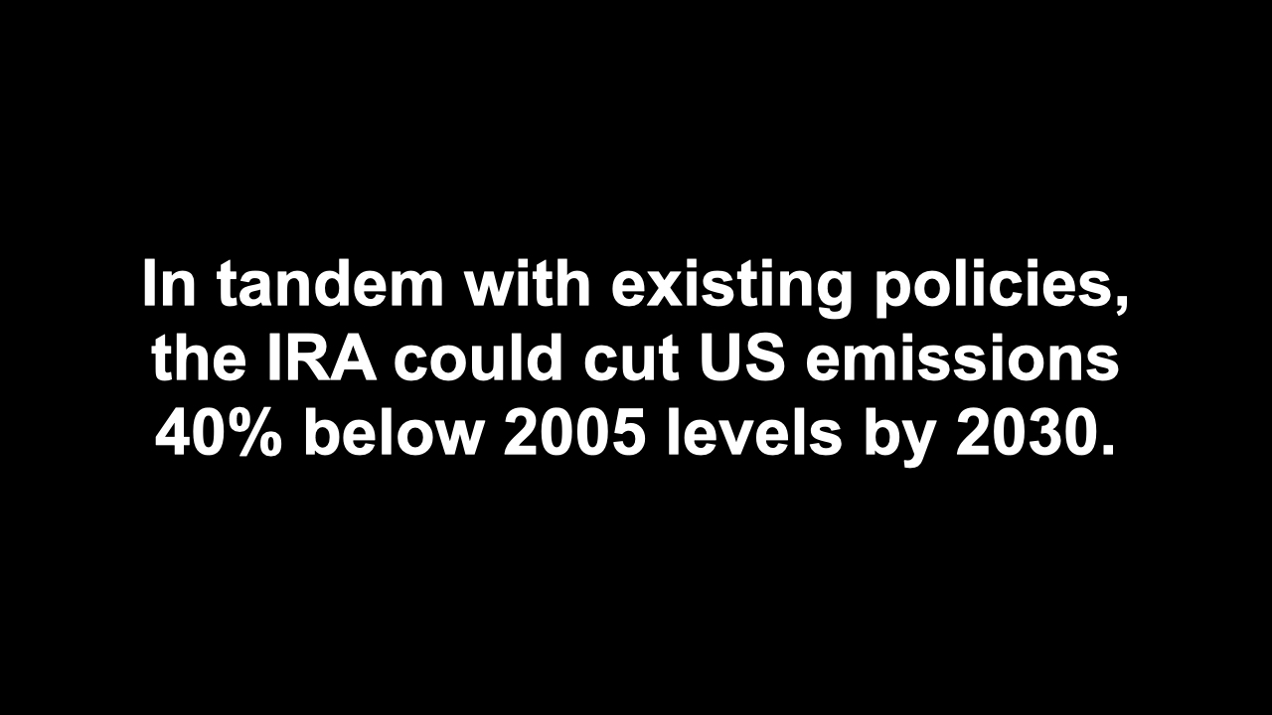
Notes:
ID #7759 - This slide deck may be used in non-commercial presentations that are recorded, broadcast, livestreamed, or presented in-person. You may add your own personal slides to it, but users should make sure they have permission to include any third-party content in their personal slides. You may also remove slides to reduce the length. This slide deck may not be re-published without permission from Climate Reality, used for commercial purposes, or used to support or oppose candidates (or groups of candidates) for elected office. Finally, this slide deck may not be used to claim that The Climate Reality Project endorses any particular legislative action.
This law, when combined with existing policy, will enable the US to sharply reduce global warming pollution by 40% or so below the 2005 levels. That's getting close to the commitments we made as part of the Paris Agreement.
DESCRIPTION: Text stating that in tandem with existing policies, the IRA could cut US emissions 40% below 2005 levels by 2030
SLIDE SOURCE(S): https://rhg.com/research/climate-clean-energy-inflation-reduction-act/

Slide 4
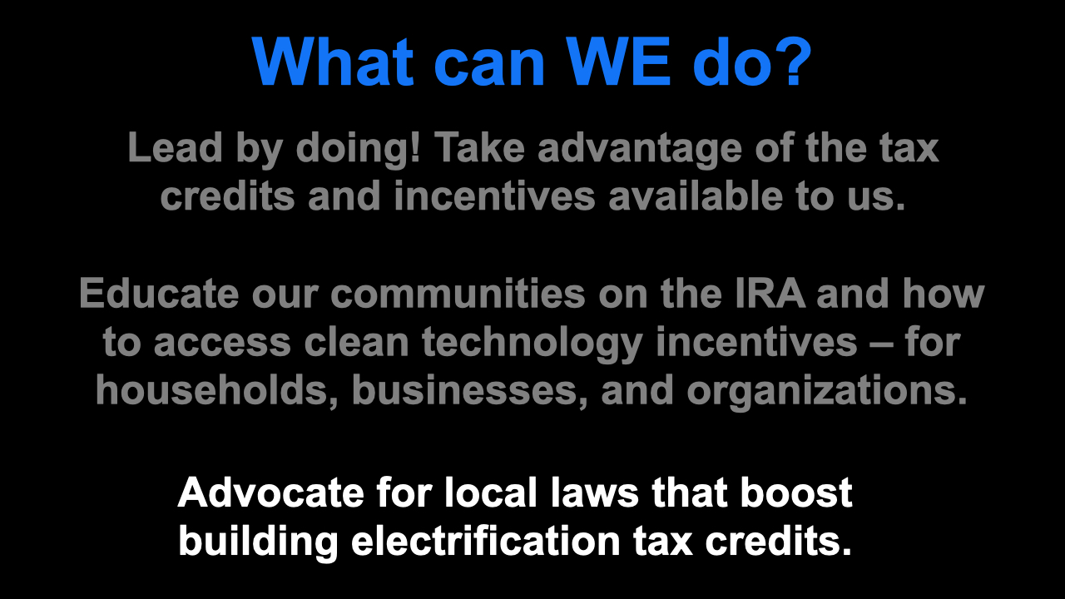
Notes:
ID #7847 - This slide deck may be used in non-commercial presentations that are recorded, broadcast, livestreamed, or presented in-person. You may add your own personal slides to it, but users should make sure they have permission to include any third-party content in their personal slides. You may also remove slides to reduce the length. This slide deck may not be re-published without permission from Climate Reality, used for commercial purposes, or used to support or oppose candidates (or groups of candidates) for elected office. Finally, this slide deck may not be used to claim that The Climate Reality Project endorses any particular legislative action.
So what can we do? Lead by doing! We need to get active and take advantage of the tax credits and incentives that are available to each one of us. We can educate our communities on the IRA and its provisions and how to gain access to the clean technology incentives. That's for households, it's for businesses, and for NGOs and other organizations. We can advocate for new local laws that boost the electrification of buildings to take advantage of the enormous tax credits that are available there.
DESCRIPTION: Text explaining what WE can do: lead by doing — take advantage of the tax credits and incentives available to us; educate our communities on the IRA and how to access clean technology incentives – for households, businesses, and organizations; and advocate for local laws that boost building electrification tax credits

Slide 5
Top 3 Greenhouse Gas (GHG) Emissions Sources in NJ: 87% of All Emissions
  Electricity generation (19%)
  Transportation (42%)
  Residential and commercial buildings (26%)
RedUCE All 3

Slide 6

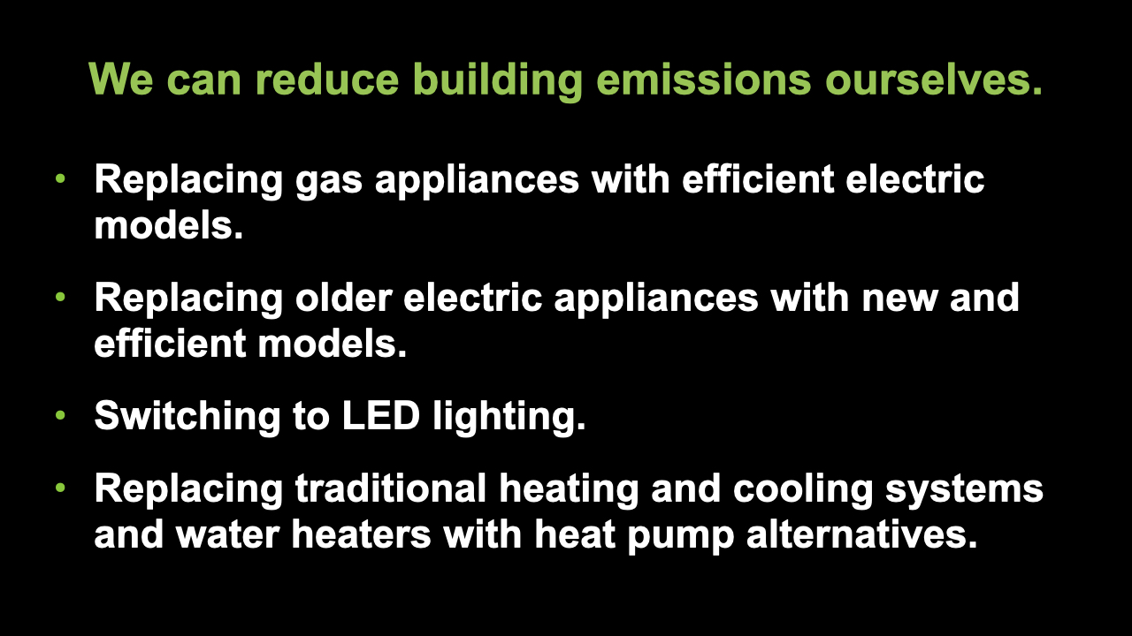
Notes:
ID #7850 - This slide deck may be used in non-commercial presentations that are recorded, broadcast, livestreamed, or presented in-person. You may add your own personal slides to it, but users should make sure they have permission to include any third-party content in their personal slides. You may also remove slides to reduce the length. This slide deck may not be re-published without permission from Climate Reality, used for commercial purposes, or used to support or oppose candidates (or groups of candidates) for elected office. Finally, this slide deck may not be used to claim that The Climate Reality Project endorses any particular legislative action.
There are many ways that individuals can pursue building decarbonization, including the replacement of gas-fueled appliances with more efficient electric alternatives. They can replace older electric appliances with newer, far more efficient models, because they've gotten a lot better in recent years. They can change the lightbulbs. I always say, "It's important to change the lightbulbs, more important to change the laws." But the lightbulbs are important. There are so many new options and different kinds of LEDs. They're cheaper, they last 10 times as long, they use far less electricity. Some people know this already, but for those who don't, let's encourage them to switch as well. They can replace their traditional HVAC systems, heating and air conditioning, with heat pumps, and they can replace their traditional water heaters with heat pump water heaters. This technology doesn't sound like it has a lot of so-called "sex appeal," but they're great, they're so much more efficient, and they save you so much money, and it doesn't matter how cold the climate is where you live. People in Maine, people in Canada, it works fine, doesn't matter how cold it is. Heat pumps are just much better.
DESCRIPTION: Text stating that we can reduce building emissions ourselves by replacing gas appliances with efficient electric models; replacing older electric appliances with new and efficient models; switching to LED lighting; and replacing traditional heating and cooling systems and water heaters with heat pump alternatives
SLIDE SOURCE(S): https://surveys.signforgood.com/rewiring-america-electrify-everything?code=jtk9-ot-fl

Slide 7

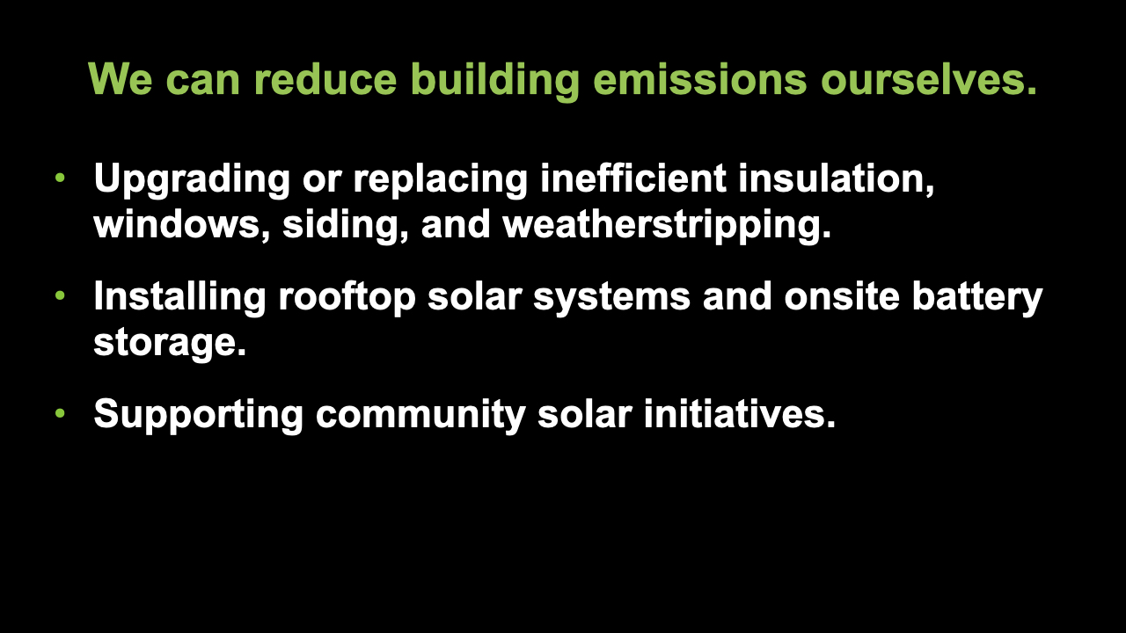
Notes:
ID #7869 - This slide deck may be used in non-commercial presentations that are recorded, broadcast, livestreamed, or presented in-person. You may add your own personal slides to it, but users should make sure they have permission to include any third-party content in their personal slides. You may also remove slides to reduce the length. This slide deck may not be re-published without permission from Climate Reality, used for commercial purposes, or used to support or oppose candidates (or groups of candidates) for elected office. Finally, this slide deck may not be used to claim that The Climate Reality Project endorses any particular legislative action.
It also means, by the way, replacing inefficient insulation, upgrading your insulation, making sure you have the best kinds of windows. Lots of heat goes out of poorly made, poorly designed windows in the winter, and a lot of cooling air goes out in the summer. Keep up with the weatherstripping and siding. There are now benefits available to help you do all of these things, including installing rooftop photovoltaic systems and installing on-site battery storage. Lots of people are doing this, and the provisions of this new law make it much easier for everybody to do it. Also, we can support community solar initiatives where individual solar systems aren't really that viable. Say, if you're living in an apartment, you can't put it on your windowsill, but you can be part of a group using community solar. That's a very fast-growing form of solar energy.
DESCRIPTION: Text stating that we can reduce building emissions ourselves by upgrading or replacing inefficient insulation, windows, siding, and weatherstripping; installing rooftop solar systems and onsite battery storage; and supporting community solar initiatives
SLIDE SOURCE(S): https://surveys.signforgood.com/rewiring-america-electrify-everything?code=jtk9-ot-fl

Slide 8
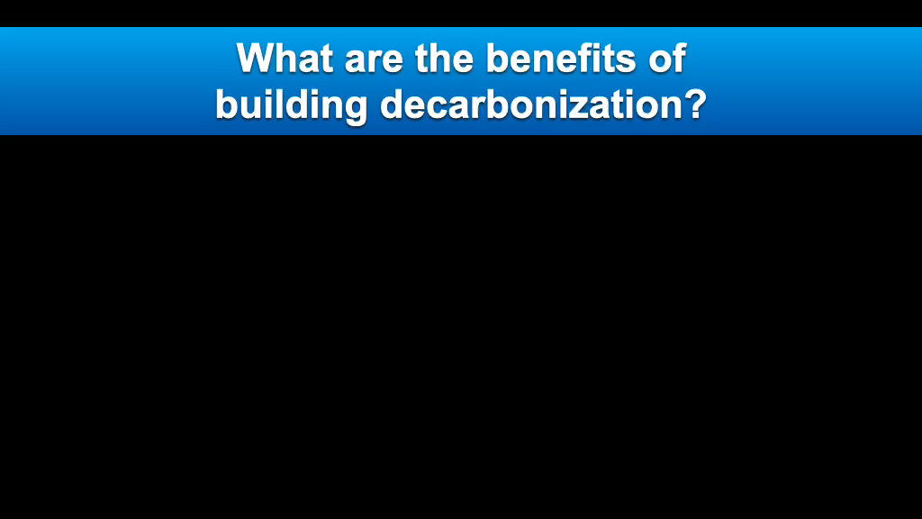
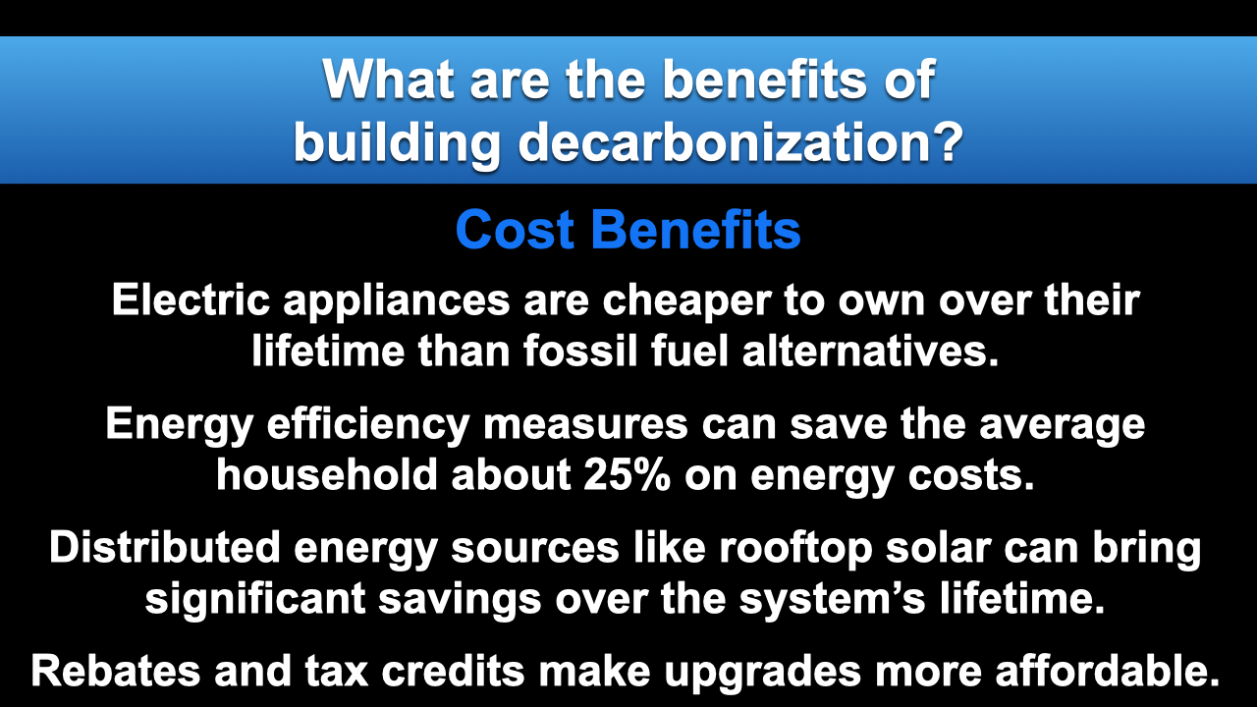
Notes:
ID #7852 - This slide deck may be used in non-commercial presentations that are recorded, broadcast, livestreamed, or presented in-person. You may add your own personal slides to it, but users should make sure they have permission to include any third-party content in their personal slides. You may also remove slides to reduce the length. This slide deck may not be re-published without permission from Climate Reality, used for commercial purposes, or used to support or oppose candidates (or groups of candidates) for elected office. Finally, this slide deck may not be used to claim that The Climate Reality Project endorses any particular legislative action.
And there are cost benefits. The electric appliances have a much lower lifetime cost of operating and cost of ownership than the fossil fuel-based alternatives. It's been proven. The energy efficiency measures can save the average household about 25% on energy costs, and that adds up to real money. Distributed energy sources – that's a phrase that often applies to rooftop solar – can bring significant savings over the life of the system. And the rebates and tax credits in this law make all of these upgrades far more affordable.
DESCRIPTION: Text explaining the cost benefits of building decarbonization. Electric appliances are cheaper to own over their lifetime than fossil fuel alternatives. Energy efficiency measures can save the average household about 25% on energy costs. Distributed energy sources like rooftop solar can bring significant savings over the system’s lifetime. Rebates and tax credits make upgrades more affordable.
SLIDE SOURCE(S): https://rmi.org/insight/the-economics-of-electrifying-buildings/; https://www.energysage.com/energy-efficiency/why-conserve-energy/cost-of-ee/; https://news.energysage.com/much-solar-panels-save/

Slide 9
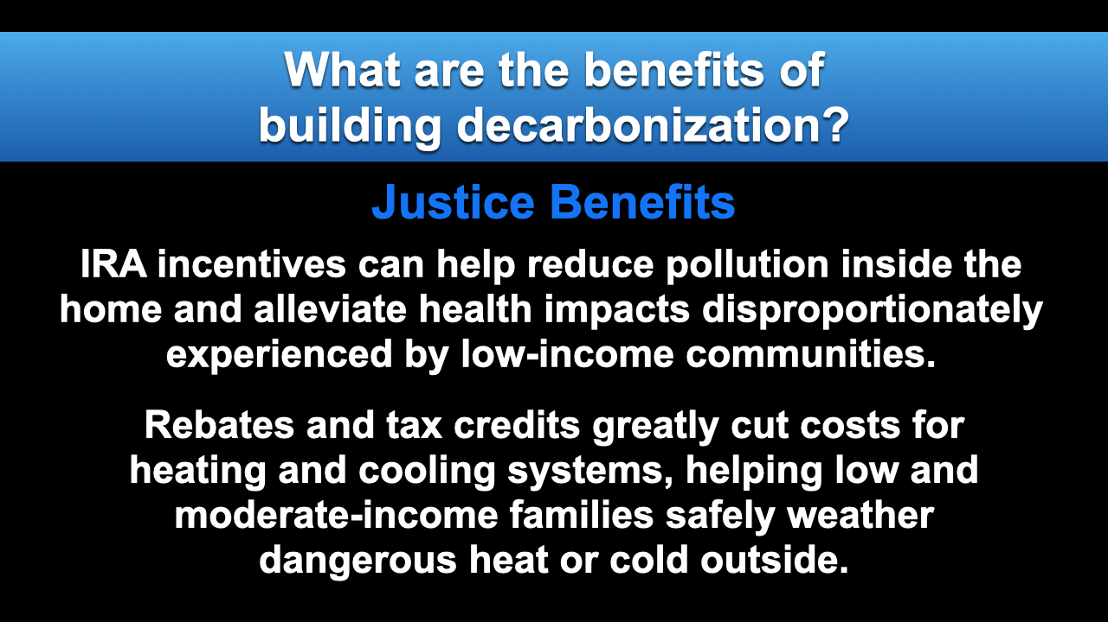
Notes:
ID #7853 - This slide deck may be used in non-commercial presentations that are recorded, broadcast, livestreamed, or presented in-person. You may add your own personal slides to it, but users should make sure they have permission to include any third-party content in their personal slides. You may also remove slides to reduce the length. This slide deck may not be re-published without permission from Climate Reality, used for commercial purposes, or used to support or oppose candidates (or groups of candidates) for elected office. Finally, this slide deck may not be used to claim that The Climate Reality Project endorses any particular legislative action.
There are benefits where environmental justice is concerned, and it's high time that we pay the kind of attention to that horrible challenge and the needed solutions that we see in this law. Home environments have been shown to be extremely important determinants of the health of the people who live in those homes, and low-income communities experience higher rates of asthma, especially among children, and are far more likely to suffer from the health impacts related to pollution and the exposure to extreme heat. These incentives will have maybe the biggest impact in the communities that have been unable, financially, to make these improvements. They're subsidized, and the benefits are tremendous. Available incentives also especially benefit the frontline communities by lowering their exposure to pollution inside the homes and increasing access to clean and affordable heating and cooling technologies.
DESCRIPTION: Text explaining the justice benefits of building decarbonization. IRA incentives can help reduce pollution inside the home and alleviate health impacts disproportionately experienced by low-income communities. Rebates and tax credits greatly cut costs for heating and cooling systems, helping low and moderate-income families safely weather dangerous heat or cold outside.
SLIDE SOURCE(S): https://rmi.org/eight-benefits-of-building-electrification-for-households-communities-and-climate/; https://rmi.org/insight/decarbonizing-homes/; https://www.novoco.com/notes-from-novogradac/inflation-reduction-act-overview-clean-energy-provisions-and-their-impact-affordable-housing

Slide 10


Notes:
ID #7809 - This slide deck may be used in non-commercial presentations that are recorded, broadcast, livestreamed, or presented in-person. You may add your own personal slides to it, but users should make sure they have permission to include any third-party content in their personal slides. You may also remove slides to reduce the length. This slide deck may not be re-published without permission from Climate Reality, used for commercial purposes, or used to support or oppose candidates (or groups of candidates) for elected office. Finally, this slide deck may not be used to claim that The Climate Reality Project endorses any particular legislative action.
You've heard a lot about gas stoves recently. I didn't realize until I looked at all the research, and we've seen some of it in the news media, one out of every eight cases of childhood asthma is linked to gas stove pollution, which leaks the methane into the room. I didn't know it, but it's a serious problem.
DESCRIPTION: Photo of an adult holding a baby while cooking on a gas stove, with text stating that about one-in-eight cases of childhood asthma in the US are caused by gas stove pollution
SLIDE SOURCE(S): https://www.mdpi.com/1660-4601/20/1/75

Slide 11
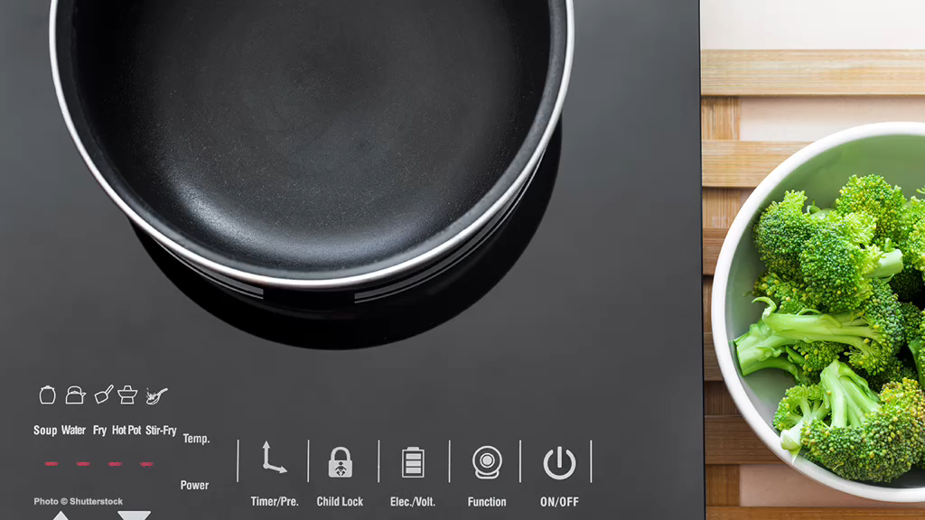
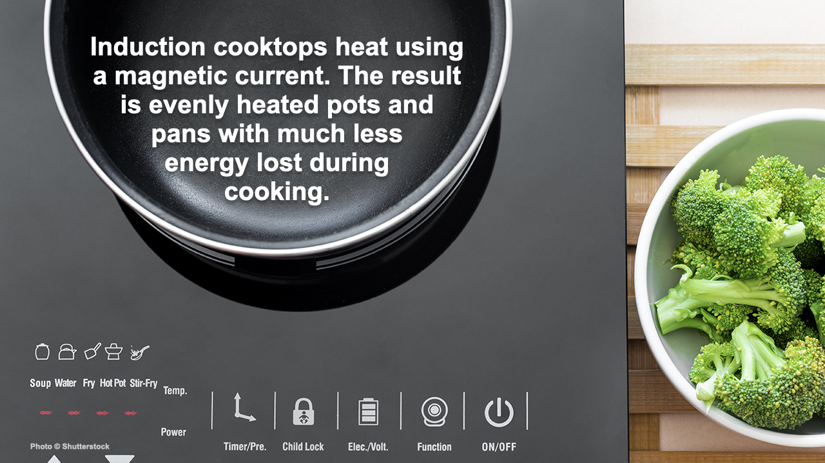
Notes:
ID #7870 - This slide deck may be used in non-commercial presentations that are recorded, broadcast, livestreamed, or presented in-person. You may add your own personal slides to it, but users should make sure they have permission to include any third-party content in their personal slides. You may also remove slides to reduce the length. This slide deck may not be re-published without permission from Climate Reality, used for commercial purposes, or used to support or oppose candidates (or groups of candidates) for elected office. Finally, this slide deck may not be used to claim that The Climate Reality Project endorses any particular legislative action.
Induction cooktops use heat in an unusual way. They use a magnetic current that is evenly distributed through the cooking pan. The experts have been recommending it for a long time. Now with these incentives, it's time to make that switch.
DESCRIPTION: Photo of an induction cooktop next to a bowl of broccoli, with text stating that induction cooktops heat using a magnetic current, and the result is evenly heated pots and pans with much less energy lost during cooking
SLIDE SOURCE(S): https://www.cnet.com/home/kitchen-and-household/induction-vs-electric-cooktops-which-is-right-for-you-in-2021/

Slide 12
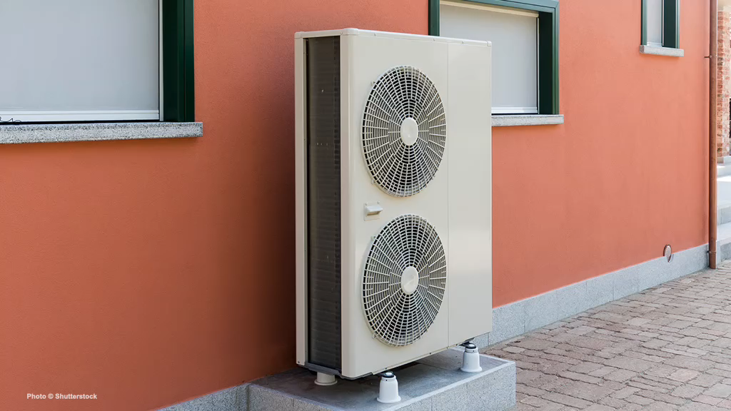
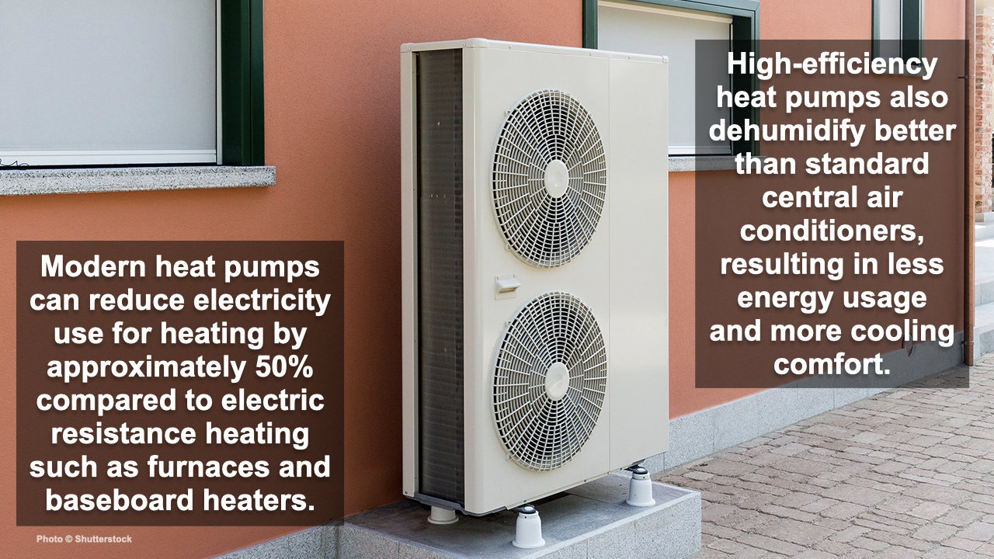
Notes:
ID #7871 - This slide deck may be used in non-commercial presentations that are recorded, broadcast, livestreamed, or presented in-person. You may add your own personal slides to it, but users should make sure they have permission to include any third-party content in their personal slides. You may also remove slides to reduce the length. This slide deck may not be re-published without permission from Climate Reality, used for commercial purposes, or used to support or oppose candidates (or groups of candidates) for elected office. Finally, this slide deck may not be used to claim that The Climate Reality Project endorses any particular legislative action.
I told you we'd talk about heat pumps. Here's an example of one. These modern heat pumps are incredibly efficient. They reduce electricity use for heating by half compared to electric resistance heating like furnaces and baseboard heaters. And the high-efficiency heat pumps dehumidify much better than the standard central air conditioning units, and that results in less energy use and more cooling comfort.
DESCRIPTION: Photo of a heat pump outside an orange building, with text stating that modern heat pumps can reduce electricity use for heating by approximately 50% compared to electric resistance heating such as furnaces and baseboard heaters. High-efficiency heat pumps also dehumidify better than standard central air conditioners, resulting in less energy usage and more cooling comfort.
SLIDE SOURCE(S): https://www.energy.gov/energysaver/heat-pump-systems

Slide 13
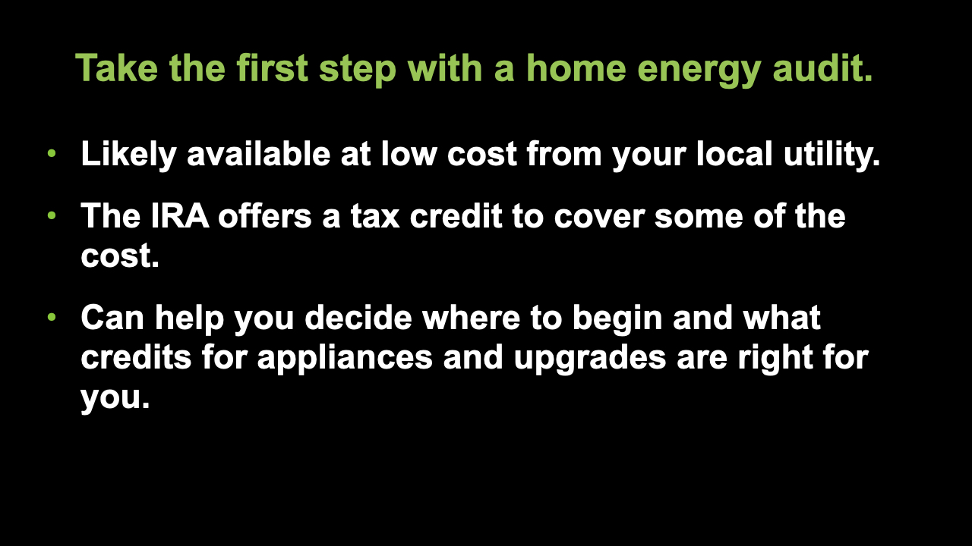
Notes:
ID #7874 - This slide deck may be used in non-commercial presentations that are recorded, broadcast, livestreamed, or presented in-person. You may add your own personal slides to it, but users should make sure they have permission to include any third-party content in their personal slides. You may also remove slides to reduce the length. This slide deck may not be re-published without permission from Climate Reality, used for commercial purposes, or used to support or oppose candidates (or groups of candidates) for elected office. Finally, this slide deck may not be used to claim that The Climate Reality Project endorses any particular legislative action.
A home energy audit is the first step on your journey toward electrification of your home. Your local electric utility likely offers this service at a very low price, and the IRA offers a tax credit to cover some of the cost of a home energy audit. It's worth getting. An audit can help you decide where to begin investing in the electrification of your home and in choosing the tax credits for efficient appliances and weatherization upgrades that are best for you.
DESCRIPTION: Text stating: take the first step with a home energy audit. Likely available at low cost from your local utility; the IRA offers a tax credit to cover some of the cost; and can help you decide where to begin and what credits for appliances and upgrades are right for you.
ADDITIONAL TALKING POINTS: A home energy audit will help you identify where your house may be leaking heat or otherwise consuming unnecessary energy.
SLIDE SOURCE(S): https://www.energy.gov/energysaver/professional-home-energy-assessments; https://www.nrdc.org/stories/consumer-guide-inflation-reduction-act; https://www.rewiringamerica.org/app/ira-calculator/information/weatherization

Slide 14
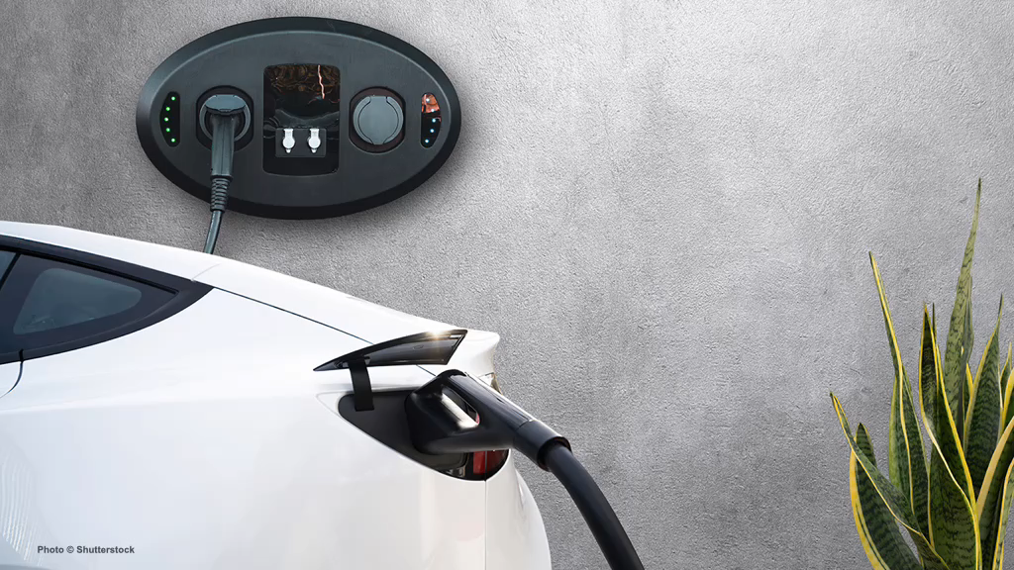
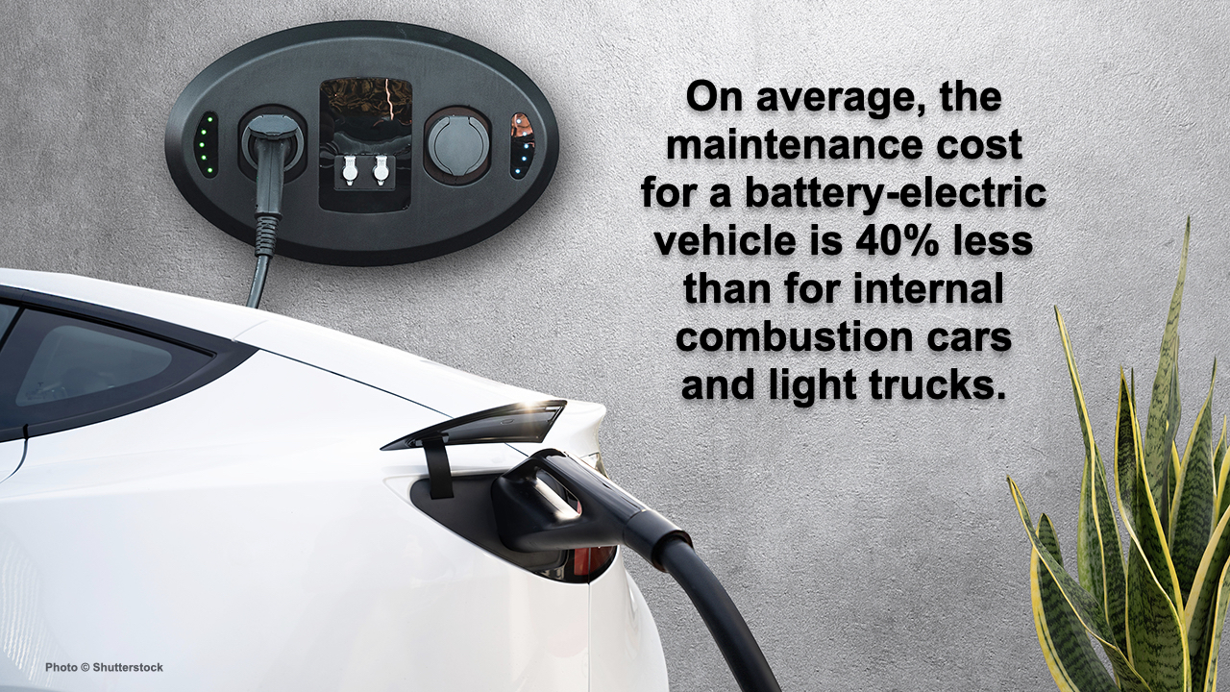
Notes:
ID #7872 - This slide deck may be used in non-commercial presentations that are recorded, broadcast, livestreamed, or presented in-person. You may add your own personal slides to it, but users should make sure they have permission to include any third-party content in their personal slides. You may also remove slides to reduce the length. This slide deck may not be re-published without permission from Climate Reality, used for commercial purposes, or used to support or oppose candidates (or groups of candidates) for elected office. Finally, this slide deck may not be used to claim that The Climate Reality Project endorses any particular legislative action.
When it comes to electric vehicles (EVs), you see the same improvements. On average, the maintenance cost for a battery-electric vehicle is 40% less than the maintenance cost for internal combustion engines and, of course, the cost of operation is much, much lower.
DESCRIPTION: Photo of a white EV plugged into a wall charger, with text stating that on average, the maintenance cost for a battery-electric vehicle is 40% less than for internal combustion cars and light trucks
SLIDE SOURCE(S): https://cleantechnica.com/2021/06/22/its-official-us-government-says-electric-vehicles-cost-40-less-to-maintain/

Slide 15
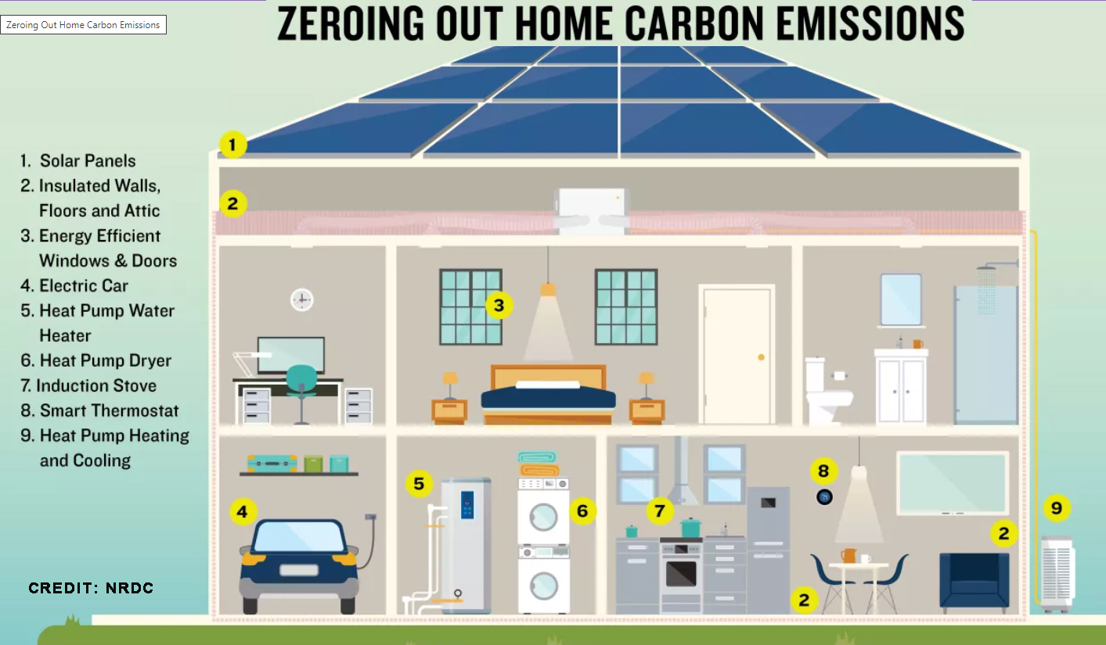

Slide 16
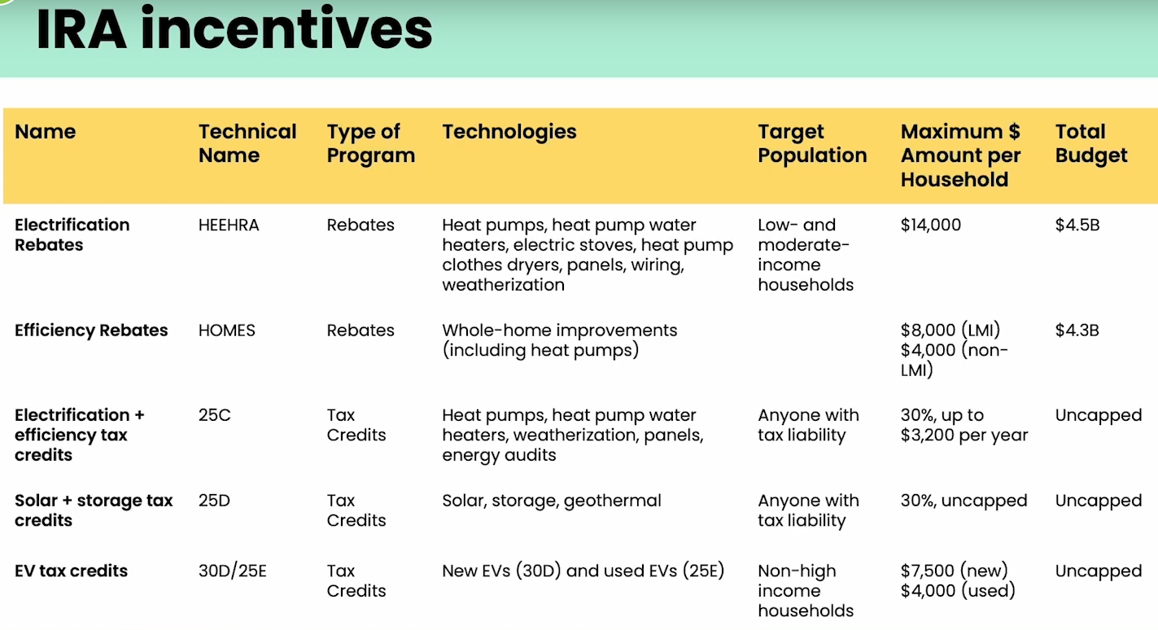
Navigating Individual incentives, by Dr. Leah Stokes
https://www.climaterealityproject.org/electrification-journey
Notes:
We know there are still many, many questions we all have about how the IRA rebates and tax credits will work. Pat showed some of the individual amounts that are available for some building electrification and efficiency measures, Evs and solar. This chart is a different view of the rebates and tax credits, by different programs they fall into. This is from a talk by Dr. Leah Stokes, who is affiliated with Rewiring America. She is showing the different provisions among the programs. For example, the top 2 lines are rebate programs covering electrification and efficiency, respectively. The electrification program, called HEEHRA, includes mostly electric appliances and basic weatherization for space heating. It is available only to low or moderate income, and has a cap for household and an overall budget cap. When the money allocated to each state runs out, it is done with.
The HOMES program is for whole-home efficiency measures. It is available to all, but in different amounts. The bottom 3 lines are tax credits. They each have different limitations such as annual caps by household, but the total budget is uncapped, meaning anyone can use them any year, and they never run out. The program names 25C, 25D,etc are IRS codes. You can google them to find details, but they are already in existence and change in 2023 so make sure you google 2023 details.

Slide 17
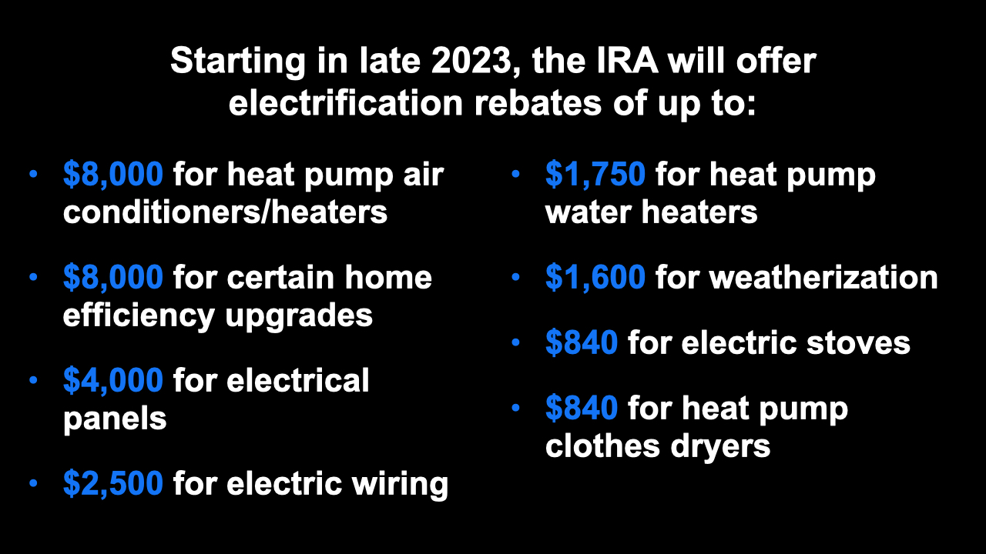
Notes:
ID #7855 - This slide deck may be used in non-commercial presentations that are recorded, broadcast, livestreamed, or presented in-person. You may add your own personal slides to it, but users should make sure they have permission to include any third-party content in their personal slides. You may also remove slides to reduce the length. This slide deck may not be re-published without permission from Climate Reality, used for commercial purposes, or used to support or oppose candidates (or groups of candidates) for elected office. Finally, this slide deck may not be used to claim that The Climate Reality Project endorses any particular legislative action.
Starting late this year, the IRA is going to offer rebates for electrification of up to $8,000 for heat pumps. So that makes it possible for virtually everybody to get. Another $8,000 for some home efficiency upgrades. These are really super important. $4,000 for electrical panels, and also $2,500 for electric wiring. So this is really helpful. And the heat pump water heaters that are so much more efficient, $1,750 per individual in the form of a rebate if you want to switch there, which you should. $1,600 for weatherization, which we were just talking about. $840 to help purchase the induction electric stoves, and $840 for heat pump clothes dryers also, another big efficiency gain.
DESCRIPTION: Text stating that starting in late 2023, the IRA will offer electrification rebates of up to: $8,000 for heat pump air conditioners/heaters; $8,000 for certain home efficiency upgrades; $4,000 for electrical panels; $2,500 for electric wiring; $1,750 for heat pump water heaters; $1,600 for weatherization; $840 for electric stoves; and $840 for heat pump clothes dryers
SLIDE SOURCE(S): https://www.rewiringamerica.org/app/ira-calculator

Slide 18
Navigating Individual incentives, by Dr. Leah Stokes
https://www.climaterealityproject.org/electrification-journey
Notes:
We know there are still many, many questions we all have about how the IRA rebates and tax credits will work. Pat showed some of the individual amounts that are available for some building electrification and efficiency measures, Evs and solar. This chart is a different view of the rebates and tax credits, by different programs they fall into. This is from a talk by Dr. Leah Stokes, who is affiliated with Rewiring America. She is showing the different provisions among the programs. For example, the top 2 lines are rebate programs covering electrification and efficiency, respectively. The electrification program, called HEEHRA, includes mostly electric appliances and basic weatherization for space heating. It is available only to low or moderate income, and has a cap for household and an overall budget cap. When the money allocated to each state runs out, it is done with.
The HOMES program is for whole-home efficiency measures. It is available to all, but in different amounts. The bottom 3 lines are tax credits. They each have different limitations such as annual caps by household, but the total budget is uncapped, meaning anyone can use them any year, and they never run out. The program names 25C, 25D,etc are IRS codes. You can google them to find details, but they are already in existence and change in 2023 so make sure you google 2023 details.

Slide 19
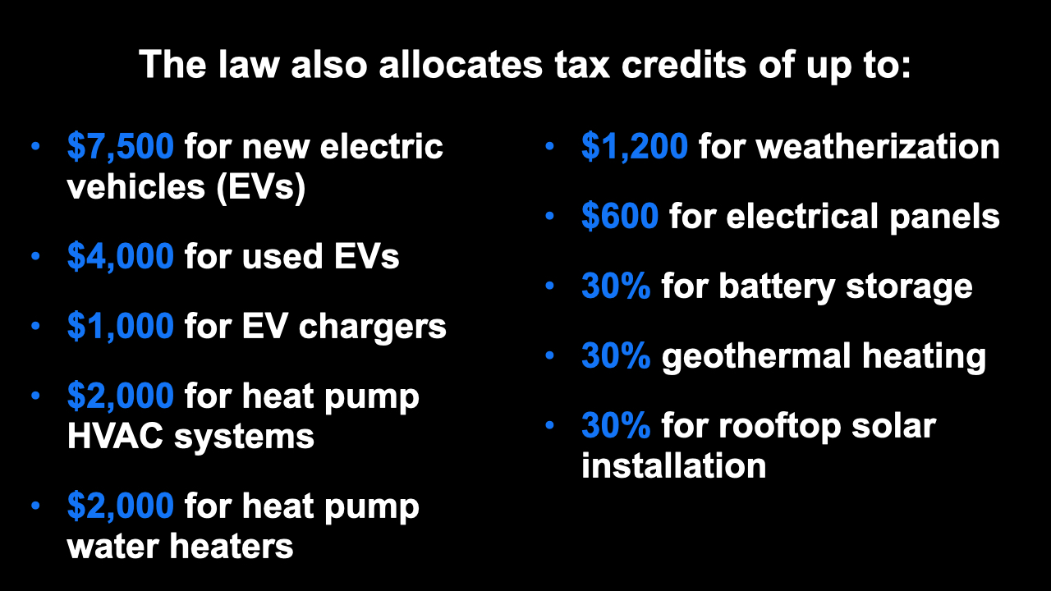
Notes:
ID #7856 - This slide deck may be used in non-commercial presentations that are recorded, broadcast, livestreamed, or presented in-person. You may add your own personal slides to it, but users should make sure they have permission to include any third-party content in their personal slides. You may also remove slides to reduce the length. This slide deck may not be re-published without permission from Climate Reality, used for commercial purposes, or used to support or oppose candidates (or groups of candidates) for elected office. Finally, this slide deck may not be used to claim that The Climate Reality Project endorses any particular legislative action.
The law also allocates tax credits of up to $7,500 for new EVs, and $4,000 for used EVs. That was an interesting debate when it took place, and the advocates made it clear this is really going to help low-income people who want to buy EVs and can't afford a new one. $1,000 for EV chargers you can put in your garage or wherever. And of course, they're also expanding in other provisions of the law, the public network of charging. $2,000 for heat pump HVAC systems. Another $2,000 for heat pump water heaters. These are all tax credits. $1,200 for weatherization. And again, money for the electrical panels, $600. And 30% for battery storage. 30% for geothermal heating – I use that. Not everybody does. I think everybody should, for new construction particularly. 30% for rooftop solar installation.
DESCRIPTION: Text stating that the law also allocates tax credits of up to: $7,500 for new electric vehicles (EVs); $4,000 for used EVs; $1,000 for EV chargers; $2,000 for heat pump HVAC systems; $2,000 for heat pump water heaters; $1,200 for weatherization; $600 for electrical panels; 30% for battery storage; 30% for geothermal heating; and 30% for rooftop solar installation
SLIDE SOURCE(S): https://www.rewiringamerica.org/app/ira-calculator

Slide 20
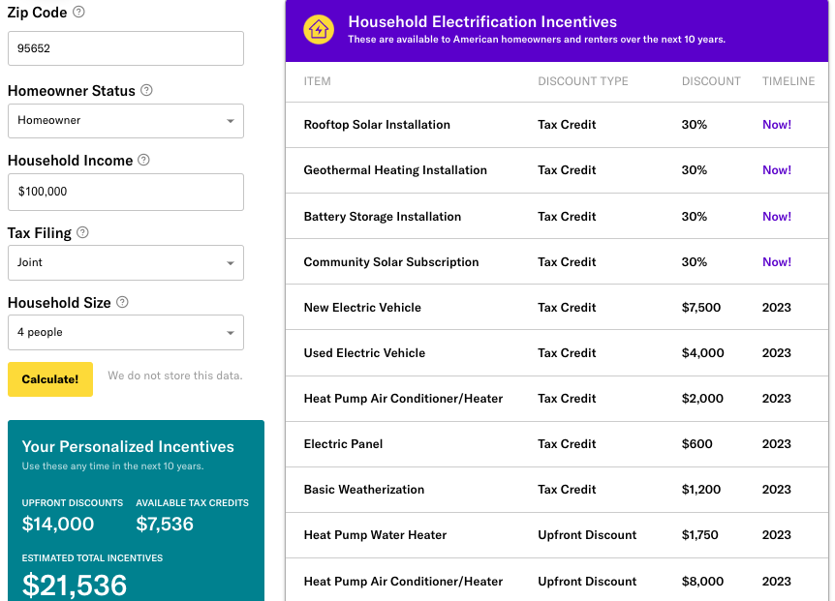
Rewiring America Savings Calculator https://www.rewiringamerica.org/app/ira-calculator
Rebates available up to $14,000 per household, plus tax credits
100% cost coverage for low-income households
  Up to $83,000 per year
50% cost coverage for mid-income households
  $83,000 to $155,000
Notes:
The home electrification and efficiency rebates in the bill include:
heat pumps for heating/air conditioning, water heaters, and clothes dryers
electric stoves;
electric cars;
home weatherization like improved insulation and windows;
rooftop solar and battery storage;
and wiring and breaker box upgrades.
• For low-income: will cover 100% of the costs of these upgrades up to $14,000
- low-income = 80% of median: Monmouth County: $83,000
• For middle-income: will cover 50% of the costs
- $83,000 — $155.000
• See URL above for Rewiring America to calculate your possible rebates and tax credits and when they go into effect

Slide 21
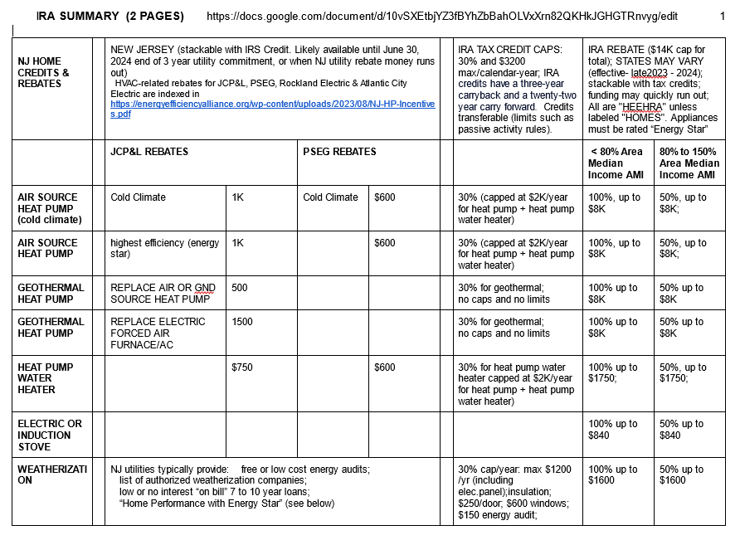
Notes:
There is a LOT more money available in a hundred pots at a higher level. For instance, to boost NEW construction closer to the ultimate of Net Zero, the Inflation Reduction Act offers $330 million in grants to states and local governments that adopt the latest energy codes meeting or exceeding the latest standards—plus double that for stretch codes aiming for Net Zero. New Jersey is poised to snag its share of cash with its adoption of the 2021 IECC (International Energy Conservation Code). Money can be used for many things, such as training of code enforcement officials.

Slide 22
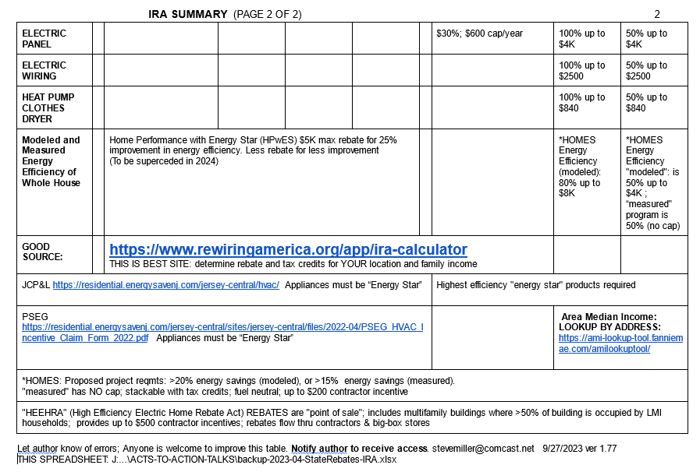

Slide 23
MILLER HOME
MIDDLETOWN, NJ
STAGED EFFICIENCY
AND ELECTRIFICATION by Steve Miller

Slide 24
Top 3 Greenhouse Gas (GHG) Emissions Sources in NJ: 87% of All Emissions
  Electricity generation (19%)
  Transportation (42%)
  Residential and commercial buildings (26%)
RedUCE All 3

Slide 25

COMMUNITY SOLAR
Clean Energy
Lower Energy Costs
No Panels on Your Property
BPU/Sustainable Jersey Community Solar www.sustainablejersey.com/communitysolar

Slide 26
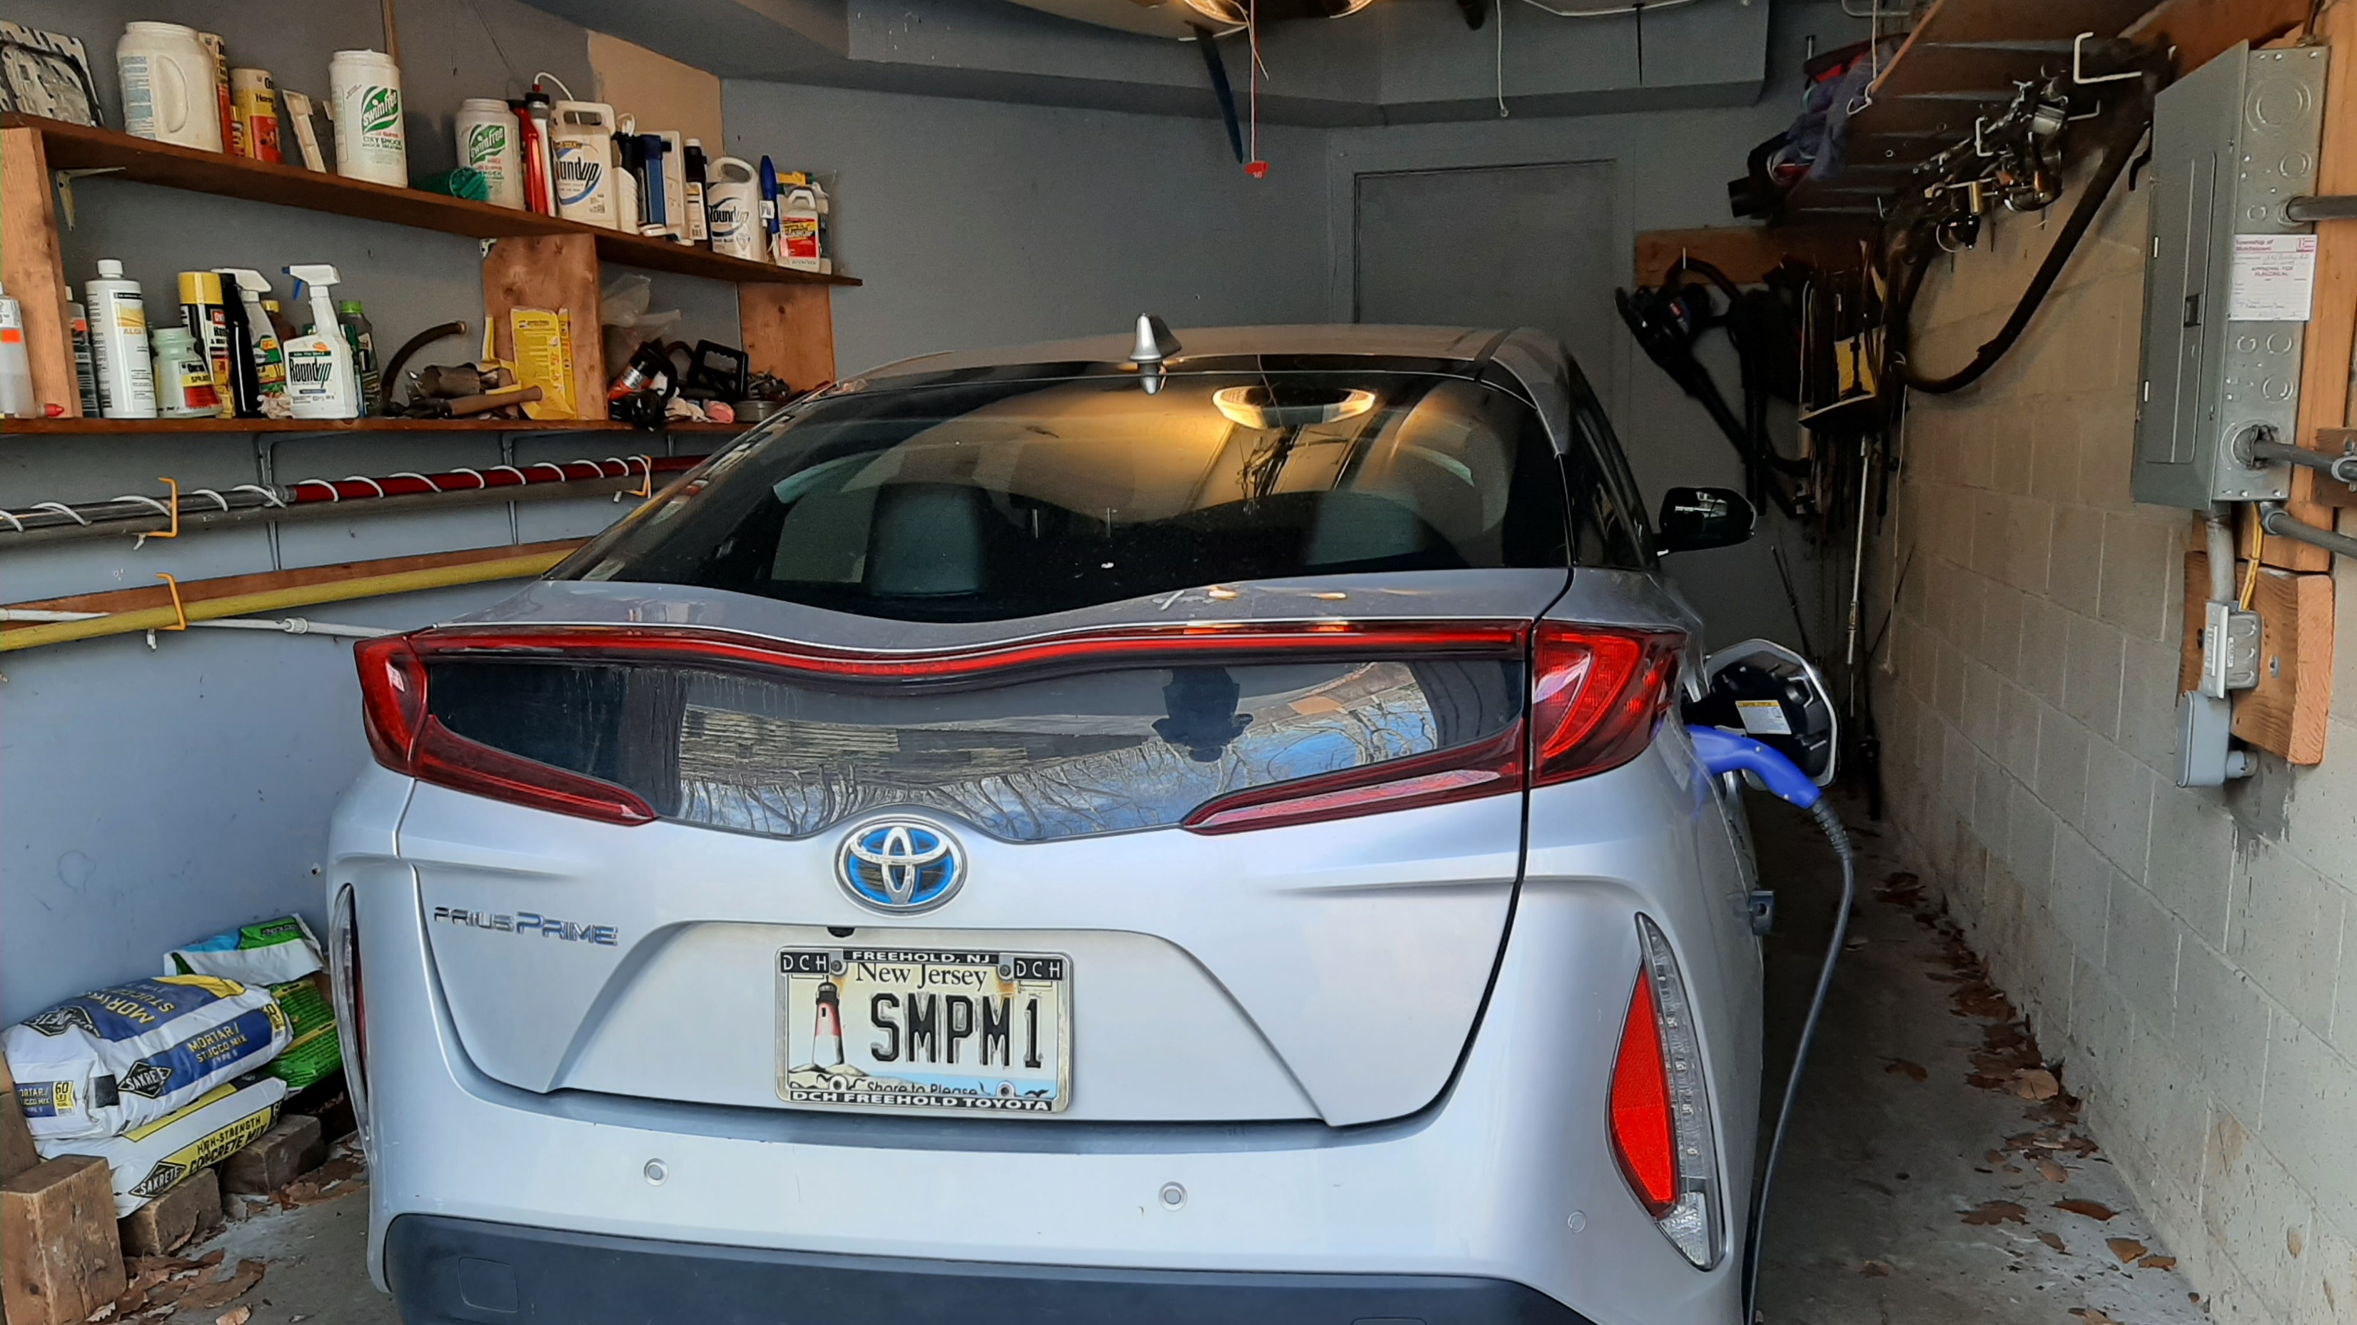
OUR EV – PRIUS PRIME PLUG-IN
Notes:
READ

Slide 27
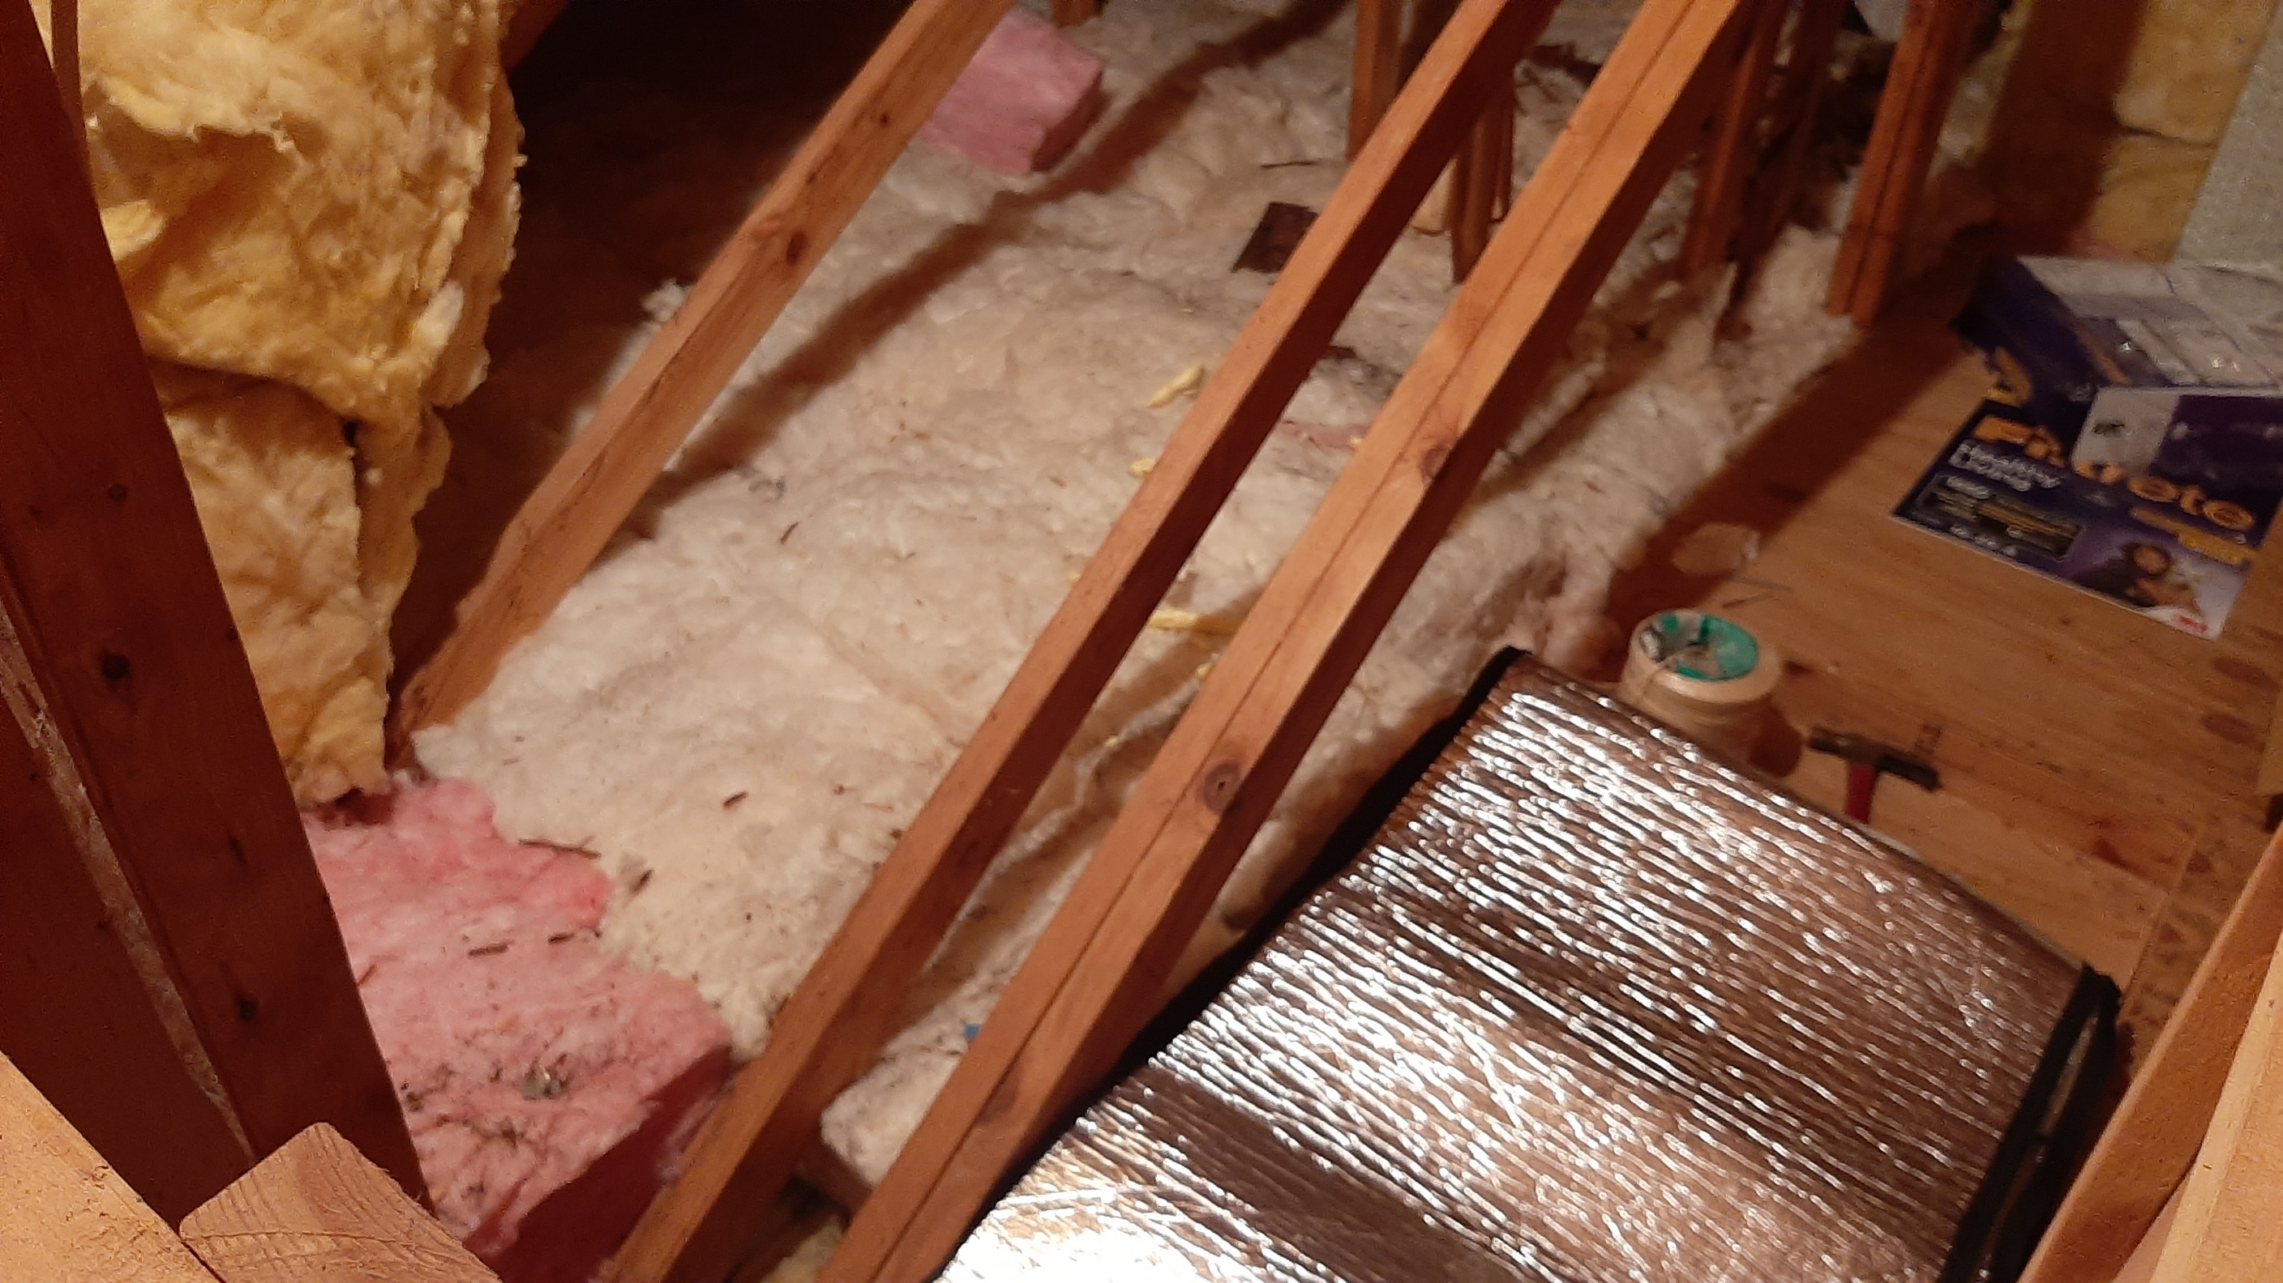
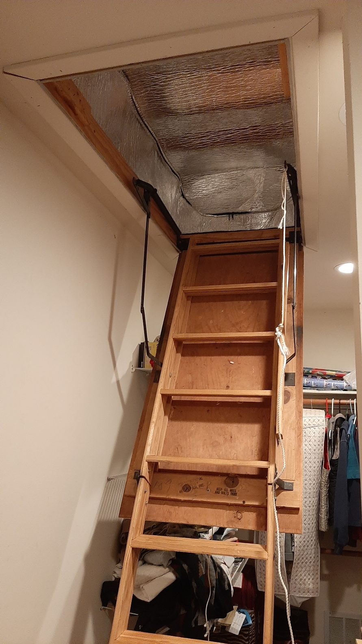
Energy Efficiency – Use Less Energy
Notes:
READ

Slide 28
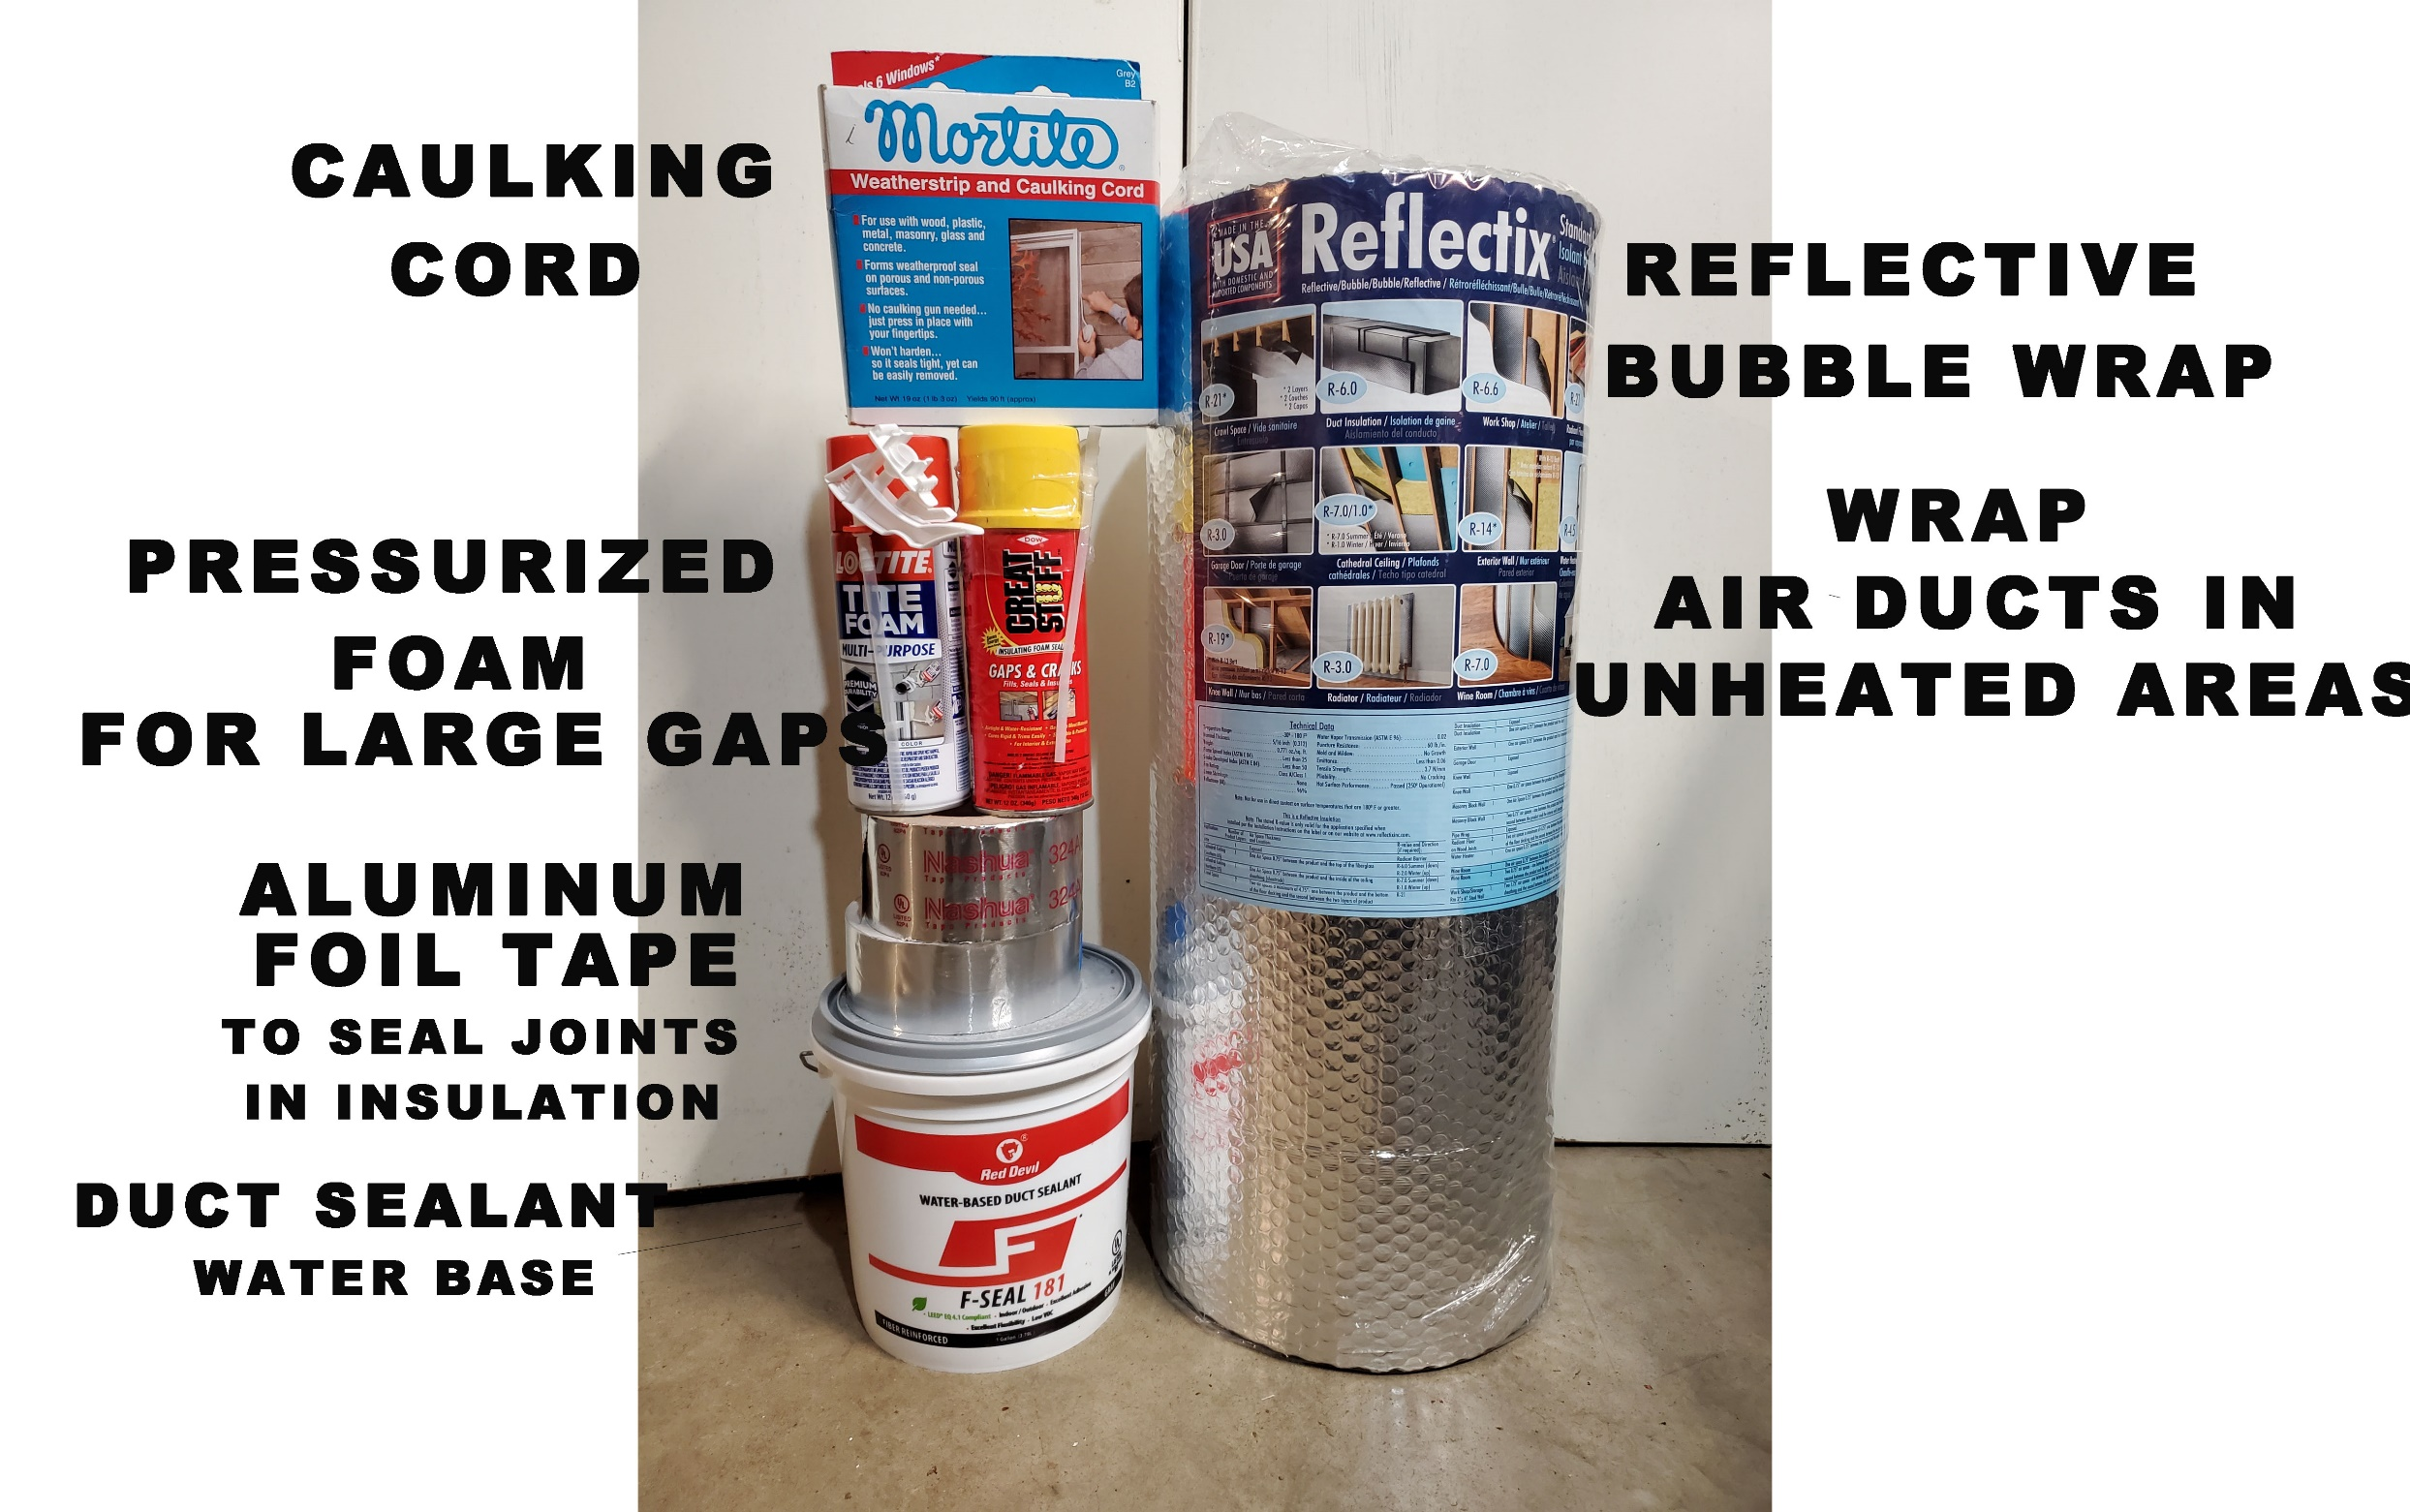
A SIMPLE DO-IT-YOURSELF PROJECT
DUCT SEALING

Slide 29
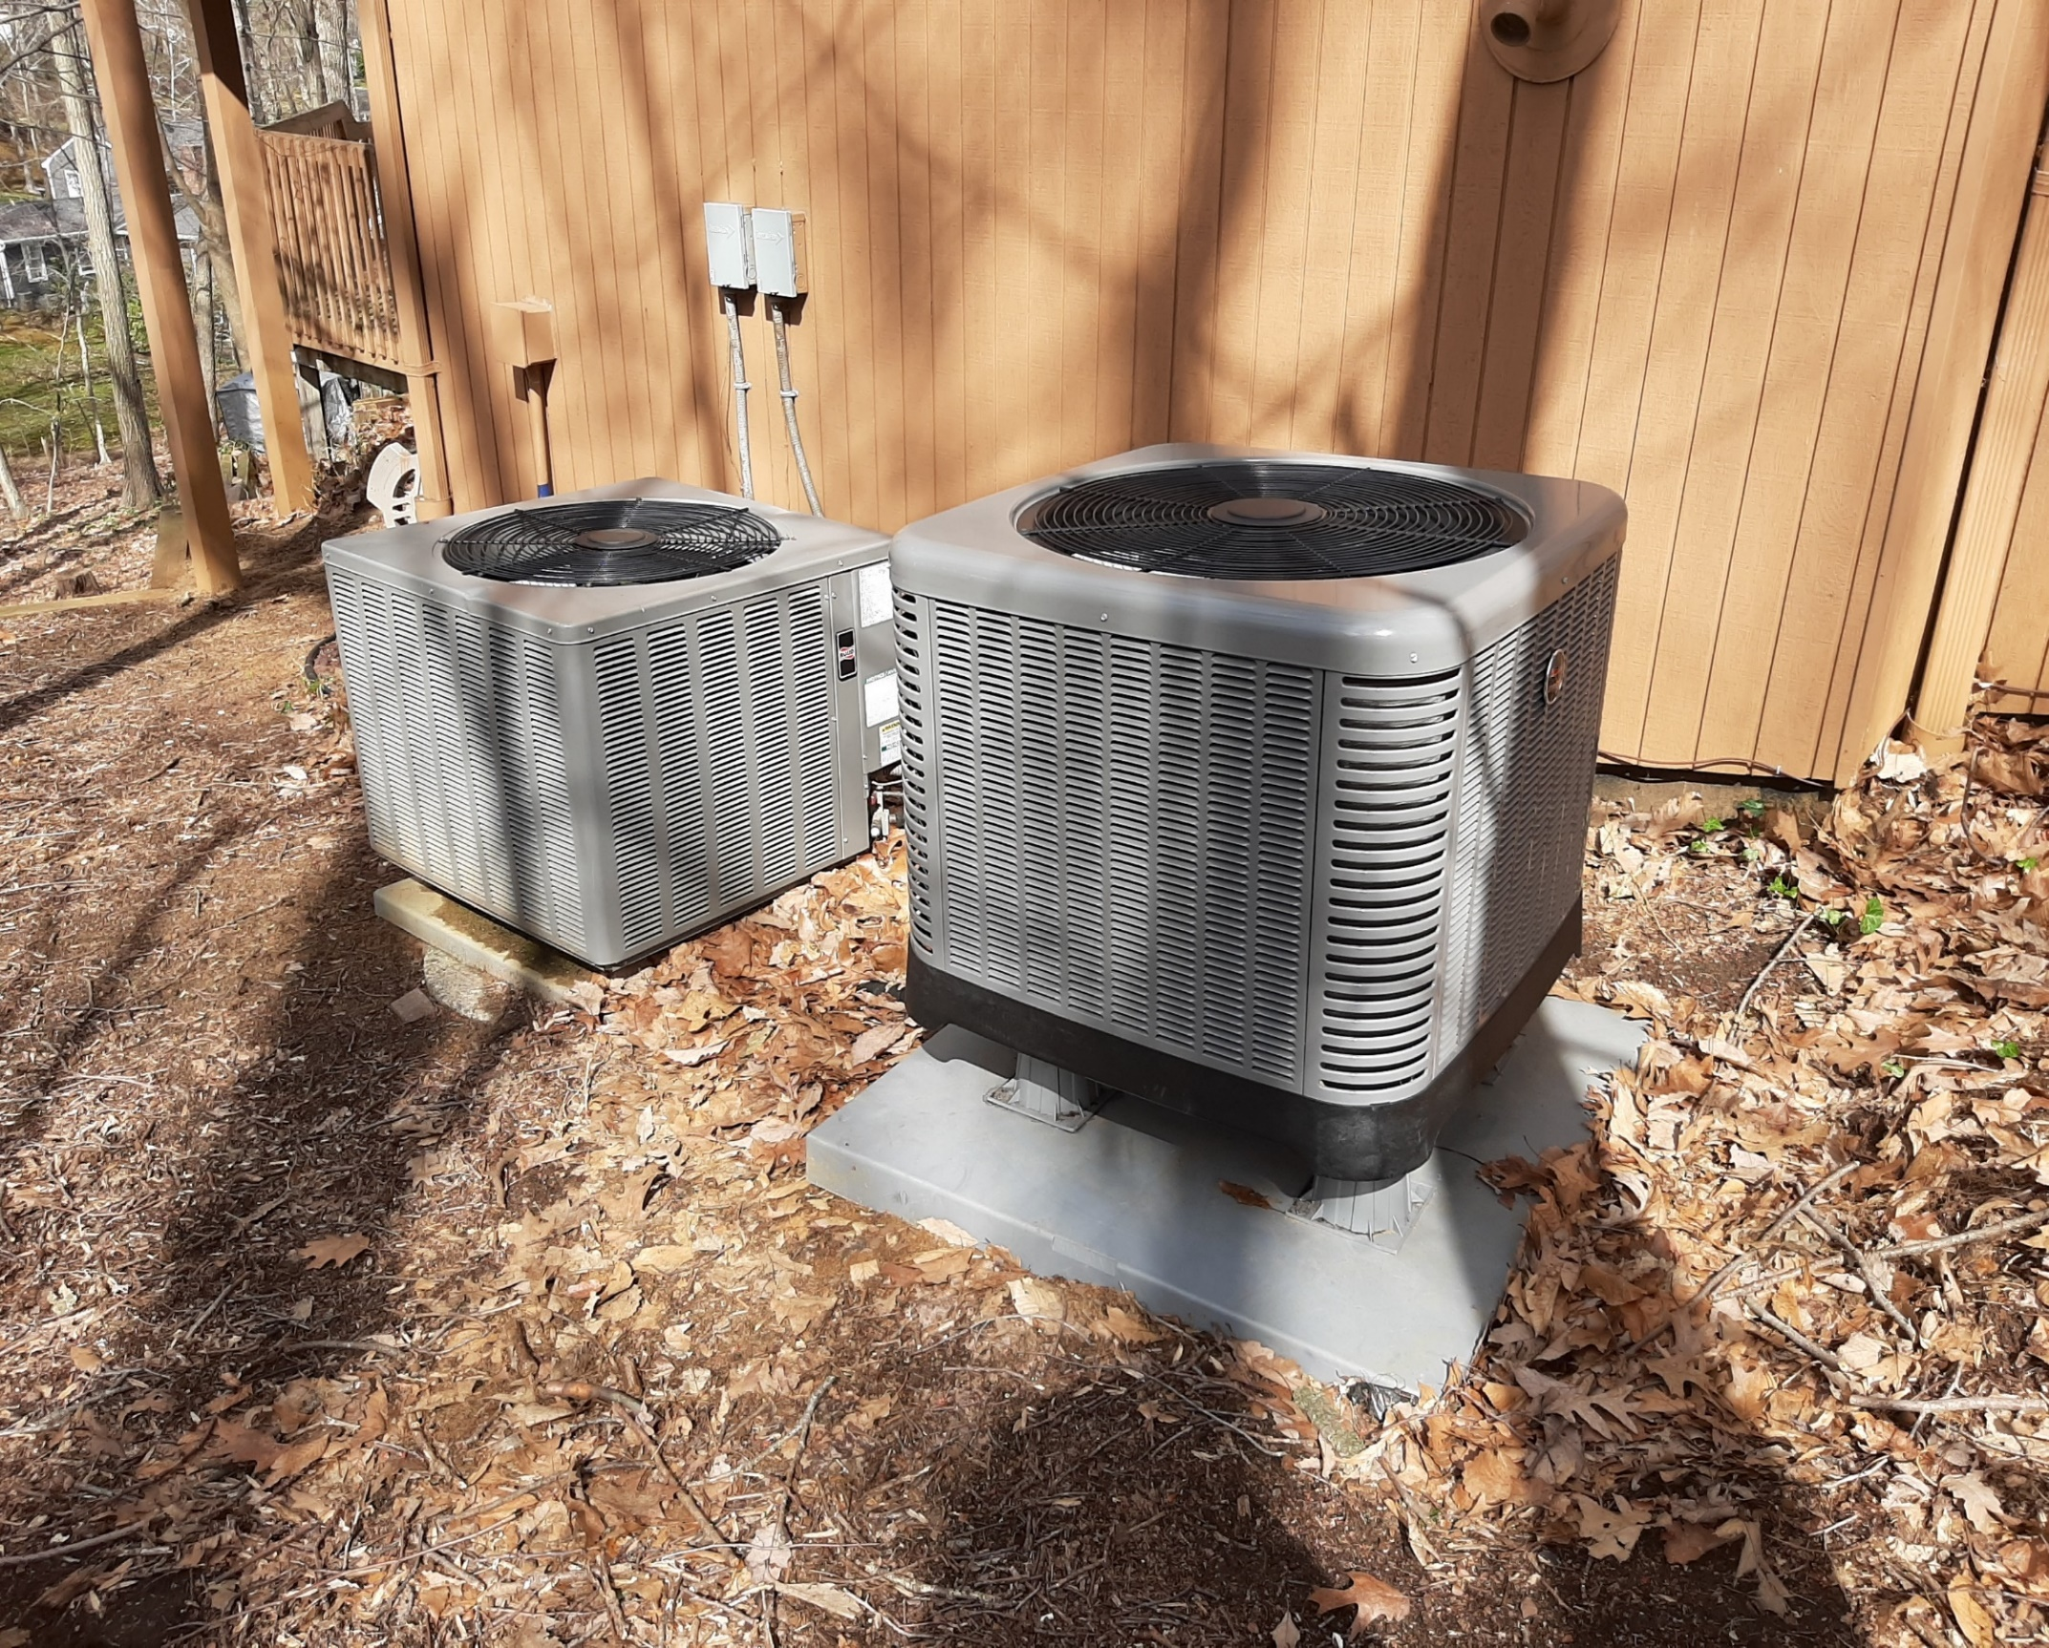
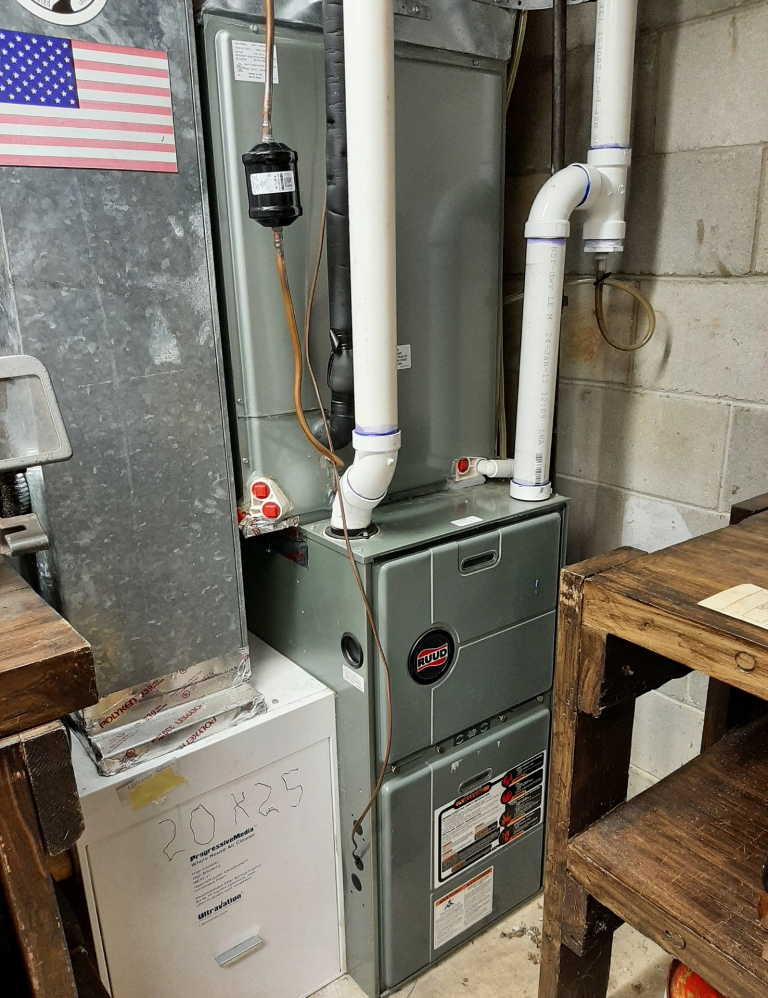
SPACE HEATING & COOLING WITH ELECTRIC HEAT PUMP
Gas Furnace Backup on Right
Notes:
READ

Slide 30
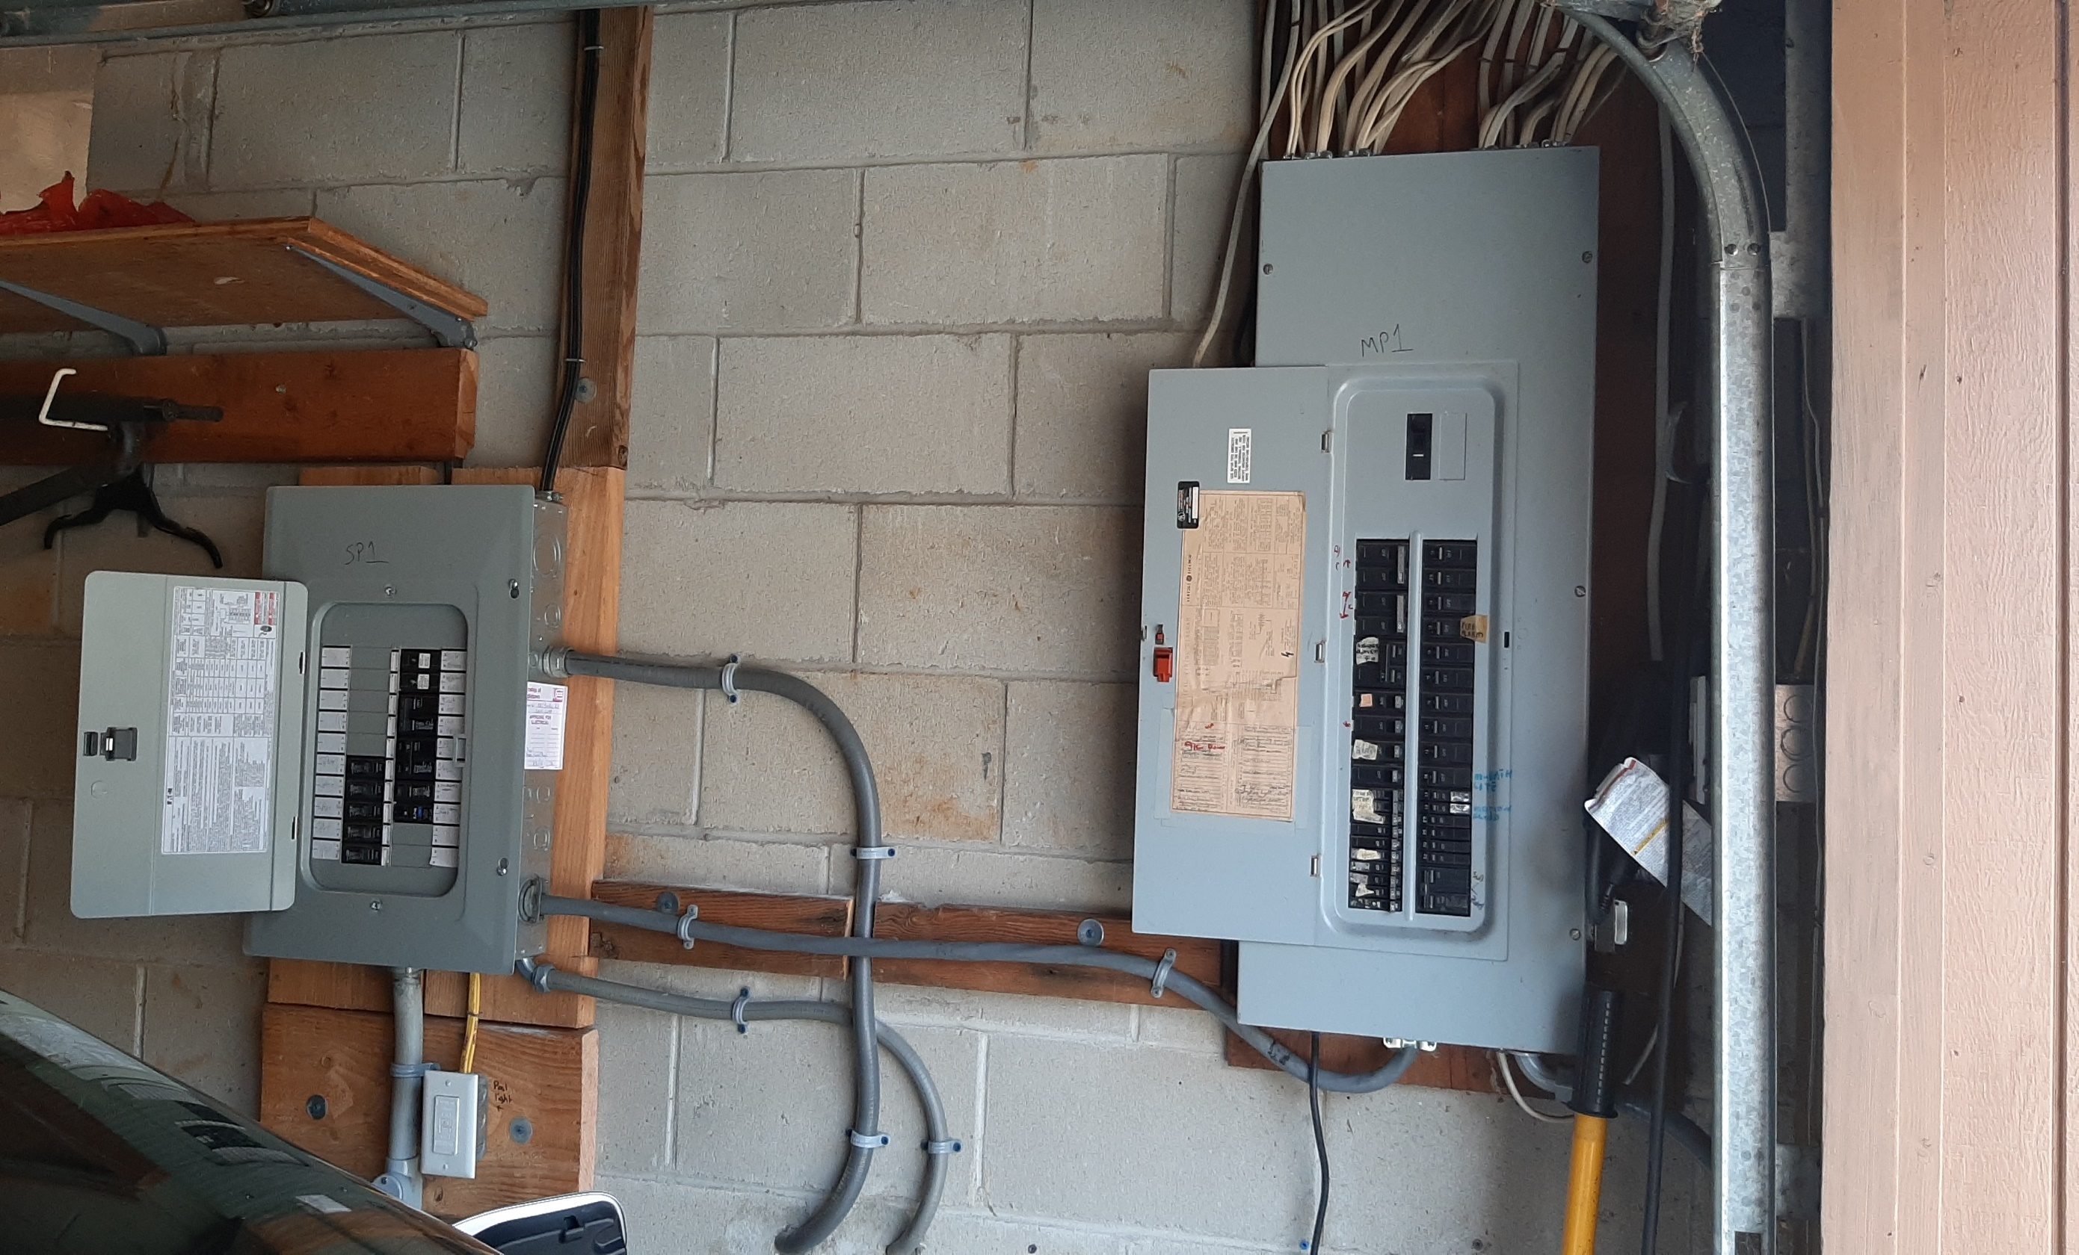
Spare Circuits for Future Electric Appliances
New Box on Left for New/Future
2nd Heat Pump Space Heater/AC
Heat Pump Water Heater
Stove
Dryer
2nd EV
Notes:
READ

Slide 31
Electric Heat Costs Less, Pollutes Less
2022 ENERGY COSTS
 | ACTUAL with heat pump | CALCULATED (no heat pump) | % CHANGE with heat pump | With Heat Pump
TOTAL Gas + Electric* | $2441 | $3153 | (23%) | Savings
GAS Cost | $394 | $1681 | (77%) | Reduction
ELECTRIC Cost | $2047 | $1472 | 39% | Increase
THERMS Gas Burned | 201 | 1163 | (83%) | Savings
TONS CO₂ Emitted** | 1.2 | 6.8 | (83%) | Savings
* 2022 Gas and electric costs include ALL uses for Miller household 2
* 2023 gas and electric total costs and CO2 will be lowered by new heat pump water heater
* 2024 electricity is 100% clean AND 21% lower cost, supplied by nearby Community Solar

Slide 32
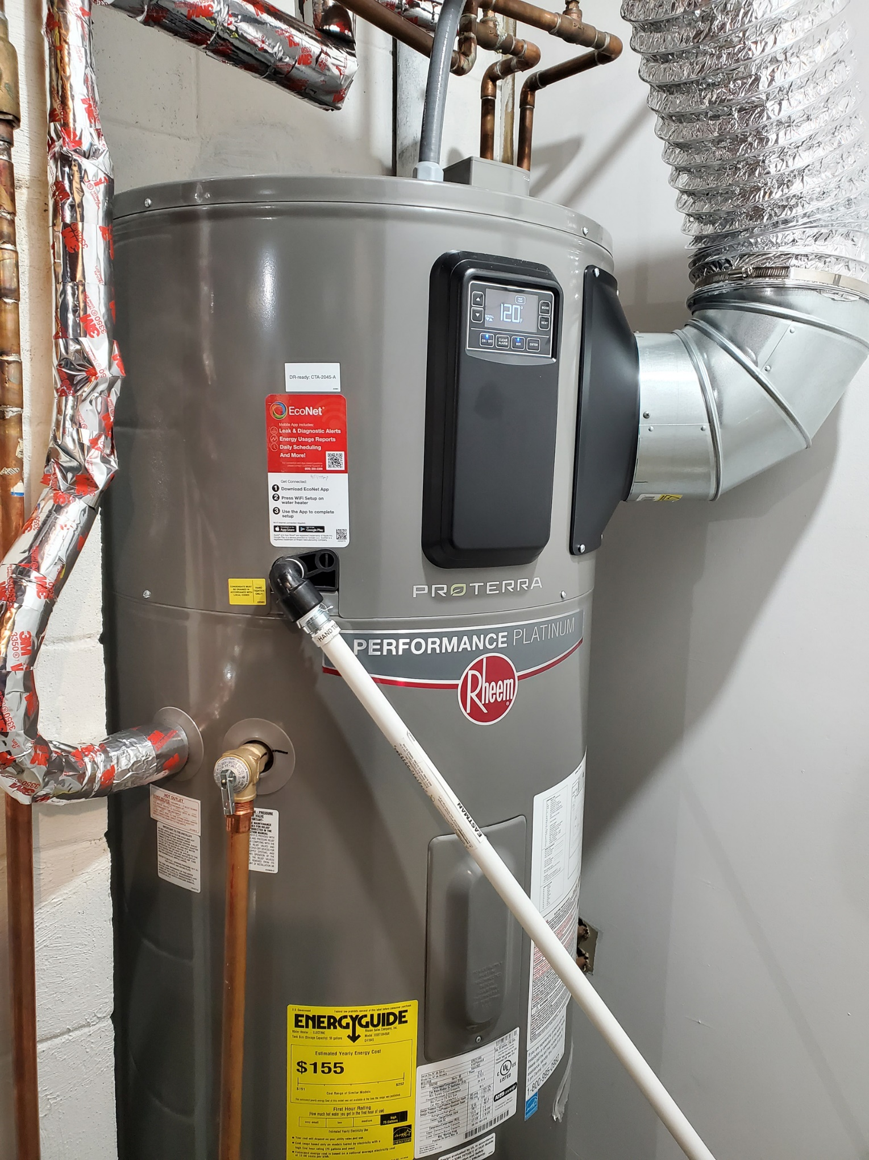
ELECTRIC HEAT PUMP WATER HEATER

Slide 33
Unitarian Universalist Congregation of Monmouth County (UUCMC)
Lincroft, NJ
Received 2nd Place National Energy Saver Award
Feb 2023 from Interfaith Power & Light
Featured in National virtual tour of churches, Oct 6 – 8, 2023 highlighting solar and renewable energy accomplishments

Slide 34

UUCMC
VIRTUAL TOUR
Oct 6 - Oct 8, 2023
U.S. largest grassroots solar,
renewable energy, and
sustainable living event
description, VIDEO AND PHOTOS LOCATED AT:
https://www.nationalsolartour.org/tourmap/unitarian-universalist-congregation-of-monmouth-county/

Slide 35
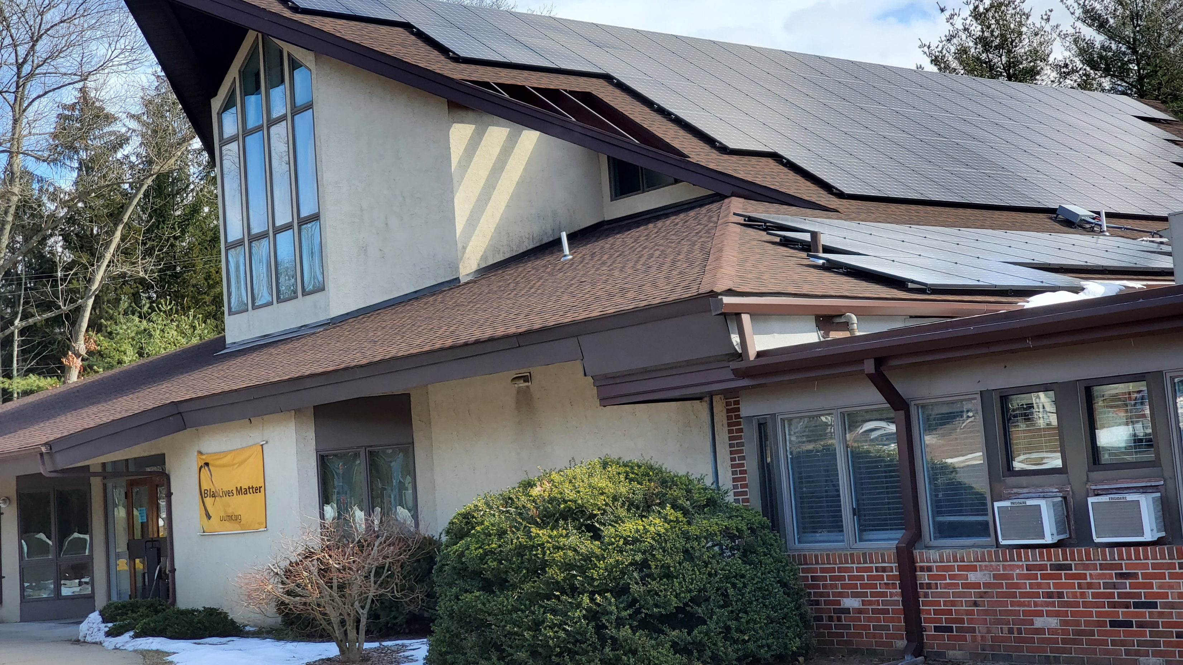
UUCMC 2022 Rooftop Solar
4 x Capacity of Old System

Slide 36
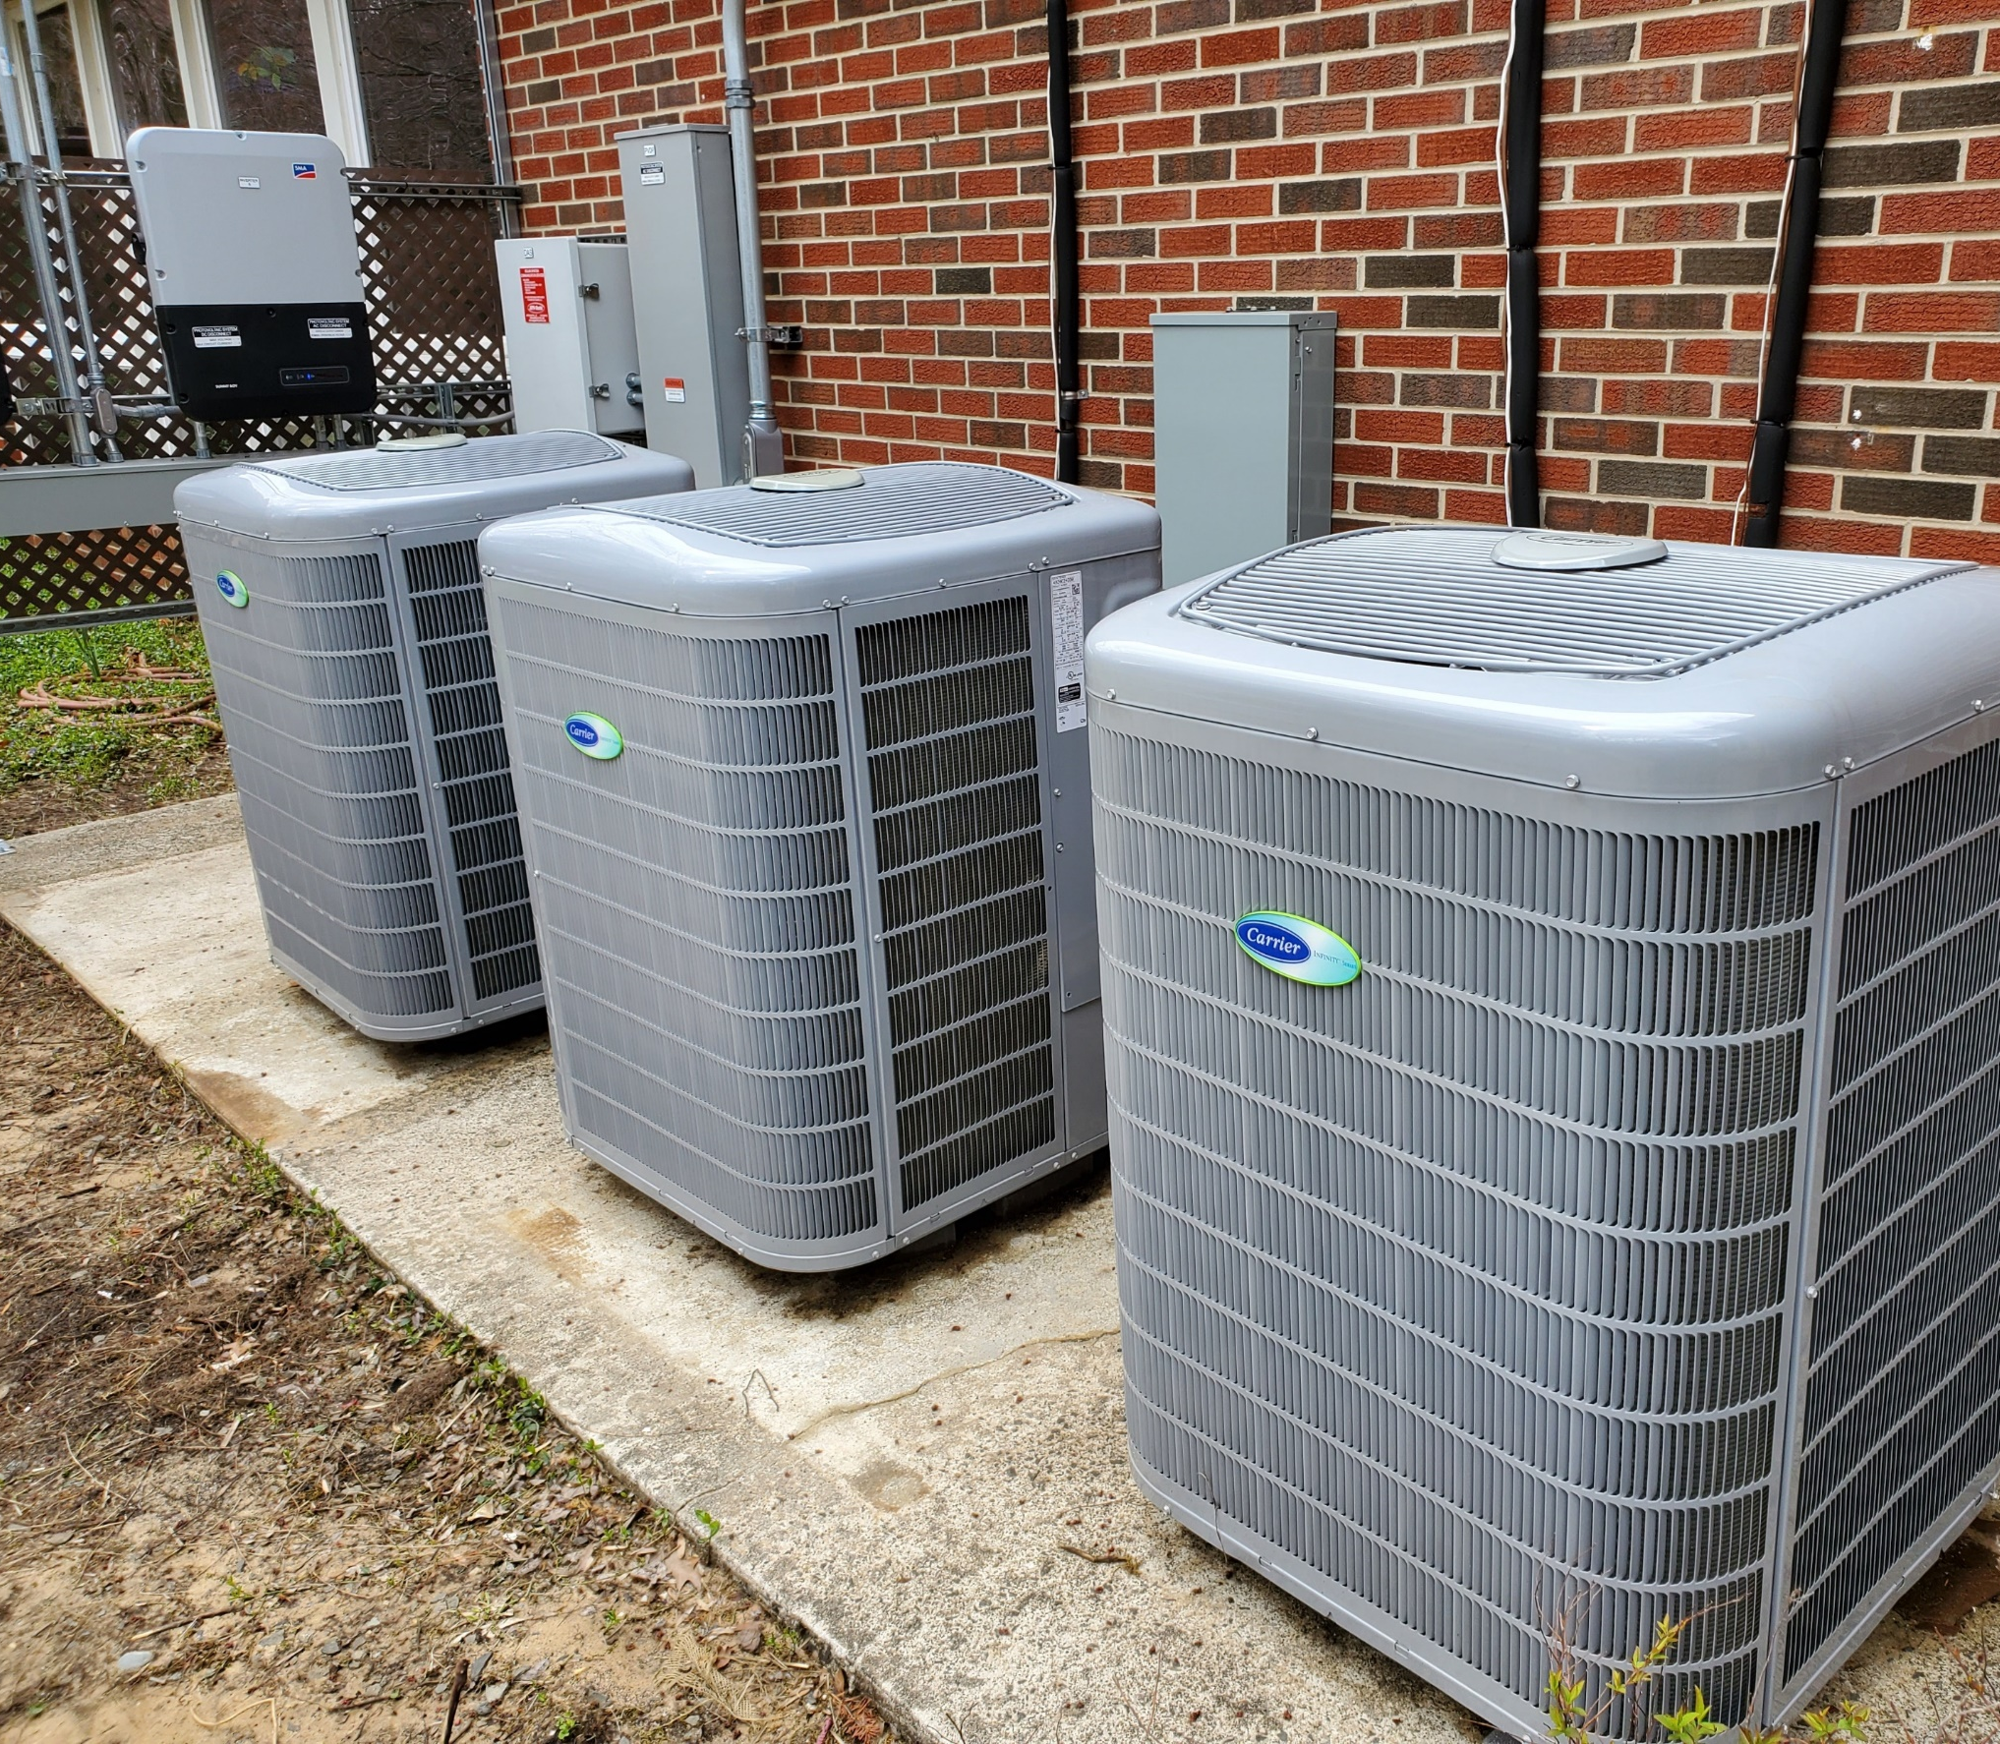
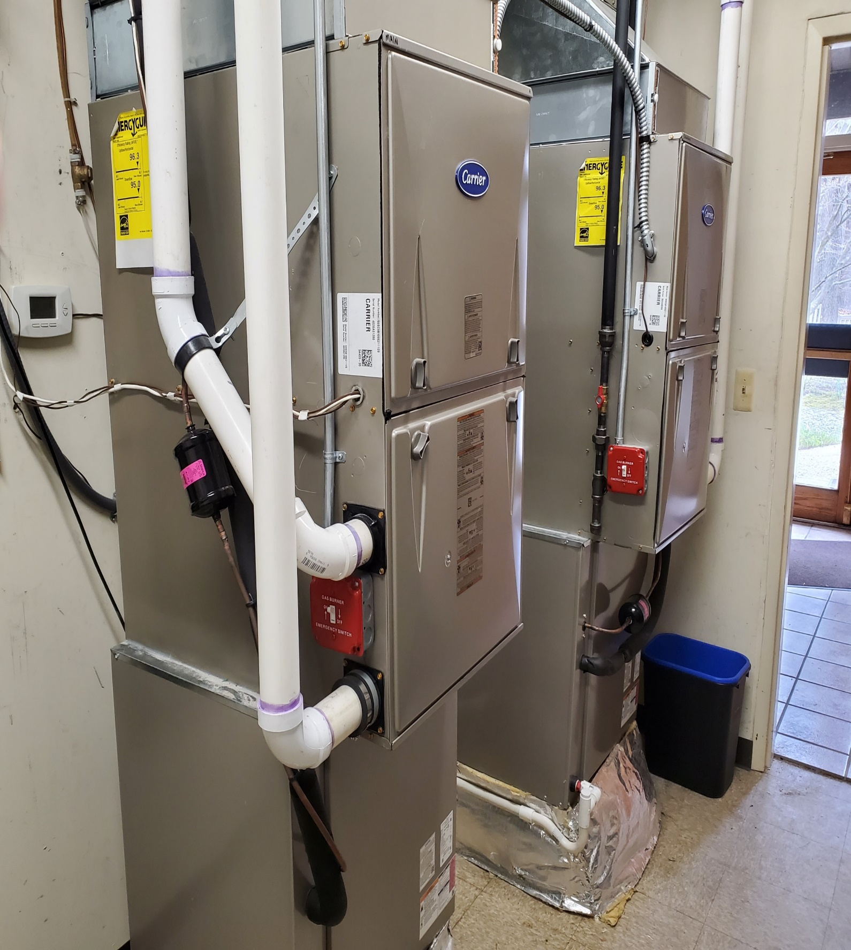
UUCMC 2021 Heat Pumps

Slide 37
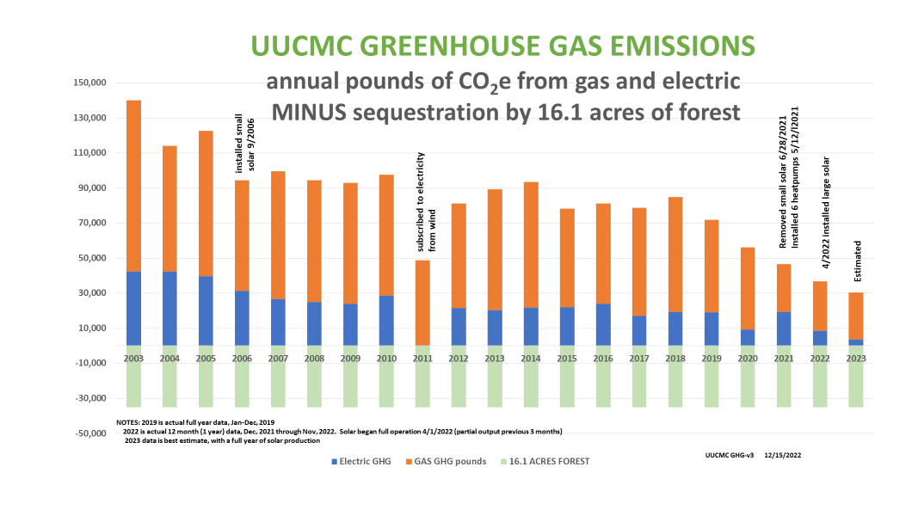
Annual
Pounds of
CO2

Slide 38
UUCMC REDUCTIONS IN CO₂ AND UTILITY BILL
2003 - 2019 insulated, sealed, LED bulbs,…
2021 - 2022 6 furnaces replaced with heat pumps;
+ installed large rooftop solar array
YEAR | GAS CO₂ Tons | ELECTRIC CO₂ Tons | TOTAL CO₂ Tons | % TOTAL CO₂ REDUCTION | ELECTRIC KwH from GRID | TOTAL BILL GAS+ELECTRIC | % TOTAL BILL REDUCTION
2003 | 49 | 21 | 70 |  | 72.4 | $22.1K
2019 | 26 | 10 | 36 | 49% | 32.8 | $12.4K | 44%
2023 (est) | 13 | 2 | 15 | 79% | 7.0 | $4.3K | 81%

Slide 39
CREATE A PLAN FOR YOUR HOUSEHOLD: ELECTRIFICATION
GHG REDUCTION
SAVE MONEY
REGISTER HERE 7PM Thurs, Nov 16 webinar
Guest Matt Kavanagh, leader of Parsippany Green Team,
uses his “Green Insight” business to help CREATE YOUR PLAN
TO REDUCE GHG FROM YOUR HOME
(including space and water heating, other appliances, solar, lawncare, and cars)
Matt provides analysis, roadmap, return on Investment, and milestones

Slide 40

REGISTER FOR Nov 16 WEBINAR

Slide 41
NEXT STEPS TO PLAN YOUR FUTURE
Arrange energy audit with your electric utility
      JCP&L “Quick Home Energy Check-ups” OR follow the JCPL “self-check”
      PSEG “Quick Home Energy checkup” or online “MyEnergy Program”
Start Your Electrification Journey today https://www.climaterealityproject.org/electrification-journey
      Watch Dr. Leah Stokes review the IRA, 41 minutes (Excellent!)
      https://youtu.be/j2Fio5kbMvs
      Determine your household benefits from the ira
      https://www.rewiringamerica.org/app/ira-calculator
Lookup your area median income (lookup by address)
https://ami-lookup-tool.fanniemae.com/amilookuptool/
Use existing references to building electrification topics
https://climate.smiller.org/REF/ (find best heat pumps, water heaters, locate HVAC vendors…)
https://climate.smiller.org/50x30/building-electrification/All-heat-pump-webinars.html (approaching 2 years of webinars)
Notes:
I highly recommend the link at the top right, to a video by Dr. Leah Stokes, which is about 40 minutes of REALLY GREAT description of the Inflation Reduction Act. ALSO there is a link the rewiring America IRA CALCULATOR- whicis the best we know of. AND if you want even more references, please look at my site with 300 current references to IRA, and all other BE topics.
https://climate.smiller.org/REF/- add to “CHAT” This has evaluations- the highest rated heat pumps (Daikin; Fujitsu; Mitsubishi); highest rated heat pump water heaters (Rheem, AO Smith), how to locate HVAC dealers for specific highest rated

Slide 42
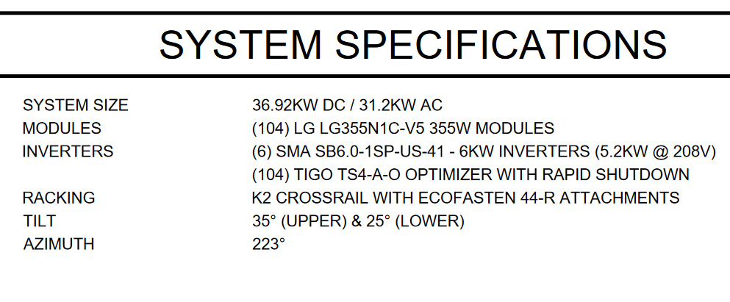
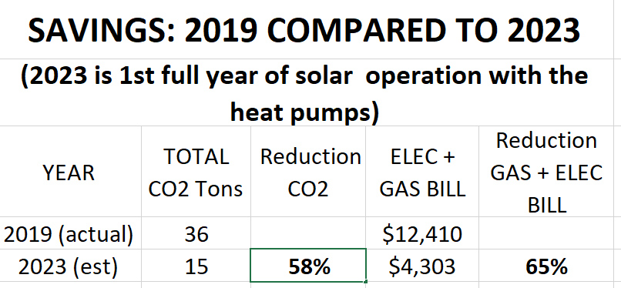

Slide 43

A

Slide 44


