Slide 1
Not All Greenhouse Gases are Created Equal
Methane – How Bad Is It?
WARNING: This presentation includes mathematical calculations. You will be alerted before this is discussed, as you may wish to cover your eyes and ears.

Slide 2
Greenhouse Gases (GHGs)
CO2
Methane (CH4)
Nitrous Oxides (NO2)
Fluorinated Gases*
Black Carbon (soot)**
Water Vapor
*Hydrofluorocarbons, perfluorocarbons, sulfur hexafluoride, and nitrogen trifluoride are synthetic, powerful greenhouse gases that are emitted from a variety of household, commercial, and industrial applications and processes.
**Climate forcer, not a gas

Slide 3
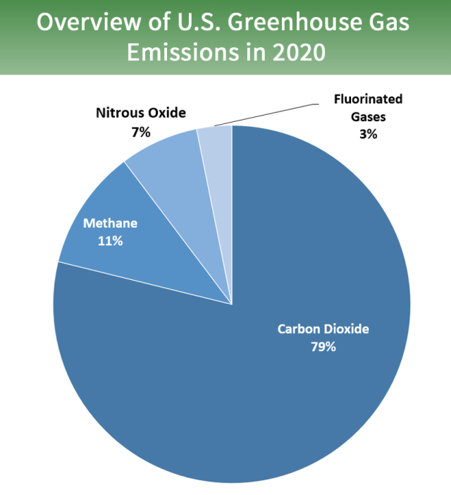
Volume of GHGs
Total U.S. Emissions in 2020 = 5,981 Million Metric Tons of CO2 equivalent (excludes land sector*).
*Excludes the effect of carbon sequestration from plants and trees

Slide 4
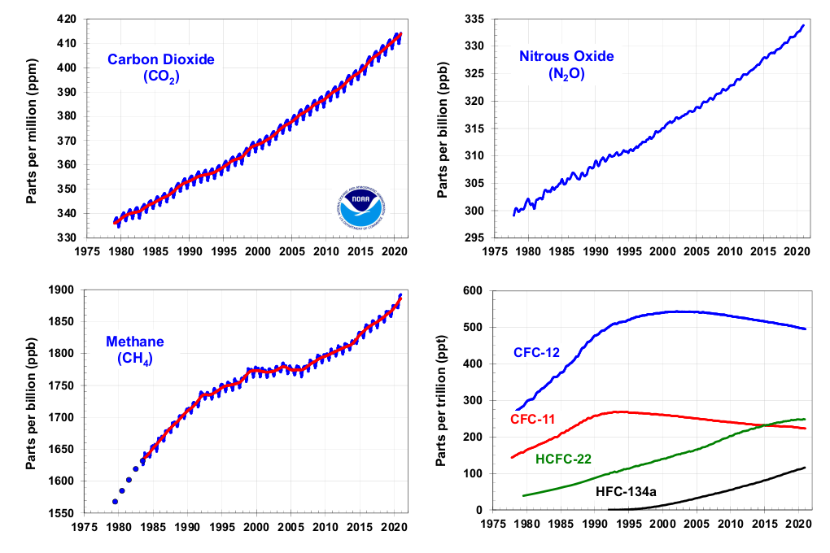
NOAA GHG Index

Slide 5
Three Major Differentiators
Lifetime in atmosphere
  Days, weeks, years, centuries
  Decays* or is absorbed into ocean or plants
Global Warming Potential (GWP)
  The Global Warming Potential (GWP) was developed to allow comparisons of the global warming impacts of different gases. Specifically, it is a measure of how much energy the emissions of 1 ton of a gas will absorb over a given period of time, relative to the emissions of 1 ton of carbon dioxide (CO2).
  GWP is a number (e.g., a value of 10 means the gas is 10 times more potent than CO2)
Volume
  Parts per million
  Metric tons** (2,204.6 lbs)
*Methane combines with ozone to decay into CO2 and water
**Also written as ‘tonnes’

Slide 6
GHGs - Lifetimes and GWPs
GHG | Lifetime | GWP
CO2 | 100’s of years (~25% forever) | 1
CH4 (Methane) | 8 - 12 years | 104 (10-year), 86 (20-year), 25 (100-year)
N₂O (Nitrous Oxides) | ~120 years | 265–298
Fluorinated Gases | 13 to 50,000 years (varies by gas)* | 6630–7350 (100-year) 4880–4950 (20-year)
Black Carbon | Days to weeks | 460 – 2,000
Water vapor** | Days to weeks | .001 to .0005 (100-year)
*Carbon Tetrafluoride CF4) has a lifetime of 50,000 years and GWP of 11,200 (500-year), HFC-23 has a lifetime of 222 years and GWP of 14,800 (100-year). Wikipedia – Global Warming Potential
**Accounts for abut 60% of climate change

Slide 7
Computation of CO2e
CO2 equivalent allows the impact of all GHGs to be measured on the same scale
CO2e enables computation of the total volume of GHGs.
Formula: Tons of GHG x GWP = Tons of CO2e
Five tons of CO2 + three tons of methane = 5*1 + 3*86 = 263MMT (million metric tons) CO2e

Slide 8
Controversy over GWP of Methane
IPCC, EPA and NJDEP use GWP of 25 (100 – year lifetime)
  IPCC compromise between 10 and 1,000 (timeframe of analyses).
  IPCC states the timeframe is a value judgment
Since GWP value has a big influence over volume of GHG, environmentalists argue we should use a value that represents time period for action.
NJ 2020* law requires use of 20-year value of 86. NJDEP has yet to conform.
*January 13, 2020 (S3215/A4606)(P.L.2019, c.319) – Assemblyman Zwicker

Slide 9
Effect of GWP on Methane Impact
Differences in total US Methane CO2e using GWP of 86 vs. 25
2020 EPA CO2e = 5,981MMT
11% Methane = 658MMT CO2e
@ GWP of 25 = 26.3MMT Methane (658/25)
@ GWP of 86 = 2,263MMT CO2e (26.3 x 86)
True total 2020 CO2e = 5,981 – 658 + 2,263 = 7,586MMT CO2e, an increase of 27%
True % of global warming in U.S. from methane is 30% (2,263/7,586), not 11%.

Slide 10
Effect of Methane Leakage
A 2011 Cornell University study, comparing GHG potency, showed that “shale (fracked) gas is worse than conventional gas, is worse than coal and worse than oil.”*
Analysts at PSE Healthy Energy estimate that a threshold for methane leakage used in power production is 2.8 percent of production. At leakage rates above this level, the GHG emissions per unit of electricity produced from a gas plant are greater than that of a coal plant.
Every study of methane leakage from all sources invariably finds higher than expected volumes.
*Robert Howarth, Cornell Chronicle - https://news.cornell.edu/stories/2011/04/fracking-leaks-may-make-gas-dirtier-coal

Slide 11
Effect of Focusing on Methane
High GWP and short lifetime means effective control can affect rate of global warming more than control of CO2 or N2O
  86 times more effective than removing CO2
2018 IPCC Report:
  Cutting methane, black carbon, and other ‘super-pollutants’ vastly increases the chances of staying below 1.5 °C.
  The likelihood that we will reach the 1.5 °C warming threshold is highly dependent upon the emission pathways of non-CO2 climate pollutants, such as methane and black carbon. If the emissions of non-CO2 pollutants are not curbed, there is a 66% likelihood of surpassing the 1.5 °C threshold, regardless of reductions to carbon dioxide.
Proposed EPA rule to cut methane by 30%

Slide 12
Effect of Focusing on Methane
IEA* October 2021 Report:
  Tackling methane emissions from fossil fuel operations represents one of the best near-term opportunities for limiting the worse effects of climate change because of its short-lived nature in the atmosphere and the large scope for cost-effective abatement.
*International Energy Agency - Curtailing Methane Emissions from Fossil Fuel Operations - Pathways to a 75% cut by 2030

Slide 13
Health Effects of Methane
High levels of methane can reduce the amount of oxygen breathed from the air. This can result in mood changes, slurred speech, vision problems, memory loss, nausea, vomiting, facial flushing and headache. In severe cases, there may be changes in breathing and heart rate, balance problems, numbness, and unconsciousness.

Slide 14
Health Effects From Burning Methane
New Jersey health burden from outdoor air pollution directly related to combustion of fossil fuels in buildings over 250 premature deaths and $2.8 billion in health impacts annually*
  Nitrogen dioxide and carbon monoxide from methane combustion
  A 2022 Stanford study found significant methane emissions even when gas stoves were turned off
Children in homes with gas stoves have a 42% higher likelihood of asthma incidents*
*Acadia 2022 Report – The Future is Electric

