Slide 1
Building Electrification – Switch To Heat Pump and All Electric Appliances.
April 21, 2022
Steve Miller and Ken Dolsky
REDUCE GLOBAL WARMING: ELIMINATE FRACKED METHANE GAS

Slide 2
About the 50x30 Building Electrification Team
Goal: eliminate GHG emissions from NJ buildings – contributes 26% of NJ total GHG
The NJ Administration Subteam is working with Governor Murphy and related Administrative offices (BPU, DEP, DCA) to develop regulations & rules
The NJ Legislative Subteam is working with NJ legislators and staff to develop legislation
The NJ Building Electrification Team
  runs a monthly Building Electrification webinar, 7PM, 3rd Thursday of each month
  helps develop the NJ “Zero Energy Building Code Roadmap”
TO JOIN THIS TEAM: click here https://eepurl.com/dpWC1n
  provide your contact info
  then click “join the 50x30 team click here” in the little box in lower left bottom corner
  you can opt-out at any time

Slide 3
NJ Laws and Regulations on Climate Change
NJ Global Warming Response Act (2007 and updated 2019)
NJ Energy Master Plan (2019)
NJ GWRA 80 by 50 report (2020)
Gov. Murphy Nov, 2021 Exec. Order #274:
50% GHG reduction by 2030

Slide 4
NJDEP GWRA Report 80 x 50 https://www.nj.gov/dep/climatechange/docs/nj-gwra-80x50-report-2020.pdf

Slide 5
Getting to 50% GHG Reduction by 2030
Top 3 GHG emissions sources in NJ: 87% of all emissions
  Transportation 42%
  Residential and commercial buildings 26%
  Electricity generation 19%
  WE MUST RedUCE All 3

Slide 6
Building Electrification to Reduce GHG
In NJ plans are underway to reduce transportation emissions by electrification of vehicles.
Plans are underway to increase clean electricity via wind and solar.
We cannot reach 50% reduction by 2030 without building electrification.
  Leverage 15 other states which have initiated pilot programs (may not be statewide) of building electrification

Slide 7
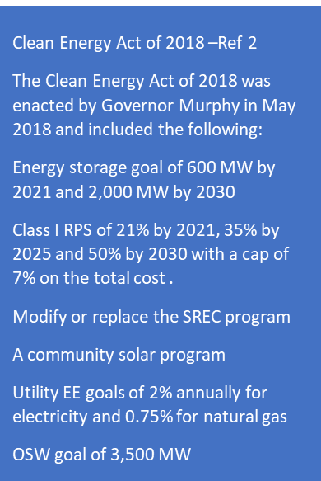
New Jersey’s 2019 Integrated Energy Plan - https://nj.gov/emp/
Policy increases to get to 50% by 2030
64
MMT
Gap in existing policies to get
To 50% by 2030
To get to 50% by 2030 Requires more than the 2019 EMP or about 8 MMT less
NJDEP 2019 GHG emissions inventory including sequestered GHG emissions of 8 MMT

Slide 8
NJ Energy Master Plan (EMP) Strategies
Transportation: EVs, public transportation, charging stations
Renewable & Distributed Energy: rooftop & community solar, onshore & offshore wind
Efficiency & Conservation: efficient buildings (insulation, seal air leaks), landscaping to reduce heat, conserve water, or provide food
Buildings: Net-zero carbon buildings – rooftop solar, all-electric space heating & appliances, EV-ready
Notes:
TONIGHT’s visioning focuses on these 5 strategies, found in the NJ 2019 Energy Master Plan.
We need YOUR visioning of what do you expect in an energy plan to enhance YOUR quality of life??
Following are examples of the 5 (These are also printed in front, above the white poster boards)

Slide 9
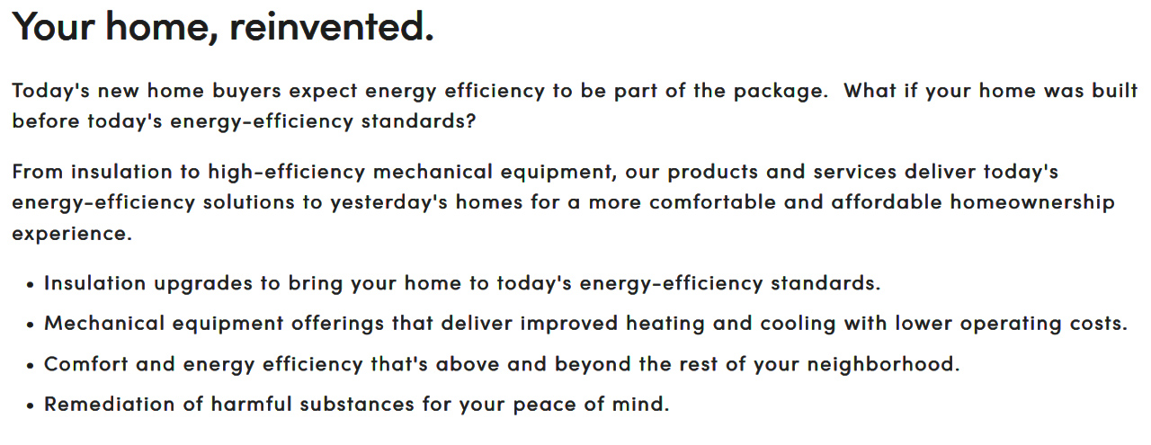
ENERGY EFFICIENCY ASSESSMENT
Schedule a $49 to $99 Ciel Home Energy Audit
~$49 in Princeton, Millburn, Glen Rock, Woodbridge, Morristown, Summit, Highland Park, Pascack Valley, Madison, Long Hill, Westfield
$99 elsewhere https://www.cielpower.com/
Schedule a $99 whole house energy assessment https://www.cielpower.com

Slide 10
MY EXPERIENCE
WITH HOME ENERGY ASSESSMENT
(sponsor: NJ Clean Energy Program- now under utilities)
3 hour energy efficiency assessment of my house
Blower Door test: located air leaks using thermal imaging camera. Suggested solutions.
Physical exam: insulation thickness,…
Safety check:
dangerous hanging main duct;
water heater temp dangerously high
At end: offered sending findings (photos & written) to 3 independent contractors (I decided to fix my own problems)

Slide 11
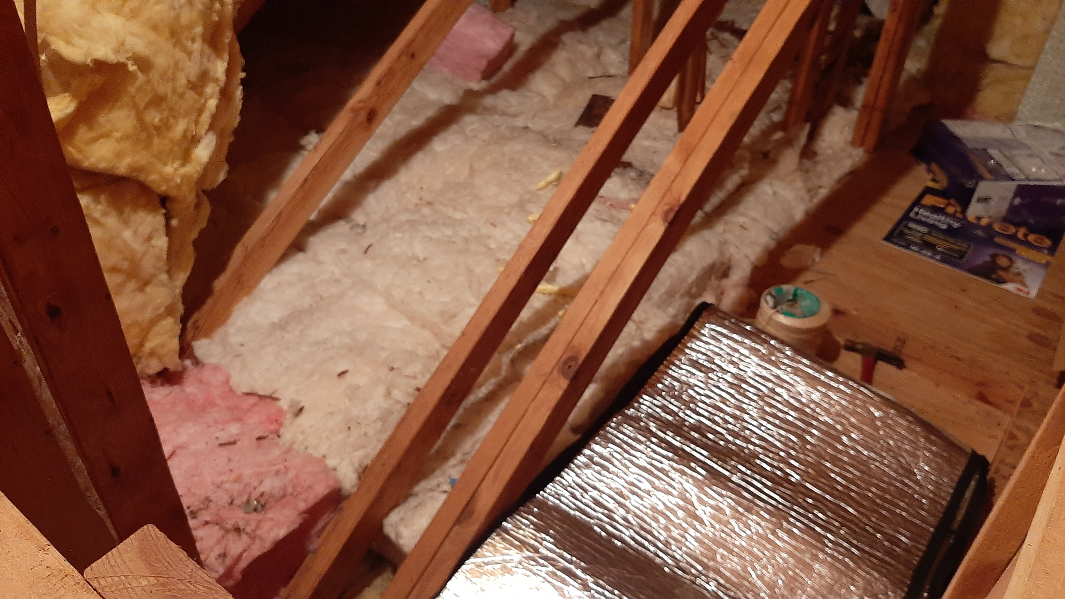
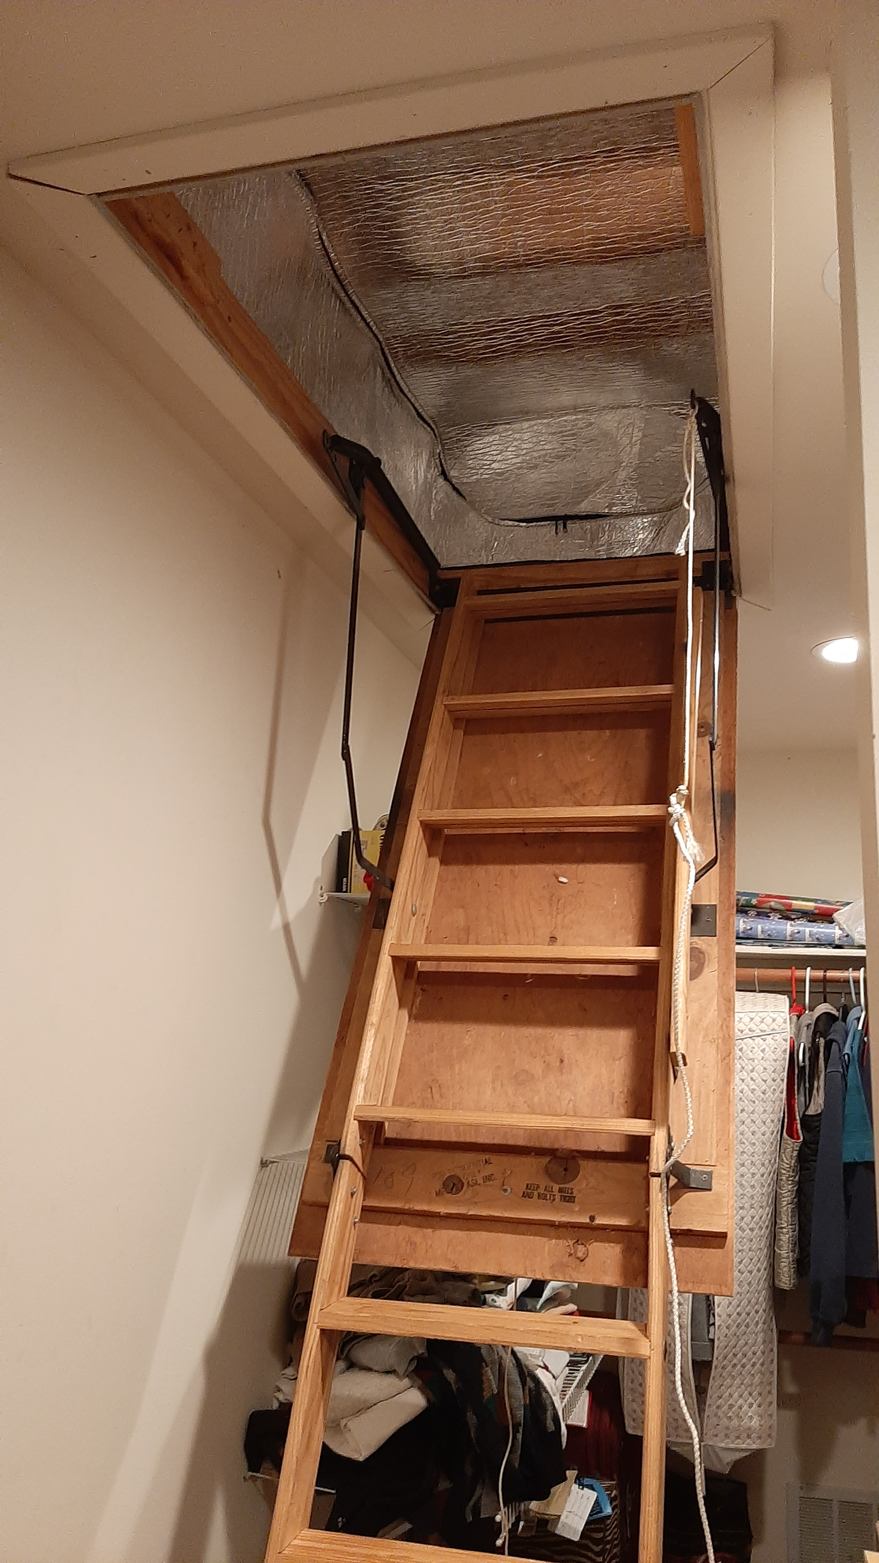
1st step: Energy Efficiency – Use Less Energy
Notes:
READ

Slide 12

Carbon Sequestration but No Solar
Tree Cover At High Noon
50 Foot Trees
Notes:
AND/OR – JOIN WITH OTHERS and push for your town to switch ALL residents to 100% renewable Community Choice Electric aggregation. This saves 5 or 10% on electric bill, and has the BIGGEST GHG reduction!

Slide 13


Slide 14
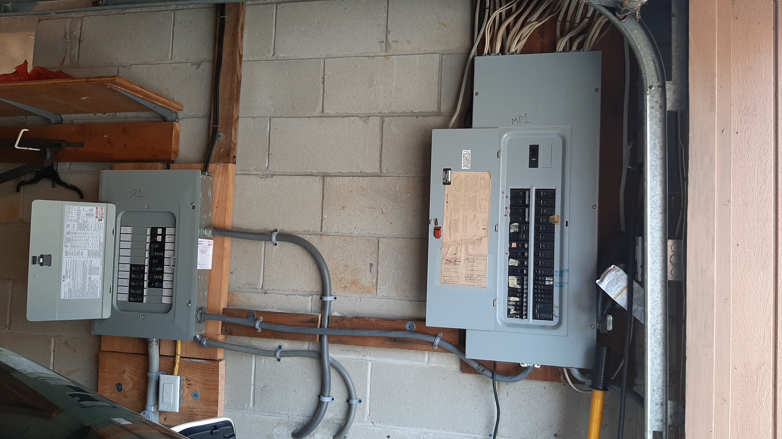
Spare Circuits for Future Electric Appliances
New Box on Left for Future
2nd Heat Pump Space Heater/AC
Heat Pump Water Heater
Stove
Dryer
2nd EV
Notes:
READ

Slide 15
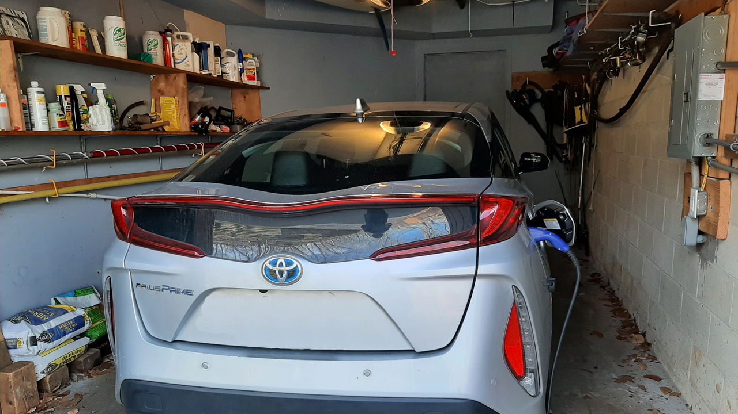
OUR EV – PRIUS PRIME PLUG-IN
Notes:
READ

Slide 16
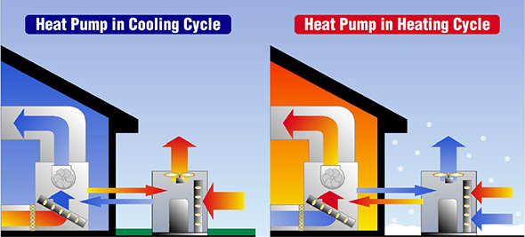
Space Heating – Switch to Clean Electric
Heat Pump
Notes:
READ

Slide 17
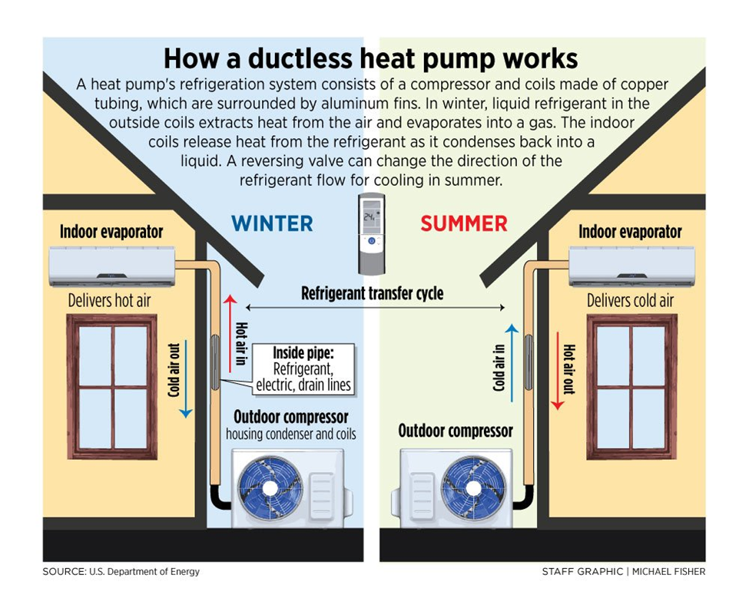

Slide 18
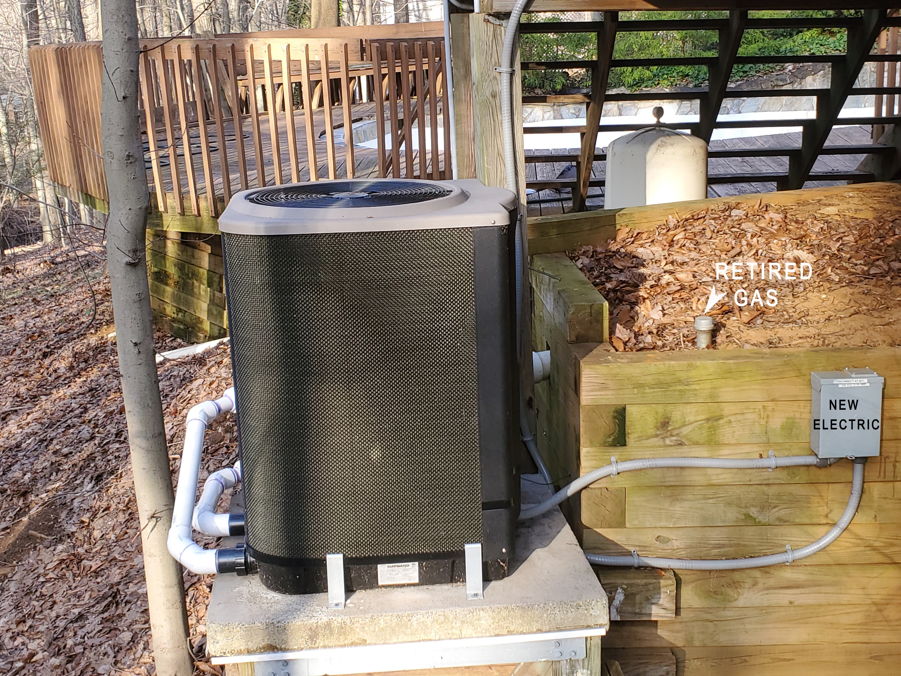
Electric Pool Heater – Air to Water Heat Pump
FUTURE STEP: “Hybrid” Water Heater is Similar Heat Pump
Notes:
READ

Slide 19
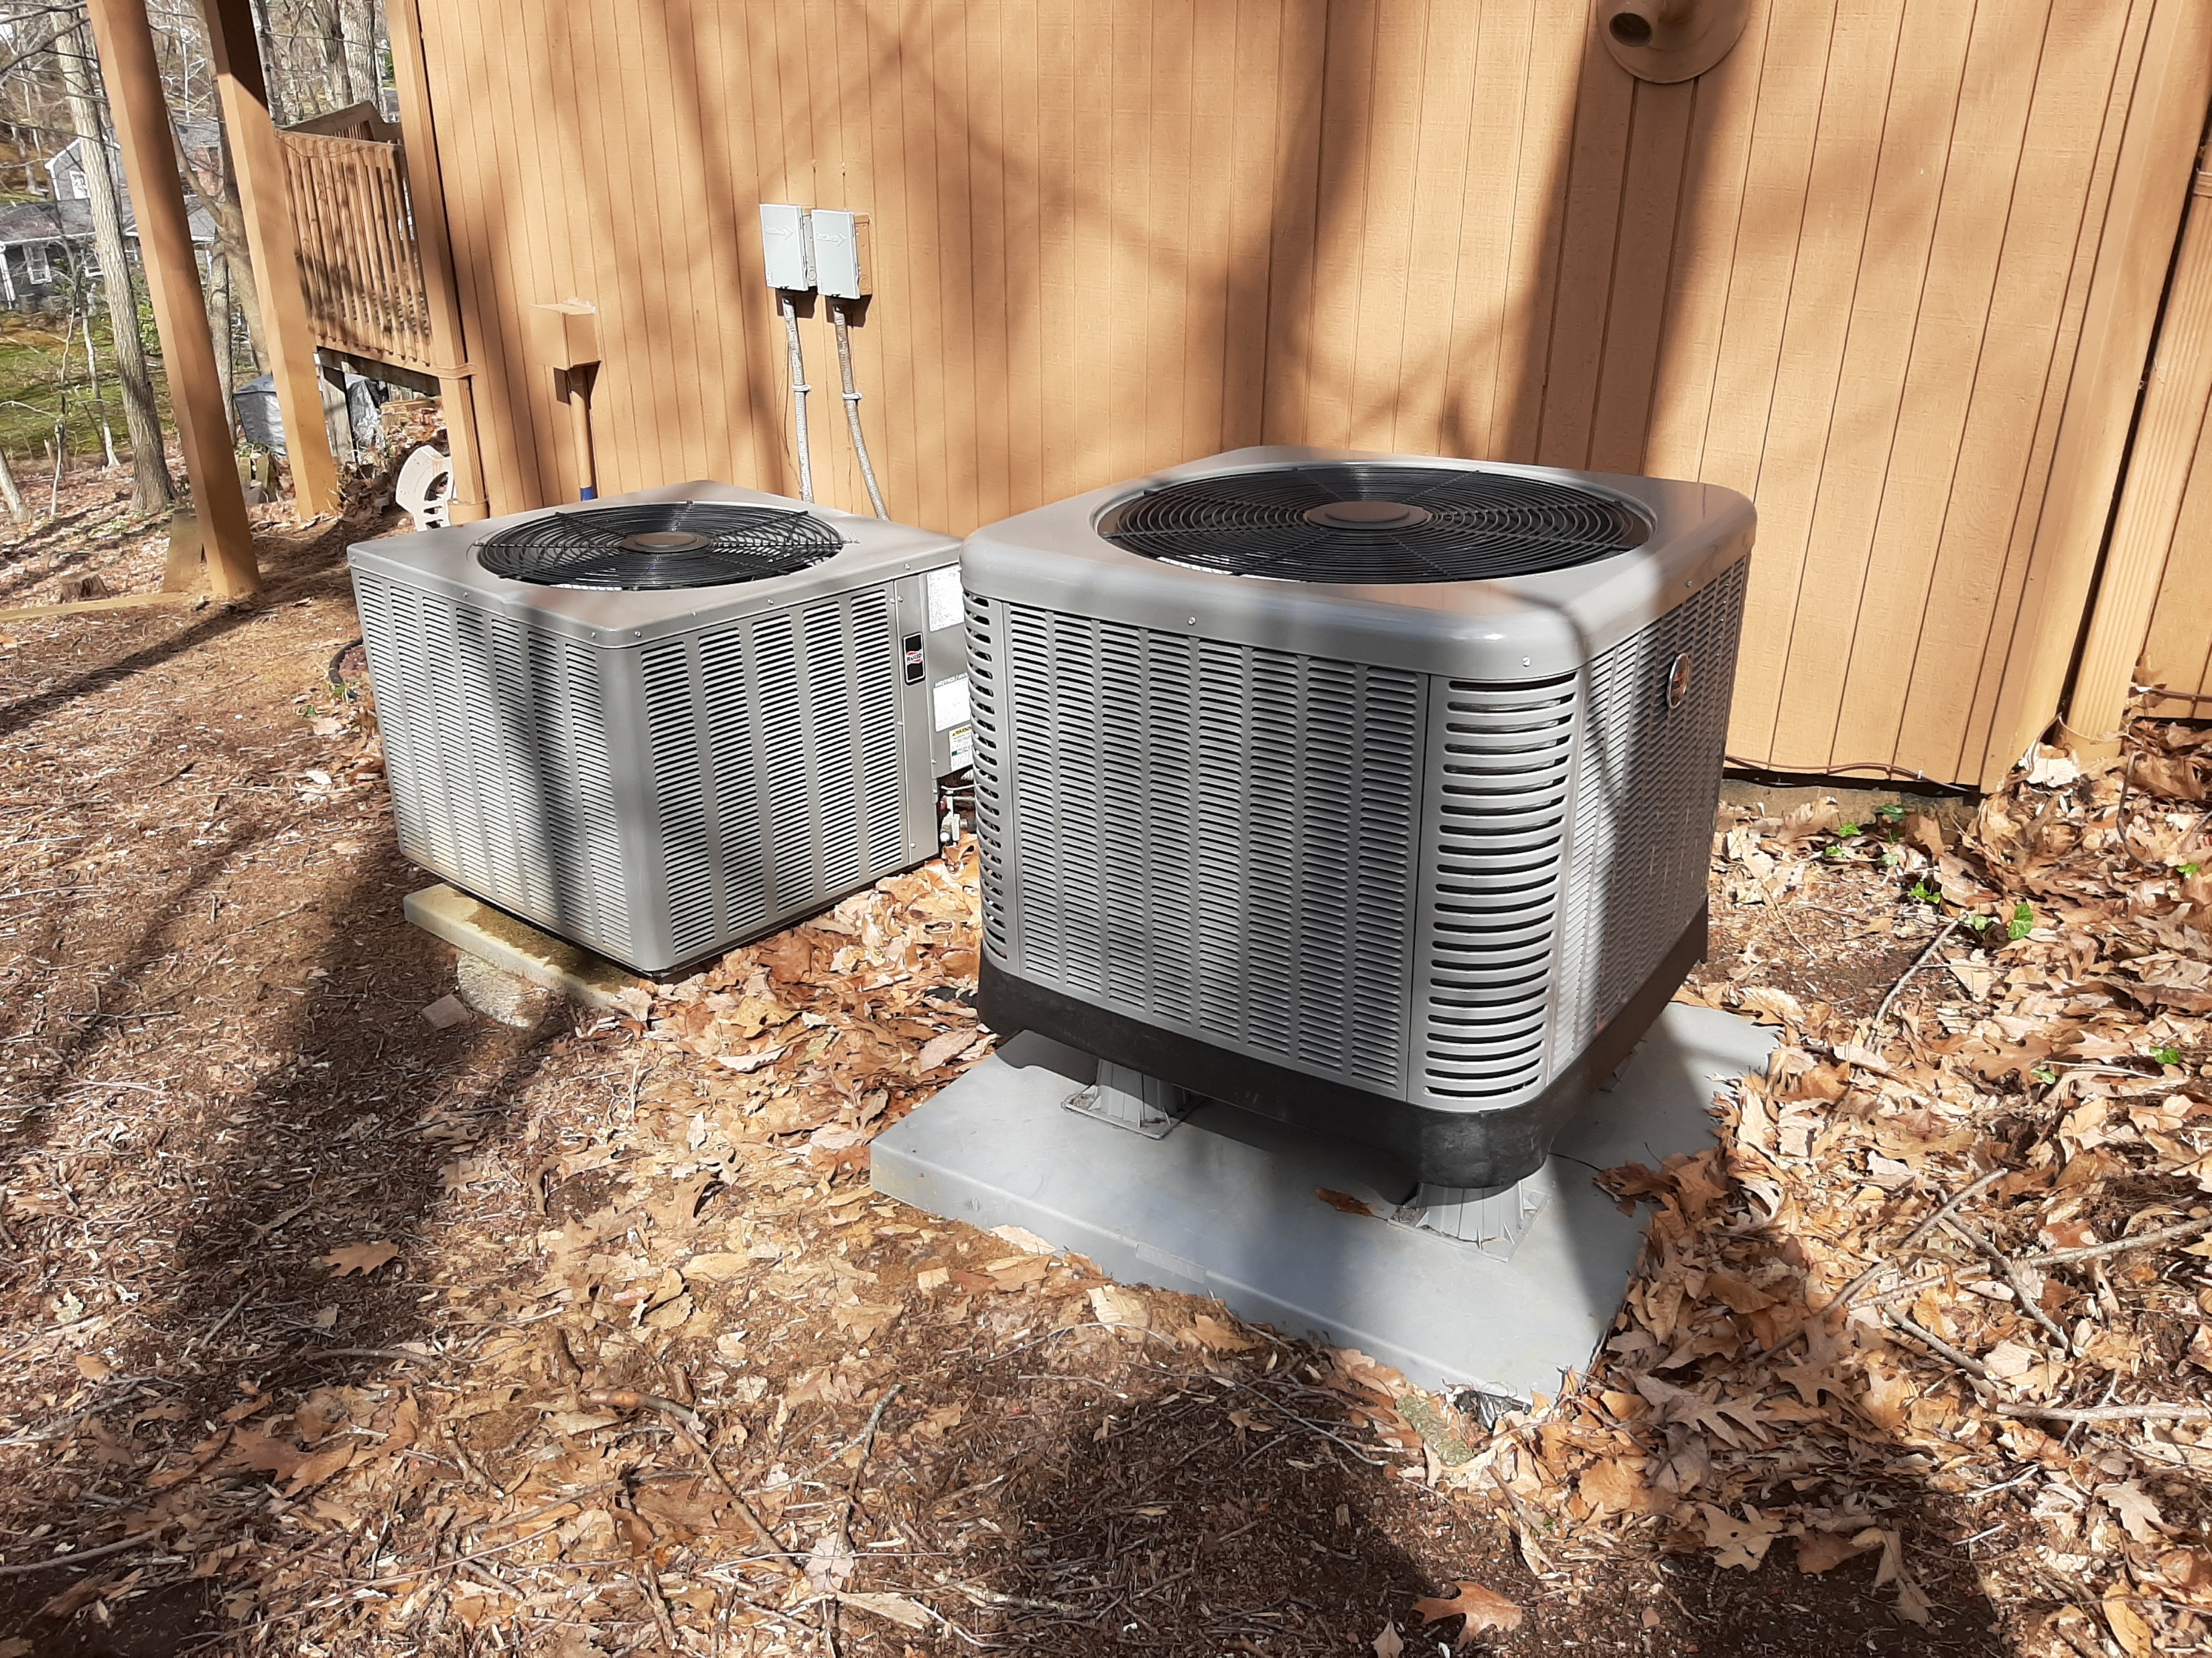
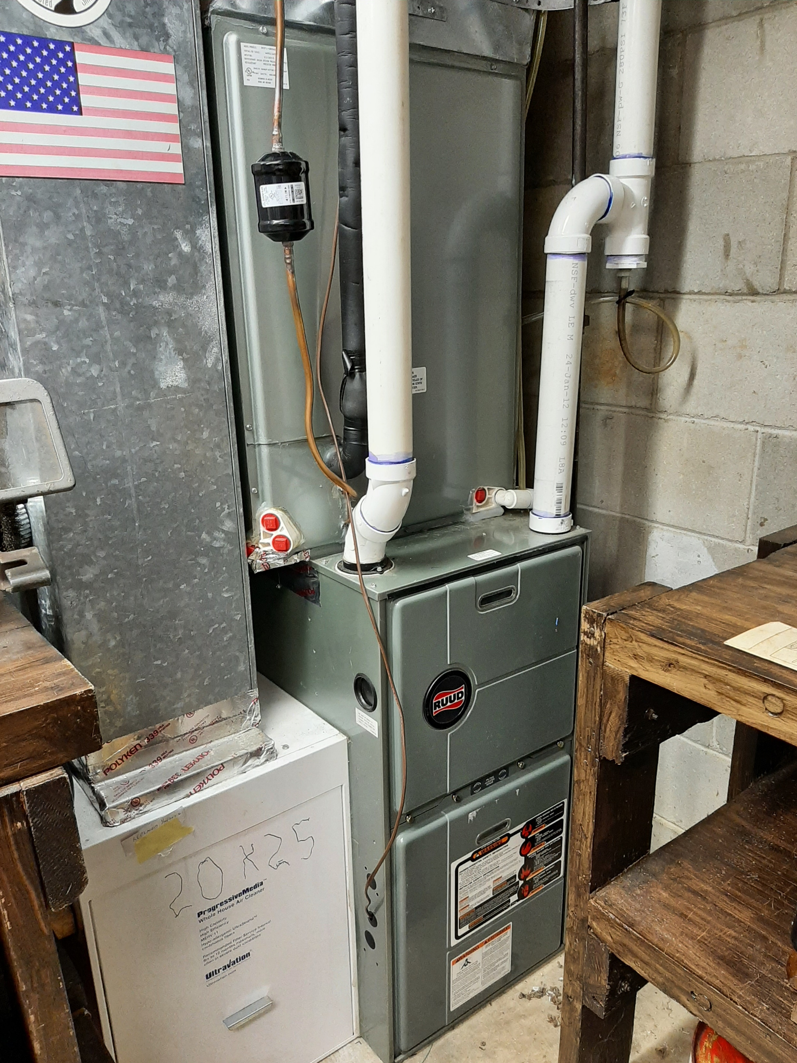
Which one is the heat pump? Gas furnace backup on right
Notes:
READ

Slide 20
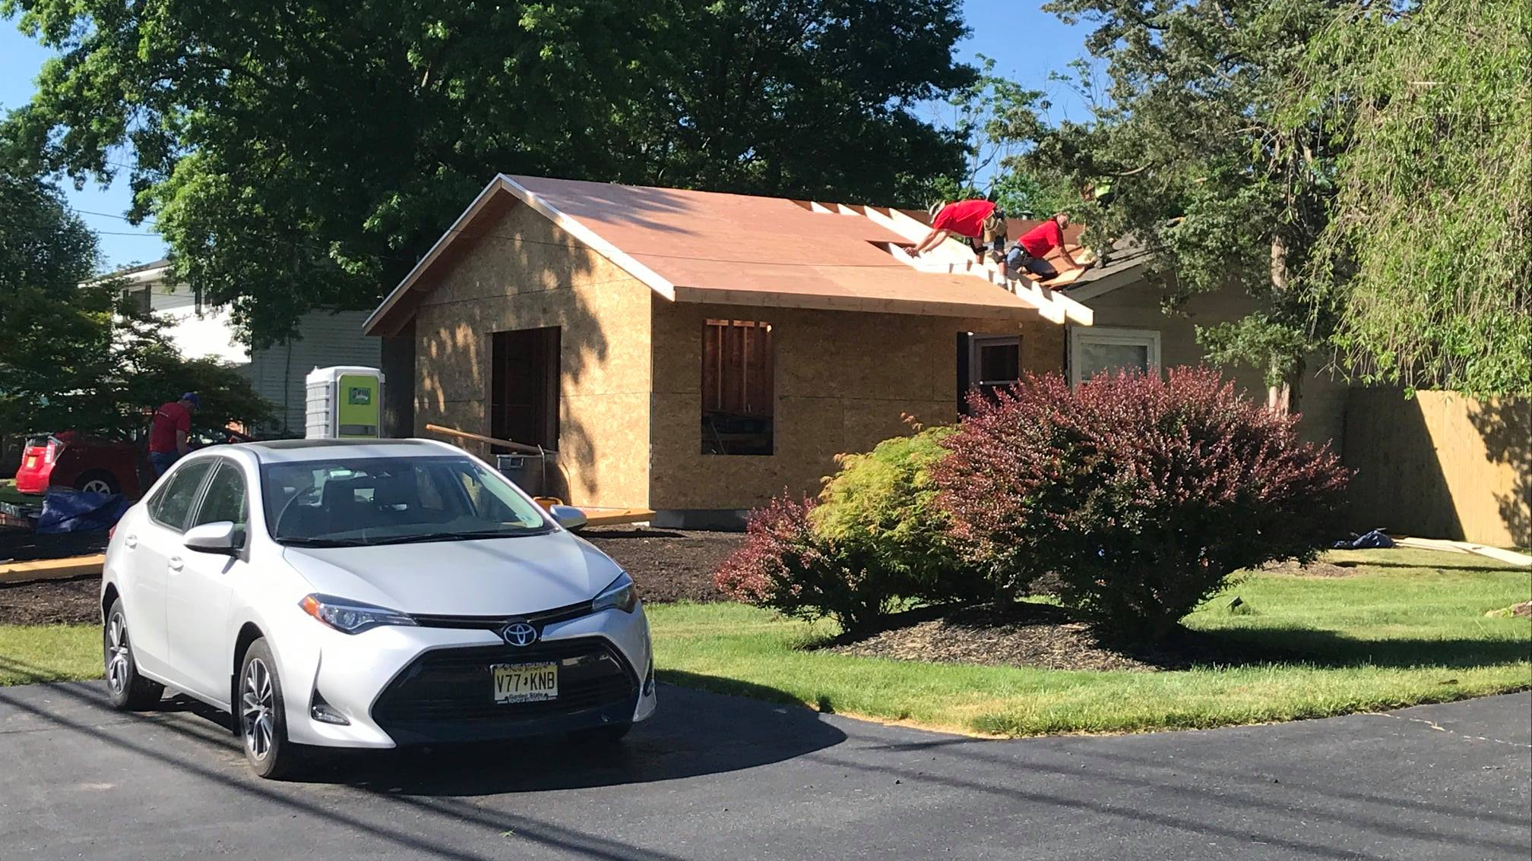
Heat Pump for New Home Addition Heating/AC

Slide 21
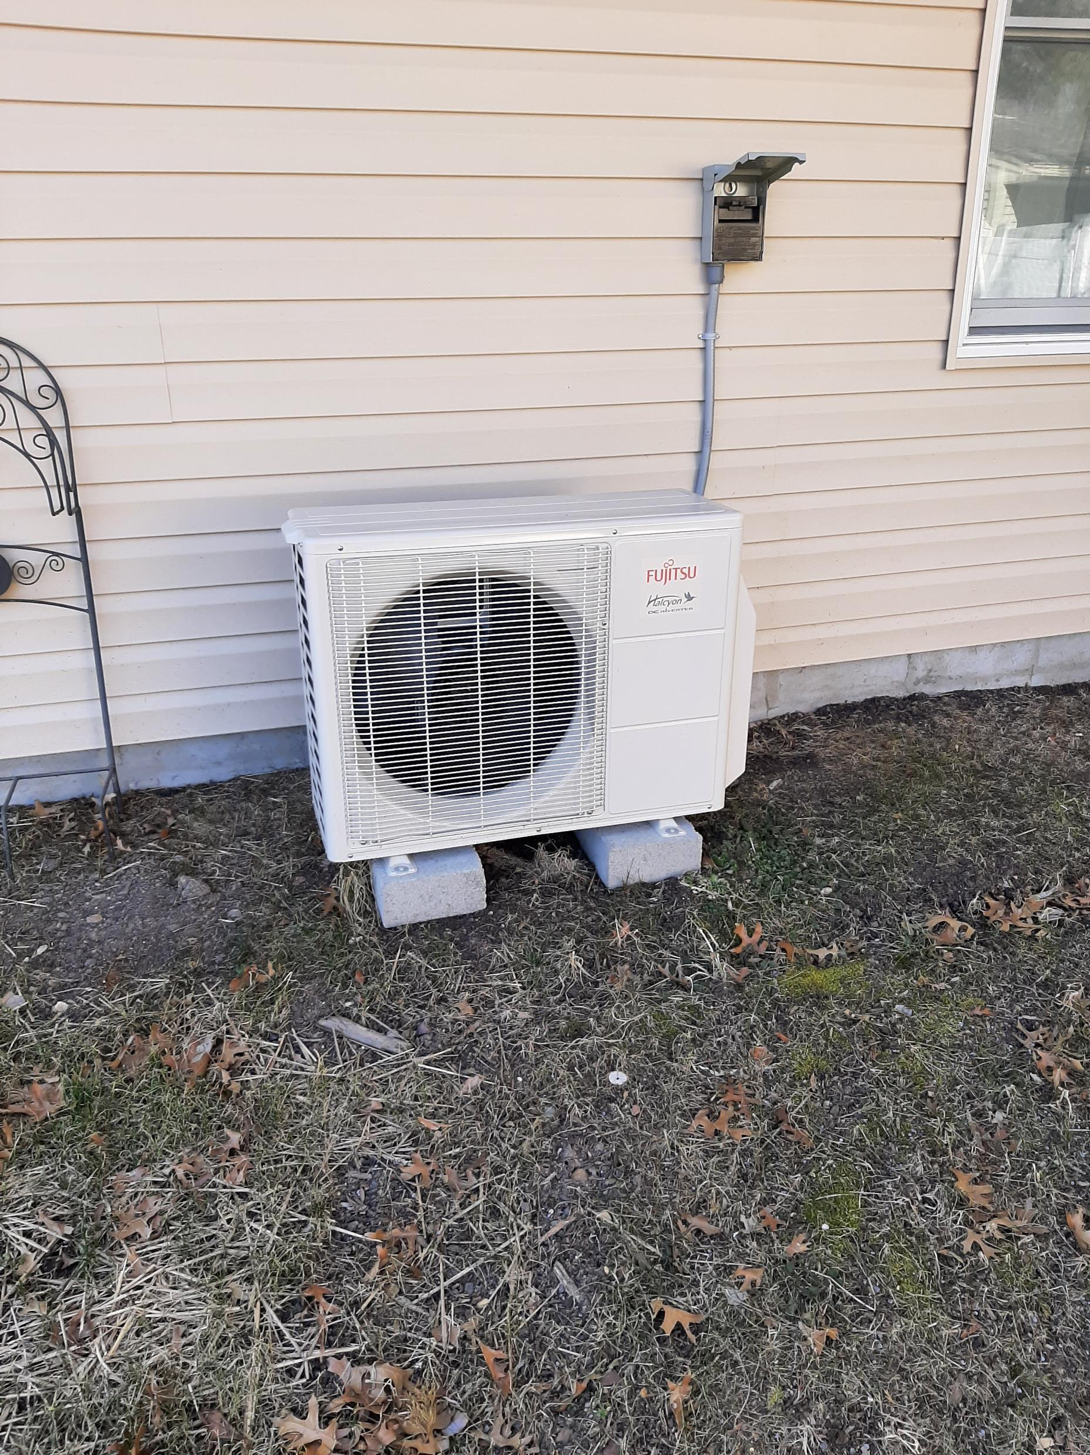
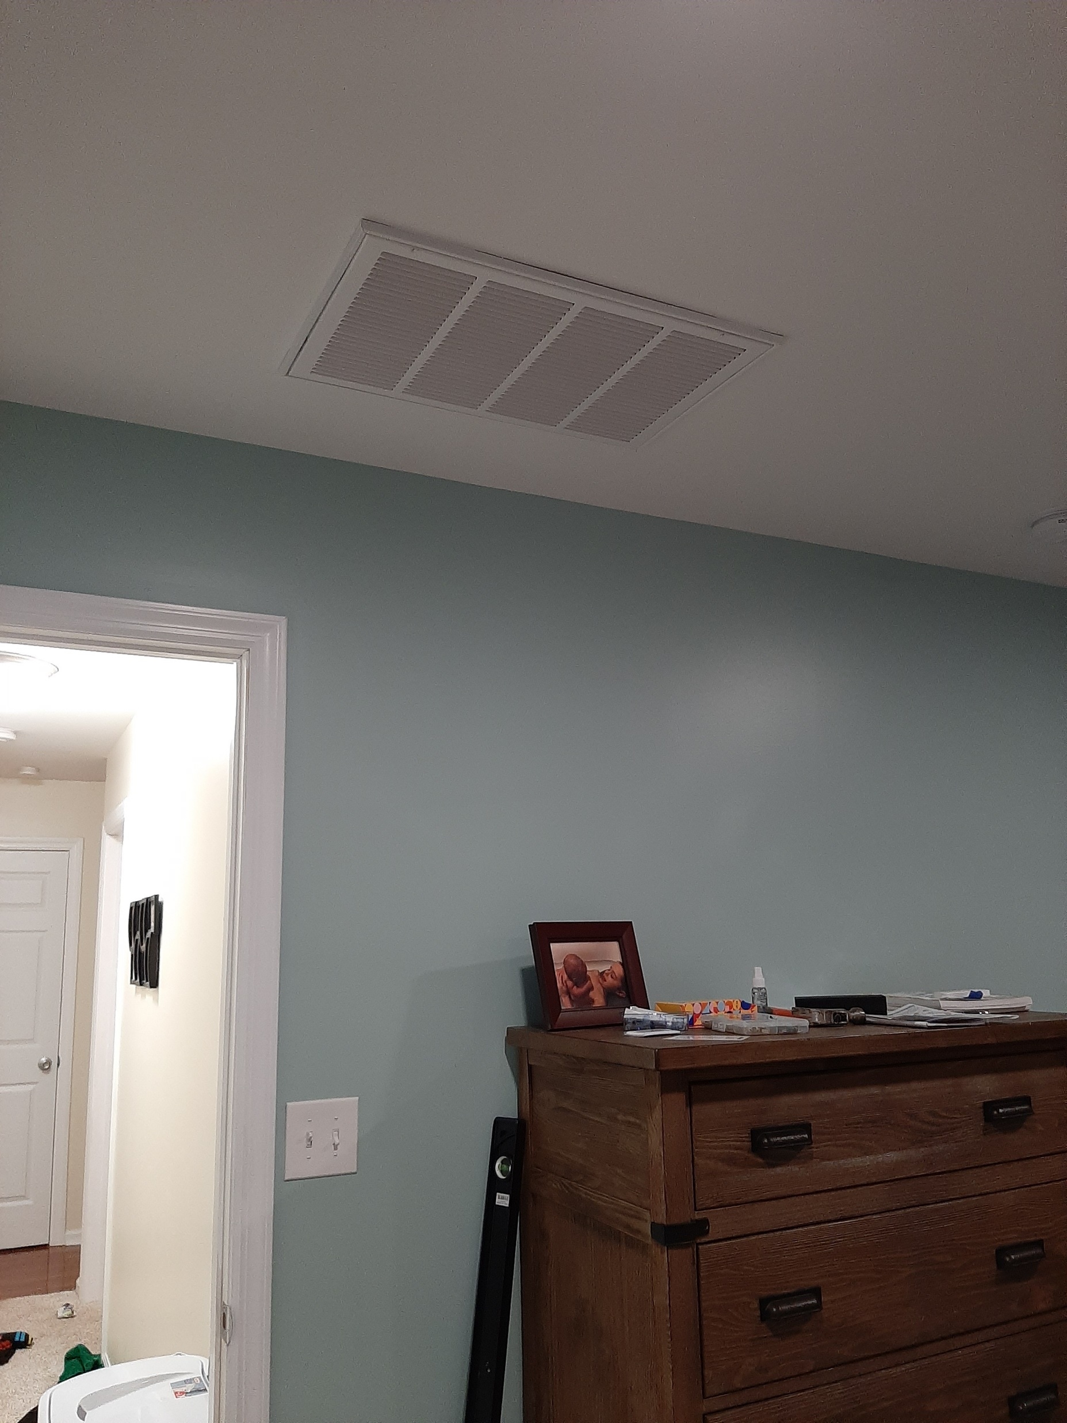
Mini-Split Heat Pump for 1-2 Rooms

Slide 22
UUCMC UPGRADES
2022 Solar System Upgrade
2021 HVAC Heat Pumps, Tankless Water Heater, Classroom T8 to LEDs
2017 Earth Room LED Flood Lights
2016 Florescent to LED Main Building
2014 Heat Pump Water Heater
YEAR
2011 New Insulated Classrooms Roof, New Hood with Make Up Air
2011 Classrooms from T12 to T8, Energy Star Refrigerator & Freezer
2010 Community Room AC
2008 Community Room Insulation, Energy Star Windows. Lighting
2006 Solar System, Green Sanctuary Application Approved
2005 Programable Thermostats –Some Compact Florescent
2004 Energy Audit
2003 Green Sanctuary Application---Carbon Footprint Focus

Slide 23
Annual Pounds
of CO2e
Est

Slide 24
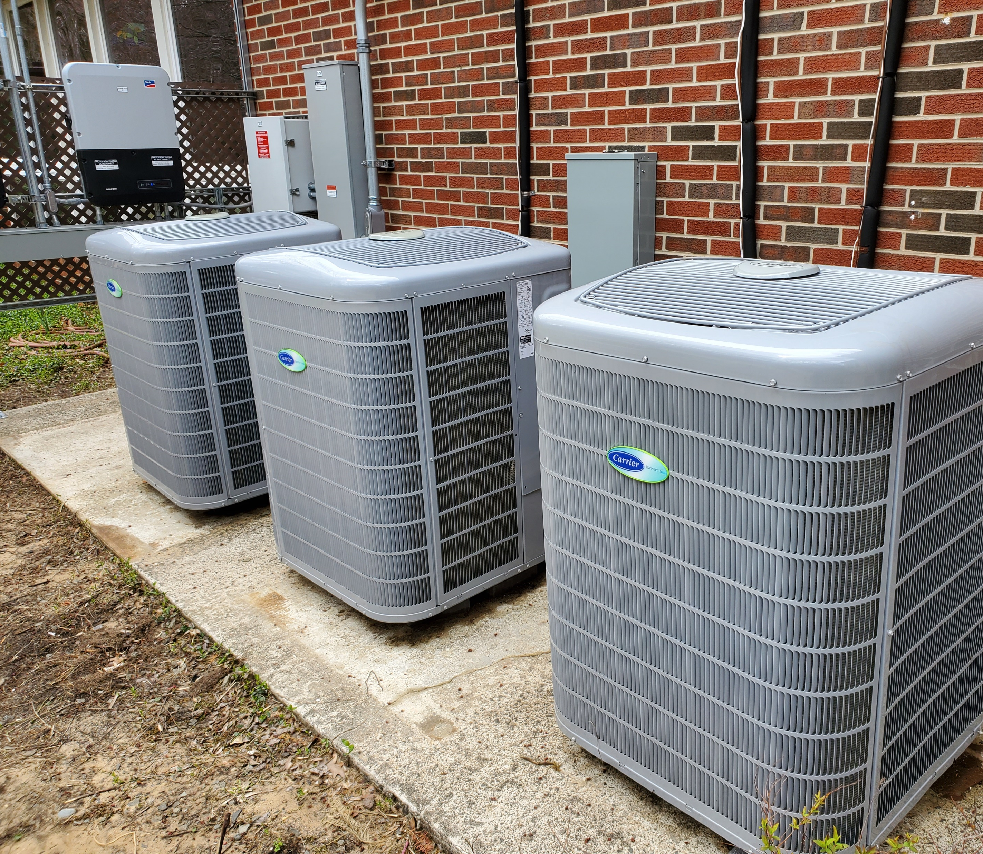
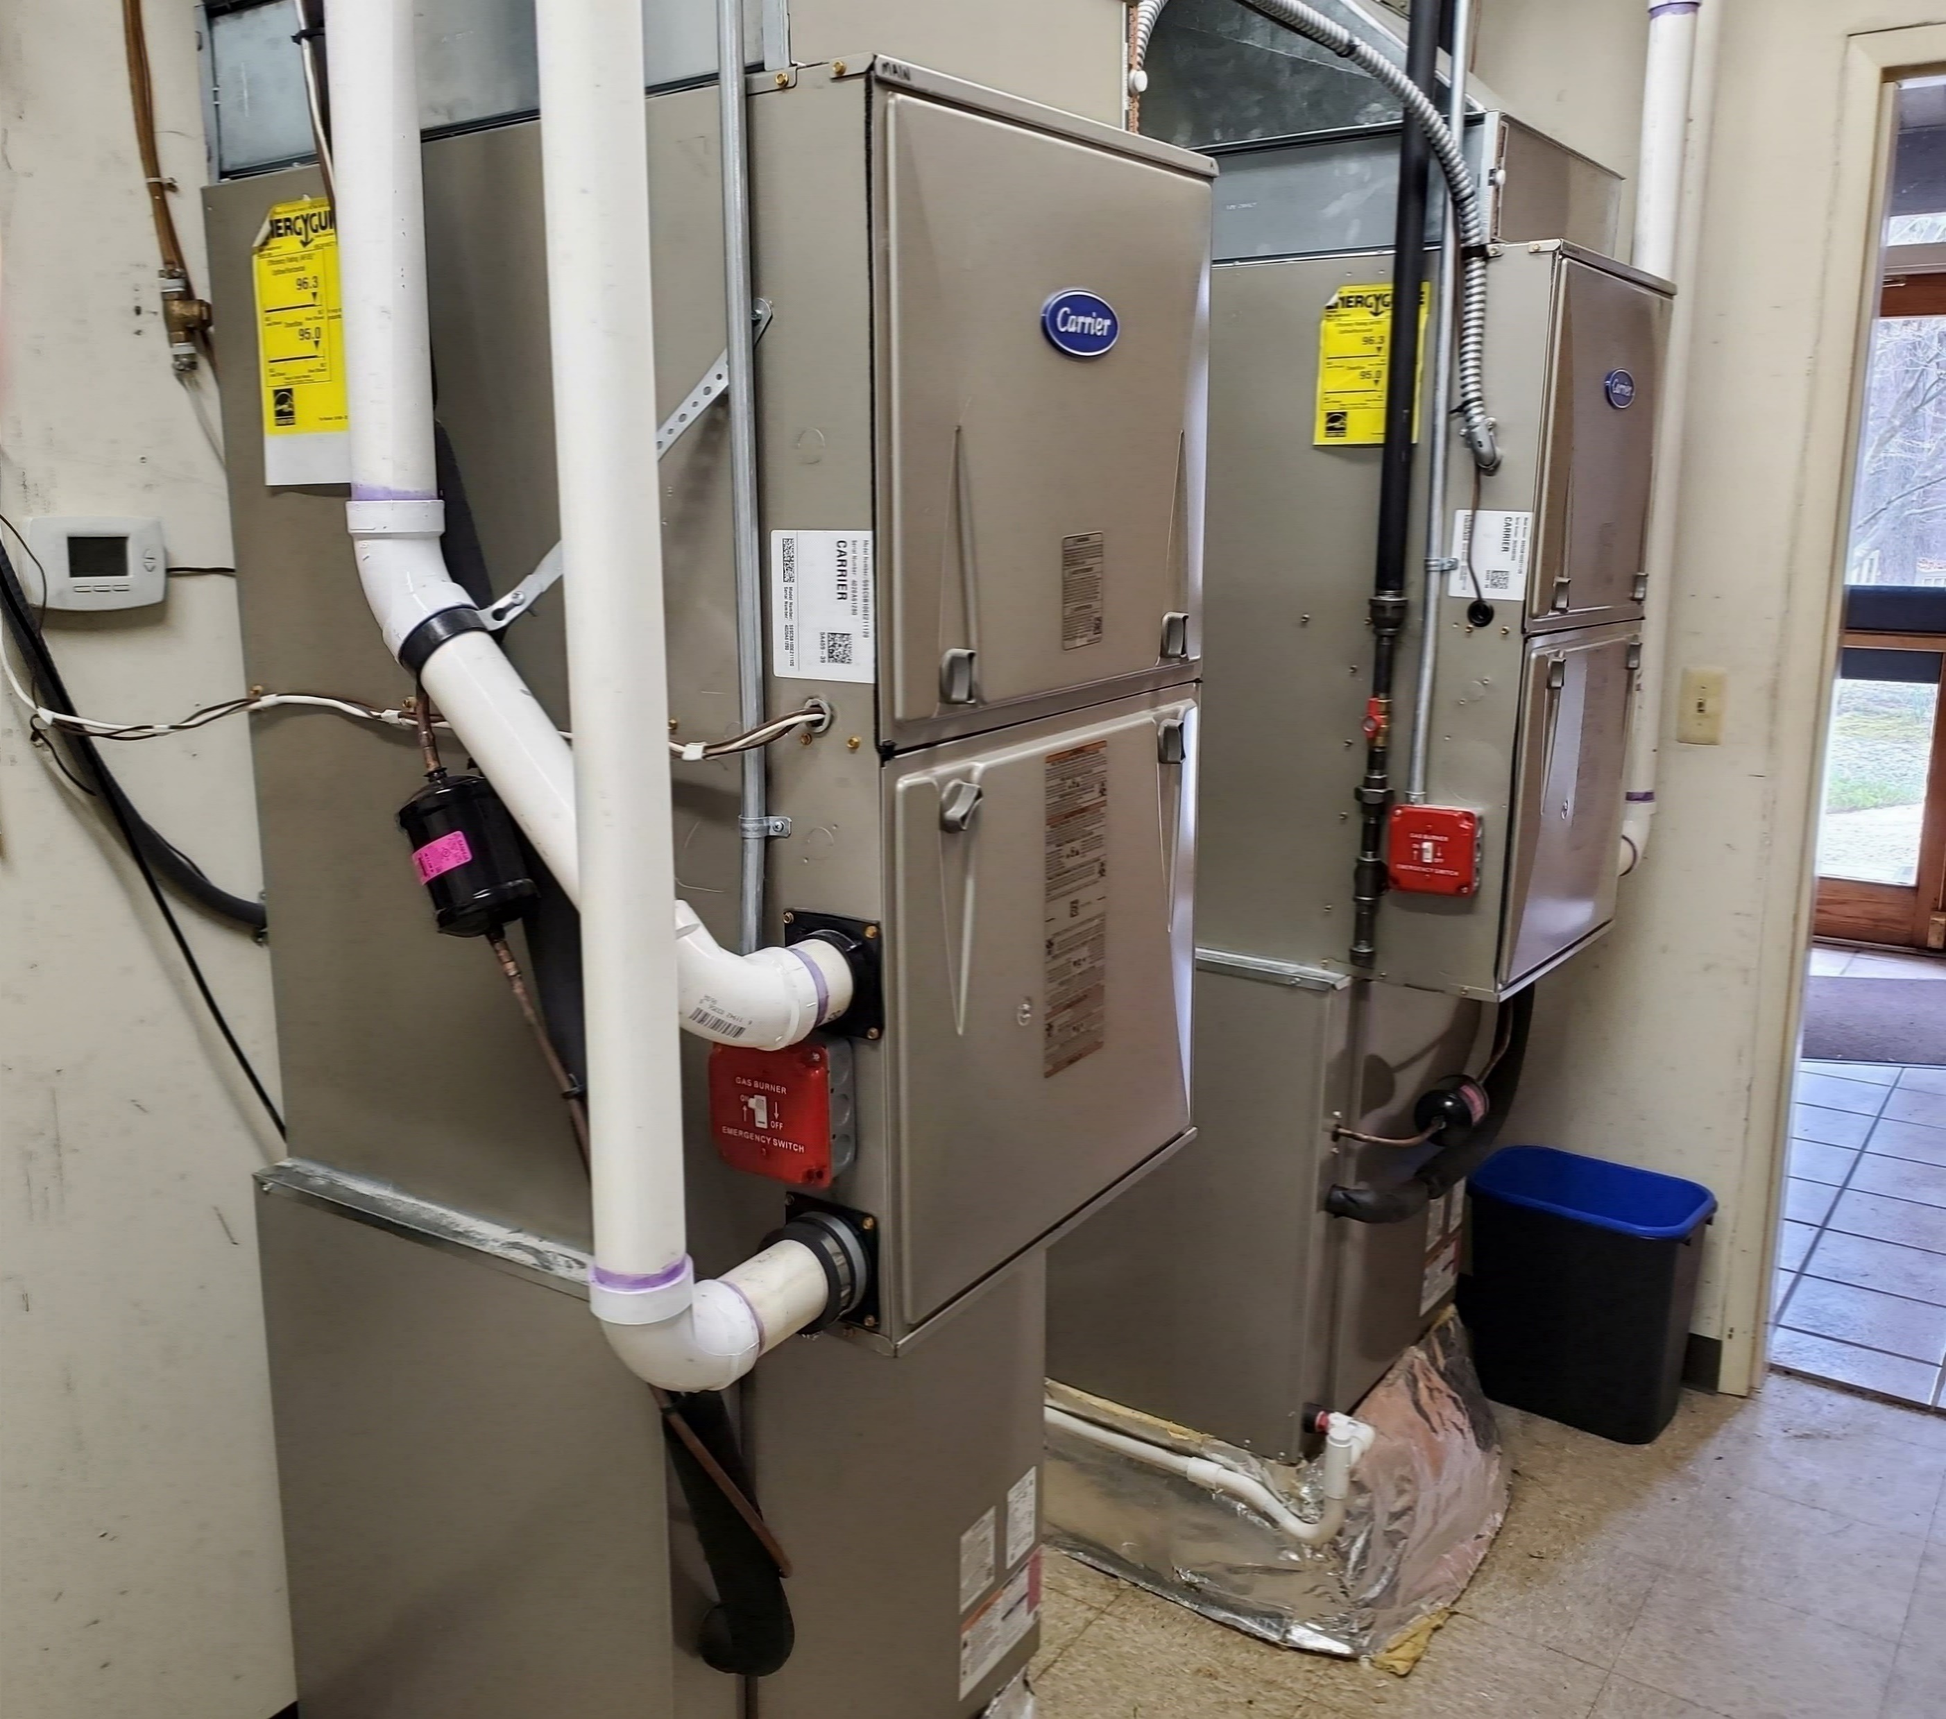
UUCMC 2021 Heat Pumps

Slide 25
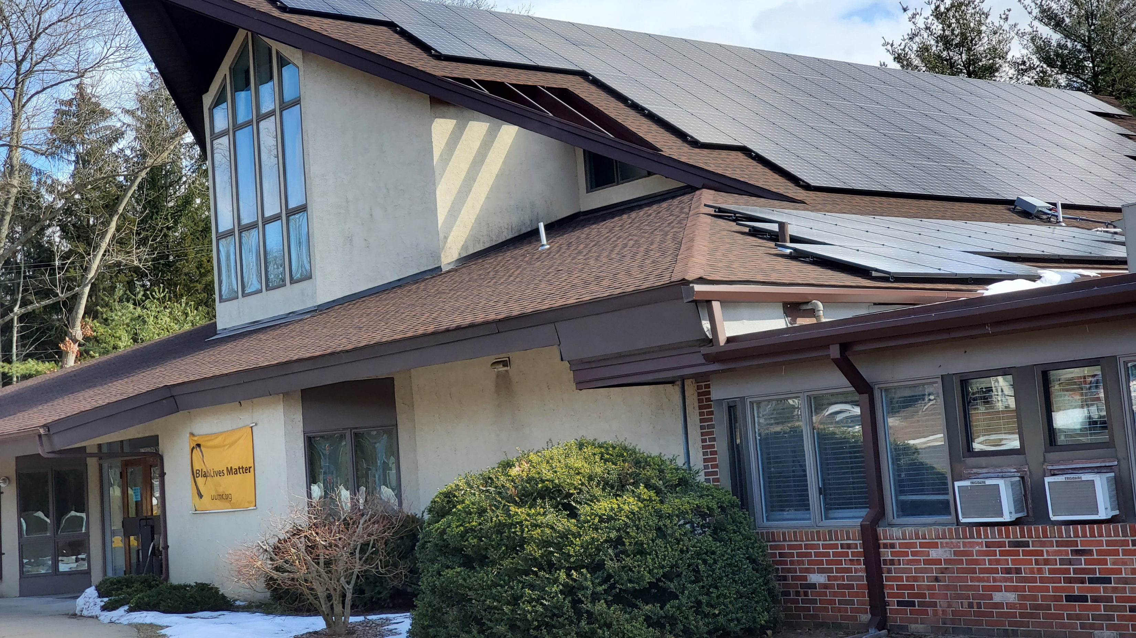
UUCMC 2022 Rooftop Solar
4 x Capacity of Old System

Slide 26
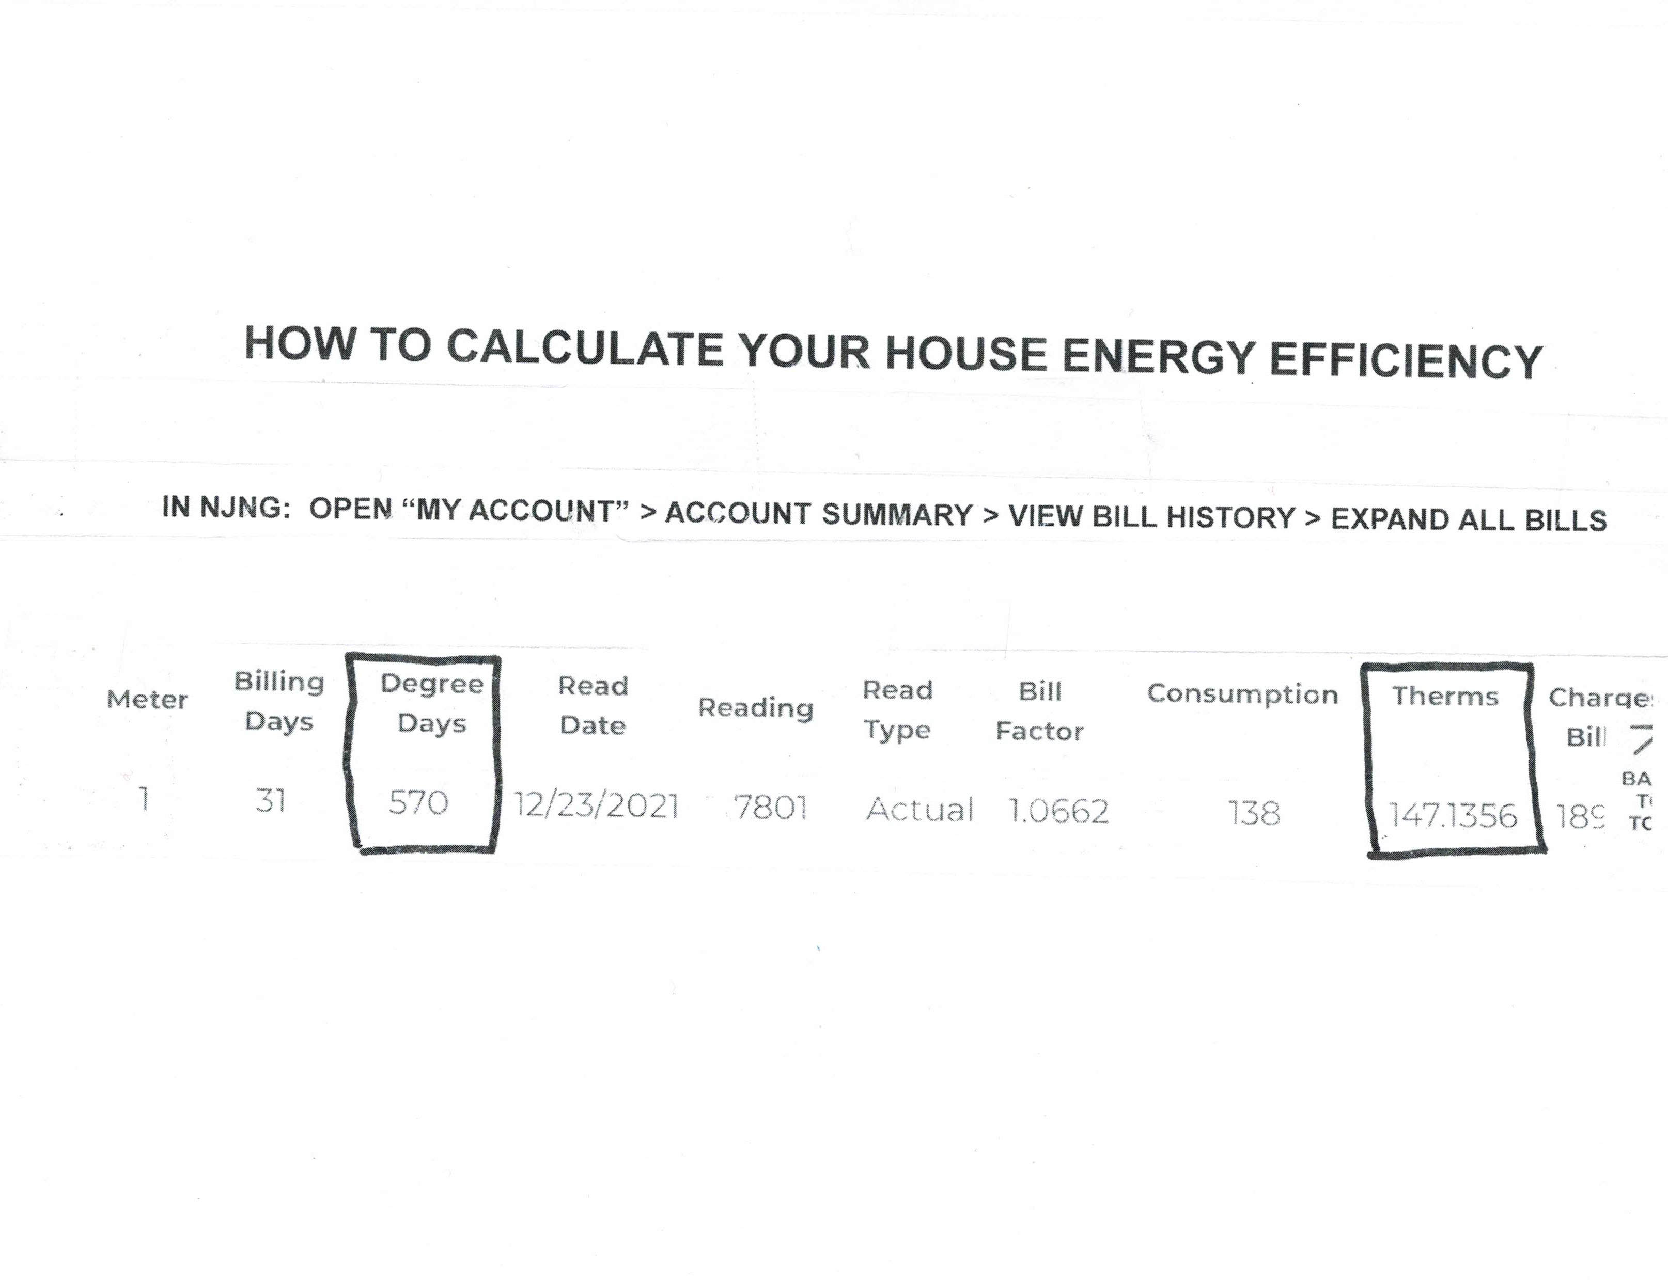
an alternative is to download free software: https://www.coolcalc.com/
Step 1: collect your house data
NOTE: for highest accuracy, choose the winter month with highest degree days
ensure this month is an “actual” reading,
And ensure the previous month is also “actual” reading
Determine your furnace/boiler efficiency
open front panel; record nameplate rating: output/input = efficiency
OR assume 90% for 10 year old; 80% for 20 year old furnace/boiler;

Slide 27
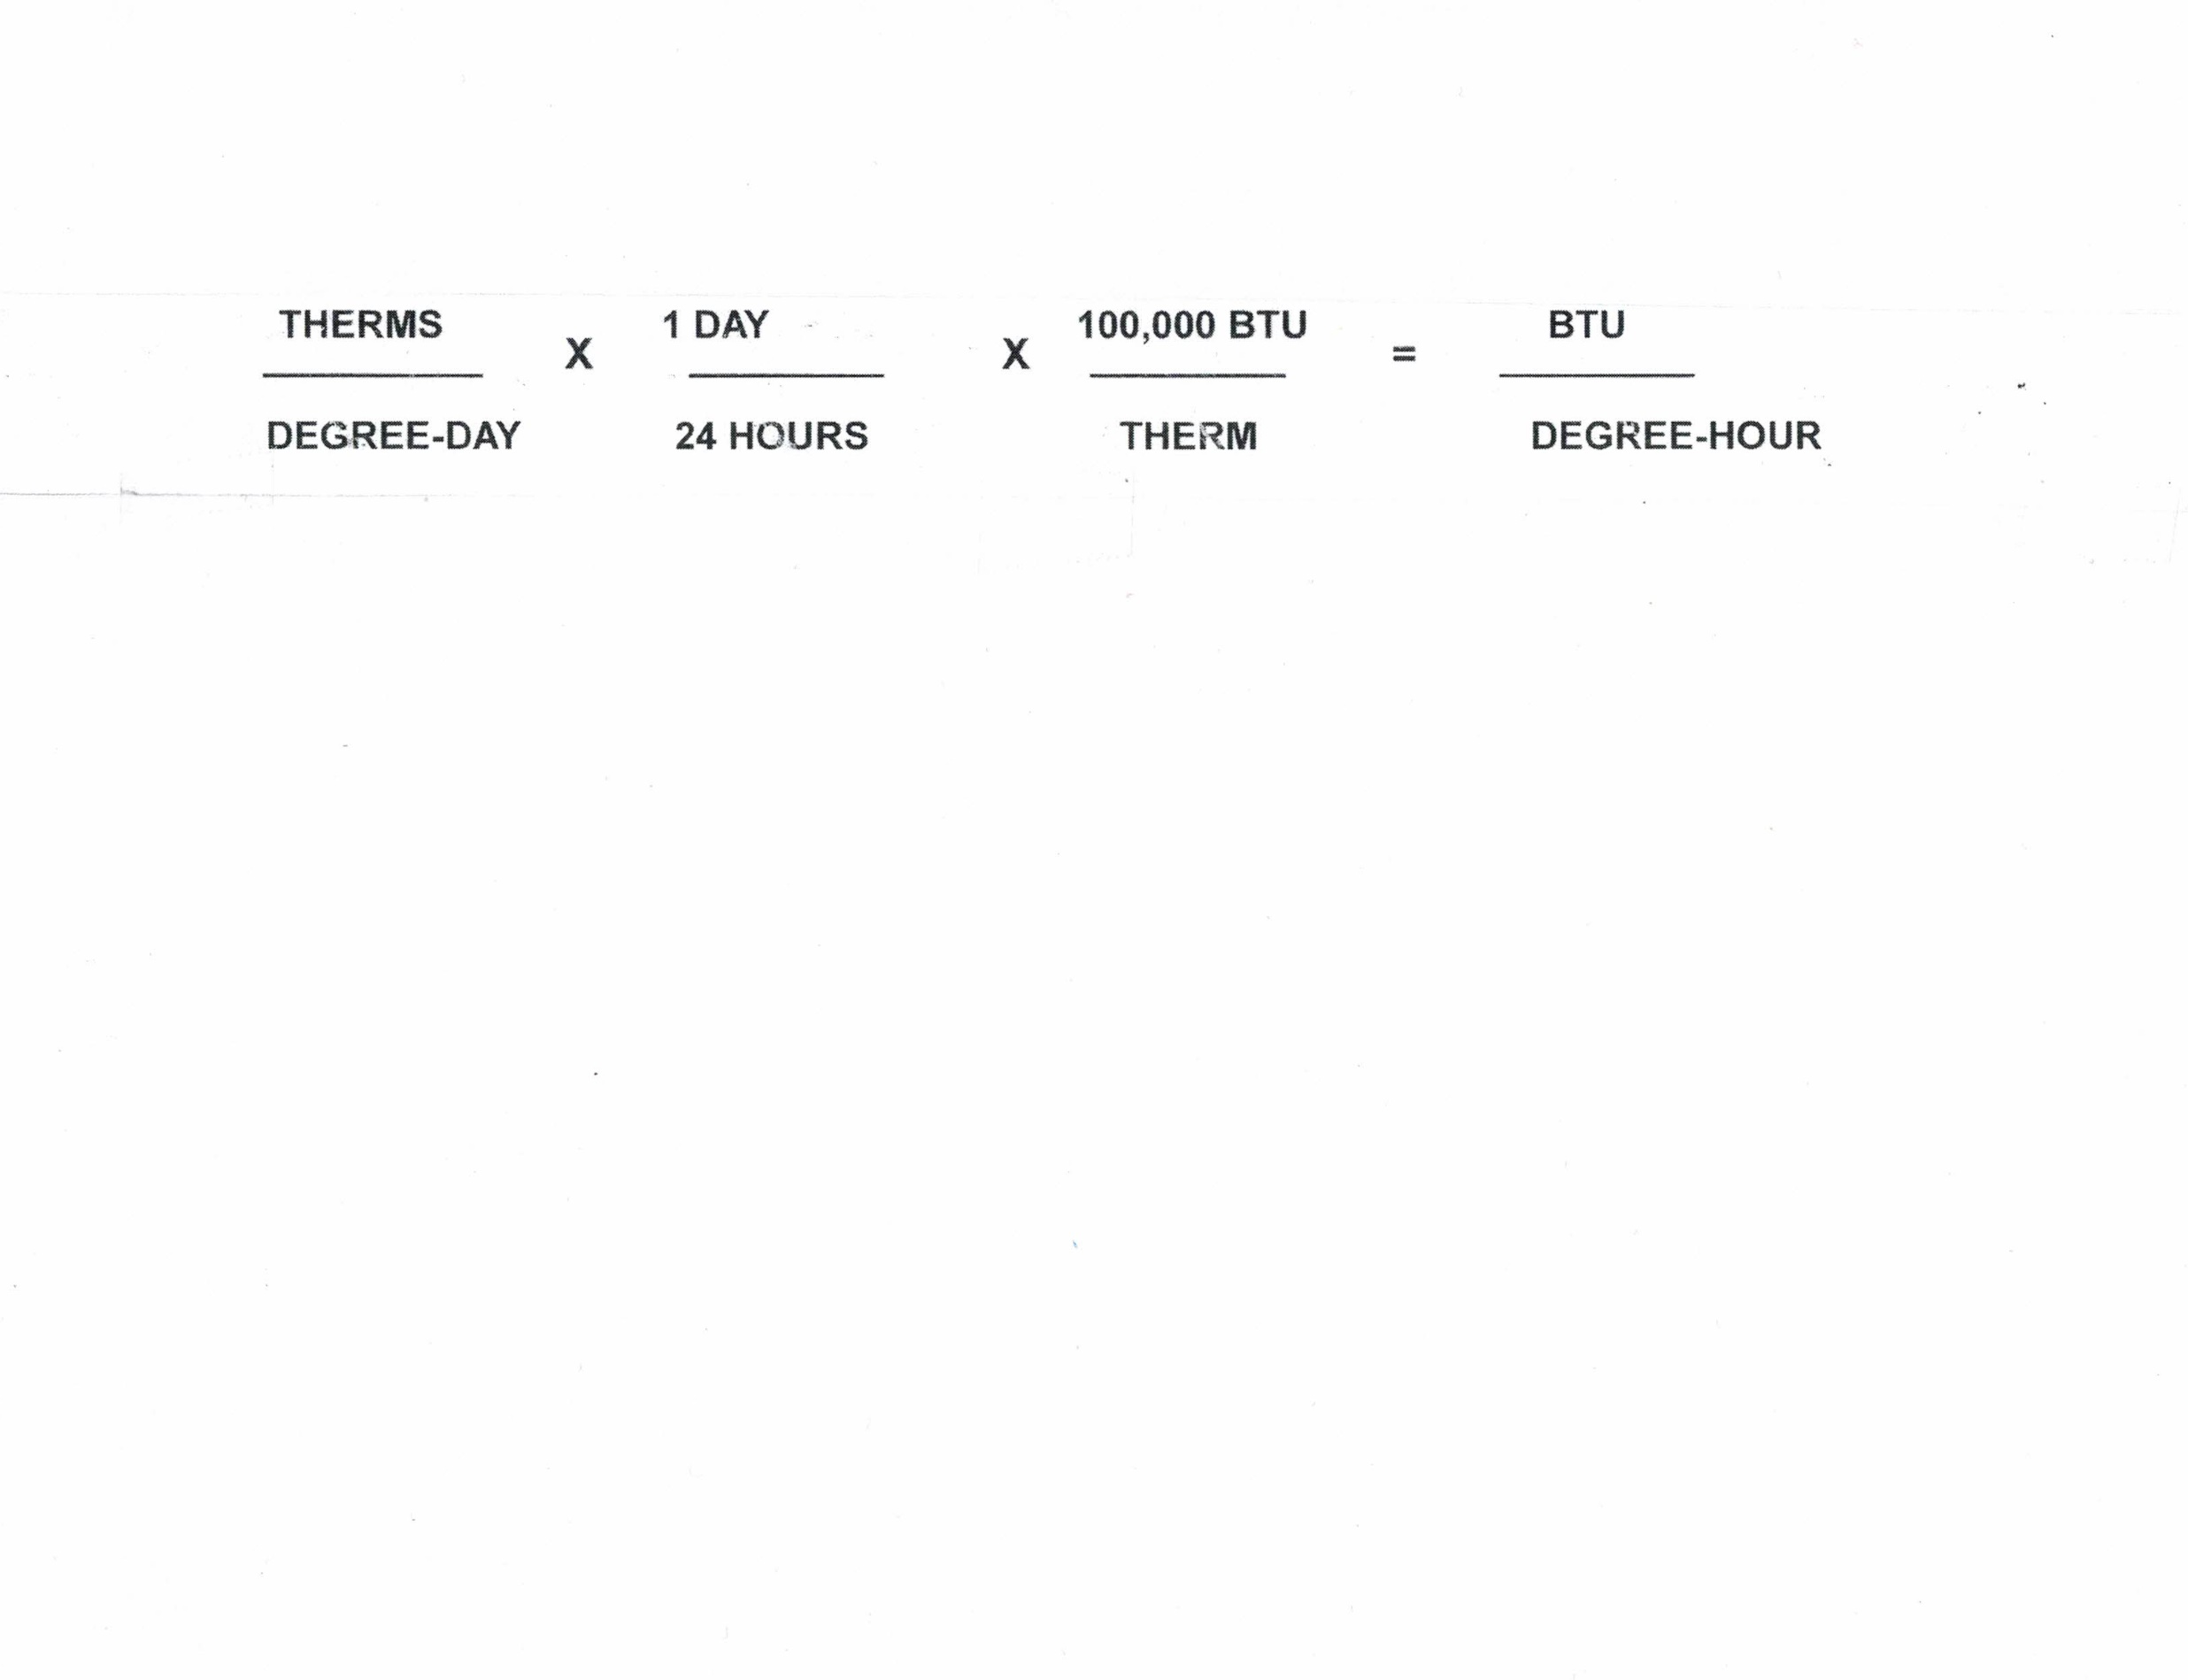
Step 2 – do the math
How to calculate youR house energy efficiency
SHORTCUTS:
(THERMS / DEGREE-DAY) * 4168 * (furnace efficiency) = (youR house BTU loss)/degree-hour
calculate the Top point of your house heat loss (for use in plotting step 3):
(therms/degree-day) * (187560) * (FURNACE EFFICIENCY) = (your house btu loss/hour) at 20 degrees f

Slide 28
Step 3 – PLOT YOUR RESULT
Calculate your house energy efficiency
Print copies of blank template (last slide in this deck)
Mark two points, and draw a straight line
Bottom point is on bottom of graph: 0BTU/hour
mark at 65 degrees F (behind the label on the graph)
top point was calculated in step 2:
mark at 20 degrees f
Draw a straight line between the bottom mark and top mark
Your line should look something like the red line on next slide

Slide 29
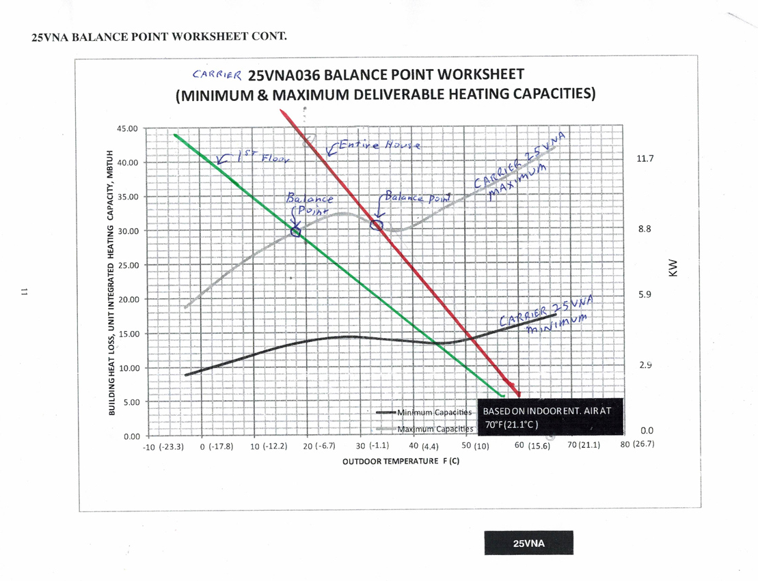
MBTUH =
Thousand BTU/hour

Slide 30
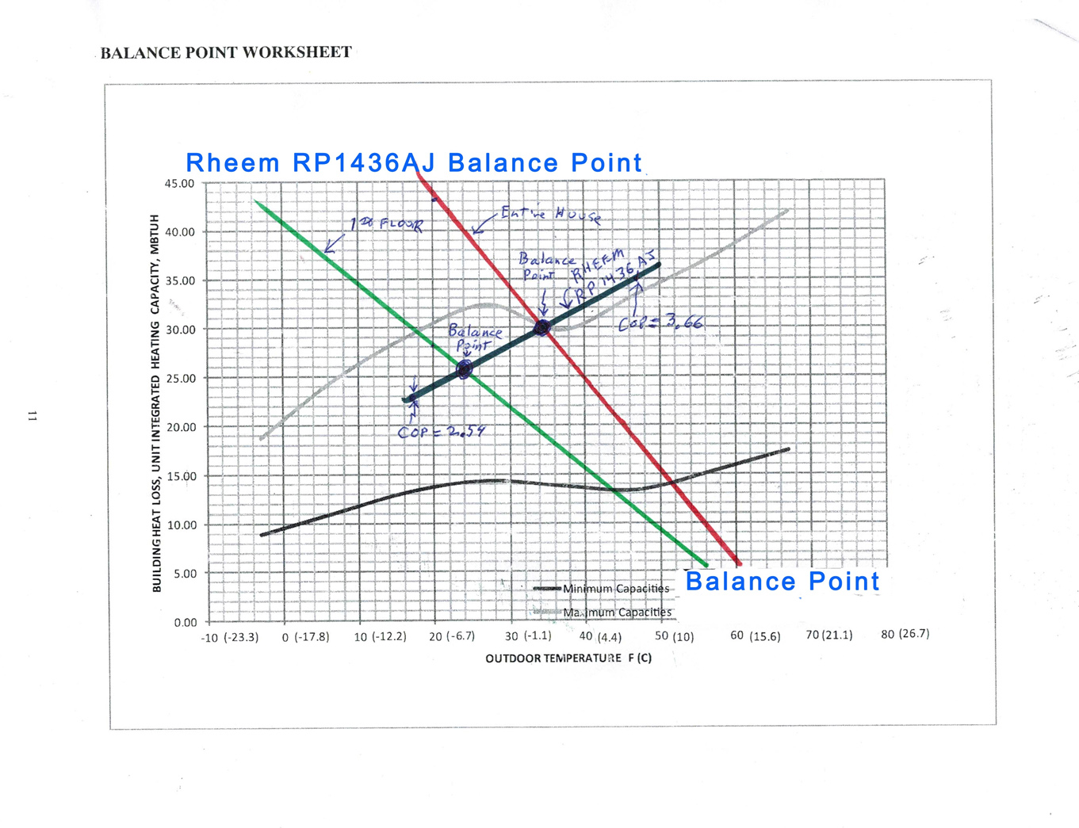
MBTUH =
Thousand BTU/hour
Plot
Plot

Slide 31
About the 50x30 Building Electrification Team
GOAL: eliminate GHG emissions from NJ buildings – contributes 26% of NJ total GHG
The NJ Administration Subteam is completing a policy/position and accompanying 2 cover letters, with requests for action by Governor Murphy and related Administrative offices: BPU, DEP, DCA
The NJ Legislative Subteam is identifying deficiencies in existing and proposed legislation, developing recommended changes and language, and meeting with NJ legislators and staff
The NJ Building Electrification Team organizes a monthly webinar, 7PM, 3rd Thursday of each month, which provides expert and homeowner discussion and examples on electrifying new buildings, and refurbed buildings in NJ
The Building Electrification Team is supporting NEEP (a consultant to the NJ BPU) to develop the NJ “Zero Energy Building Code Roadmap” for both new construction and building “refurb”
TO JOIN THIS TEAM OF ACTIVISTS: click here https://eepurl.com/dpWC1n
  provide your contact info
  then click “join the 50x30 team click here” in the little box in lower left bottom corner
  you can opt-out at any time

Slide 32
FOR MORE INFORMATION
BUILDING ELECTRIFICATION VIDEO ARCHIVE
5 webinars (including April 21, 2022)
links are provided for recording, slides, and (sometimes) Q&A
https://climate.smiller.org/50x30/building-electrification/All-heat-pump-webinars.html

Slide 33
ABOUT STEVE MILLER contact: stevemiller@comcast.net
Co-lead, 50x30 Building Electrification Team
Lead, Legislative subteam of 50x30 Building Electrification Team
“Building Electrification Issues Coordinator” Sierra Club NJ Chapter
“Climate Chair” Jersey Shore Group of Sierra Club NJ Chapter
Trained Leader & Member of NJ Gateway Chapter of Climate Reality Project
Co-Lead of the Climate Action Team of UUCMC, Lincroft NJ
Co-Founder, Middletown for Clean Energy
Websites: https://electric.smiller.org https://climate.smiller.org

Slide 34
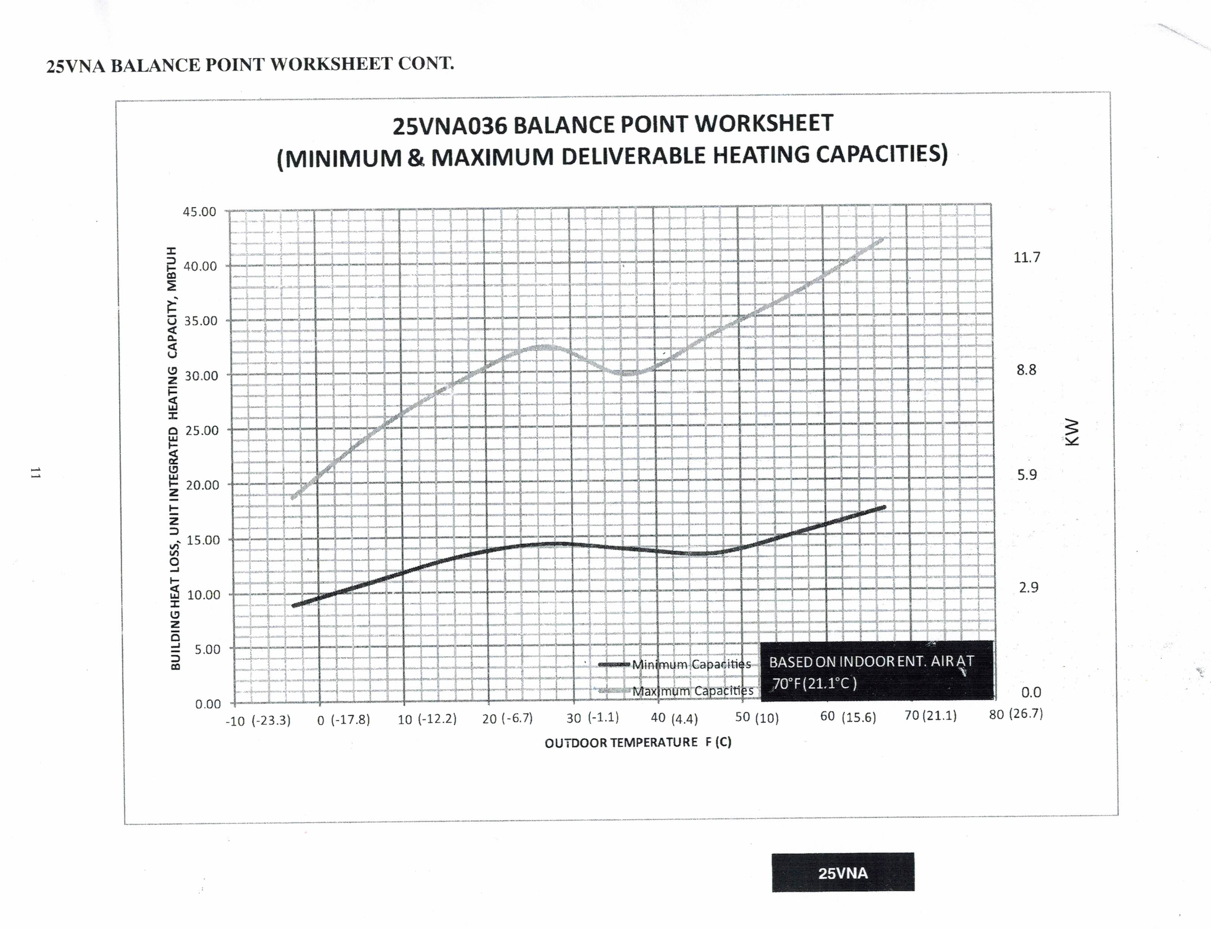
COPY THIS FOR EXTRA WORKSHEETS
MTBUH =
Thousand BTU/hour

