Slide 1
Getting to 50x30 with Building Electrification
Top 3 GHG emissions sources in NJ: 87% of all emissions
  Transportation
  Residential and commercial buildings
  Electricity generation

Slide 2
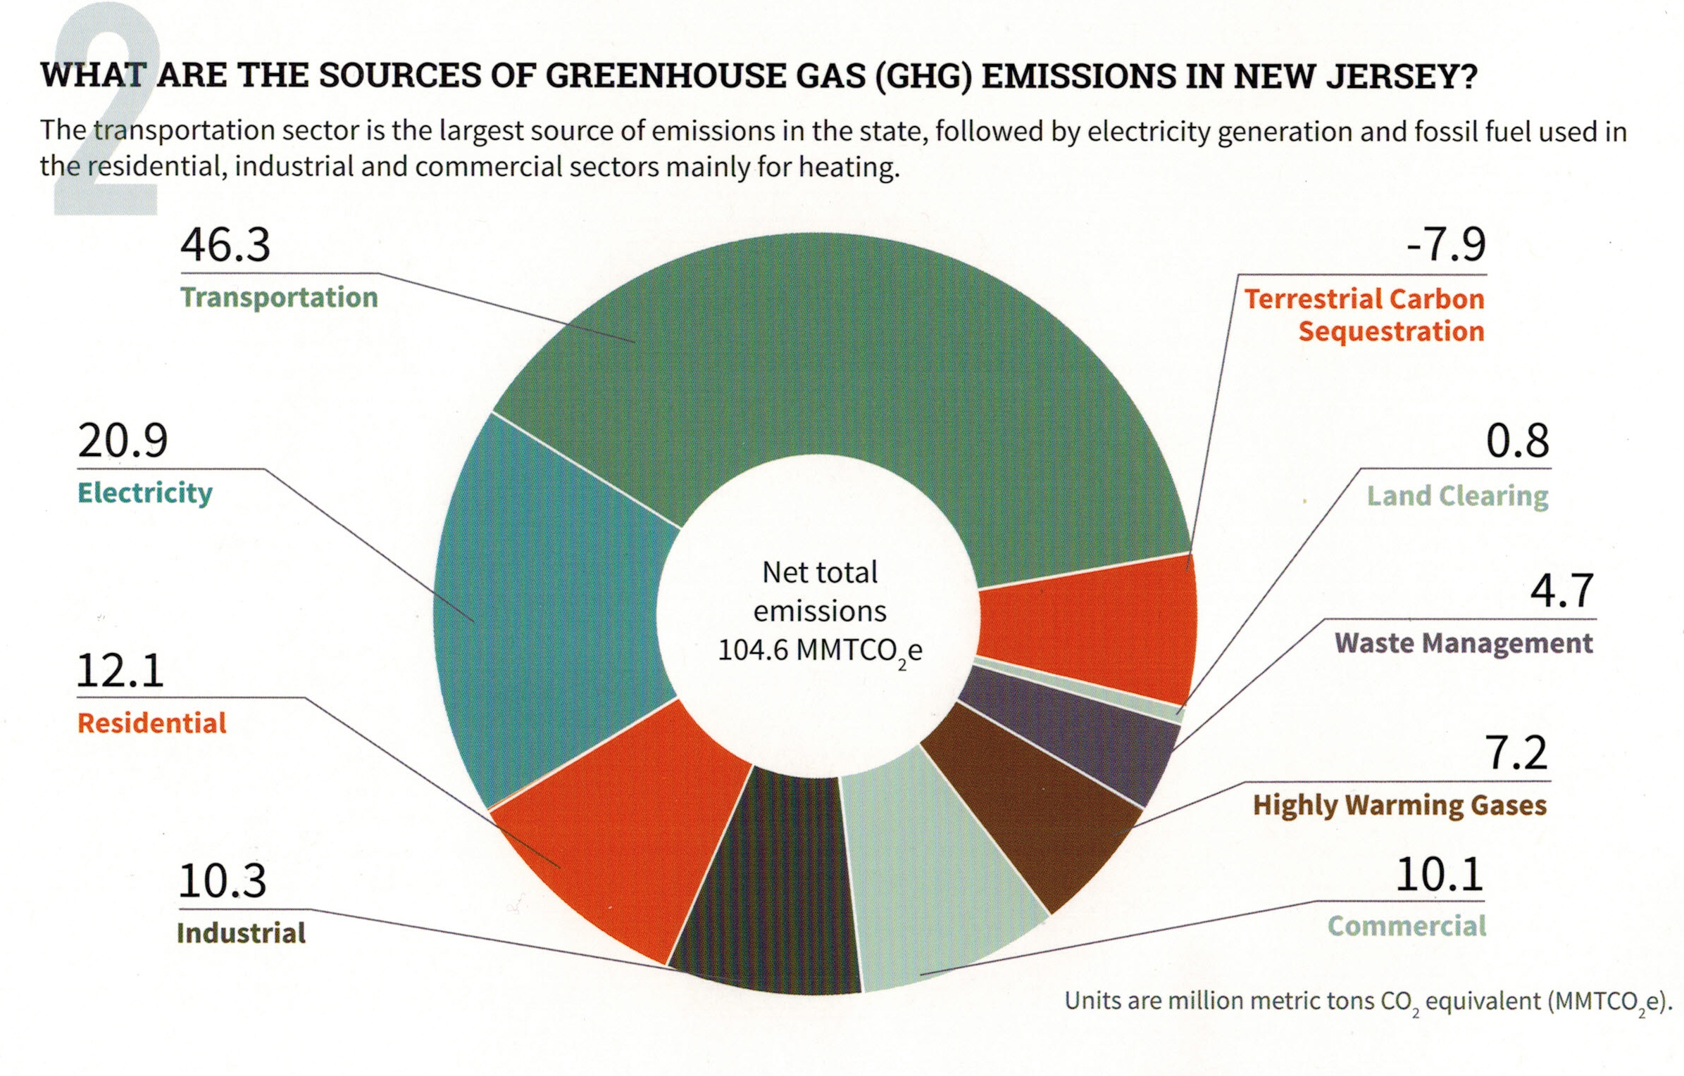
Your (Typical NJ) GHG Emissions EEEmissions
“Reducing NJ Greenhouse Gas Emissions”, Rutgers, Jan 2018
Notes:
This is the NJ “Footprint” of sources of world-heating Greenhouse gases, to show what to tackle first.
Sustainable Jersey states: “the primary goal [of “Gold Star in Energy” is reducing Green House Gases. Responding to this overarching imperative will help achieve all the other [sustainability] goals.”
20% of the GHG is from electricity generation; nearly 50% is from transportation.
Switching electricity to 100% wind/solar, then switching all vehicles to batteries charged by renewable electricity will ELIMINATE almost 70% of our GHG.
VERY IMPORTANT: -8% carbon sequestration by marshes, mudflats, trees, landscaping

Slide 3
NJDEP GWRA Report 80 x 50 https://www.nj.gov/dep/climatechange/docs/nj-gwra-80x50-report-2020.pdf

Slide 4
Clean Electrification to Reduce GHG
In NJ plans are underway to reduce transportation emissions by electrification of vehicles.
Plans are underway to increase clean electricity via wind.
We cannot reach 50% reduction by 2030 without building electrification.
15 other states have initiated pilot programs (may not be statewide) of building electrification.

Slide 5
50x30 Building Electrification Team
Statewide team of volunteers
Supported by Empower NJ coalition (incl. Sierra Club, Climate Reality Project, Clean Water Action, Food & Water Watch …)
Goal: Work with DEP, BPU, DCA, Gov admin, Legislature, Sustainable Jersey & all willing partners to establish and implement firm timeframes and goals for building electrification as part of the Statewide strategies to meet the State’s 50% reduction in 2006 GHG emissions by 2030.

Slide 6
Building Electrification Objectives
Develop targets for heat pump installations needed to meet NJ 50x30 goal and obtain a commitment by the State to meet the target.
Start the transition for new construction, gut rehabs, and existing building retrofits to be net zero carbon. Propose changes to building codes to address shortfalls and drive air- or geo-sourced heat pump installations (paired with rooftop solar, where applicable) in new construction or building remodeling. Disallow gas hookups in new construction. Have proposed changes adopted by the state.
Start the transition to electrify existing oil, propane, and natural gas-fueled buildings, and switch to efficient heat pumps, as well as convert buildings heated by resistance electricity to heat pumps. The switch includes appliances (such as heat pump water heaters, clothes dryers, or induction cooktops).
Assess and improve education, marketing and incentives for energy efficiency audits and improvement programs now conducted by the NJ Clean Energy Program and utilities.

Slide 7
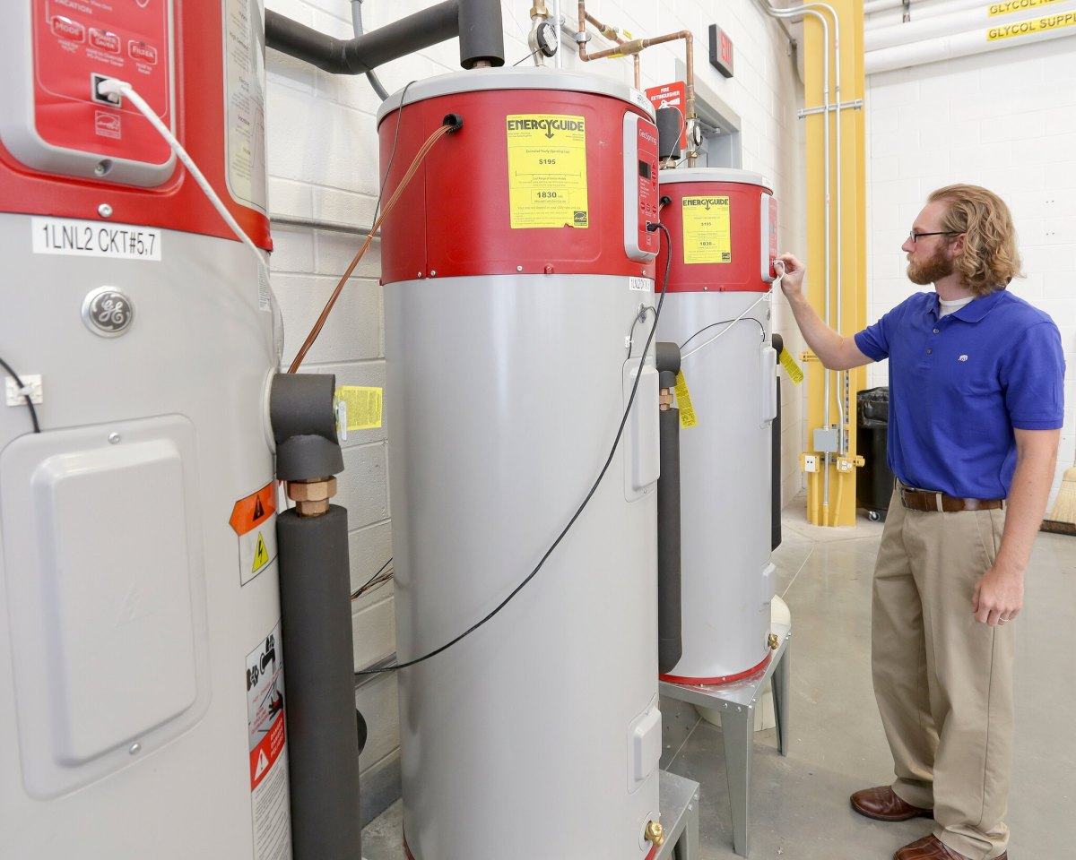
Vermont gas utility has a new service: helping electrify your home
Vermont Gas Systems announced that it would begin selling, leasing, installing and servicing electric heat pump water heaters for customers in a move that it expects to be neutral to its bottom line.
by David Thill February 7, 2022
A Vermont natural gas utility is expanding into a new and unexpected line of business: helping customers switch to electric appliances. The move comes as Vermont’s 2020 climate law raises existential questions about the future of fossil fuel in the state. Achieving a mandatory 80% reduction (from 1990 levels) in greenhouse gas emissions by 2050 will all but require a reduction in natural gas sales.

