Slide 1
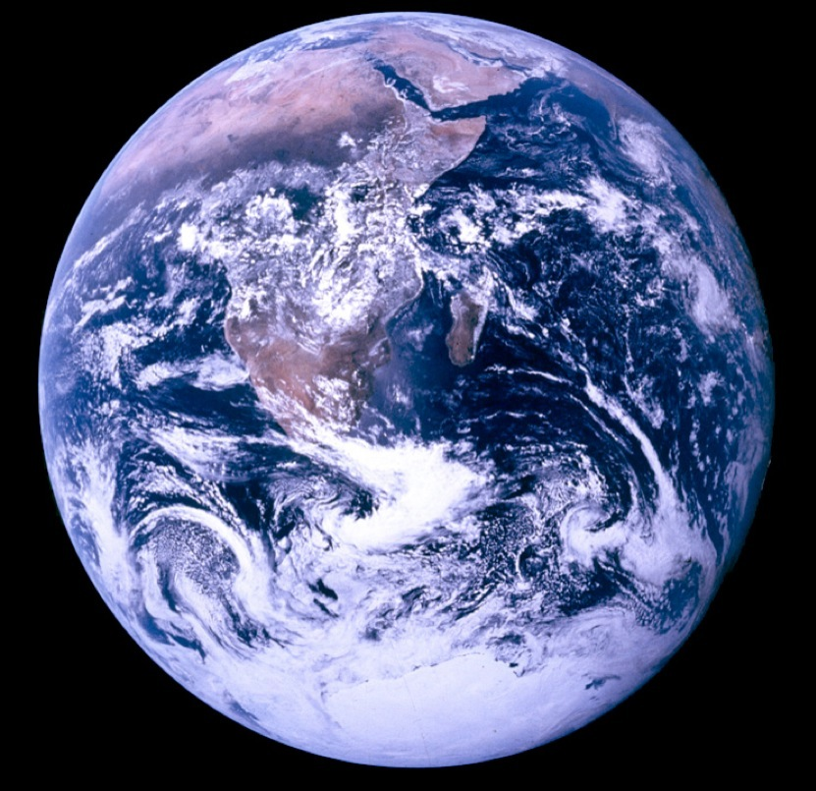
Pat and Steve
Miller
Nov 6, 2022
TOGETHER WE CAN SAVE OUR WORLD
Source: NASA
Notes:
J:\s\Documents\BE\2022-11-6-Trinity-Episcopal\2022-11-06-Moorestown-Slides.pptx
ID #3 - Can be used in noncommercial online and TV broadcasts of your presentation.
And then on the last of the Apollo missions, this image known as the Blue Marble, became the most reproduced photograph in all of human history. The climate crisis is now the biggest and most serious challenge that humanity has ever faced.
DESCRIPTION: Photo of Earth from Apollo 17, taken as the crew was traveling toward the moon, December 7, 1972
ADDITIONAL TALKING POINTS: This picture is called the “Blue Marble,” taken during the last Apollo mission.
What makes the photograph so unique and powerful is that it captures the complete circle of the earth, helping us see the big picture of our planet – and our lives on it.[1*] It was the first time the Apollo mission made it possible to capture almost the entire southern polar ice cap.[2*]
REFERENCES:
[1*] Ben Cosgrove, “Home, Sweet Home: In Praise of Apollo 17’s ‘Blue Marble’,” Time, April 11, 2014. http://time.com/3879555/blue-marble-apollo-17-photo-of-earth-from-space/
[2*] NASA Visible Earth, “The Blue Marble from Apollo 17," December 7, 1972. http://visibleearth.nasa.gov/view.php?id=55418

Slide 2
NJDEP GWRA Report 80 x 50 https://www.nj.gov/dep/climatechange/docs/nj-gwra-80x50-report-2020.pdf

Slide 3
Top 3 Greenhouse Gas (GHG) Emissions Sources in NJ: 87% of All Emissions
Electricity generation (19%)
Transportation (42%)
Residential and commercial buildings (26%)
RedUCE All 3

Slide 4
Switch To Clean Electricity
Install rooftop solar
Switch to a 100% clean supplier
http://electric.smiller.org
Invest in or subscribe to community solar
Ask your town to supply renewable community choice electrical aggregation
Notes:
You can switch to 100% clean electricity, AND save money, instead of defaulting to 20% clean electric from JCP&L.
Best investment: If you can SOON, pay cash to install rooftop solar.
OR (same GHG reduction): swtich to 100% clean supplier (spend 10 minutes, selecting vendor at URL)
OR – wait a couple of years for investors to build large array “Community Solar” fields – which should prove to be a GREAT investment for you
CLICK

Slide 5
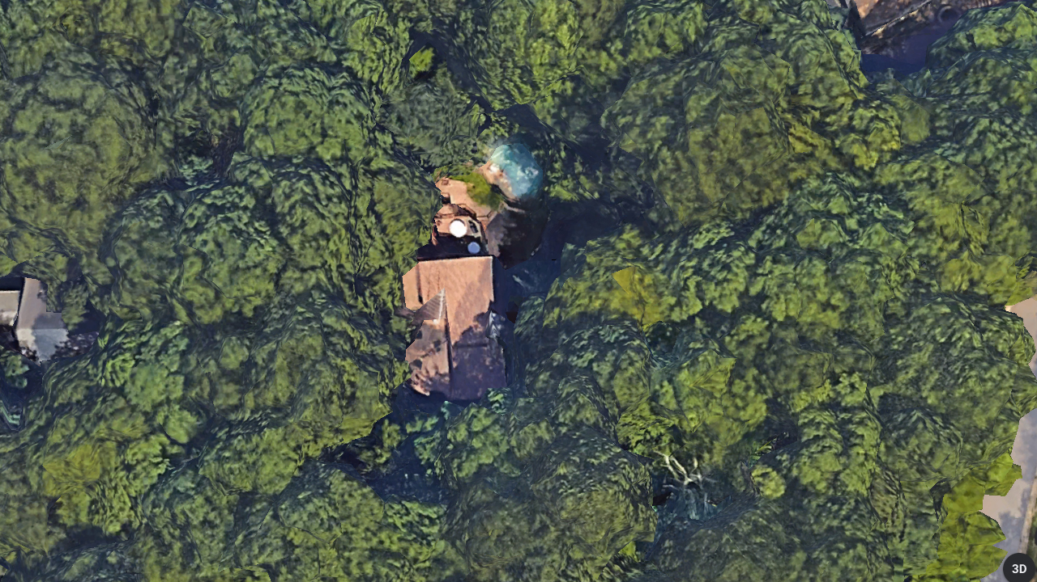
Carbon Sequestration but No Solar
Tree Cover At High Noon
50 Foot Trees
Notes:
AND/OR – JOIN WITH OTHERS and push for your town to switch ALL residents to 100% renewable Community Choice Electric aggregation. This saves 5 or 10% on electric bill, and has the BIGGEST GHG reduction!

Slide 6
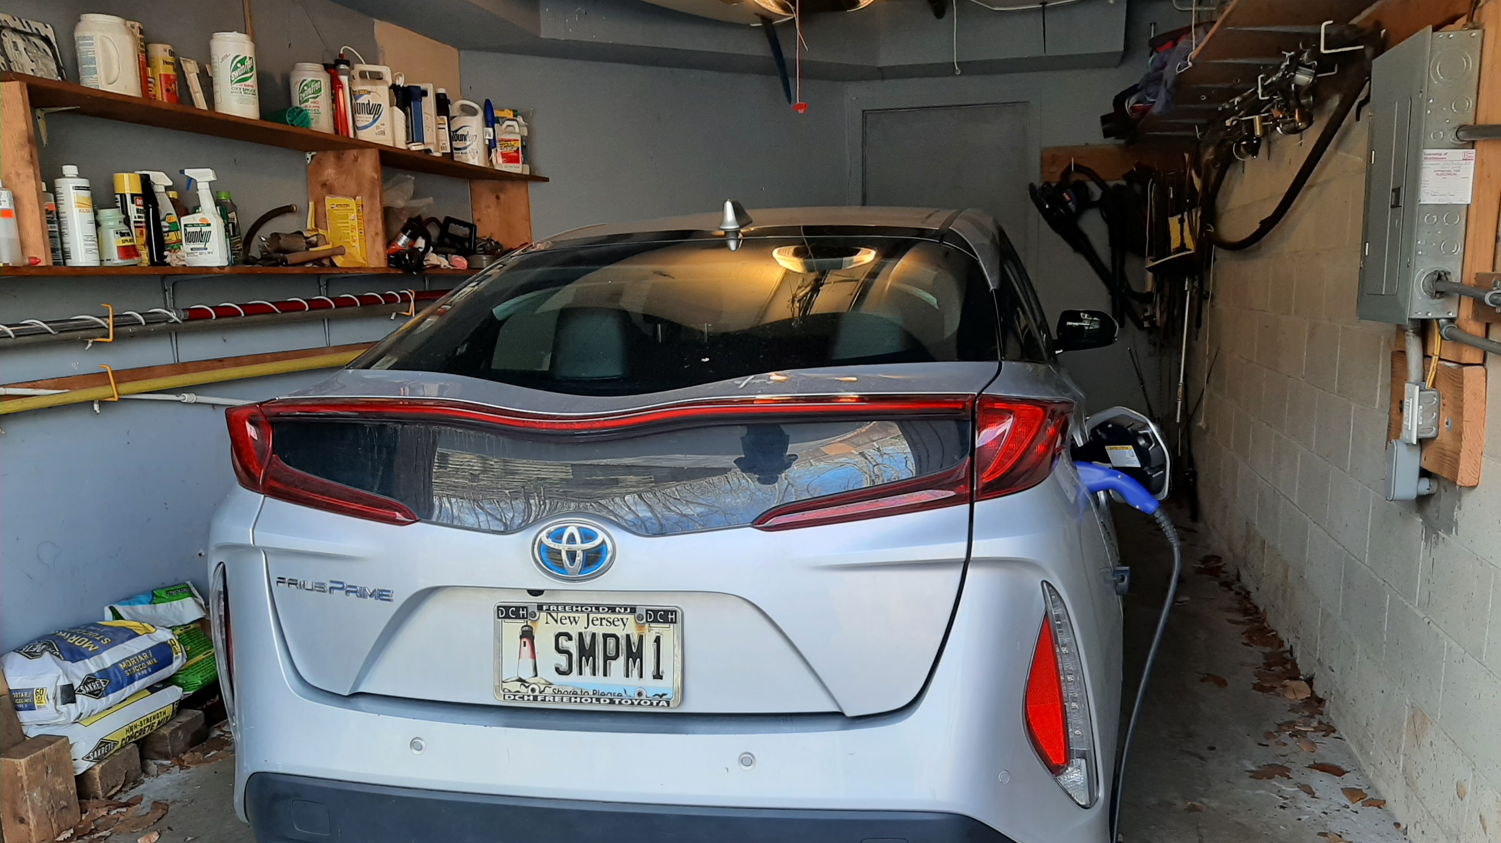
OUR EV – PRIUS PRIME PLUG-IN
Notes:
READ

Slide 7
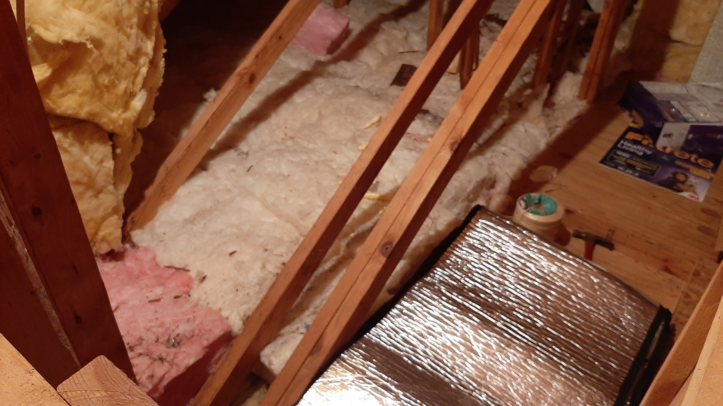
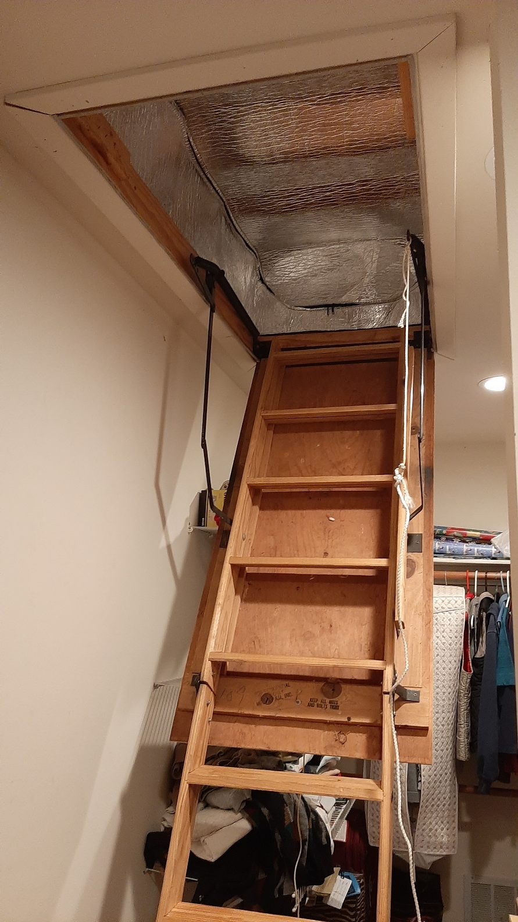
Energy Efficiency – Use Less Energy
Notes:
READ

Slide 8

Space Heating & Cooling w. Electric Heat Pump
Notes:
READ

Slide 9
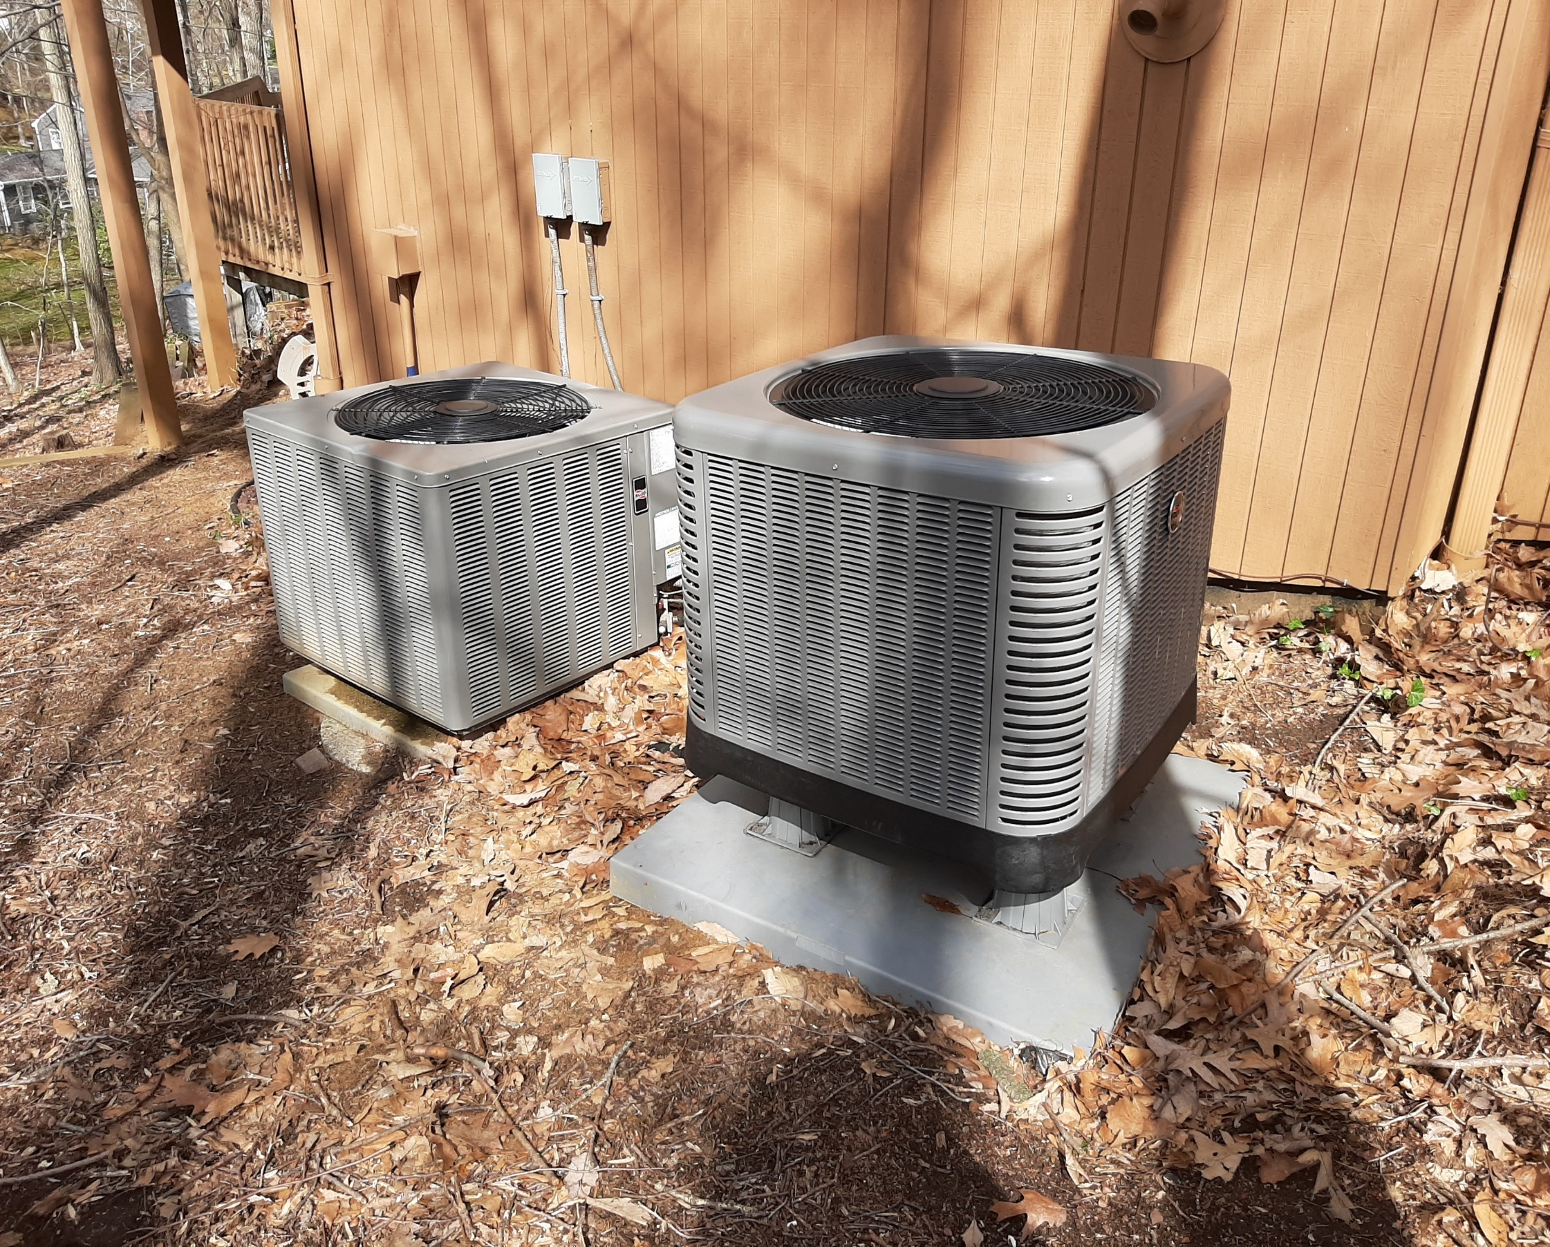
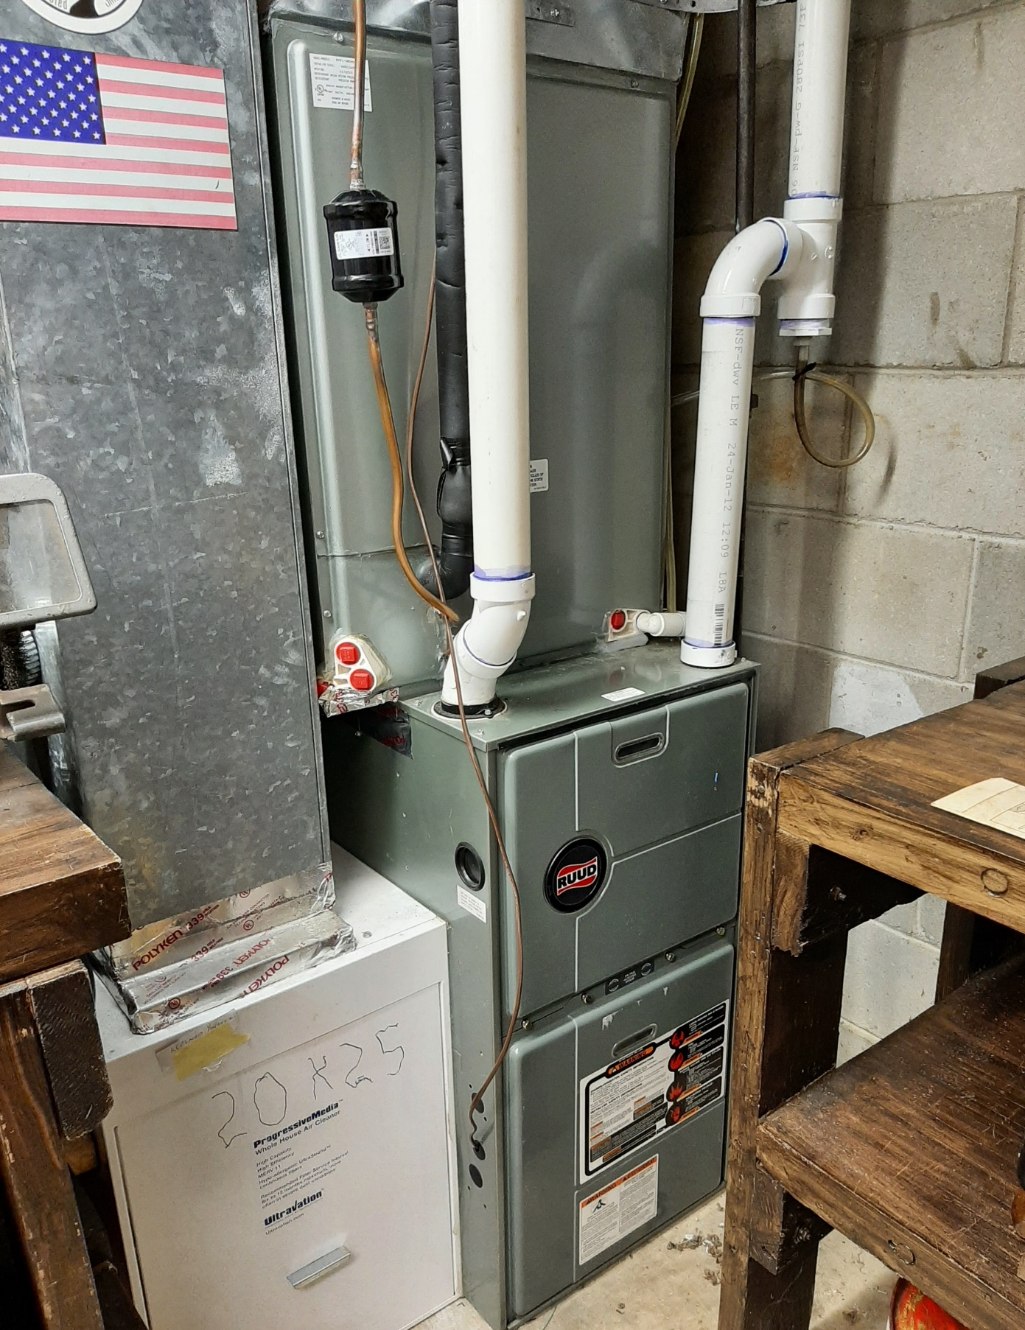
Which one is the heat pump? Gas furnace backup on right
Notes:
READ

Slide 10
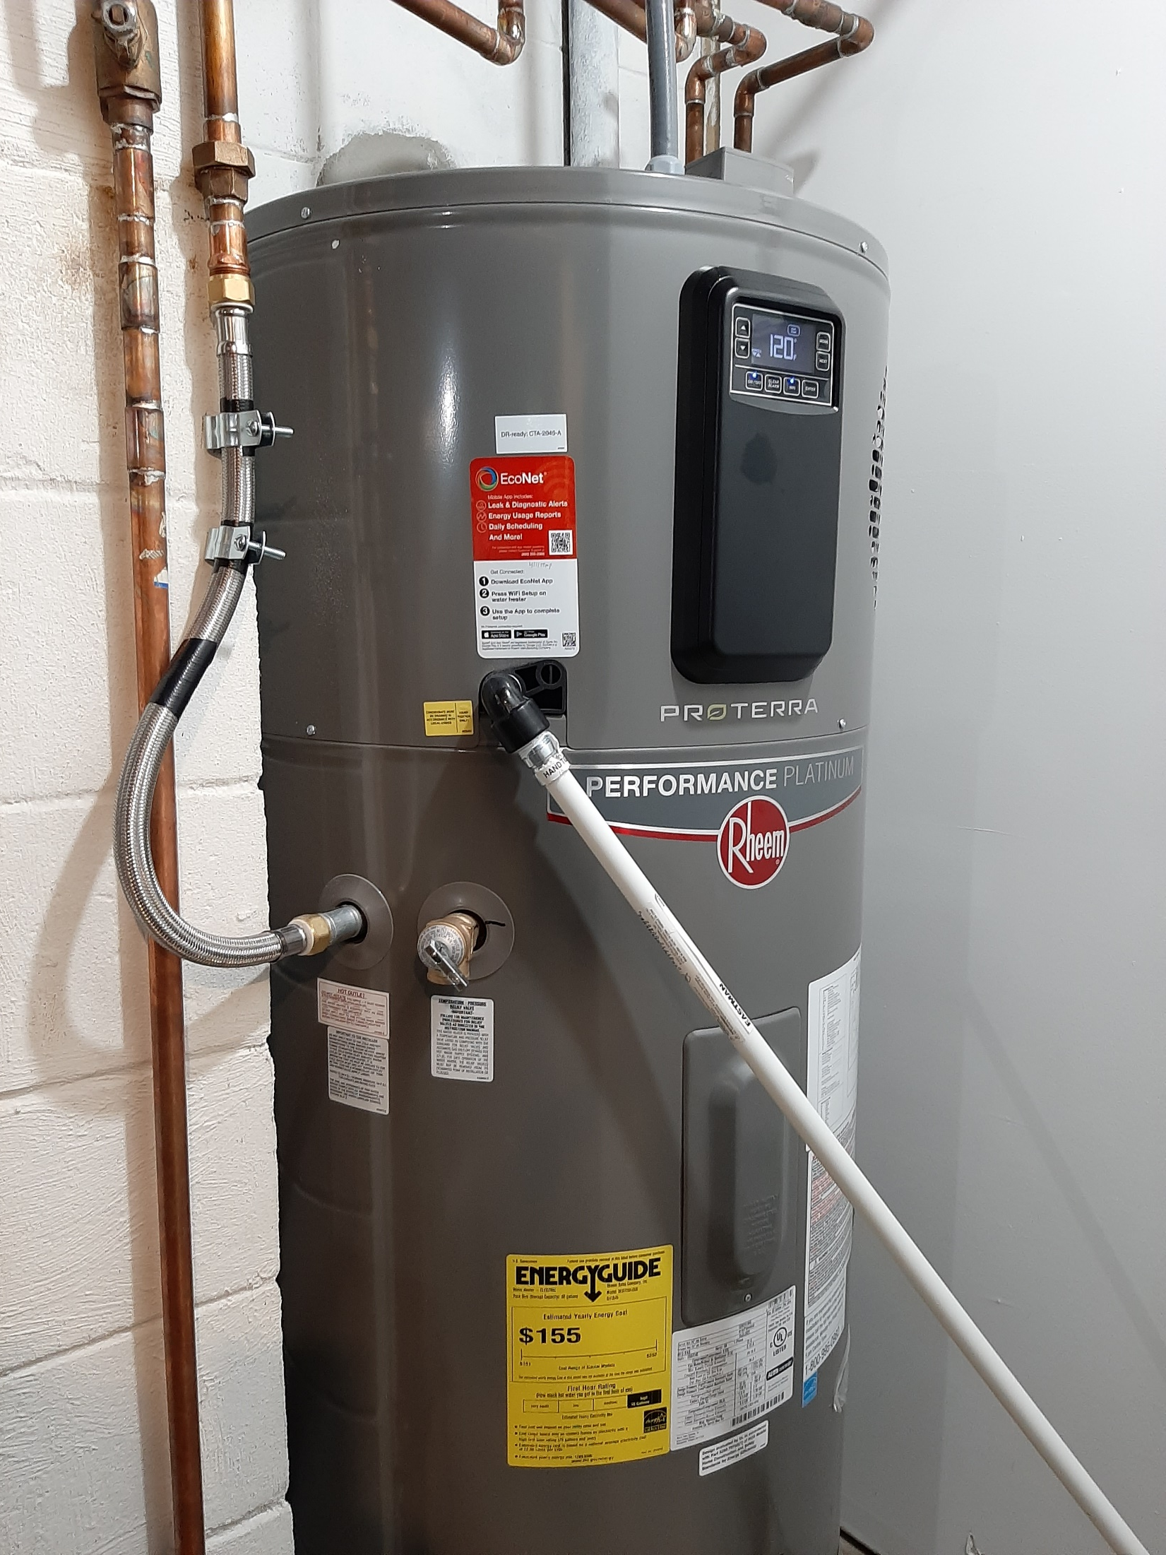
ELECTRIC HEAT PUMP WATER HEATER

Slide 11
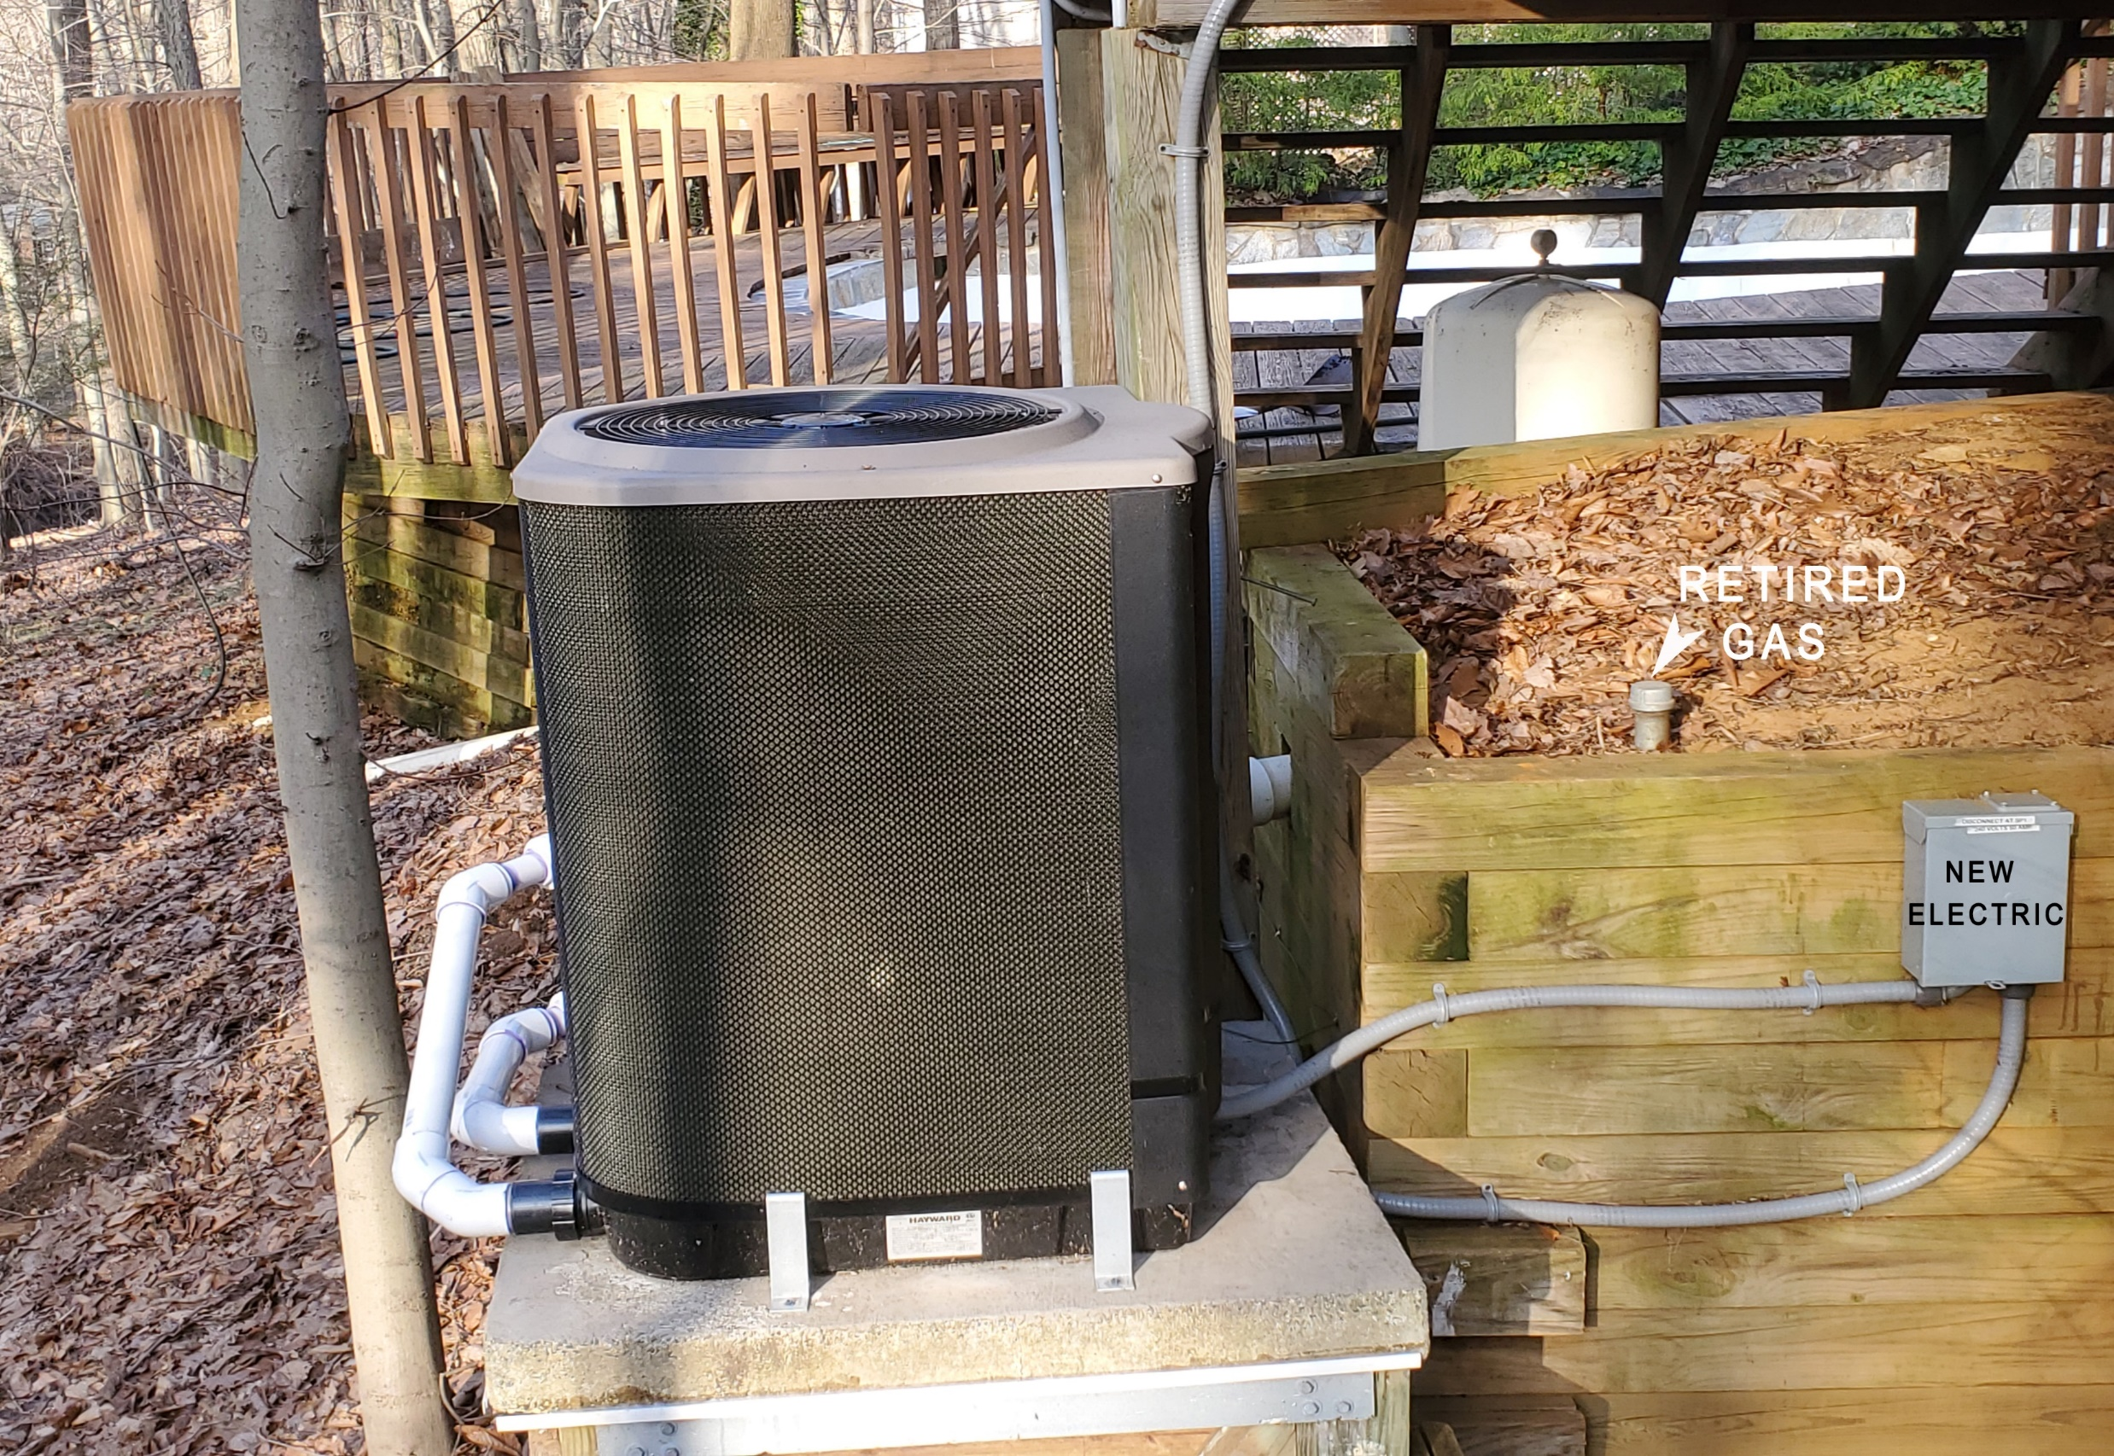
Pool Heater – Electric Heat Pump
Notes:
READ

Slide 12
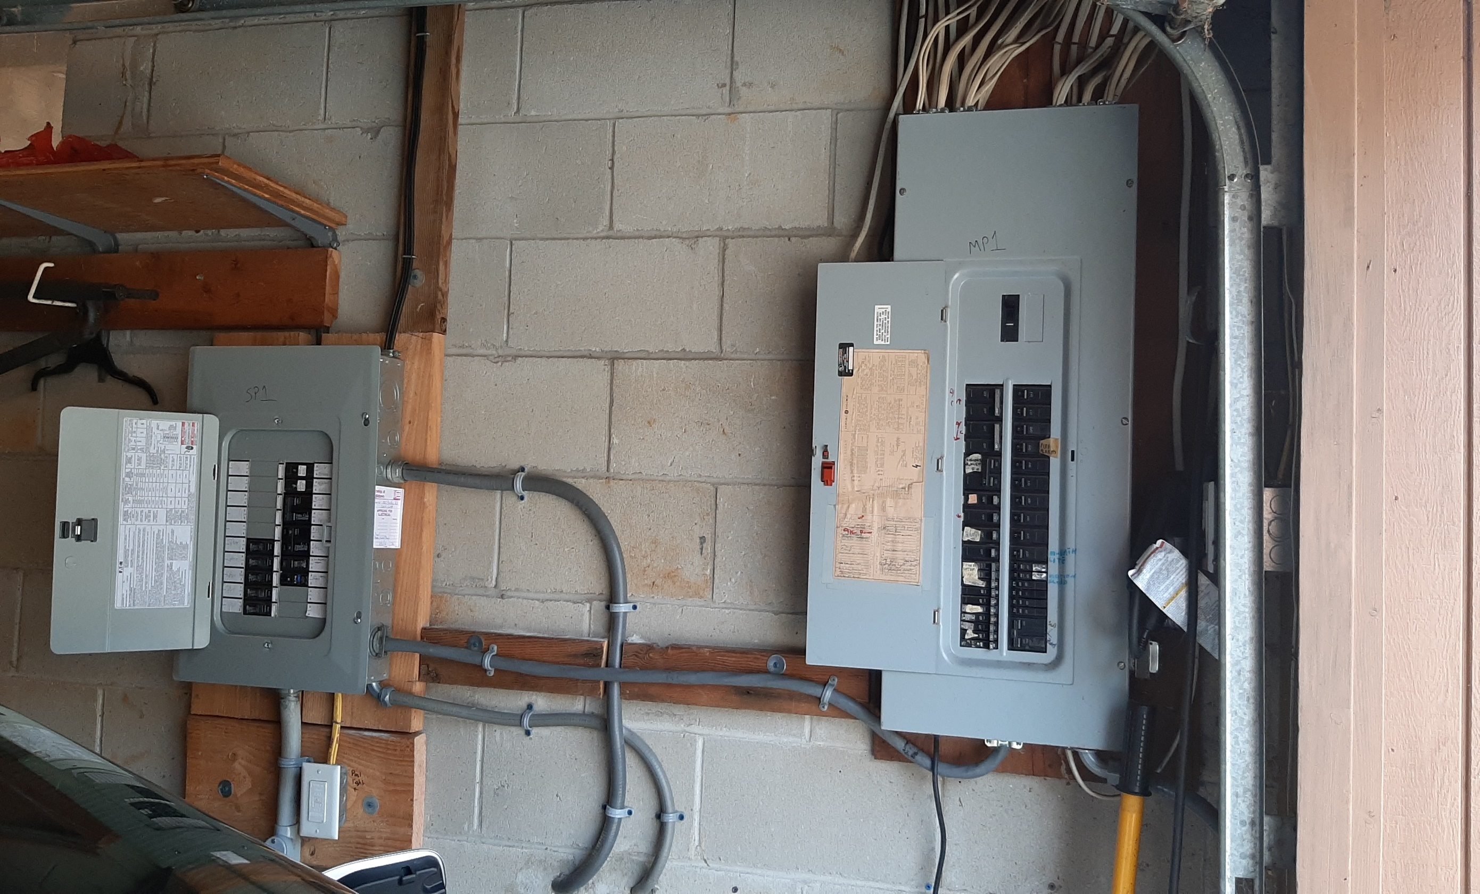
Spare Circuits for Future Electric Appliances
New Box on Left for New/Future
2nd Heat Pump Space Heater/AC
Heat Pump Water Heater
Stove
Dryer
2nd EV
Notes:
READ

Slide 13
What can WE as a commercial enterprise (congregation or business) do together?
Notes:
ID #1630 - Can be used in noncommercial online and TV broadcasts of your presentation, but not modified.
Well, luckily the answer to that question is yes, too, because we have the solutions at hand.
DESCRIPTION: Text slide stating that we have solutions to the climate crisis at hand

Slide 14
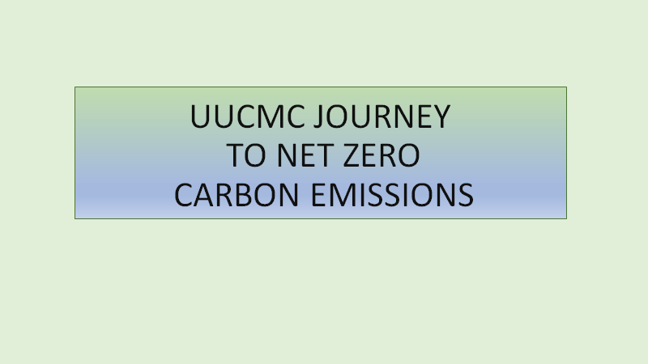

Slide 15
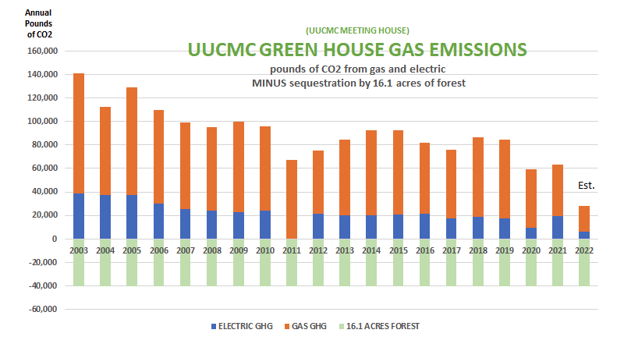
2003-2022

Slide 16
Property Upgrades to Lower GHG Emissions 2003-2022
2003 Earth Day tree planting (church + homes)
2004 Energy audit
2005 Programmable thermostats; start replacing bulbs with compact fluorescent
2006 Installed rooftop solar
2008 Community room insulation; installed Energy Star windows; more efficient lighting
2008-2012 Tracked reduction in carbon footprint
2010 Community room A/C
2011 Energy Star refrig + freezer; updated classroom lighting; new insulated classroom roof
2011-2012 Subscribed to 100% wind renewable electricity
2014 Heat pump water heater
2016 Switched to LED in main building
2017 Converted Earth Room flood lights to LED
2021 HVAC heat pumps (6); tankless water heater, classroom lights to LED; reshingled roof
2022 New solar system

Slide 17
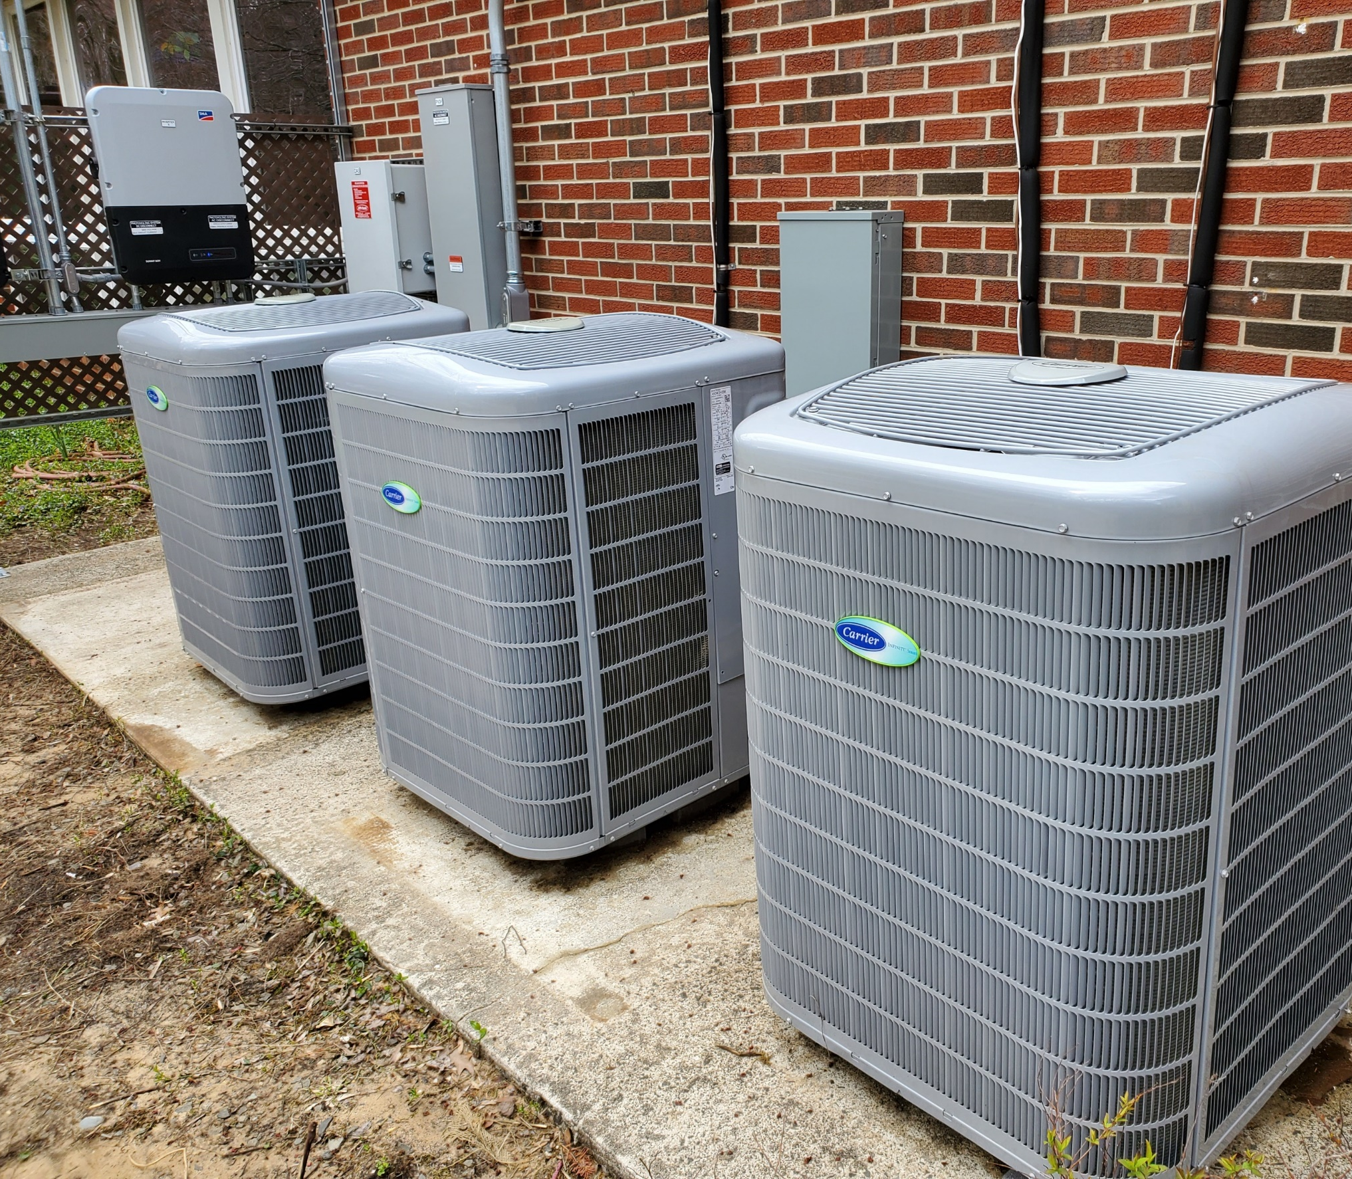
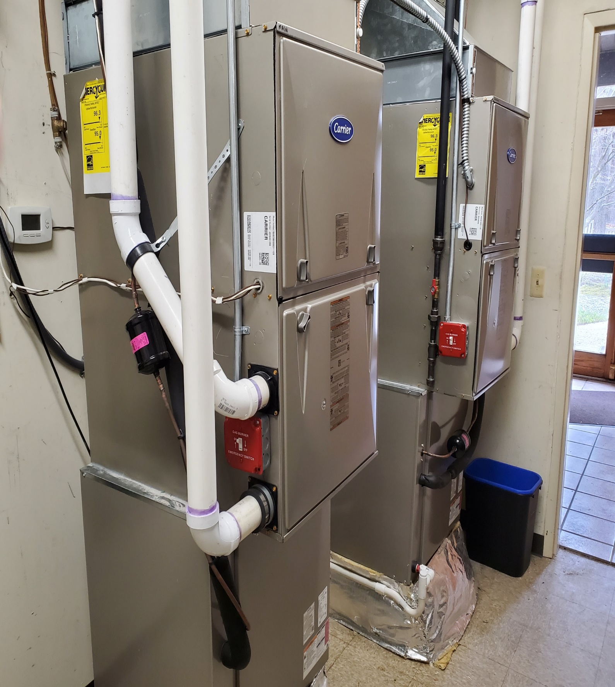
UUCMC 2021 Heat Pumps

Slide 18
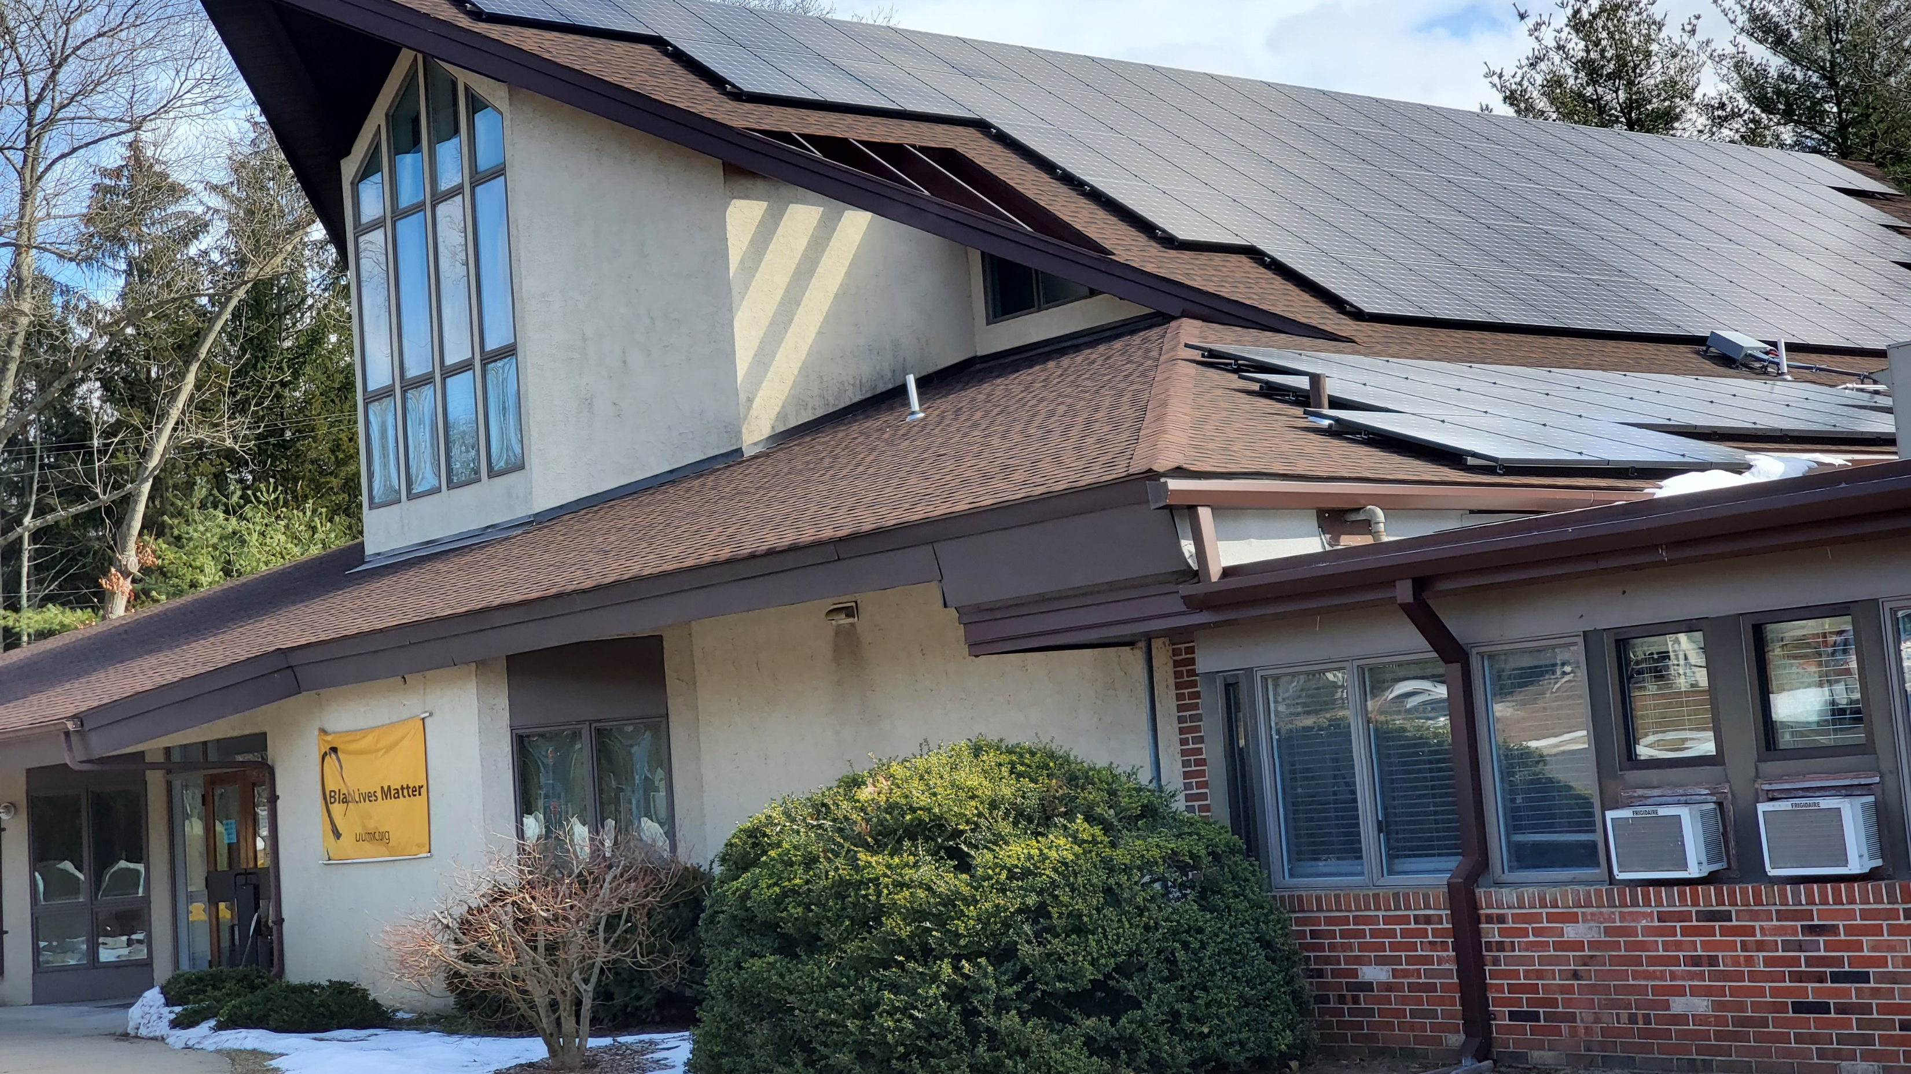
UUCMC 2022 Rooftop Solar
4 x Capacity of Old System

Slide 19
Together We Can Save Our World from Climate Catastrophe Through Greenhouse Gas Emissions Drawdown Actions
Clean Electricity | Transportation | Buildings | Food & Land Use | Health, Education, & Gender | Environmental Activism across Sectors
Install rooftop solar or subscribe to community solar | Make new car an EV or hybrid | Replace gas/oil furnace or electric resistance heat OR AC with heat pump | Cut down on meat or adopt vegan or plant-rich diet | Donate to school or fund girls’ education in a place where girls’ educ is repressed | Volunteer for environmental org; focus on climate
Switch to 100% clean electricity service provider | Use public transit | Choose LED bulbs to replace incandescent | Grow a vegetable garden or buy from a local farm market | Give a microloan for a women-owned business | Direct career path toward clean energy or sustainability
Consider geothermal as heat source for heat pump | Cut air travel or buy carbon offset | Get home energy assessment, take efficiency measures – insulate, seal air leaks | Compost food waste, leaves and grass clippings | Support women-owned businesses | Donate $s to environmental orgs focused on climate
Invest in clean energy: community solar, wind, etc. | Conduct virtual meetings | Replace fossil fuel appliances with electric – water or pool heater, dryer, stove | Replace grass in lawn with native species; reduce mowing; plant trees | Donate to support family planning | Run for office as environmental candidate
Switch to solar heat for hot water or pool | Walk, bike or join a carpool when possible | Install smart thermostat; more moderate temps | Replace fossil fuel lawn equipment with electric or battery | Help elect women, BIPOC & climate friendly candidates | Consume less; waste less, esp. plastics
Advocate gov’t FOR clean energy projects, against new fossil fuel projects | Advocate for greener vehicles, high speed rail, network of charging stations | Advocate for building codes – zero carbon buildings, rooftop solar, EV chargers, no gas hookups | Advocate for Indigenous land rights, regenerative farming, against factory farms | Advocate for equity in healthcare, education, & jobs for women or BIPOC | Advocate for climate friendly actions in your town – municipal operations, services
Custom action: electricity | Custom action: transportation | Custom action: buildings | Custom action: food & land use | Custom action: health, educ, gender | Custom action

Slide 20
OTHER DRAWDOWN ACTIONS WE CAN TAKE NOW
Eat less (or no) meat.
Buy local produce. Look for regenerative (soil) farming and no pesticides.
Cut food waste. Compost.
Replace lawn with native plants. Stop mowing. Compost leaves. Plant trees.
Use less energy. Turn back thermostat. Hang clothes to dry; use cold water wash. Cook on electric cooktop, microwave, toaster oven.
Use less plastic. Buy less stuff.
Use public transportation. Travel less.
Conserve water, both indoors and on property – avoid runoff.
Notes:
BY 2050:
Highly energy efficient NETZERO building standards will be the norm.
FOSSIL FUELS are almost totally abandoned.
The world’s electric grids are upgraded for the high electrical loads
GAS STATIONS ARE NON-EXISTENT.
In Maryland, the 1st First US gas station just dumped the pumps & installed EV Chargers
Our plastic mess is gone
We are moving to a plant-based healthy diet.
We MUST make these changes to save lives.
If we wait, the solutions become ever more costly

Slide 21
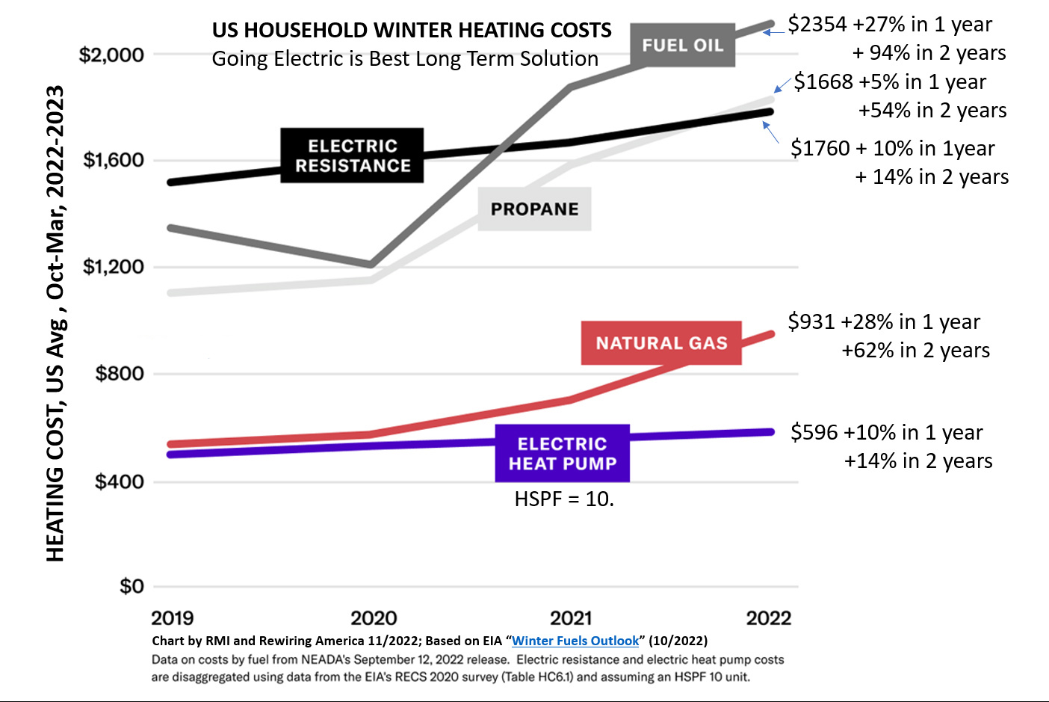

Slide 22
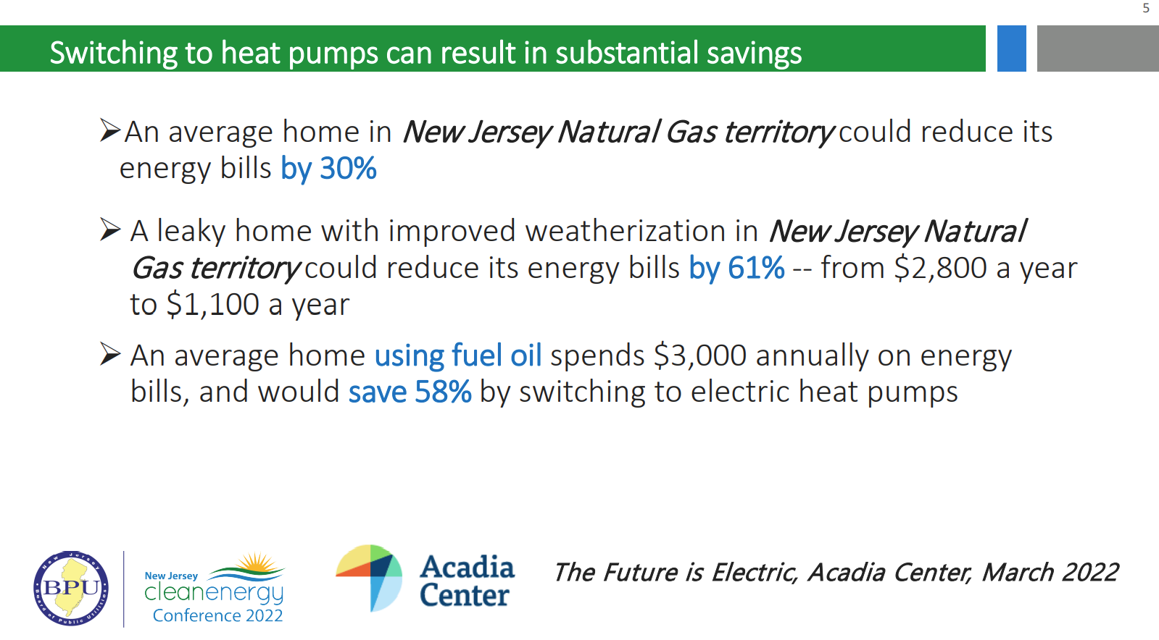
Notes:
Dr. Barbara Blumenthal, New Jersey Conservation
Presentation at NJ Cleanenergy conference, 10/2022

Slide 23
TOGETHER WE CAN SAVE OUR WORLD
Source: NASA
Notes:
ID #3 - Can be used in noncommercial online and TV broadcasts of your presentation.
And then on the last of the Apollo missions, this image known as the Blue Marble, became the most reproduced photograph in all of human history. The climate crisis is now the biggest and most serious challenge that humanity has ever faced.
DESCRIPTION: Photo of Earth from Apollo 17, taken as the crew was traveling toward the moon, December 7, 1972
ADDITIONAL TALKING POINTS: This picture is called the “Blue Marble,” taken during the last Apollo mission.
What makes the photograph so unique and powerful is that it captures the complete circle of the earth, helping us see the big picture of our planet – and our lives on it.[1*] It was the first time the Apollo mission made it possible to capture almost the entire southern polar ice cap.[2*]
REFERENCES:
[1*] Ben Cosgrove, “Home, Sweet Home: In Praise of Apollo 17’s ‘Blue Marble’,” Time, April 11, 2014. http://time.com/3879555/blue-marble-apollo-17-photo-of-earth-from-space/
[2*] NASA Visible Earth, “The Blue Marble from Apollo 17," December 7, 1972. http://visibleearth.nasa.gov/view.php?id=55418

Slide 24
Q&A
QUESTIONS for Pat, Steve, and Bob

Slide 25
PREVIEW of DECEMBER 15, 2022 WEBINAR
MATT KAVANAGH: 4 years to net zero energy; Positive Cash Flow after 6 years
6% Annual ROI After 25 years: $135K positive cash flow; 154% ROI
ALAN SPECTOR (and 15 families): reached NET ZERO (including EVs)
DAVID GREEN (and many others): reached NET ZERO, and 15%/year ROI (this is better long term return than any other investment)
TAKE ADVANTAGE OF THE IRA, and DO EVEN BETTER!
Thank you for joining us tonight!

