Slide 1
Reason to be Optimistic We can get to 50% by 2030 Policy Levers to Reach Zero Emissions Electrifying Building Heat and Transportation Powered by Clean Renewable Energy Michael Winka Executive Director Sustainable Lawrence December 16, 2021
Its really relatively easy to get to 50% by 2030 and net zero by 2050
Just change the demand curve from the bottom up

Slide 2

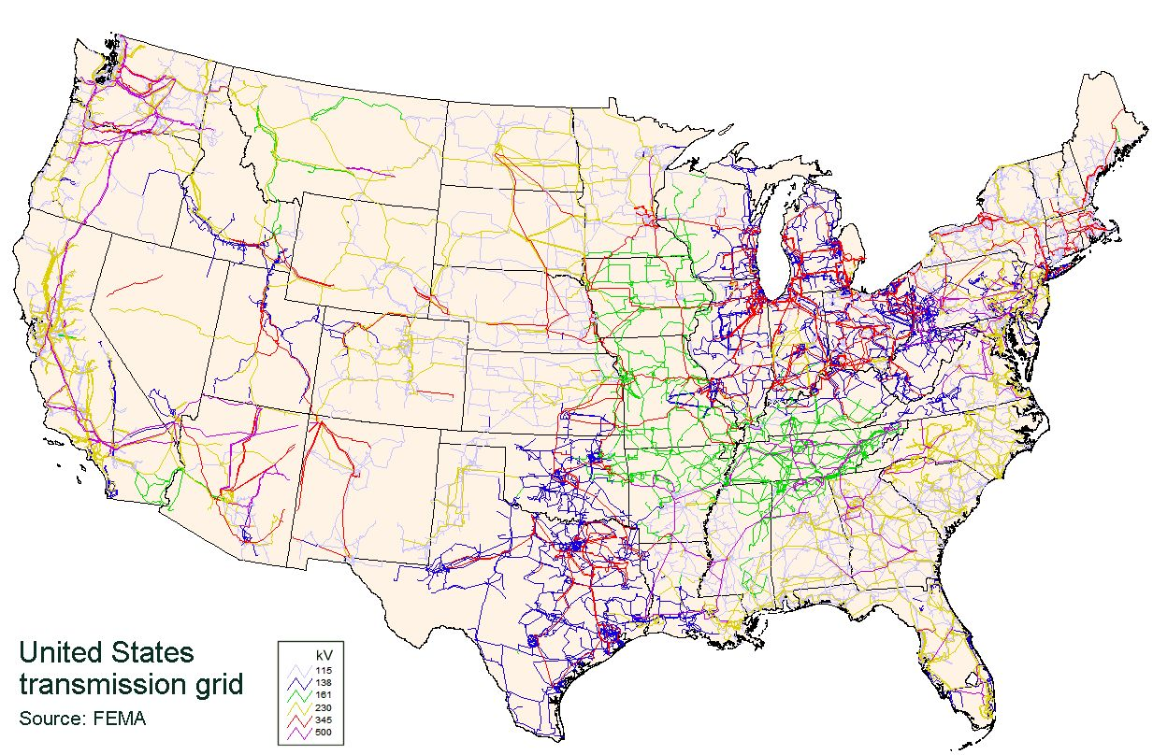
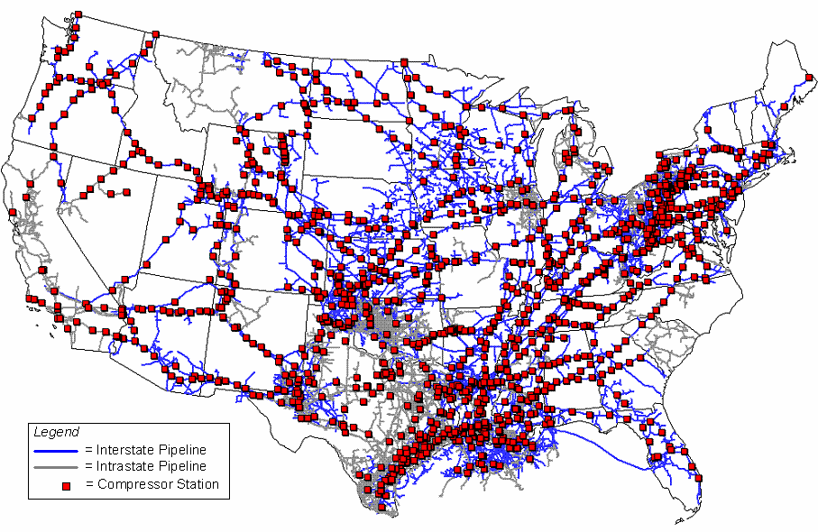
The current US Energy System of pipes and wires are large enough to transverse the US over 200 times
And is over $1.2 trillion – almost 6% of US GDP
200,000 miles of electric transmission wires and 5.5 million miles of distribution wires
193,000 miles of fuel oil pipelines in US
300,000 miles of inter and intrastate natural gas pipelines and 2.1 M miles of distribution pipes

Slide 3
To get to 50% by 2030
Some things the Federal, State and Local Governments
With Industry partners can do well.
Permit large clean renewable energy power plants
Develop more efficient energy equipment – EV and heat pumps
More energy efficient appliance standards and building code
Implement tax credits and incentives
Develop Renewable/Clean energy standards
Manage the energy systems - pipes and wires
Cap and Trade

Slide 4
But this is a Partnership between you and
The Government and Industry to help mitigate GHG emissions
You have to buy solar and wind electricity
You have to decide to add storage batteries
You have to buy EVs
You have to install a heat pump
You have to build beyond just codes and standards
You have to be the force in your municipality or school
to go Gold in Energy in Sustainable Jersey
You have to decide to actually do these things
You have to change the energy demand curves

Slide 5
NJDEP GWRA Report 80 x 50 https://www.nj.gov/dep/climatechange/docs/nj-gwra-80x50-report-2020.pdf

Slide 6
New Jersey’s 2019 Integrated Energy Plan - https://nj.gov/emp/
32MMT
Mostly
Gasoline
75%
43 MMT
Mostly Natural Gas
90%

Slide 7
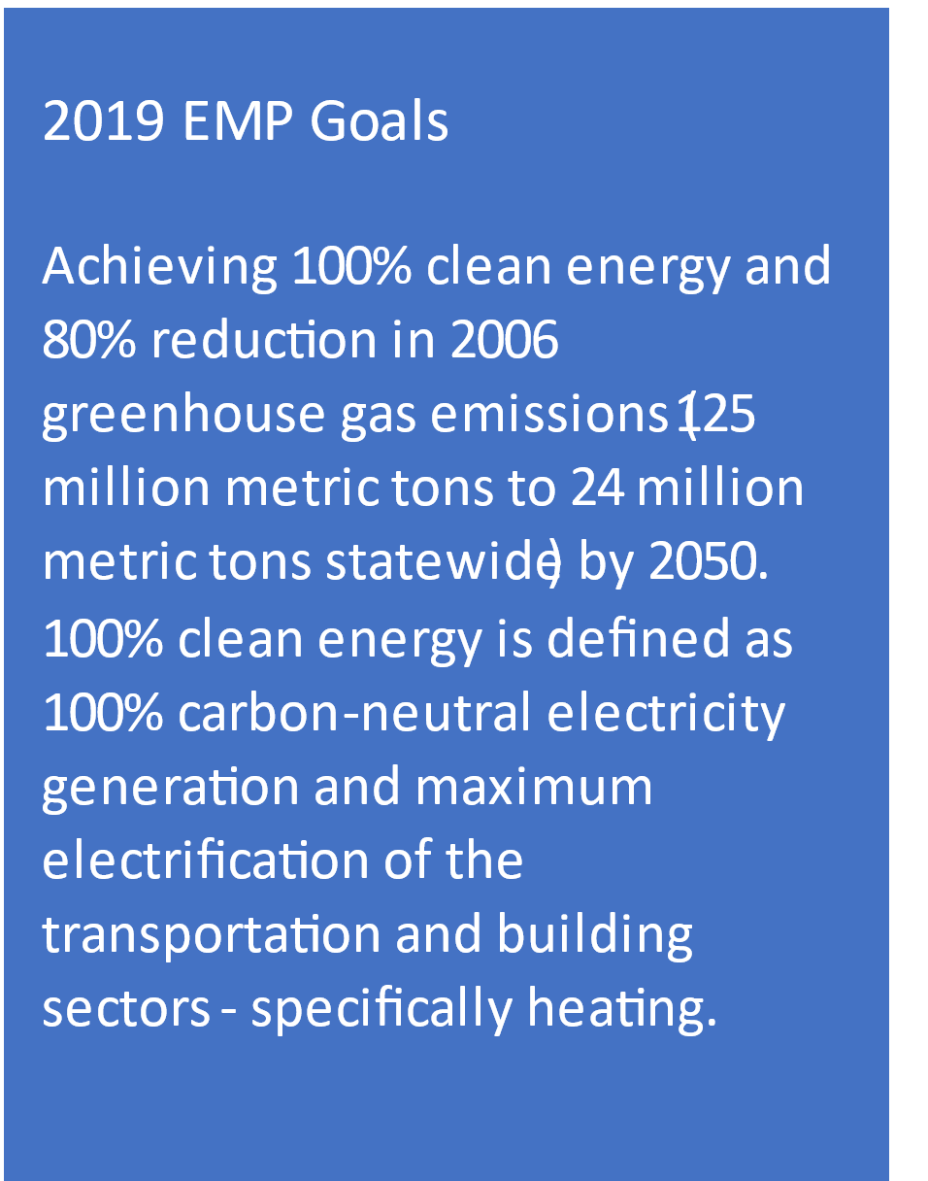
2019 Energy Master Plan – Strategies to get to 100% Clean Energy by 2050
The EMP puts mitigation in buckets – more integrated approach
2019 NJBPU EMP STRATEGIES | INTEGRATED ENERGY PLAN RECOMENADTIONS
Reduce energy use and emissions from the transportation sector | Accelerate the transition to electric vehicles powered by clean renewable electricity
Acceleration the deployment of renewable energy and DER | Continue and expand instate renewables and within PJM to supply clean electricity for the transportation and building sectors Retain near term but no expansion of existing natural gas and nuclear capacity for reliability
Maintain energy efficiency and peak demand reduction | Continue and expand existing EE and DR programs with a focus on heat pumps and EVs – powering New Jersey economy with clean energy
Reduce energy use and emissions from the building sector | Existing building electrification powered by clean renewable electricity Develop electrification programs for new construction
Decarbonize and modernize the New Jersey energy systems | Electricity to double by 2050 Plan grid modernization - integrated distribution plans Natural gas and gasoline usage declines

Slide 8
From the 2019 Integrated Energy Plan presentation – November 2018
Summary of Key Finding presented by Rocky Mountain Institute
New Jersey Can meet the goals of the 2019 EMP for 100% clean
energy and 80% reduction in GHG emissions by 2050 with
existing technologies
Cost to meet the 2019 EMP goals are relatively small compared
to total energy spending and offset by the benefits
Existing policies reduce GHG emissions are a good start
but are not enough to achieve the 2019 EMP goals
The least cost energy systems are substantially different from
today’s energy system

Slide 9
NJDEP GWRA Report 80 x 50 https://www.nj.gov/dep/climatechange/docs/nj-gwra-80x50-report-2020.pdf

Slide 10
2019 Energy Master Plan – Energy system Supply and Demand
40% less energy

Slide 11
2019 Energy Master Plan – Costs and Benefits
The overall cost is a 0.2% increase in New Jersey’s total GDP at an estimated cost of $2.1 billion and a benefit of $4.2 to $6.3 billion. That is a benefit to cost ratio of 2 times to 3 times. A benefit to cost ratio that is greater than one is defined as cost effective.

Slide 12
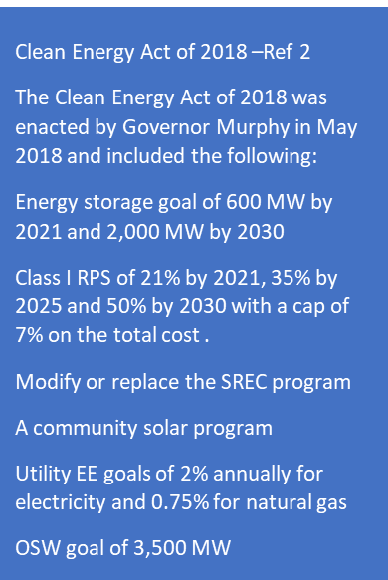
New Jersey’s 2019 Integrated Energy Plan - https://nj.gov/emp/
Policy increases to get to 50% by 2030
64
MMT
Gap in existing policies to get
To 50% by 2030
To get to 50% by 2030 Requires more than the 2019 EMP or about 8 MMT less
NJDEP 2019 GHG emissions inventory including sequestered GHG emissions of 8 MMT

Slide 13
New Jersey’s 2019 Integrated Energy Plan - https://nj.gov/emp/
97 MMT
33 MMT
64 MMT
32MMT
Mostly
Gasoline
75%
43 MMT
Mostly Natural Gas
90% natural gas

Slide 14
To get to 100% clean energy - 80 x 50 or 50 x 30
Does not depend on a federal carbon tax or
a federal clean electricity standard or a state
carbon cap and trade
Nice to have but you can mitigate the
impacts of greenhouse gas emissions today with
currently available cost effective clean energy technologies
You beat this large energy system
“From the inside out” by changing the demand curve

Slide 15
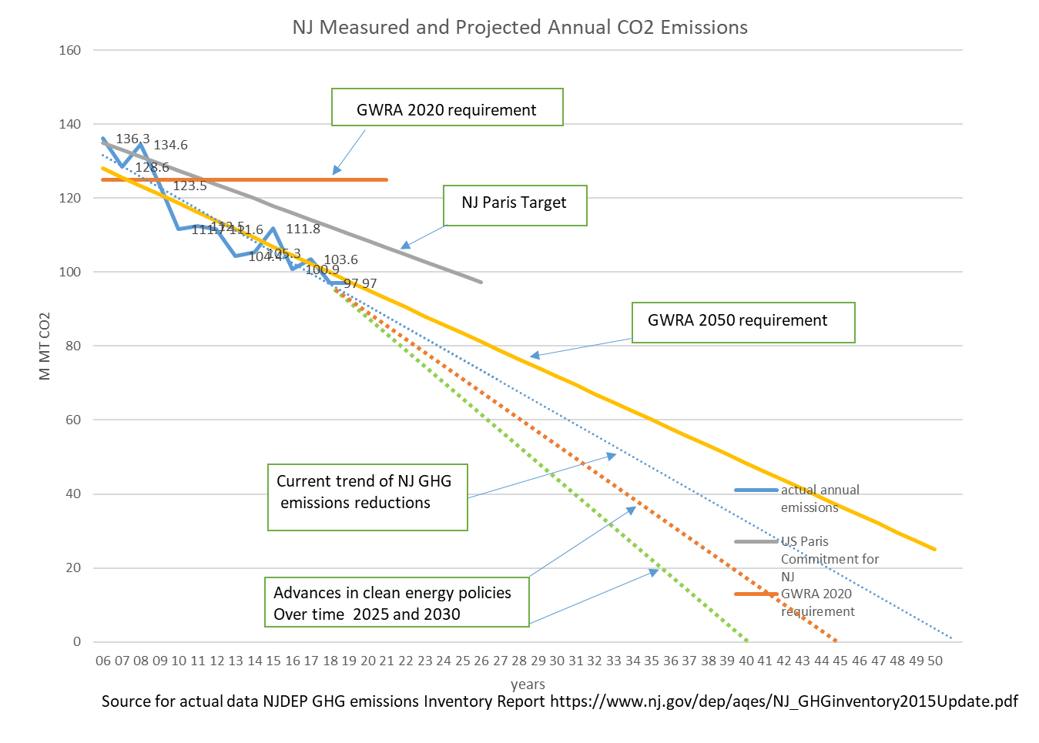
New Jersey’s Progress to achieving its GHG emissions reduction goals and more Why I'm Optimistic
Getting to 50% by 2030 and beyond depends on the partnership

Slide 16
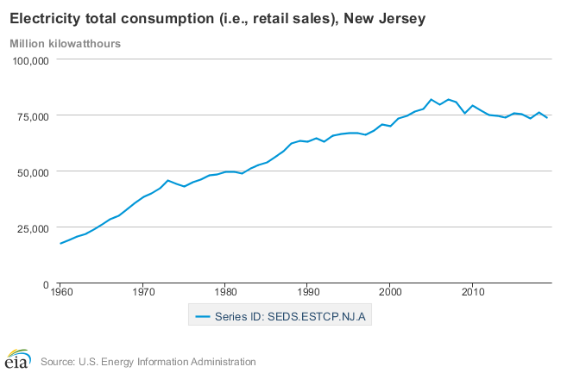
Pre-1973 Energy Policies were Economic Policies – that changed with Energy Efficiency
Great Recession
1st Gulf war
9/11 and 2nd Gulf war
1st oil embargo
< Electricity usage by 40% from 110 M MWh to 75 M MWh
< Electricity cost by $3.5billion/year in 2020 from $13.5B to $10 B
< energy percentage of state GDP from 8% to 4%
2nd oil embargo/Iran
>8.4 million metric tons of avoided CO2 emissions per year
Need to do the same with the natural gas and gasoline demand curve – reduce the curve

Slide 17

NJ Electricity Sales with and without EE, Solar and Appliance Standard Savings
Why we can change the demand curves
The Estimated annual electricity savings in 2016 are 10 million MWh. Total electricity savings from 2009 to 2016 is represented by the area beneath the curve.
This is $1 billion in annual cost saving 0r $100/person
http://njenergydata.rutgers.edu/

Slide 18
To get to 100% clean energy by 2050 or 80 x 50 or 50 x 30
Five Cost Effective (even without subsidies) Clean Energy Technologies that can be Implemented Incrementally to Mitigate Climate Change by Reducing Greenhouse Gas Emissions
Solar (RE)
Storage (CE)
Electric Vehicles (EE)
Heat Pumps (EE)
Smart Grid (CE)
You can beat this large energy system “From the inside out” by changing the demand curve

Slide 19
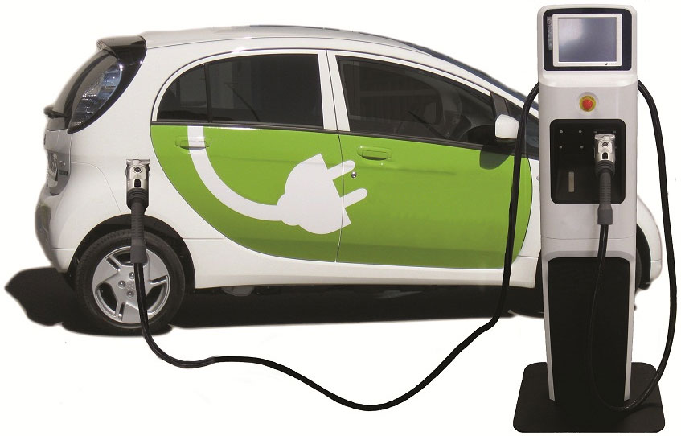
Transportation Sector - Going Electric
How to Change the Demand Curve for Oil and Gasoline
to Prevent Future Oil pipelines
Start slow and small and build into a movement
Used EV for under $20,000
40 miles RT for 260 days (5 day work week)
An average ICE vehicle
416 gal/ yr - 48.3 million Btus -$1414/yr.
An average EV
3,536 kWh /yr - 12.1 million Btu - $584/yr.
Savings $747/yr. avoiding 2.75 T of CO2
3,536 kWh / year - 3.21kilowatts (kW) of solar
@$3/watt SPB for EV and solar 15 yrs. (ROI 6.7%)
Avoiding 4 T of CO2
Reducing both gasoline and natural gas
demand and emissions and storage solar electricity
MM Btu is a million Btus

Slide 20
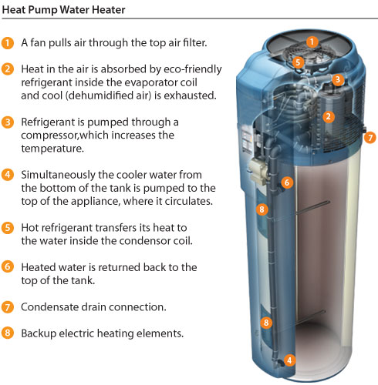
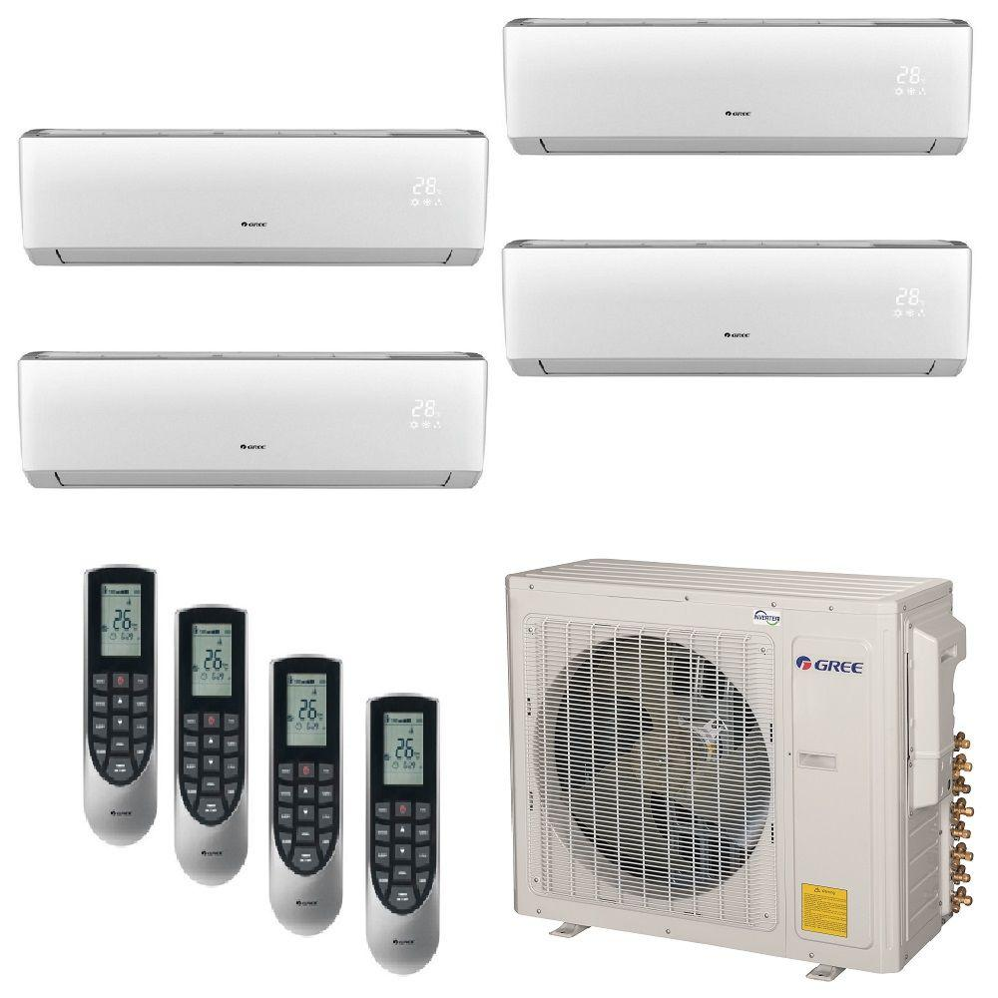
Building Sector - Going Electric
How to Change the Demand Curve for Natural Gas
to Prevent Future Natural gas pipelines
Start slow and small and build into a movement
GWH = $1,200
230 therm – 23 million Btus $320/yr emitting 2.3T
HPWH = $2,500
2,000 kWh 6.8 million Btus $330 /yr emitting 0.5T
Avoiding 1.8 T of CO2
2,000 kWh /year = 1.5 kilowatts (kW) of solar
@ $3/W = $3,330
HPWH + solar = 10.5 years (ROI 9.5%)
Avoiding 2.3 T of CO2
Reducing natural gas demand in electric and heating sectors
A major advantage is you can store your solar electricity in the HPWH

Slide 21
Policy Lever to Reach Zero Emissions
Reasons to be Optimistic
Thank You
Michael Winka
energy translator
mwinka@comcast.net

