Slide 1
Dec 16,7PM Webinar
Building Efficiency and Electrification

Slide 2
Dec 16 7PM AGENDA
90 minutes (1 hr + Q&A)
Audience: 20K + SC members/supporters
Objective: education for homeowners and potential evangelists
OVERVIEW
  NY – quickly electrifying – direct marketing; HVAC tools/training
  NJ - still on drawing board (50% by 2030 goal is likely to speed)
PRESENTERS (10-15 minutes each), + Q&A:
  Overview (former BPU Policy Energy Advisor)
  NYSERDA (consultant) overview (direct marketing; HVAC training; HVAC tools)
  NJ CEP (successor): heatpump overview
  HVAC consultant: “Home Comfort and Energy Experts”
  NJ Satisfied Homeowner

Slide 3
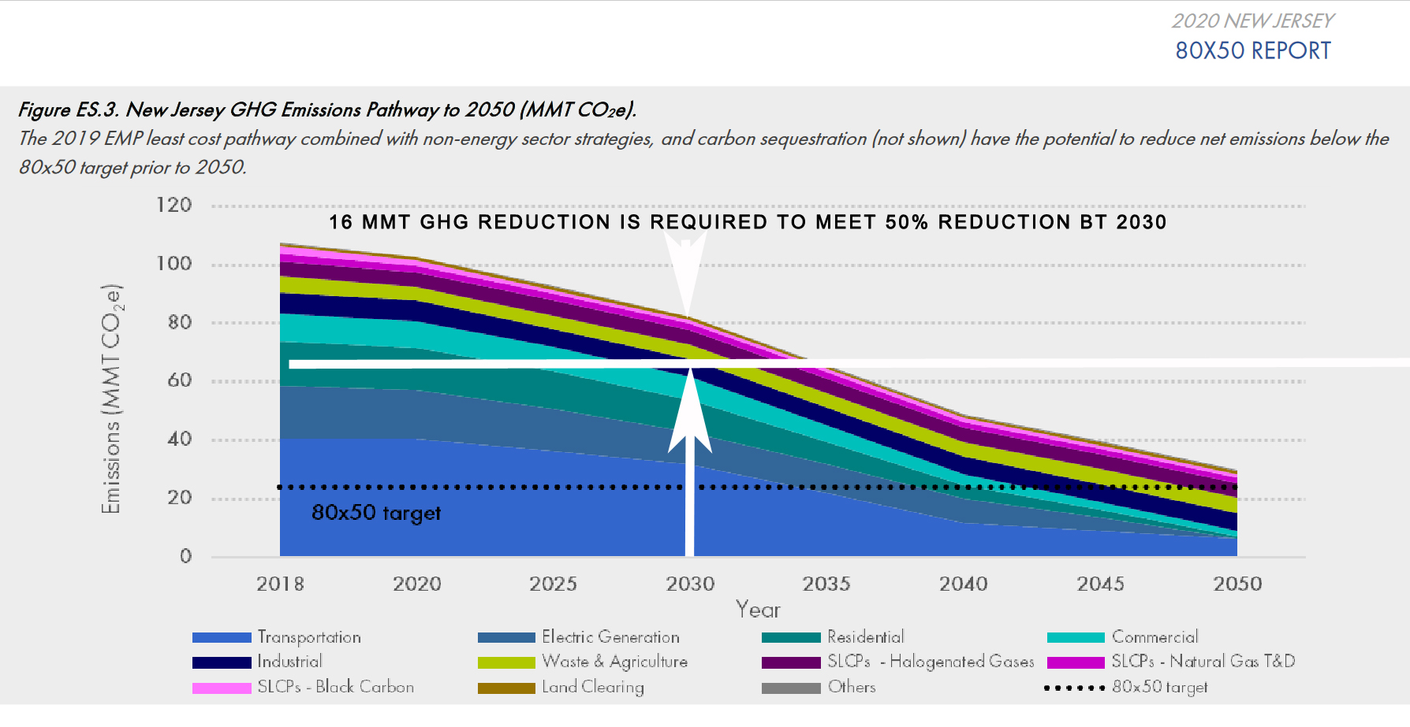

Slide 4
