Slide 1



Sierra Club
100% Committed
Global climate change, and what we can do about it
Steve Miller Oct 12, 2020
Climate Chair, Sierra Club NJ ShorE group
Co-founder, Middletown for clean energy
Trained climate reality leader
stevemiller@comcast.net
http://electric.smiller.org
Our mission is to leave a legacy of a livable world for our children and grandchildren.

Slide 2
Global Surface Temperature – Departure from Average
1880 – 2019
There is a 72% chance 2020 will be the new hottest year ever.
Anomaly (°C)
Source: NASA
Notes:
ID #3628.G - Can be used in noncommercial online and TV broadcasts of your presentation, but not modified.
As a result, the temperatures are going up very fast. It's unmistakably clear, and the scientists are telling us that this year already has more than a 70 percent chance of being the hottest year ever measured with instruments.
DESCRIPTION: Graph showing the global average land and ocean temperature anomalies every year from 1880 - 2019 with a projection that that there is a 72 percent chance that 2020 will be the new hottest year ever
ADDITIONAL TALKING POINTS: Increasing levels of heat-trapping greenhouse gases – such as carbon dioxide (CO2), methane, and nitrous oxide – in the atmosphere are causing global average temperatures to rise.[1*]
We can see it happening: Surface temperatures in each of the last three decades have been successively warmer than in any preceding decade since 1850.[1*]
In 2019, global average surface temperature (both land and sea) was 0.95 degrees Celsius (1.71 degrees Fahrenheit) above the twentieth-century average, making it the second-hottest year in history.[2*]
According to the Intergovernmental Panel on Climate Change (IPCC) and based on multiple independent analyses of measurements, it is virtually certain (99-100 percent confidence) that the lowest level of the atmosphere (the troposphere) all around the world has warmed since the mid-twentieth century.[1*]
Oceans have stored much of the increased energy in our climate system.[1*]
Ocean warming accounts for more than 90 percent of the energy accumulated between 1971 and 2010.[1*]
This is in contrast to only about 1 percent stored in the atmosphere.[1*]
Globally, the ocean has warmed the most in the water closest to the surface, with the upper 75 meters warming 0.11 degrees Celsius per decade from 1971–2010.[1*]
In 2019, the amount of heat stored by the oceans was the highest ever recorded [3*]
Heat waves are becoming more frequent in many regions, thanks to human activity.[1*]
According to the IPCC, it is likely (66-100 percent confidence) that heat waves are becoming more and more frequent in large parts of Europe, Asia, and Australia and that human activity has made them twice as probable.[1*]
IPCC scientists say is very likely (90-100 percent confidence) that heat waves will occur more often and last longer over the twentieth century.[1*]
Temperatures keep rising.[1*]
Scientists expect global mean surface temperatures to increase an additional 0.3-0.7 degrees Celsius from 2016–2035.[1*]
Scientists expect global surface temperature change will likely exceed 1.5 degrees Celsius between 2081–2100 in all but the most conservative projections.[1*]
REFERENCES:
[1*] Rajendra K. Pachauri et al., “Climate Change 2014: Synthesis Report,” Contribution to the Fifth Assessment Report of the Intergovernmental Panel on Climate Change, Cambridge University Press, Topics 1 and 2 (November 2, 2014): 40-62. https://www.ipcc.ch/site/assets/uploads/2018/05/SYR_AR5_FINAL_full_wcover.pdf
[2*] Rebecca Lindsey and LuAnn Dahlman, “Climate Change: Global Temperature,” NOAA, January 16, 2020. https://www.climate.gov/news-features/understanding-climate/climate-change-global-temperature
[3*] NOAA, “2019 was the 2nd hottest year on record for Earth say NOAA, NASA,” January 15, 2020. https://www.noaa.gov/news/2019-was-2nd-hottest-year-on-record-for-earth-say-noaa-nasa
SLIDE SOURCE(S): https://www.cbsnews.com/news/warmest-year-on-record-2020-likely/; https://data.giss.nasa.gov/gistemp/graphs/customize.html

Slide 3
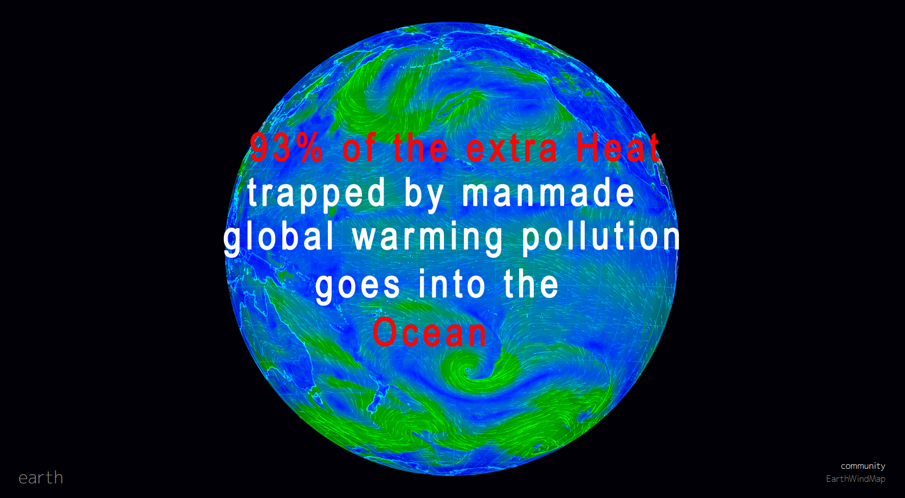

Slide 4
Ocean Temperatures Set a New Record in 2019
2020 is likely to set a new record again.
Change in Heat Content (Upper 2,000 m)
Relative to 1981-2010 Avg. (ZJ)
Data: Cheng, L. J., and J. Zhu, 2018: “2017 was the warmest year on record for the global ocean,” Advances in Atmospheric Sciences, 34(3)
Notes:
ID #5241.D - Can be used in noncommercial online and TV broadcasts of your presentation, but not modified.
We're seeing ocean temperatures also hit a new record last year, and almost certainly again, this year. This makes the ocean-based storms stronger.
DESCRIPTION: Chart showing global ocean temperature anomalies (from baseline), 1940 - 2019 with a projection that 2020 will likely set a new record in 2020
ADDITIONAL TALKING POINTS: Oceans are absorbing most of the extra heat energy trapped by increased greenhouse gases.[1*]
Between 1971 and 2010, the world’s oceans absorbed more than 90 percent of the extra accumulated heat energy resulting from higher greenhouse gas levels.[1*]
This extra energy is warming the oceans, especially in the water closest to the surface.[1*]
Globally, from 1971–2010, the upper 75 meters of ocean warmed an average of 0.11 degrees Celsius per decade.[1*]
Scientists project that the oceans will continue to warm during the twenty-first century, with the strongest ocean warming forecasted for the surface in tropical and Northern Hemisphere subtropical regions.[1*]
In deeper waters, the warming will be most pronounced in the Southern Ocean.[1*]
Climate change is disrupting how oceans regulate global temperatures.
Oceans circulate heat around the world through massive surface and deep-water currents – one of the largest of which is the Atlantic Meridional Overturning Circulation (AMOC) – which help regulate global climate and weather.[2*]
Warmer, less dense water can slow down ocean heat circulation, as can salinity changes (a notable consequence of runoff from melting land-based freshwater ice).[2*]
According to the Intergovernmental Panel on Climate Change, it is very likely (90–100 percent confidence) that the AMOC could weaken between 11 and 34 percent, depending on future emissions levels, over the twenty-first century.[1*]
This slowdown could mean cooling across the entire Northern Hemisphere while parts of the Southern Hemisphere become hotter.[2*]
While cooler temperatures might sound good in the face of global warming, it could mean massive sea-level rise in eastern North America and shifting rainfall patterns that could dry up Europe’s rivers.[2*]
Warming oceans are devastating the world’s coral reefs.
Coral reefs are some of the most biodiverse habitats on the planet, home to nearly one-quarter of all ocean species, yet occur in less than 1 percent of the world’s oceans.[3*]
Prolonged high water temperatures (among other factors) can cause coral polyps to expel their symbiotic algae partners (zooxanthellae) that help them produce food.[3*]
The result is coral bleaching, which puts the health of the whole reef system at risk.[3*]
The world’s largest reef, the Great Barrier Reef off the Australian coast, frequently suffers from catastrophic bleaching events in response to regular heat stress.[4*]
During the nine-month marine heatwave of 2016, an estimated 30 percent of the Great Barrier Reef’s corals died.[4*]
Higher levels of carbon dioxide in the atmosphere are making oceans increasingly acidic, disrupting natural processes and entire ecosystems.[6*]
The ocean plays a critical role in the storage of carbon, as it holds about 50 times more carbon than the atmosphere.[5*]
The ocean absorbs this carbon largely through a chemical reaction at its surface: CO2 combines with sea water to form carbonic acid, which then breaks down into bicarbonate ions and hydrogen ions. This increase in hydrogen ions results in increased ocean acidity.[6*]
Since 1750, the global ocean has absorbed about 28 percent of the CO2 from burning fossil fuels.[6*]
Ocean acidification makes it more difficult for creatures – like plankton, corals, and shellfish – to produce calcium carbonate, the main ingredient in their hard skeletons or shells.[6*]
This can lead to broader changes in the overall structure of ocean and coastal ecosystems, which can affect fish populations and the people that depend on them.[6*]
The degradation of coral reef ecosystems due to warming and acidification will significantly affect communities in tropical developing nations that heavily depend on them for both nutrition and livelihoods.[7*]
Warmer oceans can encourage dangerous algae overgrowths that produce toxins and lower oxygen levels in the water.
Increased ocean temperature combined with excessive nutrients like phosphorous and nitrogen (often from agricultural fertilizer runoff) is conducive to rapid algae growth known as algal blooms.[8*]
Some types of algal blooms can produce extremely dangerous toxins that can cause eye and lung irritation and worsen asthma. These blooms can even kill people and animals.[8*]
The growth of the algae depletes oxygen content necessary for marine organisms to live, forcing species to flee or perish.[8*]
From 1960–2010, the oceans lost an estimated 77 billion metric tons of oxygen, affecting an accumulated area approximately the size of the European Union.[9*]
According to the National Oceanic and Atmospheric Administration (NOAA), 65 percent of studied estuaries and coastal water bodies in the contiguous US are moderately to severely degraded by excessive nutrients such as phosphorous from agricultural fertilizer runoff, treated sewage wastewater, and atmospheric fallout from burning fossil fuels.[10*]
Pollution has severe impacts on ocean ecosystems and communities that depend on them.
Plastic pollution in oceans has become an increasing concern, with 4.8–12.7 million metric tons entering the ocean in 2010 according to UN Environment. Marine mammals, seabirds, turtles, fish, and crustaceans can become entangled in debris or ingest plastic materials, causing them to drown, starve, or incur wounds. The plastic can also cover phototropic organisms, cutting off access to light and oxygen.[11]
Oil spills in the ocean interfere with the insulating ability of fur-bearing mammals and the water repellency of birds, exposing them to the elements and raising the risk of death by hypothermia. Oil can also poison birds and animals that accidentally ingest it while trying to clean themselves. Exposure to oil can cause reduced growth, enlarged livers, eroded fins, altered heart and respiration rates, and reduced egg and larval survival in fish.[12*]
The economic impacts of oil spills include the cost of cleanup as well as losses from fisheries, aquaculture, tourism, recreation, and industries that depend on clean water such as nuclear power plants and desalination plants.[13*]
Poor and vulnerable communities are disproportionately affected by mismanaged plastic waste, oil spills, and other sources of harmful pollution.[14*][15*]
REFERENCES:
[1*] Rajendra K. Pachauri et al., “Climate Change 2014: Synthesis Report,” Contribution to the Fifth Assessment Report of the Intergovernmental Panel on Climate Change, Cambridge University Press, Topics 1 and 2 (November 2, 2014): 40-62. http://www.ipcc.ch/pdf/assessment-report/ar5/syr/SYR_AR5_FINAL_full.pdf
[2*] Nicola Jones, “How Climate Change Could Jam The World’s Ocean Circulation,” Yale Environment 360, September 6, 2016. https://e360.yale.edu/features/will_climate_change_jam_the_global_ocean_conveyor_belt
[3*] NOAA Fisheries, “Shallow Coral Reef Habitat,” National Oceanic and Atmospheric Administration, last updated February 6, 2018. https://www.fisheries.noaa.gov/national/habitat-conservation/shallow-coral-reef-habitat
[4*] Ben Smee, “Great Barrier Reef: 30% of coral died in ‘catastrophic’ 2016 heatwave,” The Guardian, April 18, 2018. https://www.theguardian.com/environment/2018/apr/19/great-barrier-reef-30-of-coral-died-in-catastrophic-2016-heatwave
[5*] National Oceanic and Atmospheric Administration, “Carbon Cycle,” last updated February 2019. http://www.noaa.gov/resource-collections/carbon-cycle
[6*] US Environmental Protection Agency, “Climate Change Indicators: Ocean Acidity,” last updated December 17, 2016. https://www.epa.gov/climate-indicators/climate-change-indicators-ocean-acidity
[7*] Christopher D. Golden et al., “Fall in fish catch threatens human health,” Nature, June 16, 2016. https://www.nature.com/news/polopoly_fs/1.20074!/menu/main/topColumns/topLeftColumn/pdf/534317a.pdf
[8*] National Institute of Environmental Health Sciences, “Algal Blooms,” last updated July 13, 2020. https://www.niehs.nih.gov/health/topics/agents/algal-blooms/index.cfm
[9*] Mindy Weisberger, “The Ocean Is Suffocating and It’s Our Fault,” Live Science, January 4, 2018. https://www.livescience.com/61338-ocean-losing-oxygen.html
[10*] NOAA, “What is eutrophication?” last updated January 7, 2020. https://oceanservice.noaa.gov/facts/eutrophication.html
[11*] UNEP, “Research highlights true impacts of plastics on our planet, ecosystems and people,” March 12, 2019. https://www.unenvironment.org/news-and-stories/press-release/research-highlights-true-impacts-plastics-our-planet-ecosystems
[12*] NOAA, “How does oil impact marine life?” last updated March 11, 2020. https://oceanservice.noaa.gov/facts/oilimpacts.html
[13*] Jonathan L. Ramseur, "Oil Spills: Background and Governance,” Congressional Research Service, September 15, 2017. https://fas.org/sgp/crs/misc/RL33705.pdf
[14*] Columbia Magazine, “Children and the Poor Hurt Worst by Gulf Spill,” Fall 2010. https://magazine.columbia.edu/article/children-and-poor-hurt-worst-gulf-spill
[15*] Fiona Harvey, “Mismanaged Waste ‘kills up to a million people a year globally,’” The Guardian, May 13, 2019. https://www.theguardian.com/environment/2019/may/14/mismanaged-waste-kills-up-to-a-million-people-a-year-globally
SLIDE SOURCE(S): https://link.springer.com/content/pdf/10.1007/s00376-020-9283-7.pdf; data on file

Slide 5
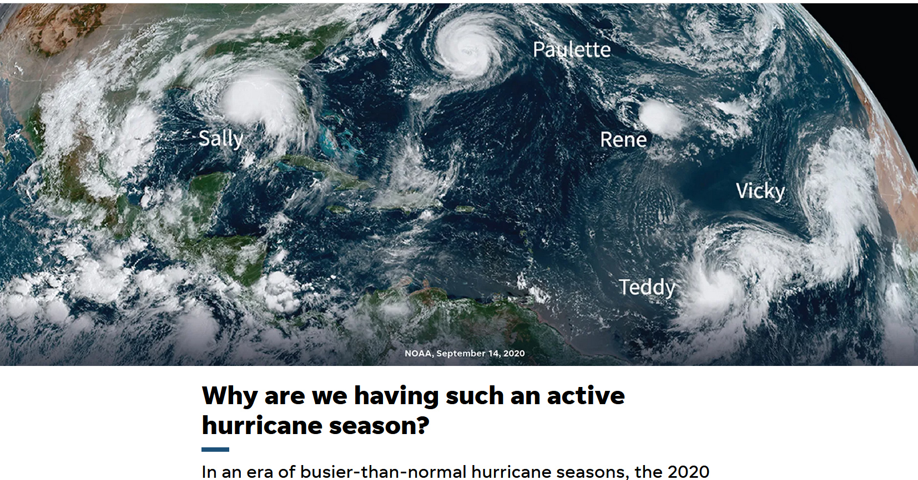
10/8/2020
USA TODAY
Notes:
9/14/2020 tracked 5 storms at once
10/8/2020 “Busy 2020 Hurricane Season has Louisiana bracing a 6th time
10/8/1010 “Mexico Prepares for Hurricane Delta, which beat the old record for 25th named storm by more than 1 month
The National Hurricane Center went to its backup list for storm names for only the 2nd time in history
WHY: several factors came together in 2020 to create ideal conditions for storm formation.. The cycle, known as the Atlantic Multidecadal Oscillation, varies based on sea surface temperature. The ocean temperatures are warmer than normal

Slide 6
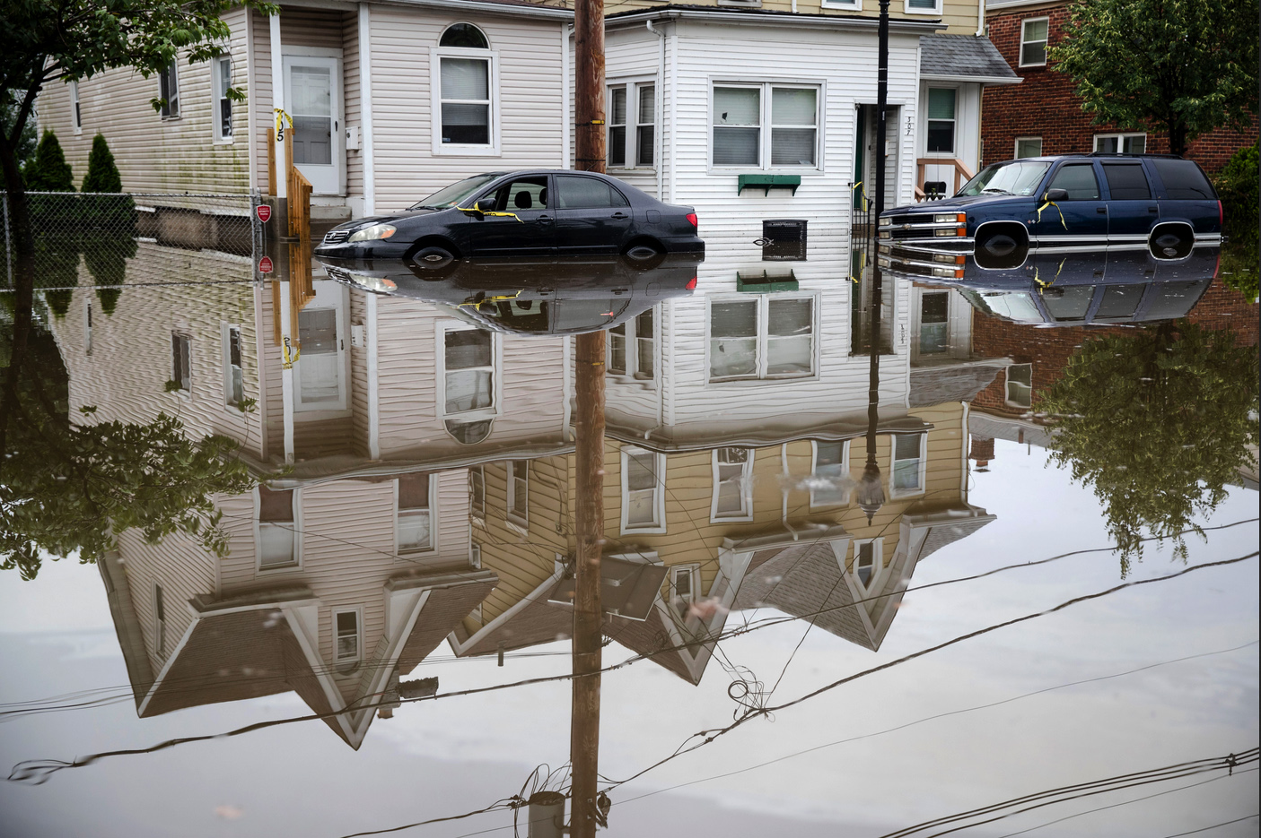
WESTVILLE, NJ
JUNE 20, 2019

Slide 7
U.S. Counties Most Vulnerable to Disaster
Brooks, TX
Dimmit, TX
Duval, TX
Luna, NM
Zavala, TX
Cibola, NM
Presidio, TX
Imperial, CA
Evangeline, LA
Culberson, TX
The population in the 10 U.S. counties rated most vulnerable to disasters by the Centers for Disease Control and Prevention is 81% minority, on average.
Data: U.S. CDC
Notes:
ID #6575 - Can be used in noncommercial online and TV broadcasts of your presentation, but not modified.
If you look at the 10 counties most affected by flooding in the United States, 81 percent of the population is minority, on average.
DESCRIPTION: Graphic highlighting the U.S. counties most vulnerable to disaster, with text stating that the population in the 10 U.S. counties rated most vulnerable to disasters by the Centers for Disease Control and Prevention is 81 percent minority, on average
ADDITIONAL TALKING POINTS:
We know that communities of color and low-income neighborhoods are disproportionately at risk from the climate crisis. Notably, minority communities are more vulnerable to disasters and extreme heat.
Counties, cities, and neighborhoods with large numbers of black and Hispanic residents are more likely than others to suffer from events such as flooding and extreme heat because they are often located in damage-prone areas and frequently lack the resources and investment to recover quickly from disaster.
In the US, this is in part a result of decades-long policies that clustered minorities in undesirable areas such as floodplains and denied amenities like green spaces and tree canopies.
In the ten counties rated most vulnerable to extreme heat by the National Oceanic and Atmospheric Administration (NOAA), the population is 67 percent minority on average.[1*]
REFERENCES:
[1*] Thomas Frank, “Population of top 10 counties for disasters: 81% minority,” E&E News, June 8, 2020. https://www.eenews.net/climatewire/2020/06/08/stories/1063347205?utm_campaign=edition%2BMGkN8vMVEV1xZhYWhDA0AQ%3D%3D&utm_medium=email&utm_source=eenews%3Aclimatewire
SLIDE SOURCE(S): https://www.eenews.net/climatewire/2020/06/08/stories/1063347205?utm_campaign=edition%2BMGkN8vMVEV1xZhYWhDA0AQ%3D%3D&utm_medium=email&utm_source=eenews%3Aclimatewire

Slide 8

California, August 13, 2020
The Lake Fire grew to 10,000 acres within 1 day,
and threatened more than 5000 structures

Slide 9
Declining Ice Mass in Greenland
Declining Ice Mass in Greenland Gigatons
Data: NASA
Notes:
Declining Mass In Gigatons

Slide 10
Antarctic Ice Loss
Ice Loss Per Year in Billion Metric Tons
Data: Rignot et al, 2019, PNAS
Notes:
ID #5874 - Can be used in noncommercial online and TV broadcasts of your presentation, but not modified.
The same thing is true in Antarctica, where the ice melting has accelerated quite dramatically. And when this massive amount of ice in those two regions melts, sea levels go up.
Both south and north poles are warming 3X faster than the world as a whole. RESULT: Sea-level rise is accelerating. It is now rising 25% faster than 20 years ago.
1/3 of world’s population live within 100 km of a coastline.
DESCRIPTION: Graph of Antarctic ice loss by period 1979 - 2017
ADDITIONAL TALKING POINTS: With greenhouse gas emissions increasing and the planet warming, global mean sea-level rise is happening 25 percent faster than in the late twentieth century – with serious consequences for the planet.[1*]
Researchers conclude that even if the strictest global emissions standards are met, sea levels would still rise from 0.7 to 1.2 meters within the next two centuries.[2*]
Dozens of countries are exposed to the risk of coastal flooding caused by sea-level rise.[3*]
Nearly one-third of the world’s population, or 2.4 billion people, live within 100 kilometers of a coastline, further emphasizing the vulnerabilities associated with increased sea-level rise.[3*]
Sea-level rise is caused by melting glaciers and ice sheets, particularly on Greenland and Antarctica, as well as the thermal expansion of warmer ocean water.[4*]
Large land-based ice formations naturally retreat each summer, but unusually warm temperatures have led to greater-than-average melting.[4*]
In addition, winter seasons are becoming shorter, resulting in an imbalance that perpetuates ice melt and therefore increases sea-level rise.[5*]
These factors have contributed to the highest annual average of global sea-level rise on record.[4*]
Ice sheets and glaciers located in Greenland and Antarctica are disappearing faster than expected.[6*]
Between 2011 and 2014, satellite and modeling data found that the Greenland ice sheet lost an approximated 269 billion tons of snow and ice annually, raising sea levels about 0.74 millimeters (mm) each year.[6*]
This rapid decline in ice volume has triggered a positive feedback loop for additional warming and perpetuates sea-level rise.[6*]
Liquid water in glaciers, together with the plant and microbial life it fosters, darken the ice and increase absorption of solar energy, which leads to further ice melt.[6*]
In addition, scientists are discussing the impact of melting ice streams, which are located inside and under ice sheets, lubricating them and causing them to move more quickly into the sea.[5*]
Nearly half of the past century’s sea-level rise is attributed to thermal expansion – water expands when heated, so increased ocean heat means oceans are occupying more space.[5*]
Thermal expansion is responsible for about 1.6 mm per year of sea-level rise.[5*]
Projections show global sea-level rise could range from 0.2 to 2.5 meters by 2100.[7*]
REFERENCES:
[1*] The Maritime Executive, “Sea Level Rising Faster This Century,” April 26, 2017.
https://www.maritime-executive.com/article/sea-level-rising-faster-this-century
[2*] Josh Gabbatiss, “Global sea level to rise by up to 1.2 metres despite Paris agreement, say scientists,” Independent, February 20, 2018. https://www.independent.co.uk/environment/sea-level-rise-climate-change-paris-agreement-global-warming-greenhouse-gas-a8219681.html
[3*] National Aeronautics and Space Administration (NASA), “Living Ocean,” last updated July 2020. https://science.nasa.gov/earth-science/oceanography/living-ocean
[4*] National Oceanic Atmospheric Administration, “Is sea level rising?,” last accessed February 2020. https://oceanservice.noaa.gov/facts/sealevel.html
[5*] Christina Nunez, “Sea level rise, explained,” February 19, 2019. https://www.nationalgeographic.com/environment/global-warming/sea-level-rise/
[6*] Eli Kintisch, “The great Greenland meltdown,” Science Magazine, February 23, 2017. http://www.sciencemag.org/news/2017/02/great-greenland-meltdown
[7*] Rebecca Lindsey, "Climate Change: Global Sea Level," National Oceanic and Atmospheric Administration, last updated November 19, 2019. https://www.climate.gov/news-features/understanding-climate/climate-change-global-sea-level
SLIDE SOURCE(S): https://www.washingtonpost.com/energy-environment/2019/01/14/ice-loss-antarctica-has-sextupled-since-s-new-research-finds/?utm_term=.058e64406459

Slide 11
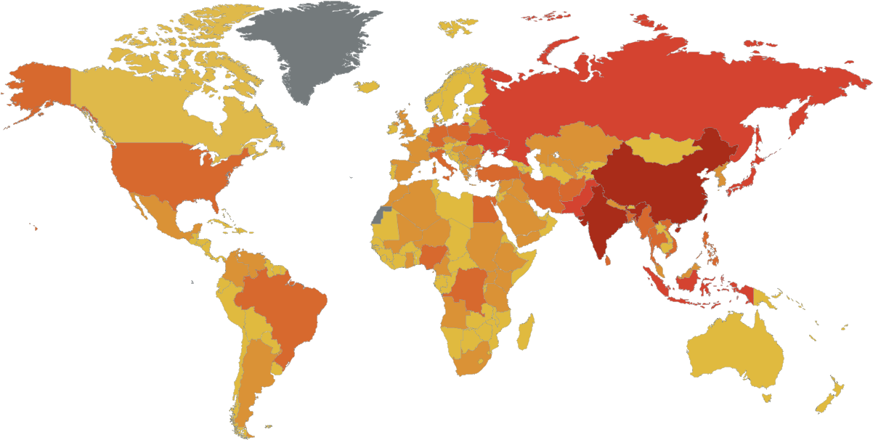
Deaths Attributable to Ambient Air Pollution
Deaths Per Year
0 – 4,999
5,000 – 19,999
20,000 – 49,999
50,000 – 149,999
> 150,000
Data: World Health Organization, 2016
Notes:
ID #3706.B - Can be used in noncommercial online and TV broadcasts of your presentation, but not modified.
Air pollution kills nine million people a year, and the same burning of fossil fuels that creates the global warming pollution also creates the particulates that causes more lung diseases and heart diseases.
DESCRIPTION: Map of deaths attributable to ambient air pollution with countries colored by the number of deaths per year
ADDITIONAL TALKING POINTS:
Pollution from extracting and burning fossil fuels isn’t only driving the climate crisis – it’s also creating a public and environmental health crisis worldwide.
Burning fossil fuels releases deadly pollution into the air.
Air pollution – such as that produced from burning fossil fuels like coal and oil – can expose people to small particulate matter of 2.5 microns or less in diameter (PM2.5). These particles can penetrate the lung barrier and enter the blood system, resulting in cardiovascular and respiratory diseases, and cancers.[1*]
Ambient outdoor air pollution kills millions of people every year.[1*]
In 2016, around 58 percent of deaths from ambient air pollution were due to ischaemic heart disease and strokes. Another 18 percent were due to chronic obstructive pulmonary disease, 18 percent were due to acute lower respiratory infections, and 6 percent were due to lung cancer.[1*]
Additionally, indoor smoke is a serious health risk for some 3 billion people who use biomass, kerosene fuels, and coal for cooking or for heating their homes.[1*]
People with pre-existing medical conditions are worse off. For example, chronic obstructive pulmonary disease (COPD) patients are especially sensitive to changes in ambient air quality associated with climate change.[2*]
Among the many byproducts of coal combustion is mercury, a potent neurotoxin that can bioaccumulate and biomagnify in organic tissue. Consuming contaminated fish, for example, can seriously harm both people and wildlife.[3*]
Fossil fuel pollution also impacts the water and land.
Coal mining operations can contaminate nearby rivers, lakes, and aquifers with heavy metals like arsenic, copper, and lead. One common technique, mountain top removal, requires clearcutting forests and vegetation before using explosives to blast away the tops of mountains, with the resulting debris typically dumped into the valleys below.[4*]
Before being burned, coal is washed with water and chemicals to remove impurities, producing a coal slurry that must be stored, either with coal ash or in improvised ponds that can leak, spill, or fail.[4*]
In 2000, the bottom of a Kentucky coal slurry impoundment gave way, contaminating more than a hundred miles of rivers and streams with more than 300,000,000 gallons of thick black sludge – a spill 30 times larger than the Exxon-Valdez oil spill.[4*]
Hydraulic fracturing (or “fracking”) is a drilling technique for extracting oil or natural gas by injecting huge quantities of water, chemicals, and sand deep underground, the hazardous consequences of which may include contaminating drinking water supplies and triggering small earthquakes.[5*]
Oil spills, such as from the Deepwater Horizon offshore oil rig in 2010, are devastating environmental disasters with long-lasting effects to the landscape, native species, and inhabitants who depend on the area.[6*]
While pollution is a threat to common resources, some people are disproportionately impacted.
Around the world, poor people are the most affected by air pollution.[7*]
As of 2016, more than 90 percent of air pollution-related deaths occurred in low- and middle-income countries.[1*]
In the United States, due to historical racism and economic inequality, minority and poor communities are most affected by air pollution: Black Americans have a 54 percent higher health burden compared to the overall population; non-White communities overall have a 28 percent higher health burden; and those living below the poverty line have a 35 percent higher burden.[8*]
The biggest polluters, including hazardous waste treatment, storage, and disposal plants, in the US are overwhelmingly located in poor, non-White areas.[9*]
Residents of Louisiana’s “Cancer Alley” – home to about 150 fossil fuel and petrochemical facilities – are about 50 times more likely to get cancer than the average American.[10*]
Fossil fuel pollution is changing our climate – and climate change is making the public health impacts of COVID-19 worse.
While there is no evidence of climate change directly contributing to the emergence of COVID-19, climate change can indirectly affect the larger COVID-19 response due to its impacts on public health and stress on health systems.[11*]
People living with poor air quality – especially those most vulnerable, like the homeless, people with homes lacking air filtration, or people with compromised health – are more likely to die from COVID-19, just as research shows that people exposed to more air pollution and who smoke fare worse with respiratory infections.[12*]
Due to longstanding racist housing policies and practices and other systemic inequalities, communities of color in the US are more likely to live with higher rates of pollution and be at higher risk of getting COVID-19 or contracting severe illness.[13*]
COVID-19 may affect planning and preparing for hurricanes and other natural disasters, as well as recovery efforts, due to the strained medical and personal hygiene resources and difficulty maintaining physical distancing in public shelters.[14*]
REFERENCES:
[1*] World Health Organization, "Ambient (outdoor) air pollution," May 2, 2018. https://www.who.int/news-room/fact-sheets/detail/ambient-(outdoor)-air-quality-and-health
[2*] John Balbus, et al., “Climate and Health Assessment Chapter 1: Climate Change and Human Health,” (The US Global Change Research Program, 2016). https://health2016.globalchange.gov/climate-change-and-human-health
[3*] US Geological Survey, "Mercury," last accessed July 2020. https://usgs.gov/mission-areas/water-resources/science/mercury?qt-science_center_objects=0#qt-science_center_objects
[4*] Union of Concern Scientists, "Coal and Water Pollution," December 6, 2017. https://www.ucsusa.org/resources/coal-and-water-pollution
[5*] Marc Lallanilla, "Facts About Fracking," Live Science, February 10, 2018. https://www.livescience.com/34464-what-is-fracking.html
[6*] US Geological Survey, "Large Oil Spills," last accessed July 2020. https://www.usgs.gov/mission-areas/water-resources/science/large-oil-spills
[7*] UN Environment, “Air pollution hurts the poorest most,” May 9, 2019. https://www.unenvironment.org/news-and-stories/story/air-pollution-hurts-poorest-most
[8*] Miranda Green, “EPA scientists find black communities disproportionately hit by pollution,” The Hill, February 23, 2018. https://thehill.com/policy/energy-environment/375289-epa-scientists-find-emissions-greater-impact-low-income-communities
[9*] Erik Sherman, “If You’re a Minority and Poor, You’re More Likely to Live Near a Toxic Waste Site,” Fortune, February 4, 2016. https://fortune.com/2016/02/04/environmental-race-poverty-flint/
[10*] James Pasley, “Inside Louisiana’s horrifying ‘Cancer Alley,’ an 85-mile stretch of pollution and environmental racism that’s now dealing with some of the highest coronavirus death rates in the country,” Business Insider, April 9, 2020. https://www.businessinsider.com/louisiana-cancer-alley-photos-oil-refineries-chemicals-pollution-2019-11#to-get-an-idea-of-the-toxicity-people-living-in-reserve-louisiana-are-50-times-more-likely-to-get-cancer-than-an-average-american-3
[11*] World Health Organization, "Q&A: Climate change and COVID-19," April 22, 2020. https://www.who.int/news-room/q-a-detail/q-a-on-climate-change-and-covid-19
[12*] Harvard T.H. Chan School of Public Health, "Coronavirus and Climate Change," last accessed July 2020. https://www.hsph.harvard.edu/c-change/subtopics/coronavirus-and-climate-change/
[13*] Center for Disease Control, “COVID-19 in Racial and Ethnic Minority Groups,” June 25, 2020. https://www.cdc.gov/coronavirus/2019-ncov/need-extra-precautions/racial-ethnic-minorities.html
[14*] US Centers for Disease Control and Prevention, "Natural Disasters, Severe Weather, and COVID-19," last updated July 1, 2020. https://www.cdc.gov/disasters/covid-19/disasters_severe_weather_and_covid-19.html
SLIDE SOURCE(S): apps.who.int/iris/bitstream/handle/10665/250141/9789241511353-eng.pdf?sequence=1

Slide 12
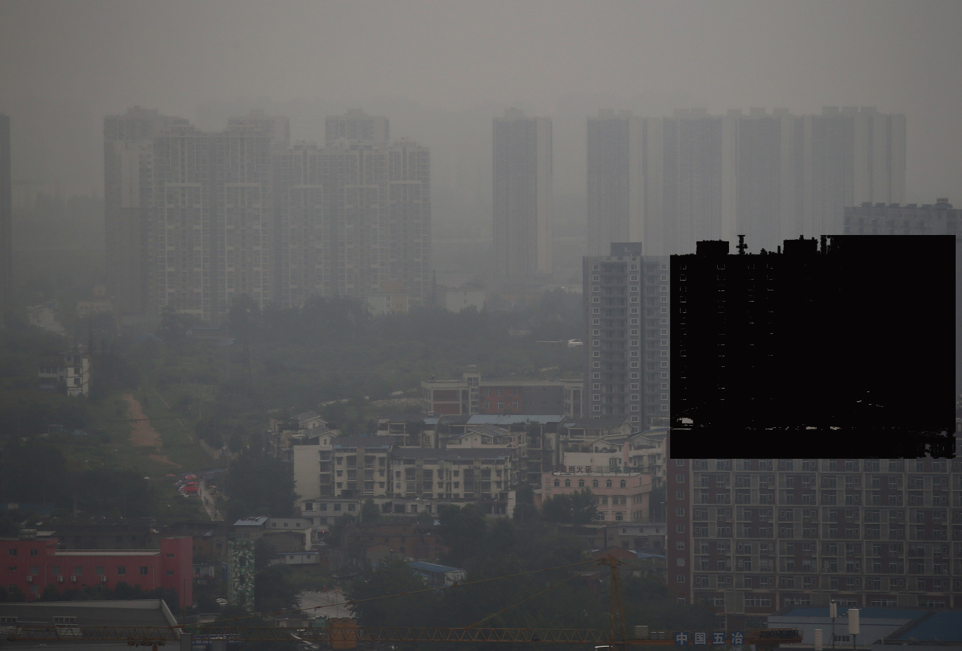
Sichuan Provincial Capital, China
324 cities in China found 15 – 22% increase in COVID-19 in areas with elevated NO2 and PM 2.5 particulates

Slide 13
U.S. COVID-19 Deaths, by Race
Through June 23, 2020
The death rate for Black Americans from COVID-19 is more than twice that white Americans.
Deaths per 100,000 People
Data: APM Research Lab, June 2020
Notes:
ID #6608 - Can be used in noncommercial online and TV broadcasts of your presentation, but not modified.
And again, we see this pattern show up worse among minority populations and poor populations. Black Americans are dying at a rate more than twice as high as white Americans from COVID-19; many reasons, but the climate crisis is one of the principal ones.
DESCRIPTION: Graph of COVID-19 death rates by race through June 24, 2020 with text stating that the death rate for Black Americans from COVID-19 is more than twice that white Americans
ADDITIONAL TALKING POINTS:
Pollution from extracting and burning fossil fuels isn’t only driving the climate crisis – it’s also creating a public and environmental health crisis worldwide.
Burning fossil fuels releases deadly pollution into the air.
Air pollution – such as that produced from burning fossil fuels like coal and oil – can expose people to small particulate matter of 2.5 microns or less in diameter (PM2.5). These particles can penetrate the lung barrier and enter the blood system, resulting in cardiovascular and respiratory diseases, and cancers.[1*]
Ambient outdoor air pollution kills millions of people every year.[1*]
In 2016, around 58 percent of deaths from ambient air pollution were due to ischaemic heart disease and strokes. Another 18 percent were due to chronic obstructive pulmonary disease, 18 percent were due to acute lower respiratory infections, and 6 percent were due to lung cancer.[1*]
Additionally, indoor smoke is a serious health risk for some 3 billion people who use biomass, kerosene fuels, and coal for cooking or for heating their homes.[1*]
People with pre-existing medical conditions are worse off. For example, chronic obstructive pulmonary disease (COPD) patients are especially sensitive to changes in ambient air quality associated with climate change.[2*]
Among the many byproducts of coal combustion is mercury, a potent neurotoxin that can bioaccumulate and biomagnify in organic tissue. Consuming contaminated fish, for example, can seriously harm both people and wildlife.[3*]
Fossil fuel pollution also impacts the water and land.
Coal mining operations can contaminate nearby rivers, lakes, and aquifers with heavy metals like arsenic, copper, and lead. One common technique, mountain top removal, requires clearcutting forests and vegetation before using explosives to blast away the tops of mountains, with the resulting debris typically dumped into the valleys below.[4*]
Before being burned, coal is washed with water and chemicals to remove impurities, producing a coal slurry that must be stored, either with coal ash or in improvised ponds that can leak, spill, or fail.[4*]
In 2000, the bottom of a Kentucky coal slurry impoundment gave way, contaminating more than a hundred miles of rivers and streams with more than 300,000,000 gallons of thick black sludge – a spill 30 times larger than the Exxon-Valdez oil spill.[4*]
Hydraulic fracturing (or “fracking”) is a drilling technique for extracting oil or natural gas by injecting huge quantities of water, chemicals, and sand deep underground, the hazardous consequences of which may include contaminating drinking water supplies and triggering small earthquakes.[5*]
Oil spills, such as from the Deepwater Horizon offshore oil rig in 2010, are devastating environmental disasters with long-lasting effects to the landscape, native species, and inhabitants who depend on the area.[6*]
While pollution is a threat to common resources, some people are disproportionately impacted.
Around the world, poor people are the most affected by air pollution.[7*]
As of 2016, more than 90 percent of air pollution-related deaths occurred in low- and middle-income countries.[1*]
In the United States, due to historical racism and economic inequality, minority and poor communities are most affected by air pollution: Black Americans have a 54 percent higher health burden compared to the overall population; non-White communities overall have a 28 percent higher health burden; and those living below the poverty line have a 35 percent higher burden.[8*]
The biggest polluters, including hazardous waste treatment, storage, and disposal plants, in the US are overwhelmingly located in poor, non-White areas.[9*]
Residents of Louisiana’s “Cancer Alley” – home to about 150 fossil fuel and petrochemical facilities – are about 50 times more likely to get cancer than the average American.[10*]
Fossil fuel pollution is changing our climate – and climate change is making the public health impacts of COVID-19 worse.
While there is no evidence of climate change directly contributing to the emergence of COVID-19, climate change can indirectly affect the larger COVID-19 response due to its impacts on public health and stress on health systems.[11*]
People living with poor air quality – especially those most vulnerable, like the homeless, people with homes lacking air filtration, or people with compromised health – are more likely to die from COVID-19, just as research shows that people exposed to more air pollution and who smoke fare worse with respiratory infections.[12*]
Due to longstanding racist housing policies and practices and other systemic inequalities, communities of color in the US are more likely to live with higher rates of pollution and be at higher risk of getting COVID-19 or contracting severe illness.[13*]
COVID-19 may affect planning and preparing for hurricanes and other natural disasters, as well as recovery efforts, due to the strained medical and personal hygiene resources and difficulty maintaining physical distancing in public shelters.[14*]
REFERENCES:
[1*] World Health Organization, "Ambient (outdoor) air pollution," May 2, 2018. https://www.who.int/news-room/fact-sheets/detail/ambient-(outdoor)-air-quality-and-health
[2*] John Balbus, et al., “Climate and Health Assessment Chapter 1: Climate Change and Human Health,” (The US Global Change Research Program, 2016). https://health2016.globalchange.gov/climate-change-and-human-health
[3*] US Geological Survey, "Mercury," last accessed July 2020. https://usgs.gov/mission-areas/water-resources/science/mercury?qt-science_center_objects=0#qt-science_center_objects
[4*] Union of Concern Scientists, "Coal and Water Pollution," December 6, 2017. https://www.ucsusa.org/resources/coal-and-water-pollution
[5*] Marc Lallanilla, "Facts About Fracking," Live Science, February 10, 2018. https://www.livescience.com/34464-what-is-fracking.html
[6*] US Geological Survey, "Large Oil Spills," last accessed July 2020. https://www.usgs.gov/mission-areas/water-resources/science/large-oil-spills
[7*] UN Environment, “Air pollution hurts the poorest most,” May 9, 2019. https://www.unenvironment.org/news-and-stories/story/air-pollution-hurts-poorest-most
[8*] Miranda Green, “EPA scientists find black communities disproportionately hit by pollution,” The Hill, February 23, 2018. https://thehill.com/policy/energy-environment/375289-epa-scientists-find-emissions-greater-impact-low-income-communities
[9*] Erik Sherman, “If You’re a Minority and Poor, You’re More Likely to Live Near a Toxic Waste Site,” Fortune, February 4, 2016. https://fortune.com/2016/02/04/environmental-race-poverty-flint/
[10*] James Pasley, “Inside Louisiana’s horrifying ‘Cancer Alley,’ an 85-mile stretch of pollution and environmental racism that’s now dealing with some of the highest coronavirus death rates in the country,” Business Insider, April 9, 2020. https://www.businessinsider.com/louisiana-cancer-alley-photos-oil-refineries-chemicals-pollution-2019-11#to-get-an-idea-of-the-toxicity-people-living-in-reserve-louisiana-are-50-times-more-likely-to-get-cancer-than-an-average-american-3
[11*] World Health Organization, "Q&A: Climate change and COVID-19," April 22, 2020. https://www.who.int/news-room/q-a-detail/q-a-on-climate-change-and-covid-19
[12*] Harvard T.H. Chan School of Public Health, "Coronavirus and Climate Change," last accessed July 2020. https://www.hsph.harvard.edu/c-change/subtopics/coronavirus-and-climate-change/
[13*] Center for Disease Control, “COVID-19 in Racial and Ethnic Minority Groups,” June 25, 2020. https://www.cdc.gov/coronavirus/2019-ncov/need-extra-precautions/racial-ethnic-minorities.html
[14*] US Centers for Disease Control and Prevention, "Natural Disasters, Severe Weather, and COVID-19," last updated July 1, 2020. https://www.cdc.gov/disasters/covid-19/disasters_severe_weather_and_covid-19.html
SLIDE SOURCE(S): https://www.apmresearchlab.org/covid/deaths-by-race

Slide 14
We have
the solutions
at hand...
Notes:
ID #1630 - Can be used in noncommercial online and TV broadcasts of your presentation, but not modified.
Well, luckily the answer to that question is yes, too, because we have the solutions at hand.
DESCRIPTION: Text slide stating that we have solutions to the climate crisis at hand

Slide 15
Global Wind Energy Capacity
1980 – Present
Wind Capacity (Megawatts)
2019
Data: Earth Policy Institute/Bloomberg New Energy Finance
Notes:
ID #3089.F - Can be used in noncommercial online and TV broadcasts of your presentation, but not modified.
…
DESCRIPTION: Graph showing the growth of global wind energy capacity in megawatts, 1980 - 2019
ADDITIONAL TALKING POINTS:
With demand for electricity growing and the climate crisis deepening, the world needs a viable, cost-competitive replacement for dirty fossil fuels. Wind energy can be an excellent alternative, powering our lives without destroying our planet.
Wind energy has the potential to supply the world’s electricity needs 40 times over.[1*]
Global wind capacity reached almost 650 GW in 2019[2*]. Wind capacity is expected to quadruple by 2040, relative to 2017 , with $3.3 trillion in investments.[3*]
Wind and solar are the cheapest sources of electricity generation for people across more than two-thirds of the world as of 2019.[4*]
In 2000, the International Energy Agency projected global wind capacity would only reach 30 GW by 2010. Instead in 2010, it reached 200 GW, overshooting projections by over 660 percent.[5*]
Global offshore wind markets are surging, and turbines are growing more powerful.
Global offshore wind is expected to grow dramatically, with projections showing the potential for up to a 15-fold increase in capacity and around $1 trillion of cumulative investment by 2040.[6*]
Offshore turbines are experiencing an arms race, with individual turbines getting larger. One rotation of a Vestas 8.8 MW wind turbine is enough to power the average home in the United Kingdom for an entire day and next generation turbines are expected to be even larger at 12–15 MW.[7*]
Expanding wind energy will help bring abundant and affordable clean energy and good jobs to people across the globe for years to come.
Employment in wind power, primarily onshore projects, supports 1.2 million jobs around the world. China is the largest employer (44 percent of total jobs). In the US, wind employment grew 8 percent in 2018. Now, wind employs 114,000 Americans in total.[8*]
Global employment in the industry is expected to grow significantly from 1.16 million jobs in 2018 to over 3.7 million jobs in 2030 and more than 6 million in 2050.[9*]
The US wind industry hires veterans at a rate 67 percent higher than the national average. The industry also supports 24,000 manufacturing jobs at over 500 US factories.[10*]
Renewable energy also leads the field in equitable hiring, with women making up about 32 percent of the renewable workforce, compared to 22 percent in the energy sector overall.[11*]
Wind energy is a staple in the US and provides much-needed tax revenue to rural communities.
In 2019, the US added 9,143 MW of new wind capacity, enough to power over 3 million homes, and the wind industry had the third-strongest year on record.[12*]
Wind energy is taking off in the US, with another 44,000 MW of capacity under construction or in advanced development, representing over $62 billion in investment.[12*]
REFERENCES:
[1*] Xi Lua, Michael B. McElroy, and Juha Kiviluoma, “Global Potential for Wind-Generated Electricity,” Proceedings of the National Academy of Sciences of the United States of America 106, No. 27 (July 7, 2009): 10933-10938. http://www.pnas.org/content/106/27/10933.full.pdf
[2*] World Wind Energy Association, “World wind capacity at 650,8 GW, Corona crisis will slow down markets in 2020, renewables to be core of economic stimulus programmes,” April 16, 2020. https://wwindea.org/blog/2020/04/16/world-wind-capacity-at-650-gw/
[3*] Bloomberg New Energy Finance, “Global wind and solar costs to fall even faster, while coal fades even in China and India,” June 15, 2017. https://about.bnef.com/blog/global-wind-solar-costs-fall-even-faster-coal-fades-even-china-india/
[4*] Bloomberg New Energy Finance, “New Energy Outlook 2019,” (2019). https://bnef.turtl.co/story/neo2019?teaser=true
[5*] David Roberts, “Why do ‘experts’ always lowball clean energy projections?," Grist, July 9, 2012. http://grist.org/renewable-energy/experts-in-2000-lowballed-the-crap-out-of-renewable-energy-growth/
[6*] International Renewable Energy Agency, “Offshore wind to become a $1 trillion industry,” October 25, 2019. https://www.iea.org/news/offshore-wind-to-become-a-1-trillion-industry
[7*] Jason Deign, “Global Wind Market to Add 65 GW per Year to 2027,” GreenTechMedia, January 1, 2019. https://www.greentechmedia.com/articles/read/global-wind-market#gs.wtl6fv
[8*] International Renewable Energy Agency, “Renewable Energy and Jobs – Annual Review 2019,” (June 2019). https://www.irena.org/-/media/Files/IRENA/Agency/Publication/2019/Jun/IRENA_RE_Jobs_2019-report.pdf
[9*] International Renewable Energy Agency, “Future of wind: Deployment, investment, technology, grid integration and socio-economic aspects,” (October 2019). https://irena.org/-/media/Files/IRENA/Agency/Publication/2019/Oct/IRENA_Future_of_wind_2019.pdf
[10*] T&D World, “U.S. Wind Power Grows a Record 8% in 2018,” April 17, 2019. https://www.tdworld.com/renewables/us-wind-power-grows-record-8-2018
[11*] International Renewable Energy Agency, “Renewable Energy: A Gender Perspective,” (January 2019). https://www.irena.org/publications/2019/Jan/Renewable-Energy-A-Gender-Perspective
[12*] American Wind Energy Association, “Wind Industry Experiences Third Strongest Year on Record with 9,143 MW of Wind Power Added to U.S. Grid,” January 29, 2020. https://www.awea.org/resources/news/2020/wind-industry-experiences-third-strongest-year-on
SLIDE SOURCE(S): Bloomberg New Energy Finance

Slide 16
World Solar PV Installations
1980 – 2019
Gigawatts (Cumulative)
2019
Data: Earth Policy Institute/BP, Statistical Review of World Energy June 2014 (London: 2014); Bloomberg New Energy Finance
Notes:
ID #3733.G - Can be used in noncommercial online and TV broadcasts of your presentation, but not modified.
This exponential curve is even steeper than the one for wind and rising even faster, …
DESCRIPTION: Graph showing the worldwide growth of solar PV installations in gigawatts, 1980 - 2019
ADDITIONAL TALKING POINTS:
Solar capacity has grown exponentially in the past decade.
Solar technology has been around since the 1970s, but its capacity has grown significantly in recent years, driven by falling costs, continued government support, and technological innovation. There were more renewable solar installations in 2019 than fossil fuel and nuclear power additions combined, which occurred for the fifth year in a row. Solar energy accounted for 57 percent of this new renewable capacity.[1*]
Major greenhouse gas emitters like China, the United States, and India are taking the lead in installing large-scale solar photovoltaics (PV).[1*]
By the end of 2019, at least 39 countries had 1 GW or more of solar capacity, up from 31 in 2018.[1*]
Off-grid solar systems provide rural and off-grid communities with access to electricity. The market for off-grid solar systems grew 13 percent in 2019 – the highest growth of the past five years – with sales totaling 35 million units, up from 31 million units in 2018.[1*]
The cost of solar has dropped significantly in recent decades and the technology has tremendous potential to become even cheaper and more widespread in the future.
Globally, the cost of solar PV has fallen by 99 percent over the last four decades.[2*]
Solar prices have fallen to the point of cost competitiveness with conventional generation technologies (fossil fuels), even without government subsidies.[3*]
In a single hour, the Earth receives more solar energy than humans use in a full year.[4*] It’s just a matter of harnessing what we need.
In 2017, the average solar panel converted 17 percent of all solar energy to usable electricity. Projections show this conversion efficiency could grow to roughly 25 percent by 2027.[5*]
The US continues to ramp up solar investment and installations.
In 2019, solar accounted for nearly 40 percent of all new electricity capacity added in the US – the largest annual share in the industry’s history. The US market installed 13.3 GW of solar PV, which is a 23 percent increase from 2018.[6*]
US solar capacity now exceeds 76 GW, up 7,600 percent from just 1 GW at the end of 2009. Solar capacity is projected to more than double over the next five years, with annual installations reaching 20.4 GW in 2021.[6*]
Solar markets worldwide are blossoming
The Chilean government and the country's four largest electric utility companies reached a voluntary agreement to phase out their coal units by 2040. As solar grows cheaper, coal plants are phased out, and pro-solar government policies continue to be implemented, Chile will accelerate its progress on solar.[7*]
In 2018, Chile’s Installed solar capacity accounted for 9.8 percent of total power generation in 2018, up from only 0.06 percent in 2013.[7*]
Meanwhile, in India, declining costs of solar technologies and government policies that promote foreign investment into Indian markets have driven the rapid adoption of solar PV.[8*]
The pay-as-you-go (PayGo) solar power model allows electricity end-users to pay for their energy consumption and solar technology in small installments – thus avoiding any restrictive up-front investment.[9*]
In 2019, over 1.7 million households were using off-grid PayGo solar products in Sub Saharan Africa and Asia. That number is expected to continue rising rapidly due to its financial accessibility.[10*]
REFERENCES:
[1*] Renewable Energy Policy Network for the 21st Century, “Renewables 2020 Global Status Report,” (2020). https://www.ren21.net/wp-content/uploads/2019/05/gsr_2020_full_report_en.pdf
[2*] David Chandler, “Explaining the plummeting cost of solar power,” MIT News, November 20, 2018. http://news.mit.edu/2018/explaining-dropping-solar-cost-1120
[3*] Lazard, “Lazard's Levelized Cost Of Energy Analysis – Version 13.0,” (November 2019). https://www.lazard.com/media/451086/lazards-levelized-cost-of-energy-version-130-vf.pdf
[4*] Rebecca Harrington, “This incredible fact should get you psyched about solar power,” Business Insider, September 29, 2015. https://www.businessinsider.com/this-is-the-potential-of-solar-power-2015-9
[5*] Ricky Dunbar, “How Efficient Will Solar PV Be In The Future? 10-Year Predictions For The Industry,” Clean Technica, August 15, 2017. https://cleantechnica.com/2017/08/15/efficient-will-solar-pv-future-10-year-predictions-industry/
[6*] Solar Energy Industries Association, “Solar Market Insight Report 2019 Year In Review,” March 17, 2020. https://www.seia.org/research-resources/solar-market-insight-report-2019-year-review
[7*] Mordor Intelligence, “Chile Solar Energy Market – Growth, Trends, And Forecast (2020-2025),” (2019). https://www.mordorintelligence.com/industry-reports/chile-solar-energy-market
[8*] Mordor Intelligence, “India Solar Energy Market – Growth, Trends, And Forecast (2020-2025),” (2019). https://www.mordorintelligence.com/industry-reports/india-solar-energy-market
[9*] Marcus Wiemann and David Lecoque, “The weekend read: A bump in the road for pay-as-you-go solar and self-sustainability,” PV Magazine, October 19, 2019. https://www.pv-magazine.com/2019/10/19/the-weekend-read-a-bump-in-the-road-for-pay-as-you-go-solar-and-self-sustainability/
[10*] Yinka Adegoke, “Africa is facing an electricity crisis – a pay-as-you-go model could solve this problem,” World Economic Forum, July 4, 2019. https://www.weforum.org/agenda/2019/07/pay-as-you-go-africas-solar-energy/
SLIDE SOURCE(S): Bloomberg New Energy Finance

Slide 17
Cost of Crystalline Silicon Solar Cell Modules
1976
$79.40/watt
$ Cost per Watt (Inflation Adjusted)
2020
$0.20/watt
Data: Bloomberg New Energy Finance
Notes:
ID #3212.G - Can be used in noncommercial online and TV broadcasts of your presentation, but not modified.
… because the cost of renewable energy continues to come down dramatically.
DESCRIPTION: Graph showing the decline in cost of crystalline silicon solar cells in US dollars per watt (inflation adjusted), 1976 - 2020
ADDITIONAL TALKING POINTS:
Solar capacity has grown exponentially in the past decade.
Solar technology has been around since the 1970s, but its capacity has grown significantly in recent years, driven by falling costs, continued government support, and technological innovation. There were more renewable solar installations in 2019 than fossil fuel and nuclear power additions combined, which occurred for the fifth year in a row. Solar energy accounted for 57 percent of this new renewable capacity.[1*]
Major greenhouse gas emitters like China, the United States, and India are taking the lead in installing large-scale solar photovoltaics (PV).[1*]
By the end of 2019, at least 39 countries had 1 GW or more of solar capacity, up from 31 in 2018.[1*]
Off-grid solar systems provide rural and off-grid communities with access to electricity. The market for off-grid solar systems grew 13 percent in 2019 – the highest growth of the past five years – with sales totaling 35 million units, up from 31 million units in 2018.[1*]
The cost of solar has dropped significantly in recent decades and the technology has tremendous potential to become even cheaper and more widespread in the future.
Globally, the cost of solar PV has fallen by 99 percent over the last four decades.[2*]
Solar prices have fallen to the point of cost competitiveness with conventional generation technologies (fossil fuels), even without government subsidies.[3*]
In a single hour, the Earth receives more solar energy than humans use in a full year.[4*] It’s just a matter of harnessing what we need.
In 2017, the average solar panel converted 17 percent of all solar energy to usable electricity. Projections show this conversion efficiency could grow to roughly 25 percent by 2027.[5*]
The US continues to ramp up solar investment and installations.
In 2019, solar accounted for nearly 40 percent of all new electricity capacity added in the US – the largest annual share in the industry’s history. The US market installed 13.3 GW of solar PV, which is a 23 percent increase from 2018.[6*]
US solar capacity now exceeds 76 GW, up 7,600 percent from just 1 GW at the end of 2009. Solar capacity is projected to more than double over the next five years, with annual installations reaching 20.4 GW in 2021.[6*]
Solar markets worldwide are blossoming
The Chilean government and the country's four largest electric utility companies reached a voluntary agreement to phase out their coal units by 2040. As solar grows cheaper, coal plants are phased out, and pro-solar government policies continue to be implemented, Chile will accelerate its progress on solar.[7*]
In 2018, Chile’s Installed solar capacity accounted for 9.8 percent of total power generation in 2018, up from only 0.06 percent in 2013.[7*]
Meanwhile, in India, declining costs of solar technologies and government policies that promote foreign investment into Indian markets have driven the rapid adoption of solar PV.[8*]
The pay-as-you-go (PayGo) solar power model allows electricity end-users to pay for their energy consumption and solar technology in small installments – thus avoiding any restrictive up-front investment.[9*]
In 2019, over 1.7 million households were using off-grid PayGo solar products in Sub Saharan Africa and Asia. That number is expected to continue rising rapidly due to its financial accessibility.[10*]
REFERENCES:
[1*] Renewable Energy Policy Network for the 21st Century, “Renewables 2020 Global Status Report,” (2020). https://www.ren21.net/wp-content/uploads/2019/05/gsr_2020_full_report_en.pdf
[2*] David Chandler, “Explaining the plummeting cost of solar power,” MIT News, November 20, 2018. http://news.mit.edu/2018/explaining-dropping-solar-cost-1120
[3*] Lazard, “Lazard's Levelized Cost Of Energy Analysis – Version 13.0,” (November 2019). https://www.lazard.com/media/451086/lazards-levelized-cost-of-energy-version-130-vf.pdf
[4*] Rebecca Harrington, “This incredible fact should get you psyched about solar power,” Business Insider, September 29, 2015. https://www.businessinsider.com/this-is-the-potential-of-solar-power-2015-9
[5*] Ricky Dunbar, “How Efficient Will Solar PV Be In The Future? 10-Year Predictions For The Industry,” Clean Technica, August 15, 2017. https://cleantechnica.com/2017/08/15/efficient-will-solar-pv-future-10-year-predictions-industry/
[6*] Solar Energy Industries Association, “Solar Market Insight Report 2019 Year In Review,” March 17, 2020. https://www.seia.org/research-resources/solar-market-insight-report-2019-year-review
[7*] Mordor Intelligence, “Chile Solar Energy Market – Growth, Trends, And Forecast (2020-2025),” (2019). https://www.mordorintelligence.com/industry-reports/chile-solar-energy-market
[8*] Mordor Intelligence, “India Solar Energy Market – Growth, Trends, And Forecast (2020-2025),” (2019). https://www.mordorintelligence.com/industry-reports/india-solar-energy-market
[9*] Marcus Wiemann and David Lecoque, “The weekend read: A bump in the road for pay-as-you-go solar and self-sustainability,” PV Magazine, October 19, 2019. https://www.pv-magazine.com/2019/10/19/the-weekend-read-a-bump-in-the-road-for-pay-as-you-go-solar-and-self-sustainability/
[10*] Yinka Adegoke, “Africa is facing an electricity crisis – a pay-as-you-go model could solve this problem,” World Economic Forum, July 4, 2019. https://www.weforum.org/agenda/2019/07/pay-as-you-go-africas-solar-energy/
SLIDE SOURCE(S): Bloomberg New Energy Finance

Slide 18
Global Electric Cars on the Road
Cumulative; Battery and Plug-in Hybrid EVs
Electric Car Stock (Millions)
Data: Global EV Outlook © OECD/IEA 2016
Notes:
ID #4075.F - Can be used in noncommercial online and TV broadcasts of your presentation, but not modified.
… which can cut the global warming pollution there. This is another positive sign.
DESCRIPTION: Graph of the global electric car stock, cumulative of battery and plug-in hybrids between 2010 - 2020
ADDITIONAL TALKING POINTS:
The transportation sector is the second-largest source of global greenhouse gas emissions. To slash emissions and avert catastrophic climate change, we need to transition to cleaner transportation alternatives.[1*]
The danger goes beyond climate impacts: air pollution from vehicle emissions increases the risk of cancer and respiratory issues like asthma and bronchitis.[2*]
Communities of color in the Northeast and Mid-Atlantic United States are exposed to approximately 66 percent more air pollution from vehicles than White residents.[3*]
Globally, vehicle emissions have been linked to approximately 385,000 premature deaths in 2015.[4*]
It took five years to sell the first million electric passenger cars, 17 months to sell the second million, and just six months to get from 3 million to 4 million.[5*]
Though the total volume of electric vehicles (EVs) is still low compared to traditional gas-powered vehicles, EV adoption is skyrocketing – with global sales growing by 46 percent in the first half of 2019, compared to the same period in 2018.[6*]
Much of the recent growth, especially in the US, has been due to the mass production of the Tesla Model 3, which was the highest-selling EV globally in 2019 – making up 13 percent of the global plug-in vehicle market.[7*]
Between 2010–2019, the price of lithium-ion batteries fell by 87 percent, contributing to the increasing competitiveness of EVs.[8*]
When the first mass-market EVs were introduced in 2010, the average cost of a battery pack was $1,000 per kWh. Falling costs meant that by 2017, Tesla’s Model 3 battery packs were only $190 per kWh.[8*], [9*]
f the price of battery packs falls between $125 and $150 per kWh, then EVs are forecast to cost the same or less than internal combustion vehicles. Experts project this will happen by the mid-2020s.[9*]
Some forecasts project the price of battery packs to fall to around $73 per kWh by 2030, as manufacturing methods and materials improve.[9*]
Financial incentives have helped to bridge the gap to make EVs cost-competitive.[10*]
Each of the top-10 countries for electric car registrations has some type of financial incentive in place.[10*]
China, the world’s largest market for electric cars, employs regulatory and purchase incentives that, together, led to nearly 800,000 electric vehicle registrations in 2018.[10*]
Germany, the United Kingdom, Italy, and Romania all offer purchase incentives for electric vehicles. Whereas, the US Norway, and the Netherlands offer tax bonuses, and France offers a combination purchase incentive and scrappage bonus for older non-EVs.[10*]
The US federal government offers a $7,500 consumer tax break for the first 200,000 vehicles an automaker sells. As of the beginning of 2020, only Tesla and General Motors hit the cap.[10*]
With the climate crisis deepening and viable alternatives to gas vehicles increasing, a growing number of countries are planning to phase out combustion engines. Many major auto manufacturers are also developing plans to phase out traditional vehicles and transition to entirely electric lineups.[11*]
Countries like China, India, the UK, and France have all announced plans or intentions to begin phasing out fossil fueled vehicles by 2030 or 2040.[11*]
The trend is similar in the auto manufacturer space:
Daimler (owner of Mercedes-Benz) is accelerating its EV program to have 10 new EVs by 2022.[11*]
All Volvo models introduced in 2019 and after will be hybrid or electric.[11*]
BMW will have 12 new battery electric vehicles (BEVs) and 13 new hybrids by 2025.[11*]
Volkswagen announced that it would attempt to bring 30 or more BEVs to the market by 2025.[11*]
The global electric vehicle market is expected to grow exponentially in the coming years.[12*]
The International Energy Agency projects that by 2030, electric vehicle stock could grow by more than 30 times 2019 levels and reach 245 million electric cars, buses, and trucks.[12*]
The US is projected to see 18.7 million EVs on its roads by 2030, up from 1 million at the end of 2018.[13*]
In 2019, electric buses continued to witness dynamic developments, with about half a million vehicles on the road worldwide.[12*]
REFERENCES:
[1*] International Energy Agency, "CO2 Emissions," last accessed July 2020.
https://www.iea.org/data-and-statistics?country=WORLD&fuel=CO2%20emissions&indicator=CO2%20emissions%20by%20sector
[2*] Union of Concerned Scientists, “Vehicles, Air Pollution, and Human Health,” July 18, 2014. https://www.ucsusa.org/clean-vehicles/vehicles-air-pollution-and-human-health
[3*] Union of Concerned Scientists, “Inequitable Exposure to Air Pollution from Vehicles in the Northeast and Mid-Atlantic,” June 21, 2019. https://www.ucsusa.org/resources/inequitable-exposure-air-pollution-vehicles
[4*] Susan Anenberg, et al., "A global snapshot of the air pollution-related health impacts of transportation sector emissions in 2010 and 2015," (The International Council on Clean Transportation, February 2019). https://theicct.org/publications/health-impacts-transport-emissions-2010-2015
[5*] Bloomberg New Energy Finance, "Cumulative Global EV Sales Hit 4 Million," August 30, 2018. https://about.bnef.com/blog/cumulative-global-ev-sales-hit-4-million/
[6*] Edison Electric Institute, "Electric Vehicle Sales: Facts & Figures," (October 2019). https://www.eei.org/issuesandpolicy/electrictransportation/Documents/FINAL_EV_Sales_Update_Oct2019.pdf
[7*] Zachary Shahan, “Tesla Model 3 Sales = ~4× Nissan LEAF Sales, World’s 2nd Best Selling EV Outside Of China — November EV Sales Report,” CleanTechnica, January 4, 2020.
https://cleantechnica.com/2020/01/04/tesla-model-3-sales-4x-nissan-leaf-sales-worlds-2nd-best-selling-ev-outside-of-china-november-ev-sales-report/
[8*] Veronika Henze, "Battery Pack Prices Fall As Market Ramps Up With Market Average At $156/kWh In 2019," Bloomberg New Energy Finance, December 3, 2019. https://about.bnef.com/blog/battery-pack-prices-fall-as-market-ramps-up-with-market-average-at-156-kwh-in-2019
[9*] Union of Concerned Scientists, “Electric Vehicle Batteries: Materials, Cost, Lifespan,” March 9, 2018. https://www.ucsusa.org/clean-vehicles/electric-vehicles/electric-cars-battery-life-materials-cost
[10*] Volkswagen Aktiengesellschaft, “How electric car incentives around the world work,” May 28, 2019. https://www.volkswagenag.com/en/news/stories/2019/05/how-electric-car-incentives-around-the-world-work.html
[11*] David Roberts, “The world’s largest car market just announced an imminent end to gas and diesel cars,” Vox, September 13, 2017. https://www.vox.com/energy-and-environment/2017/9/13/16293258/ev-revolution
[12*] International Energy Agency, “Global EV Outlook 2020,” June 2020. https://www.iea.org/reports/global-ev-outlook-2020
[13*] Adam Cooper and Kellen Schefter, “Electric Vehicle Sales Forecast and the Charging Infrastructure Required Through 2030,” The Edison Foundation Institute for Electric Innovation and the Edison Electric Institute, November 30, 2018. https://www.edisonfoundation.net/-/media/Files/IEI/publications/IEI_EEI-EV-Forecast-Report_Nov2018.ashx
SLIDE SOURCE(S): https://www.iea.org/reports/global-ev-outlook-2019; https://data.bloomberglp.com/promo/sites/12/678001-BNEF_2020-04-22-ExecutiveFactbook.pdf?link=cta-text

Slide 19
Auto Manufacturers Are Moving to Electric Vehicles
Companies with Electric Models in Production
Aixam
Aston Martin
Audi
BAIC
BMW
Bolloré
Buddy Electric
BYD
ChangAn
Chery
Chevy
Citroën
Citydom GmbH
CODA
Daimler
Exagon
Fiat
Fisker
Ford
Geely
GM
Goupil
Honda
Hyundai
JAC
Kandi
Kantanka
Kia
Kyburz
Mahindra
Mercedes-Benz
Mitsubishi
Mullen
NIO
Nissan
Opel
Peugeot
Qiantu
Rayttle
Renault
$mart
Subaru
Tata
Tesla
Toyota
Trumpchi
Venturi
Volkswagen
Zotye
Data: Bloomberg New Energy Finance, EVObsession
Notes:
ID #4842.B - Can be used in noncommercial online and TV broadcasts of your presentation, but not modified.
In transportation, we're seeing the beginnings of a massive shift to electric vehicles, …
DESCRIPTION: Text slide listing auto manufacturers with an electric model in production
ADDITIONAL TALKING POINTS:
The transportation sector is the second-largest source of global greenhouse gas emissions. To slash emissions and avert catastrophic climate change, we need to transition to cleaner transportation alternatives.[1*]
The danger goes beyond climate impacts: air pollution from vehicle emissions increases the risk of cancer and respiratory issues like asthma and bronchitis.[2*]
Communities of color in the Northeast and Mid-Atlantic United States are exposed to approximately 66 percent more air pollution from vehicles than White residents.[3*]
Globally, vehicle emissions have been linked to approximately 385,000 premature deaths in 2015.[4*]
It took five years to sell the first million electric passenger cars, 17 months to sell the second million, and just six months to get from 3 million to 4 million.[5*]
Though the total volume of electric vehicles (EVs) is still low compared to traditional gas-powered vehicles, EV adoption is skyrocketing – with global sales growing by 46 percent in the first half of 2019, compared to the same period in 2018.[6*]
Much of the recent growth, especially in the US, has been due to the mass production of the Tesla Model 3, which was the highest-selling EV globally in 2019 – making up 13 percent of the global plug-in vehicle market.[7*]
Between 2010–2019, the price of lithium-ion batteries fell by 87 percent, contributing to the increasing competitiveness of EVs.[8*]
When the first mass-market EVs were introduced in 2010, the average cost of a battery pack was $1,000 per kWh. Falling costs meant that by 2017, Tesla’s Model 3 battery packs were only $190 per kWh.[8*], [9*]
f the price of battery packs falls between $125 and $150 per kWh, then EVs are forecast to cost the same or less than internal combustion vehicles. Experts project this will happen by the mid-2020s.[9*]
Some forecasts project the price of battery packs to fall to around $73 per kWh by 2030, as manufacturing methods and materials improve.[9*]
Financial incentives have helped to bridge the gap to make EVs cost-competitive.[10*]
Each of the top-10 countries for electric car registrations has some type of financial incentive in place.[10*]
China, the world’s largest market for electric cars, employs regulatory and purchase incentives that, together, led to nearly 800,000 electric vehicle registrations in 2018.[10*]
Germany, the United Kingdom, Italy, and Romania all offer purchase incentives for electric vehicles. Whereas, the US Norway, and the Netherlands offer tax bonuses, and France offers a combination purchase incentive and scrappage bonus for older non-EVs.[10*]
The US federal government offers a $7,500 consumer tax break for the first 200,000 vehicles an automaker sells. As of the beginning of 2020, only Tesla and General Motors hit the cap.[10*]
With the climate crisis deepening and viable alternatives to gas vehicles increasing, a growing number of countries are planning to phase out combustion engines. Many major auto manufacturers are also developing plans to phase out traditional vehicles and transition to entirely electric lineups.[11*]
Countries like China, India, the UK, and France have all announced plans or intentions to begin phasing out fossil fueled vehicles by 2030 or 2040.[11*]
The trend is similar in the auto manufacturer space:
Daimler (owner of Mercedes-Benz) is accelerating its EV program to have 10 new EVs by 2022.[11*]
All Volvo models introduced in 2019 and after will be hybrid or electric.[11*]
BMW will have 12 new battery electric vehicles (BEVs) and 13 new hybrids by 2025.[11*]
Volkswagen announced that it would attempt to bring 30 or more BEVs to the market by 2025.[11*]
The global electric vehicle market is expected to grow exponentially in the coming years.[12*]
The International Energy Agency projects that by 2030, electric vehicle stock could grow by more than 30 times 2019 levels and reach 245 million electric cars, buses, and trucks.[12*]
The US is projected to see 18.7 million EVs on its roads by 2030, up from 1 million at the end of 2018.[13*]
In 2019, electric buses continued to witness dynamic developments, with about half a million vehicles on the road worldwide.[12*]
REFERENCES:
[1*] International Energy Agency, "CO2 Emissions," last accessed July 2020.
https://www.iea.org/data-and-statistics?country=WORLD&fuel=CO2%20emissions&indicator=CO2%20emissions%20by%20sector
[2*] Union of Concerned Scientists, “Vehicles, Air Pollution, and Human Health,” July 18, 2014. https://www.ucsusa.org/clean-vehicles/vehicles-air-pollution-and-human-health
[3*] Union of Concerned Scientists, “Inequitable Exposure to Air Pollution from Vehicles in the Northeast and Mid-Atlantic,” June 21, 2019. https://www.ucsusa.org/resources/inequitable-exposure-air-pollution-vehicles
[4*] Susan Anenberg, et al., "A global snapshot of the air pollution-related health impacts of transportation sector emissions in 2010 and 2015," (The International Council on Clean Transportation, February 2019). https://theicct.org/publications/health-impacts-transport-emissions-2010-2015
[5*] Bloomberg New Energy Finance, "Cumulative Global EV Sales Hit 4 Million," August 30, 2018. https://about.bnef.com/blog/cumulative-global-ev-sales-hit-4-million/
[6*] Edison Electric Institute, "Electric Vehicle Sales: Facts & Figures," (October 2019). https://www.eei.org/issuesandpolicy/electrictransportation/Documents/FINAL_EV_Sales_Update_Oct2019.pdf
[7*] Zachary Shahan, “Tesla Model 3 Sales = ~4× Nissan LEAF Sales, World’s 2nd Best Selling EV Outside Of China — November EV Sales Report,” CleanTechnica, January 4, 2020.
https://cleantechnica.com/2020/01/04/tesla-model-3-sales-4x-nissan-leaf-sales-worlds-2nd-best-selling-ev-outside-of-china-november-ev-sales-report/
[8*] Veronika Henze, "Battery Pack Prices Fall As Market Ramps Up With Market Average At $156/kWh In 2019," Bloomberg New Energy Finance, December 3, 2019. https://about.bnef.com/blog/battery-pack-prices-fall-as-market-ramps-up-with-market-average-at-156-kwh-in-2019
[9*] Union of Concerned Scientists, “Electric Vehicle Batteries: Materials, Cost, Lifespan,” March 9, 2018. https://www.ucsusa.org/clean-vehicles/electric-vehicles/electric-cars-battery-life-materials-cost
[10*] Volkswagen Aktiengesellschaft, “How electric car incentives around the world work,” May 28, 2019. https://www.volkswagenag.com/en/news/stories/2019/05/how-electric-car-incentives-around-the-world-work.html
[11*] David Roberts, “The world’s largest car market just announced an imminent end to gas and diesel cars,” Vox, September 13, 2017. https://www.vox.com/energy-and-environment/2017/9/13/16293258/ev-revolution
[12*] International Energy Agency, “Global EV Outlook 2020,” June 2020. https://www.iea.org/reports/global-ev-outlook-2020
[13*] Adam Cooper and Kellen Schefter, “Electric Vehicle Sales Forecast and the Charging Infrastructure Required Through 2030,” The Edison Foundation Institute for Electric Innovation and the Edison Electric Institute, November 30, 2018. https://www.edisonfoundation.net/-/media/Files/IEI/publications/IEI_EEI-EV-Forecast-Report_Nov2018.ashx
SLIDE SOURCE(S): https://evobsession.com/electric-car-sales/

Slide 20
HOW DO I KNOW WE WILL HAVE A CLEAN ENERGY FUTURE BY 2050?
Because the people demand it.
Notes:
.

Slide 21

GLOBAL
YOUTH
CLIMATE
STRIKE
NYC
September 20, 2019
Notes:
And the Youth of the world demanded Climate Action during this Strike, Sept, 2019, by 250K people in NYC (8 million people, in thousands of events during the week before and during the 2019 UN Climate summit in this was the current UN Climate summit in NYC.
Pat and I were down there carrying Climate Crisis signs as we marched and chanted to Battery Park to hear Greta Thunberg, the climate hero of the world’s youth.

Slide 22
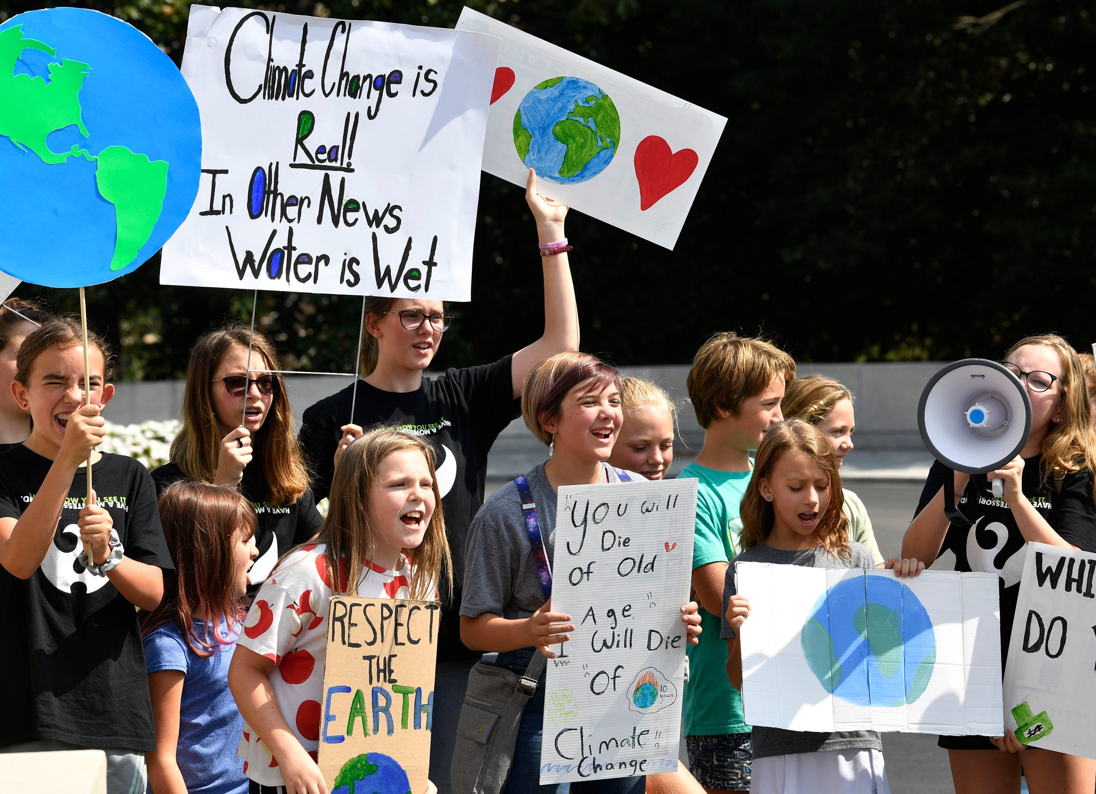
Nashville, Tennessee
September 20, 2019
Photo © 2019 Larry McCormack/The Tennessean
Notes:
ID #6671 - May be live-streamed, broadcast, and presented in-person, but may not be recorded or modified.
And the rising young generation, the Greta generation, they're leading the way. They are demanding a better world as they have a right to do.
DESCRIPTION: Photo of students participating in the Global Climate Strike at the Tennessee state capitol on September 20, 2019
ADDITIONAL TALKING POINTS:
The September 20, 2019 Global Climate Strikes brought out an estimated four million people in over 163 countries on all seven continents to more than 2,500 events. Inspired in part by Greta Thunberg’s school strike for climate, and organized by youth around the world, the September strikes were one of the largest youth-led demonstrations in history, and likely the largest ever demonstration for climate action.[1*][2*]
REFERENCES:
[1*] Eliza Barclay and Brian Resnick, “How big was the global climate strike? 4 million people, activists estimate,” Vox, last updated September 22, 2019. https://www.vox.com/energy-and-environment/2019/9/20/20876143/climate-strike-2019-september-20-crowd-estimate
[2*] Sarah Kaplan,, Lauren Lumpkin, and Brady Dennis, “'We will make them hear us’: Millions of youths around the world strike for action,” The Washington Post, September 20, 2019. https://www.washingtonpost.com/climate-environment/2019/09/20/millions-youth-around-world-are-striking-friday-climate-action/

Slide 23
HOW DO I KNOW WE WILL HAVE A CLEAN ENERGY FUTURE BY 2050?
And the market will drive it.
Notes:
197 countries have signed or acceded to the Paris agreement. Subsequently, the Trump administration announced its intention to withdraw

Slide 24
Conventional Energy Stocks Are the Worst Investments
“Energy has been…the worst performer since the U.S. bull stock market began more than a decade ago.”
– Reuters
S&P 500 Index
S&P 500
S&P 500 Energy Sector Index
Data: MarketWatch
Notes:
ID #6633 - Can be used in noncommercial online and TV broadcasts of your presentation, but not modified.
The market is also changing to help us in this journey. Here is the stock market going up, but here is the energy sector, the fossil fuels sector. They're bad investments now, and that word is getting out, and we're seeing a huge shift of assets toward the sustainability revolution.
During the 2020 pandemic, oil barrel prices went NEGATIVE. Oil tankers were piled up at sea, with no where to go!
DESCRIPTION: Graph comparing the S&P 500 and the S&P 500 Energy Sector Index from 2010 to 2020 with a quote from Reuters stating that, “Energy has been…the worst performer since the U.S. bull stock market began more than a decade ago.”
ADDITIONAL TALKING POINTS:
To meet the goals of the Paris Agreement, approximately half of gas reserves and more than 80 percent of proven coal reserves must stay in the ground.[1*]
The Social Cost of Carbon.[2*]
Mining, drilling, and burning fossil fuels like coal, oil, and natural gas are harming our environment and our health. We see the cost of carbon clearly in devastating impacts from extreme weather events like flooding and deadly storms to fast-spreading diseases to rising seas to ecosystem loss. What we don’t always see are the costs of the lingering aftermath and recovery from these disasters, such as increased health care expenses, destruction of property, increased food prices, and more.
The current estimate of the social cost of carbon is roughly $50 per ton, which many experts argue is far lower than the true cost of carbon pollution.
As the world moves fast to a low-carbon economy, investments in fossil fuels reaching into the trillions will become lost as stranded assets.
According to a 2018 study, up to $4 trillion worth of fossil fuel assets could be wiped off the global economy due to changes in technology, markets, and social habits.[1*]
Furthermore, there is a reputational risk for investors that their investment is not in line with global climate goals, which is a growing concern among many institutional investors around the world.[3*]
The CEO of the Colombian coal giant, Cerrejon, agrees that the coal industry is in terminal decline and prices continue to plunge.[4*]
Global investments in fossil fuels continued to rise in recent years, despite many of the world’s most prominent investors divesting from fossil fuels.
The International Energy Agency’s World Energy Investment 2020 report estimates that clean energy investment has been relatively resilient in the 2020 economic downturn. However, investments in renewables have been stagnant since 2015 and are far from the level needed for emissions reductions.[5*]
The energy return on investment (how much energy a source will produce compared to how much energy it takes to extract or develop the source) for fossil fuels is getting lower and lower, especially as easily accessible fossil fuel resources become exhausted. On the other hand, as renewable infrastructure is built out, the energy return on investment for renewable sources will likely increase, further building the case for increasing investment in renewables.[6*]
As of early 2020, nearly 1,200 institutions across world, representing over $14 trillion in assets under management, have pledged to divest from their investments in coal, oil, and gas companies.[7*]
REFERENCES:
[1*] Joel Makower, “The growing concern over stranded assets,” GreenBiz, September 10, 2019. https://www.greenbiz.com/article/growing-concern-over-stranded-assets
[2*] Environmental Defense Fund, “The true cost of carbon pollution,” last accessed July 7, 2020. https://www.edf.org/true-cost-carbon-pollution
[3*] Bill McKibben, “At last, divestment is hitting the fossil fuel industry where it hurts,” The Guardian, December 16, 2018. https://www.theguardian.com/commentisfree/2018/dec/16/divestment-fossil-fuel-industry-trillions-dollars-investments-carbon
[4*] Matthew Bristow, “One Coal CEO Sees Writing on Wall, Says Make Money While You Can,” Bloomberg, August 9, 2019. https://www.bloomberg.com/news/articles/2019-08-09/one-coal-ceo-sees-writing-on-wall-says-make-money-while-you-can
[5*] International Energy Agency, “World Energy Investment 2020,” May, 2020. https://www.iea.org/reports/world-energy-investment-2020
[6*] University of Leeds, "Fossil fuels increasingly offer a poor return on energy investment," July 11, 2019. https://www.sciencedaily.com/releases/2019/07/190711114846.htm
[7*] Fossil Free Divestment, “1000+ Divestment Commitments,” last accessed July, 2020. https://gofossilfree.org/divestment/commitments/
SLIDE SOURCE(S): https://www.reuters.com/article/us-usa-energy-stocks-analysis/no-ready-spark-seen-for-lagging-u-s-energy-shares-idUSKCN1VF0DU; marketwatch.com/investing/index/spx/charts; https://www.marketwatch.com/investing/index/sp500.10/charts?countrycode=xx

Slide 25
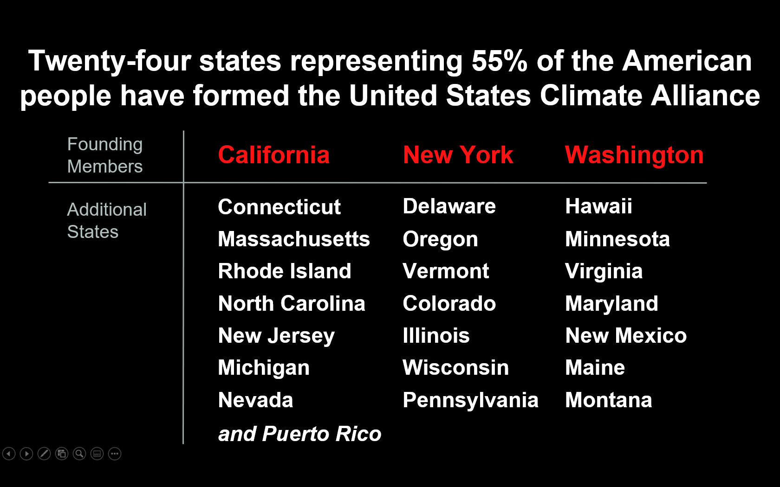

Slide 26
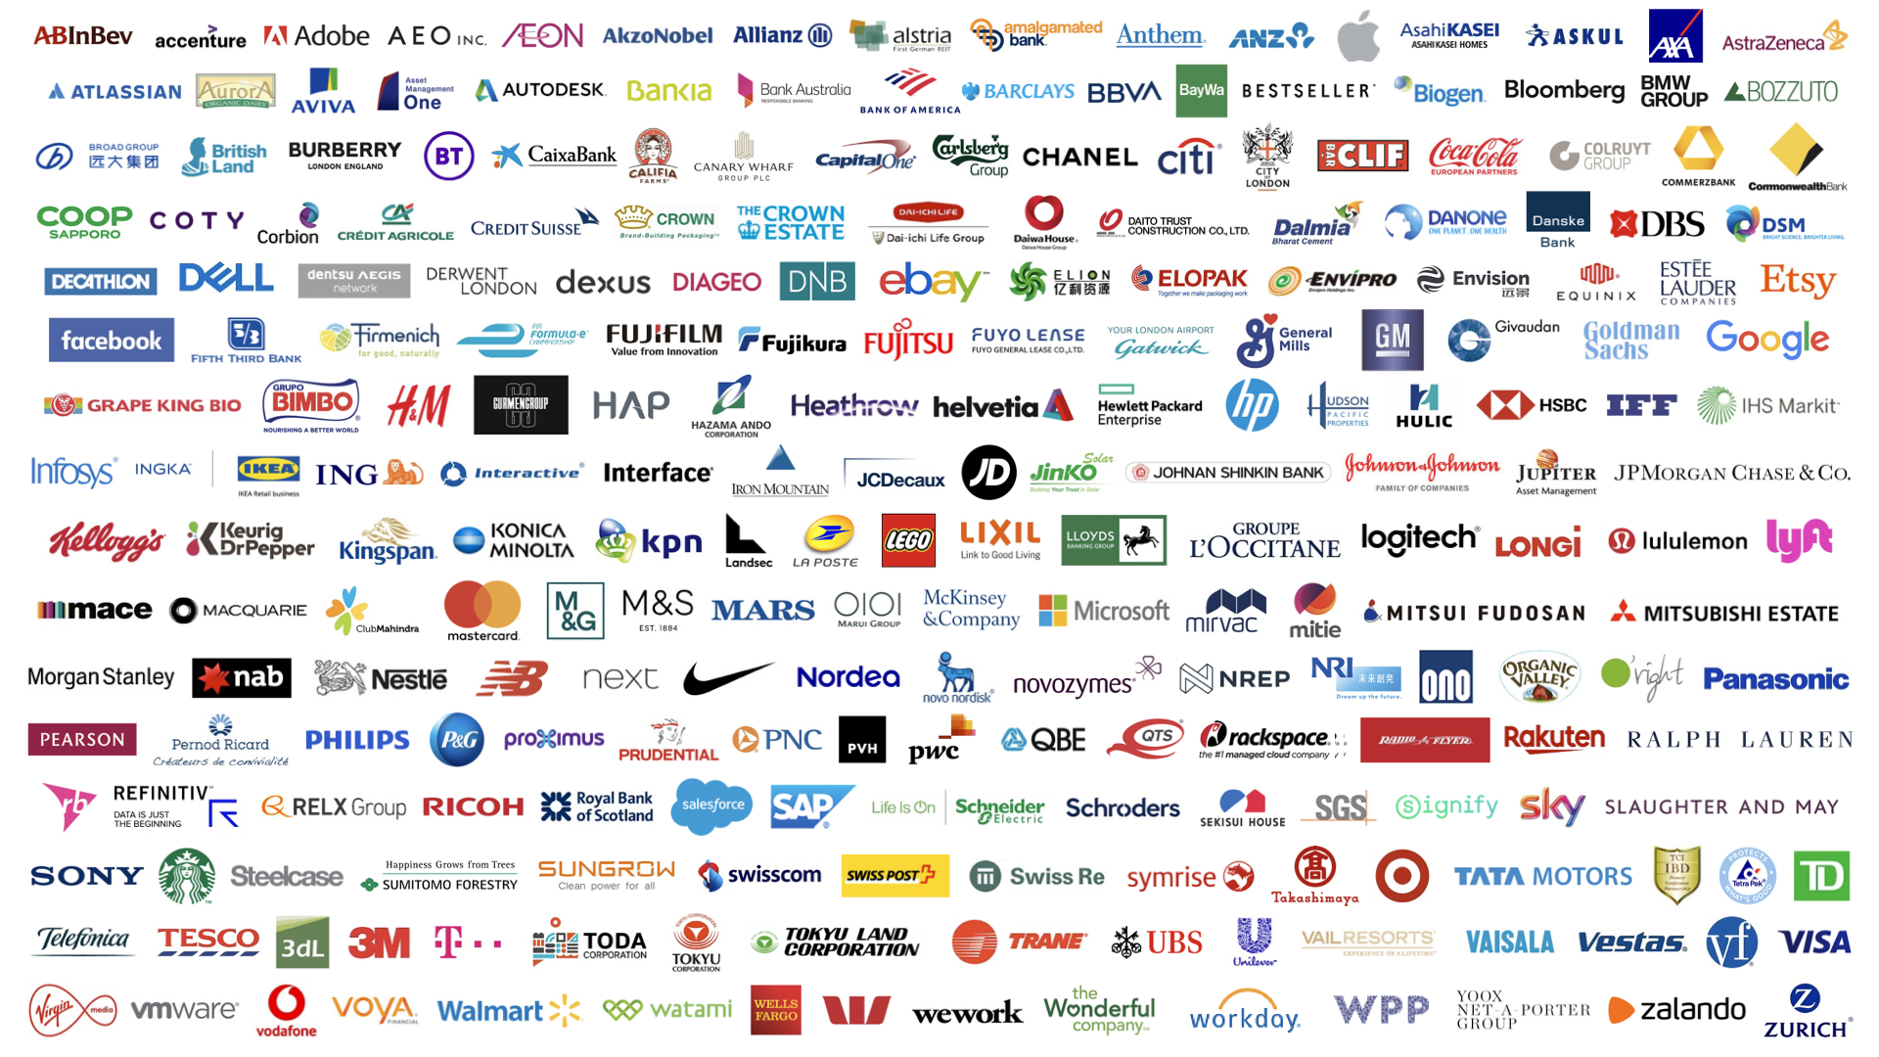
Over 240 global companies have made a commitment to go 100% renewable
Notes:
ID #5071.K - Can be used in noncommercial online and TV broadcasts of your presentation, but not modified.
And we're seeing businesses move. More than 240 global companies have pledged to go 100 percent renewable, and more companies are adding their names and pledges to this list every single day.
DESCRIPTION: Corporate logos with overlaid text stating that over 240 global companies have made a commitment to go 100-percent renewable
ADDITIONAL TALKING POINTS:
In the absence of climate leadership at the federal level, the United States is still moving forward with clean and renewable energy commitments.
The US made record investments in clean energy in the first three years of the Trump Administration. These increases were largely driven by investments in solar and wind due to their cost-competitiveness and an anticipated rollback of tax credits in 2020.[1*]
As of early 2020, over 150 US cities had made public commitments to transition to 100 percent renewable energy, and 15 states, along with Washington, DC and Puerto Rico, have publicly announced targets to source at least 50 percent of their electricity from clean energy.[2*]
The clean energy commitments of state and local governments, as well as those of businesses and utilities, could put these subnational US actors on track to reduce emissions 25 percent below 2005 levels by 2030.[2*]
Corporations are taking climate action through global sustainability initiatives like RE100 and the Science-Based Targets Initiative.
Corporations release an average of 31 gigatons of greenhouse gases globally each year – equivalent to the emissions from more than 8,000 coal power plants. Private sector engagement in climate change mitigation would make a significant difference in emissions while protecting $4 trillion in assets that will be at risk from climate change by 2030.[3*]
RE100 is a global corporate leadership initiative that brings together companies that have committed to sourcing 100 percent renewable electricity, either through the production or purchasing of renewable electricity.[4*] As of mid-2020, there are over 240 members in RE100.[5*] In 2018, one-in-three members were sourcing over 75 percent renewable electricity, and more than 30 members had already met their 100 percent goals.[4*]
Through the Science-Based Targets initiative, corporations must set clearly defined emissions reductions targets that are in line with the goals of the Paris Agreement. As of mid-2020, over 900 global companies were actively taking science-based climate actions and over 400 have committed to science-based emissions-reduction targets.[6*]
Power purchase agreements are tools corporations use to meet their renewable energy goals.
A power-purchase agreement (PPA) is a legal contract between an electricity generator (seller) and a power purchaser (buyer). PPAs can be used to finance implementation of renewable energy projects. PPAs facilitate the delivery of predictable, low-cost energy without large upfront costs.[7*]
Global corporate clean energy purchases reached a record high of 19.5 GW in 2019, more than triple the activity in 2017.[8*]
In the US, 13.6 GW of new clean energy purchase agreements were signed in 2019, more than all global activity in 2018.[8*]
REFERENCES:
[1*] Bloomberg New Energy Finance, “Late Surge in Offshore Wind Financings Helps 2019 Renewables Investment to Overtake 2018,” January 16, 2020. https://about.bnef.com/blog/late-surge-in-offshore-wind-financings-helps-2019-renewables-investment-to-overtake-2018/
[2*] Lacey Shaver, “Watch these four clean energy trends in U.S. cities” GreenBiz, February 13, 2020. https://www.greenbiz.com/article/watch-these-four-clean-energy-trends-us-cities
[3*] CDP Disclosure Insight Action, “Companies,” last accessed July, 2020. https://www.cdp.net/en/companies
[4*] RE100, “RE100 Progress and Insights Annual Report,” (December 2019).
https://www.theclimategroup.org/sites/default/files/dec_2019_re100_progress_and_insights_annual_report.pdf
[5*] RE100, “Companies,” last accessed July, 2020. http://there100.org/companies
[6*] Science Based Targets, “Companies taking action,” last accessed July, 2020. https://sciencebasedtargets.org/companies-taking-action/
[7*] Jesse Heibel and Jocelyn Durkay, “State Policies for Power Purchase Agreements,” National Conference of State Legislatures, July 10, 2015. http://www.ncsl.org/research/energy/state-policies-for-purchase-agreements.aspx
[8*] Bloomberg New Energy Finance, “Corporate Clean Energy Buying Leapt 44% in 2019, Sets New Record,” January 28, 2020.
https://about.bnef.com/blog/corporate-clean-energy-buying-leapt-44-in-2019-sets-new-record/
SLIDE SOURCE(S): http://there100.org/companies

Slide 27
New Jersey’s Clean Energy Initiatives
NJ 2019 Energy Master Plan: 100% Clean Energy by 2050
Rejoin Regional Greenhouse Gas Initiative (RGGI)
Join US Climate Alliance
Renewable Energy Law
  Renewable Energy Standard (graduated to 50% by 2030)
  Solar, Offshore Wind, Energy Efficiency, Energy Storage
  Energy Aggregation, Community Solar, EVs (330K by 2025; 2M by 2035)
2020 NJ Scientific Report on Climate Change (6/30/2020, NJ DEP - 205 pages)
Notes:
Gov Murphy Executive Order #28 on 5/23/2018: 50% renewable electricity by 2030 and 100% Clean Energy by 2050 –
rollout is being nailed down by 2019 Energy Master Plan, to be final by end of year.
We will have 3500 MW of Offshore Wind, new solar programs, Energy Storage AND
CLICK
RGGI provides carbon trading across east cost states. NJ is officially back in RGGI as of Jun 2019 and stands to benefit financially from credits that could be used for additional renewable projects.
BAN OFFSHORE DRILLING : we cant actually control drilling in Federal Waters (beyond 3 miles or so). BUT WE CAN and ARE PROHIBITING any use of land-based facilities – no ships, pipelines, etc.
12/18/2018 NJ joined with 9 other regional and mid-atlantic states in the “Transportation and Climate Initiative” (TCI) to within 1 year, define a low-carbon transportation policy

Slide 28
NJ Energy Master Plan (EMP) Strategies
Transportation
Renewable & Distributed Energy
Efficiency & Conservation
Buildings
Environmental Justice Communities
Modernize the Grid Infrastructure
Clean Energy Innovation Economy
Notes:
TONIGHT’s visioning focuses on these 5 strategies, found in the NJ 2019 Energy Master Plan.
We need YOUR visioning of what do you expect in an energy plan to enhance YOUR quality of life??
Following are examples of the 5 (These are also printed in front, above the white poster boards)

Slide 29
Integrated Energy Plan Cost Analysis
Consultant: Rocky Mountain Institute
Conclusion: Least cost scenario for reaching carbon neutral by 2050 would cost only a few % more than business as usual
  Assumes cost of renewable stays flat (and does not fall)
  Assumes price of fossil fuel stays flat (and does not rise)
  Assumes no new technology
  Does not count benefits of reduced emissions at all

Slide 30
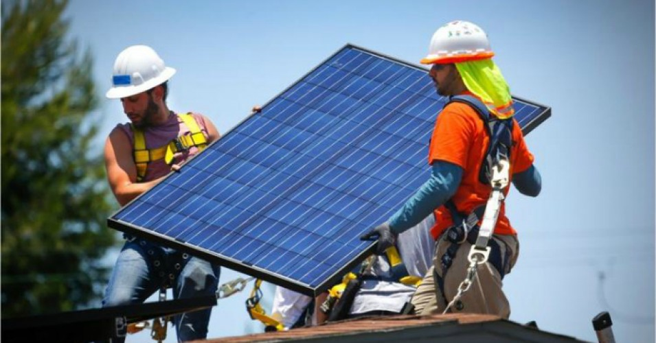
NJ Top 6 Solar States: Solar Panels on 2 Million Homes
Notes:
NJ has dropped a little, but remains #6 in the nation in rooftop solar.

Slide 31
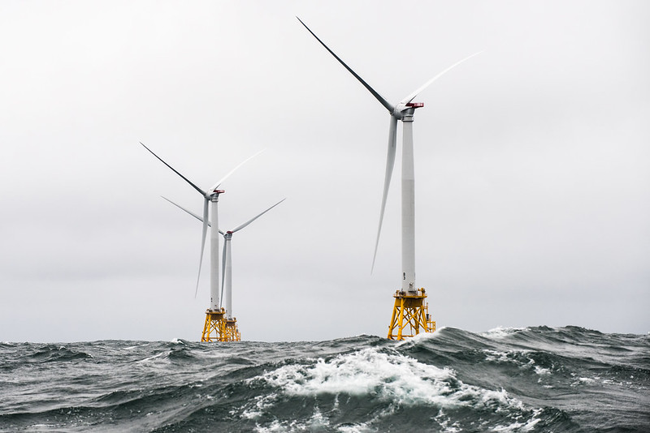
NJ has goal of 7,500 MW from offshore wind by 2035
Notes:
A number of world’s countries have demonstrated they can switch to 100% wind and solar. Read “NJ goal of 3500MW….”In fact, I read those offshore sites have potential for further future expansion by 3 or 4 times the wind power.

Slide 32
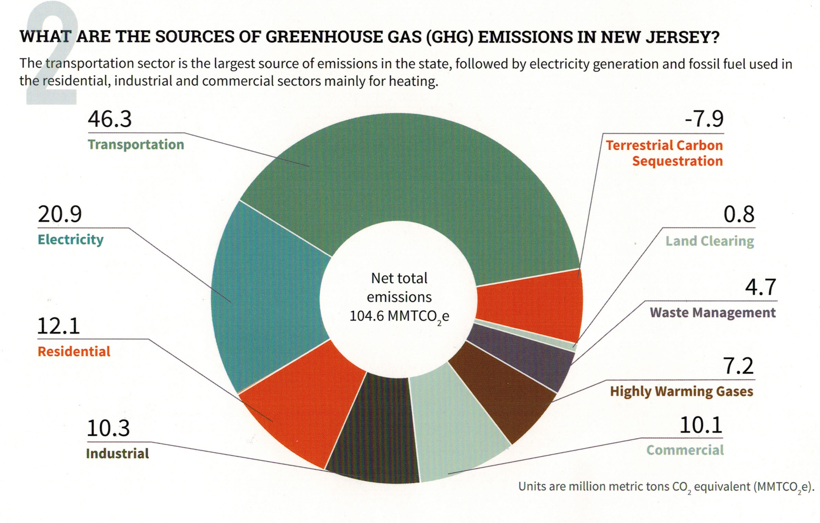
Your (Typical NJ) GHG Emissions EEEmissions
“Reducing NJ Greenhouse Gas Emissions”, Rutgers, Jan 2018
Notes:
This is the NJ “Footprint” of sources of world-heating Greenhouse gases, to show what to tackle first.
Sustainable Jersey states: “the primary goal [of “Gold Star in Energy” is reducing Green House Gases. Responding to this overarching imperative will help achieve all the other [sustainability] goals.”
20% of the GHG is from electricity generation; nearly 50% is from transportation.
Switching electricity to 100% wind/solar, then switching all vehicles to batteries charged by renewable electricity will ELIMINATE almost 70% of our GHG.
VERY IMPORTANT: -8% carbon sequestration by marshes, mudflats, trees, landscaping

Slide 33
Middletown 2020 Energy Plan Goals
Make Middletown 100% clean energy by 2050
  As per NJ Global Warming Response Act
  As per NJ Energy Master Plan
Achieve Sustainable Jersey Gold Star in Energy
Notes:
Edit to introduce Energy Plan.

Slide 34
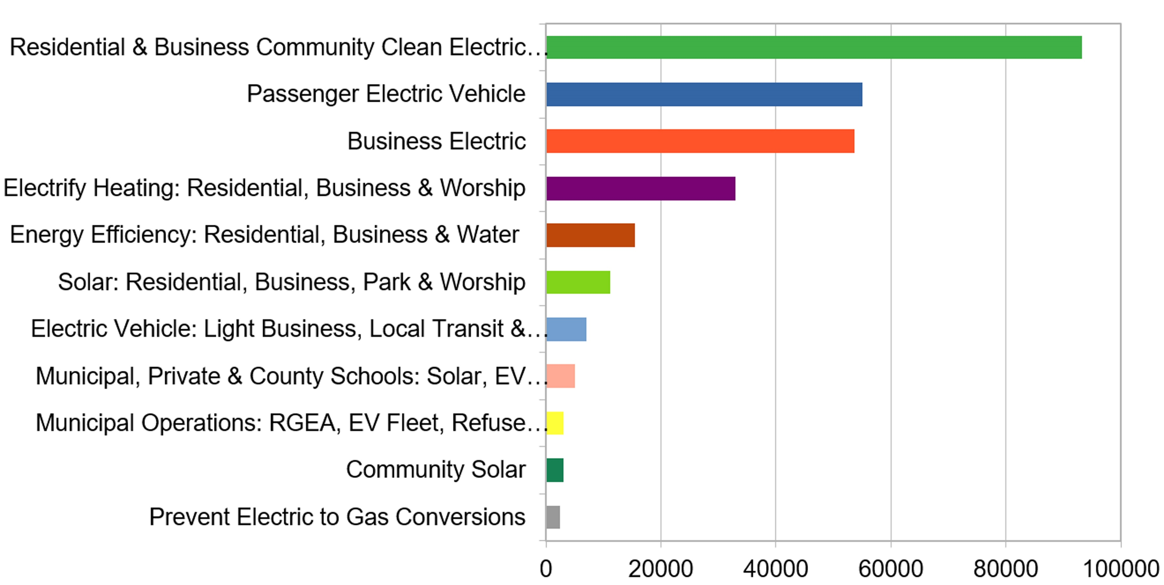
Middletown Energy Plan: GHG emission reductions during year 2030
In 2018, Middletown emissions were 705K Tons (CO2 equiv)- calculated per capita of NJ total
266K Tons TotAl CO2 (equivalent) reduction in year 2030
(38% reduction of 2018 Emissions)
Middletown Energy Plan https://bit.ly/2FZi0ti
Tons CO2 reduction in 2030
Notes:
Start with personal story [show grandkids photo]- I now have 2 grandsons- and want a better life for them. During a 9/15/2020 talk, Joseph Fiordliso, longtime President of the NJ Board of Public Utilities stressed that it is NOW OBVIOUS that our descendants’ lives will be affected by climate change- it will be a different, less friendly life for them.
ASSUMPTIONS on ACCEPTANCE RATES:
Residential (100%) & Business (10%) Community Choice Electric
Passenger Vehicles 25% are electric
Business Electric RPS + 10% for all not otherwise counted
Electrify heating 25%
savings in Energy Efficiency (10%) – consistent with projection from Middletown actual experience
Solar: (10% solar penetration) Residential, Business, park & worship
Delivery trucks ALREADY moving to EV Trucks
Municipal/private/schools: 25% area utilized for solar
Municipal operations: 25% conversations of vehicles to EV & buildings to electric heat

Slide 35
What Am I To Do?
Switch To Clean Electricity
Install rooftop solar
Switch to a 100% clean supplier http://electric.smiller.org
Invest in or subscribe to community solar
Ask your town to supply renewable community choice electrical aggregation
Notes:
You can switch to 100% clean electricity, AND save money, instead of defaulting to 20% clean electric from JCP&L.
Best investment: If you can SOON, pay cash to install rooftop solar.
OR (same GHG reduction): swtich to 100% clean supplier (spend 10 minutes, selecting vendor at URL)
OR – wait a couple of years for investors to build large array “Community Solar” fields – which should prove to be a GREAT investment for you
CLICK

Slide 36

Influence Your Town To Adopt Clean Energy
FLORIDA
Notes:
AND/OR – JOIN WITH OTHERS and push for your town to switch ALL residents to 100% renewable Community Choice Electric aggregation. This saves 5 or 10% on electric bill, and has the BIGGEST GHG reduction!

Slide 37

New Jersey Renewable Government Energy (Electric) Aggregation (R-GEA) for Community
Also called Community Choice Aggregation
Most effective carbon reduction action: accounts for 40% of potential savings of first decade actions
Provides cost savings to residents; low or no cost to Township
Notes:
For last 3 years, I have maintained a price-ranked list of 3rd party suppliers of renewable electricity

Slide 38
Switch To Plug-in Electric Vehicle (EV)
Plug Into Your Clean Electricity
Save On Fuel Costs (~30-70% more efficient)
Save On Car Maintenance
Notes:
MAKE YOUR NEXT CAR A PLUG-IN EV!
Save money, and stop the world from continued heating that will severely degrade your own, and descendants’ quality of life

Slide 39
OTHER CHANGES WE WILL SEE IN 2050
Building standards to require net-zero emissions, net-zero waste, net-zero water, rooftop solar (where practical)
Heating and appliances all electric; no gas furnaces, hot water heaters, stoves, or dryers
Electric grid upgraded for reliability and smart metering
EV charging stations replace gas stations; or exchangeable batteries
Diets will be more local and plant-rich, and less animal-based or factory farmed
Notes:
BY 2050:
Highly energy efficient NETZERO building standards will be the norm.
FOSSIL FUELS are almost totally abandoned.
The world’s electric grids are upgraded for the high electrical loads
GAS STATIONS ARE NON-EXISTENT.
In Maryland, the 1st First US gas station just dumped the pumps & installed EV Chargers
Our plastic mess is gone
We are moving to a plant-based healthy diet.
We MUST make these changes to save lives.
If we wait, the solutions become ever more costly

Slide 40
Speak up, act, and vote
Like your world depends on it
Notes:
ID #6251 - Can be used in noncommercial online and TV broadcasts of your presentation, but not modified.
Become a part of this movement to speak truth to power. Do it like your world depends on it…
DESCRIPTION: Text slide encouraging the audience to speak truth to power - like your world depends on it

Slide 41

Your world depends on it.
Source: NASA
Notes:
ID #5132 - Can be used in noncommercial online and TV broadcasts of your presentation.
…because, after all, your world does depend on it. Thank you.
DESCRIPTION: Photo of the Earth with text stating that your world depends on it

