Slide 1
New Jersey Renewable
Government Energy Aggregation (R-GEA)
(Applies only to Electric Aggregation)
Also known generically as
Community Choice Aggregation
Sept 18, 2019 Mayor Tony Perry

Slide 2
R-GEA Benefits
Government Energy Aggregation (GEA) allows municipalities to purchase electricity on behalf of their residents. R-GEAs are aggregations with increased renewable content.
The combined purchase power of residents means better pricing and a higher percentage of renewables.
R-GEA contracts are subject to several layers of consumer protection, including review by the New Jersey Board of Public Utilities and the municipal attorney.
Notes:
Slides from Tracey Woods, Sustainable Jersey, 2019-9-17

Slide 3
Renewable Government Energy Aggregation (R-GEA)
Sustainable Jersey Points Available
5 points: Pass an ordinance and engage an energy consultant, plus
30 points: R-GEA with renewable content at least 10% above the prevailing NJ Renewable Portfolio Standard (RPS), with all the renewable supply coming from Class 1 resources located within PJM*.
Or 45 points: R-GEA with renewable content at least 20% above the prevailing NJ RPS, with all the renewable supply coming from Class 1 resources located within PJM*.
*PJM provides wholesale electricity in eastern US
Notes:
Slides from Tracey Woods, Sustainable Jersey, 2019-9-17

Slide 4
“This action is for towns…to make renewable energy available to its residents and businesses, above and beyond any value the GEA framework may provide for cost savings and consumer protection. It is….suitable for communities (and their leaders) that are proactively committed to increased renewable energy use.”
SUSTAINABLE JERSEY RENEWABLE ENERGY AGGREGATION
Source: Sustainable Jersey “Renewable Government Energy Aggregation (R-GEA)”, March, 2019

Slide 5

Renewable Community Electric Aggregation
Towns That Have Contracted Jun2019-June2020
CITY | RENEWABLE CONTENT | RESIDENT SAVINGS
Essex Hub: South Orange, Glen Ridge, Maplewood, Montclair, Verona (PSE&G) | 41% | 10%
West Orange (PSE&G) | 100% | 5%
Glen Rock (PSE&G) | 100% | 8%
New Brunswick (PSE&G) | 2 options: 50% 100% | 10% 5%
Livingston: 2 (PSE&G) territories (JCP&L) | 100% ($.113/kwh) 41% ($.090/kwh) | $165 annual avg. 8%
Plainsboro (PSE&G) | 41% | $140 annual avg.
Red Bank (JCP&L) | TBD | TBD
Piscataway (PSE&G) | TBD | TBD
Princeton (PSE&G | 50% 100% | 3.4% 1.1% premium
Notes:
Edit to introduce Energy Plan.

Slide 6
The price of renewable is steadily decreasing. It is now cheaper than fossil fuel and will continue to drop.
Capacity is increasing exponentially.
Notes:
Cost of renewable energy will continue to drop.
By contrast, the wholesale cost of NJ electricity continues to rise ~0.4 cents/kwh per year:
Final bids, for wholesale JCP&L electricity in the yearly February “BGS-RSCP” auctions (BPU requires the consumer prices to be averaged over 3 years):
2019: 7.715 cent/kwh
2018: 7.311 cents/kwh
2017: 6.908 cents/kwh
SOURCES: BPU “BGS Auctions” (published by NJ BPU after each annual auction)

Slide 7
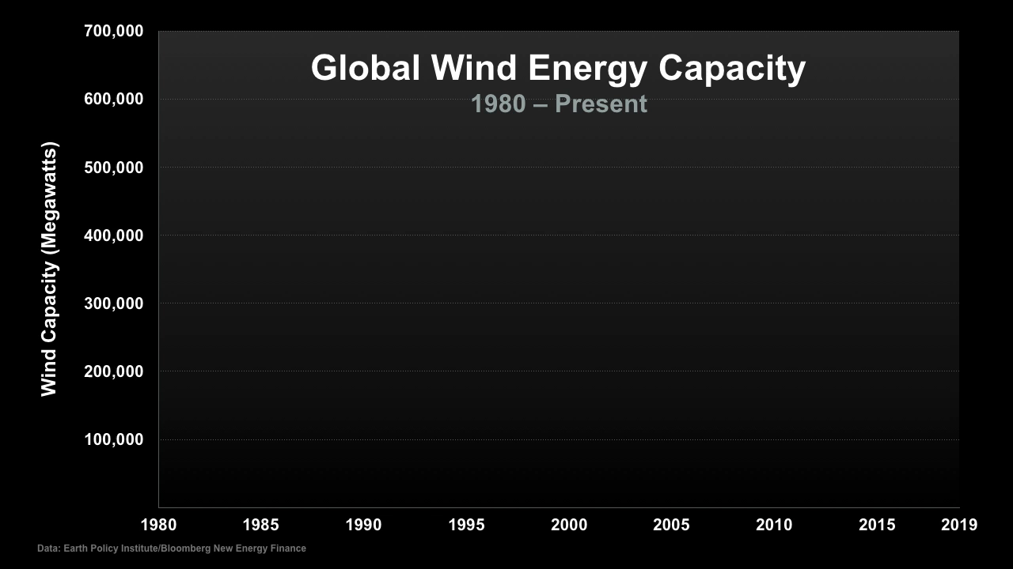
Notes:
This Truth in Ten slide deck is available to the public, not just Climate Reality Leaders, to be used in noncommercial, nonpromotional presentations broadcast on TV, streamed online, and in-person, but this slide may not be modified.
TALKING POINTS:
The growth in wind energy being built around the world is an exponential curve.

Slide 8
Onshore Wind Cost
1984 – 2014
1984
1990
Euros Per Megawatt Hour
2000
2004
2014
Megawatts Deployed
Data: Bloomberg New Energy Finance
Notes:
ID #3727 - Can be used in noncommercial online and TV broadcasts of your presentation, but not modified.
DESCRIPTION: Graph showing how the levelized cost of onshore wind power technologies (in Euros per megawatt-hour) has decreased over time as the amount of megawatts deployed has increased, 1984-2014
ADDITIONAL TALKING POINTS:
With demand for electricity growing and the climate crisis deepening, the world needs a viable, cost-competitive replacement for dirty fossil fuels. Wind energy can be an excellent alternative, powering our lives without destroying our planet. [1*]
The world has the wind energy potential to supply global electricity demand more than 40 times over.[2*]
Minnesota has the wind energy potential to supply the state’s energy needs almost 23 times over (in 2017).[3*]
Despite this incredible potential, wind generated only 18 percent of Minnesota’s electricity in 2018.[4*]
Minnesota spends $13 billion importing fossil fuels into the state each year, which could be greatly reduced with greater use of wind.[5*]
Government-funded research and development together with tax incentives brought significant improvements to wind turbine technology. Now the private sector can build on this progress.[6*]
The Renewable Electricity Production Tax Credit and the Business Energy Investment Tax Credit were both pivotal in reducing investment costs and beginning renewable energy projects. Both tax credits are in the middle of being phased-down.[7*]
Between 2008 and 2018, the US Department of Agriculture awarded $545 million for 8,800 renewable energy projects. 7*]
By the end of 2018, Minnesota already reached its renewable energy standard goal of 25 percent by 2025 using wind, solar, biomass, and hydro. The state is on pace to reach its solar electricity standard of 1.5 percent by the end of 2020.[8*]
Rapidly falling costs and continued tax incentives helped wind energy blow away early projections – and it’s continuing to grow at a rapid pace. [9*]
In 2000, the International Energy Agency projected global wind capacity would reach 30 gigawatts (GW) by 2010.
Instead, by 2010, global wind capacity had reached 200 GW.[9*]
Without subsidies, new wind projects in Minnesota are cost competitive with combined-cycle natural gas plants. With federal subsidies, wind is the cheapest source of new generation in Minnesota.[10*]
In 2018, Minnesota ranked seventh in the nation in installed wind capacity.[11*]
As of the first quarter of 2019, Minnesota has 3,845 MW of wind capacity installed, with 500 MW of wind capacity under construction enough to power well over 53,000 homes.[11*]
Expanding wind energy will help bring abundant and affordable clean energy and good jobs to people across the globe for years to come.
Two-thirds of the global population live in countries where wind and solar are the cheapest sources of electricity generation.[12*]
In 2018, global wind power capacity reached almost 600 GW, exceeding the IEA capacity prediction for 2010 by a factor of 20.[13*]
By 2040, wind power is estimated to draw $3.3 trillion in investment and see a fourfold increase in capacity.[14*]
Wind and solar could provide 70 percent of electricity in Minnesota by 2050 at prices comparable to natural gas generation.[15*]
REFERENCES:
[1*] Stephen Leahy, “Earth Will Likely Be Much Warmer in 2100 Than We Anticipated, Scientists Warn,” Vice, December 6, 2017. https://www.vice.com/en_us/article/xwvx5q/earth-will-likely-be-much-warmer-in-2100-ipcc-projections
[2*] Xi Lua, Michael B. McElroya, and Juha Kiviluoma, “Global Potential for Wind-Generated Electricity,” Proceedings of the National Academy of Sciences of the United States of America 106, No. 27 (July 7, 2009): 10933-10938. http://www.pnas.org/content/106/27/10933.full.pdf
[3*] National Renewable Energy Laboratory, “Renewable Energy Technical Potential,” last accessed June 2019. https://www.nrel.gov/docs/fy12osti/51946.pdf
[4*] American Wind Energy Association, “Wind Energy In Minnesota,” (2018). https://www.awea.org/Awea/media/Resources/StateFactSheets/Minnesota.pdf
[5*] Minnesota Environmental Quality Board, “Minnesota’s Energy,” last accessed May 1, 2019. https://www.mcknight.org/wp-content/uploads/McKnight_ClimateChangeMaster_MNsEnergy.pdf
[6*] U.S. Department of Energy, “Next-Generation Wind Technology,” last accessed July 17, 2019. https://www.energy.gov/eere/next-generation-wind-technology
[7*] U.S. Department of Energy, “Advancing the Growth of the U.S. Wind Industry: Federal Incentives, Funding, and Partnership Opportunities,” (February 2017). https://www.energy.gov/sites/prod/files/2017/02/f34/67742_0.pdf
[8*] Ines Kagubare, “Minnesota Is on Track to Meet Its Renewable Energy Goals,” E&E News, November 19, 2018. https://www.scientificamerican.com/article/minnesota-is-on-track-to-meet-its-renewable-energy-goals/
[9*] David Roberts, “Why do ‘experts’ always lowball clean energy projections?," Grist, July 9, 2012. http://grist.org/renewable-energy/experts-in-2000-lowballed-the-crap-out-of-renewable-energy-growth/
[10*] BloombergNEF, “State energy factsheet: Minnesota,” March 11, 2019. https://www.bcse.org/images/2019%20Factbook/BNEF%20Minnesota%20State%20Energy%20Factsheet%203%2011%2019.pdf
[11*] American Wind Energy Association, “Wind Energy In Minnesota,” (2018). https://www.awea.org/Awea/media/Resources/StateFactSheets/Minnesota.pdf; 2019. Mn.Gov. Accessed July 23 2019. http://mn.gov/commerce-stat/pdfs/MN714MW.pdf
[12*] BloombergNEF, “New Energy Outlook 2019,” (2019). https://bnef.turtl.co/story/neo2019?teaser=true
[13*] World Wind Energy Association, “Statistics: Wind Power Capacity Worldwide Reaches 600 GW, 53,9 GW added in 2018,” last updated February 25, 2019. http://wwindea.org/information-2/information/ ; David Roberts, “Why do ‘experts’ always lowball clean energy projections?," Grist, July 9, 2012. http://grist.org/renewable-energy/experts-in-2000-lowballed-the-crap-out-of-renewable-energy-growth/
[14*] Bloomberg New Energy Finance, “Global wind and solar costs to fall even faster, while coal fades even in China and India,” June 15, 2017. https://about.bnef.com/blog/global-wind-solar-costs-fall-even-faster-coal-fades-even-china-india/
[15*] Ines Kagubare, “Minnesota Is on Track to Meet Its Renewable Energy Goals,” E&E News, November 19, 2018. https://www.scientificamerican.com/article/minnesota-is-on-track-to-meet-its-renewable-energy-goals/

Slide 9
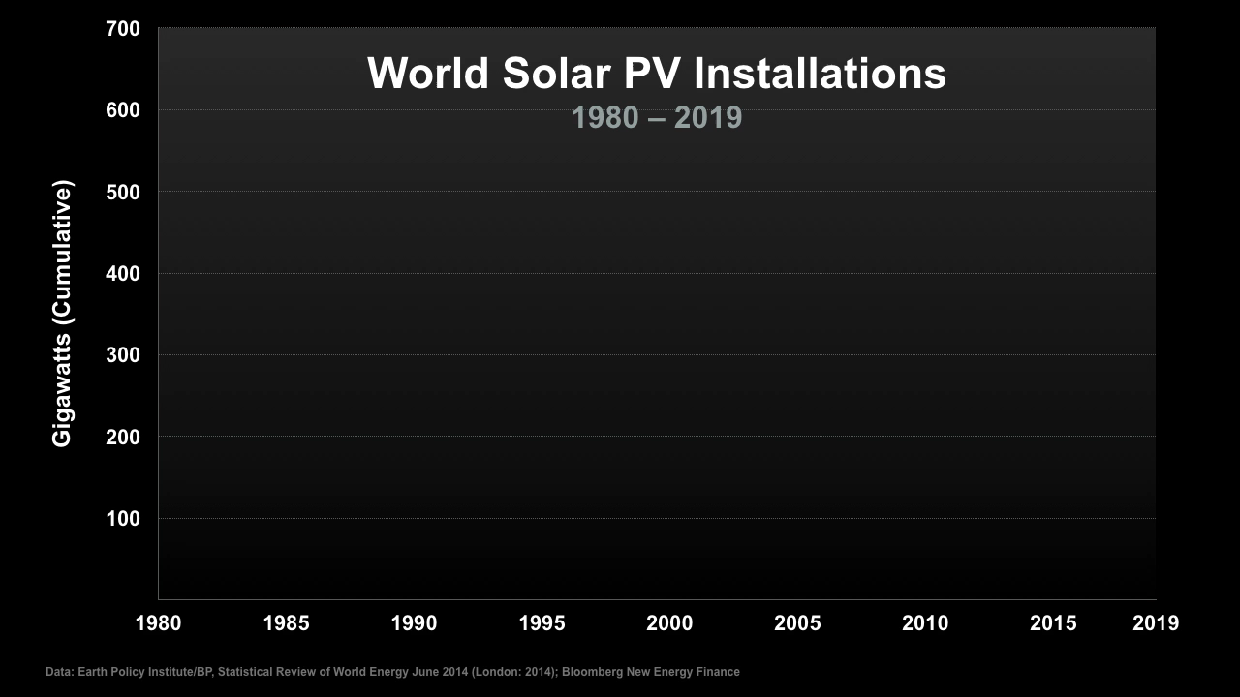
Notes:
This Truth in Ten slide deck is available to the public, not just Climate Reality Leaders, to be used in noncommercial, nonpromotional presentations broadcast on TV, streamed online, and in-person, but this slide may not be modified.
TALKING POINTS:
Even more dramatically than with wind, we see an exponential curve in the amount of solar energy installed around the world.

Slide 10
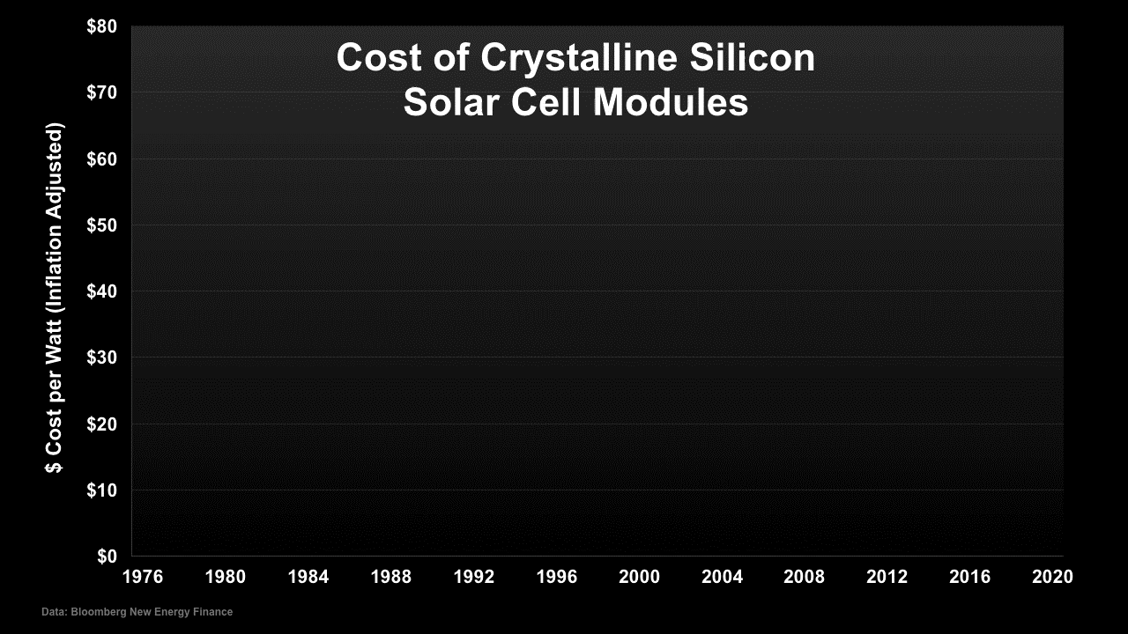
Notes:
This Truth in Ten slide deck is available to the public, not just Climate Reality Leaders, to be used in noncommercial, nonpromotional presentations broadcast on TV, streamed online, and in-person, but this slide may not be modified.
TALKING POINTS:
Just as we have seen with other technologies, such as computer chips and cell phones, solar costs have fallen dramatically. In some regions, solar energy is less than half the cost of electricity from burning coal.

Slide 11
Levelized Cost of Energy in the U.S.
Levelized Cost ($/MWh)
Conventional
Renewable
Nuclear
Coal
Gas Combined Cycle
Solar PV –
Utility Scale
Wind – Onshore
Data: Nov 2018 Lazard, Lazard's Levelized Cost of Energy Analysis v.10.0; Energy Innovation Policy & Technology, LLC
Notes:
ID #4697.D - Can be used in noncommercial online and TV broadcasts of your presentation, but not modified.
DESCRIPTION: Graph comparing the unsubsidized levelized cost of renewables and conventional energy sources in the US in dollars per megawatt-hour
ADDITIONAL TALKING POINTS: “Levelized cost of electricity” is often cited as a convenient summary measure of the overall competitiveness of different generating technologies. It represents the per kilowatt-hour (or megawatt-hour) cost in discounted real dollars of building and operating a generating plant over an assumed financial life and duty cycle.[1*]
According to a November 2018 report by the financial advisory and asset management firm, Lazard, wind power costs have dropped 68 percent between 2009-2018. The cost of large-scale solar showed an even more substantial decline, dropping 88 percent during the same time period.[2*] Lazard concluded the report by saying “we find that Alternative Energy technologies are complementary to conventional generation technologies, and believe that their use will be increasingly prevalent for a variety of reasons, including renewable energy portfolio standard requirements, carbon regulations, continually improving economics as underlying technologies improve and production volumes increase, and government subsidies in certain regions.”[2*]
REFERENCES:
[1*] US Energy Information Administration, “Levelized Cost and Levelized Avoided Cost of New Generation Resources in the Annual Energy Outlook 2017” (April 2017). https://www.eia.gov/outlooks/aeo/pdf/electricity_generation.pdf
[2*] Lazard, “Lazard’s Levelized Cost of Energy Analysis- Version 12.0” (November 2018). https://www.lazard.com/media/450784/lazards-levelized-cost-of-energy-version-120-vfinal.pdf

Slide 12
CARBON REDUCTION FROM 100% RENEWABLE AGGREGATION IN MIDDLETOWN
81K TONS OF CARBON ANNUALLY
from Middletown Residential electricity consumption
(Equiv to emissions from 16,000 cars and light trucks)
CALCULATION:
              8902* KWH consumption per NJ household per year
              0.758** pounds of carbon per KWH
              3.4 tons*** emitted per household per year
              23962 households in Middletown
* New Jersey: https://www.eia.gov/consumption/residential/reports/2009/state_briefs/pdf/nj.pdf Middletown usage may vary, e.g. based on climate, house size, insulation, and windows, appliance age & size, lighting types, personal habits, future EV usage, etc.
** https://www.epa.gov/sites/production/files/2018-02/documents/egrid2016_summarytables.pdf
*** North American “short ton”
Notes:
Calculation by Bob Erickson, Middletown for Clean Energy for use in our spreadsheet for prioritizing Actions in Middletowns Energy Plan.
For comparison, 81K tons/year is equivalent to removing 16,000 cars and light trucks from Middletown’s roads (using EPA averages)
Basis: EPA reports 4.7 metric tons/year CO2 (equiv) emissions for an average car and light truck (1 metric ton =1.1 ton)
Source: https://www.epa.gov/energy/greenhouse-gases-equivalencies-calculator-calculations-and-references
Bob is busy looking at about 60 energy actions and creating a spreadsheet structure that will allow us to prioritize

Slide 13
“Today more than two-thirds of the global population lives in countries where solar and wind are the cheapest sources of new bulk generation.”
Bloomberg New Energy Finance
  New Energy Outlook 2019
Notes:
ID #6155 - Can be used in noncommercial online and TV broadcasts of your presentation, but not modified.
Two-thirds of all the people in the world now live in regions where the cheapest forms of electricity are solar and wind. And since the cost of solar and wind electricity continues to go down significantly year after year, month after month, we will soon be at nearly 100 percent of all the people in the world being able to turn to renewables as the cheapest form of electricity.
DESCRIPTION: Text stating that today more than two-thirds of the global population lives in countries where solar and wind are the cheapest sources of new bulk generation
ADDITIONAL TALKING POINTS: Onshore wind and solar PV global weighted average cost decreased 13 percent in 2018 and the trend is expected to continue in the following years. Among projects to be commissioned in 2020, 77 percent of onshore wind and 83 percent of utility-scale solar PV in IRENA’s Database will offer electricity prices lower than the cheapest fossil-fuel powered new generation.[2*] By 2030, new wind and solar will be cheaper than almost all running coal and gas plants. Increasing cost-competitiveness of renewable energy will reshape electricity generation systems[1*]
REFERENCES:
[1*] Bloomberg NEF, New Energy Outlook 2019 (2019) https://bnef.turtl.co/story/neo2019?teaser=true
[2*] IRENA, Renewable Power Generation Costs In 2018 (2019) https://www.irena.org/publications/2019/May/Renewable-power-generation-costs-in-2018

Slide 14
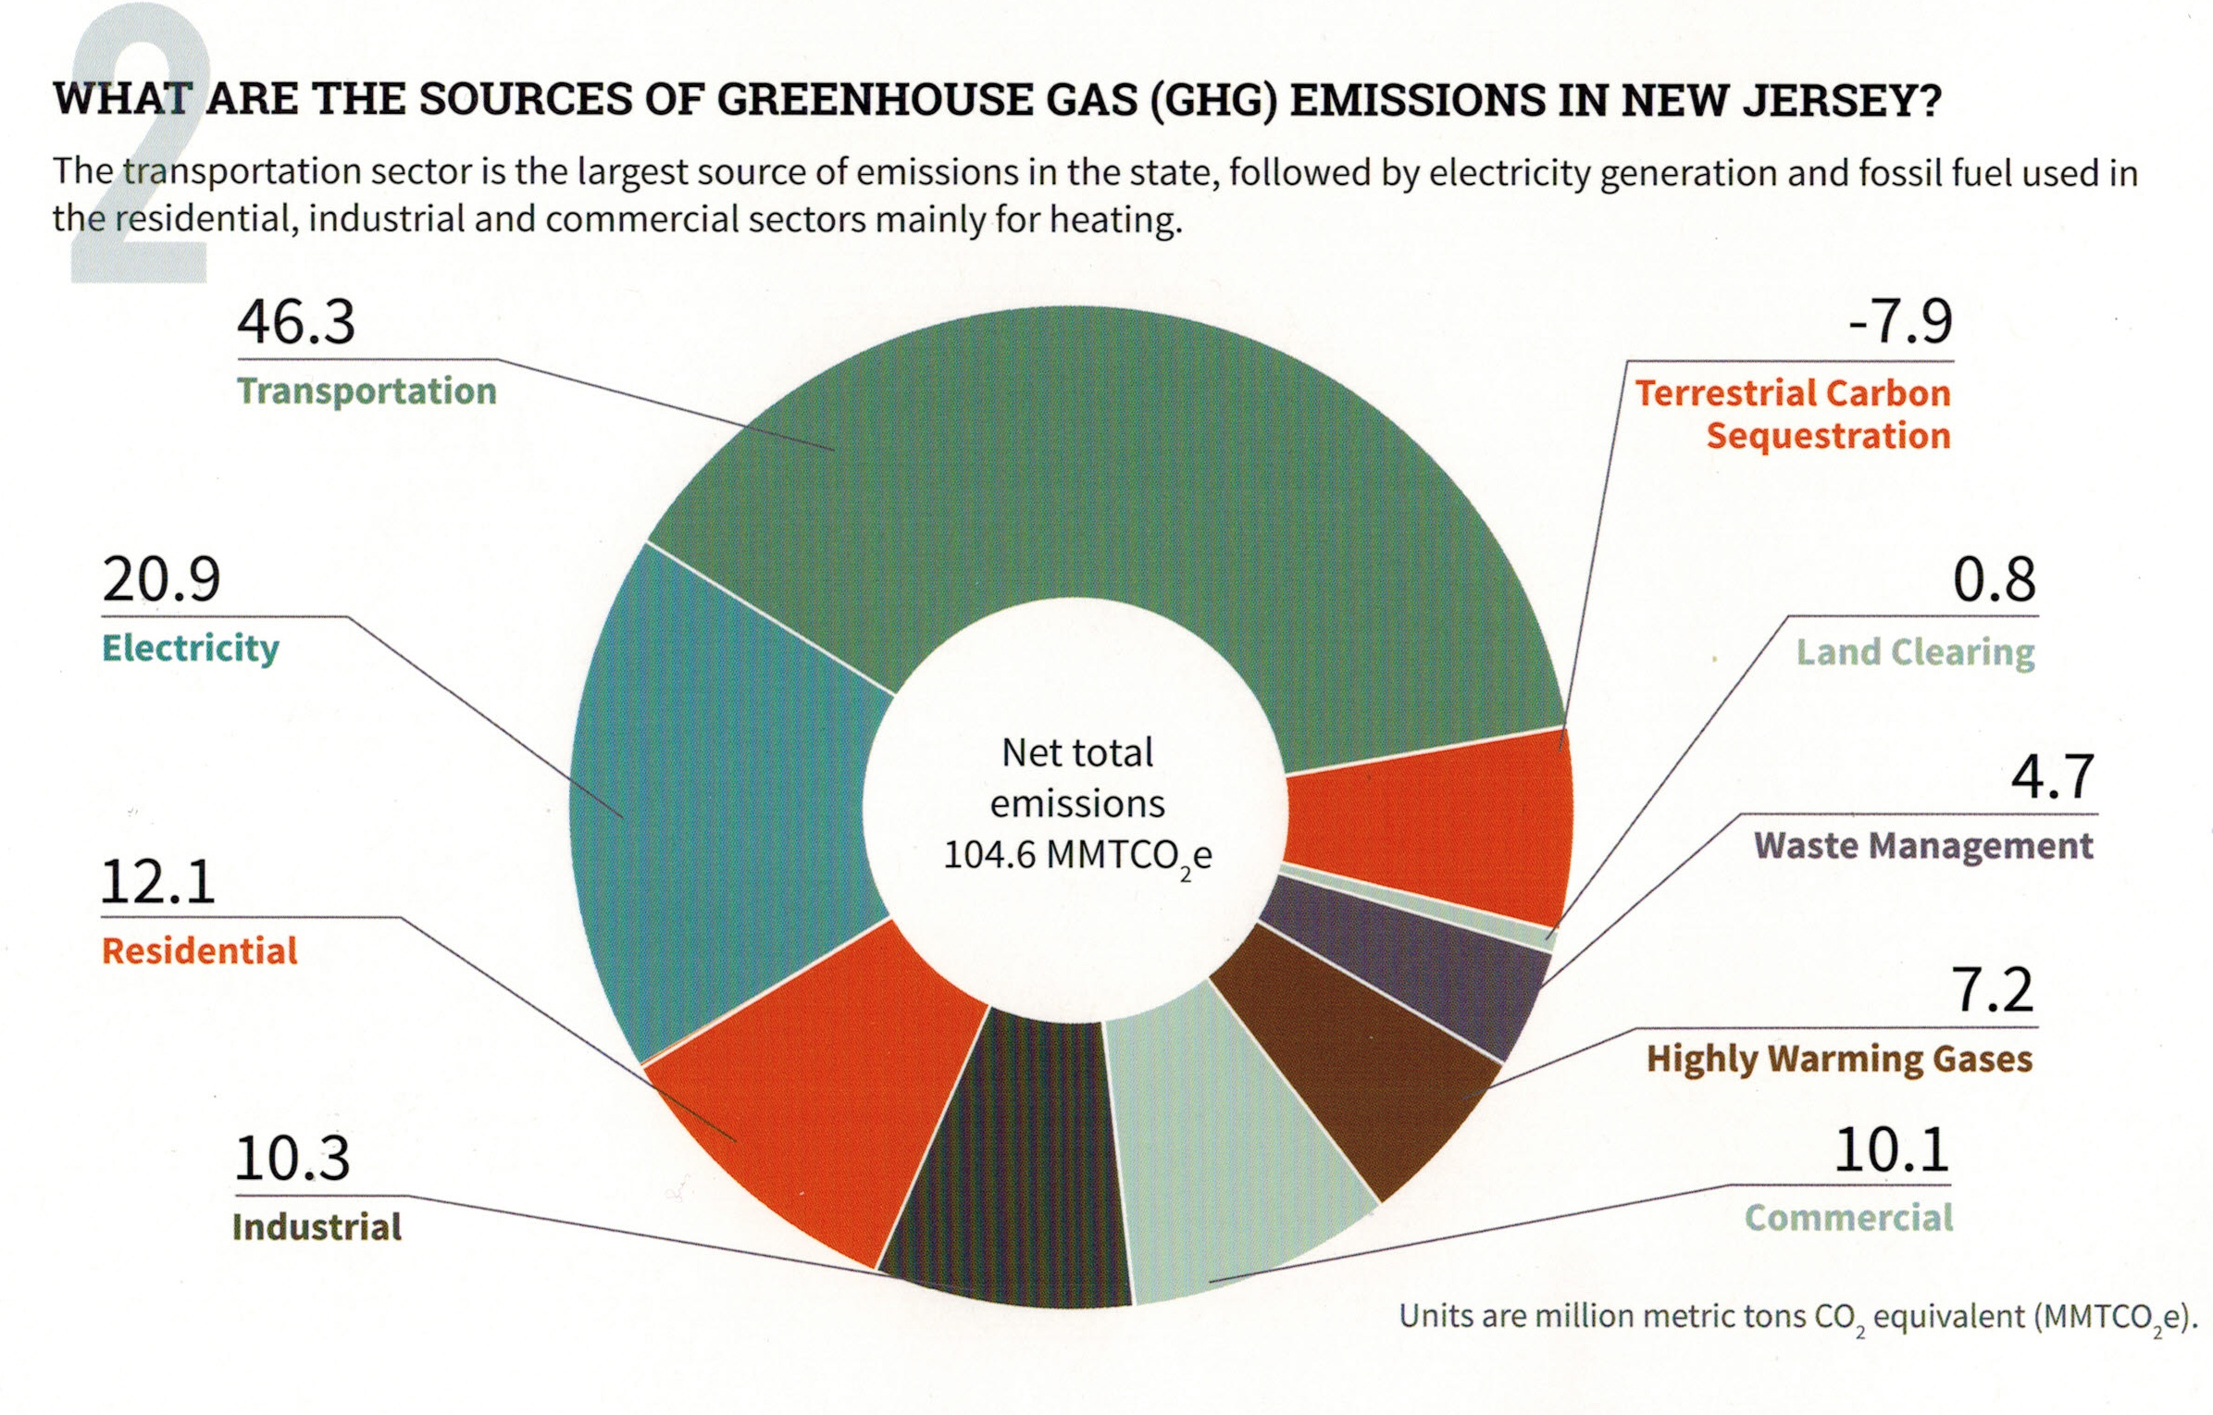
Typical NJ GHG Emissions
“Reducing NJ Greenhouse Gas Emissions”, Rutgers, Jan 2018
Notes:
Rutgers, “Reducing NJ Greenhouse Gas Emissions, Jan, 2018

Slide 15
Powertrain Cost Comparison
600kWh / 500km Range Without Subsidies
Mainstream Battery-Electric cars are projected to achieve cost parity with efficient fossil fuel cars in 2023-24.
Mainstream Battery-Electric Cars
Powertrain Cost ($ US)
Efficient Fossil Fuel-Powered Cars
Data: Bernstein, September 2017
Notes:
ID #5047 - Can be used in noncommercial online and TV broadcasts of your presentation, but not modified.
The powertrain, which is the most expensive part of these vehicles, is going to be cheaper in an electric vehicle than in an internal combustion engine vehicle by next year or the year after, maybe two years from now.
DESCRIPTION: Graph showing powertrain costs for mainstream battery-electric cars and efficient fossil-fuel powered cards between 2012-2034, with cost parity occurring around 2023-2024
ADDITIONAL TALKING POINTS:
The transportation sector is the second-largest source of global greenhouse gas emissions. To slash emissions and avert catastrophic climate change, we need to transition to cleaner transportation alternatives.[1*]
The danger goes beyond climate impacts: Air pollution from vehicle emissions increases the risk of cancer and respiratory issues like asthma and bronchitis.[2*]
Vehicle emissions contribute to roughly 150 million Americans living in areas that don’t meet federal air quality standards.[2*]
Globally, air pollution from vehicle emissions and other sources contributes to about 8.8 million additional deaths every year.[3*]
It took five years to sell the first million electric passenger cars, 17 months to sell the second million, and just six months to get from 3 million to 4 million. [4*]
Though the total volume of electric vehicles (EVs) is still low compared to traditional gas-powered vehicles, EV adoption is skyrocketing – with global sales growing by 70 percent in 2018. [5*]
Much of the recent growth, especially in the US, has been due to the mass production of the Tesla Model 3, which was the highest selling EV globally in 2018 – making up 7 percent of the global plug-in vehicle market. [6*]
Between 2010–2018, the price of lithium-ion batteries fell by 85 percent. With battery packs typically accounting for about one-third of vehicle costs, the price of EVs is getting closer and closer to traditional car prices.[7*]
A 2019 Bloomberg New Energy Finance Outlook report found that the cost of EVs is expected to be equal to that of internal combustion vehicles by the mid-2020s.[8*]
When the first mass-market EVs were introduced in 2010, the average cost of a battery pack was $1,000 per kWh. Falling costs meant that in 2017, Tesla’s Model 3 battery packs were only $190 per kWh.[9*]
The price of battery packs is expected to fall to an estimated $73 per kWh by 2030, as manufacturing methods and materials improve.[9*]
Financial incentives have helped to bridge the gap to make EVs cost-competitive.[10*]
Each of the top 10 countries for electric car registrations has some type of financial incentive in place.[10*]
China, the world’s largest market for electric cars, employs regulatory and purchase incentives which, together, led to nearly 800,000 electric vehicle registrations in 2018.[10*]
Germany, UK, Italy, and Romania all offer purchase incentives for electric vehicles. Whereas, the United States, Norway, and the Netherlands offer tax bonuses, and France offers a combination purchase incentive and scrappage bonus for older non-EVs.[10*]
With the climate crisis deepening and viable alternatives to gas vehicles increasing, a growing number of countries are planning to phase out combustion engines. Many major auto manufacturers are also developing plans to phase out traditional vehicles and transition to entirely electric lineups.[11*]
Countries like China, India, Great Britain, Canada, and France have all announced plans or intentions to begin phasing out fossil fueled vehicles by 2030 or 2040.[11*]
The trend is similar in the auto manufacturer space:
Daimler (owner of Mercedes-Benz) is accelerating its EV program to have 10 new EVs by 2022.
All Volvo models introduced in 2019 and after will be hybrid or electric.
BMW will have 12 new EVs and 13 hybrids by 2025.
Volkswagen announced that it would attempt to bring 30-plus EVs to the market by 2025.[11*]
The global electric vehicle market is expected to grow exponentially in the coming years.[12*]
The International Energy Agency projects that by 2030, electric vehicle sales could reach 43 million with more than 250 million EVs on the road, including cars, buses, and trucks.[12*]
In 2018, electric buses continued to witness dynamic developments, with more than 460,000 vehicles worldwide, almost 100,000 more than in 2017.[12*]
REFERENCES:
[1*] "CO2 Emissions". 2019. IEA.org. Accessed July 23 2019.
https://www.iea.org/statistics/co2emissions/
[2*] Union of Concerned Scientists, “Dirty cars, dirty air,” last accessed July 19, 2019. https://www.ucsusa.org/clean-vehicles/vehicles-air-pollution-and-human-health
[3*] Megan Trimble, “Air Pollution Casues 8.8 Million Extra Deaths a Year,” U.S. News & World Report, March 12, 2019. https://www.usnews.com/news/national-news/articles/2019-03-12/air-pollution-causes-88-million-extra-deaths-worldwide-each-year-study-says
[4*] "Cumulative Global EV Sales Hit 4 Million | BloombergNEF". 2018. BloombergNEF. Accessed July 23 2019. https://about.bnef.com/blog/cumulative-global-ev-sales-hit-4-million/.
[5*] Bloomberg New Energy Finance, “Transition in Energy, Transport – 10 Predictions for 2019,” January 16, 2019. https://about.bnef.com/blog/transition-energy-transport-10-predictions-2019/
[6*] Zachary Shahan, “Tesla Model 3 = #1 Best Selling EV in World, 7% of Global EV Market in 2018,” CleanTechnica, February 9, 2019. https://cleantechnica.com/2019/02/09/tesla-model-3-1-best-selling-electric-car-in-world-7-of-global-ev-market/
[7*] "A Behind The Scenes Take On Lithium-Ion Battery Prices | BloombergNEF". 2019. BloombergNEF. Accessed July 23 2019. https://about.bnef.com/blog/behind-scenes-take-lithium-ion-battery-prices/; Alex Davies, “The Electric Car Revolution is Now Scheduled for 2022,” Wired, February 25, 2016. https://www.wired.com/2016/02/electric-car-revolution-now-scheduled-2022/
[8*] "Electric Vehicle Outlook 2019 | Bloomberg New Energy Finance". 2019. BloombergNEF. Accessed July 23 2019. https://about.bnef.com/electric-vehicle-outlook/
[9*] Union of Concerned Scientists, “Electric Vehicle Batter: Materials, Cost, Lifespan,” March 9, 2018. https://www.ucsusa.org/clean-vehicles/electric-vehicles/electric-cars-battery-life-materials-cost
[10*] Volkswagen Aktiengesellschaft, “How electric car incentives around the world work,” May 28, 2019. https://www.volkswagenag.com/en/news/stories/2019/05/how-electric-car-incentives-around-the-world-work.html
[11*] David Roberts, “The world’s largest car market just announced an imminent end to gas and diesel cars,” Vox, September 13, 2017. https://www.vox.com/energy-and-environment/2017/9/13/16293258/ev-revolution
[12*] International Energy Agency, “Global EV Outlook 2019, May 27, 2019. https://www.iea.org/publications/reports/globalevoutlook2019/

Slide 16

U.S. Commitments to 100% Renewable Electricity
Whatcom County
Edmonds
Spokane
Portland
Multnomah County
Burlington, VT
Milwaukie
Hanover
Plainfield
Cornish
St. Louis Park
Concord
Minneapolis
Eau Claire
Amherst
Cambridge
Eureka
St. Paul
Windsor
Lowell
Northampton
Middleton
Southampton
East Hampton
Nevada City
Truckee
Salt Lake City
Summit County
Madison
E. Bradford
New Brunswick
Breckenridge
Evanston
Cleveland
Downingtown
Haverford
San Fran.
S. Lake Tahoe
Park City
Nederland
Ft. Collins
Kennett Township
Phoenixville
Menlo Park
Berkeley
Aspen, CO
Longmont
Rock Port, MO
Washington, DC
West Chester
Palo Alto
Lafayette
Columbia, MD
Portola Valley
San Jose
Moab
Boulder
Denver
Kansas City
Cincinatti
Monterey
Summit County
Pueblo
St. Louis
San Luis Obispo
Pueblo County
Greensburg, KS
Blacksburg
Floyd County
Goleta
Santa Barbara
Questa
Hillsborough
Orange County
Ventura
Oxnard
Taos Ski Valley
Red River
Ojai
Culver City
Eagle Nest
Wake County
Santa Monica
Rolling Hills
Taos
Angel Fire
Norman
Fayetteville
Buncombe County
Encinitas
La Mesa
Taos County
Solana Beach
San Diego
Clarkston
Columbia
Committed
Del Mar
Chula Vista
Atlanta
Denton
Augusta
Already There
Georgetown, TX
Abita Springs
Gainesville
Dunedin
Orlando
Kodiak Island, AK
St. Petersburg
Sarasota
Largo
Data: The Sierra Club
Notes:
ID #4910.G - Can be used in noncommercial online and TV broadcasts of your presentation, but not modified.
DESCRIPTION: Map of the US showing the cities that have committed to 100% renewable energy or are already there
ADDITIONAL TALKING POINTS:
In 2015, nearly 200 countries committed to work together to slash emissions and solve the climate crisis through the historic Paris Agreement.
The agreement sets ambitious goals that require action from every nation.
The Paris Agreement aims to keep global average temperature rise to well below 2 degrees Celsius, while working to hold it under 1.5 degrees Celsius.
The agreement sets a target of peaking global emissions as soon as possible, then aiming for net-zero greenhouse gas emissions in the second half of this century.
To achieve these goals, each country submits an action plan (known as a “nationally-determined contribution,” or NDC) every five years, progressively strengthening the plan over time.
The accord also establishes new frameworks for measuring, reporting, and verifying emissions reductions, and providing capacity building for less-developed countries.
The result is a global framework for action to solve the climate crisis.[1*]
However, nearly two years after the Paris Agreement was signed, President Trump announced he would take the US out of the agreement.
Despite the president’s announcement, the earliest that any country can leave the agreement is November 4, 2020, the day after the 2020 US presidential election.[2*]
Fortunately, other nations are stepping up and on track to overachieve their Paris commitments.
China and India are projected to reduce global carbon emissions by roughly 2–3 billion metric tons by 2030 due largely to positive developments in coal use in both countries.
China’s coal consumption has declined for three consecutive years (2013– 2016), and the outlook is for a continued slow decline.
India has stated that planned coal-fired power plants may not be needed, and if the country fully implements the policies it’s announced, it would see significantly slower growth of CO2 emissions over the next decade.
As a result, both China and India look set to overachieve their Paris Agreement climate pledges. Five years ago, the idea of either country stopping – or even slowing – coal use was considered highly unlikely. Yet both are now on the way to achieving this critical goal.[3*]
Federal inaction on climate policy in the United States has sparked innovation and action at the state level.
States have established coalitions:
In response to President Trump’s decision to withdraw the US from the Paris Agreement, several states joined together to create the United States Climate Alliance. Washington, New York, and California governors spearheaded the initiative and eleven other states, as well as Puerto Rico, joined the bipartisan coalition initially.
The member states represent 55 percent of the US population and overall US GDP, at over $11.7 trillion combined. Their goal is to together help the US meet its Paris goal of reducing emissions 26–28 percent below 2005 levels [4*]
In 2018, the Alliance reported that the original member states collectively reduced net greenhouse gas emissions by 14 percent between 2005 and 2016 (compared to 11 percent for the rest of the country). All while outperforming other states in economic growth (16 percent growth in total economic output, compared to 14 percent for the rest of the country).[4*]
States have committed to being carbon neutral and using 100 percent clean electricity – some as soon as 2032.
California recently set even more ambitious goals for climate action, committing to use 100 percent carbon-free electricity by 2045.[5*]
Other states have committed to using 100 percent clean electricity: Washington, DC by 2032; Hawaii, New Mexico, and Washington State by 2045; and Puerto Rico and Nevada by 2050.[6*][7*]
Growing numbers of cities across the United States are joining the movement and committing to 100 percent renewable electricity.
As of January 2019, over 100 cities had adopted policies committing them to a goal of 100 percent clean energy.
Seven cities have already reached that goal: Aspen, CO; Burlington, VT; Greensburg, KS; Kodiak Island, AK; Georgetown, TX; Columbia, MD; and Rock Port, MO.[6*]
Minnesota and the Twin Cities have become key players in this movement.
Minnesota plans to reduce emissions 30 percent below 2005 levels by 2025, and 80 percent by 2050.[8*]
In 2016, Minnesota had reduced overall GHG emissions by 12 percent relative to 2005 levels. Even so, it fell short of the state’s Next Generation Energy Act’s (NGEA) goal of a 15 percent GHG emissions reduction by 2015.[9*]
The city governments of both Minneapolis and St. Paul have pledged to transition to 100 percent renewable electricity community-wide by 2030. The neighboring town of St. Louis Park has also made a similar commitment.[6*]
Minneapolis is one of 20 cities that has joined the Carbon Neutral Cities Alliance (CNCA), a global collaboration of cities working to achieve aggressive long-term carbon reduction goals.[10*]
Saint Paul’s first Climate Action and Resilience Plan has an ambitious target of achieving carbon neutrality in city operations by 2030 and citywide by 2050.[11*]
REFERENCES:
[1*] United Nations Framework Convention on Climate Change, Paris Agreement (December 2015). https://unfccc.int/files/meetings/paris_nov_2015/application/pdf/paris_agreement_english_.pdf
[2*] Brad Plumer, “The U.S. Won’t Actually Leave the Paris Climate Deal Anytime Soon,” The New York Times, June 7, 2017. https://www.nytimes.com/2017/06/07/climate/trump-paris-climate-timeline.html
[3*] Niklas Höhne et al., “Action by China and India slows emissions growth, President Trump’s policies likely to cause US emissions to flatten” (Climate Action Tracker, May 2017). https://climateactiontracker.org/documents/51/CAT_2017-05-15_UpdateChinaIndiaUS_CATUpdate.pdf
[4*] US Climate Alliance, “2018 Annual Report: Fighting for our Future,” (September 2018).
https://static1.squarespace.com/static/5a4cfbfe18b27d4da21c9361/t/5b9bda1d1ae6cf830c7f80a7/1536940617096/USCA_2018+Annual+Report_20180911-FINAL.pdf
[5*] Executive Department, State of California, “Executive Order B-55-18 To Achieve Carbon Neutrality,” September, 2018. https://www.ca.gov/archive/gov39/wp-content/uploads/2018/09/9.10.18-Executive-Order.pdf
[6*] Sierra Club, “100% Commitments in Cities, Counties, & States,” last accessed June 2019. https://www.sierraclub.org/ready-for-100/commitments
[7*] Emma Foehringer Merchant, “Washington State Passes Law Requiring 100% Clean Energy by 2045,” Green Tech Media, April 23, 2019. https://www.greentechmedia.com/articles/read/washington-state-passes-100-clean-energy-by-2045-law
[8*] Bloomberg New Energy Finance, “State energy factsheet: Minnesota,” March 11, 2019. https://www.bcse.org/images/2019%20Factbook/BNEF%20Minnesota%20State%20Energy%20Factsheet%203%2011%2019.pdf
[9*] Anne Claflin and Fawkes Steinwand, “Greenhouse gas emissions in Minnesota: 1990-2016” (Minnesota Pollution Control Agency Department of Commerce, January 2019). https://www.pca.state.mn.us/sites/default/files/lraq-2sy19.pdf
[10*] Carbon Neutral Cities Alliance, “Minneapolis,” last accessed July 2019. https://carbonneutralcities.org/cities/minneapolis/
[11*] City of Saint Paul, Climate Action & Resilience Draft Plan (April 2019).
https://www.stpaul.gov/sites/default/files/Media%20Root/Mayor%27s%20Office/CLIMATE%20ACTION%20AND%20RESILIENCE%20PLAN_April%202019%20draft_0.pdf

Slide 17
FUTURE MARKET IMPACTS OF RENEWABLE ELECTRIC
Rapid Increase in Electric Vehicles (2023 -?)*
            Transportation is nearly half current carbon emissions
Massive Conversions of oil/gas heating and appliances to electric (2030-2050) Heating is about 30% of emissions
NJ plans 3.6GW of offshore wind energy by 2030**
* NYT 9/8/19 VW Hopes Logo Signals an Emission Free Future. NYT 9/16/19 Vegas Charges Ahead with Electric Car Spots. NYT 9/16/19 Frankfurt Auto Show “Honda [introduced ] E and BMW showed ...electric ….. Mini”. Marcus Schafer of Daimler: “Of course, the main focus is on electrification”
** http://www.njcleanenergy.com/nj-offshore-wind#2030
Notes:
Research by Bob Erickson, Middletown for Clean Energy

Slide 18
First Step - Hiring a Consultant
The energy consultant has two key jobs in R-GEA projects:
Guiding the municipality through the process of completing a third party supply contract
Managing the outreach and logistics of the project for the whole term including:
  Conducting outreach to residents, including the opt-out notice mailing
  Providing customer support, including a call center
  Managing opt-ins and opt-outs
  Resolving billing issues for residents

Slide 19
The R-GEA Implementation Process
Enactment of Ordinance creating the R-GEA entity | ML
RFP for Energy Consultant | ME
Outreach to constituents | EC
Interfacing with local utility & review of EDC agreement | EC
Interface with Department of Consumer Affairs | EC
Collecting all utility usage information | EC
Design and creation of bid documents | EC
Review of all required documents with BPU/Ratepayer | EC
Running the RFP process to solicit bids | EC
Evaluation, analysis and recommendation for award | EC
Award of contract | EC
Opt-Out | R
Customer service/billing issues/follow up questions | EC
ML: Municipal Leadership ME: Municipal Employee EC: Energy Consultant
WS: Winning Supplier R: Resident
Source: Sustainable Jersey R-GEA Guidebook Version 2.0 May 2019
Notes:
Source: Sustainable Jersey R-GEA Guidebook Version 2.0 May 2019

Slide 20

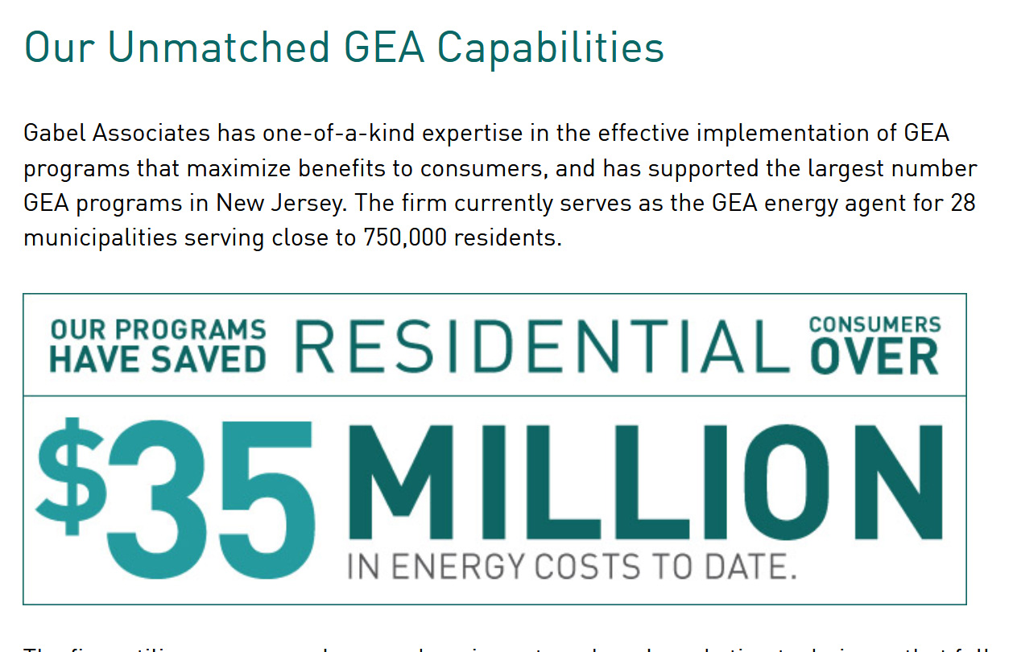
Renewable Government Energy Aggregation (R-GEA)
Gabel is the energy consultant for the NJSEM “NJ Sustainable Joint Meeting” buying service
Other energy consultants: ESCNJ, Good Energy, Concord Energy,…
Sources: https://gabelassociates.com/services/energy-users/government-energy-aggregation/ https://www.njsem.org
Notes:
Source: “Going for Energy Gold”, Sustainable Jersey Workshop, May 31, 2019

Slide 21

Source: njgea.com

