Slide 1

Middletown For Clean Energy
Foundations for the Energy Plan
Aug, 2010 Rutgers “Energy Plan” (prepared for Middletown Twp.; Howell Twp.; Parsippany-Troy Hills Twp.; Fort Lee; Perth Amboy; East Orange; West Orange; Plainfield; Edison Township; Montclair Township; and Willingboro Township)
NJ 2019 Master Energy Plan (when signed, Fall, 2019)
Sustainable Jersey ACTIONS (already established/well documented)
Notes:
MIDDLETOWN HAS 3 FOUNDATIONS for drafting the energy plan
In 2010, Rutgers used common methodology for 11 towns
(see “resources” for link to the Middletown Energy Plan)
Leverage the NJ Master Energy Plan (when signed, Fall, 2019).
3. Sustainable Jersey ACTIONS

Slide 2

Sustainable Jersey Actions:
A Framework for Getting To
100% Clean Energy
Sustainable Jersey Certification: A Prestigious Designation For Municipal Governments In New Jersey
450 NJ Towns Participating
203 Towns Currently Certified
Actions To Score Points Toward Certification Are Documented. Review Comparable Cities’ Documentation As Models.
Certification Is Free And Completely Voluntary.
http://sustainablejersey.com Has All Actions, Resources, Numerous Presentations, And Complete Documentation From All Certified Communities.

Slide 3
Sustainable Jersey Certifications
A Framework for Getting To 100% Clean Energy
Bronze certification: commitment to sustainability, implemented first significant steps, 150 points
Silver certification: significant progress toward sustainability, 350 points, state-wide and national leader
Gold Star Standard is a NEW level of recognition for silver certified communities.
  Gold Star in Energy
  Gold Star in Waste
1 Town has Achieved Gold Star in Energy: Woodbridge
Notes:
Thank you, Pat. Middletown for Clean Energy campaigned hard for a city-wide energy plan.
We succeeded! We were told: YES, but you need to create the energy plan!
The Middletown Mayor has been pushing hard for Silver Certification.
THIS HIGH LEVEL ATTENTION IS IMPORTANT!!
This week, the Middletown Green Team leader is preparing an application for 420 points, and we expect to achieve Silver in November.
When silver certified, Middletown is eligible for Gold Star recognition--
A step in our energy plan goals: 100% clean electricity by 2030 and netzero by 2050.
WE CAN LEARN FROM WOODBRIDGE- THE ONLY GOLD STAR ACHIEVER IN NJ – to be discussed later
*****************
FOR NEXT STEPS we will benchmark other cities

Slide 4
Middletown For Clean Energy
Sustainable Jersey Actions
3 OF THESE PRIORITY ACTIONS REQUIRED for SILVER
Climate Adaptation: Flooding Risk | Municipal Carbon Footprint
Diversity on Boards & Commissions | Natural Resource Inventory
*Energy Tracking & Management | Prescription Drug Safety and Disposal
*Energy Efficiency for Municipal Facilities | Recycling and Waste Reduction Education and Compliance
*Fleet Inventory | Sustainable Land Use Pledge
Green Business Recognition Program | Water Conservation Ordinance
*ENERGY-RELATED actions Underway; already started toward “gold energy star”
Notes:
Middletown has ALREADY started working toward the Gold Star in Energy
There are 12 “Priority Actions” for Bronze or Silver certification.
Silver requires you to choose 3 of these 12 priority actions.
HERE IS A SHORT CUT: choose the ENERGY-related ACTIONS while pursuing Bronze or Silver Certification.
THE RESULT: you will be automatically earning ACTIONS for Gold Star in Energy!
Middletown has ALREADY achieved:
“Energy Tracking & Management”
“Energy Efficiency for Municipal Facilities”
“Fleet Inventory”

Slide 5
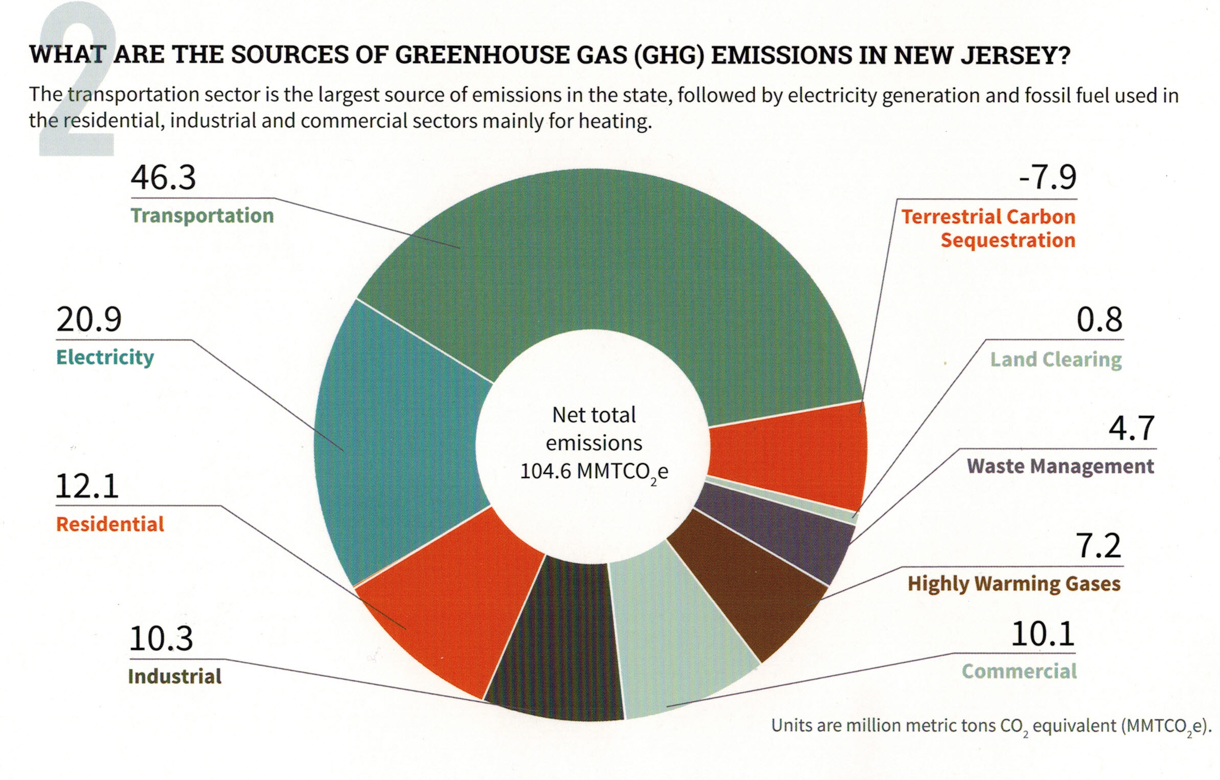
Middletown (Typical NJ) GHG Emissions EEEmissions
“Reducing NJ Greenhouse Gas Emissions”, Rutgers, Jan 2018
Notes:
Sustainable Jersey states: “the primary goal [of “Gold Star in Energy” is reducing Green House Gases. Responding to this overarching imperative will help achieve all the other [sustainability] goals.”
The green team needs to decide: what to TACKLE FIRST?
A short cut is to use this NJ average carbon footprint.
TRANSPORTATION + ELECTRICAL ARE GREATEST EMISSION SOURCES.
EXAMPLE: As an individual, switching your electrical supplier to 100% clean electricity (OR INSTALLING ROOFTOP SOLAR) will reduce your emissions 21%
Then take the next step- buy a plug-in EV, you reduce emissions another 46% - a total of 67% reduction – you have eliminated 2/3 of your total emissions!!
This can be expanded to your entire city!!

Slide 6
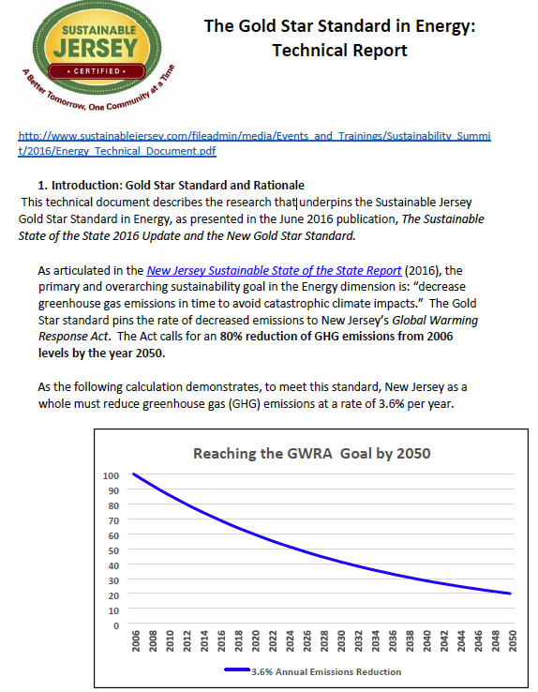
GOLD STAR STANDARD IN ENERGY
3.6% / per year
Enables reaching 80% emission reduction by 2050
Notes:
Green Teams, must reduce GHG gas emissions of BOTH municipal and the residents/businesses in town.
This curve shows the MUNICIPAL emission reduction must be at least 3.6% reduction per year.
This compounded 3.6%/year will meet the 80% mandated emission reductions under New Jersey’s Global Warming Response Act, which requires 80% reduction in GHG, below 2006 levels, by 2050.

Slide 7
Middletown received EDF GRANT (early spring, 2017)
Environmental Defense Fund (EDF) Climate Corps interns funded by NJ Natural Gas
  focusED on jump starting energy efficiency programs
  (currently underway)
Municipal (buildings)
Residential Outreach
Commercial Outreach
Notes:
HERE IS A FUNDAMENTALLY IMPORTANT SHORTCUT taken by Middletown - AN OFFER your city can not refuse- a free expert working several months to jump-start your Gold Star energy ACTIONS.
These EDF masters-level experts will get you started to save money and to save GHG emissions
EDF interns start NEXT WEEK! Those here from Keyport, Red Bank, Manalapan or Neptune applied early this spring!
Energy efficiency is the bottom rung. The energy not spent is the cheapest energy of all

Slide 8
START ENERGY ACTIONS WITH ENERGY EFFICIENCY IMPROVEMENT
funded by BPU societal benefit fund
MUNICIPAL:
Free energy audit
Recommended energy efficiency improvements funded by:
70% paid by direct install (arrange through NJ Nat Gas)
  30% paid via loans (payments guaranteed to be less than energy savings)
  BUSINESS:
free energy audit
recommended energy efficiency improvements funded by:
70% paid by direct install (arrange through NJ Nat Gas)
  30% paid through gas bill
  RESIDENTS:
  free audit for income-qualified residents; $49 for higher incomes (limited time)
  Recommended energy efficiency improvements partly funded by SaveGreen
Notes:
The HUB has heard this directly from NJ Natural Gas – I wont repeat. GO TO NEXT SLIDE
********************
Municipal and Business energy efficiency programs are similar: free energy audit, then 70% off energy improvements!
Residents are different: low income households receive a free audit.
All households benefit from attractive BPU-sponsored Clean Energy programs and Energy Star discounts
I signed up for the $49 energy audit for my house. An auditor installed a door fan to create a vacuum in my house, and spent a couple of hours using an IR camera taking numerous photos of cold air leaks into house.
I thought my house was well insulated, but found air leaks everywhere.
I followed the auditor around the house, and tagged the air leaks. I elected NOT to sign the automatic requests from 3 contractors, to bid on fixing the leaks.
Instead, I spent ~$100 on supplies to do it myself. I now offer a “CLUB” of similar people to share practices/advice to MIDDLETOWN homeowners to patch up our houses after the audit reveals the problems!

Slide 9
AFTER COMPLETING ENERGY EFFICIENCY ACTIONS
Begin Municipal And City-wide Energy Actions
MUNICIPAL OPERATIONS: GHG REDUCTIONS (10 ACTIONS)
Renewable Energy Generation: Solar, Wind, Geothermal
Green The Municipal Fleet
Buildings & Street Lighting Efficiency
COMMUNITY-WIDE GHG REDUCTION OPERATIONS (9 ACTIONS)
Renewable Energy Generation: Solar, Electric Aggregation
Mobile Sources
Trees – Canopy Shading Effect
Notes:
AFTER you complete the Energy Efficiency ACTIONS:
There are 19 possible Actions by the Green Team in your town. - About half MUNICIPAL, and half Community-wide
**********************
10 Actions reduce MUNICIPAL emissions
add solar to buildings and parking areas; green the municipal fleet;
9 Actions reduce COMMUNITY-wide emissions: 100 times more impact than Municipal:
Become a solar-friendly town: make permitting easy & standardized
Become an EV –friendly town: install public charging stations
Conserve your trees: they absorb carbon, and provide shading to reduce city temps.

Slide 10
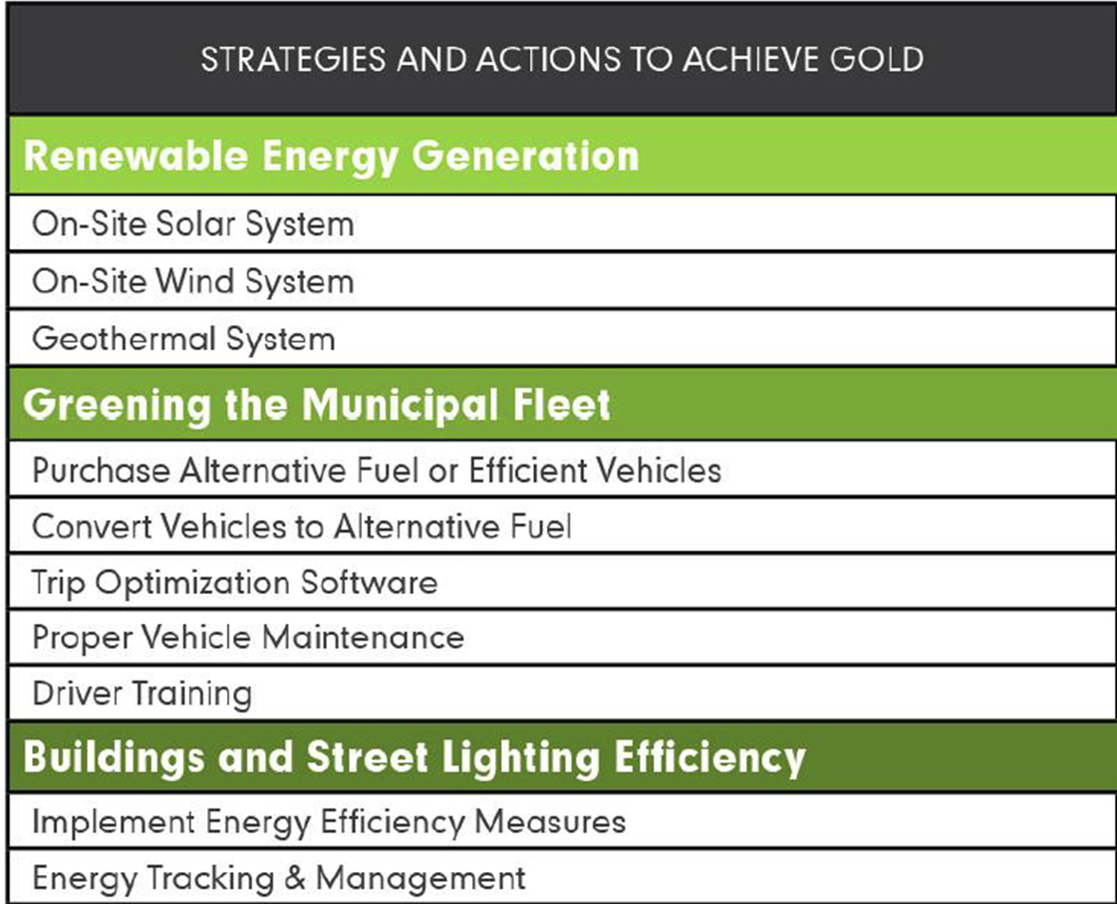
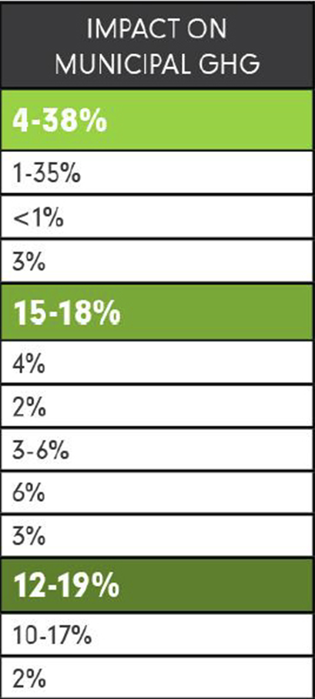
GOLD STAR STANDARD IN ENERGY
Notes:
Here are the MUNICIPAL actions. FOCUS ON THE RIGHT COLUMN: showing the percent emissions impact
RESULTS ARE TOTALLY under your control.
When ALL the ACTIONS are added, the total likely emission reduction is between 31% and 75% - good for many years at 3.6% reduction per year
***********************
Most of these “MUNICIPAL” Actions are ELECTIVE.
All you have to do is show before and after carbon footprints, to prove that you have met the 3.6% reduction, averaged over 3 years of more.
“Community Led Solar initiatives”:“Solar by Right and as Accessory”, AND a uniform permit process, fixed permit fee & 3 day processing.
ENERGY SAGE–“no annoying phone calls” automated sign up for solar
MAKE YOUR TOWN EV FRIENDLY: Amend the zoning ordinances: add charging stations as a permitted accessory use.
TRAINING FOR local first responders
CHARGING STATIONS FUNDED BY THRID PARTIES! (20% charge premium over in-home charging is gold standard)

Slide 11
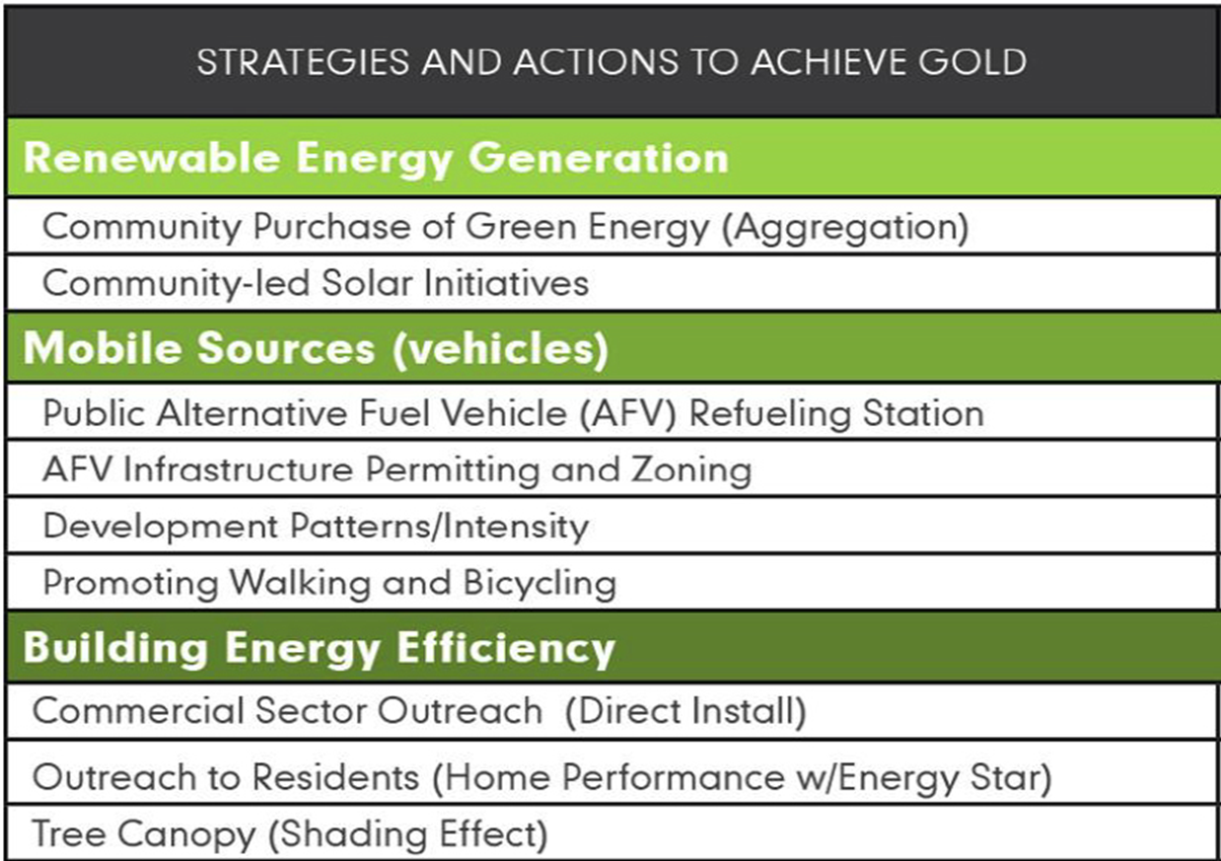
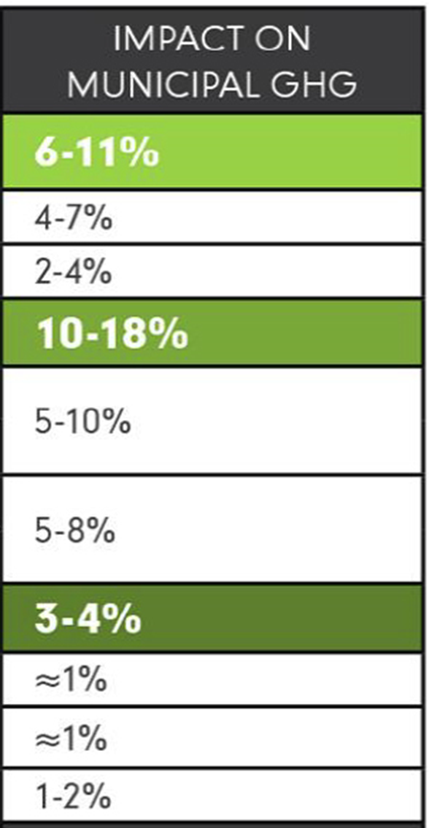
GOLD STAR STANDARD IN ENERGY
Notes:
Here are COMMUNITY-WIDE ACTIONS. (I added stars on the left, for MANDATORY ACTIONS). Look at right column
The requirement is at least 1% emission reduction per year. If all of ACTIONS are implemented, the reduction is 19% to 33% - good for MANY years at 1% per year
FIRST ITEM- AND MAYBE THE EASIEST: Electrical Aggregation to convert a whole city to 100% renewable electricity. EXAMPLES: next slide
************
“Community Led Solar initiatives: provides “Solar by Right and as Accessory”, AND a uniform permit process, fixed permit fee ($300) & 3 day processing.
ENERGY SAGE is on-line signup . EXAMPLE: 288 customers signed for site inspection; 50 new contracts signed;
PUBLIC EV CHARGING INFRASTRUCTURE “Public Alternative Fuel Vehicle (AFV) Refueling Station”
MAKE YOUR TOWN EV FRIENDLY “AFV Infrastructure Permitting and Zoning”
Amend the zoning ordinances: add charging stations as a permitted accessory use. to include regulations and design standards for charging and parking spaces,.
TRAINING FOR local first responders
CHARGING STATIONS FUNDED BY THRID PARTIES! (20% charge premium over in-home charging is gold standard)

Slide 12

Your Town For Clean Energy
Examples of Electrical Aggregation
Your Town FOR
CLEAN ENERGY
New Brunswick is a best example: 50% renewable
Essex Hub (Maplewood, Montclair, South Orange, Verona, Glen Ridge)
(10% lower electricity price than PSE&G; 41% renewable content)
Glen Rock and Livingston
Fair Haven Municipal (only) 5% renewable (added to RPS)
Woodbridge, Toms River,…
Notes:
Electrical Aggregation can eventually convert a whole city to 100% renewable electricity. EXAMPLES:
1. New Brunswick is a great example. They contracted for renewable energy provider to replace PSE&G with 50% renewable electrical content for every household (& business if they requested).
2. Essex Hub (Maplewood, Montclair, South Orange, Verona, Glen Ridge)
3. independent renewable energy in Glen Rock and Livingston
4. Fair Haven has Municipal (only) renewable energy contract thru 2020 (5% above JCP&L RPS)
5. Woodbridge, Toms River,…

Slide 13
Your Town For Clean Energy
Other Opportunities for Emission Reductions
Your Town FOR
CLEAN ENERGY
44 energy-related Actions in current Woodbridge certification
                Community Energy Initiatives
                Municipal Energy Initiatives
                Transportation Initiatives
                Green Design
                Green Design Commercial and Residential Buildings
                Innovation & Demonstration Projects
                Land Use & Transportation
                Local Economies
                Grounds & Maintenance
                Sustainability & Climate Planning
http://www.sustainablejersey.com/?type=1336777441&tx_sjcert_certification[certification][__identity]=700
Notes:
BUT YOU ARE NOT LIMITED TO ONLY GOLD STAR “ACTIONS”
WOODBRIDGE, the ONLY Gold Energy Star recipient in NJ has close to 1200 points.
Every time I scan the Woodbridge certification, I think of new ideas for Middletown!
Scattered throughout, are 44 ADDITIONAL great ideas for energy & emission reduction – for use in YOUR town!

Slide 14
Improve Your Town’s Master Plan
Add a “Green Building and Environmental Sustainability” Element to the Master Plan. This provides:
Efficient use of natural resources
Renewable Energy Systems in new and retrofitted buildings
Impact of buildings on environment
Allow Ecosystems to function naturally
Conserve and reuse water
Treat storm water on-site
Optimize site orientation and design for the Climate
http://www.sustainablejersey.com/actions-certification/actions/#open/action/484
Notes:
This is the final Middletown ACTION I want to discuss tonight. We have been advocating for 2 years for the “Green Building and Environmental Sustainability Element” to be added to Middletown’s Master Plan.
AND IT IS SCHEDULED TO HAPPEN!
All other documents flow down from the master plan.
For instance, site plans could require new and rebuilt structures to have rooftops amenable to rooftop solar!
You should consider adding this Master Plan “Element” in all future construction in YOUR TOWN!.
BEFORE MOVING ON, LET ME SUMMARIZE:
Gold Star is only a start. Middletown’s energy plan is a work in progress. This summer and fall, our Middletown Green Energy Stakeholders Team will be planning how to reduce emissions through 2050.

Slide 15
SUSTAINABLE JERSEY MAYORS SUMMIT
PLAY THE 3 MINUTE INSPIRING VIDEO!!
https://youtu.be/gXZMRYAwq6A
(this video is stored & plays locally within the next slide)

Slide 16

MAYORS CLIMATE CONFERENCE
Notes:
This 3 minute video is inspirational- NJ mayors are describing their towns’ efforts to move to a 100% renewable energy sources.
************
ALSO, Randy Solomon, the Director of Sustainable Jersey, describes Green Team support – via consultants, grants, and written guidance for all Green Team “Actions”

