Slide 1


Slide 2
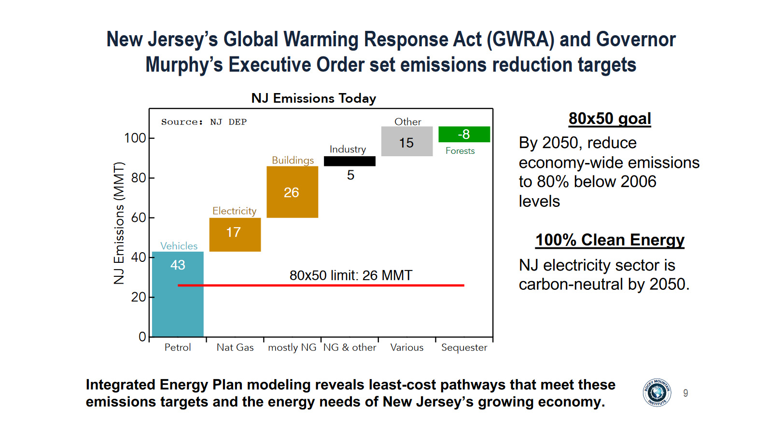

Slide 3
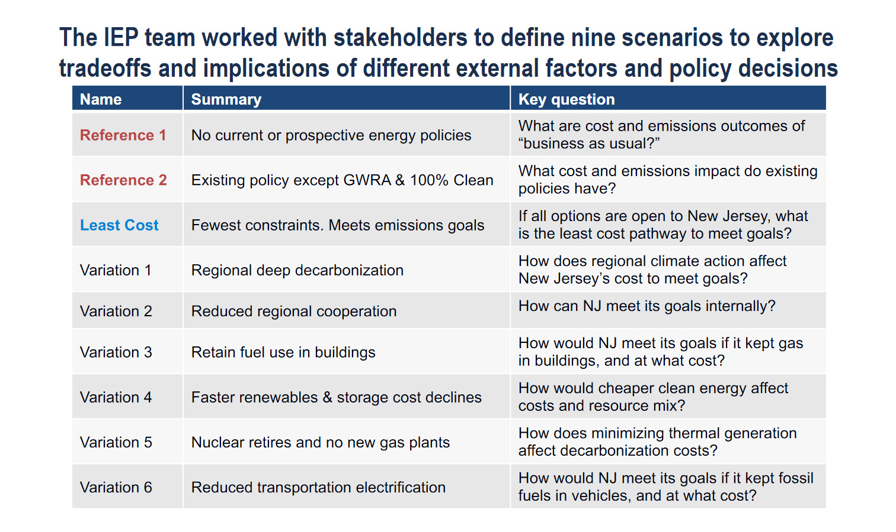

Slide 4
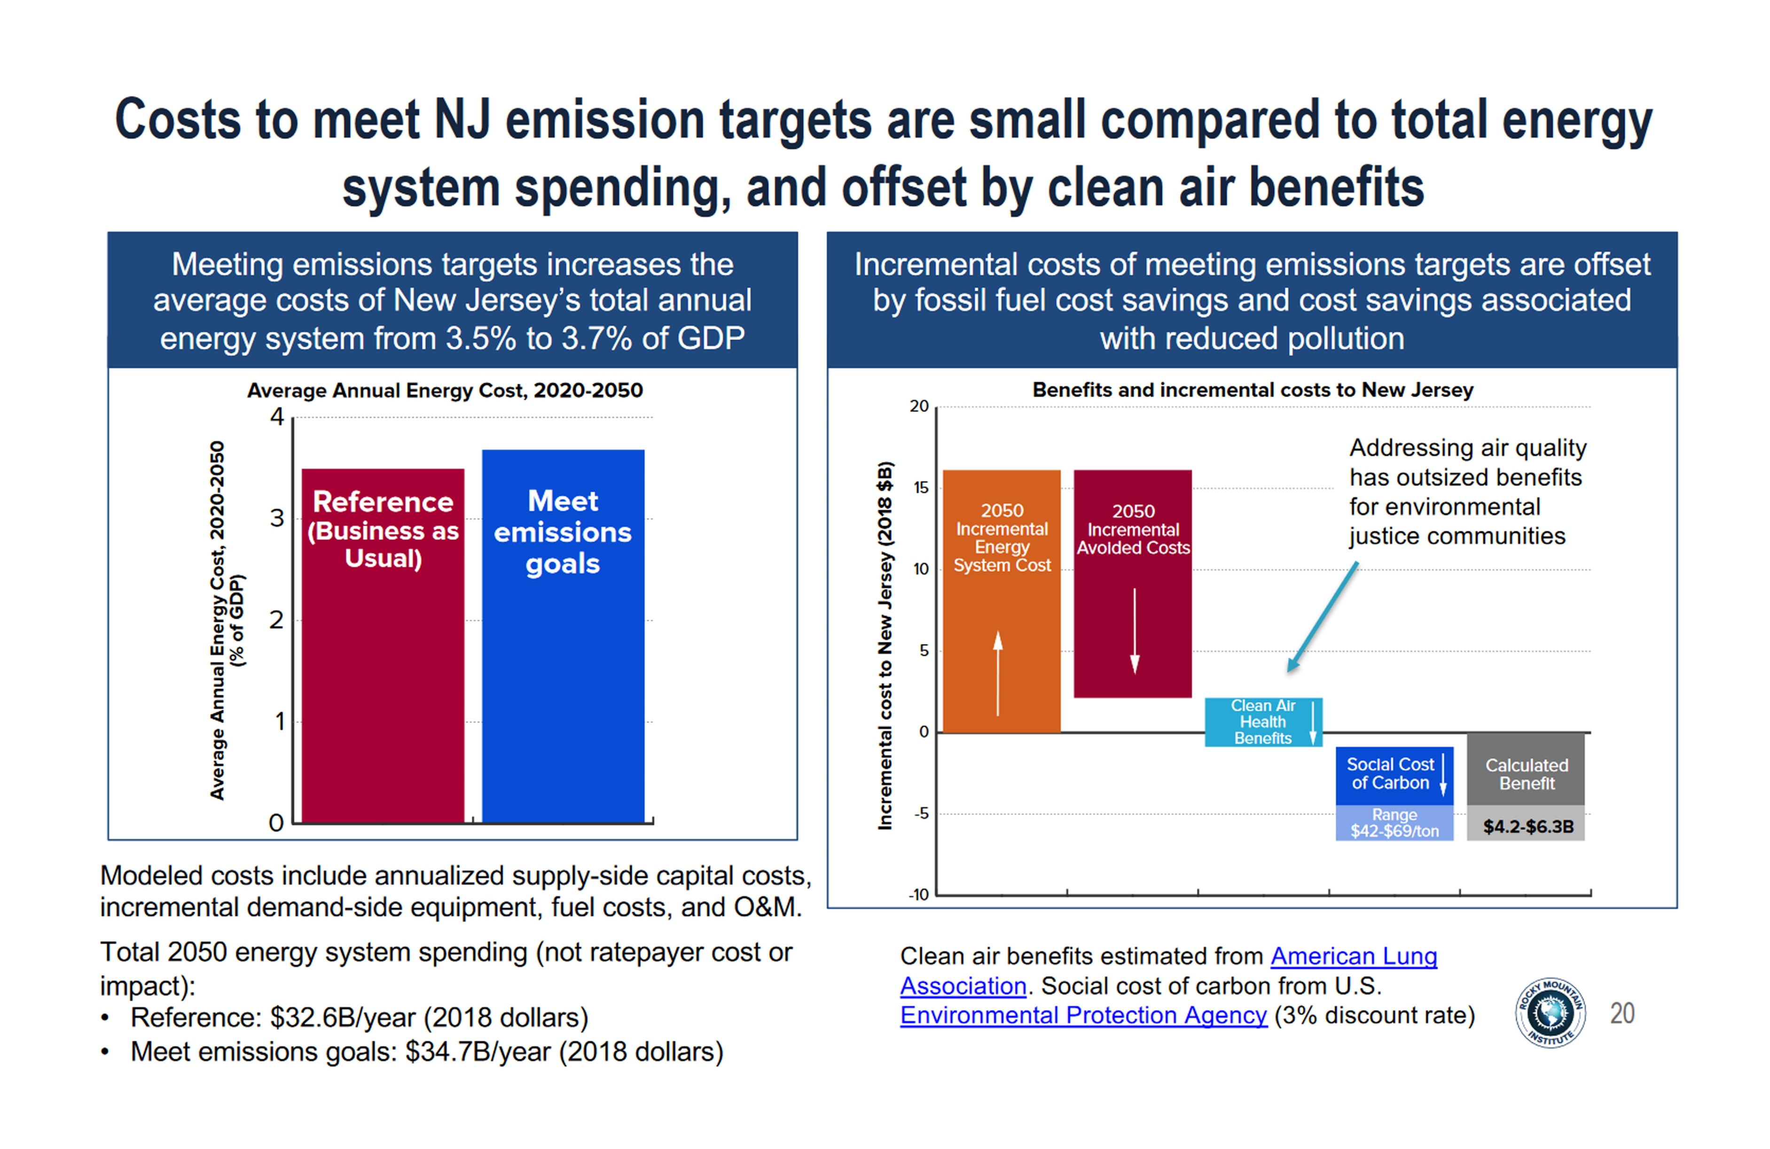

Slide 5
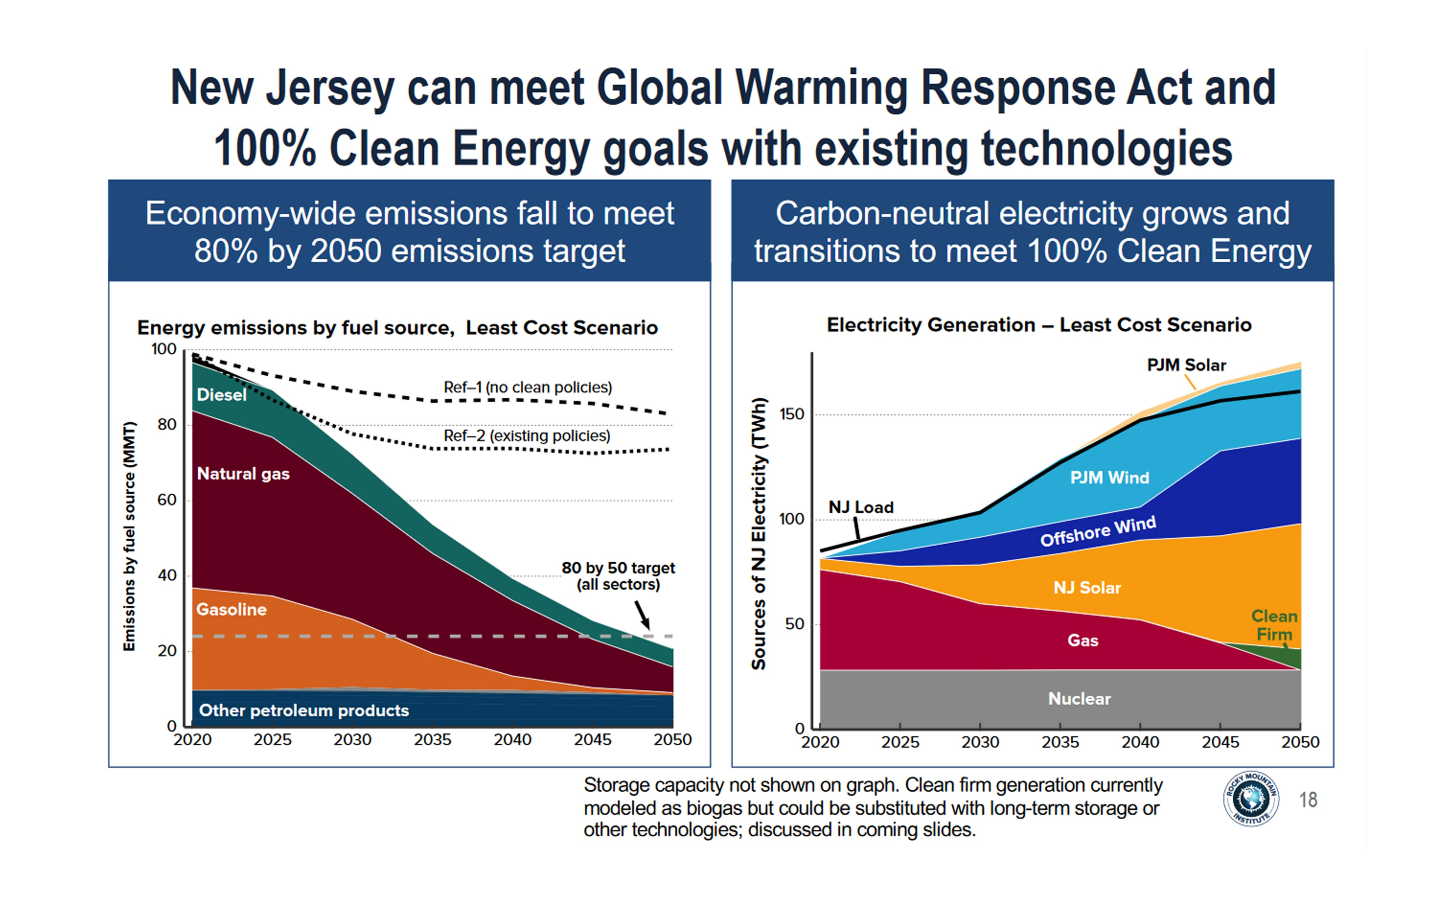

Slide 6
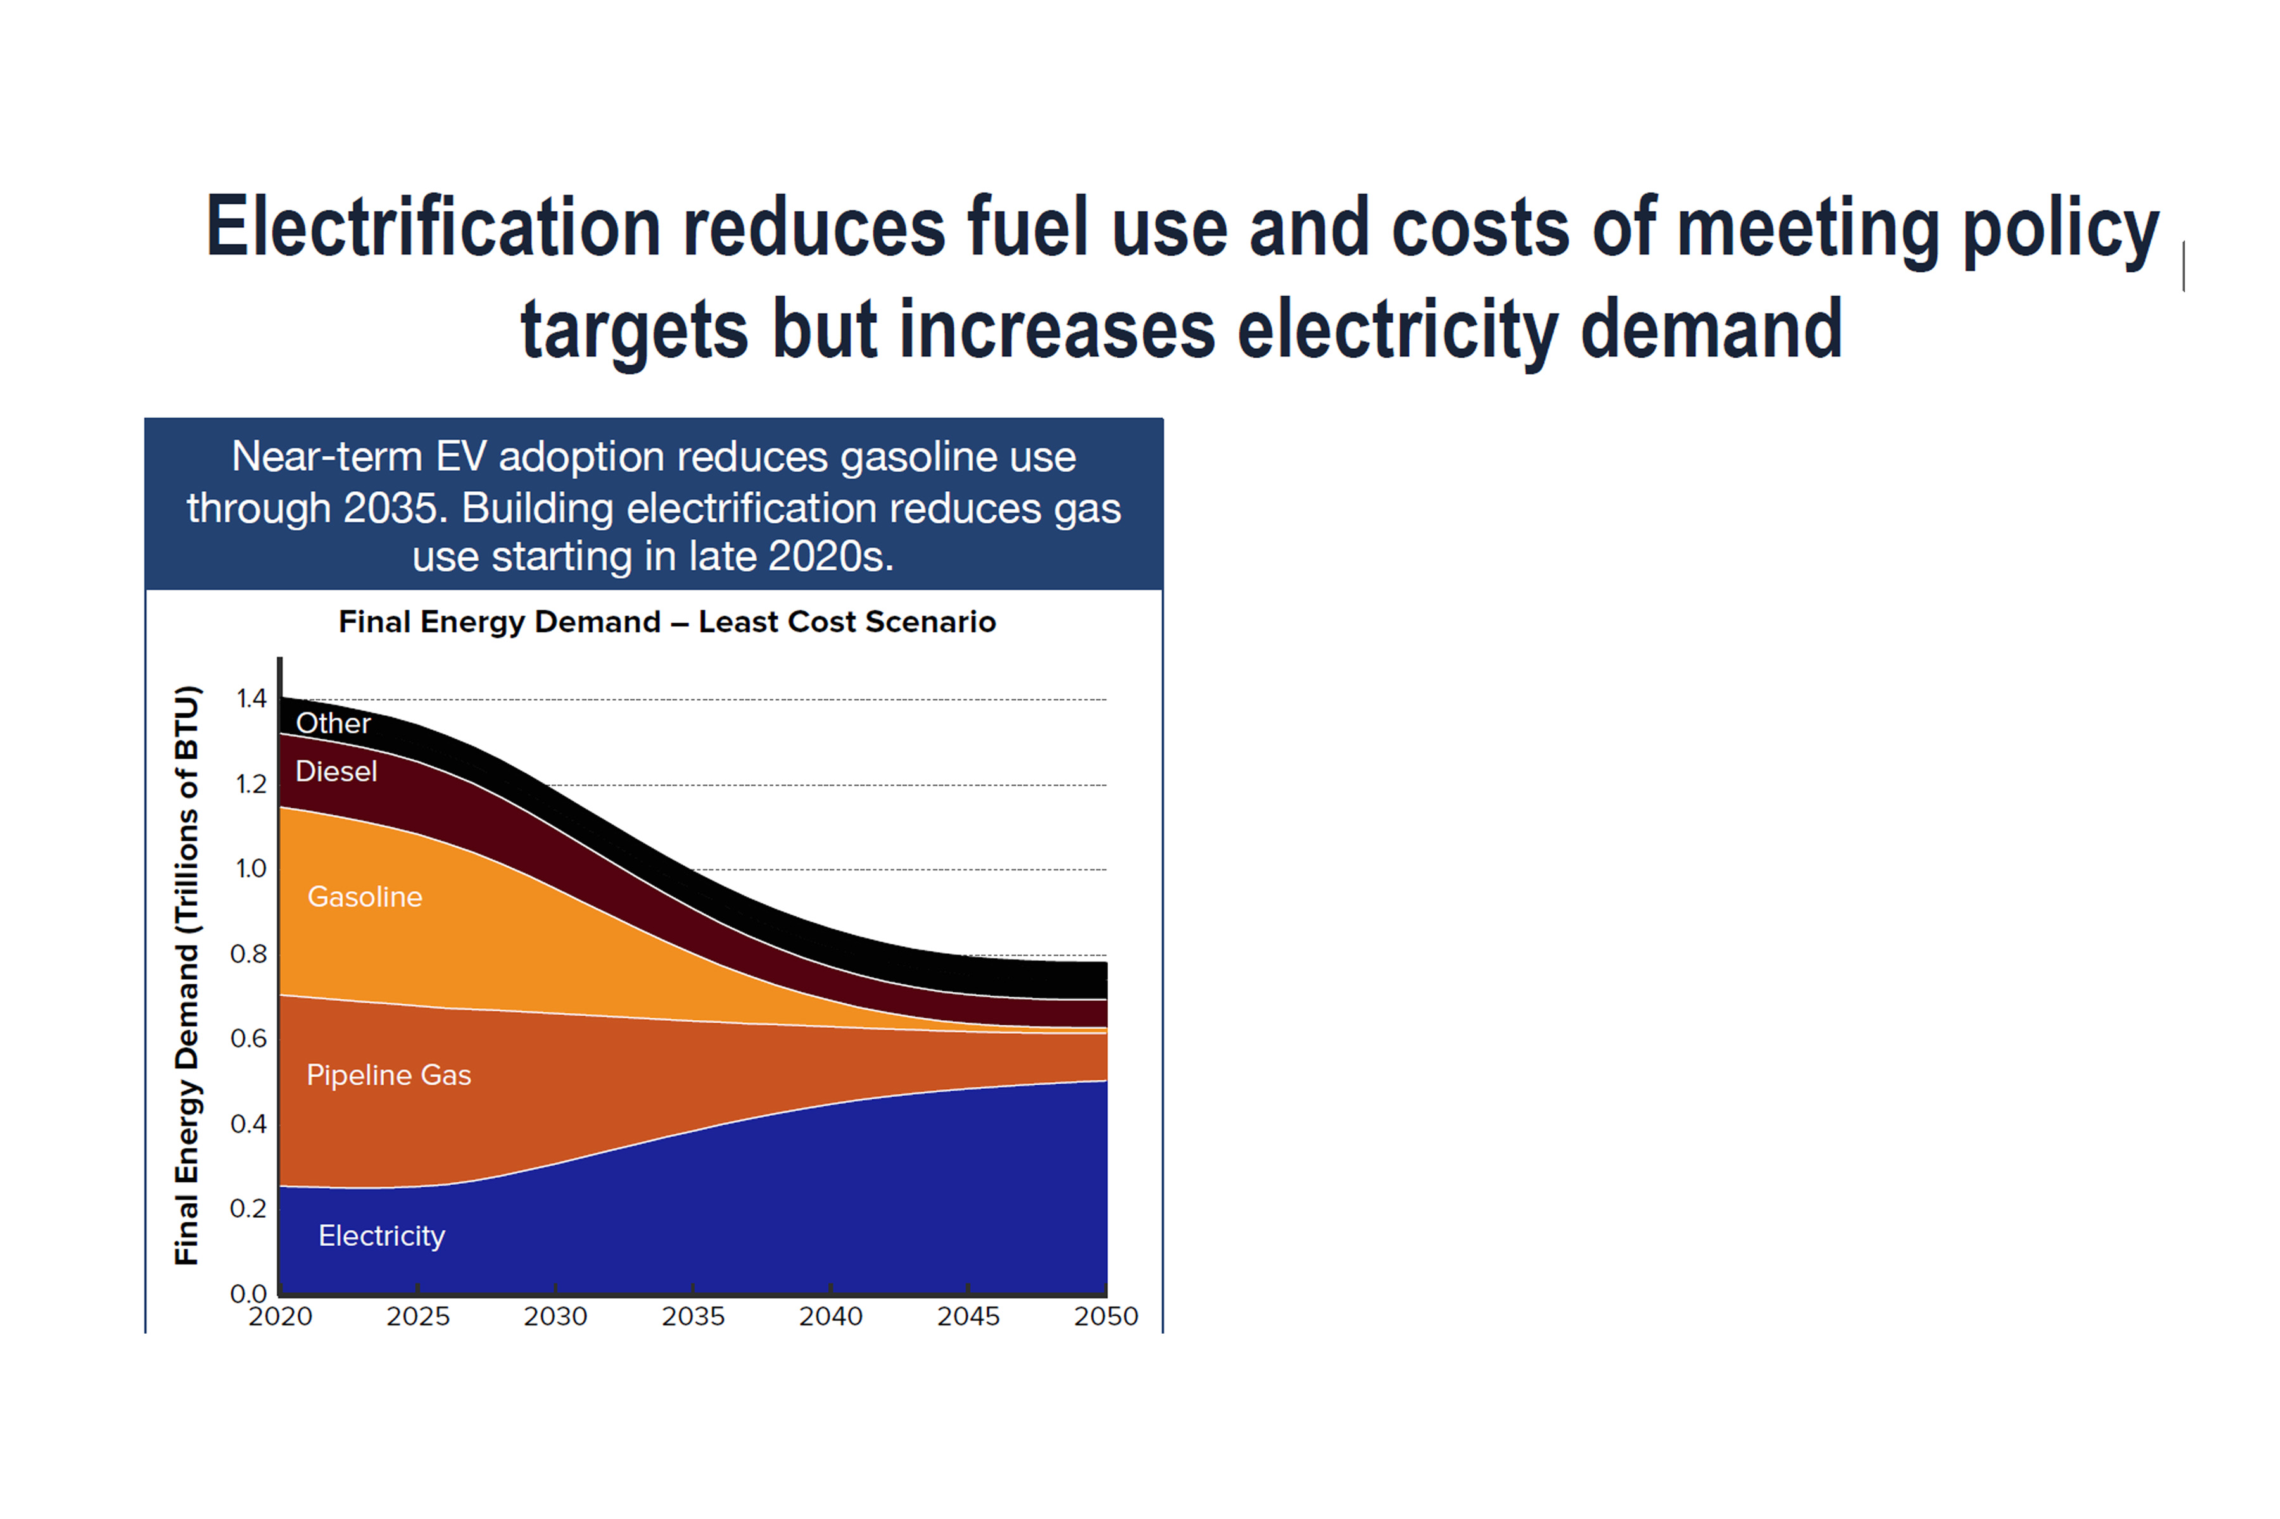
2019-Oct-27
Notes:
The cost of all these things is rapidly dropping:
Residential (rooftop ) solar
Utility solar
Wind
EV Batteries
LED bulbs
ID #5574 - Can be used in noncommercial online and TV broadcasts of your presentation, but not modified.
DESCRIPTION: A graph displaying the cost decreases of clean energy technology in the U.S. from 2008-2017
ADDITIONAL TALKING POINTS: Between 2008 and 2016, utility-scale solar photovoltaic (PV) project installation costs dropped by 71 percent, while costs for community and rooftop solar decreased by 55 percent. The installation of these small-scale solar projects increased by more than 2,000 percent from 2008 to 2016. Wind capacity in the US reached 89 gigawatts in 2017, an increase of 64 gigawatts since 2008. The 2017 total wind capacity in the US could power upwards of 25 million households. After 2017, there are now more than 750,000 electric vehicles on US roads, with 195,000 being bought in 2017 alone. Lithium-ion battery costs have fallen by 79 percent since 2008, assisting significantly in the expansion of the EV market.*
REFERENCES:
* Natural Resources Defense Fund, "Revolution Now: The Future Is Here For Clean Energy Technology," (2018). https://www.nrdc.org/revolution-now

Slide 7
